Slide 1

神小马丶技术简介篇
王云荣

Slide 2
提纲
架构简介
NLU技术简介
DM实现和优化
NLG技术简介

Slide 3
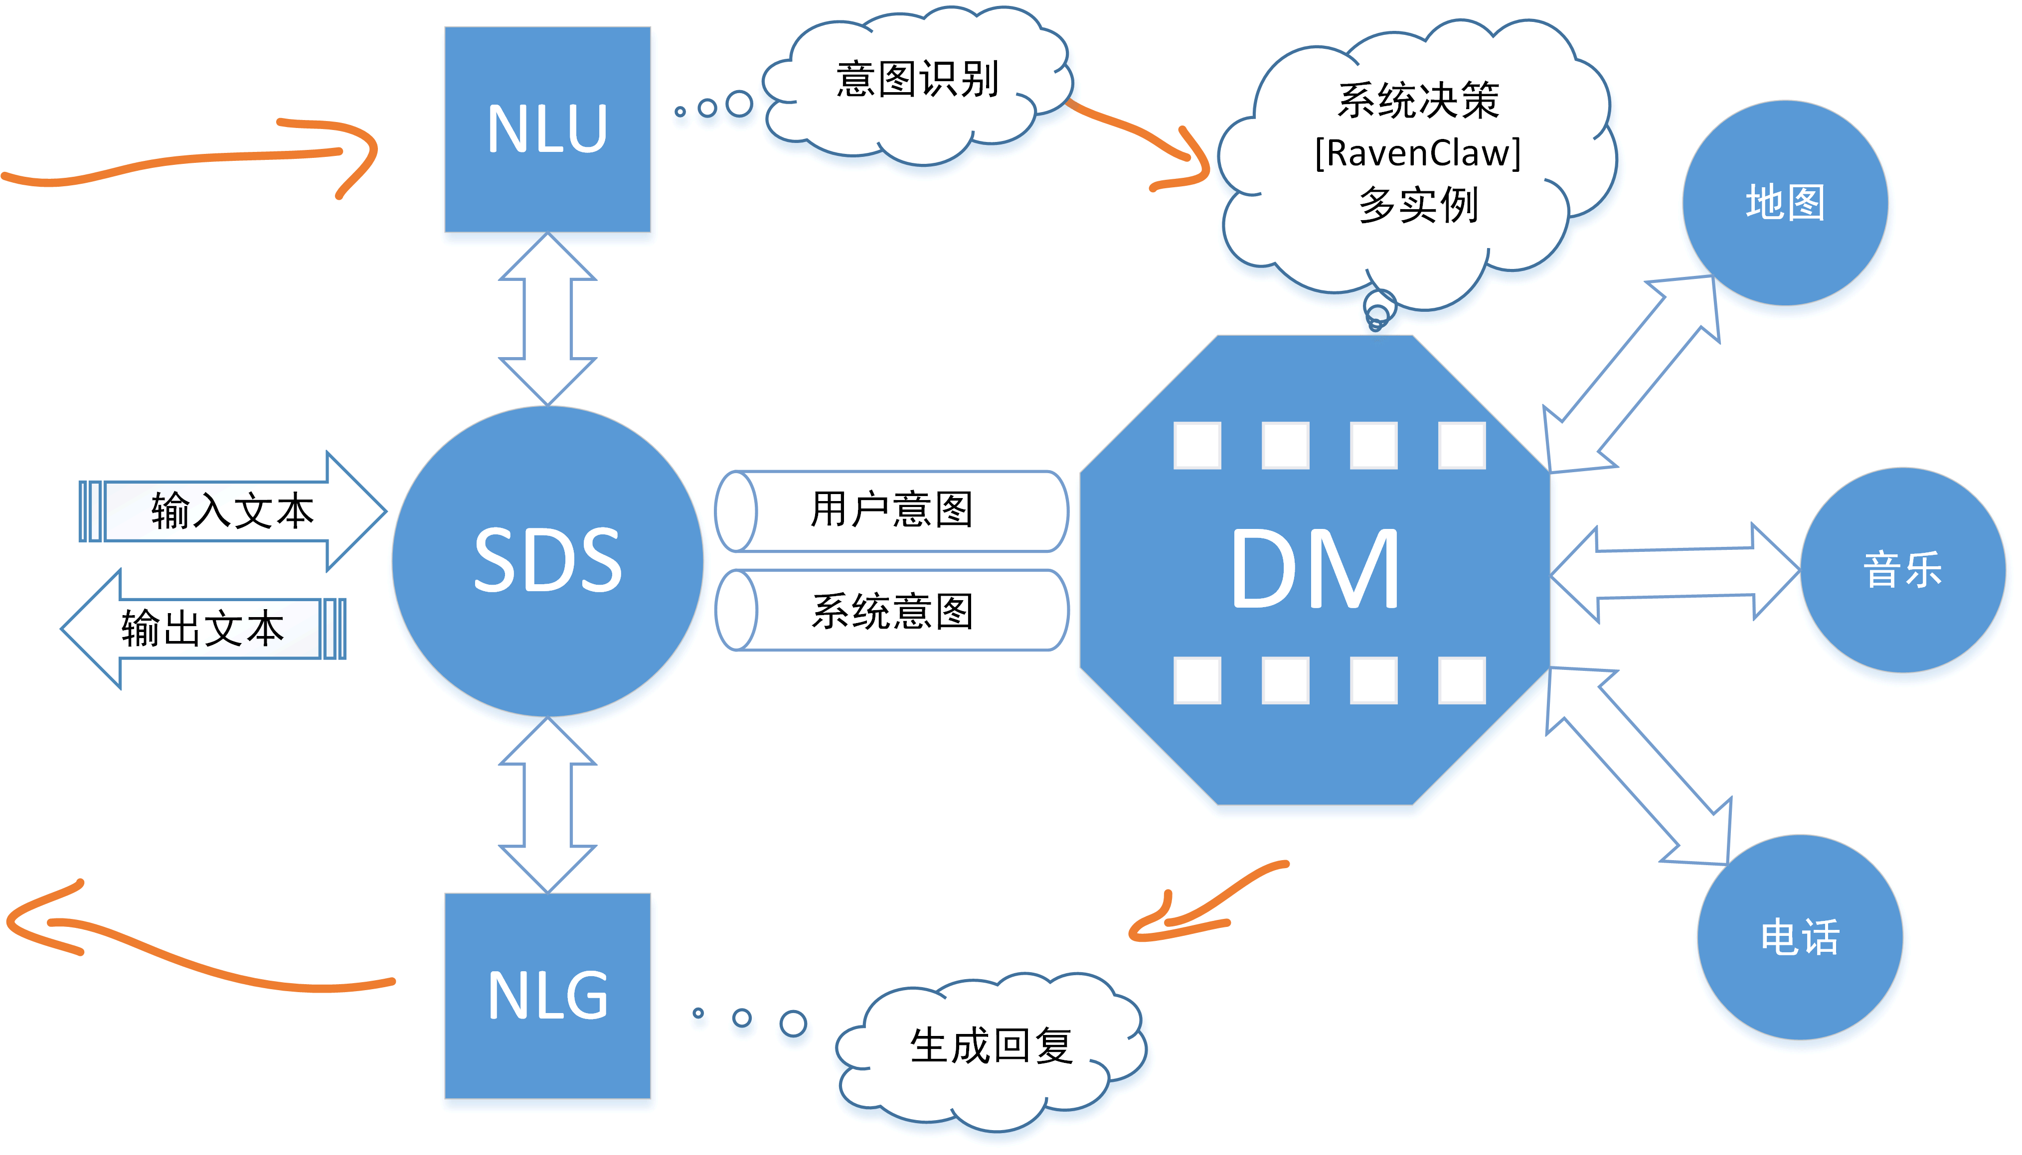
架构简介

Slide 4
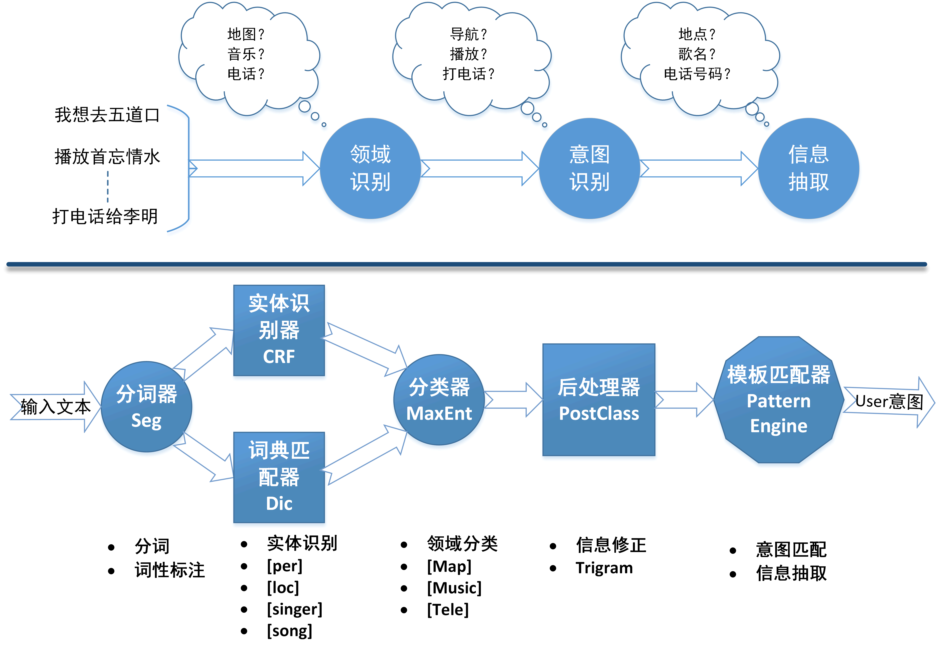
NLU技术简介
我/想/听/刘德华/的/忘情水
DIC
CRF
我想/song
刘德华/singer
忘情水/song
刘德华/per
Song/听/singer/的/忘情水
我想/听/singer/的/song
刘德华/singer
忘情水/song

Slide 5
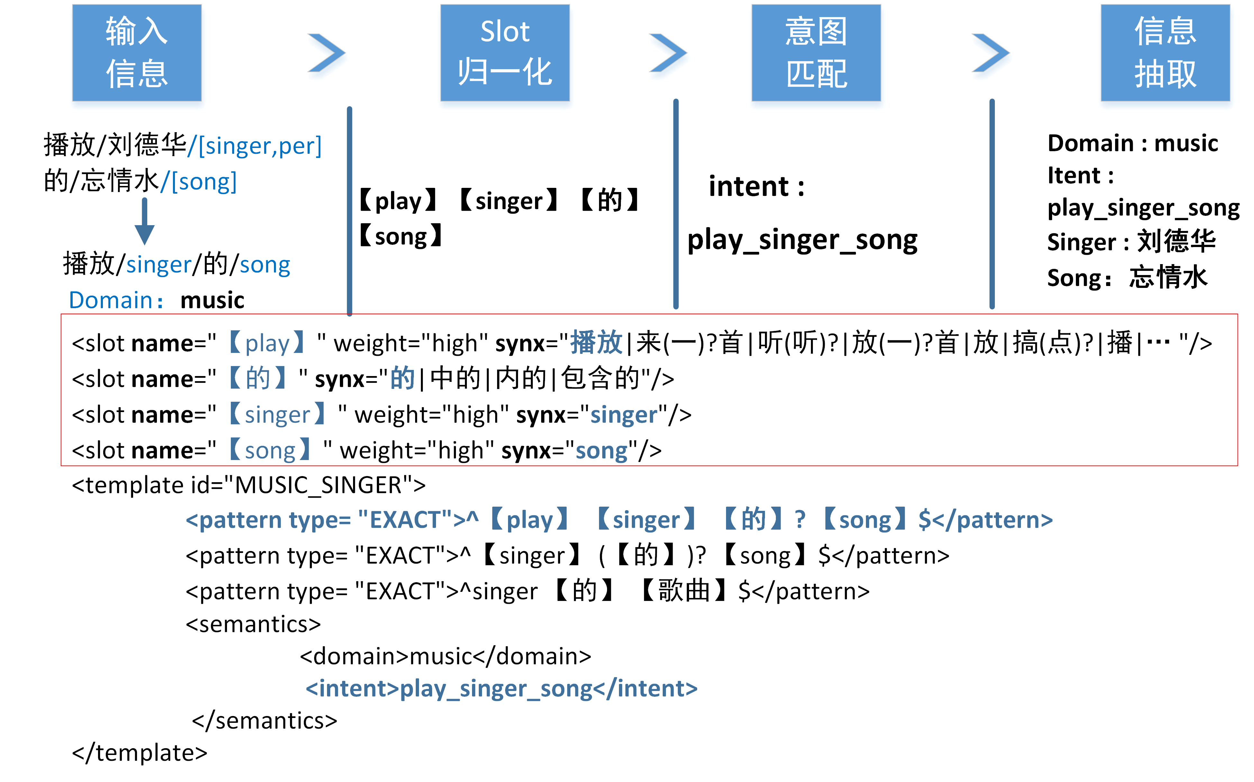
NLU模板匹配
语义
归一化

Slide 6
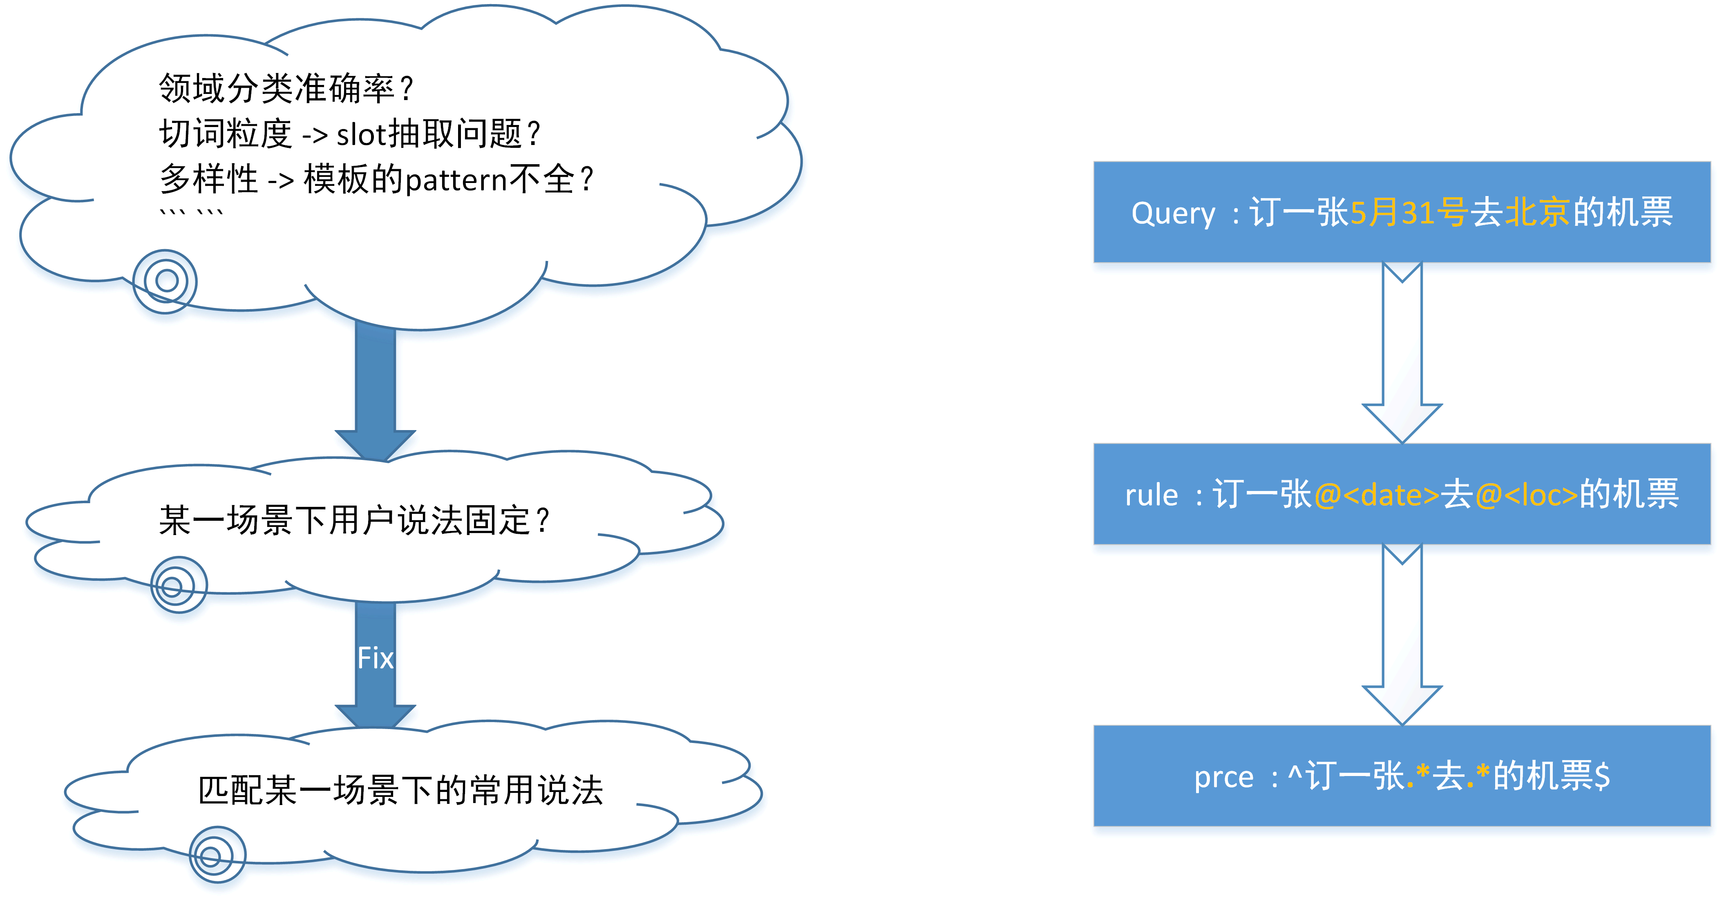
NLU模板匹配 - Direct

Slide 7
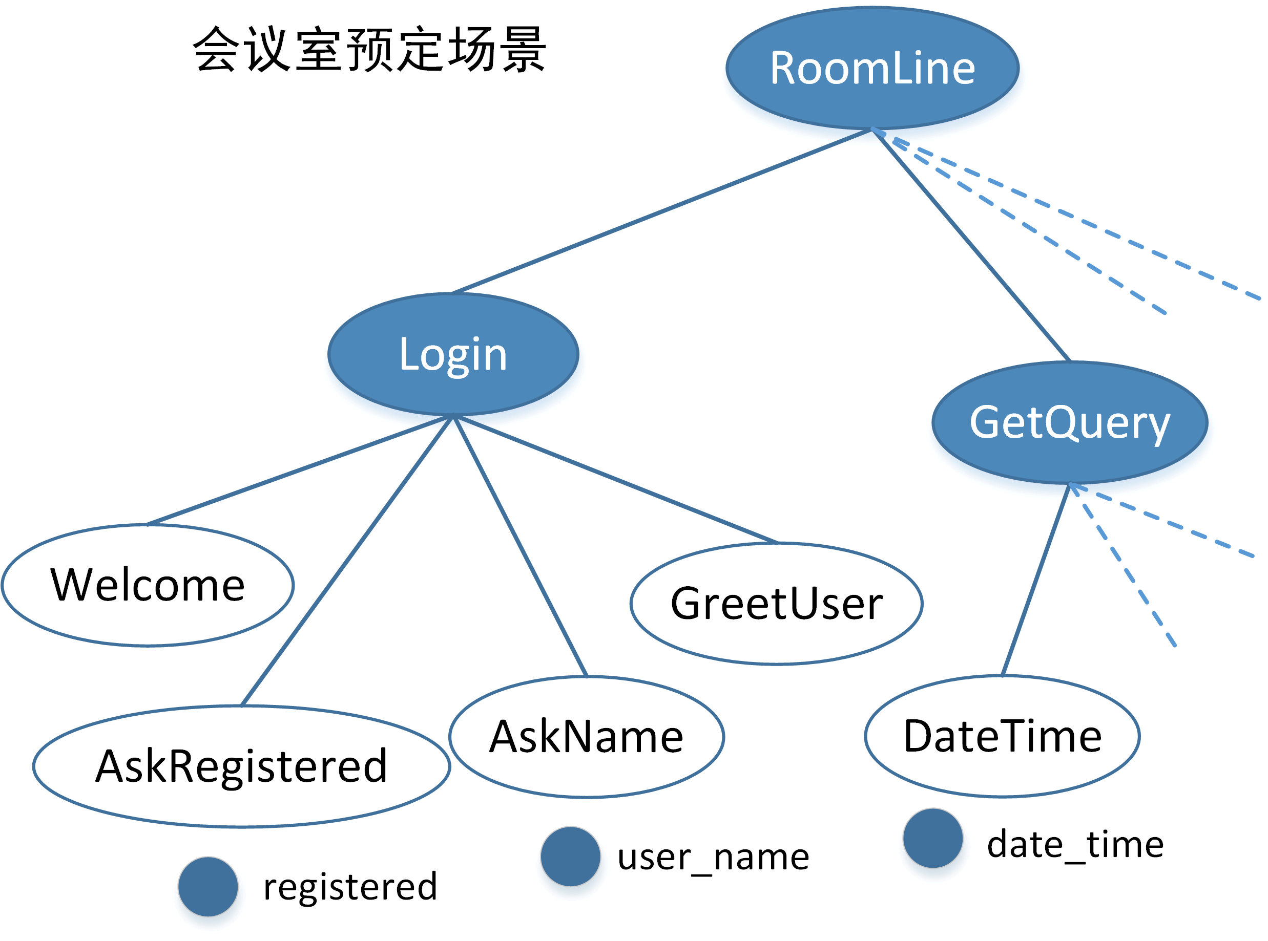
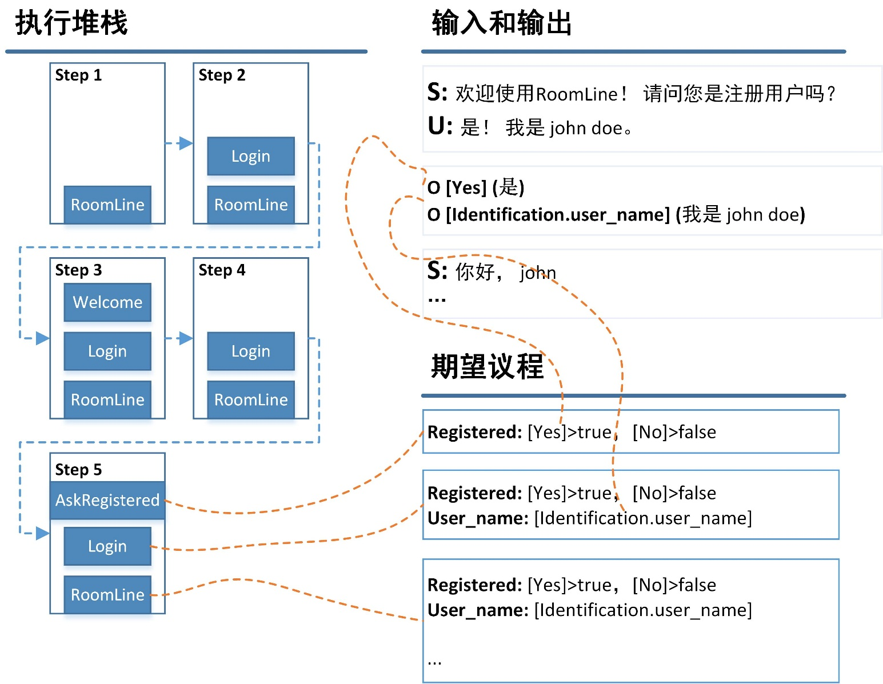
DM原理简介
DTT是对话流程的分解（计划）
Agent执行原子任务
深度遍历

Slide 8
DM优化方向
Error Handling
Grouding Action的选取 -> Policy Matrix
决策动作
Agent触发

Slide 9
DM – Error Handing
Misunderstanding
Concept Grouding Model
Non-understanding
Request Grouding Model

Slide 10
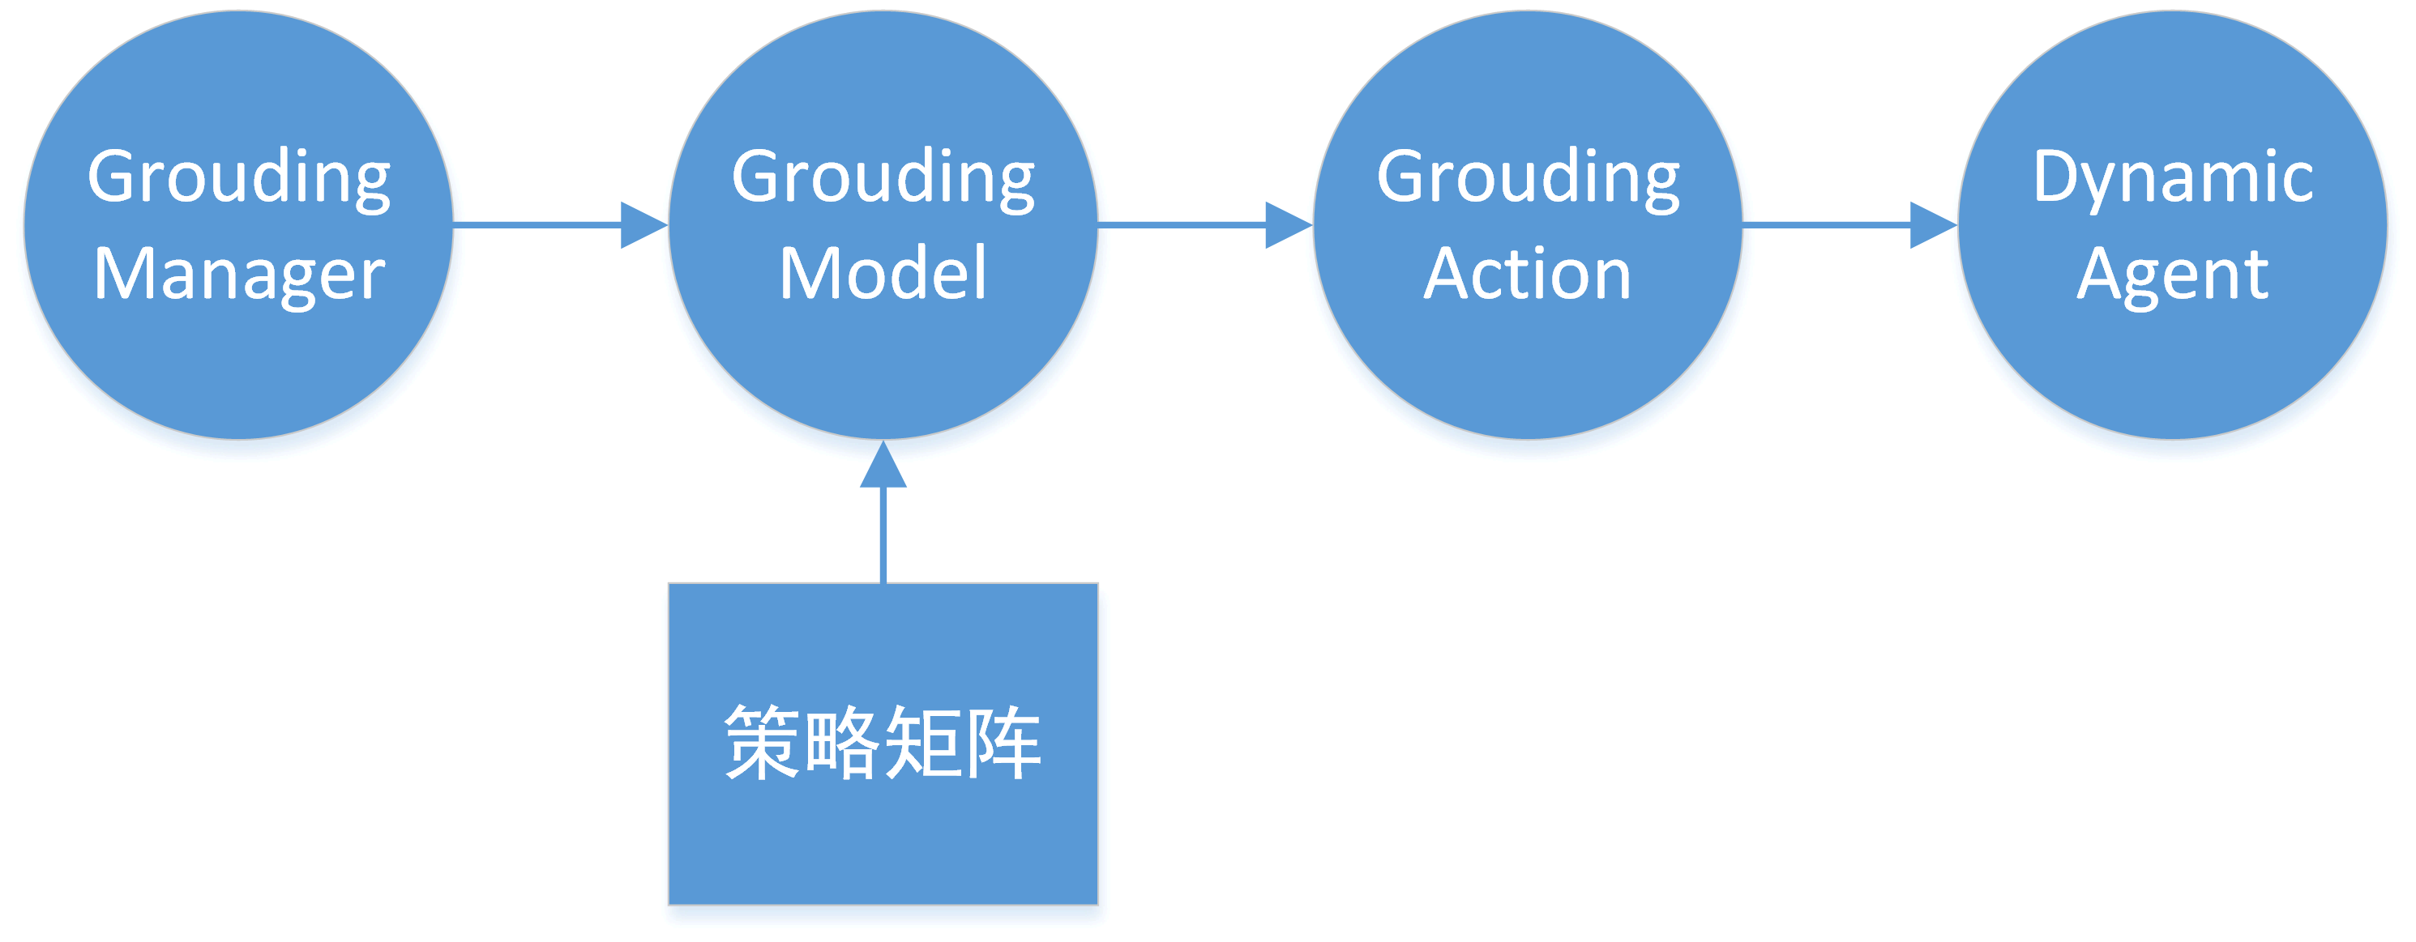
DM – Error Handing
“请您重复下地点信息！”
Action State | FAIL | NO_ACTION | REPEAT | PROMPT | HELP | NONUNDERSTANDING
FAILED | 10 | - | - | - | - | -
UNDERSTANDING | - | 10 | - | - | - | -
NONUNDERSTANDING | - | - | 5 | 5 | 5 | 5

Slide 11
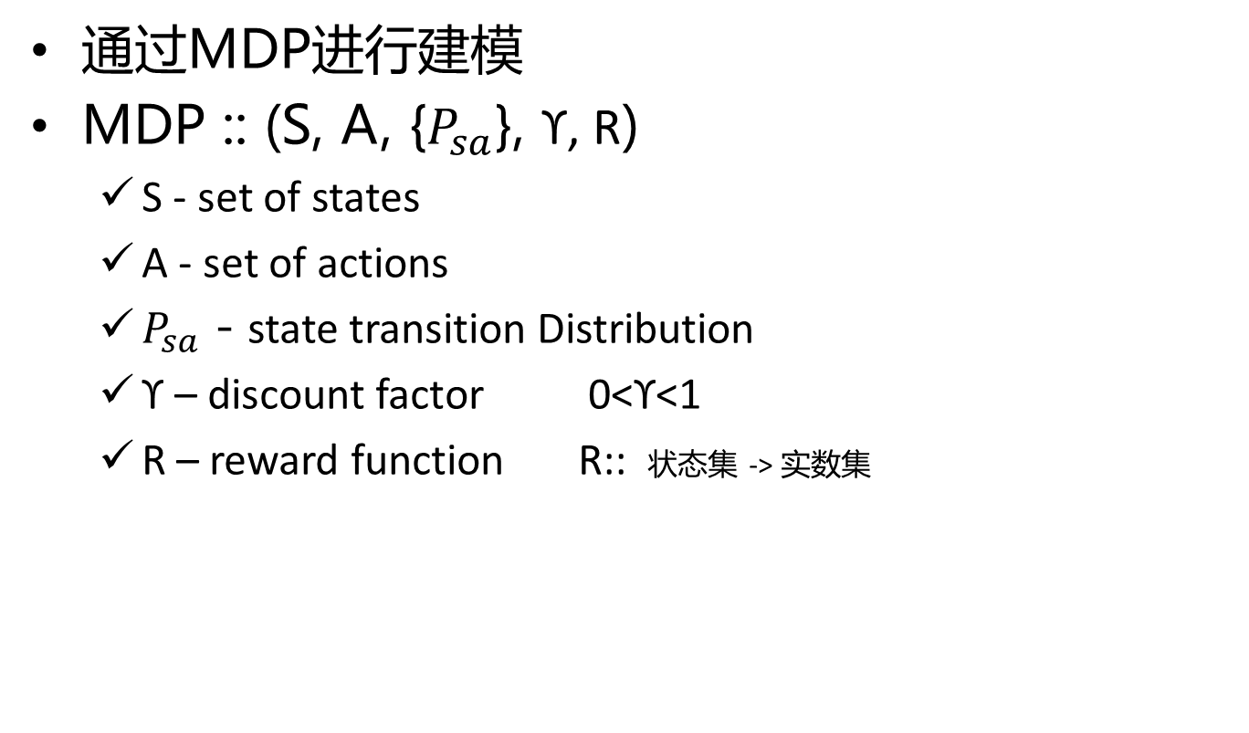
DM优化算法 - RL
通过MDP进行建模
MDP :: (S, A, {$P_{sa}$}, ϒ, R)
S - set of states
A - set of actions
$P_{sa}$ - state transition Distribution
ϒ – discount factor 0<ϒ<1
R – reward function R:: 状态集 -> 实数集

Slide 12

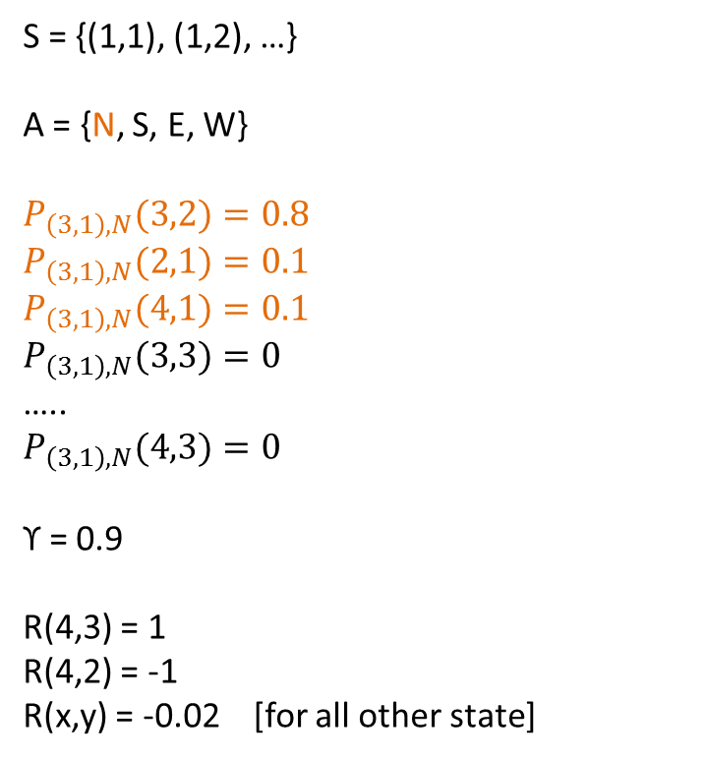

RL – Hello world!
零成本
吸收态
1 2 3 4
3
2
1
 |  |  | +1
 |  |  | -1
S = {(1,1), (1,2), …}
A = {N, S, E, W}
$$P_{\left(3,1\right),N}(3,2)=0.8$$
$P_{\left(3,1\right),N}(2,1)=0.1$
$P_{\left(3,1\right),N}(4,1)=0.1$
$P_{\left(3,1\right),N}(3,3)=0$
…..
$$P_{\left(3,1\right),N}(4,3)=0$$
ϒ = 0.9
R(4,3) = 1
R(4,2) = -1
R(x,y) = -0.02 [for all other state]
0.8
0.1
0.1
At state $S_{0}$
Choose action $a_{0}$
Get to $S_{1}\sim P_{S_{0},a_{0}}$
Choose action $a_{1}$
Get to $S_{2}\sim P_{S_{1},a_{1}}$
…..
Total Pay off :$R\left(S_{0}\right)+\text{ϒ}R\left(S_{1}\right)+ {\text{ϒ}}^{2}R\left(S_{2}\right)+…$
Choose the action over time to Maximize:
$$E[R\left(S_{0}\right)+\text{ϒ}R\left(S_{1}\right)+ {\text{ϒ}}^{2}R\left(S_{2}\right)+…]$$
A分布未知

Slide 13
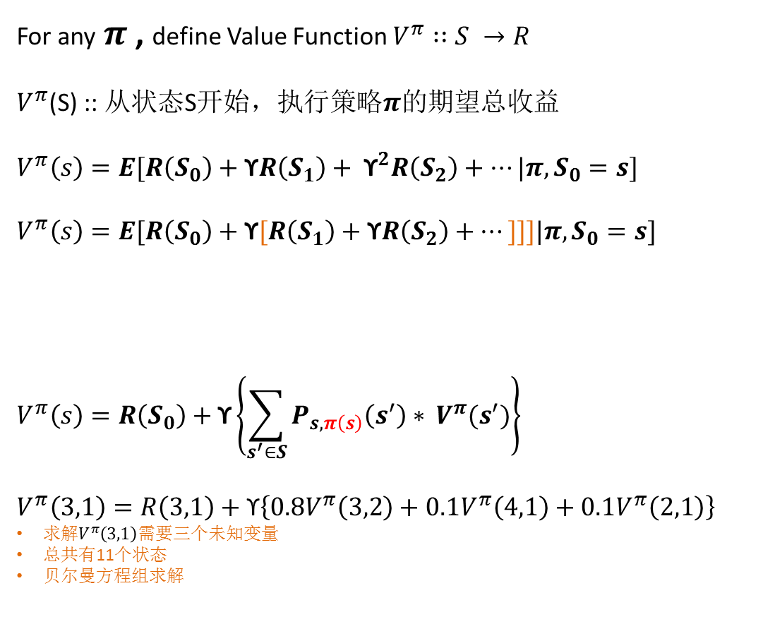



RL – Hello world!
1 2 3 4
随机初始化
For any$π$, define Value Function $V^{π}∷S →R$
$V^{π}$(S) :: 从状态S开始，执行策略$π$的期望总收益
$$V^{π}\left(s\right)=E[R\left(S_{0}\right)+\text{ϒ}R\left(S_{1}\right)+ {\text{ϒ}}^{2}R\left(S_{2}\right)+…|π,S_{0}=s]$$
$$V^{π}\left(s\right)=E[R\left(S_{0}\right)+\text{ϒ}[R\left(S_{1}\right)+\text{ϒ}R\left(S_{2}\right)+…]]]|π,S_{0}=s]$$
$$V^{π}\left(s\right)=R\left(S_{0}\right)+\text{ϒ}\left\{\sum_{s^{′}∈S}{P_{s,π\left(s\right)}\left(s^{′}\right)∗} V^{π}(s^{′})\right\}$$
$$V^{π}\left(3,1\right)=R\left(3,1\right)+\text{ϒ}\left\{0.8V^{π}\left(3,2\right)+0.1V^{π}\left(4,1\right)+0.1V^{π}\left(2,1\right)\right\}$$
求解$V^{π}\left(3,1\right)$需要三个未知变量
总共有11个状态
贝尔曼方程组求解
$$π$$
3
2
1
 |  |  | +1
 |  |  | -1
Good
1 2 3 4
Immediate reward
future reward
 |  |  | +1
 |  |  | -1
$$V$$
3
2
1
0.52
0.73
0.77
Bellman’s Equation =>$π已知$
-0.90
-0.82
Bad
-0.88
-0.87
-0.85
-1.0

Slide 14
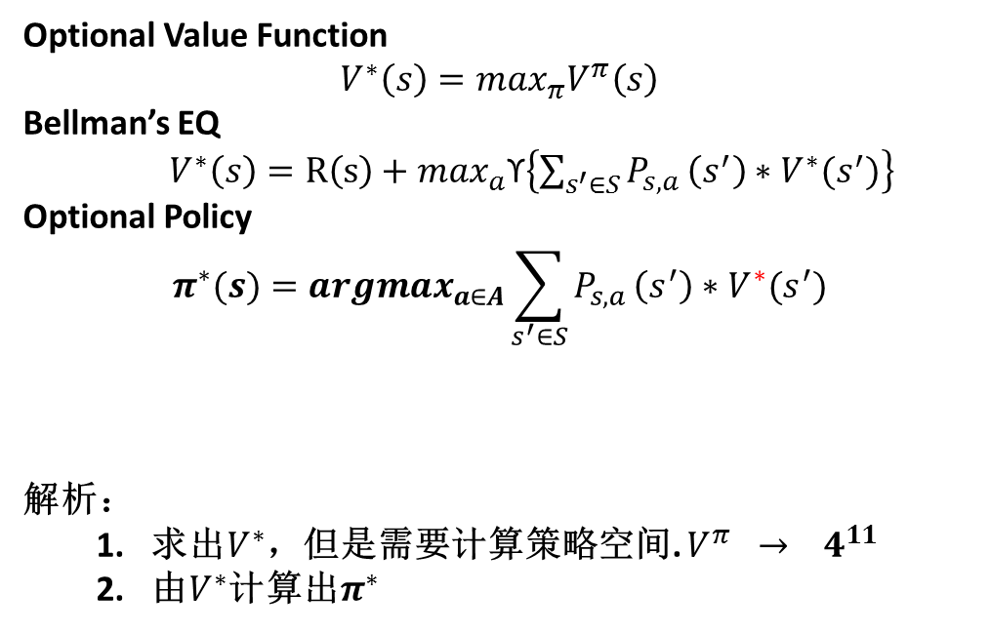

RL – Hello world!
1 2 3 4
$$π$$
Optional Value Function
$$V^{∗}\left(s\right)=\max_{π}V^{π}\left(s\right)$$
Bellman’s EQ
$V^{∗}\left(s\right)=R\left(s\right)+\max_{a}\text{ϒ}\left\{\sum_{s^{′}∈S}{P_{s,a}}\left(s^{′}\right)∗V^{∗}(s^{′})\right\}$
Optional Policy
$$π^{∗}(s)={argmax}_{a∈A}\sum_{s^{′}∈S}{P_{s,a}}\left(s^{′}\right)∗V^{∗}(s^{′})$$
解析：
求出$V^{∗}$，但是需要计算策略空间. $V^{π} → 4^{11}$
由$V^{∗}$计算出$π^{∗}$
3
2
1
 |  |  | +1
 |  |  | -1
未来收益最大化的动作a
1 2 3 4
 |  |  | +1
 |  |  | -1
$$V$$
3
2
1
0.52
0.73
0.77
-0.90
-0.82
-0.88
-0.87
-0.85
-1.0

Slide 15

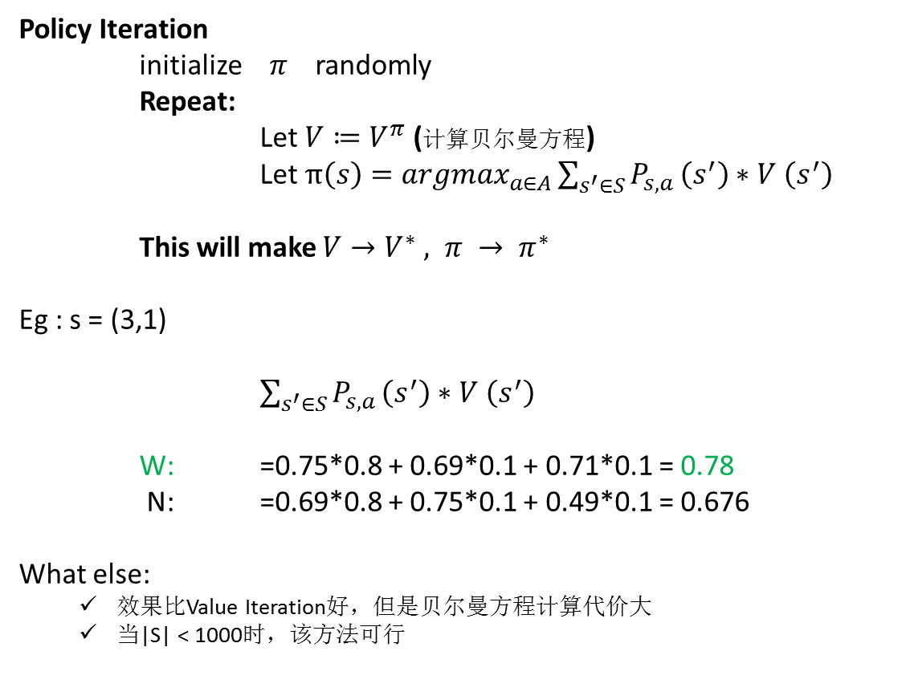

RL – Hello world!
1 2 3 4
$$π^{∗}$$
Policy Iteration
initialize$π$randomly
Repeat:
Let $V≔V^{π}$ (计算贝尔曼方程)
Let $π\left(s\right)={argmax}_{a∈A}\sum_{s^{′}∈S}{P_{s,a}}\left(s^{′}\right)∗V \left(s^{′}\right)$
This will make $V→V^{∗} , π → π^{∗}$
Eg : s = (3,1)
$\sum_{s^{′}∈S}{P_{s,a}}\left(s^{′}\right)∗V \left(s^{′}\right)$
W: =0.75*0.8 + 0.69*0.1 + 0.71*0.1 = 0.78
N: =0.69*0.8 + 0.75*0.1 + 0.49*0.1 = 0.676
What else:
效果比Value Iteration好，但是贝尔曼方程计算代价大
当|S| < 1000时，该方法可行
3
2
1
 |  |  | +1
 |  |  | -1
1 2 3 4
$$V^{∗}$$
 |  |  | +1
 |  |  | -1
3
2
1
0.86
0.90
0.93
0.82
0.69
0.78
0.75
0.71
0.49

Slide 16
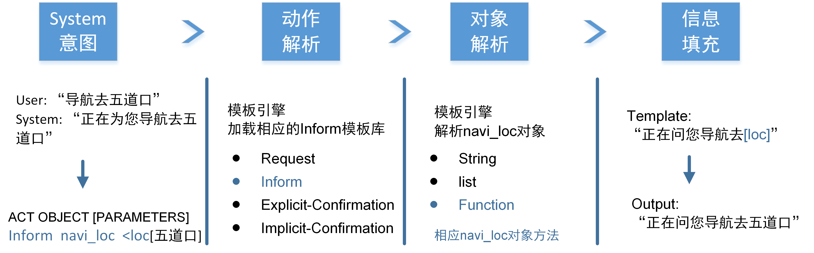
NLG技术简介

Slide 17
NLG技术简介
解析为list集合 => [‘start’,’{’'act', 'inform', 'object', 'result', 'origin_place', …]
获取一个解析对象 => start{}{}..{}end
递归解析当前对象 => parseKV函数
There is a < result.route bus> leaving < origin_place wudaokou> at < result.departure_time 1418>.
It will arrive at <destination_place huilongguan> at <result.arrival_time 1920>.

Slide 18


