Slide 1
Android App Development
By: Mohd. Anas Khan
Software Engineer
Softpro India (P) Ltd.
android
architecture
environment
setup
timeline
history
components
about

Slide 2


android
architecture
environment
setup
timeline
components
history
about
Android is a mobile operating system developed by Google, based on a modified version of the Linux kernel and other open source software and designed primarily for touchscreen mobile devices such as smartphones and tablets.

Slide 3
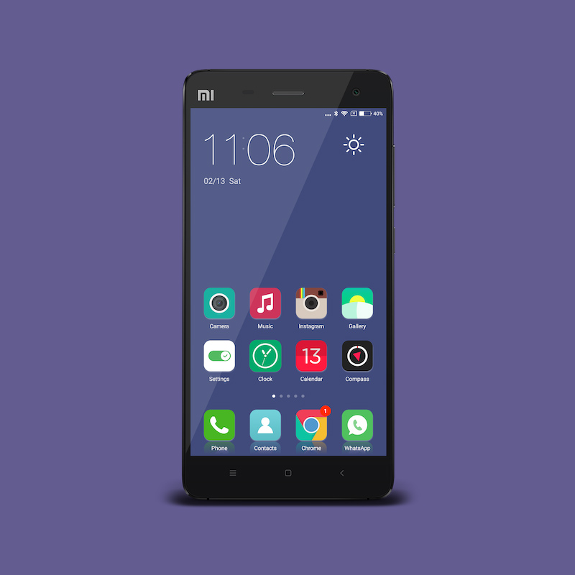
android
architecture
environment
setup
Android powers hundreds of millions of mobile devices in more than 190 countries around the world. It's the largest installed base of any mobile platform and growing fast. Every day more than 1 million new Android devices are activated worldwide.
The code names of android ranges from A to O currently, such as Aestro, Blender, Cupcake, Donut, Eclair, Froyo, Gingerbread, Honeycomb, Ice Cream Sandwitch, Jelly Bean, KitKat, Lollipop ,Marshmallow, Nougat and Oreo.
timeline
history
components
about

Slide 4
2
ANDROID DONUT
> Screen density
> Quick Search Box
> Google Play
2009
ANDROID ECLAIR
2010
> Google map Navigation
> Speech to Text
android
architecture
environment
setup
timeline
history
components
about
ANDROID GINGERBREAD
> NFC Support
> Dual Camera Support
2010
ANDROID HONEYCOMB
2011
> Tablet Friendly Design
> System Bar

Slide 5
2
ANDROID ICE CREAM SANDWICH
2011
> Customized Home Screen
> Data Usage Control
ANDROID JELLYBEAN
2012
> Account Switching
> Actionable Notification
android
architecture
environment
setup
timeline
history
components
about
ANDROID KITKAT
> Screen density
> Quick Search Box
> Google Play
2013
ANDROID LOLLIPOP
2014
> Material Design
> Multi-Screen
> Notifications

Slide 6
2
ANDROID MARSHMALLOW
> Battery Usage
> One-Tap Support
> Permission
2015
ANDROID NOGUT
> Split Screen Mode
> Picture in Picture Mode
> Quick Switch
2016
android
architecture
environment
setup
timeline
history
components
about
ANDROID OREO
> Notification Channel
> Smart text selection
2017
ANDROID PIE
2018
> Smart Navigation
> Digital Wellbeing

Slide 7
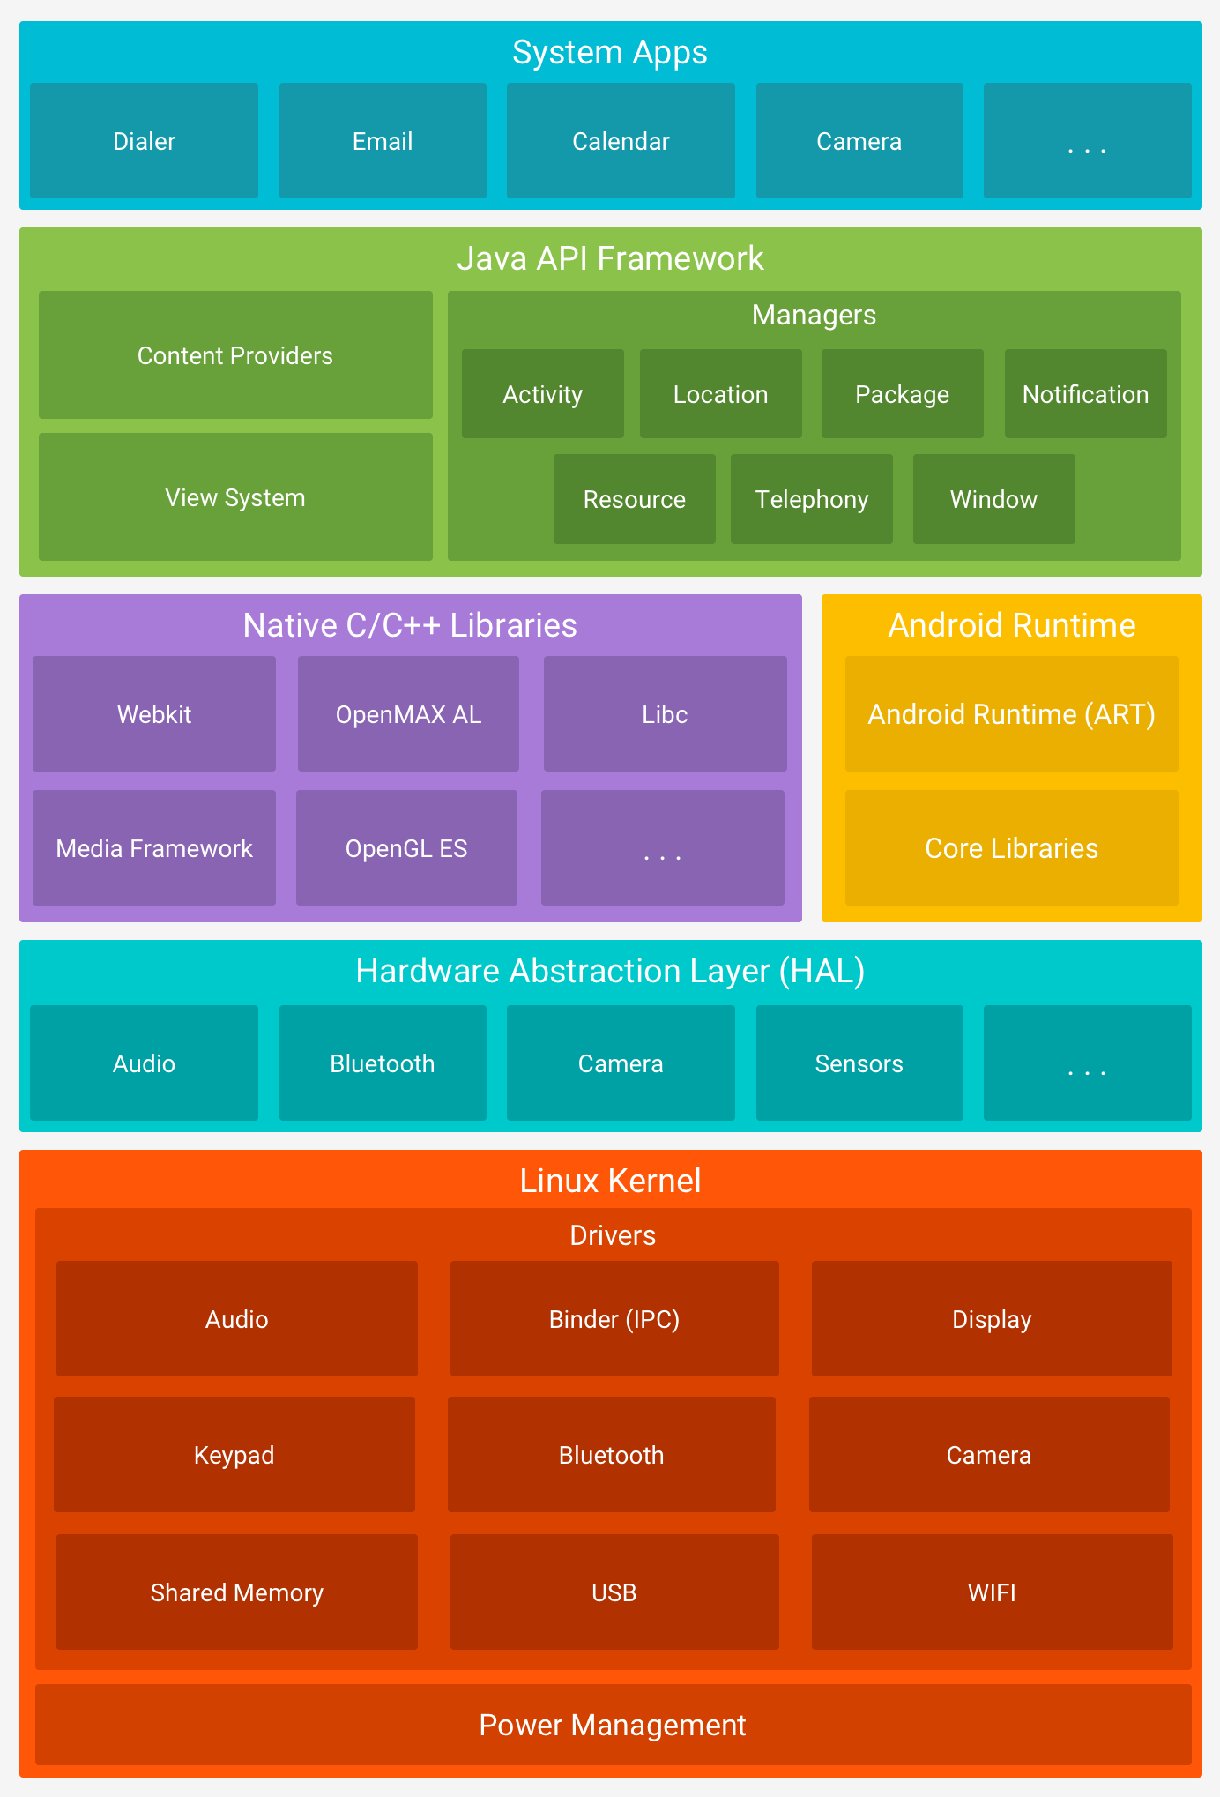
2
environment
setup
android
architecture
timeline
history
components
about
Android operating system is a stack of software components which is roughly divided into five sections and four main layers .

Slide 8
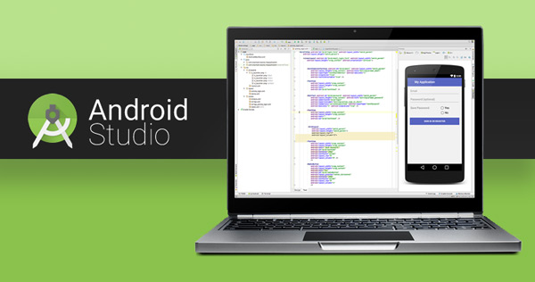
Hardware Requirements
At least 4GB of RAM
3.5GB Disk Space
Platforms Supported:
Microsoft Windows 7 or later version.
Mac OS X 10.5.8 or later version with Intel chip.
Linux including GNU C Library 2.7 or later.
Tools and IDE's:
Java JDK5 or later version
Android Studio (predominantly used)
Perquisites:
Java Programming
OOP Concepts
Design Skills
android
architecture
environment
setup
timeline
history
components
about

Slide 9
There are additional components which will be used in the construction of above mentioned entities, their logic, and wiring between them. These components are −
Fragments
Represents a portion of user
interface in an Activity.
Views
UI elements that are drawn on-screen including buttons, lists forms etc.
Layouts
View hierarchies that control screen format and appearance of the views.
Intents
Messages wiring components together.
Resources
External elements, such as strings, constants and drawable pictures.
Manifest
Configuration file for the application.
environment
setup
timeline(contd.)
timeline
history
components
about

Slide 10
Application components are the essential building blocks of an Android application. These components are loosely coupled by the application manifest file AndroidManifest.xml that describes each component of the application and how they interact.
There are following four main components that can be used within an Android application:
environment
setup
Activities
They dictate the UI and handle the user interaction
to the smart phone screen.
Services
They handle background processing associated with
an application.
Broadcast Receivers
They handle communication between Android OS and applications.
Content Providers
They handle data and database management issues.
timeline(contd.)
timeline
history
components
about

Slide 11

START MAKING YOUR FIRST APP!
environment
setup
android
architecture
timeline
history
about
create

