Slide 1
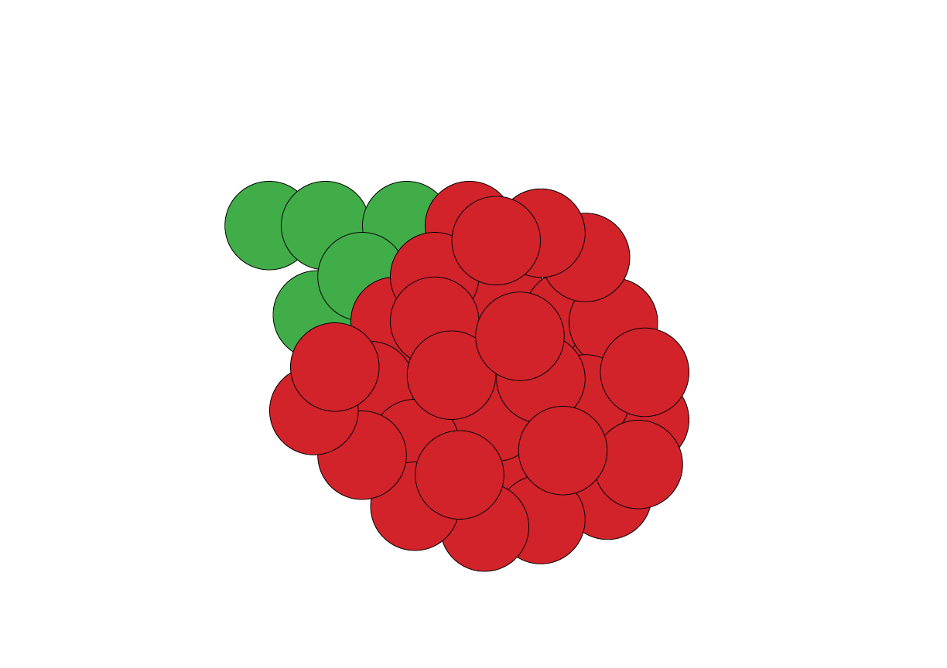
Raspberries
Abdullatif Al-Abduljaleel - Aaron Barge Liam Kolber - Cooper Timmerman - Ryan Close Wenle Feng

Slide 2
Tools Used
Raspberry Pi - 2
Arduino - 5
Trello - 4
Github - 5
Forecast.io - 5
Canvas JS - 5
Bootstrap - 5
Python - 5
Html/CSS - 5
PHP Unit test and scripts - 3
MySQL - 4
GearHost - 5
Aglie - 5
Linux – 4
Pair Programming – 5
DHT-11 – 5
Google map API – 3
C - 4
ESP8266 - 3

Slide 3
Challenges
Raspberry Pi was not the best option for our application
Connecting the database to the web
Initial problems connecting to the hot spot
Website formatting
Hosting the database
Google maps API is outdated(3 years old)
Mapping the points to the sensor location

Slide 4
DEMO

