Slide 1
Interpretable Feature Selection Using GPSR
Cooper Hansen - M’ Lab
Materials Informatics Final Project

Slide 2
Introduction
Problem Statement: Utilize genetic programming for symbolic regression to select important features (or combinations of features) from high dimensional data in materials science problems.
Hypothesis: Feature selection using GPSR will have similar performance to random forest and improve models.

Slide 3
Literature
A few studies related to this have been conducted:
Development of interpretable, data-driven plasticity models with symbolic regression, Bomarito et al.
Comparing transfer learning to feature optimization in microstructure classification, Banerjee et al.

Slide 4


Methods
Setup
Initial Equation Population
(Symbolic Regression)
Crossover + Mutation
(Genetic Programming)
-
Input Variables
New Population
cos
*
Mathematical Operators
Evolution
Evaluate Fitness
x
a
b
$$f\left(x\right)=\cos\left(x\right)−(a∗b)$$
FEAT python package takes in high dimensional data and returns the best combinations of features.
Used very high dimensional CBFV data from HW3 that I had very little domain knowledge of.
Final Potential Solutions
$$\begin{matrix}{f(x)}_{1} \\ {f(x)}_{2} \\ ⋮\end{matrix}$$

Slide 5
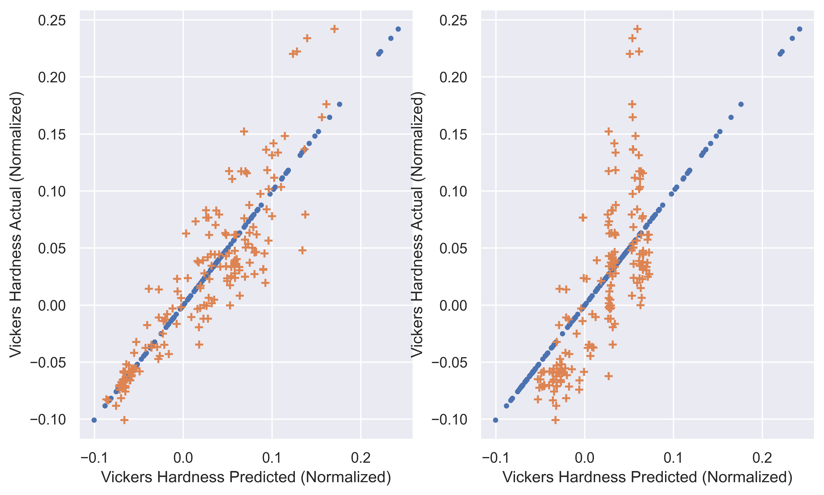
Results
Feature selection of random forest vs GPSR
Random Forest
GPSR
Important features:
‘avg_metal’
‘avg_crystal_radius’
‘mode_specific_heat’
Important features:
‘avg_metal’
‘avg_crystal_radius’
No others matched
$$X_{2}=(0.5007∗x_{239}+0.1299∗(1.4497∗x_{239} +0.1816 ∗(0.2978∗x_{15}+0.1611∗x_{234}))$$

Slide 6
Future Work
Multiple GPSR iterations on small stack sizes
Seeding the equation population
Using data that I am more familiar with.

Slide 7
Questions?
Email me: u0736958@utah.edu

