Slide 1
Managing a dev team
Eli Elhadad - intel

Slide 2
Some numbers
3 cyber
18 years
9 starts
1 animation studio
3 game studios
1 exit
4 companies - same core people

Slide 3

Disclaimer
רַק עַל עַצְמִי לְסַפֵּר יָדַעְתִּי. צַר עוֹלָמִי כְּעוֹלַם נְמָלָה, גַּם מַשָּׂאִי עָמַסְתִּי כָּמוֹהָ רַב וְכָבֵד מִכְּתֵפִי הַדַּלָּה.

Slide 4

Who?
Fight the bozo explosion

Slide 5
How to become an A player?
Try everything once!
(you will need it)

Slide 6
How to become an A player?
Ask for help
(you will need it)

Slide 7

The interview

Slide 8
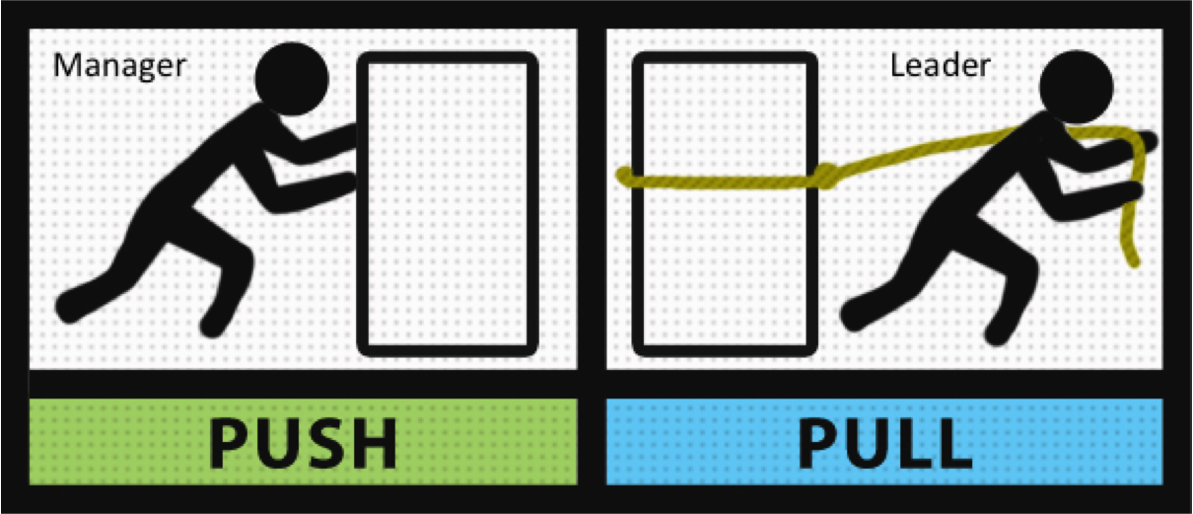
Who is the manager?

Slide 9

Quit the team

Slide 10

Projects

Slide 11

1 on 1

Slide 12
Questions?
Thanks

