Slide 1
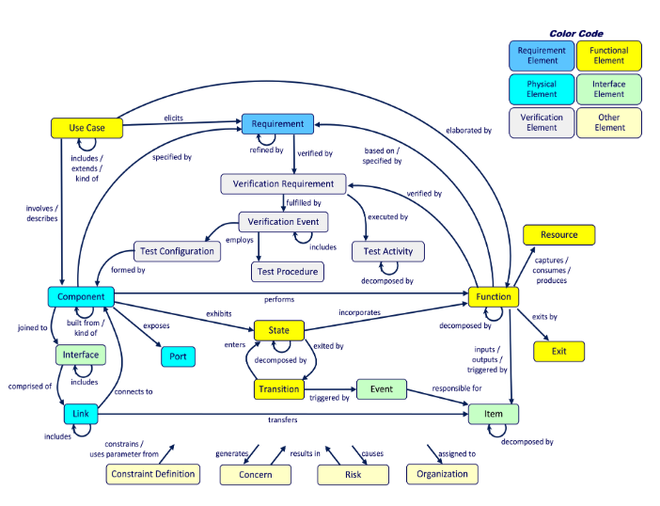

Slide 2
specifies
Requirement
(Functional)
verified by
Component
Verification Requirement
executed by
Test Activity
collects
connects to
basis of
joined to
Code Coverage
Interface
Resource
captures /
consumes /
produces
Function
comprised of
Link
inputs /
outputs /
triggered by
detected by monitoring
Item
Requirement
is precipitated by
has process model
is a
Functional
Loss Scenario
leads to
Unsafe Action
Context
Control Action
Feedback
Physical
protects against
is remediated by
is variation of
managed by
Interface
is a
Sentinel
is a
elicits
Requirement
(Constraint)
STPA / MA
Threat Simulator
simulates
leads to
Verification
contained by
Mode
is a
Resilient Mode
Hazard
Loss
Static Analysis
leads to
is recovered by

