Slide 1
自我介紹 (nizima Live)
Notes:
自我介紹

Slide 2
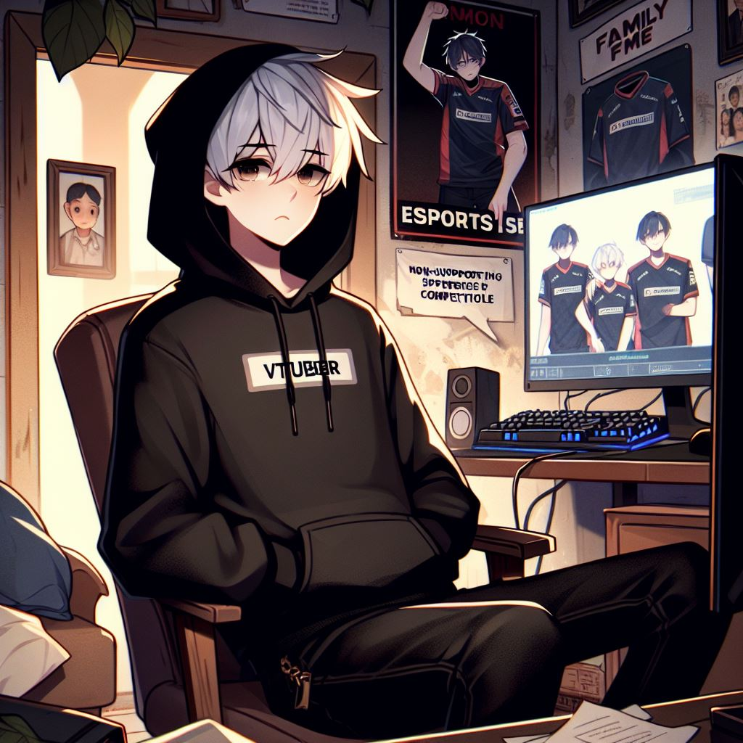
目標
Notes:
目標
“prompt“:”白色短髮身穿黑色連帽衣，黑色牛仔褲的男子，坐在書桌的電腦前，螢幕上有電競相關內容，插圖風格接近日本動畫"

Slide 3
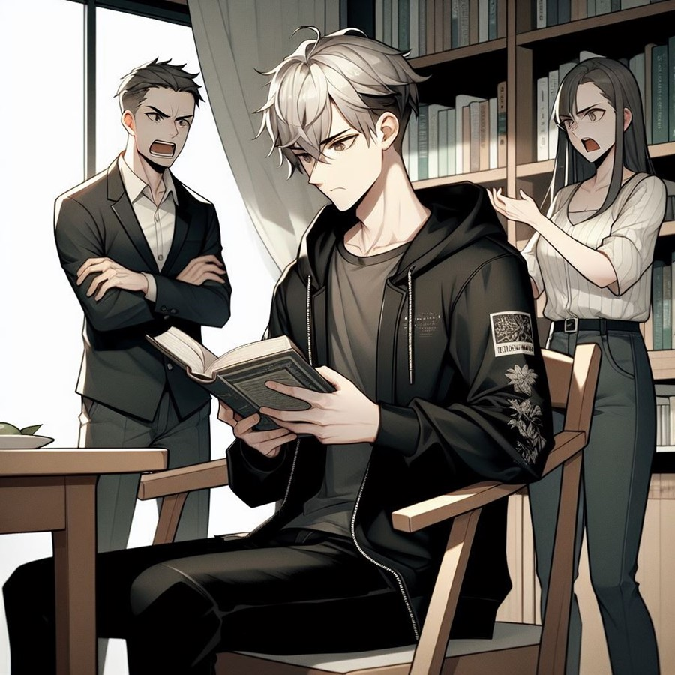
阻礙
Notes:
阻礙
"prompt":"白色短髮，身穿拉上拉鍊的黑色連帽衣，黑色牛仔褲的男子，主角正在練習電競，父母站在書桌旁生氣的反對，插圖風格接近日本動畫"

Slide 4
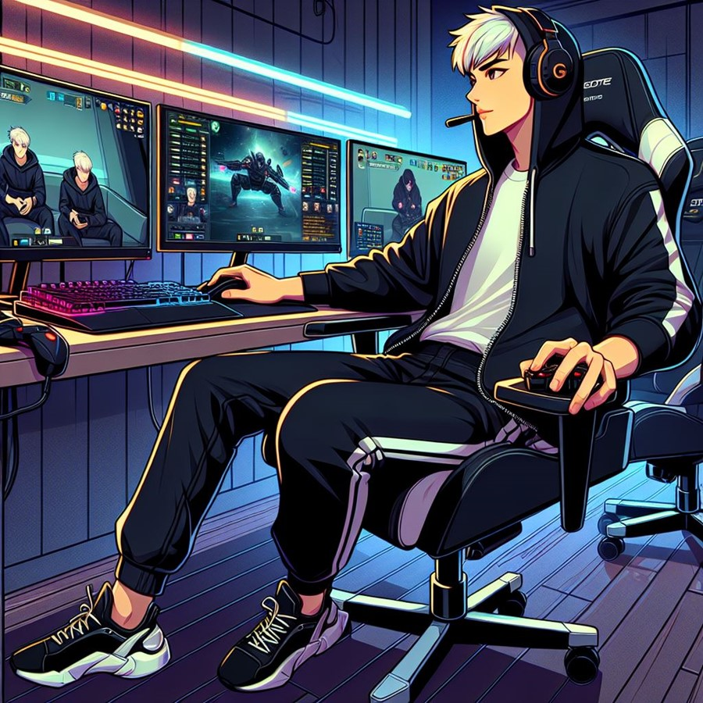
努力
Notes:
努力
"prompt":"白色短髮，身穿拉上拉鍊的黑色連帽衣，黑色牛仔褲的男子，主角正在練習努力練習電競，獲得多場勝利與失敗，插圖風格接近日本動畫"

Slide 5
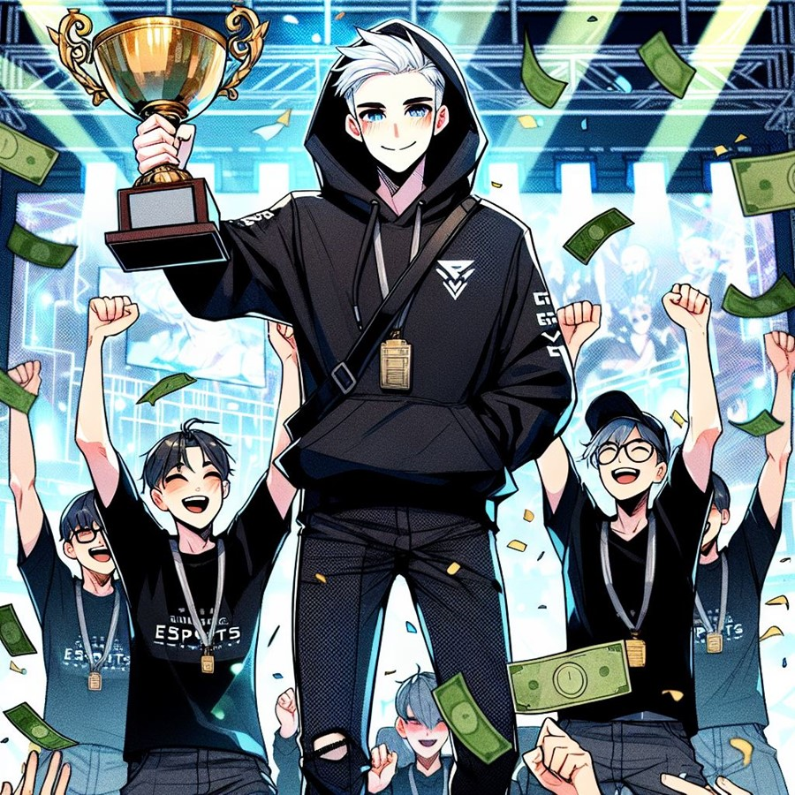
結果
Notes:
結果
"prompt":"white short Hair，clear face，上身只穿一件黑色連帽衣，黑色牛仔褲的男子，和隊友獲得電競比賽冠軍，贏得獎金，japan anime style"

Slide 6
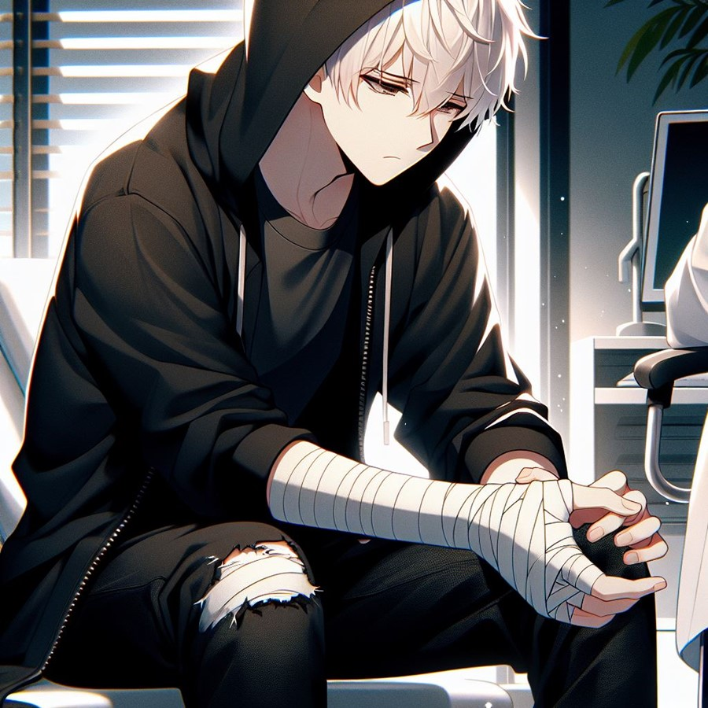
意外
Notes:
意外
"prompt":"White short hair man, Clear face, Wearing a black hoodie, Black jeans, Sitting down or looking discouraged, Holding or looking at an injured hand/arm, without blood, bandage, Japan anime style, Dim or subdued lighting (to reflect the mood), Doctor’s office or medical setting in the background, Emotional tension, showing frustration or disappointment, Symbolism of overwork (e.g., cluttered desk, multiple screens)

Slide 7
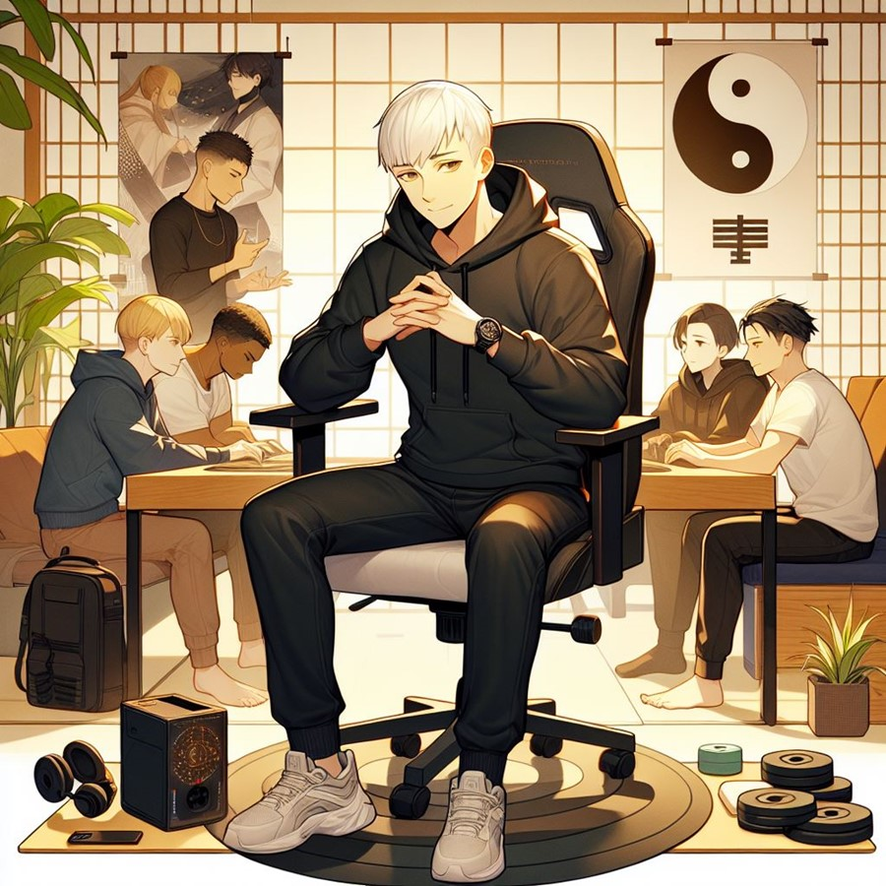
轉彎
Notes:
轉彎
"prompt":"White short hair man, Clear face with a thoughtful expression, Wearing a black hoodie, Black jeans, Sitting at a desk or relaxing in a comfortable chair, around a table with Teammates, Japan anime style, Calm and introspective atmosphere, A balanced workspace, with both gaming gear and relaxation items (e.g., yoga mat, small plant), chatting with Teammates, representing shared experiences, Subtle elements symbolizing health and balance (e.g., a clock, balanced weights, yin-yang symbol), Warm tones and calming colors (suggesting inner peace and recovery)

Slide 8
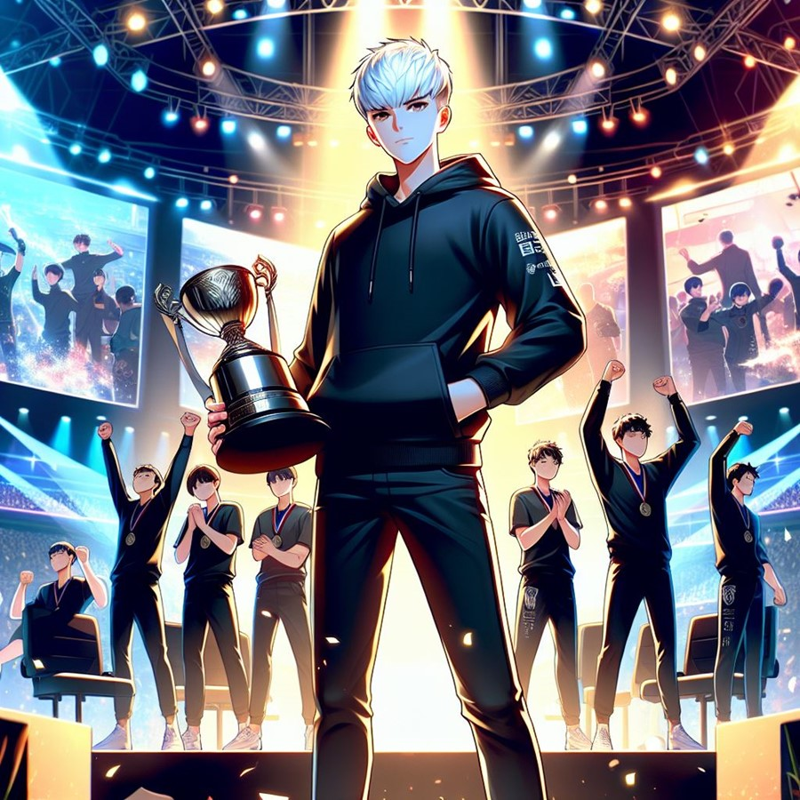
結局
Notes:
結局
"prompt":"White short hair man, Clear face, Wearing a black hoodie, Black jeans, Standing confidently on an esports stage, Team celebrating with trophies or medals, Victory pose or proud stance, Japan anime style, Bright, dynamic esports atmosphere (e.g., lights, screens, cheering crowd), Achieving dreams and balance theme (e.g., glowing effects, sense of personal growth), Balanced energy between focus and relaxation, holding trophy"

