Slide 1
冒險故事 (Vtube Studio)
Notes:
自我介紹

Slide 2
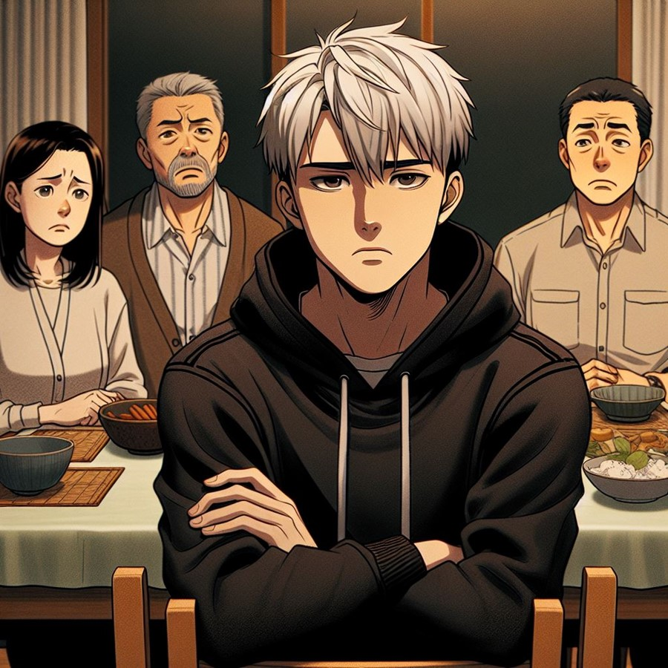
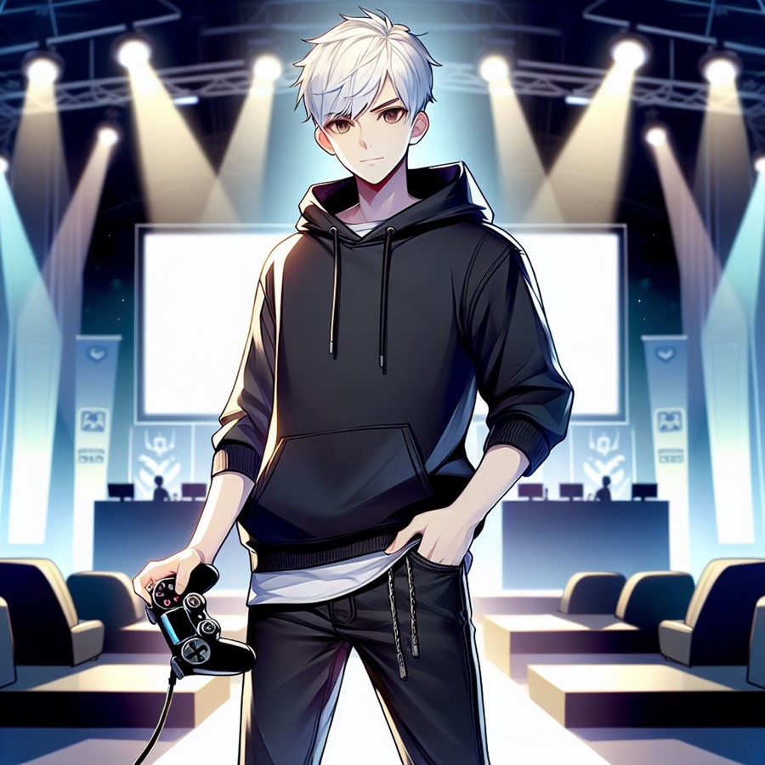
阻礙
目標
Notes:
目標
"prompt":"White short hair man,Wearing a black hoodie, black jeans,Standing confidently with a gaming controller in hand,Japan anime style,Esports stage in the background, soft lighting,Eyes focused and determined"

Slide 3
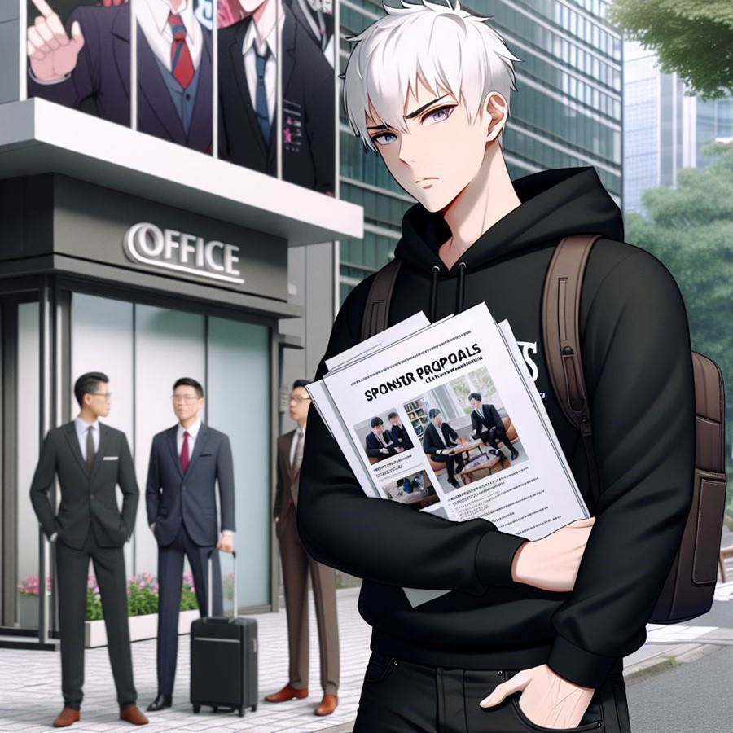
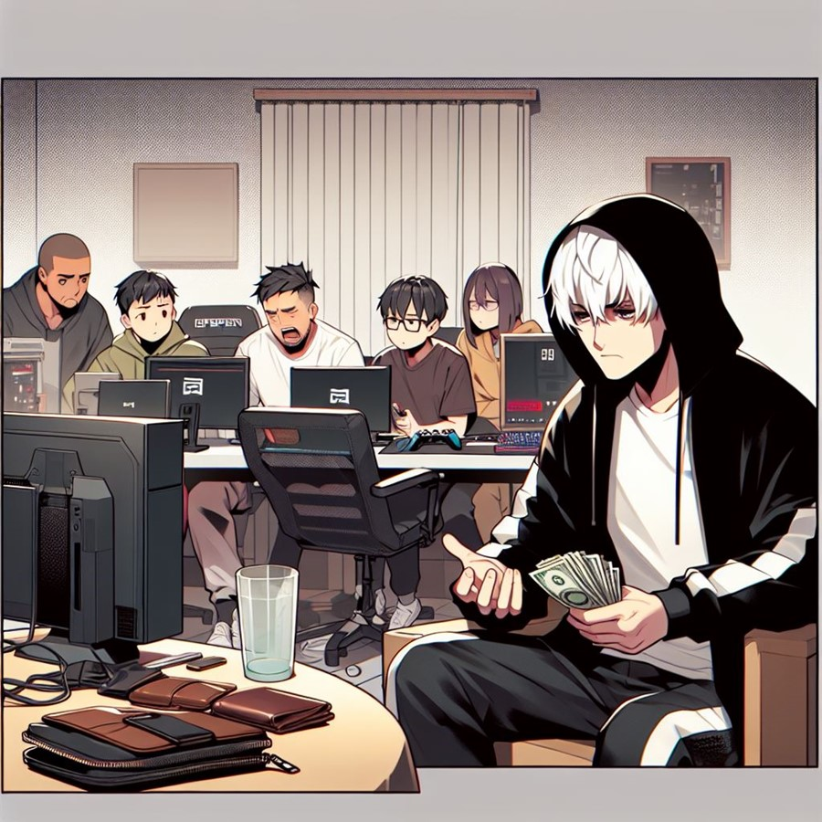
阻礙
Notes:
阻礙
"prompt":"White short hair man sitting at a dining table with family members, parents looking disapprovingly, wearing a black hoodie, family in casual clothing, Japan anime style, tense atmosphere, family conflict, dim lighting to emphasize the emotional struggle"

Slide 4
阻礙
Notes:
阻礙
"prompt":"White short hair man wearing a black hoodie, sitting with teammates in a small room filled with gaming equipment, Japan anime style, looking frustrated while discussing financial problems, empty wallets, dimly lit room to show the struggle with resources"

Slide 5
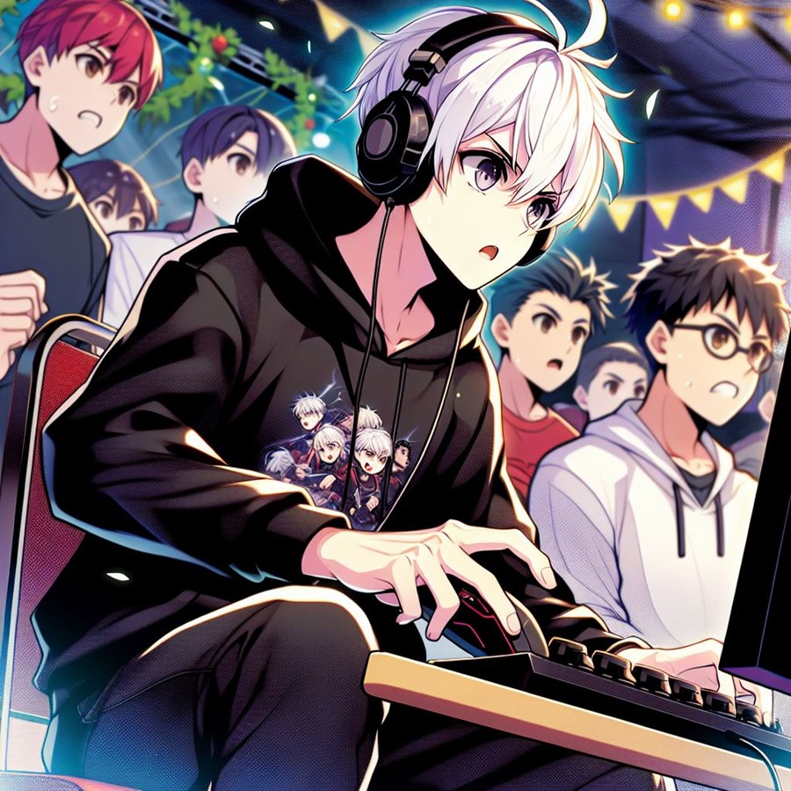
阻礙
努力
Notes:
努力
"prompt":"White short hair man, black hoodie, black jeans, Japan anime style, participating in a small gaming tournament, intense focus on the match, small crowd watching, teammates cheering, determined expression"}

Slide 6
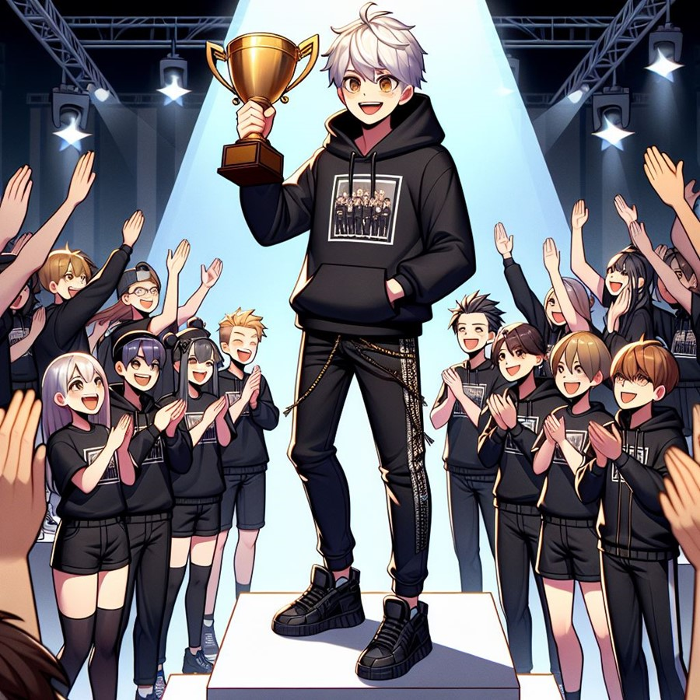
結果
努力
Notes:
努力
"prompt":"White short hair man, black hoodie, black jeans, Japan anime theme, standing outside an office building, holding a folder with sponsor proposals, determined expression, meeting with potential sponsors, handing over documents, business setting"舞台。

Slide 7

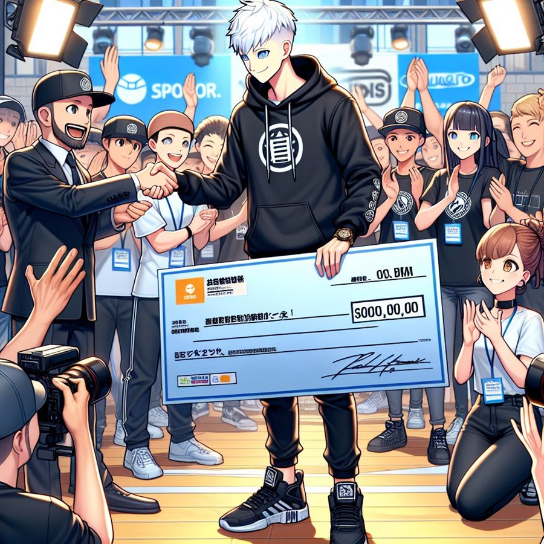
努力
結果
Notes:
結果
"prompt":"White short hair man, black hoodie, black jeans, Japan anime style, standing on a podium, holding a trophy, cheering teammates beside him, large crowd clapping, spotlight shining down, joyful and triumphant expression"

Slide 8
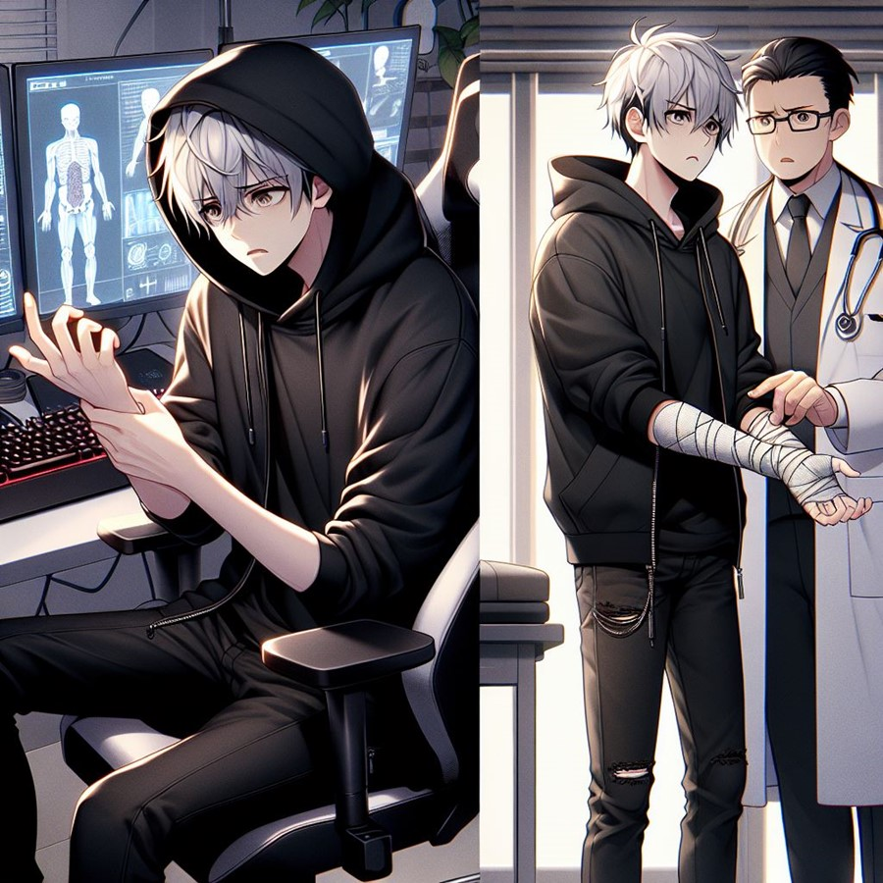
結果
Notes:
結果
"prompt":"White short hair man, black hoodie, black jeans, Japan anime style, Scene of receiving a large check or prize money, sponsors and supporters gathered around, camera flashes going off, hands shaking, expressions of pride and excitement on all faces, bright and celebratory atmosphere”

Slide 9
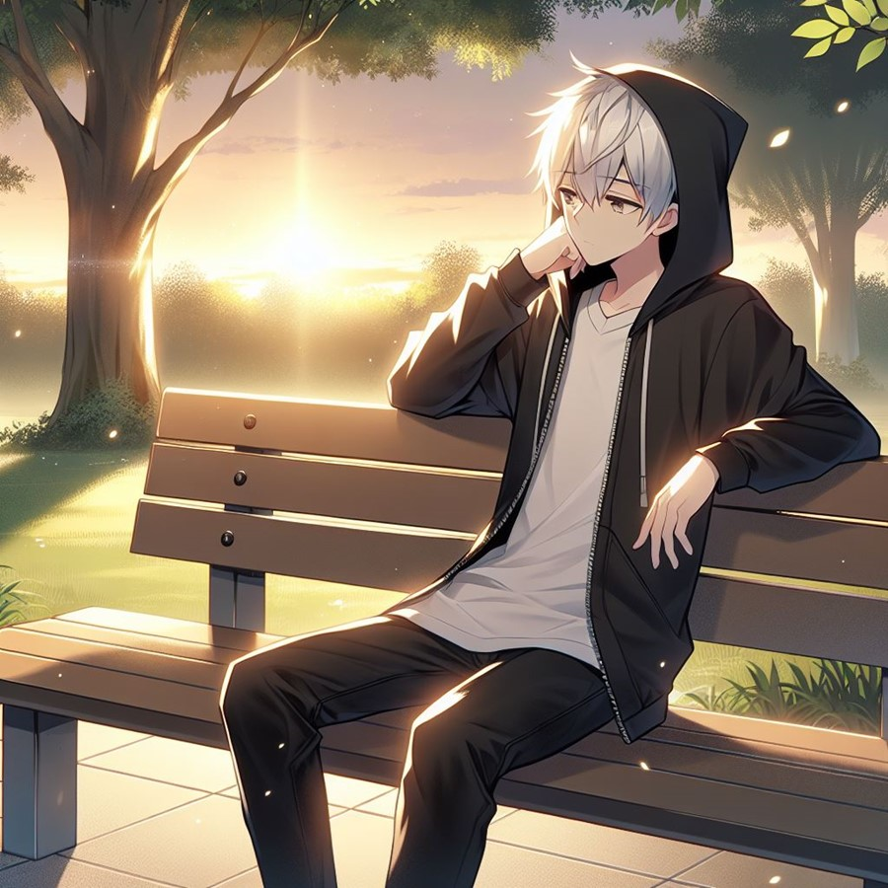
轉彎
意外
Notes:
意外
"prompt":"White short hair man, black hoodie, black jeans, Japan anime drawing style, sitting at a gaming desk late at night, intense expression, hand on his wrist in pain, gaming equipment glowing, dim lighting to show exhaustion. In a doctor’s office, man holding his injured wrist, doctor explaining the injury, serious expression on both faces, medical charts or models in the background, sterile and clinical environment, somber mood"

Slide 10
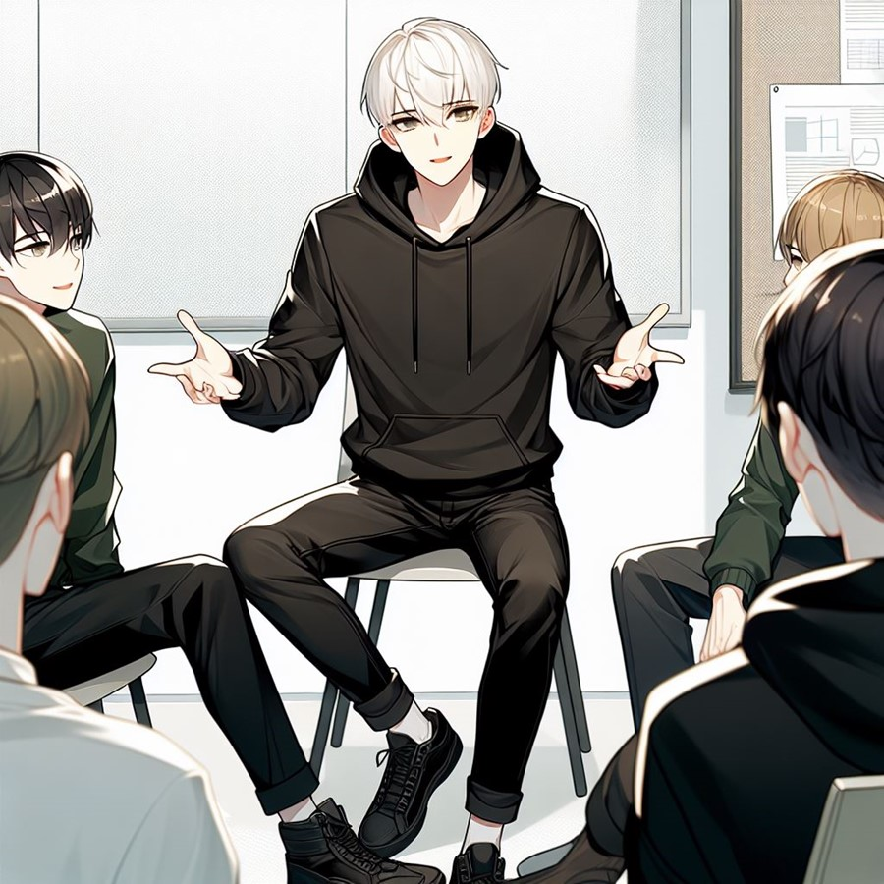
意外
轉彎
Notes:
轉彎
"prompt":"White short hair man, black hoodie, black jeans, Japan anime drawing style, sitting peacefully on a park bench, reflective expression, calm sunset in the background, nature around him, soft lighting"

Slide 11
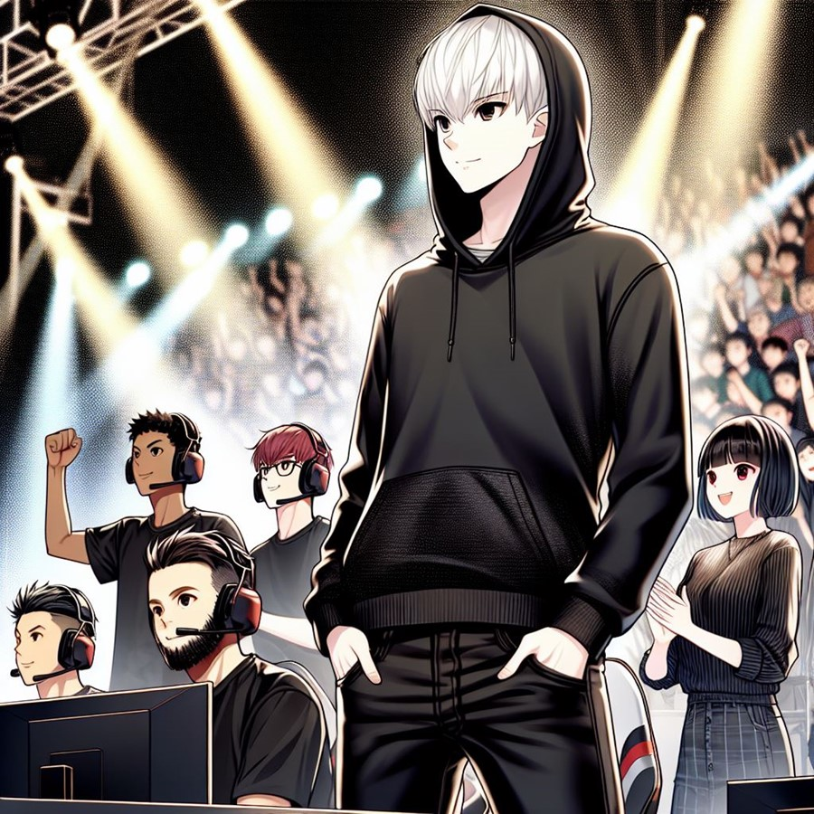

轉彎
Notes:
轉彎
"prompt":"White short hair man, black hoodie, black jeans, Japan anime drawing style, man in a small meeting room with teammates, Japan anime drawing style, gesturing while speaking, teammates listening attentively, relaxed and supportive atmosphere, whiteboard in the background, casual but focused mood“

Slide 12
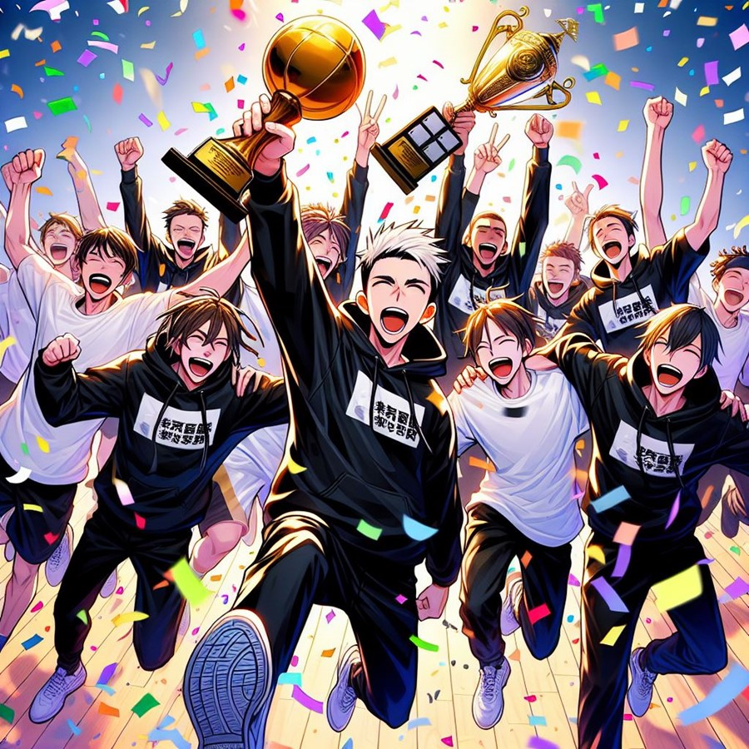
結局
Notes:
結局
"prompt":"White short hair man, black hoodie, black jeans, Japan anime drawing style, back on the gaming stage, focused expression, teammates cheering behind him, bright lights shining down, atmosphere filled with excitement"

Slide 13
結局
Notes:
結局
"prompt":"White short hair man, black hoodie, black jeans, Japan anime drawing style, scene of the team celebrating victory after winning a championship, Japan anime drawing style, holding up trophies, confetti falling, joyful expressions on all faces, bright colors and dynamic movement to show excitement"

