Slide 1
Better health and care for all
Developing our health and care system

Slide 2
Meeting the needs of local people
Emma
  42 years old and lives in Sussex with her three children and husband.
  She needs to know how they can stay well and, when they do have a health issue, how to get the most appropriate care and support as soon as possible.
Anne
  88 years old and lives alone in a rural part of Sussex
  She has a complex long-term condition and needs the support and care of a range of services from a number of different organisations
  She needs them to work together to provide joined-up care close to where she lives.
Eddie
  50 years old and has several long-term health conditions and mental health issues.
  He is unemployed, lives in poor housing and is drinking more alcohol than before.
  He needs additional help to know how he can get the advice and support he needs.
We know Emma, Anne and Eddie and many other people living across Sussex are not always getting what they need.

Slide 3
Why we need to change
Growing and ageing population
The most deprived people have worst outcomes
Disjointed experience and care
Impact of the pandemic
Limited resources

Slide 4
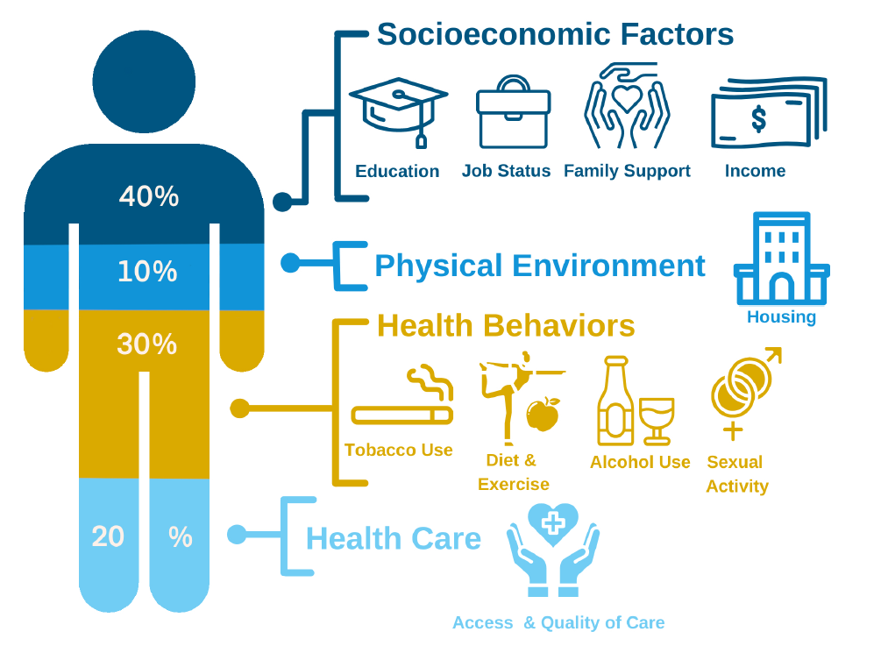
Why we need to change
Many factors influence someone’s health and wellbeing and these are the responsibility of many different health and care organisations.

Slide 5
How we are changing for you
We are developing our health and care system to allow organisations to work better together to improve the health and care for our population:
  All NHS organisations in Sussex
  2 County Councils and 1 City Council in Sussex
  Voluntary, Community and Social Enterprise organisations in Sussex
  3 Universities and 1 Medical School in Sussex
  3 Healthwatch organisations in Sussex
  Involvement of interested stakeholders and members of the public

Slide 6
How we are working differently for you
New way of working across Sussex for organisations
  A wide range of organisations with an interest in health and care will come together regularly as the ‘Health and Care Assembly’ to make sure the needs of Sussex people are being met.
New way of working for the local NHS
  We have created a new organisation called ‘NHS Sussex’ that will help improve the way the NHS plan and pay for local services, and better support local NHS organisations to give people the care they need.
New way of working for local populations
  We are creating ‘health and care partnerships’ of organisations across our local authority areas that will work closer together to better support communities to stay healthy and get the most appropriate support, care and treatment they need.

Slide 7

What this looks like in practice
Public
Health
Primary
Care
Urgent
Care
Emergency Care
Planned
Care
Community Care
Mental Health
Social
Care
VCSE
Support
Joining-up services from the person’s point of view

Slide 8
What this means for local people
By working in a more joined-up way, we will:
Enable everyone to access the care they need when they need it … waiting less
Focus on improving the health of our children and young people … starting well
Better support those with long-term conditions and multiple needs … living well
Help people to stay well and independent for as long as possible … ageing well

