Slide 1
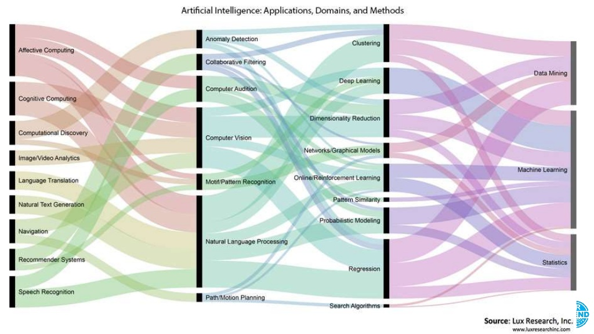

Slide 2
APPROCHES
Supervised learning
Unsupervised learning
Reinforcement learning
TECHNIQUES
Linear regression
Neural network (deep learning)
Q-Learning
ALGORITHMES
Gradient Descent
Back propagation
MACHINE LEARNING

Slide 3






training set
input x ⇒ model / hypothèse h(x) ⇒ ouput y
features
θ₀ = θ₁ =
x =
y = “CHAT”

Slide 4
Cost function J() :
J() = h(x)−y
Pour chaque item i :
J() = ∑i h(xi)−yi
Avec θ₀ = θ₁ =
J(θ₀,θ₁) = ∑i h_{θ0,θ1}(xi)−yi
Gradient descent :
Faire varier les 2 features θ₀,θ₁ pour minimiser la cost function J()

Slide 5
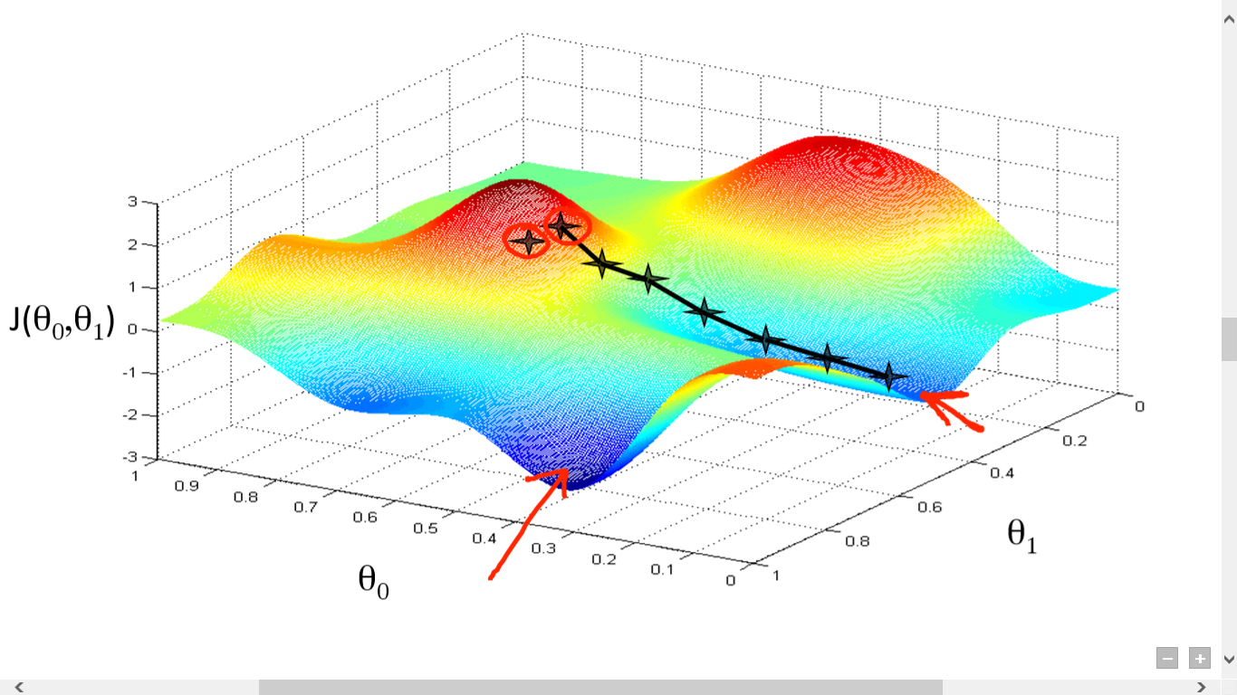

Slide 6
APPROCHES
Supervised learning
Unsupervised learning
Reinforcement learning
TECHNIQUES
Linear regression
Neural network (deep learning)
Q-Learning
ALGORITHMES
Gradient Descent
Back propagation
MACHINE LEARNING

Slide 7
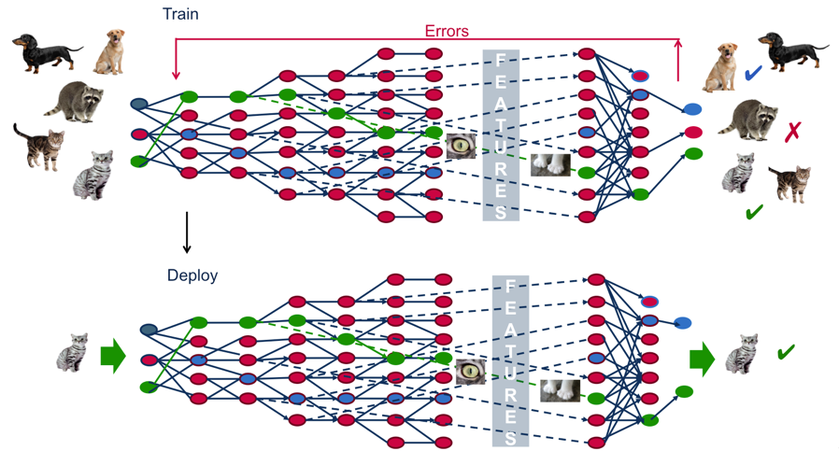

Slide 8
JAVASCRIPT dans tout ça
https://www.robinwieruch.de/machine-learning-javascript-web-developers/

