Slide 1

Common Persistable Process Execution Runtime
Native JVM Workflow Engine
http://www.copper-engine.org/

Slide 2
Short Profile
High performance, lightweight workflow engine for Java
Outstanding:
Java is the workflow description language!
OpenSource Apache License
Running in any container, e.g. Spring, JEE, ...
Support for various RDBMS, currently
Oracle
MySQL
PostgreSQL
Apache DerbyDB

Slide 3
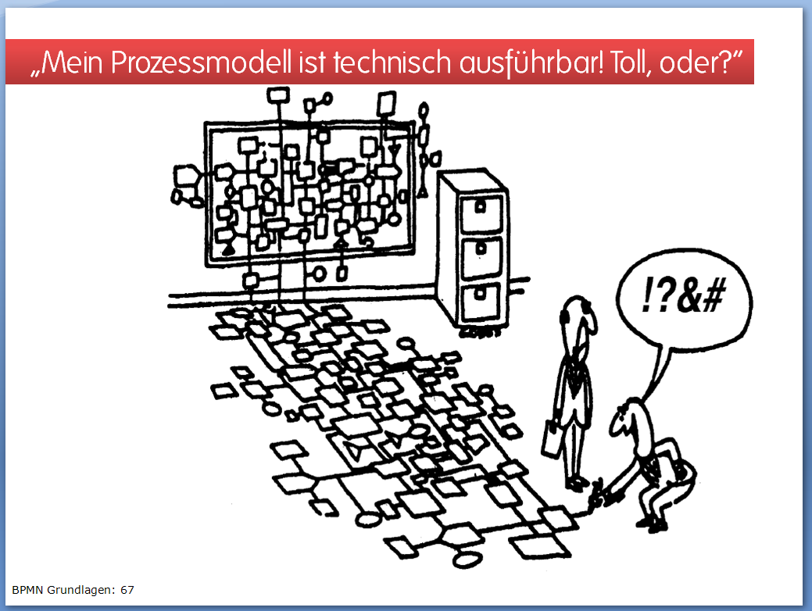
Why use Java for Workflow Design?
Source: www.bpm-guide.de/bpmn

Slide 4
Why use Java for Workflow Design?
Problems of graphical Process Modeling
Simple issues become more simple, complex issues more complex
The business process gets obscured as execution details slip in
The development process gets cumbersome
➔ Too opaque for users, too unwieldy for developers

Slide 5
Why use Java for Workflow Design?
Use the widely known Java language
Utilize the complete range of Java features
Use your favourite development environment
Use all those highly elaborated Java tools for
editing workflows
workflow compilation, debugging and profiling
teamwork support
Avoid team setup expenses because of additional languages, notations, tools and runtimes
many skilled Java professionals available

Slide 6
Core Workflow Engine Requirements
Readable and reasonable workflow description
Usually, workflows orchestrate multiple partner systems
Generally, the lifetime of a workflow is long
from seconds, to hours and days, even months
Conclusion:
Workflow instances have to survive Java process lifetime (persistence)
A workflow engine has to cope with an unlimited number of workflows instances at the same time.
Performance optimization with regard to throughput and latency

Slide 7
Why plain Java is not enough
Straightforward workflow definition in pure Java
This is simple to read, but:
Every workflow instance occupies one Java thread
➔ limited number of parallel workflow instances
A running Java thread cannot be persisted
➔ no long running workflows, no crash safety
public void execute(Process processData) {
Contract contract = crmAdapter.getContractData(processData.getCustomerId());
if (contract.isPrepay())
sepAdapter.recharge(processData.getAmount());
else
postpayInvoice.subtract(processData.getAmount());
smsAdapter.message(processData.getMSISDN(), "recharging successful");
}

Slide 8
Try it asynchronously
One Thread occupied per Workflow instance?
Why not calling a partner system asynchronously?
public void execute(Process processData) {
ResponseReference r = new ResponseReference();
Contract contract = null;
synchronized (r) {
crmAdapter.sendContractDataRequest(processData.getCustomerId(), r);
r.wait();
contract = r.getContractData();
}
…
}
But: r.wait() still blocks the thread...

Slide 9
Don't block the thread
So, we try to avoid Object.wait:
private String correlationId = null;
public void execute(Process processData) {
if (correlationId == null) {
correlationId = … // create a GUID
crmAdapter.sendContractDataRequest(processData.getCustomerId(), correlationId);
// somehow register this workflow instance to wait for correlationId
// execute is called again, when the response is available
return;
}
else {
Contract contract = crmAdapter.getResponse(correlationId);
// continue to process the workflow
…
}}
But: This approach is bad for the readability, especially with larger workflows

Slide 10
COPPER approach
Substitute Object.wait
public void execute(Process processData) {
String correlationId = getEngine().createUUID();
crmAdapter.sendContractDataRequest(processData.getCustomerId(), correlationId);
this.wait(WaitMode.ALL, 10000, correlationId);
Contract contract = this.getAndRemoveResponse(correlationId);
// continue to process the workflow
…
}
Interrupt and Resume anywhere (within the workflow)
Call stack is persisted and restored
➔ Internally implemented by Bytecode Instrumentation

Slide 11
Some more features
Crash recovery
Change Management of Workflows
supports Versioning as well as Modification of workflows
hot workflow deployment
Management & Monitoring via JMX
Distributed Execution on multiple coupled engines enables
Load Balancing
Redundancy
High Availability (requires a high available DBMS, e.g. Oracle RAC)
Fast and generic Audit Trail

Slide 12
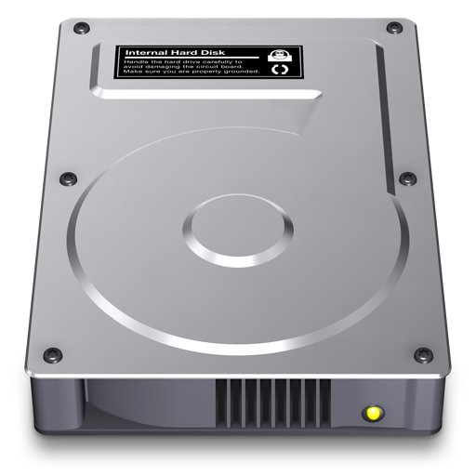
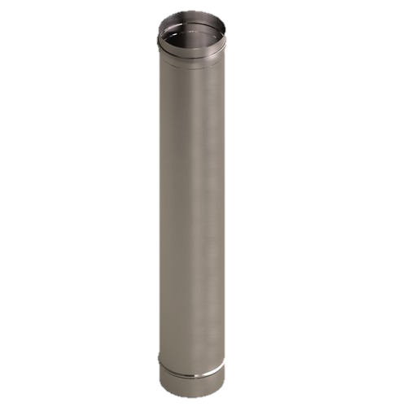

COPPER Architecture
COPPER runtime
Processor Pool
(n threads)
Processing Engine
Processor Pool
(n threads)
Processor Pool
(n threads)
Workflow
Repository
DB Layer
Batcher
Audit Trail
Workflow
Definitions
Database
Workflow
instances
Queue
Filesystem
Overview over the main COPPER components, here for a persistent engine. In a transient engine, workflow istances and queues reside in the main memory.

Slide 13
COPPER Architecture explained
ProcessingEngine
The main entity in the COPPER architecture, responsible for execution of workflow instances. Offers a Java API to launch workflow instances, notification of waiting workflow instances, etc.
The engine supports transient or persistent workflows - this depends on the concrete configuration (both provided out-of-the-box)
An engine is running in a single JVM process. A JVM process may host several engines.

Slide 14
COPPER Architecture explained
Workflow Repository
encapsulates the storage and handling of workflow definitions (i.e. their corresponding Java files) and makes the workflows accessible to one or more COPPER processing engines.
Reads workflow definitions from the file system
Observes the filesystem for modified files --> hot deployment

Slide 15
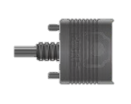
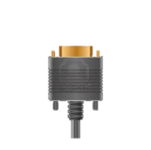
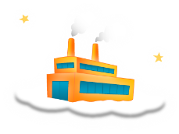
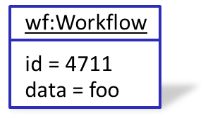
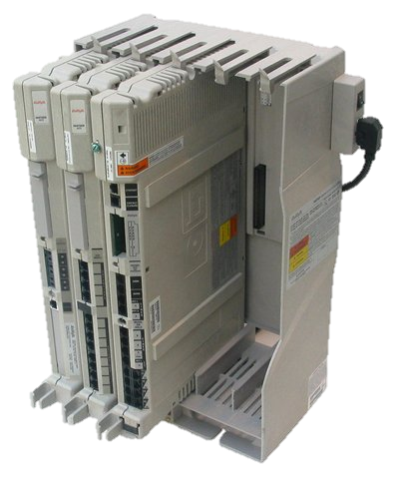
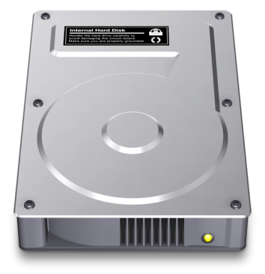
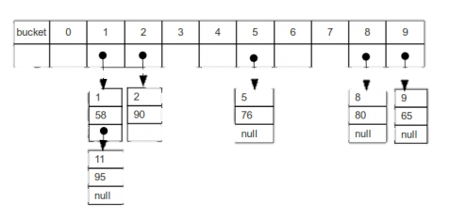
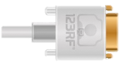
Execution Animation
invoke()
InputChannel
wf:Workflow
id = 4711
data = foo
Input Channel
newInstance()
wf:Workflow
id = null
data = null
inject dependencies
COPPER runtime
run(…)
Workflow Factory
Processing Engine
Processor pool
Remote Partner System
Queue
Workflow
Repository
Adaptor
(ansynchronous)
Processor Thread
Processor Thread
Processor Thread
Filesystem
Correlation Map

Slide 16
Execution Animation
InputChannel
Input Channel
COPPER runtime
Workflow Factory
Processing Engine
Processor pool
Remote Partner System
Queue
dequeue()
Workflow
Repository
Adaptor
(ansynchronous)
Processor Thread
Processor Thread
wf:Workflow
id = 4711
data = foo
Processor Thread
Filesystem
Correlation Map

Slide 17
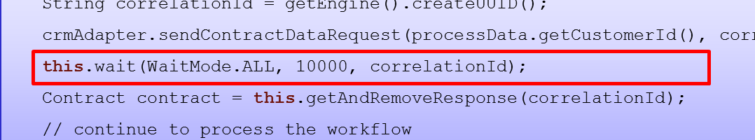
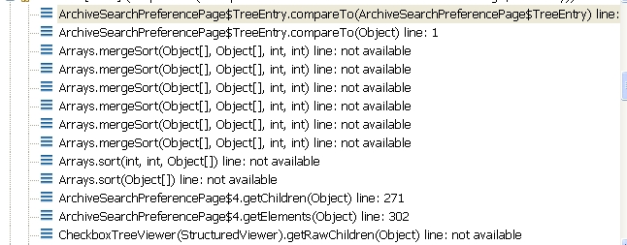
Execution Animation
InputChannel
Input Channel
Serialize Java call stack and store it persistently
COPPER runtime
Workflow Factory
Processing Engine
Processor pool
Remote Partner System
Queue
Workflow
Repository
Adaptor
(ansynchronous)
Processor Thread
Processor Thread
wf:Workflow
id = 4711
data = foo
Processor Thread
cid
Filesystem
data = foo
Correlation Map

Slide 18
Execution Animation
InputChannel
Input Channel
COPPER runtime
Workflow Factory
Processor Thread is now free to
process other workflows
Processing Engine
Processor pool
Remote Partner System
Queue
cid
Adaptor
(ansynchronous)
Workflow
Repository
Processor Thread
wf:Workflow
id = 4711
data = foo
Processor Thread
Processor Thread
data = foo
Filesystem
Correlation Map

Slide 19
Execution Animation
InputChannel
Input Channel
Retrieve persistent Java callstack and resume
COPPER runtime
Workflow Factory
Processing Engine
Processor pool
Remote Partner System
Queue
cid
Adaptor
(ansynchronous)
Workflow
Repository
Processor Thread
wf:Workflow
id = 4711
data = foo
Processor Thread
Processor Thread
response data
data = foo
Filesystem
Correlation Map

Slide 20

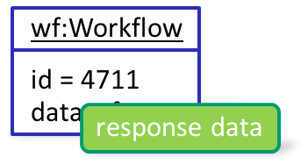
Execution Animation
InputChannel
Input Channel
Retrieve persistent Java callstack and resume
COPPER runtime
Workflow Factory
Processing Engine
Processor pool
Remote Partner System
Queue
dequeue()
cid
Adaptor
(ansynchronous)
Workflow
Repository
Processor Thread
Processor Thread
wf:Workflow
id = 4711
data = foo
Processor Thread
Filesystem
Correlation Map
response data

Slide 21
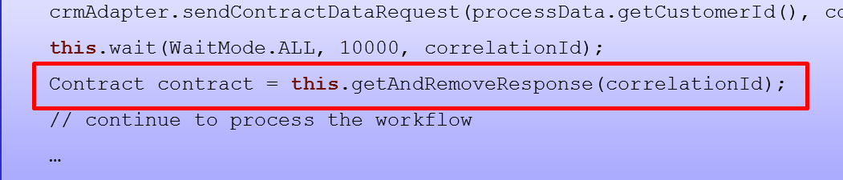
Execution Animation
Resume here
InputChannel
Input Channel
COPPER runtime
Workflow Factory
Processing Engine
Processor pool
Remote Partner System
removeWorkflow()
Queue
continue processing
Workflow
Repository
Adaptor
(ansynchronous)
Processor Thread
Processor Thread
wf:Workflow
id = 4711
data = foo
Processor Thread
Filesystem
Correlation Map
response data

Slide 22
Execution Animation
InputChannel
Input Channel
COPPER runtime
Workflow Factory
Processing Engine
Processing finished
Processor pool
Remote Partner System
Queue
Workflow
Repository
Adaptor
(ansynchronous)
Processor Thread
Processor Thread
Processor Thread
Filesystem
Correlation Map

Slide 23
COPPER Architecture explained
Processor Pool
A named set of threads executing workflow instances
Configurable name and number of processing threads
Each processor pool owns a queue, containing the workflow instances ready for execution, e.g. after initial enqueue or wakeup
a transient engine’s queue resides in memory
a persistent engine’s queue resides in the database
Supports changing the number of threads dynamically during runtime via JMX
COPPER supports multiple processor pools, a workflow instance may change its processor pool at any time

Slide 24
COPPER Architecture explained
COPPER runtime
Processing Engine
Processing Engine
Short running tasks pay for the cost induced by long running tasks because of thread pool saturation
Processor pool
Processor Thread
queue
Processor Thread
long running tasks (e.g. complex database query)
short running tasks
Processor Thread

Slide 25
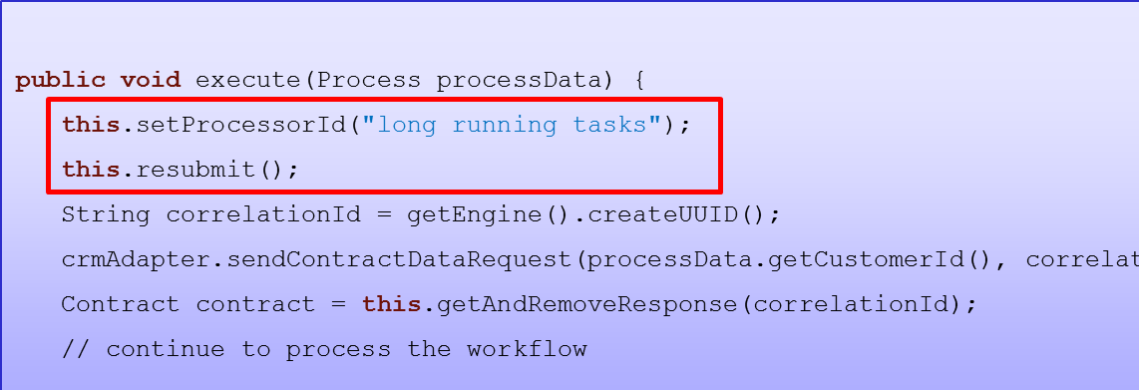
COPPER Architecture explained
COPPER runtime
Processing Engine
Processing Engine
Processor pool
Processor Thread
long running tasks
Processor Thread
default queue
Processor Thread

Slide 26
COPPER Architecture explained
COPPER runtime
Processing Engine
Processor pool
Processor Thread
Configurable thread pools help avoiding thread pool saturation for short running tasks
long running tasks
Processor Thread
default queue
Processor Thread

Slide 27
COPPER Architecture explained
Database Layer
Encapsulates the access to persistent workflow instances and queues
Decoupling of the core COPPER components and the database
Enables implementation of custom database layers, e.g. with application specific optimizations or for unsupported DBMS.
Audit Trail
Simple and generic Audit Trail implementations
Log data to the database for tracebility and analysis

Slide 28
COPPER Architecture explained
Batcher
Enables simple use of database batching/bulking,
Collects single database actions (mostly insert, update, delete) and bundles them to a single batch,
Usually increases the database throughput by a factor of 10 or more,
Widely used by the COPPER database layer, but open for custom use.

Slide 29
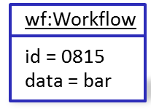
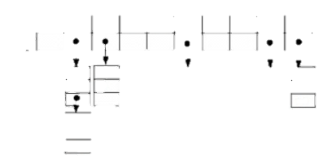
COPPER Architecture explained
COPPER runtime
Processing Engine
Processor Pool
(n threads)
Processor Pool
(n threads)
Queue
Processor Pool
(n threads)
wf:Workflow
id = 0815
data = bar
TxnData
Batcher
Correlation Map
Database

Slide 30
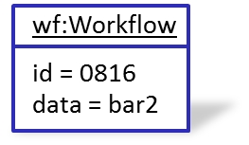
COPPER Architecture explained
COPPER runtime
Processing Engine
Processor Pool
(n threads)
Processor Pool
(n threads)
Queue
Processor Pool
(n threads)
wf:Workflow
id = 0816
data = bar2
TxnData
Batcher
Correlation Map
TxnData
Database

Slide 31
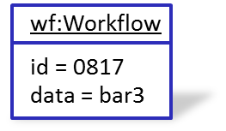
COPPER Architecture explained
COPPER runtime
Processing Engine
Processor Pool
(n threads)
Processor Pool
(n threads)
Queue
Processor Pool
(n threads)
wf:Workflow
id = 0817
data = bar3
TxnData
Batcher
Correlation Map
TxnData
TxnData
Database

Slide 32
COPPER Architecture explained
COPPER runtime
Processing Engine
Processor Pool
(n threads)
Processor Pool
(n threads)
Queue
Processor Pool
(n threads)
Batcher
TxnData
Correlation Map
TxnData
TxnData
JDBC.executeBatch()
Database

Slide 33
COPPER Architecture explained
COPPER runtime
Processing Engine
Continue processing workflows after database operations have been committed and results have been sent back to the workflow instances
Processor Pool
(n threads)
Processor Pool
(n threads)
Queue
Processor Pool
(n threads)
Batcher
Correlation Map
Database

Slide 34
COPPER
Open Source (Apache)
Available for Java 6 and 7
http://www.copper-engine.org/

Slide 35
Umfassendes Response-Handling
Early Responses möglich
Multiple Responses möglich (first oder all)
Beliebige CorreleationId

Slide 36
Performance Zahlen

