Slide 1
Unified DMA Controller (UDMA) Overview K3 Processors 18th March 2019 V1.1

Slide 2
Agenda
UDMA (NAVSS) Overview
Features (Comparison with EDMA)
Introduction to terminology: Channels, UTC, DRU, RA, IA, IR, Events, Proxy
TR and TRPD Formats
UDMA Software Architecture
API Sequence
UDMA Memcpy Example
Code Walk Through
UDMA LLD API Overview
Back-up
UDMA Hardware (In Details: Covered by Driver)

Slide 3
UDMA Features vs EDMA
Features | UDMA | EDMA
Address Range | 64b source and destination DMA buffer address | 32b source and destination DMA buffer address
Transfer Dimension | Two modes of operations Packet mode (Peripherals and scatter gather) Transfer Request (TR) mode (Memcpy, Video/Audio peripherals) Up to four transfer dimensions in TR mode (DIM0, DIM1, DIM2, DIM3) | Three transfer dimensions (A, B, C)
Transfer Synchronization | DIM0 synchronized transfer: 1D DIM1 synchronized transfer: 2D DIM2 synchronized transfer: 3D DIM3 synchronized transfer: 4D | A-synchronized transfers: one-dimension serviced per event AB-synchronized transfers: two-dimensions serviced per event
Buffer Indexing | Independent indexes and count on source and destination for DIM0/1/2/3 – This gives flexibility to read/write differently based on memory layout (gives optimized memory access) | Independent indexes on source and destination. Same ACNT, BCNT, CCNT on source and destination
Addressing Mode | Increment or FIFO transfer addressing modes | Increment or FIFO transfer addressing modes
Linking | TR Descriptor and ring accelerator allows multiple DMA transfers to be sequenced on the same UDMA channel limited only by available system memory space to store descriptors | Linking mechanism allows multiple DMAs to be sequenced on the same EDMA Channel limited by number of PaRAM entries
Chaining | Chaining allows multiple transfers to execute simultaneously on multiple UDMA channels with one event. Chaining achieved using event steering from event source to event sink on Event Transport Lane (ETL) | Chaining allows multiple transfers to execute simultaneously on multiple EDMA channels with one event

Slide 4
UDMA Features vs EDMA Contd…
Features | UDMA | EDMA
Events and Interrupts | Event generation for the following Transfer completion, intermediate transfer completion Error conditions Events can be converted to interrupts using Interrupt Aggregator and Interrupt Router | Interrupt generation for the following: Transfer completion, intermediate transfer completion Error conditions
Logical Channels | 140 TX channels (memory to peripheral) in J721E Main NAVSS 140 RX channels (peripheral to memory) in J721E Main NAVSS A pair of RX+TX channels is used for memory to memory DMA NOTE: The number of RX and TX channel can change from SoC to SoC and from Main NAVSS to MCU NAVSS. Refer to SoC TRM for exact numbers | 16 ~ 128 EDMA channels depending on the SoC Same channel can be used for RX or TX
Triggers | Synchronization based on Manual synchronization (CPU write to UDMA channel trigger register). Chain synchronization (completion of one transfer triggers another transfer using events) | Synchronization based on Event from peripheral Manual synchronization (CPU write to event set registers EDMA_TPCC_ESR and EDMA_TPCC_ESRH) Chain synchronization (completion of one transfer triggers another transfer)
Performance | 32 DRU DMA channels for high throughput memory to memory DMA | 8 QDMA channels
Parameter Memory | DMA operation described by a packet descriptor or TR descriptor in system memory. Number of descriptors only limited by amount of system memory | DMA operation described by a PaRAM set, up to 512 PaRAM set in a EDMA controller

Slide 5
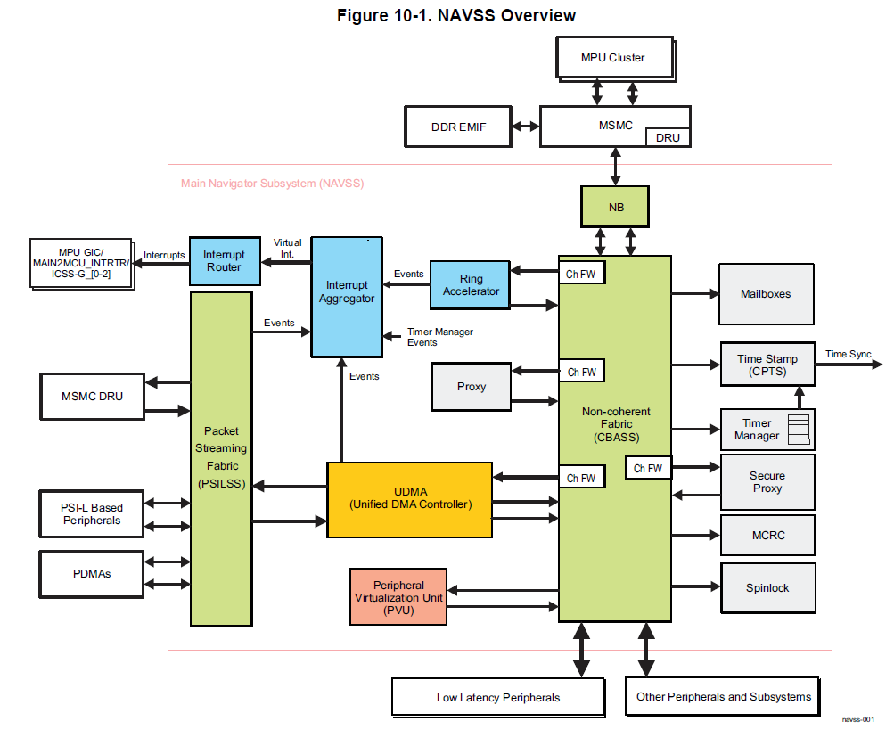
NAVSS Architecture (UDMA Focused) and Terminology
NAVSS (Navigator Subsystem)
Container which groups together components which are involved in providing DMA services in a SoC
UDMA-C (Controller)
Triggers request and receives response from UTC (Channel controller), DRU, PDMA
UTC (Unified Transfer Controller)
Received Transfer Request from UDMA and performs actual transfers (Transfer Controller)
DRU (Data Routing Unit)
Special UTC for high performance data movement esp meant for C7x algorithms
PDMA (Peripheral DMA)
Located close to peripherals
PSILSS (Packet Streaming Interface)
Switch fabric: Pairing source/destination, routing PSI-L packets
Key Features:
Split DMA: Needs a paired TX and RX channel and transfer request contains independent params for TX and RX
Multiple Instances in an SOC: Main NAVSS and MCU NAVSS (* varies from SOC to SOC)
Ethernet, SA2UL, CSI
UART, SPI, ADC, MCAN, McASP

Slide 6
NAVSS Architecture (UDMA Focused) and Terminology Contd…
RA (Ring Accelerator)
Mechanism to submit request to UDMA and get response back from UDMA
Manages queue and state for producer and consumer to exchange data (Note: not limited to UDMA alone)
Proxy
Mechanism to access RA in an atomic way: Ex: 32-bit CPU like R5 can’t perform a 64-bit single atomic write to RA
Events
16-bit unique global entity which can be generated by specific sources
Can be used to trigger interrupt to CPU via IA/IR or to trigger other transfers
Sources include: RA, DMA channel, Ring monitors, various error events
IA (Interrupt Aggregator)
With so many events possible in a system (up to 64K), it is not possible to route all events to the CPU interrupt (which are usually limited and in ~100 range)
Mechanism to aggregate events: Up to 64 event aggregation per VINT (Virtual interrupt: not yet an interrupt to the CPU, see IR)
Supports polling mode as well without generating interrupts
IR (Interrupt Router)
M:N mux (cross bar) to generate interrupt to various CPU in the system
where M is larger compared to N with sources from VINT, other NAVSS modules like Timer Manager
N interrupts to the CPU (N usually in the range of 128 to MPU/GIC, 32 to each of R5FSS; specific value varies from SOC to SOC)
There are multiple IR in the system which are identical in functionality – only source and destination differs. We will cover only NAVSS IR specifics in this training

Slide 7
UDMA Setup/Flow – At a High Level
Abstracted by UDMA LLD
RA: FQ (Forward Queue)
UDMA - C
PSILSS
Source/Sink
TRPD
Via Proxy
(based on
need)
TRPD Header
TRPD Pointer 1
DRU
TR1
TRPD Pointer 2
UDMA TX Channel
UTC (VHWA)
TR2
TRPD Pointer 3
BlockCopy
TR Responses
TRPD Pointer 4
UDMA RX Channel
PDMA
TRPD Pointer 5
RA: CQ (Completion Queue)
PSIL Peripherals
Abstracted by UDMA LLD
TRPD Pointer 1
Event
TRPD Pointer 2
IA
TRPD Pointer 3
TRPD Pointer 4
Interrupt/
Callback
IR
TRPD Pointer 5

Slide 8
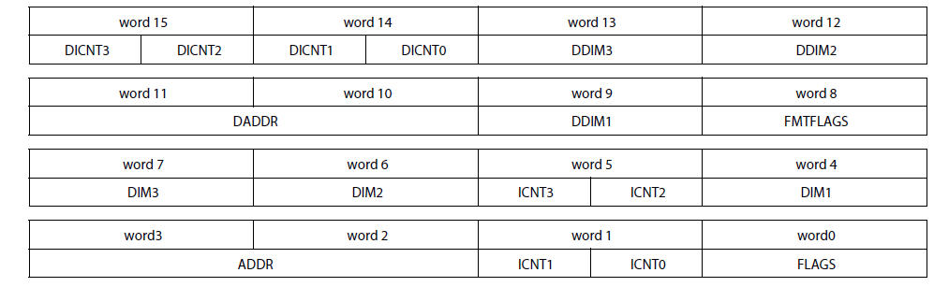
Transfer Request (TR) Record
TR Type | Descriptrion
Type 0 | 1D (word0-3)
Type 1 | 2D (word0-4)
Type 2 | 3D (word0-6)
Type 3 | 4D (word0-8)
Type 5 | Cache warm (word0-15) (MSMC DRU ONLY)
Type 8 | 4D Block Copy (word0-15)
Type 9 | 4D Block Copy with reformatting (word0-15) (MSMC DRU ONLY)
Type 10 | 2D Block Copy (word0-15)
Type 11 | 2D Block Copy with reformatting (word0-15) (MSMC DRU ONLY)
Type 15 | 4D Block Copy with reformatting and indirection (word0-15) (MSMC DRU ONLY)
Size of TR is variable from 16 bytes to 64 bytes.
Specified via TR Type in FLAGS field

Slide 9
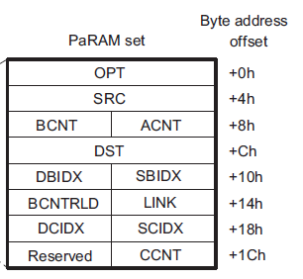
Comparison of TR Record with EDMA PaRAM
UDMA TR | EDMA PaRAM | Remarks
ADDR | SRC | 64b address
DADDR | DST | 64b address
ICNT0 | ACNT | ICNT0 is 1st DIM for data @ ADDR
ICNT1 | BCNT | ICNT1 is 2nd DIM for data @ ADDR
ICNT2 | CCNT | ICNT2 is 3rd DIM for data @ ADDR
ICNT3 | na | ICNT3 is 4th DIM for data @ ADDR
DIM1 | SBIDX | 2nd DIM stride in bytes for data @ ADDR
DIM2 | SCIDX | 3rd DIM stride in bytes for data @ ADDR
DIM3 | Na | 4th DIM stride in bytes for data @ ADDR
DICNT0/1/2/3 | Na | ICNTx for DIMx for data @ DADDR
DDIM1/2/3 | DBIDX / DCIDX / na | DIMx Stride in bytes for data @ DADDR
FLAGS | OPT | TR Type, Trigger type, Event condition
na | LINK | No equivalent in TR. Linking done via Ring Accelerator.
na | BCNTRLD | No equivalent in TR.
FMTFLAGS | na | Data reformatting options (used by MSMC DRU)
EDMA Params

Slide 10
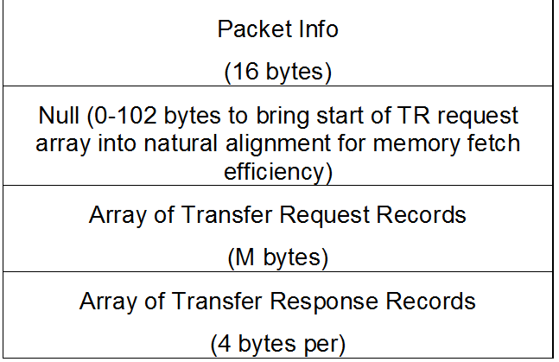
TRPD (TR Packet Descriptor) Layout
TRPD
Packet Info important fields
Number of TR records
Reload enable
Loop to index “IDX” within TR records
TR Record Size
Packet Return Queue (CQ RA)
TR Response
Status of TR – no error, transfer error, aborted
CMDID from TR.FLAGS – helps associate TR response to TR
TRPD Header
TR1
TR2
TR Responses

Slide 11
UDMA and Peripherals
Peripheral | DMA Type | DMA descriptor | Remarks
McSPI* | PDMA + UDMA-P | HOST Descriptor
UART* |  | HOST Descriptor
MCAN** |  | HOST Descriptor
McASP* |  | TR Descriptor | Special mode in PDMA for MCAN
ADC** |  | TR Descriptor
CPSWx* | Native PSI + UDMA-P | HOST Descriptor
ICSSG* |  | HOST Descriptor
SA2UL* |  | HOST Descriptor
CSI2 TX / RX* |  | TR Descriptor
VPAC / DMPAC* | VPAC/DMPAC UTC + UDMA-P | TR Descriptor | UDMA-P only used to transfer TR
C7x/MMA** | MSMC DRU + UDMA-P | TR Descriptor | UDMA-P only used to transfer TR
OSPI* | UDMA-P | HOST/TR Descriptor | UDMA-P used in block copy (memory to memory) mode. Peripheral acts as memory mapped region
PCIe* |  | HOST/TR Descriptor
 |  | TR Descriptor
CRC**
NOTE:
* Already supported/abstracted by TI RTOS drivers
** CSL-FL based examples or DMA utils provided for DMA demonstration
DSS, GPU, D55xx encode/decode, VPE, USB, MMCSD, FlexRay, MLB, UFS have embedded DMA, i.e no UDMA/NavSS interaction

Slide 12
UDMA Driver: Dependencies and Features
UDMA
Customer Application
Data Transfer
CPSW2G
CPSW9G
ICSSG
MCAN
CRC
ADC
SA2UL
TIDL
Algorithms
CSI-RX
CSI-TX
VHWA (MSC, DOF, SDE, NF, VISS, LDC)
UART
McSPI
McASP
OSPI
UDMA
TI-RTOS
Baremetal
AUTOSAR
Event Management
DMSC Interaction and Abstraction
Low overhead runtime API
API for all the DMA modules
Multiple Context Handle for FFI Support
Resource Management
Dependent SW Modules
Features

Slide 13
UDMA SW Architecture
UDMA Driver
API
PDMA
Flow
Event
RM
DRU
Proxy
IA
Channel
Ring
IR
DMSC Running on M3
Run Time Config (RT)
Non-Run Time Config (NRT)
CSL-FL
SCICLIENT
Secure Proxy
Channelized Firewall
UDMA HW
Setup/Configuration (Firewalled based on DMSC board config)

Slide 14
UDMA LLD API Flow
RM init and static partition across cores
SW init; no HW initialization
UDMA Init
UdmaInitPrms_init(instId, &initPrms);
Udma_init(drvHandle, &initPrms);
UdmaChPrms_init(&chPrms, chType);
Udma_chOpen(drvHandle, chHandle, chType, &chPrms);
UdmaChTxPrms_init(&txPrms, chType);
Udma_chConfigTx(chHandle, &txPrms);
UdmaEventPrms_init(&eventPrms);
Udma_eventRegister(drvHandle, eventHandle, &eventPrms);
Udma_chEnable(chHandle);
Udma_ringQueueRaw(Udma_chGetFqRingHandle(chHandle), (uint64_t) trpdMem);
/* Wait for event */
Udma_ringDequeueRaw(Udma_chGetCqRingHandle(chHandle), &pDesc);
Udma_chDisable(chHandle, UDMA_DEFAULT_CH_DISABLE_TIMEOUT);
Udma_eventUnRegister(eventHandle);
Udma_chClose(chHandle);
Udma_deinit(drvHandle);
Channel Open
Resource Allocation: Channel, FQ ring, CQ ring
Ring configuration
Channel Config
Channel parameters: Priority, burst size, channel type
Event Registration
Interrupt registration
Share IA, Polling, Interrupt priority
Channel Enable/Pairing
PSIL Pairing (Split DMA)
Channel Enable (Doesn’t start transfer)
Ring Queue
Wait for Completion (Event CB)
Push /Queue TRPD to FQ ring (This starts transfer)
Ring Dequeue
Channel Disable/Teardown
Event Free
Pop /DeQueue TRPD from CQ ring (This completes transfer)
Channel Close
UDMA Deinit

Slide 15

© Copyright 2019 Texas Instruments Incorporated. All rights reserved.
This material is provided strictly “as-is,” for informational purposes only, and without any warranty.
Use of this material is subject to TI’s Terms of Use, viewable at TI.com

Slide 16
Back-up (Advance users)

Slide 17
UDMA Setup
Describe the DMA transfer
Using Descriptors – HOST descriptors, TR descriptors
Submit the DMA transfer
Using Proxy, RING Accelerator
Execute the DMA transfer
Using UDMA-P, PDMA, PSI
Wait for DMA transfer completion
Using Events, Interrupt Aggregator, Interrupt Router

Slide 18
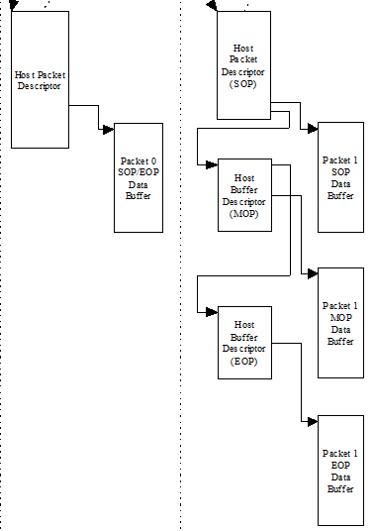
HOST Descriptor (Used in peripherals)
Useful to describe “packet” like data structures
Ex, networking packets
Useful to describe scatter gather data structures

Slide 19
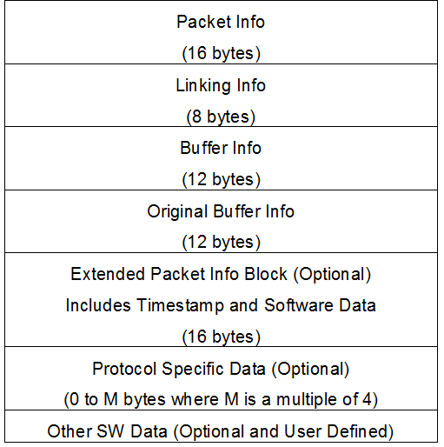
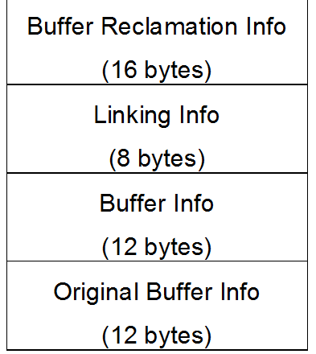
HOST Descriptor
HOST Packet Descriptor
HOST Buffer Descriptor

Slide 20
To use UDMA
Describe the DMA transfer
Using Descriptors – HOST descriptors, TR descriptors
Submit the DMA transfer
Using Proxy, RING Accelerator
Execute the DMA transfer
Using UDMA-P, PDMA, PSI
Wait for DMA transfer completion
Using Events, Interrupt Aggregator, Interrupt Router

Slide 21
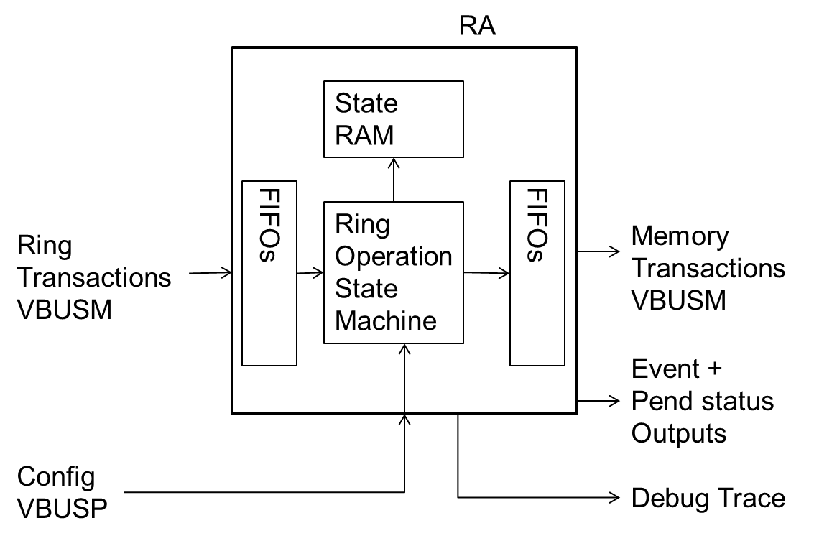
RING Accelerator
The Ring Accelerator implements a HW Queue
Used to submit descriptors to UDMA-P
Used to exchange arbitrary messages between SW entities (i.e IPC)
N independent RINGs are provided
Ex, 1024 RINGs in J721E (Varies across SOC)
Each queue is implemented as a circular buffer in memory which is external to the RA
Any size ring from 1 entry to 1M-1 entries is supported
Each element on the ring can be up to 256 bytes
Contents of a ring element are as follows:
The message data (can be an actual data value set or a reference to a set of data)
Optional credentials (priv, privid,secure,virtid)
Optional message length
NOTE: Bottom “N” (equal to channel count) RING instance to UDMA-P channel association is fixed

Slide 22
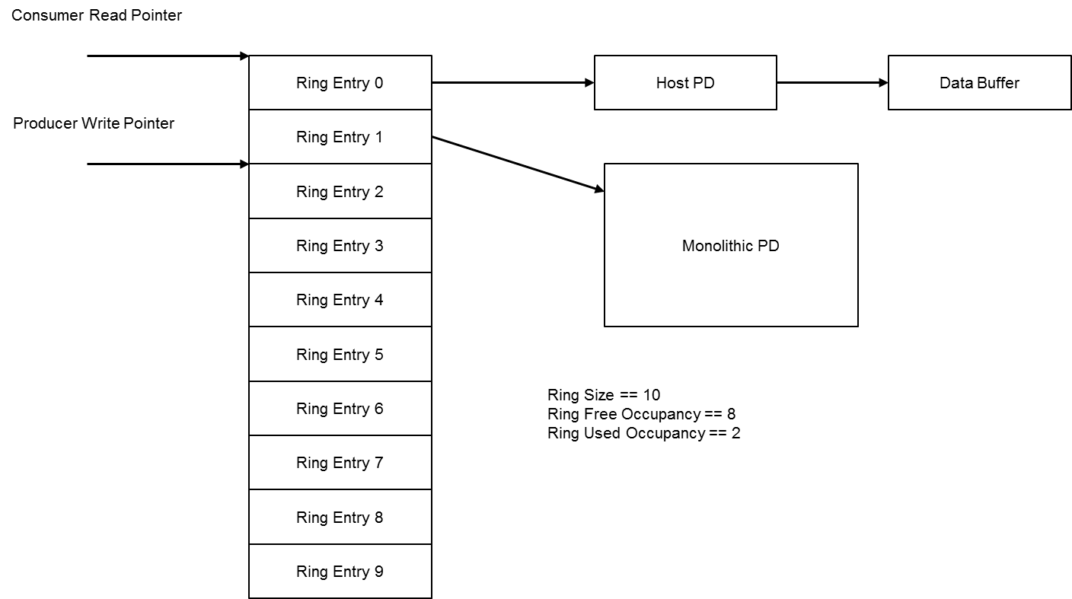
Pass By Reference RING mode

Slide 23
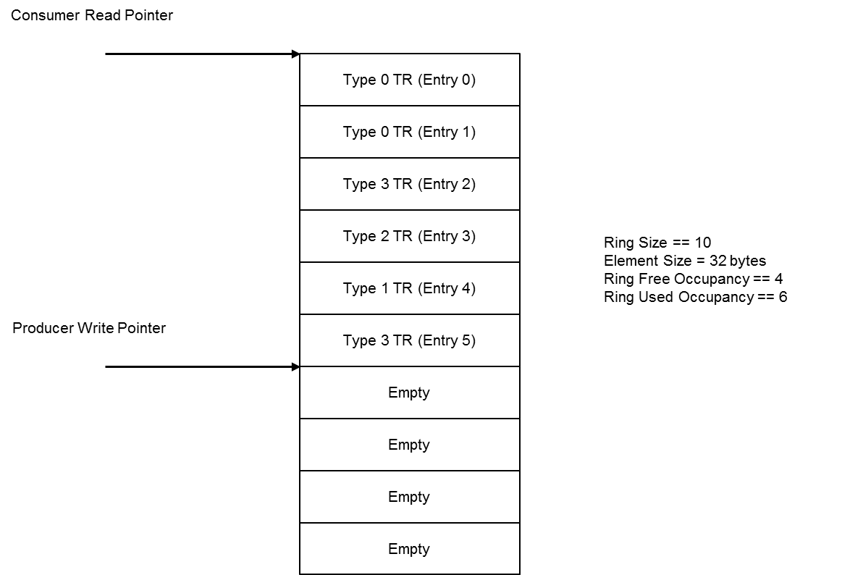
Pass By Value RING mode

Slide 24
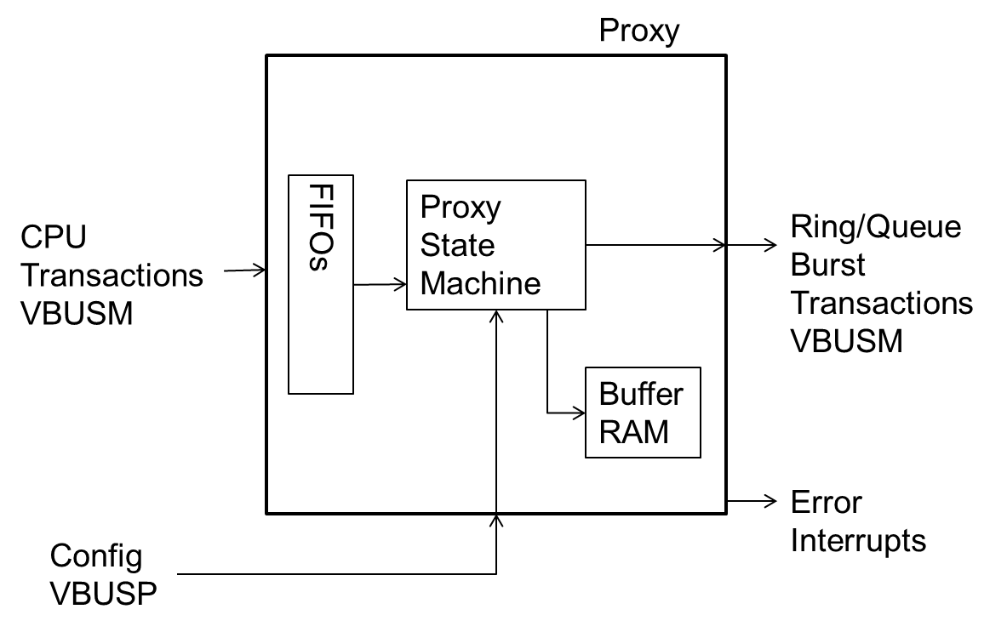
PROXY
The Proxy receives small CPU transactions to write or read parts of messages (as CPU transactions cannot handle a single 64 byte message), while accessing the RA in atomic message bursts to simplify queuing
For writes the Proxy stores the partial message as it is built in the Buffer RAM
When the message is completed (by writing the final message byte) the Proxy sends the full burst to the RA
For reads the Proxy reads the full message from the RA (upon CPU initial read) into the Buffer RAM
Then each CPU read will read from the buffer RAM message until completed (by reading the final message byte)
The Proxy IP is built to support N threads of execution and M size messages
Each thread maps to a CPU thread that can independently access a message
Each thread can store up to a single max sized message, M bytes, in the Buffer RAM
Each thread has a 64KB (MMU aligned) memory range to access its window, with the offset determining which queue to access
The Proxy IP will detect errors when thread access changes rings/queues while in the middle of a message
Once the proxy is in error, it will no longer send or receive messages until the error status is cleared
Used to indirectly access a RING.
Allow use-case of multiple producer – single consumer
Typically one proxy used per CPU or per VM
Ex, 64 proxies in J721E

Slide 25
To use UDMA
Describe the DMA transfer
Using Descriptors – HOST descriptors, TR descriptors
Submit the DMA transfer
Using Proxy, RING Accelerator
Execute the DMA transfer
Using UDMA-P, PDMA, PSI
Wait for DMA transfer completion
Using Events, Interrupt Aggregator, Interrupt Router

Slide 26
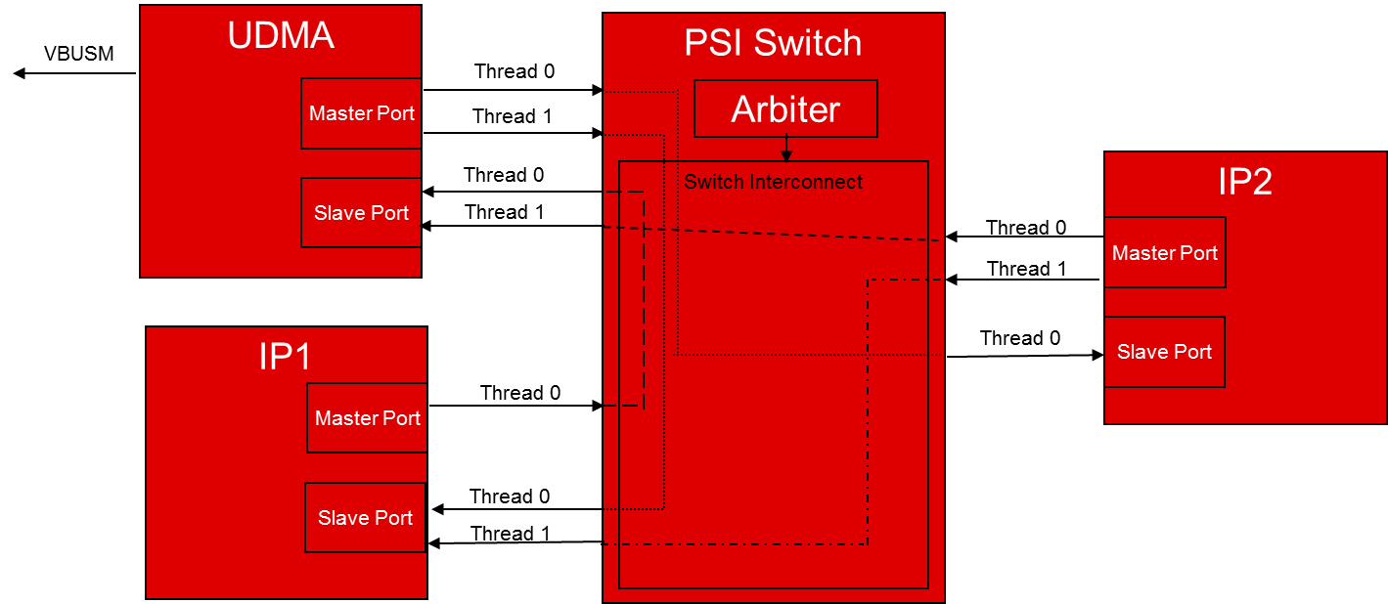
PSI
PSI is a push-based interface for routing packets of data between peripherals
Packets of data can be any generic packet of work
Features
Multi-threaded
Point-to-Point
Non-blocking
Highly Efficient
Single cycle arbitration
Data transfers every cycle
Easy to pipeline with no throughput penalty

Slide 27
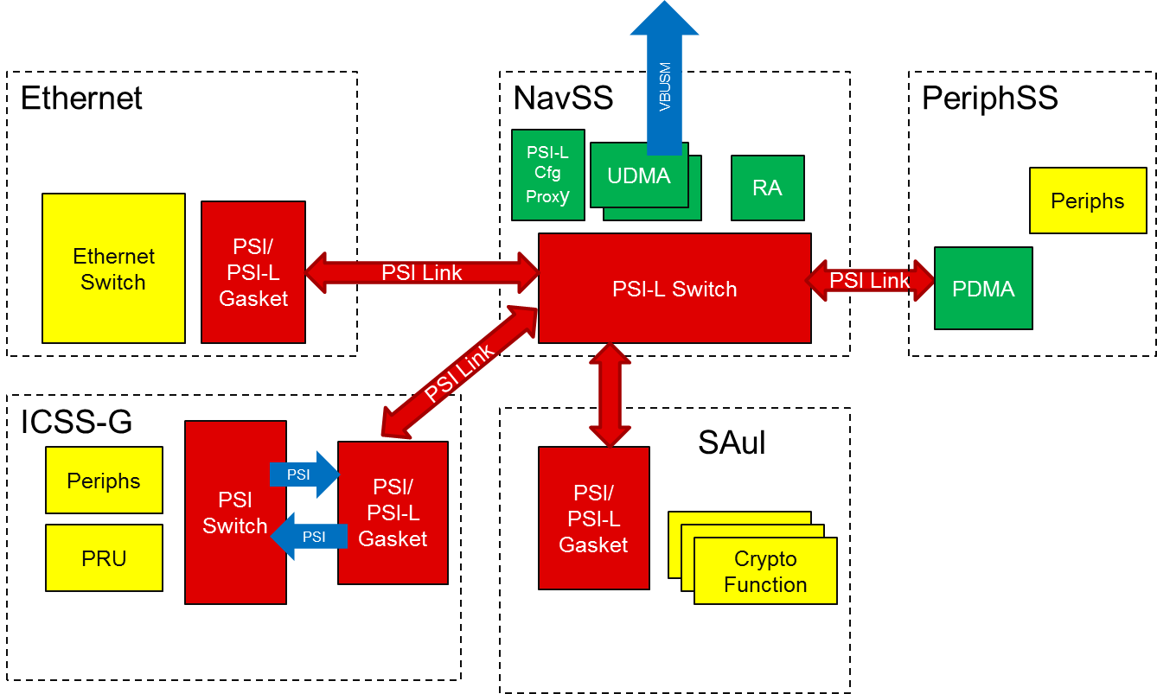
UDMA – PSI – PDMA System in K3

Slide 28
To use UDMA
Describe the DMA transfer
Using Descriptors – HOST descriptors, TR descriptors
Submit the DMA transfer
Using Proxy, RING Accelerator
Execute the DMA transfer
Using UDMA-P, PDMA, PSI
Wait for DMA transfer completion
Using Events, Interrupt Aggregator, Interrupt Router

Slide 29
Events and Interrupts
Events provide information to indicate that a condition has asserted or de-asserted
Ex, TR complete event or TR ICNT1 complete event or RING not empty event or peripheral FIFO threshold reached
Events can be of two types
Local events
Each event is signaled on a dedicated pin in the PDMA or UTC
Local events are typically used between peripherals and PDMA or UTC
Global events
Signaled as message on Event Transport Lanes (ETL)
Events in are not the same as interrupts !!!
Interrupt Aggregator (IA) used to convert event to interrupt for SW notification

Slide 30
Global Events
Global Event represented as 16b index, i.e there can be 64K distinct events
The index value is generated using a direct lookup table which is controlled by SW.
When an IP block needs to generate a global event it provides the ability to set the index value
Once set, the index becomes the destination address to which the event is to be sent
All event sinks in the system are mapped into a unified event map which contains up to 64K different destination slots.
Example,
DMA channel chaining can be implemented using events
In TR.FLAGS.EVENT_SIZE set the condition for generating an event, TR complete, ICNT0/1/2 complete
In UDMAP.TXCHAN[a].TOES = CHAINED_CHANNEL_B_EVENT_ID
Specifies the event to generate (or indirectly channel to trigger) when event is generated

Slide 31
Interrupt Aggregator (IA) - Global Event to Interrupt Mapping
For each received event, the IA performs a lookup into an interrupt mapping table which specifies:
Interrupt Status Register Number (regnum)
Interrupt Status Bit Number (bitnum)
For each up event which is received, the IA will set bit ‘bitnum’ in ISR ‘regnum’
For each down event which is received, the IA will clear bit ‘bitnum’ in ISR ‘regnum’
Provides an active high level sensitive virtual interrupt line for each ISR which is asserted anytime any enabled bit is set in the ISR

Slide 32
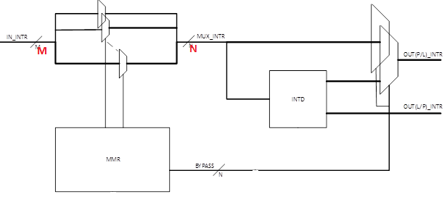
Interrupt Router (IR)
Interrupt Router is a M to N mux
Virtual Interrupt from IA + interrupts for other sources within NavSS example MailBox, feed as input to Interrupt router
N interrupts from IR appear at NavSS boundary and feed GIC (A72) or CLEC (C7x) or VIM (R5F)

Slide 33
Putting it all together …

Slide 34
System and SW View (DMA and Interrupt)
CPU or SW
1
To SoC Top Level
10
McSPI
UART
McASP
TR or Host Desc Q / DQ
Proxy
4
1
1
INTR_ROUTER
RING MODE
MSG MODE
7
2
9
ICSS-G
5
RINGACC
SA2UL
ICSS-G
PDMA1
PDMA0
2
INTR_AGGR0
ICSS-G
TR or Host Desc
6
3
INTR_AGGR1
4
UDMA-P
3
INTR_AGGR2
8
5
8
7
PSI Switch (NavSS)
TIMER_MGR0
TIMER_MGR1
6
NavSS
Data over PSI
Data over
VBUS.P
Events over ETL
To MCU NavSS PSI Switch
DRU
Outside NavSS
Data over
VBUS.M Or
VBUS.C
Config Step
TR over PSI
Interrupts
Control Flow
To DDR / MSMC
Notes:
Add notes for the sequence numbers showed in the diagram

