Slide 1
TCP3D Driver Design
Ravi Sankar Korada
Version 0.0.4
August 25, 2009

Slide 2
Revision History
Version | Date | Author | Note
0.0.1 | 03/31/2009 | Ravi Korada | Initial
0.0.2 | 05/03/2009 | Ravi Korada | Updated APIs and Diagrams
0.0.3 | 05/19/2009 | Ravi Korada | Updated API descriptions and the flow diagrams
0.0.4 | 08/25/2009 | Ravi Korada

Slide 3
TCP3D Driver - Preliminary

Slide 4
TCP3D Driver Operating Modes
Split Mode
  Two separate EDMA channels are used for both Input and Output transfers (4 physical channels required)
  Two input and output memory sets are used independently
  Two MAP decoders are used independently to operate with two independent memory sets
Double Buffer Mode
  Two separate EDMA channels are used for both Input and Output transfers (4 physical channels required)
  Two independent input memory sets are used for input transfers, but the decoding will happen only after reading the previous outputs
  Two MAP decoders are used with one input data memory set
Single Buffer Mode
  Two separate EDMA channels are used for both Input and Output transfers (2 physical channels required)
  Only one MAP decoder is used
  Only one memory set is used

Slide 5
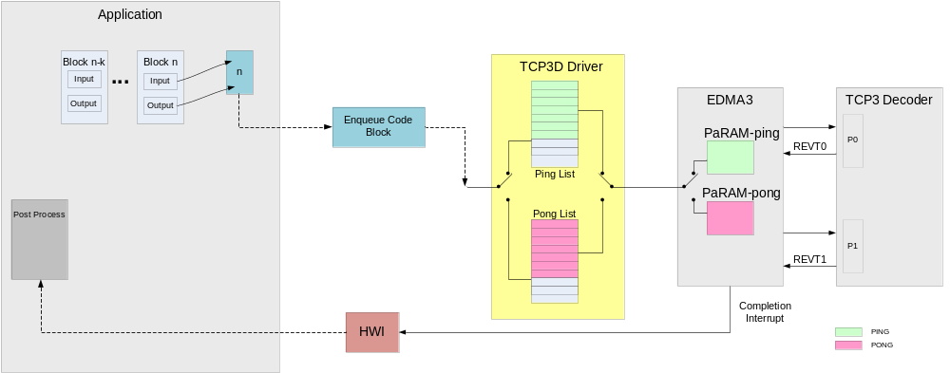
TCP3D Driver – Design Idea
Pre-processing task upon soft bits (LLR) ready performs:
  Enqueues CBs to TCP3D input pseudo PaRAM list in L2 which holds the actual PaRAMs prepared.
  TCP3D driver copies pseudo PaRAM sets to EDMA PaRAM space and executes them.
  Restarts TCP3D driver if it is not running. This can be done by polling the stop flag or by using ISR function.
Post-processing task can be triggered by enabling the driver to generate interrupt on decoding a specific code block.

Slide 6
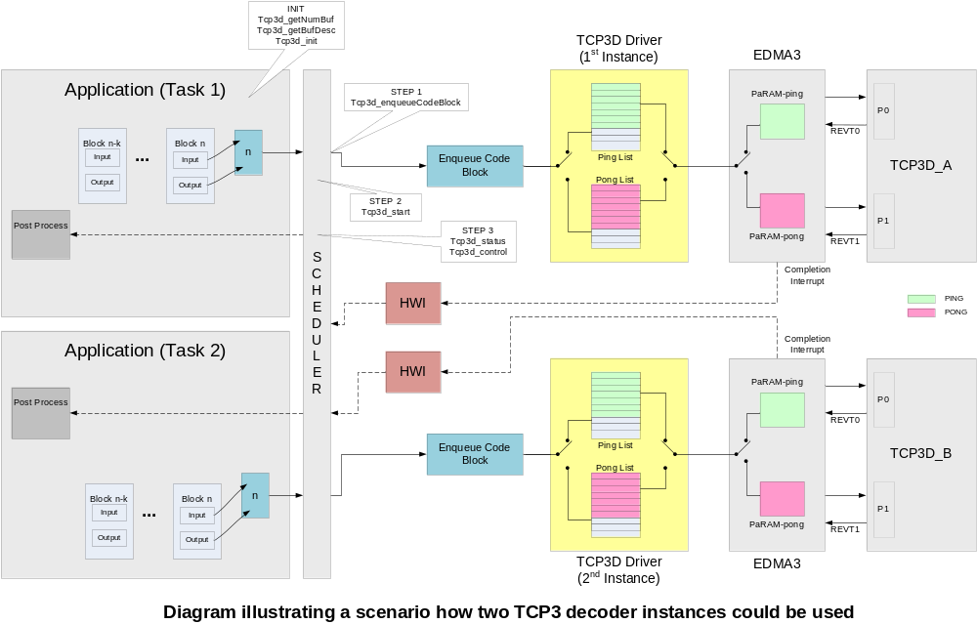

Slide 7
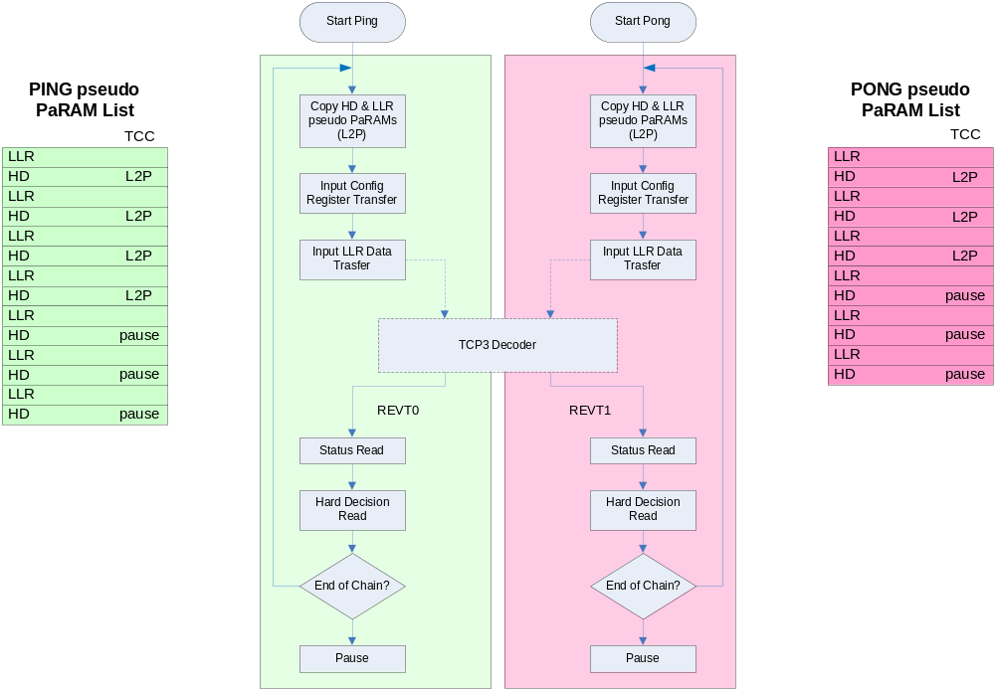
TCP3D Driver – High Level Flow

Slide 8
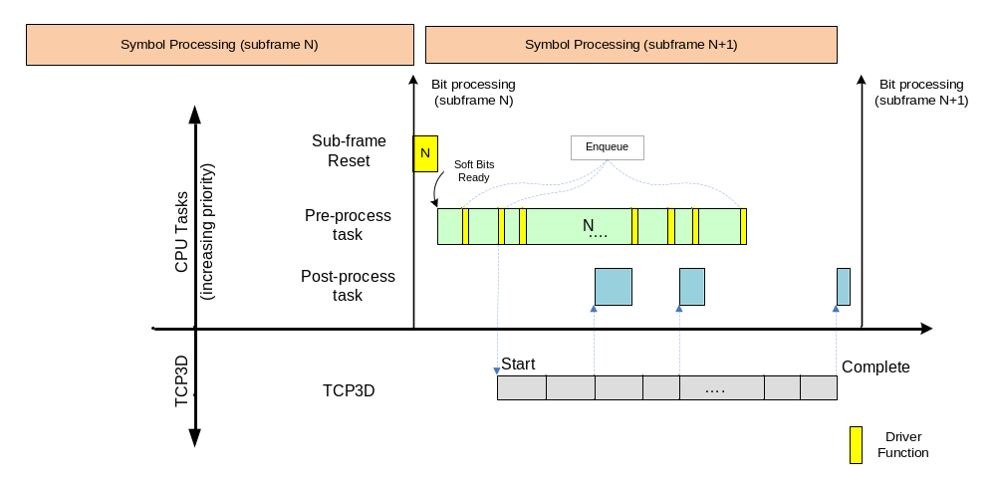
TCP3D Driver – Task Flow Example

Slide 9
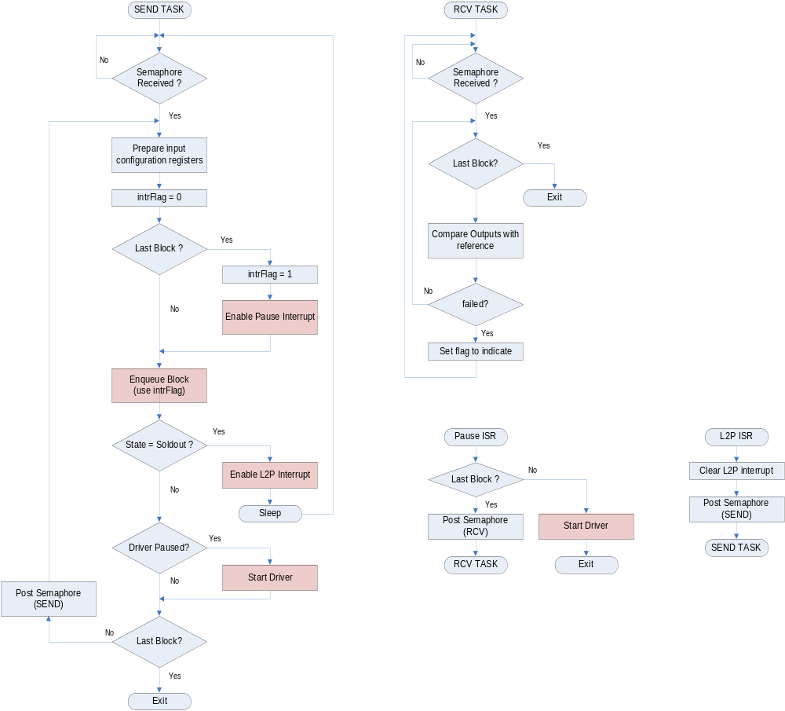
Application Example flow

Slide 10
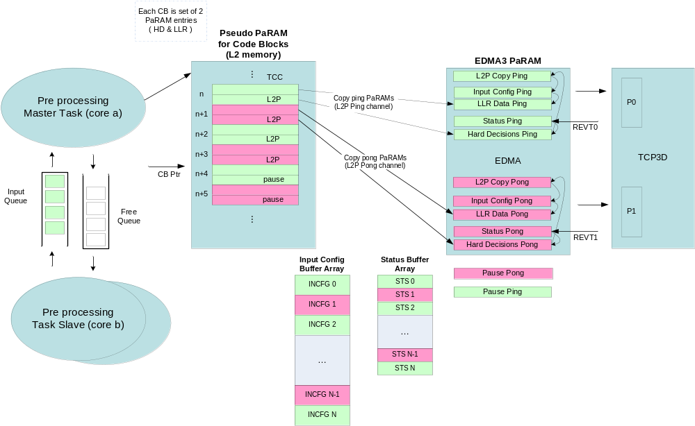
TCP3D Driver – Design details

Slide 11
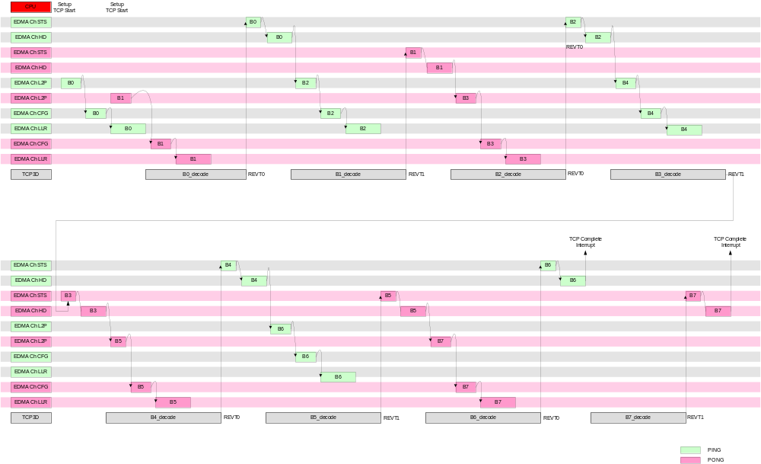
TCP3D Timing Diagram – 8 code blocks

Slide 12
TCP3D Driver APIs (Initialization)
TCP3D_DRV_getNumBuf()
  Input parameters
    Pointer for returning the number of buffers required information
    Pointer for Driver Size configuration parameters
  Functionality
    Computes the buffer requirements based on the size configuration information provided
    Writes the number of buffers required into the pointer provided
TCP3D_DRV_getBufDesc()
  Input parameters
    Pointer to the memBuffer array
    Pointer for Driver Size configuration parameters
  Functionality
    Fills the memBuffer structure fields for each buffer required
    Possible memBuffer fields are size, alignment, memory type (volatile or non-volatile), memory class needed, etc.
    This function required two fields from the size configuration structure be set before calling. Size values are computed from the mode and the maxCodeBlocks values.
TCP3D_DRV_init()
  Input parameters
    Pointer to the memBuffer array with base addresses filled after allocating memory
    Pointer to the driver initialization parameters structure which covers all the possible inputs required for the driver
      Control Configuration Parameters Structure for TCP3 decoder
      DSP Core ID
      Maximum code blocks possible in any sub-frame
      Pointer to the EDMA3 LLD handle
      EDMA channels for Ping and Pong, etc
  Functionality
    It is called once to setup driver for the operating mode as specified in the control configuration parameters
    Driver initializes all the internal buffers and instances with the memBuffer structure values
    Takes all the required resources provided through the driver init structure – for example EDMA channels, PaRAMs, etc.
    Starts the TCP3D internal state machine by writing into the common Configuration registers (mode, emulation, execution)
    Fills all the known fields in the pseudo PaRAM memory based on the mode to make the enqueue function as light as possible
    Initializes the EDMA3 PaRAM entries of all the allocated physical channels with the known values at this time

Slide 13
TCP3D Driver APIs (Run-time)
TCP3D_DRV_subFrmReset()
  Input parameters
    Pointer to the TCP3D driver instance
    Pointer of the status array buffer for the sub-frame where the status output will be DMAed
    Number of code blocks in the sub-frame
  Functionality
    Updates the driver instance with the input arguments
    Initializes the driver sub-frame variables to the default values
    Resets the pseudo PaRAM fields and allocated EDMA channel PaRAM fields
TCP3D_DRV_enqueCodeBlock()
  Input parameters
    Pointer to the TCP3D driver instance
    Pointer to the prepared input configuration registers memory
    Code Block length value
    Pointer to the input LLR data streams (systematic, parity0 and parity1)
    Offset between the input LLR streams
    Pointer where the output hard decisions to be DMAed
    Interrupt Flag
  Functionality
    This function is to be called in the run-time for appending the code blocks to the input lists. This function appends the code blocks alternately among the Ping and Pong lists which are used for loading into either the Ping or Pong memories of TCP3 Decoder.
    First this function copies the input configuration registers memory to the appropriate location in the initialization time allocated buffer array
    Updates the Hard Decision pseudo PaRAM entries to enable the chaining from the previous one in the list
    Updates the LLR pseudo PaRAM entries with the given pointers and values according to the mode
    It also checks for the end of the list using the subFrmCodeBlocks value set when the sub-frame reset function is called, so as to generate completion interrupts for Ping and Pong paths.

Slide 14
TCP3D Driver APIs (Run-time) (cont..)
TCP3D_DRV_start()
  Input parameters
    Pointer to the TCP3D driver instance
  Functionality
    It is required to pass a valid command to choose ping or pong list to be started using the startFlag in the instance before calling this API, otherwise this API does nothing and returns No Error.
    This API can be used for starting the input data transfers to the TCP3 decoder ping or pong memories.
TCP3D_DRV_control()
  Input parameters
    Pointer to the TCP3D driver instance
    Pointer to the driver control structure
  Functionality
    It is required to specify a valid command in the control structure before calling this API, otherwise it will throw an Error.
    This API can be used for doing specific things in the driver as defined by the control commands.
    Currently, there are very few commands defined and scope of this API can be extended in future to include more commands as needed.
TCP3D_DRV_status()
  Input parameters
    Pointer to the TCP3D driver instance
    Pointer to the driver status structure
  Functionality
    It is required to specify a valid command in the status structure before calling this API, otherwise it will throw an Error.
    This API can be used for providing specific information from the driver instance as defined by the status commands. For example one can use this to get the state of the driver.
    Currently, there are very few commands defined and scope of this API can be extended in future to include more commands as needed.

Slide 15
TCP3D Driver Utility APIs
TCP3D_DRV_prepConfigRegs()
  Input parameters
    Ptr to input configuration parameters structure
    Ptr to the final IC registers memory for the current code block
    Ptr to the temp IC memory created
    Flag to tell whether to generate fixed registers (genFixedRegs) or copy from temp IC memory
    Flag to tell the decoder type
  Functionality
    It will place all parameters into appropriate fields into the given final IC registers memory from the input parameters structure
    If genFixedRegs flag is NULL, then fixed registers are copied from the temp IC memory
    For 3GPP type decoder, IC12-14 are always zeroed
TCP3D_DRV_prepFixedConfigRegs()
  Input parameters
    Ptr to input configuration parameters structure
    Ptr to the temp IC registers memory
  Functionality
    Prepares the fixed portions of temporary register memory from the parameters sent
    Mode value is used to determine which fixed registers are prepared

Slide 16
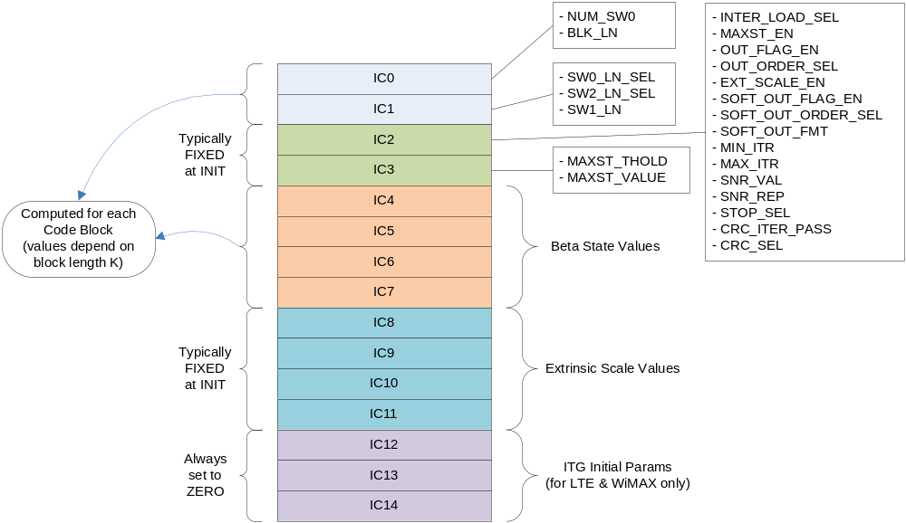
Input Configuration Registers (3GPP MODE)

Slide 17
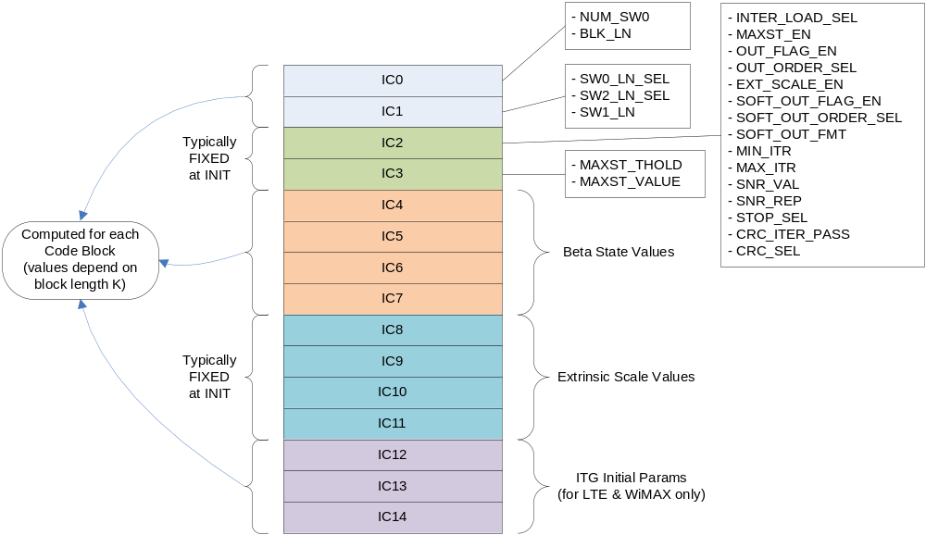
Input Configuration Registers (LTE/WIMAX MODE)

