Slide 1
Landscape of GPL Enforcement
Karen M. Sandler & Bradley M. Kuhn
OSCON 2017 tutorial
May 9, 2017

Slide 2
The landscape of compliance

Slide 3
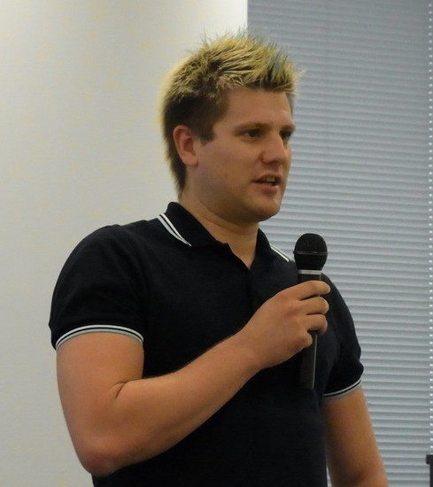

vs.

Slide 4





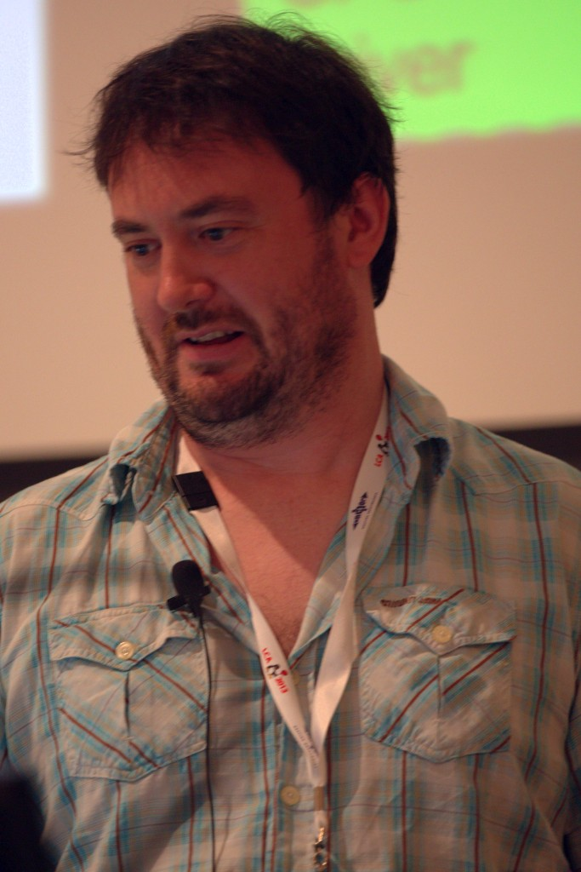

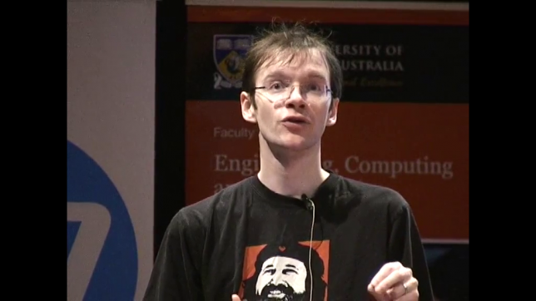
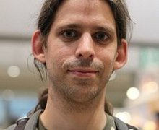



Slide 5
Corporate enforcement

Slide 6
Other Individual enforcement

Slide 7
The primary goal is compliance.

Slide 8
Stop incorrect distribution
Encourage corrected distribution
Address damage done
Notes:
Check iphone in public space

Slide 9
Legal action is a last resort

Slide 10
Most violations are just mistakes
Staying out of court is a win
Notes:
Check iphone in public space

Slide 11
Confidentiality can be ok.

Slide 12
Can't overlook problems for money

Slide 13
Financial penalties are reasonable
...to a point
No selling out principle
Notes:
Check iphone in public space

Slide 14
Verify violations,
Conduct comprehensive analysis

Slide 15
Fully check reports
Comprehensive analysis
Eye towards ongoing compliance
Notes:
Check iphone in public space

Slide 16
termination

Slide 17
v2 versus v3
Reasonable flexibility
Notes:
Check iphone in public space

Slide 18
These principles should be useful to the industry and community.

Slide 19
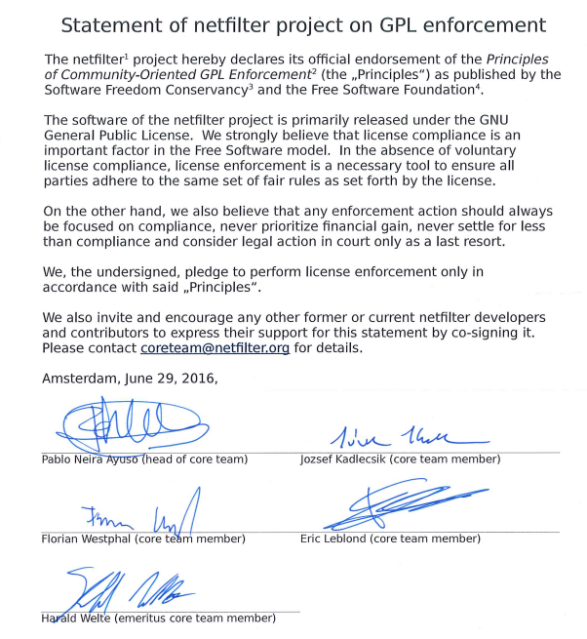

Slide 20
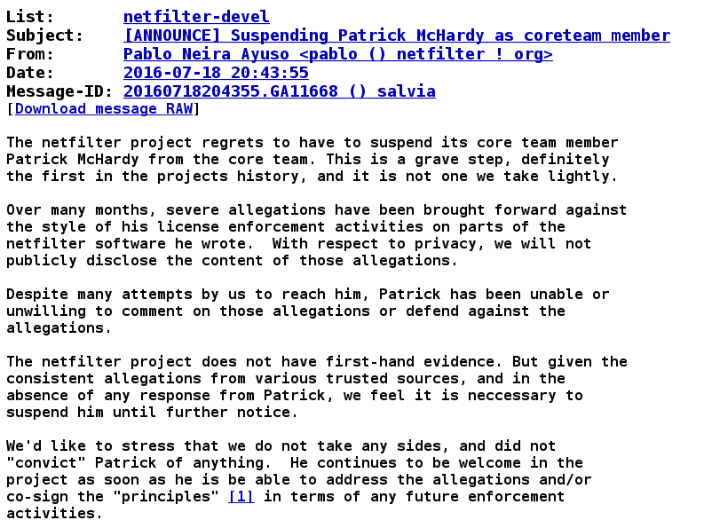

Slide 21
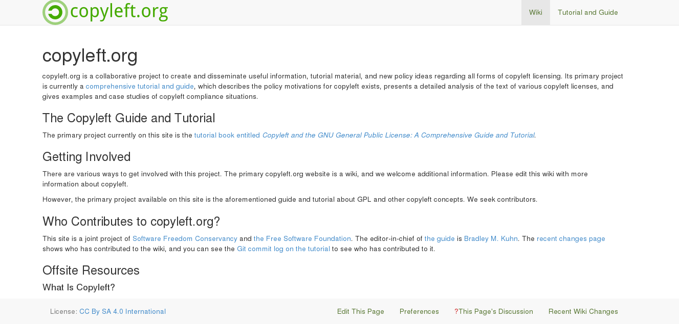

Slide 22
https://copyleft.org/guide/comprehensive-gpl-guidech14.html#x19-12100013.3 https://copyleft.org/guide/comprehensive-gpl-guidech19.html#x24-15000018.5
Relevant copyleft.org Links

Slide 23

Q&A
Conservancy is a 501(c)(3) charity, become a supporter!
These slides, this talk, and audio/video recordings thereof (except for photos by others) are licensed under the Creative Commons Attribution-ShareAlike 4.0 International
(CC BY-SA 4.0)
      https://sfconservancy.org/supporter

