Slide 1
Bijectivity certification of 3D digitized rotations
K. Pluta^{1,2}, P. Romon², Y. Kenmochi¹, N. Passat³
¹University Paris-Est, LIGM
²University Paris-Est, LAMA
³University of Reims, CreSTIC
15.06.2016

Slide 2
Agenda
Introduction to digitized rotations
Bijectivity of 3D digitized rotations
Bijectivity certification algorithm
Conclusion and perspectives

Slide 3
Introduction to digitized rotations
“How do I rotate in 3D, George? “
“That is easy Lenny, take a quaternion and apply a sandwiching.”
“Quater-, what, George?”

Slide 4
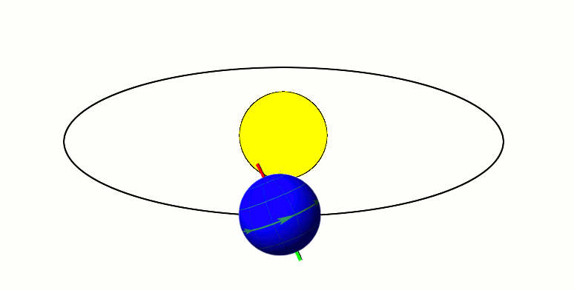
Properties:
distance and angle preservation
bijective
The orbit of Earth is nearly circular, its eccentricity is just about 0.0167.

Slide 5
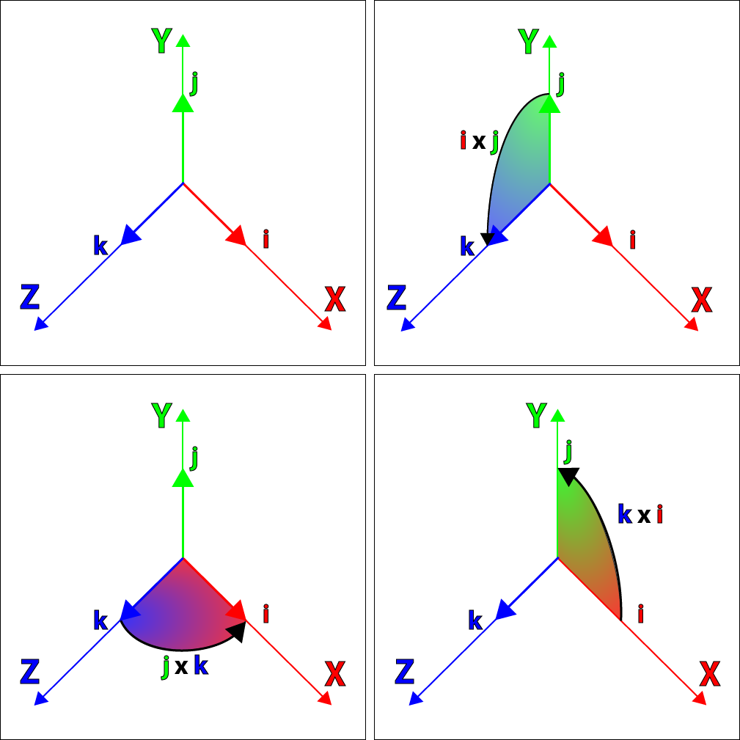
Spatial rotations and quaternions
Properties:
Hamilton product is not commutative
We can derive a rotation matrix
Figure. Source: http://www.3dgep.com/understanding-quaternions/

Slide 6
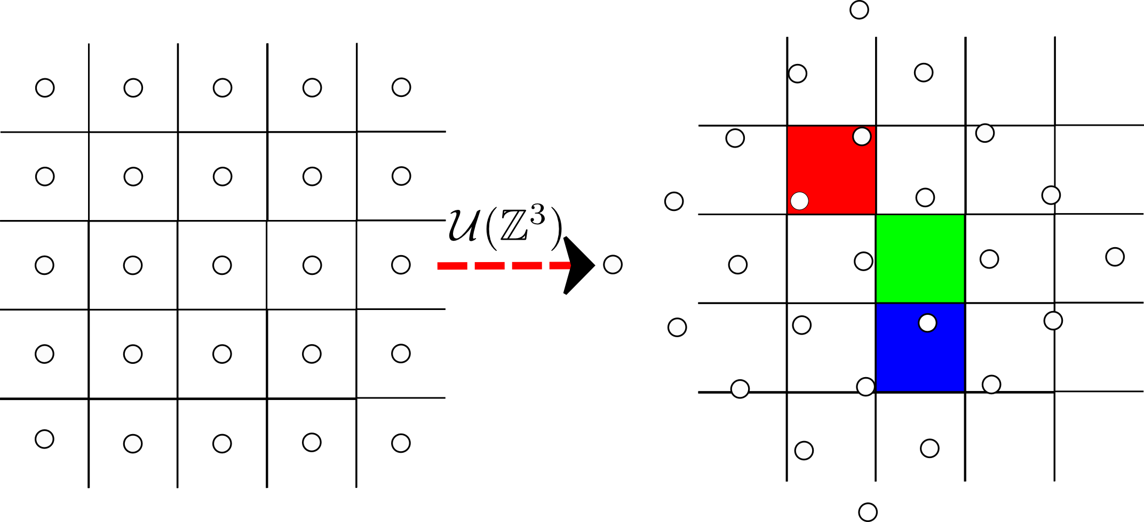
Properties:
in general, do not preserve distances and angles
not always injective
not always surjective

Slide 7
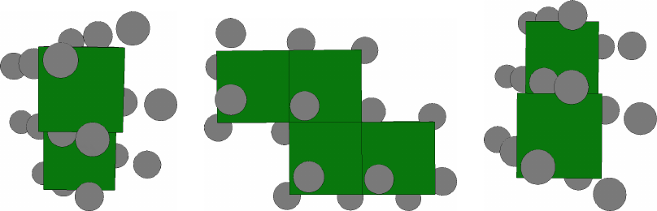
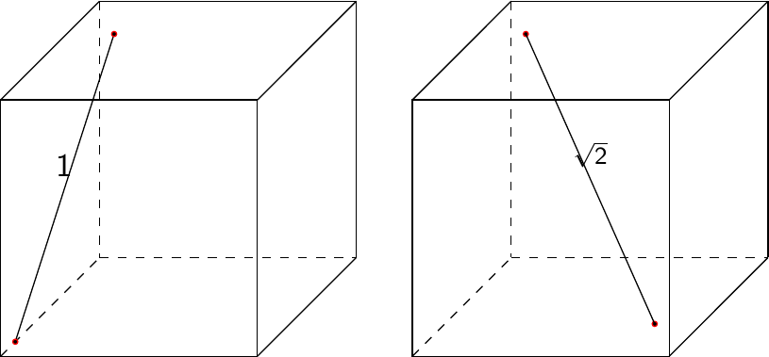
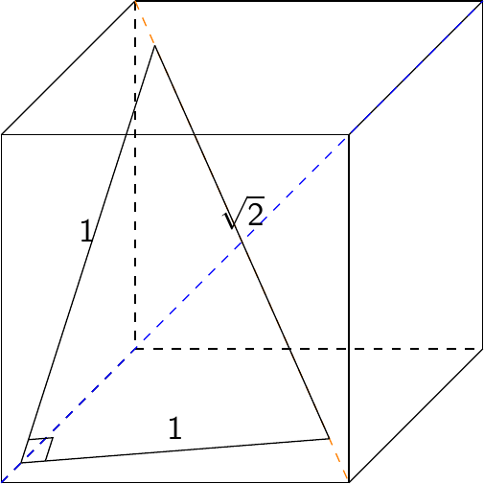
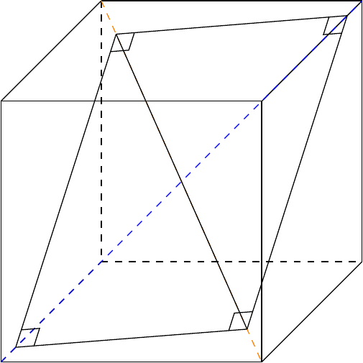
3D point statuses

Slide 8
Related work
Tristan Roussillon and David Cœurjolly, Characterization of bijective discretized rotations by Gaussian integers, 2014
Bertrand Nouvel and Eric Rémila, Characterization of bijective discretized rotations, 2004
Eric Andres, Marie-Andrée Da Col, On discrete rotations, 1995

Slide 9
Contributions
Algorithm for certification whether a 3D digitized rotation given by a quaternion is bijective or not.

Slide 10
Bijectivity of 3D digitized rotations
“I do not like your 3D digitized rotations, George. Look what happened to my digital simulation of Solar System. Moon disappeared and there is a micro-singularity in Mars.”
“Welcome in the digital world Lenny. “

Slide 11
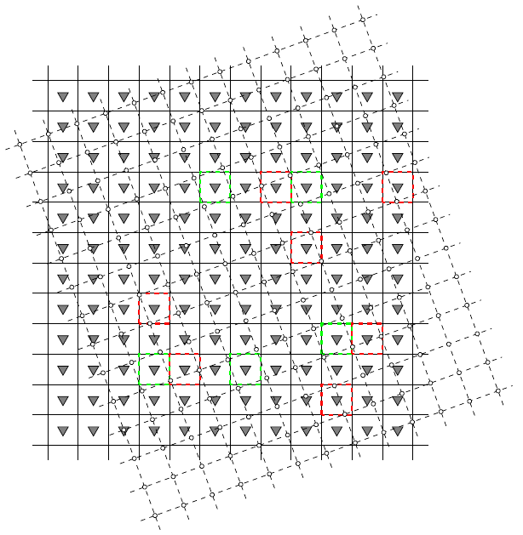
Conditions for bijectivity

Slide 12
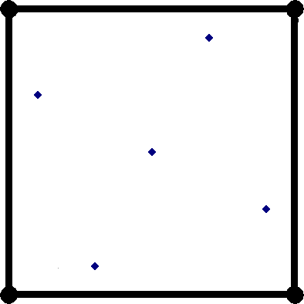
Remainders
3D digitized rotation is then
bijective when

Slide 13
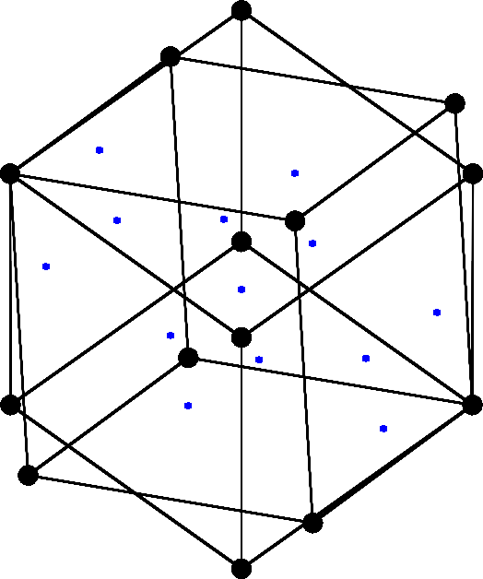
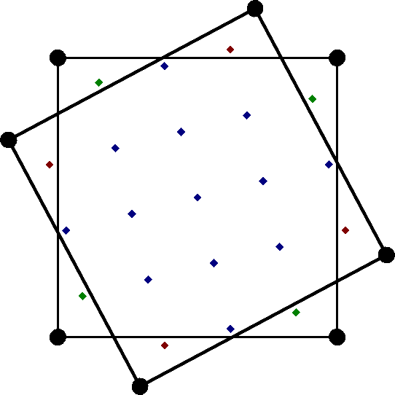
Remainders
Equivalently and more computational friendly (we will see later)
such that

Slide 14
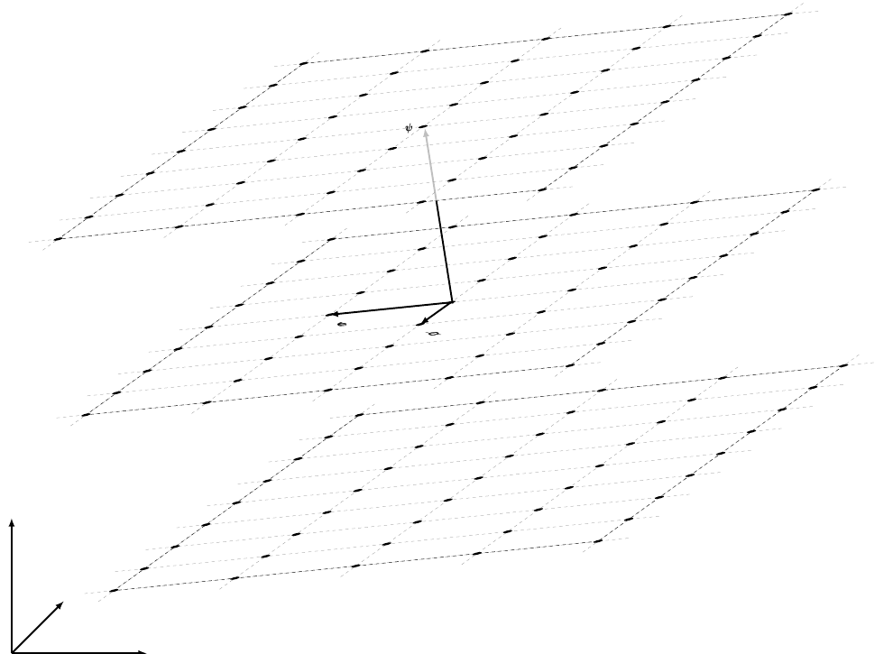
Proposition

Slide 15
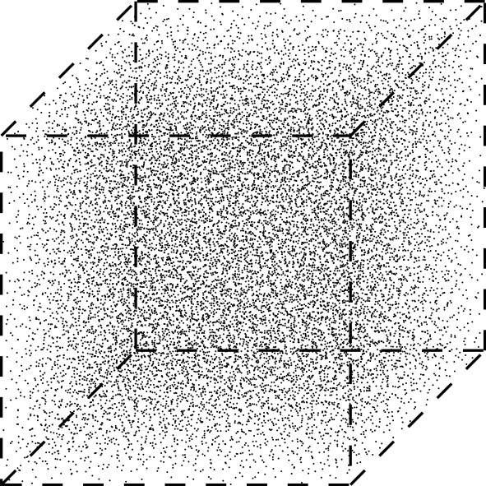
Lemma

Slide 16
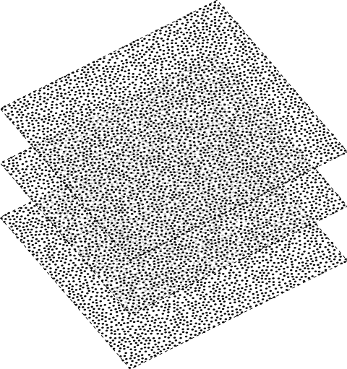
Conjecture

Slide 17
Lipschitz quaternions and rational rotations
Proposition

Slide 18
From George's cookbook
“Bijectivity certification algorithm”
Ingredients:
1 Lipschitz quaternion
Unit cube centered at the origin
Hermite normal form algorithm
Yields:
True when 3D digitized rotation is bijective and false otherwise

Slide 19
Preparation
Step 1. Turning into integers

Slide 20
Preparation
Step 2. Reducing left factor

Slide 21
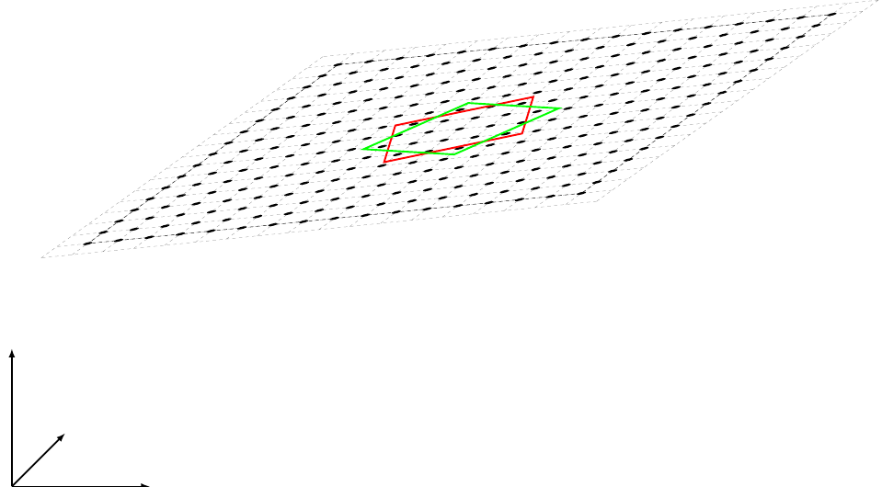
Preparation

Slide 22
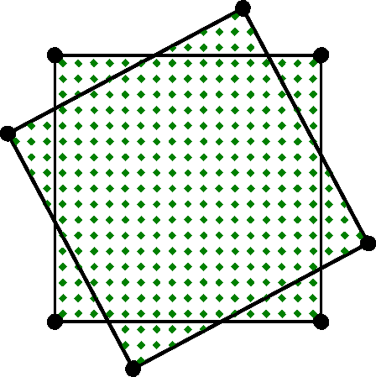
Certification algorithm – step 1

Slide 23
Certification algorithm – step 2

Slide 24
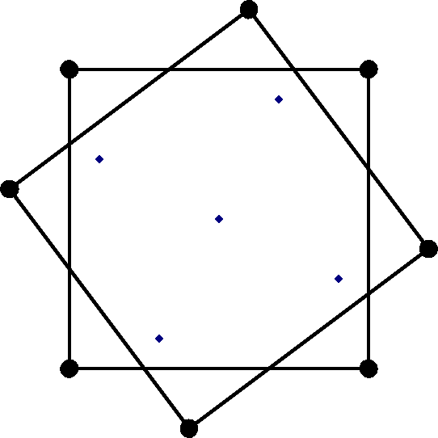
Certification algorithm – step 3

Slide 25
Some experimental results
“George, I was told by this guy there that 3D bijective digitized rotations do not exist. He said that he tried to find some 20 years ago and he could not.”
“Forget about him, Lenny. He has lived in 2D world for a bit too long.“

Slide 26
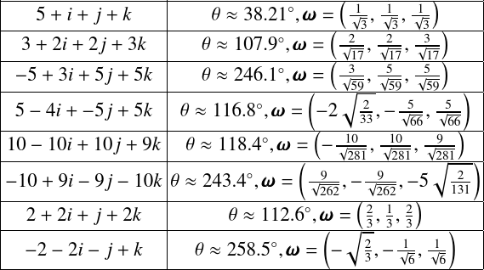
Examples of bijective digitized rotations
You can find more at http://dx.doi.org/10.5281/zenodo.50674

Slide 27
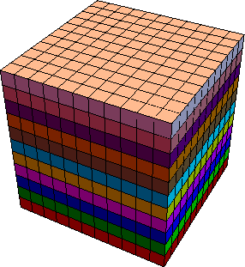
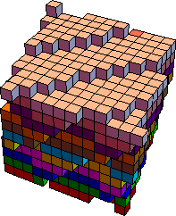
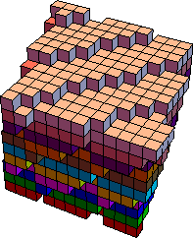
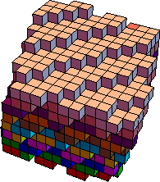
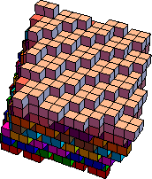
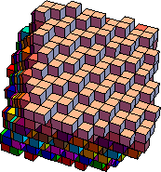
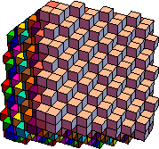
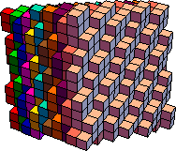
Examples of bijective digitized rotations

Slide 28

Conclusion and perspectives
Conclusion
Algorithm for characterization of bijectivity of 3D digitized rotations
We show the existence of bijective non-simple 3D digitized rotations
“To boldly go where no one has gone before” – perspectives
Analytical characterization of bijective 3D digitized rotations
Proving our conjecture on half-dense groups
Implemented in Mathematica 10 under
Simplified BSD License (and Coffeeware license rev. 1)
github.com/copyme/BijectiveDigitizedRigidMotions

Slide 29
Thank you for your attention

