Slide 1
Free Software World and Linux
Vasudev Kamath
kamathvasudev@gmail.com
http://vasudevkamath.blogspot.com
Chethan S.
chethanuniversal@gmail.com
http://gischethans.blogspot.com
This work is licensed under LGPL 2+. GNU Head Logo from GNU.org
Tux Logo from Wikipedia Free Online Encyclopedia
http://www.fosscommunity.in/wiki/Mangalore/NMAMIT

Slide 2
Overview
PART I
  Free Software
  The Beginning
PART II
  Linux
  About Today's Programme

Slide 3
PART I

Slide 4
Free Software
Free software is a matter of the users' freedom to run, copy, distribute, study, change and improve the software.
It refers to four kinds of freedom, for the users of the software
http://www.gnu.org/

Slide 5

The Beginning
http://en.wikipedia.org/wiki/File:Rms_at_pitt.jpg

Slide 6

Linus Torvalds
http://en.wikipedia.org/wiki/File:Linus_Torvalds.jpeg

Slide 7
Result = GNU/Linux

Slide 8
PART II

Slide 9
Is Linux Relevant?
Benefits, Beneficiaries, Supporters

Slide 10
Benefits of Linux
Very stable, modern, rich and powerful
No high hardware requirements
Advanced GUI – GNOME, KDE, XFCE etc.
Updated every day – Newer releases, updates!
Thousands of free, efficient tools
Highly specialized applications
Ultimate freedom – free for both personal and commercial use, open source, no lock-ins, no product activation/registration hassles
Linux will be here for ever!
Derived From: http://linux.about.com/od/linux101/l/blnewbie0_4.htm

Slide 11


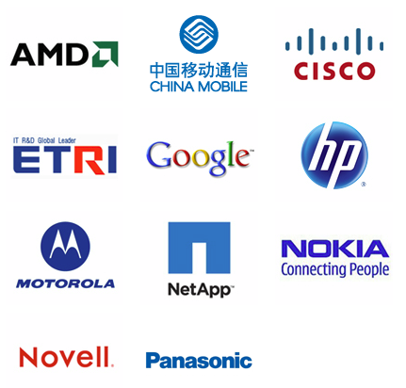
Corporate Members: Linux Foundation
to name a few....
http://www.linuxfoundation.org/about/members

Slide 12
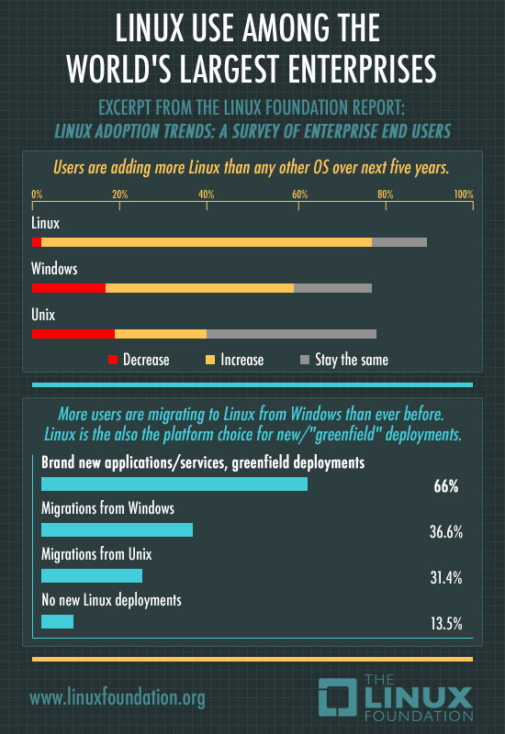

Slide 13
Why they switch?
Technical Superiority
Total Cost of Ownership
Lack of Vendor lock-in and openness of code
Choice of hardware and software
In cloud context
Linux is continuously improving
http://www.pcworld.com/businesscenter/article/207479/linux_is_on_the_rise_for_business.html

Slide 14
Myths, Realities and More....

Slide 15
Top 8 Linux Myths
It's hard to install
It's Just for Experts
It's Free, So It Must Be Pirated
There's No Support
It's Not Compatible
It's Less Secure
It's Not Reliable
It's TCO Is Higher
http://www.pcworld.com/businesscenter/article/205147/fact_or_fiction_top_8_linux_myths_debunked.html

Slide 16
Top 5 Mistakes Made by Linux First-Timers
Expecting Windows
Running as Root Unnecessarily
Using Google to Find Software
Fearing the Command Line
Giving Up Too Easily
http://www.pcworld.com/businesscenter/article/207739/top_5_mistakes_made_by_linux_firsttimers.html

Slide 17
New User Misconceptions
Linux will behave like Windows.
Windows software looks better than Linux software
Either no software available/installation is difficult
No quality control
Linux has no malware
No technical support
http://itmanagement.earthweb.com/osrc/article.php/3925611/20-New-User-Misconceptions-about-Linux.htm

Slide 18
Why is Linux more Secure?
Privileges
Social Engineering
The Monoculture effect
Audience Size
How many eyeballs?
http://www.pcworld.com/businesscenter/article/202452/why_linux_is_more_secure_than_windows.html

Slide 19
You may be interested to
Connect to Web
Use Specific Applications: Google Chrome, Google Earth
Watch Videos

Slide 20
Some Support Options
Online Forums/Communities
Mailing Lists
IRC
Paid Support
Wiki

Slide 21
Today
Edubuntu Installation
Software Demos
Localization
Build your online presence

Slide 22
“In a world without walls and fences, who needs Windows and Gates”
Thank You
“Microsoft gives you only Windows, Linux gives you the entire house”

