Slide 1
AWS ENTERPRISE SUPPORT · GenAI Core TFC
Valentin
One product · Two agent platforms · Same model
AgentCore vs Fargate + DynamoDB — a controlled A/B
Coral Magen · Technical Account Manager · September 2026

Slide 2





1
The Business Problem and the Application
Small nudges over time — from a partner who's paying attention when you can't.
THE BUSINESS PROBLEM
WHAT VALENTIN IS
We're busy. The little things that make our partner feel seen slip through the cracks — until we need them.
A personal AI assistant that listens, remembers per partner, and acts weeks early — with your final word.
1
+
2
+
3
4
Chatbot
Persistent Memory
Tool Using
Triggers & Loop
Amazon Bedrock · AgentCore Runtime
Amazon DynamoDB · AgentCore Memory
AWS Lambda · MCP
EventBridge Scheduler
Claude in context of the partner profile — same model, two delivery paths.
8 preference categories captured & recalled across months.
21 real tools: calendar, mail, restaurants, Spotify, Shabbat times.
Reminders fire weeks later — no human, no model, deterministic.
VALENTIN · GenAI TFC Capstone Deep-Dive
2 / 12

Slide 3
2
Valentin Agentic Workflow
One loop, always running — it never ends on a reply. Two flows enter it: the timeline of events, and everything new he learns about her.
GOAL
LOOP
TOOLS
MEMORY
Make her feel seen.
Observe → decide → act → re-read.
21 real tools, 6 live integrations.
Her file, written back each turn.
A standing objective, not one prompt. Every turn is judged against it.
Up to 5 tool iterations per turn. The model chooses the next step from the last result.
Every write is a proposal awaiting her yes — nothing is sent on the model’s word alone.
8 preference categories, past outings, pending reminders. The next turn starts richer.
…and back to the goal — the loop closes. Memory is the reason turn 40 is better than turn 1.
FLOW 1 · TIME
Events on the timeline. Nothing is waiting on her to ask.
Occasion appears on the timeline — anniversary, birthday
Model decides now, schedules the reminder weeks out
EventBridge fires on the date — no human, no model
She gets the nudge with a plan already assembled
tools: get_hebrew_occasions · check_shabbat · find_occasions · set_reminder · propose_calendar_event · propose_email · propose_whatsapp_nudge
FLOW 2 · PREFERENCE
Ongoing updates about her. Every conversation makes the profile sharper.
She mentions something in passing — a dish, a band
extract_preferences pulls it into 8 categories
Her file is updated — DynamoDB / AgentCore Memory
The next plan is built from it, and the outing is written back
tools: extract_preferences · find_restaurants · check_availability · propose_reservation · find_music / propose_playlist · search_hotels · search_activities · order_flowers · read_webpage
Goal · Loop · Memory · Tools — remove any one and it stops being an agent.
VALENTIN · GenAI TFC Capstone Deep-Dive
3 / 12

Slide 4
3
Demo
Live product · deployed on AWS · 6 real integrations
OPEN THE DEMO
Valentin — Live Demo ↗
The four beats: extract · remember · decide · act
VALENTIN · GenAI TFC Capstone Deep-Dive
4 / 12

Slide 5
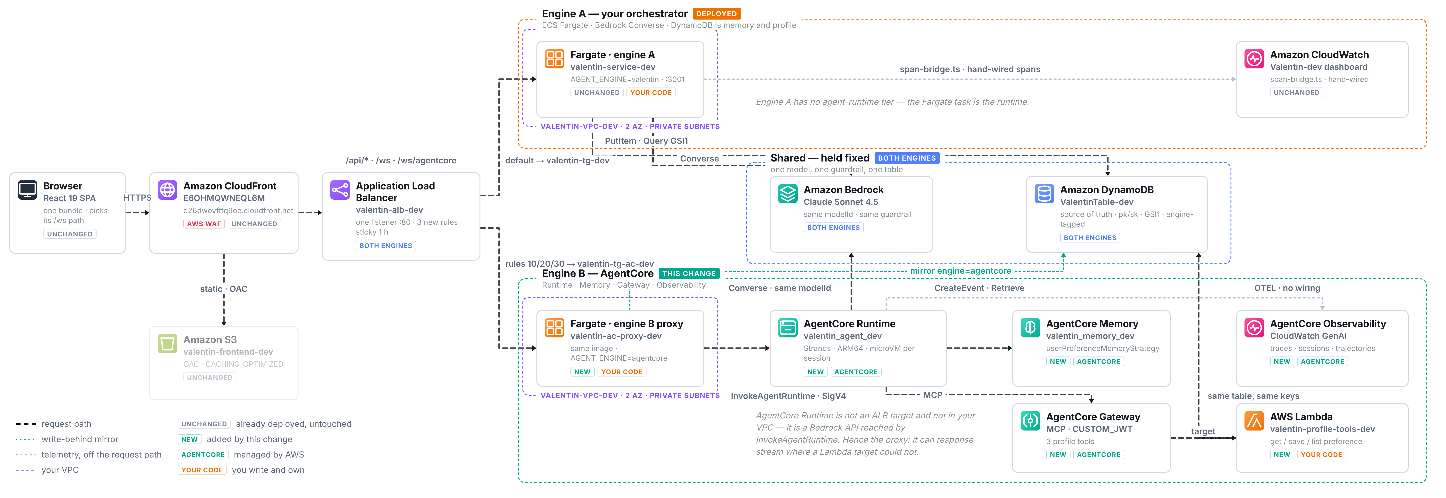
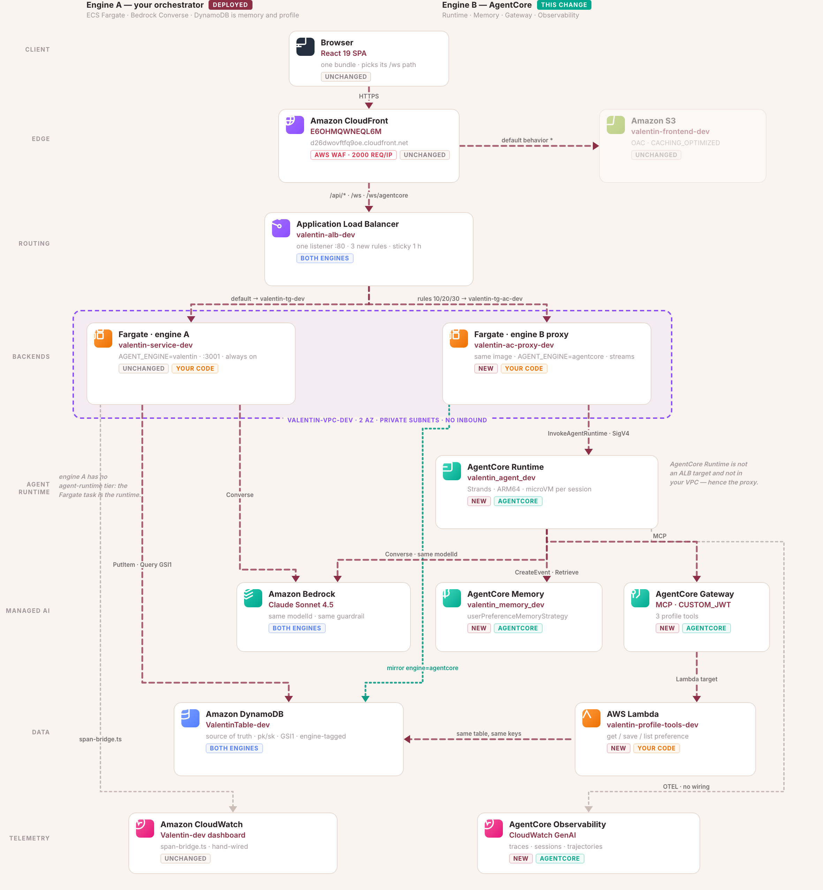
4
Architecture — Two Engines, One Product
The front door and the middle strip are shared. Only the two dashed bands differ.
VALENTIN · GenAI TFC Capstone Deep-Dive
5 / 12

Slide 6
5
Deep-Dive · Runtime (where the agent runs)
An always-on task vs a per-session microVM
ENGINE A · Fargate + DynamoDB
ENGINE B · AgentCore
ECS Fargate task — always on
AgentCore Runtime — per-session microVM
One task, one container, always paying
Each session gets its own isolated compute
All sessions share one process (logical isolation)
Per-second billing, 1-second minimum
At 500 turns/mo the task runs at 0.057% utilisation
Runtime price is 2.2× dearer per vCPU — but only pays while running
Simple to deploy, expensive at low load
Cannot be an ALB target → still needs a proxy
AgentCore wins at low utilisation. Session isolation goes from logical → physical. But you still keep a Fargate proxy in front — no compute deletion.
VALENTIN · GenAI TFC Capstone Deep-Dive
6 / 12

Slide 7
6
Deep-Dive · Memory (how the agent remembers)
A DIY extraction call per turn vs a managed memory strategy
ENGINE A · Fargate + DynamoDB
ENGINE B · AgentCore
DynamoDB + a 2nd Claude call every turn
AgentCore Memory — managed strategy
DynamoDB stores conversation + profile items
Configure userPreferenceMemoryStrategy — extraction is managed
Every turn: a second Bedrock call to extract preferences
No per-turn extraction call from you
~656 lines of extraction & memory glue code
But: extraction is async → profile trails by one message
This second call = 99.95% of Engine A's per-turn cost
Memory expires at 90 days → DynamoDB still source of truth
Biggest cost win, but caveat: $0.50 / 1k retrievals — if billed per-record not per-call, AgentCore becomes 3.8× more expensive. Unresolved.
VALENTIN · GenAI TFC Capstone Deep-Dive
7 / 12

Slide 8
7
Deep-Dive · Gateway (how the agent uses tools)
Tools in-process vs tools behind an authenticated API
ENGINE A · Fargate + DynamoDB
ENGINE B · AgentCore
TypeScript tool registry — in-process
AgentCore Gateway — MCP + CUSTOM_JWT
21 tools live inside the agent process
Tools are Lambdas behind an MCP endpoint
One IAM role for all tools (the task's role)
Each tool has its own execution role — scoped blast radius
Prompt injection = tool runs with agent's credentials
CUSTOM_JWT required — no anonymous access
One failing tool target loses all 40 tools
confirm_* tools deployed but hidden from the model
Strongest architectural argument for AgentCore. Tool failure blast radius: 40/40 → 1/40. Trust boundary lives outside the model.
VALENTIN · GenAI TFC Capstone Deep-Dive
8 / 12

Slide 9
8
Deep-Dive · Identity (who the agent acts as)
One shared role vs per-session workload identity
ENGINE A · Fargate + DynamoDB
ENGINE B · AgentCore
Task role — one identity for everything
AgentCore Identity — per-session actor
Whole Fargate task uses one IAM role
actorId per user (sanitised for Memory)
No per-user or per-session identity
Workload identity via JWT for Gateway calls
No workload identity for tool calls
user_id and session_id stripped from the model's tool schema
Auditing is coarse-grained
Injected server-side — model can't spoof identity
AgentCore wins on identity. Cost: two identities per user (actorId vs userId) — and a # in actorId will silently break Memory.
VALENTIN · GenAI TFC Capstone Deep-Dive
9 / 12

Slide 10
9
Deep-Dive · Observability (what you can see)
Hand-wired spans vs managed OTEL — with a surprise
ENGINE A · Fargate + DynamoDB
ENGINE B · AgentCore
Hand-wired OpenTelemetry — full-fat
AgentCore Observability — managed, incomplete today
Real durations, real token counts per turn
OTEL traces & sessions → CloudWatch GenAI
4 CloudWatch alarms + 1 dashboard
Runtime reports NO token usage today (blank counter)
Custom span-bridge.ts wired manually
Requires manual CLI enablement (Transaction Search)
You maintain it, but you can query anything
monitoring-stack.ts covers Engine B not at all
Engine A wins observability today. AgentCore will catch up — but as-is, the platform we're recommending has the weaker instrumentation.
VALENTIN · GenAI TFC Capstone Deep-Dive
10 / 12

Slide 11
10
Summary & Lessons Learned
What AgentCore actually bought — and what it cost
BOUGHT
COST
• Blast radius: 1-of-40 tools fail instead of 40-of-40
• Latency: extra network hop, no streaming today
• Tool trust boundary — enumerable outside the model
• Observability: no tokens, no alarms, manual setup
• ~62× cheaper at 500 turns/mo
• Contradictory naming rules · untaggable resources
• Physical session isolation (microVMs)
• Two identities per user (actorId vs userId)
• ~656 lines of extraction code stop being yours
• "Deployed & green" served ZERO turns for weeks
Three numbers to never get wrong on stage
62×
cheaper at 500 turns/mo
1 of 40
tools survive a failure
12
real defects behind 3,591
with the Memory billing caveat
vs 40 of 40 with in-process registry
green unit tests — why live evals matter
VALENTIN · GenAI TFC Capstone Deep-Dive
11 / 12

Slide 12
Thank you.
Questions?
Coral Magen
Technical Account Manager · coralst@amazon.com

