Slide 1
AWS ENTERPRISE SUPPORT · GenAI Core TFC
Valentin
One product · Two agent platforms · Same model
AgentCore vs Fargate + DynamoDB — a controlled A/B
Coral Magen · Technical Account Manager · September 2026
Notes:
[0:20 · cumulative 0:20 of 10:00]
Valentin is an agent that helps me be a better partner. Ten minutes: what it does, why the loop is the interesting part, then the decision I actually came to present — build the agent platform myself on Fargate, or buy AgentCore.

Slide 2





1
The Business Problem and the Application
Small nudges over time — from a partner who's paying attention when you can't.
THE BUSINESS PROBLEM
WHAT VALENTIN IS
We're busy. The little things that make our partner feel seen slip through the cracks — until we need them.
A personal AI assistant that listens, remembers per partner, and acts weeks early — with your final word.
1
2
3
4
/
/
Chatbot
Persistent Memory
Tool Using
Triggers & Loop
Amazon Bedrock · AgentCore Runtime
Amazon DynamoDB · AgentCore Memory
AWS Lambda · MCP
EventBridge Scheduler
Claude in context of the partner profile — same model, two delivery paths.
8 preference categories captured & recalled across months.
21 real tools: calendar, mail, restaurants, Spotify, Shabbat times.
Reminders fire weeks later — no human, no model, deterministic.
VALENTIN · GenAI TFC Capstone Deep-Dive
2 / 15
Notes:
[0:45 · cumulative 1:05 of 10:00]
The problem is not that I forget her birthday. It is that being thoughtful is a background job: noticing an occasion is coming, remembering what she liked last time, and doing something about it before the day arrives. That is three different jobs, and a chat window only does the middle one.

Slide 3
2
Valentin Workflow – what make it agentic?
GOAL
LOOP
MEMORY
TOOLS
3
4
Discussion and preference extraction
Propose
TOOLS — THE LOOP’S HANDS
check_shabbat
get_hebrew_occasions
find_occasions
find_restaurants
check_availability
propose_reservation
find_music
propose_playlist
search_hotels
search_activities
order_flowers
propose_email
GOAL
propose_whatsapp_nudge
set_reminder
propose_calendar_event
2
Make her feel seen
5
21 registered tools · 6 live integrations. Every write leaves as a proposal, never as a fact.
Feedback after the Event
Use tools
MEMORY
LOOP
Her file, rewritten every turn
It never ends on a reply
1
8 preference categories · past outings · pending reminders. DynamoDB / AgentCore Memory.
Each pass reorganises the timeline: new dates land, stale ones fall off, reminders re-scheduled.
Triger and planning
sets a new event
EVERY FRIDAY
3 NOV
14 FEB
21 MAR
JUNE
Shabbat dinner
Anniversary
Her birthday
Bat mitzvah
Anniversary trip
VALENTIN · GenAI TFC Capstone Deep-Dive
3 / 15
Notes:
[1:05 · cumulative 2:10 of 10:00]
This is the whole system in one picture, and it is the slide I would defend hardest. An event on the timeline triggers a planning pass — that is the arrow coming up from the calendar. The agent uses tools, proposes something, we talk, and it extracts what it learned about her. Then feedback after the event can set the next event, which is the arrow going back down to the timeline. Claude is one step in that ring. EventBridge is what closes it.

Slide 4
3
Demo
Live product · deployed on AWS · 6 real integrations
OPEN THE DEMO
Valentin — Live Demo ↗
The four beats: extract · remember · decide · act
VALENTIN · GenAI TFC Capstone Deep-Dive
4 / 15
Notes:
[1:15 · cumulative 3:25 of 10:00]
Short demo. Watch two things: it opens with an occasion I never typed, and by the end it has written something into her file that changes what it says next time.

Slide 5
4
Architecture — four decisions, four deep-dives
Same product, two engines. Each row is one decision, the deep-dive that follows it, and the single number that settles it.
THE DECISION
ENGINE A · GLUE CODE
ENGINE B · AGENTCORE
WHAT SETTLES IT
Compute
One Fargate task, 0.5 vCPU, billed 730 h a month whether anyone talks to Valentin or not. Forty live sessions share one Node process and one heap.
One microVM per session, billed per second of actual agent work. A process-level fault has nowhere to travel.
AGENTCORE
AgentCore Runtime
40 → 1
sessions lost to one process fault
Memory
DynamoDB, plus a second Bedrock call every turn to extract preferences — an extraction prompt I own and maintain.
One event in, one retrieval out. Extraction is part of the service, not a second model call.
AGENTCORE
AgentCore Memory
14×
cheaper per user, per month
Tool use
An in-process tool registry — a process-wide singleton holding every user’s credentials in the same heap as every session.
Three tools indexed outside the process, auth resolved per tool. Adding a tool stops being a deploy.
AGENTCORE
AgentCore Gateway
$0.0006
the only fixed line on the bill
Observability
Hand-wired OTEL spans emit exactly the fields I debug with: turn id, tool name, extraction latency, which reminder fired.
Session traces for free, but on AgentCore’s schema — not the fields I actually reach for.
GLUE CODE
AgentCore Observability
the one
dimension the DIY side wins
Three of four go to AgentCore. The fourth is the honest half: observability is where hand-wired spans still win.
VALENTIN · GenAI TFC Capstone Deep-Dive
5 / 15
Notes:
[1:00 · cumulative 4:25 of 10:00]
Now the real content. Same product, built twice: once as glue code I own on Fargate, once on AgentCore. Four decisions, one row each, and the number that settles it in the last column. Three of the four go to AgentCore. The fourth does not, and I will not skip it — a comparison that goes four-nil is a sales pitch.

Slide 6
5
Compute — Fargate vs. AgentCore Runtime
PLACEHOLDER · MESSAGES ONLY
Where the agent actually runs, and what that costs you in dollars and in blast radius.
1
Engine A never scales to zero. One Fargate task at 0.5 vCPU bills 730 hours a month whether anyone talks to Valentin or not — $18.02 before the first turn.
2
Engine B bills per second of real work. 3 s × 104 turns is $0.0047 a month. The floor disappears entirely; that is the whole of the cost difference at one user.
3
AgentCore’s unit price is worse, not better. Runtime is 2.20× dearer per vCPU-hour. It wins on billing granularity, and only on billing granularity — say this before anyone checks.
4
The real difference is isolation, not money. One microVM per session, versus forty sessions sharing one Node process, one heap and one event loop. The next slide is that experiment.
5
What you give up. Control of the container: no sidecars, no long-lived in-process cache, and a cold start on the first turn of an idle session.
VALENTIN · GenAI TFC Capstone Deep-Dive
6 / 15
Notes:
[0:35 · cumulative 5:00 of 10:00]
Compute first. Engine A never scales to zero: one task, eighteen dollars a month before anyone says a word. Engine B bills per second of actual agent work — under a cent. But its unit price is worse, two point two times dearer per vCPU-hour. It wins on granularity, not on rate.

Slide 7
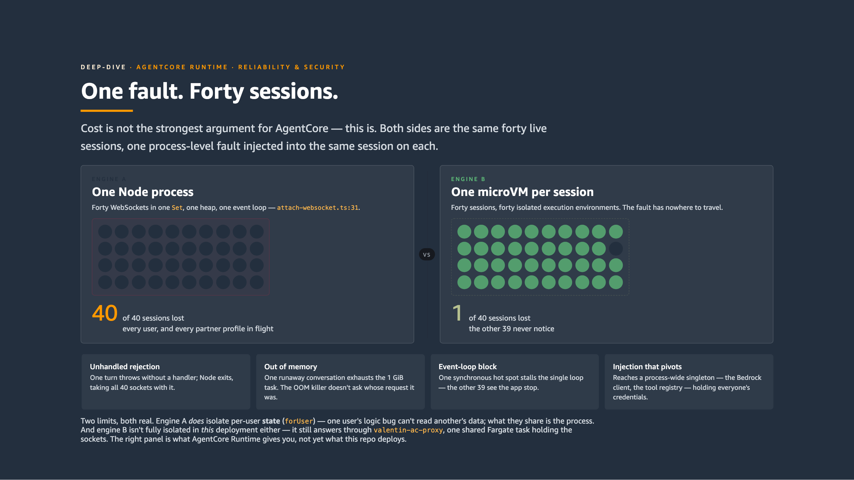
6
VALENTIN · GenAI TFC Capstone Deep-Dive
7 / 15
Notes:
[0:40 · cumulative 5:40 of 10:00]
And this is what I actually care about. In-process, forty sessions share one Node process, one heap, one crash. A microVM per session means a fault has nowhere to travel. Same for credentials: one shared IAM role versus one role per tool.

Slide 8
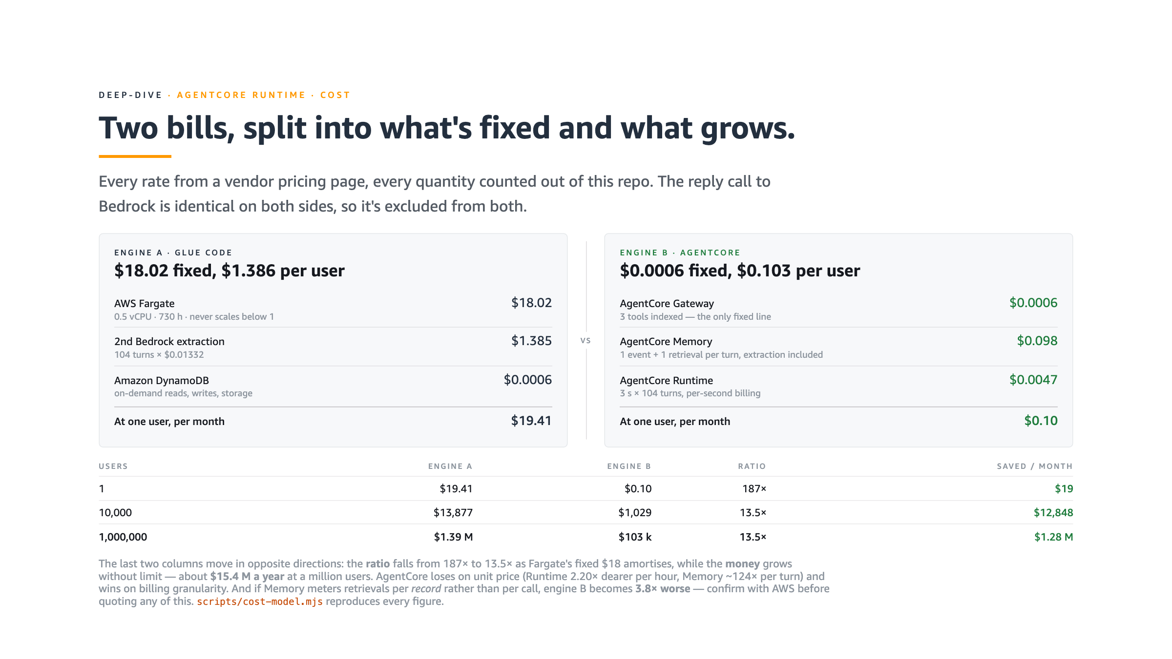
7
VALENTIN · GenAI TFC Capstone Deep-Dive
8 / 15
Notes:
[0:35 · cumulative 6:15 of 10:00]
The bill, itemised, with every rate from a pricing page and every quantity counted out of this repo. The reply call to Bedrock is identical on both sides, so I excluded it from both — otherwise it dominates and hides the difference.

Slide 9
8
Memory — DynamoDB + a second call vs. AgentCore Memory
PLACEHOLDER · MESSAGES ONLY
How the agent remembers her, and who owns the extraction prompt.
1
Engine A pays a second model call per turn. Extracting preferences needs its own Bedrock invocation — $1.385 per user per month, and an extraction prompt that is mine to maintain forever.
2
AgentCore Memory folds extraction into the service. One event written, one retrieval read per turn: $0.098 per user per month, 14× cheaper, and one fewer prompt to own.
3
It is not cheap storage — it is a replaced call. Per turn, Memory is roughly 124× DynamoDB’s price. It only wins because it removes the extraction call, and that is the argument to make.
4
One unresolved risk, worth flagging out loud. If retrievals meter per record rather than per call, engine B becomes 3.8× worse. Confirm with the service team before quoting any figure.
5
What you give up. The extraction schema. DynamoDB let me define exactly what counts as a preference — including preferenceCategoryCount, which nothing managed would have given me.
VALENTIN · GenAI TFC Capstone Deep-Dive
9 / 15
Notes:
[0:35 · cumulative 6:50 of 10:00]
Memory. Engine A pays a second model call every turn just to extract preferences, and I own that prompt forever. AgentCore Memory folds extraction into the service: fourteen times cheaper per user. One caveat I have not resolved — if retrieval meters per record instead of per call, that reverses.

Slide 10
9
Tool use — in-process registry vs. AgentCore Gateway
PLACEHOLDER · MESSAGES ONLY
How the agent reaches Spotify, Gmail and the calendar — and who holds the credentials.
1
The in-process registry is the worst thing in engine A. A process-wide singleton holds every user’s credentials in the same heap as every live session.
2
That is the highest-severity finding in the comparison. An injection that pivots to the registry reaches the shared Bedrock client and everyone’s tokens — not just the attacker’s own session.
3
Gateway moves the tool surface out of the process. Three tools indexed, auth resolved per tool, $0.0006 a month — the only fixed line on the entire AgentCore bill.
4
It also turns the tool list into data. Adding or revoking a tool stops being a deploy, which is what actually changes how fast the agent can grow.
5
What you give up. In-process latency, and the freedom to hand a tool an arbitrary Node object instead of a serialisable contract.
VALENTIN · GenAI TFC Capstone Deep-Dive
10 / 15
Notes:
[0:35 · cumulative 7:25 of 10:00]
Tool use, and the worst thing in engine A: a process-wide registry holding every user’s credentials in the same heap as every session. Gateway moves the tool surface out of the process and resolves auth per tool, for six ten-thousandths of a dollar a month.

Slide 11
10
Observability — hand-wired OTEL vs. AgentCore Observability
PLACEHOLDER · MESSAGES ONLY
What you can actually see when a turn goes wrong at two in the morning.
1
This is the one dimension the DIY side wins. Say it plainly — a comparison that goes 4–0 is a sales pitch, and this one does not.
2
Hand-wired OTEL emits exactly the fields I debug with. Turn id, tool name, extraction latency, which reminder fired, which partner profile was in flight.
3
AgentCore Observability gives traces for free — on its schema. Session-level traces arrive with no work at all, but the fields I actually reach for at 2am are not the ones it emits.
4
The DIY cost here is real, not rhetorical. I wrote the span plumbing and now maintain it, and CloudWatch is another bill and another place to go looking.
5
Where I actually landed. Take AgentCore’s traces as the floor, and keep hand-wired spans for the two or three fields that decide an incident.
VALENTIN · GenAI TFC Capstone Deep-Dive
11 / 15
Notes:
[0:30 · cumulative 7:55 of 10:00]
Observability is the one dimension the DIY side wins. Hand-wired OTEL emits exactly the fields I debug with. AgentCore gives me traces for free, but on its schema. Where I landed: take its traces as the floor, keep my own spans for the two or three fields that decide an incident.

Slide 12
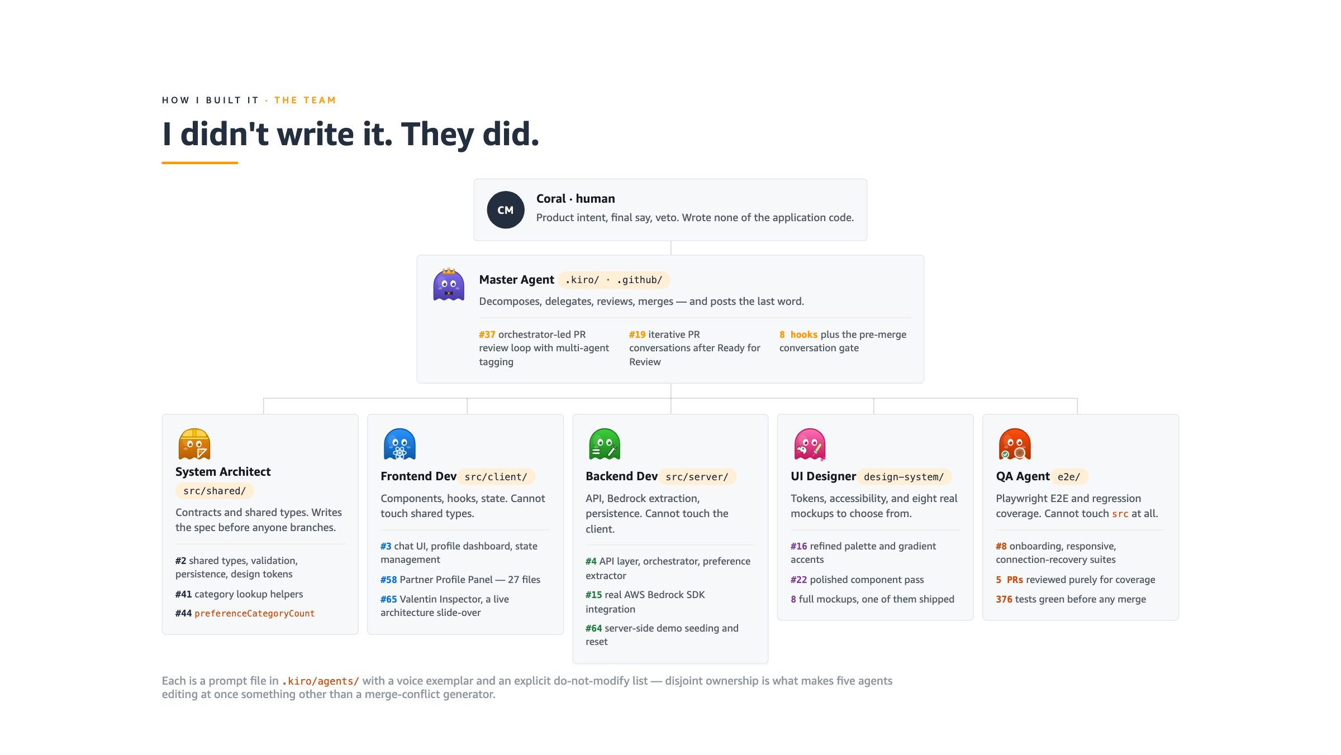
11
VALENTIN · GenAI TFC Capstone Deep-Dive
12 / 15
Notes:
[0:30 · cumulative 8:25 of 10:00]
A word on how this got built, because it is the part people ask about. I wrote none of the application code. Six agents did, each with a prompt file and an explicit do-not-touch list — disjoint ownership is what stops five agents editing at once from being a merge-conflict generator.

Slide 13

12
VALENTIN · GenAI TFC Capstone Deep-Dive
13 / 15
Notes:
[0:25 · cumulative 8:50 of 10:00]
Every node here is a real pull request, in the order it was opened, connected to where it merged. Fifty-seven of them. The link opens the interactive version if you want to read any review thread.

Slide 14
13
What I learned
Five things I would tell the next person building one of these — three about the agent, two about building it.
1
An agent is a loop, not a chatbot. The agentic part of Valentin isn’t Claude — it’s trigger → tools → propose → extract → re-schedule, and every pass rewrites the timeline that feeds the next one. EventBridge closes the loop, not the model.
2
When you and the agent are both stuck, the next prompt is not the answer. Stop and spend five minutes with pen and paper. Every long débâcle in this project ended the moment I stopped prompting and drew the thing.
3
Most of the tokens went to the workflow, not the code. 31 of 56 PRs built the factory — specs, review loops, merge gates, regression tests for the automation itself. That is what made the other 25 safe to merge.
4
The strongest case for AgentCore isn’t the bill, it’s the blast radius. In-process, one crashed tool takes down all 40 sessions and one shared IAM role means a prompt injection can touch everything. Behind Gateway each tool is its own Lambda with its own role — a failure or a hijack is contained to 1-of-40.
5
It’s easy to gate “the service is up,” hard to gate “the LLM works.” A missing Bedrock permission returned a polite fallback with HTTP 200; a # in the actorId made Memory silently store nothing while chat kept chatting. The only gate that caught either was a live conversation asserting on what the agent remembered.
VALENTIN · GenAI TFC Capstone Deep-Dive
14 / 15
Notes:
[1:00 · cumulative 9:50 of 10:00]
Five things I would tell the next person. An agent is a loop, not a chatbot. When you and the agent are both stuck, stop prompting and pick up a pen. Most of my tokens went to the workflow, not the code — and that is what made the code safe to merge. The strongest case for AgentCore is blast radius, not the bill. And it is easy to gate that the service is up, hard to gate that the model still works — a missing permission returned a polite fallback with a two hundred.

Slide 15
Thank you.
Questions?
Coral Magen
Technical Account Manager · coralst@amazon.com
Notes:
[0:10 · cumulative 10:00 of 10:00]
That is Valentin. Happy to go deeper on any of the four deep-dives, or on the agent workflow that built it.

