Slide 1
AWS ENTERPRISE SUPPORT · GenAI Core TFC
Valentin
One product · Two agent platforms · Same model
AgentCore vs Fargate + DynamoDB — a controlled A/B
Coral Magen · Technical Account Manager · September 2026

Slide 2





1
The Business Problem and the Application
Small nudges over time — from a partner who's paying attention when you can't.
THE BUSINESS PROBLEM
WHAT VALENTIN IS
We're busy. The little things that make our partner feel seen slip through the cracks — until we need them.
A personal AI assistant that listens, remembers per partner, and acts weeks early — with your final word.
(with two beckends: DIY / Agentcore)
1
2
3
4
/
/
Chatbot
Persistent Memory
Tool Using
Triggers & Loop
Amazon Bedrock · AgentCore Runtime
Amazon DynamoDB · AgentCore Memory
AWS Lambda · MCP
EventBridge Scheduler
VALENTIN · GenAI TFC Capstone Deep-Dive
2 / 12

Slide 3
2
Valentin Agentic Workflow
VALENTIN · GenAI TFC Capstone Deep-Dive
3 / 12

Slide 4
3
Demo
Live product · deployed on AWS · 6 real integrations
OPEN THE DEMO
Valentin — Live Demo ↗
The four beats: extract · remember · decide · act
VALENTIN · GenAI TFC Capstone Deep-Dive
4 / 12

Slide 5
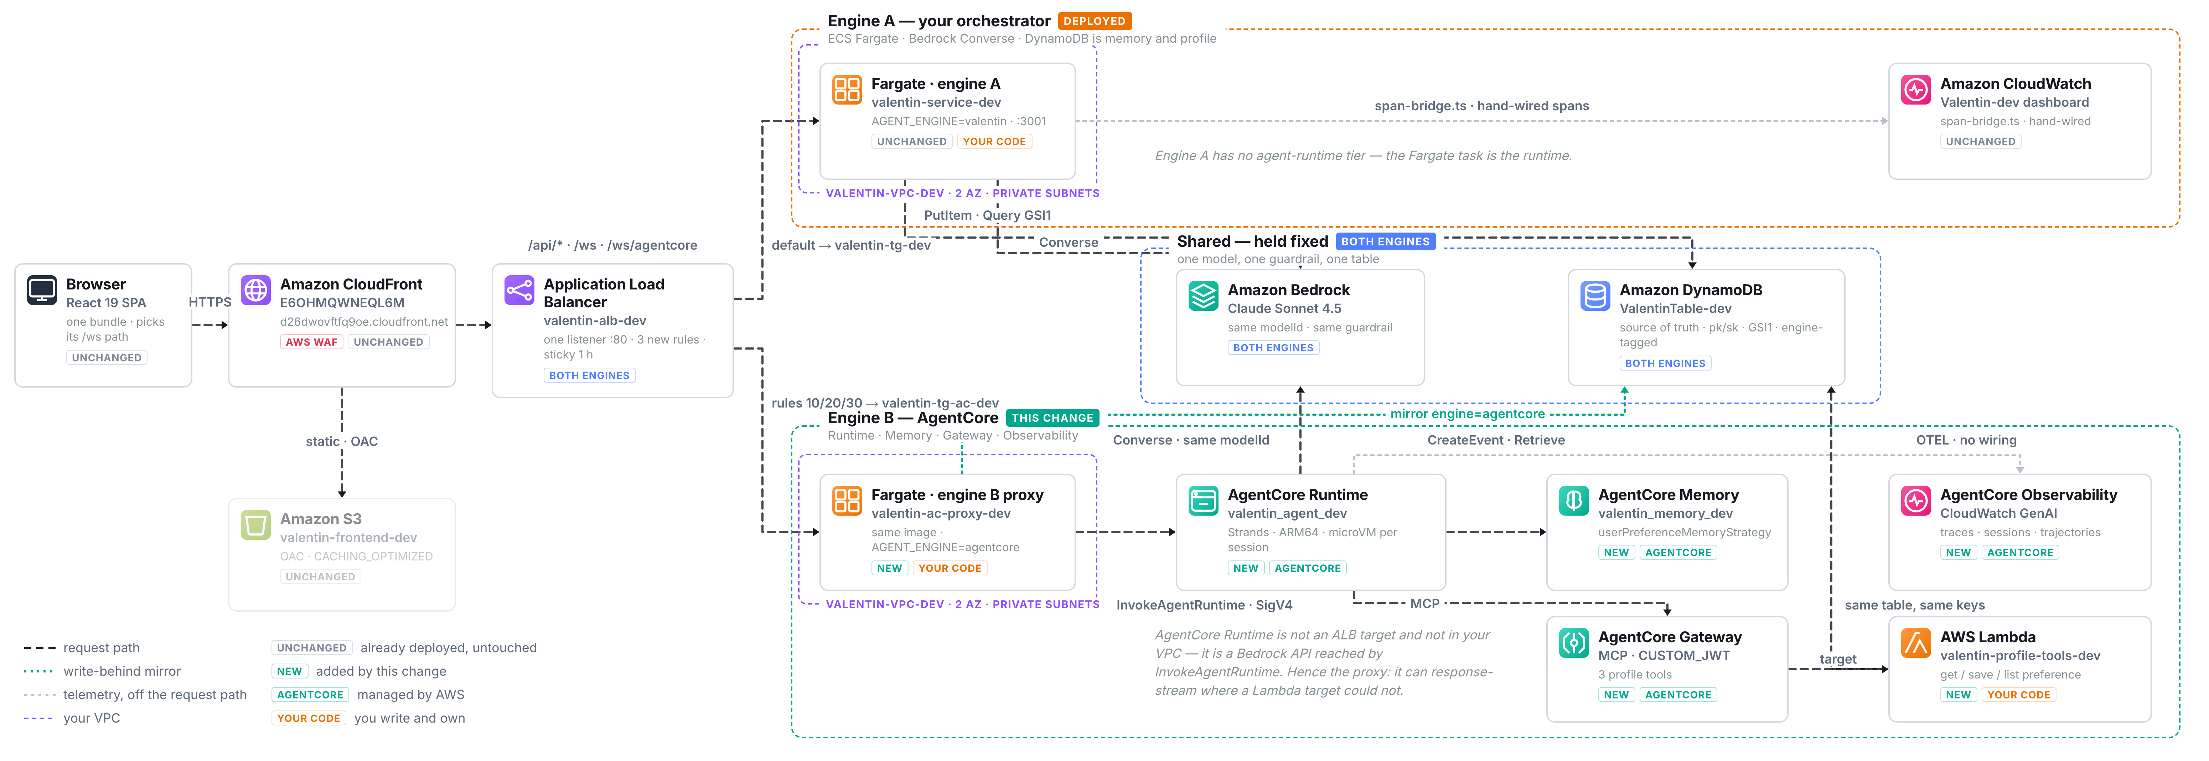
4
Architecture — Two Engines, One Product
Everything at top and bottom is shared. Only the middle changes.
VALENTIN · GenAI TFC Capstone Deep-Dive
5 / 12

Slide 6
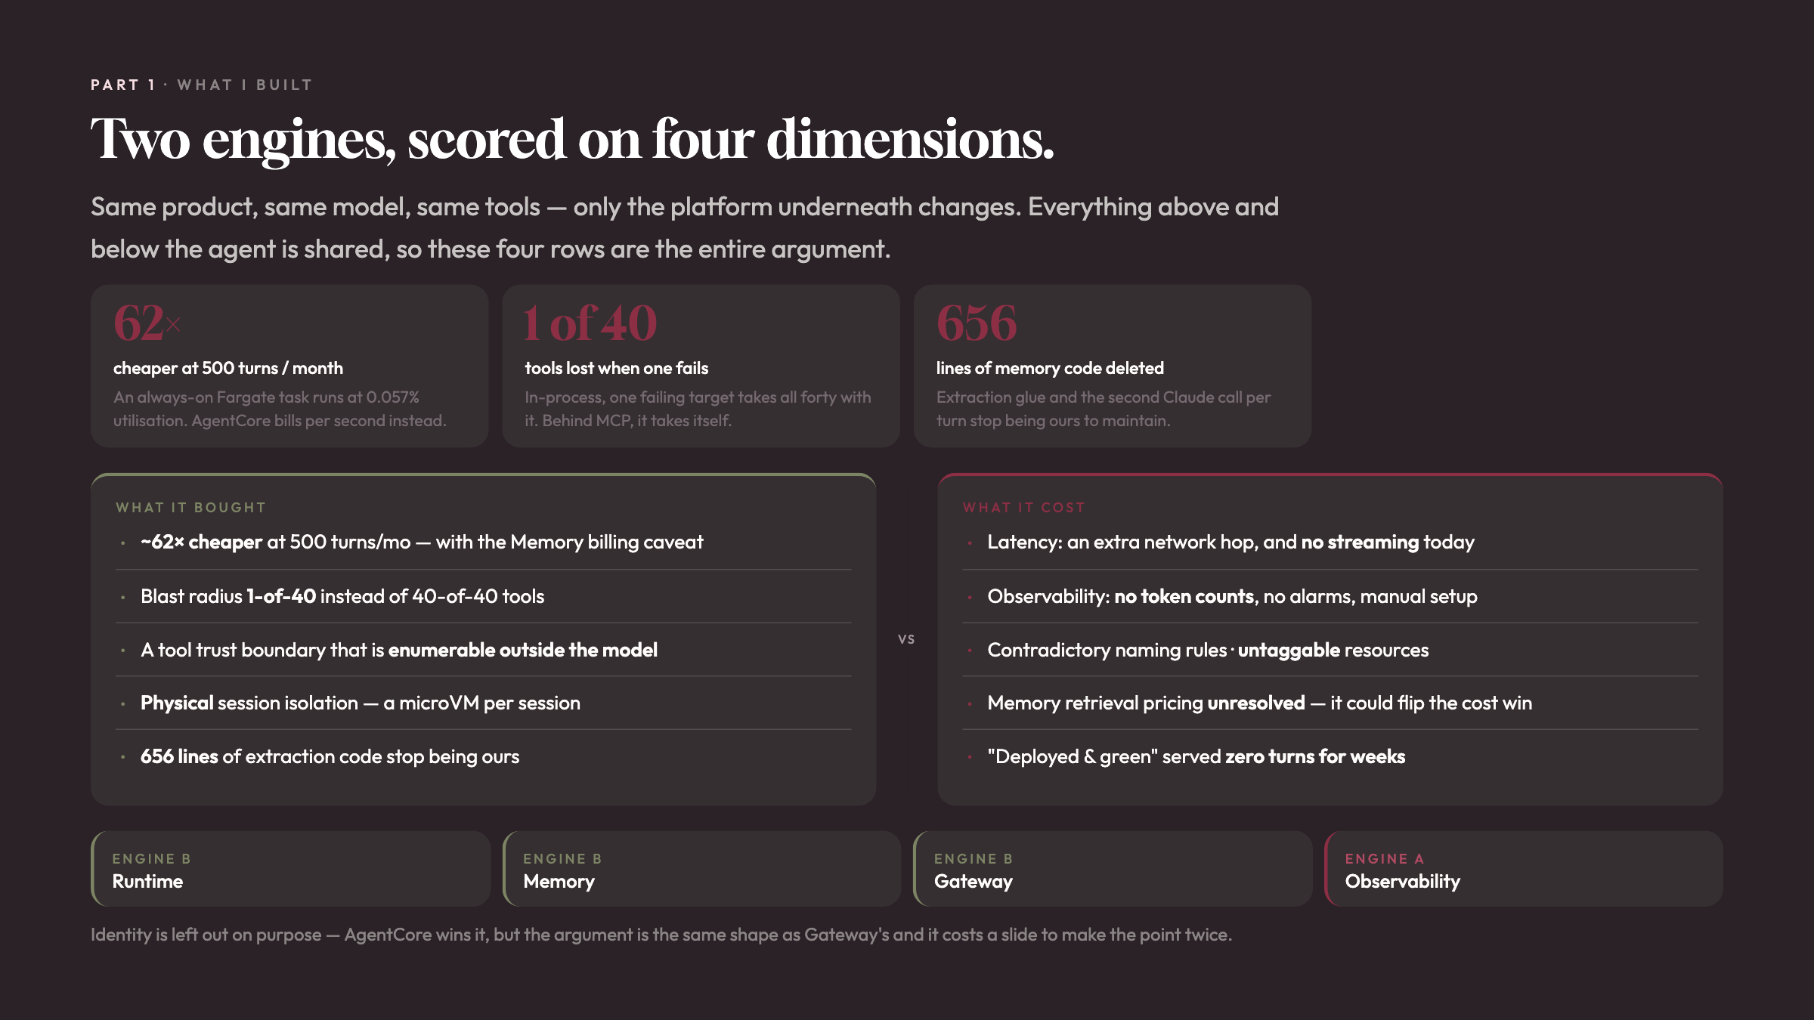

Slide 7
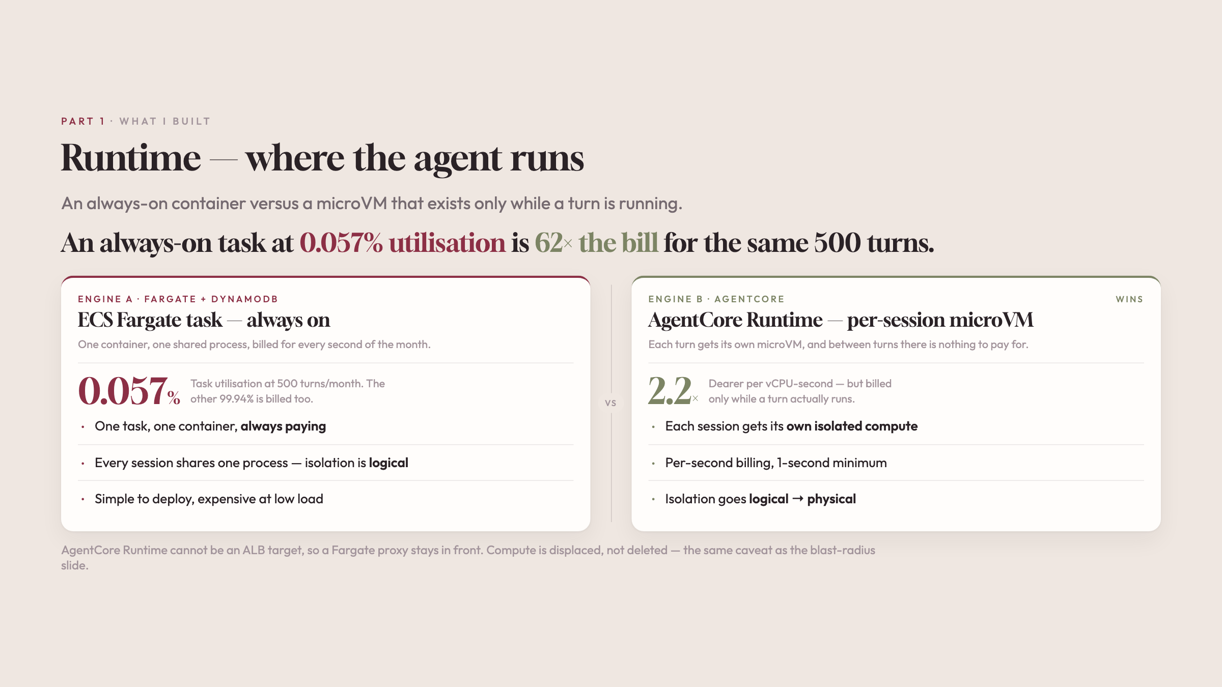

Slide 8
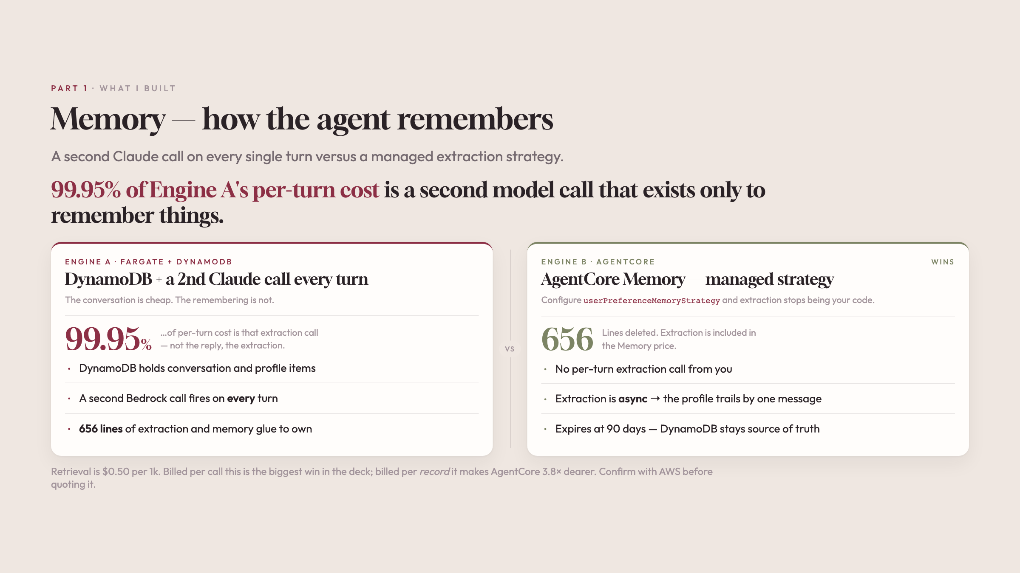

Slide 9
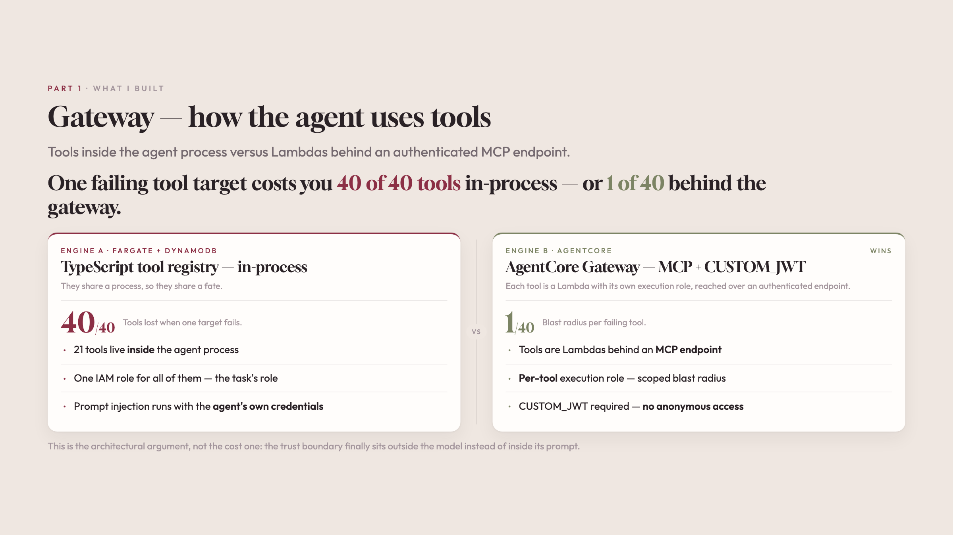

Slide 10
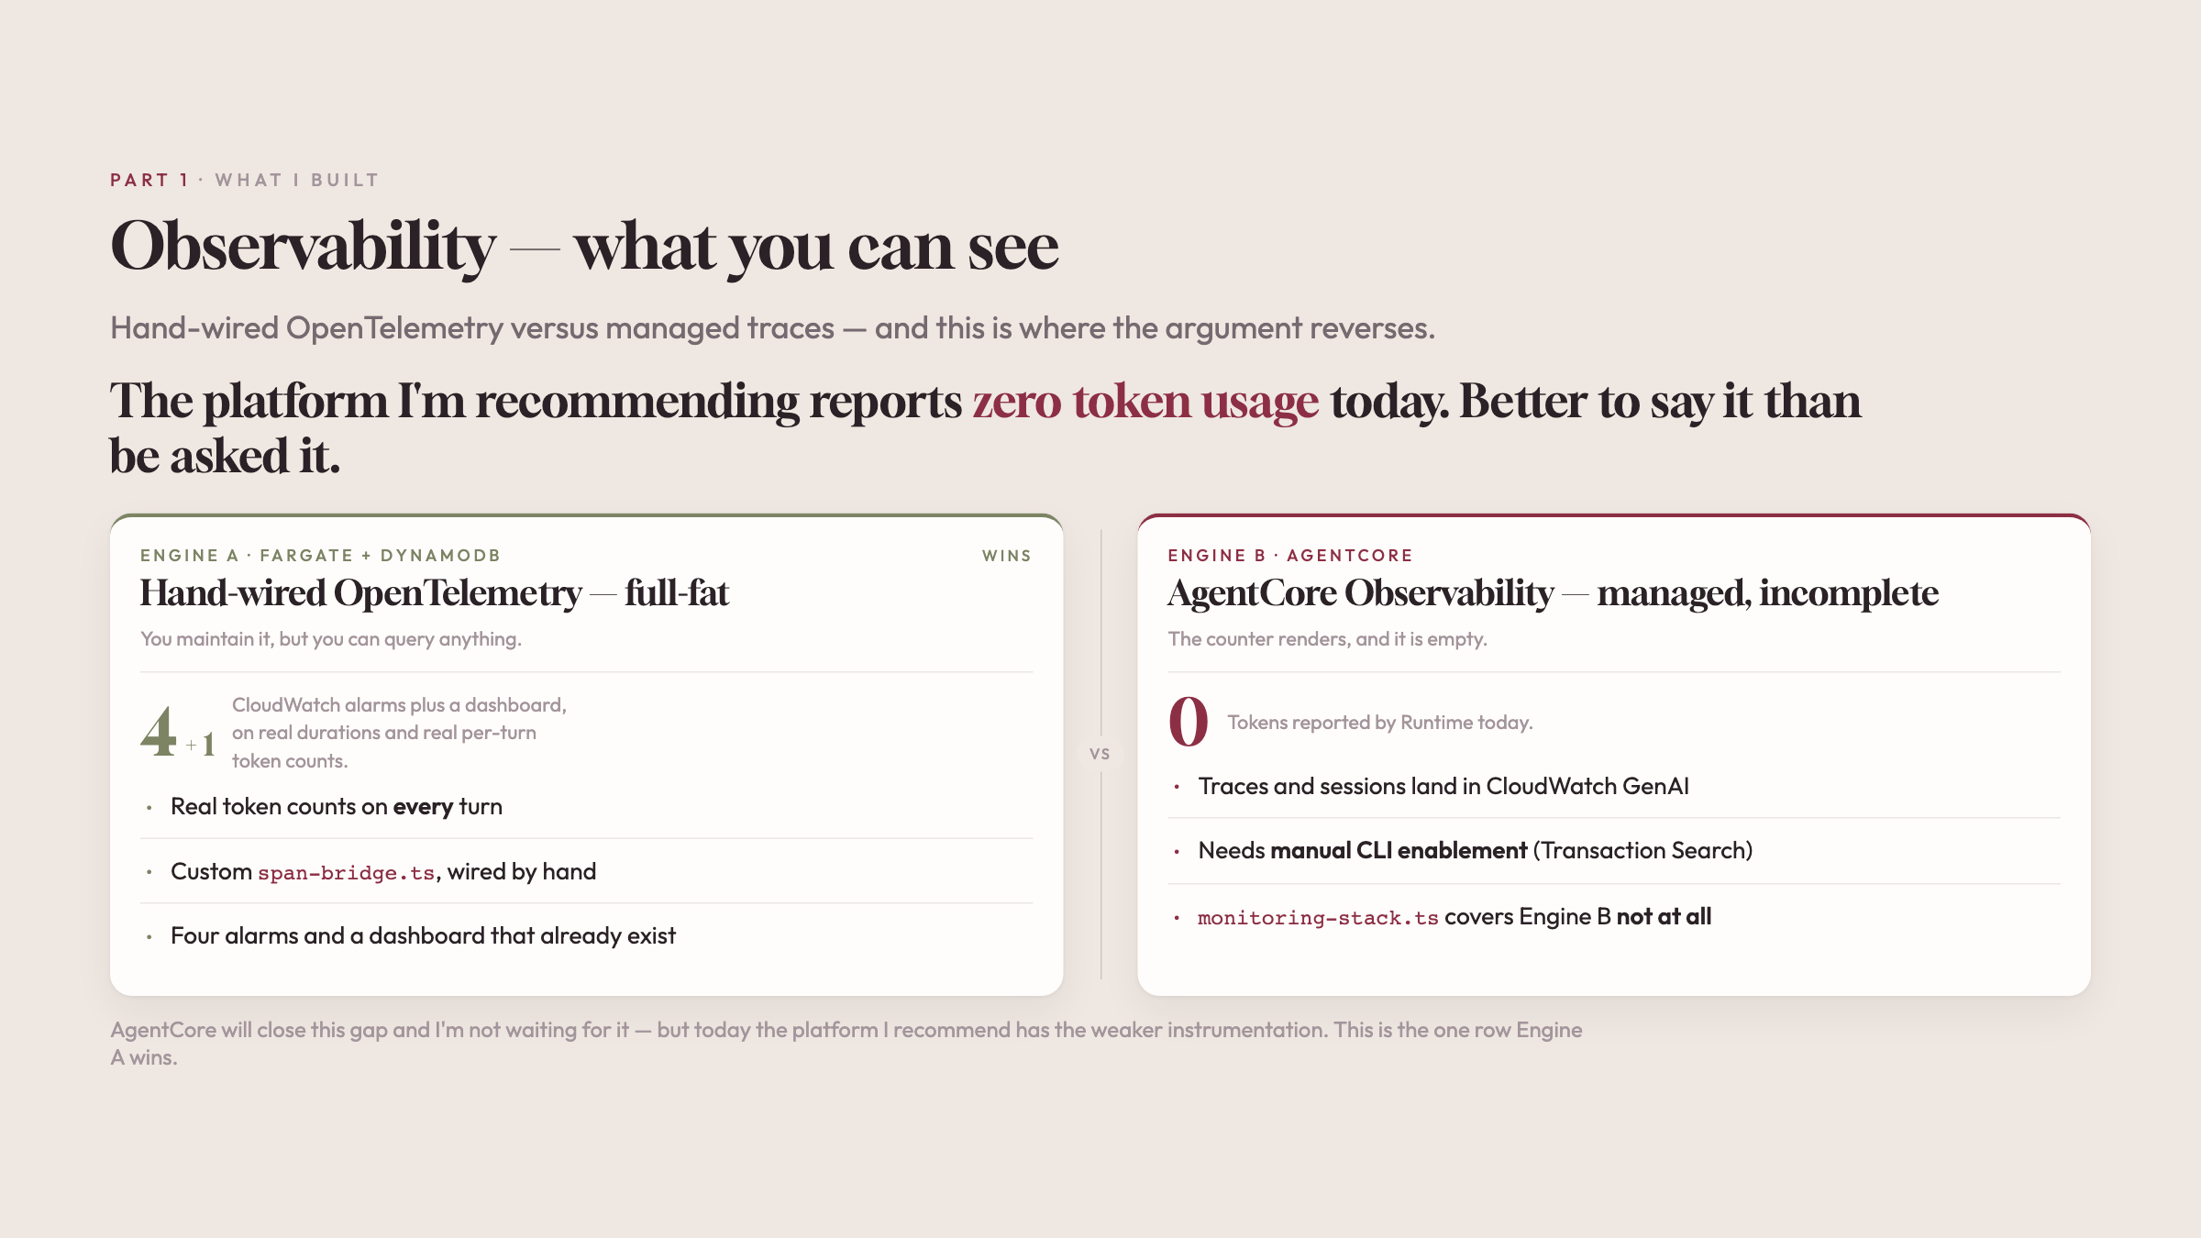

Slide 11
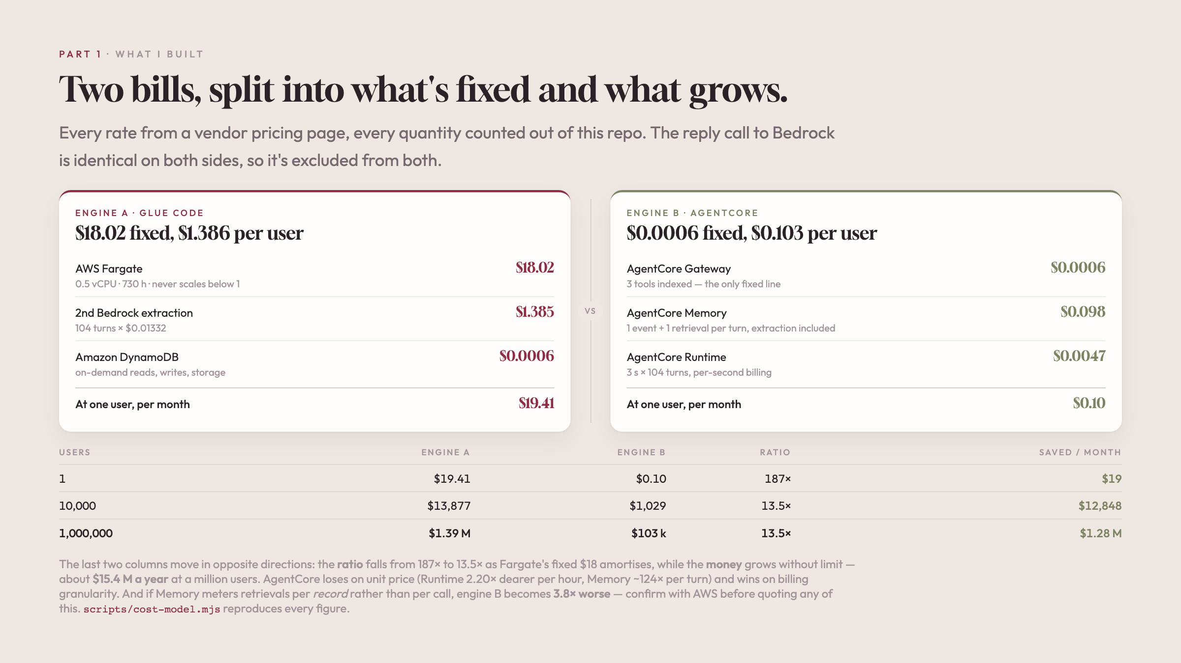

Slide 12
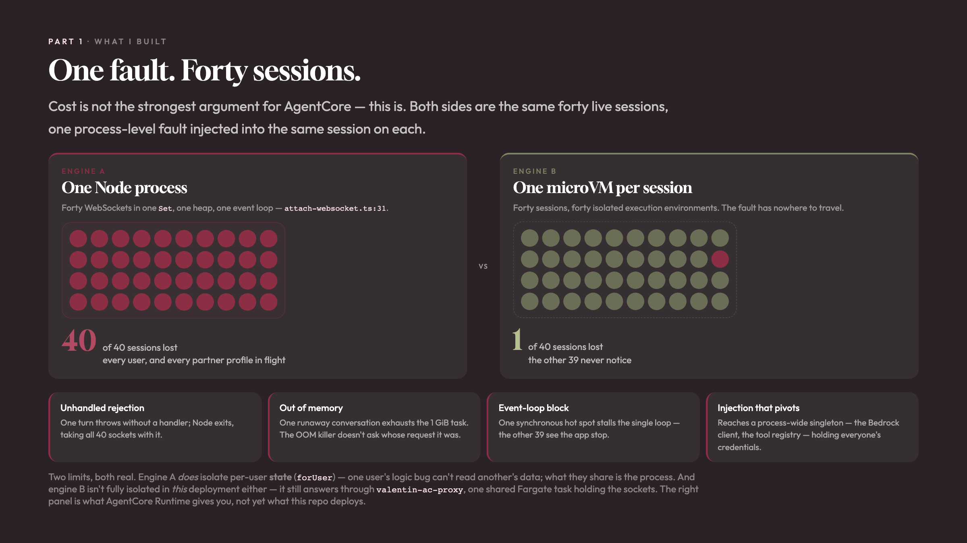

Slide 13
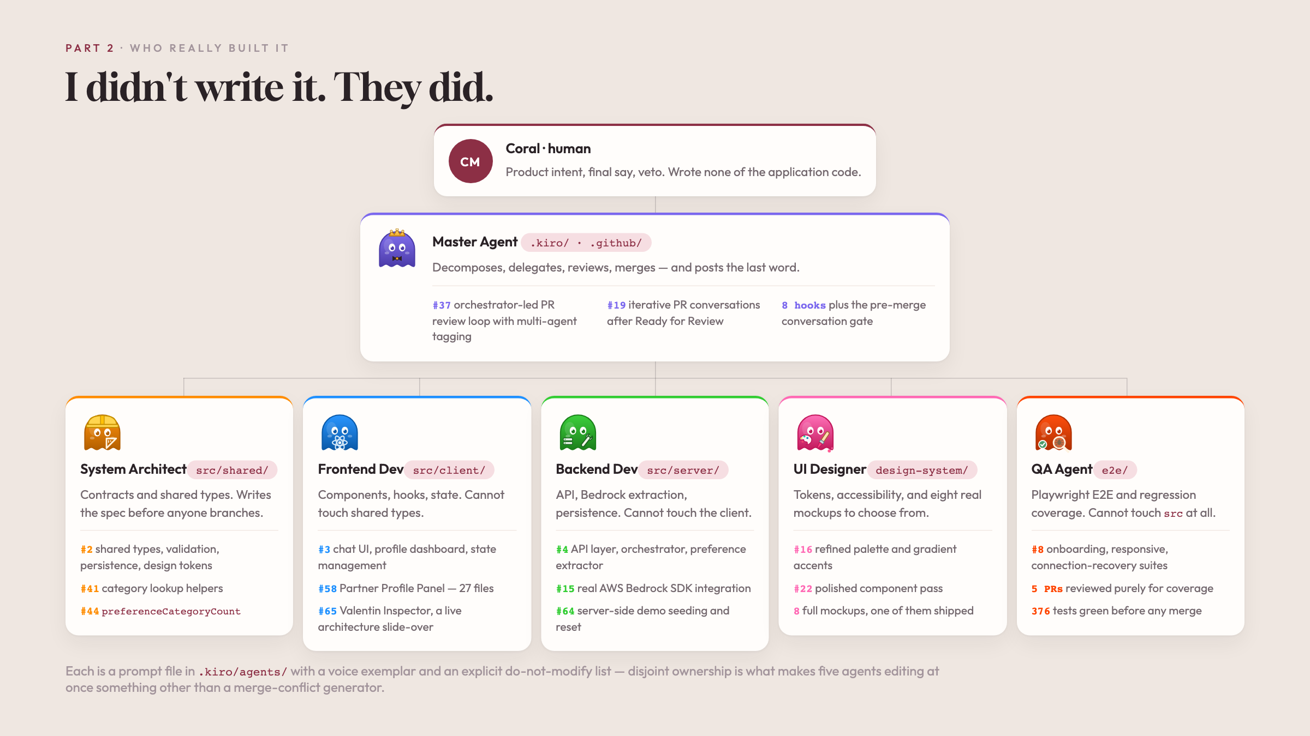

Slide 14
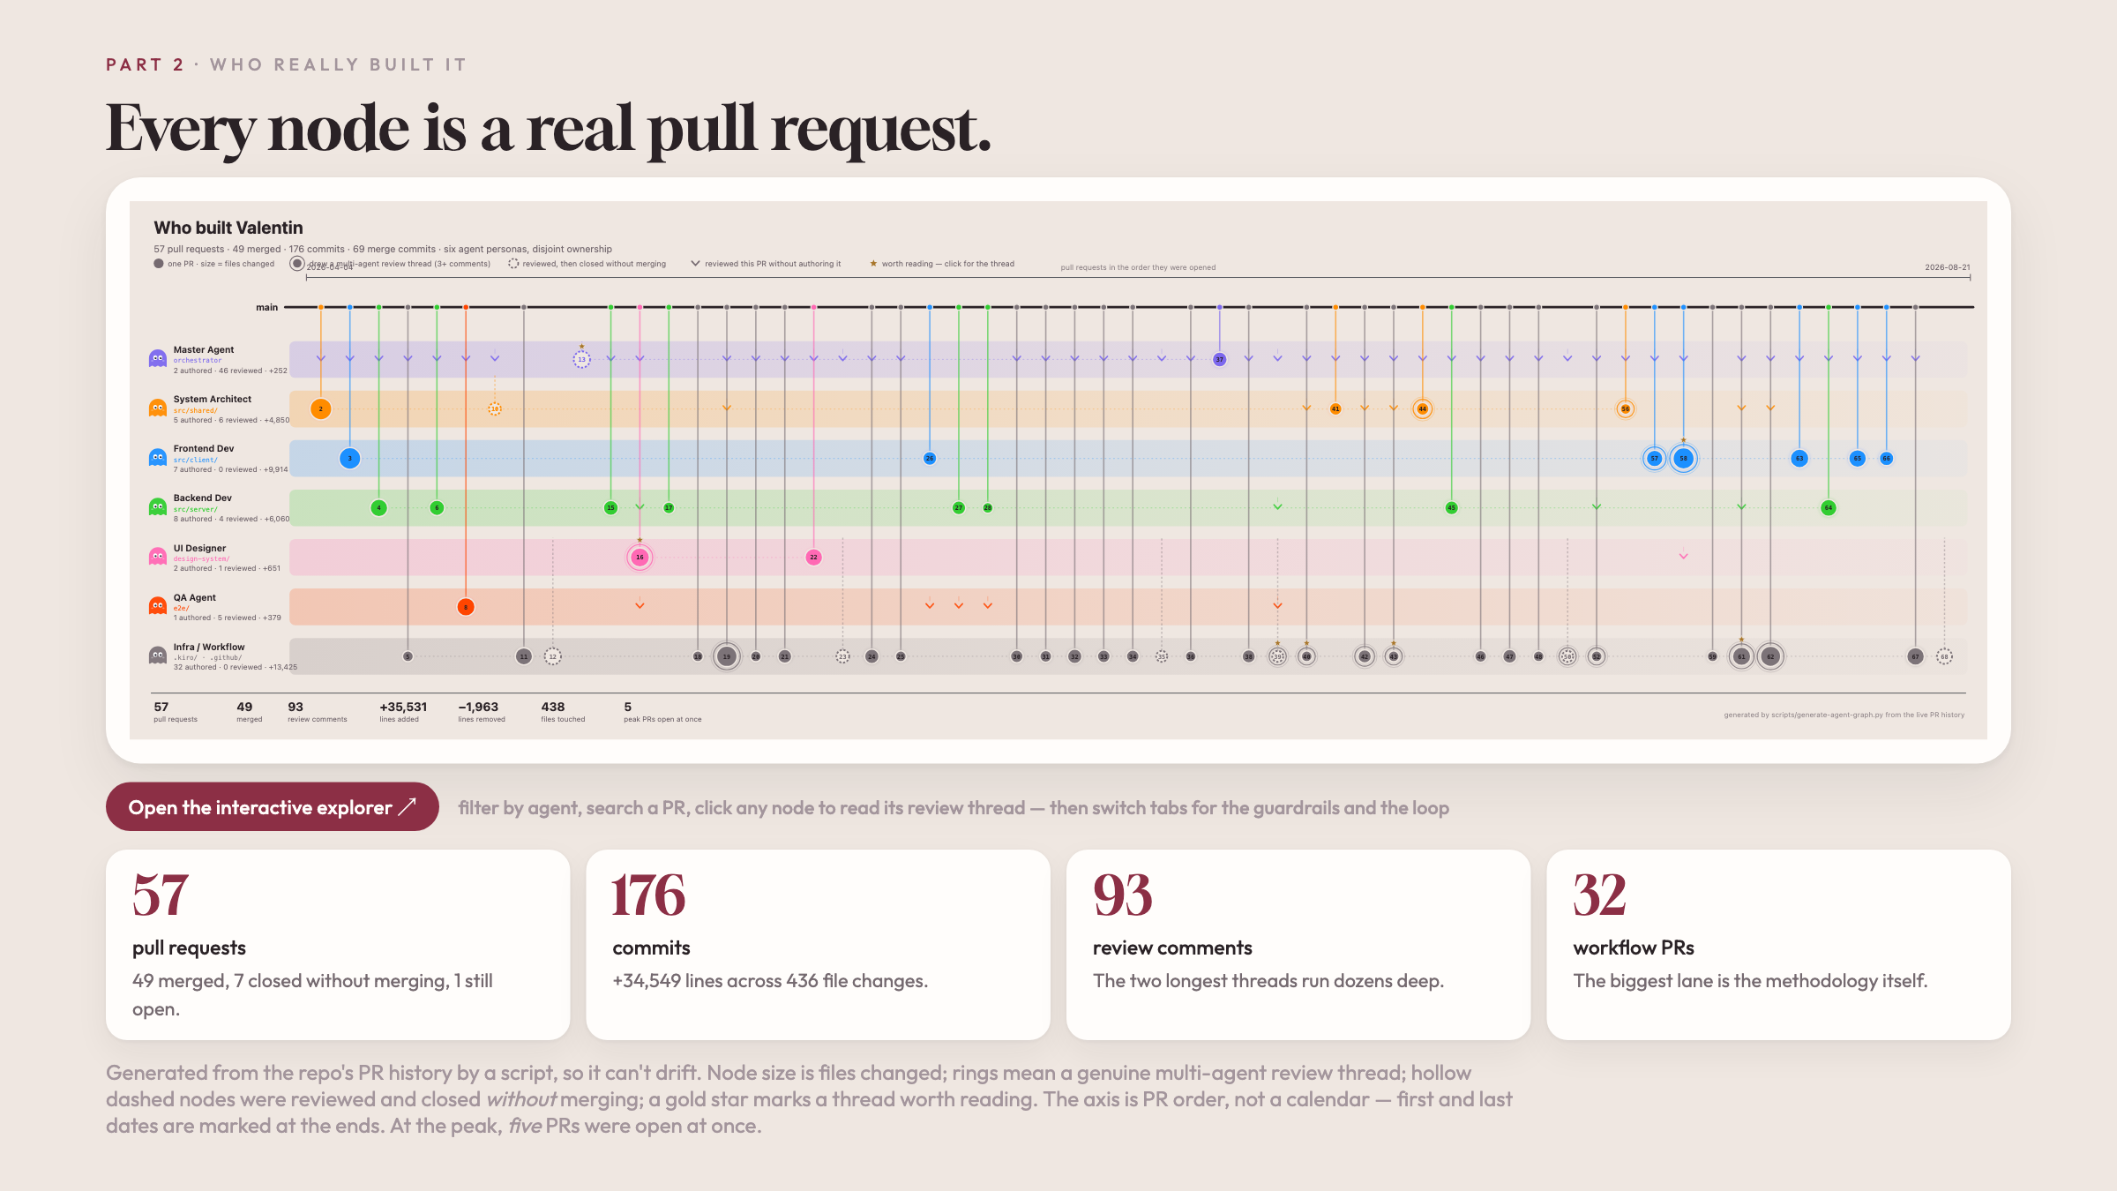

Slide 15
10
Summary & Lessons Learned
VALENTIN · GenAI TFC Capstone Deep-Dive
11 / 12

Slide 16
10
Summary & Lessons Learned
VALENTIN · GenAI TFC Capstone Deep-Dive
11 / 12

Slide 17
10
Summary & Lessons Learned
What AgentCore actually bought — and what it cost
BOUGHT
COST
• Blast radius: 1-of-40 tools fail instead of 40-of-40
• Latency: extra network hop, no streaming today
• Tool trust boundary — enumerable outside the model
• Observability: no tokens, no alarms, manual setup
• ~62× cheaper at 500 turns/mo
• Contradictory naming rules · untaggable resources
• Physical session isolation (microVMs)
• Two identities per user (actorId vs userId)
• ~656 lines of extraction code stop being yours
• "Deployed & green" served ZERO turns for weeks
VALENTIN · GenAI TFC Capstone Deep-Dive
11 / 12

Slide 18
Thank you.
Questions?
Coral Magen
Technical Account Manager · coralst@amazon.com

