Slide 1
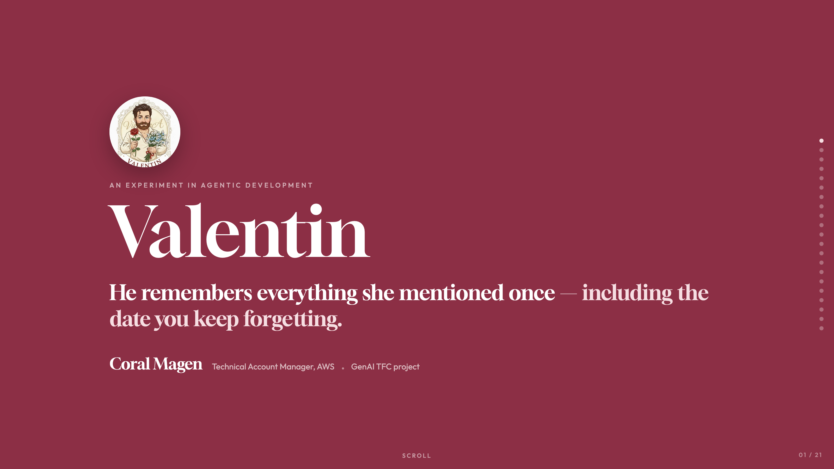
Notes:
AN EXPERIMENT IN AGENTIC DEVELOPMENT
Valentin
He remembers everything she mentioned once — including the date you keep forgetting.
Coral Magen
Technical Account Manager, AWS
GenAI TFC project
SCROLL

Slide 2
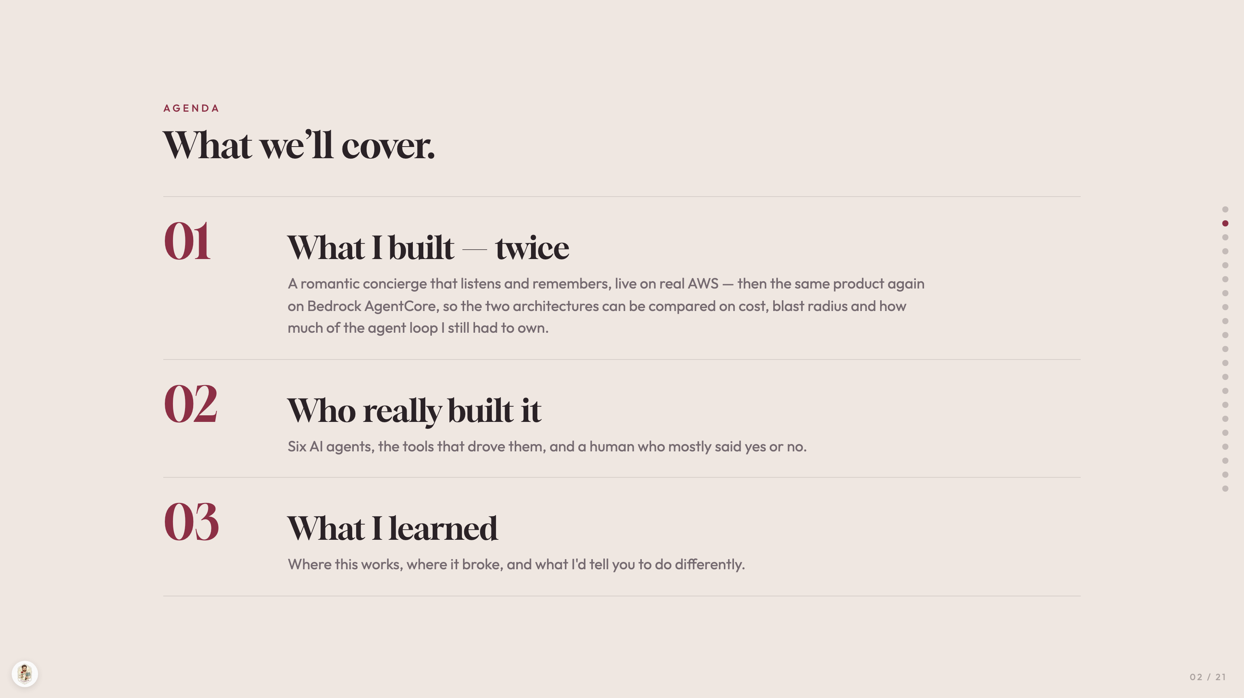
Notes:
AGENDA
What we’ll cover.
01
What I built — twice
A romantic concierge that listens and remembers, live on real AWS — then the same product again on Bedrock AgentCore, so the two architectures can be compared on cost, blast radius and how much of the agent loop I still had to own.
02
Who really built it
Six AI agents, the tools that drove them, and a human who mostly said yes or no.
03
What I learned
Where this works, where it broke, and what I'd tell you to do differently.

Slide 3
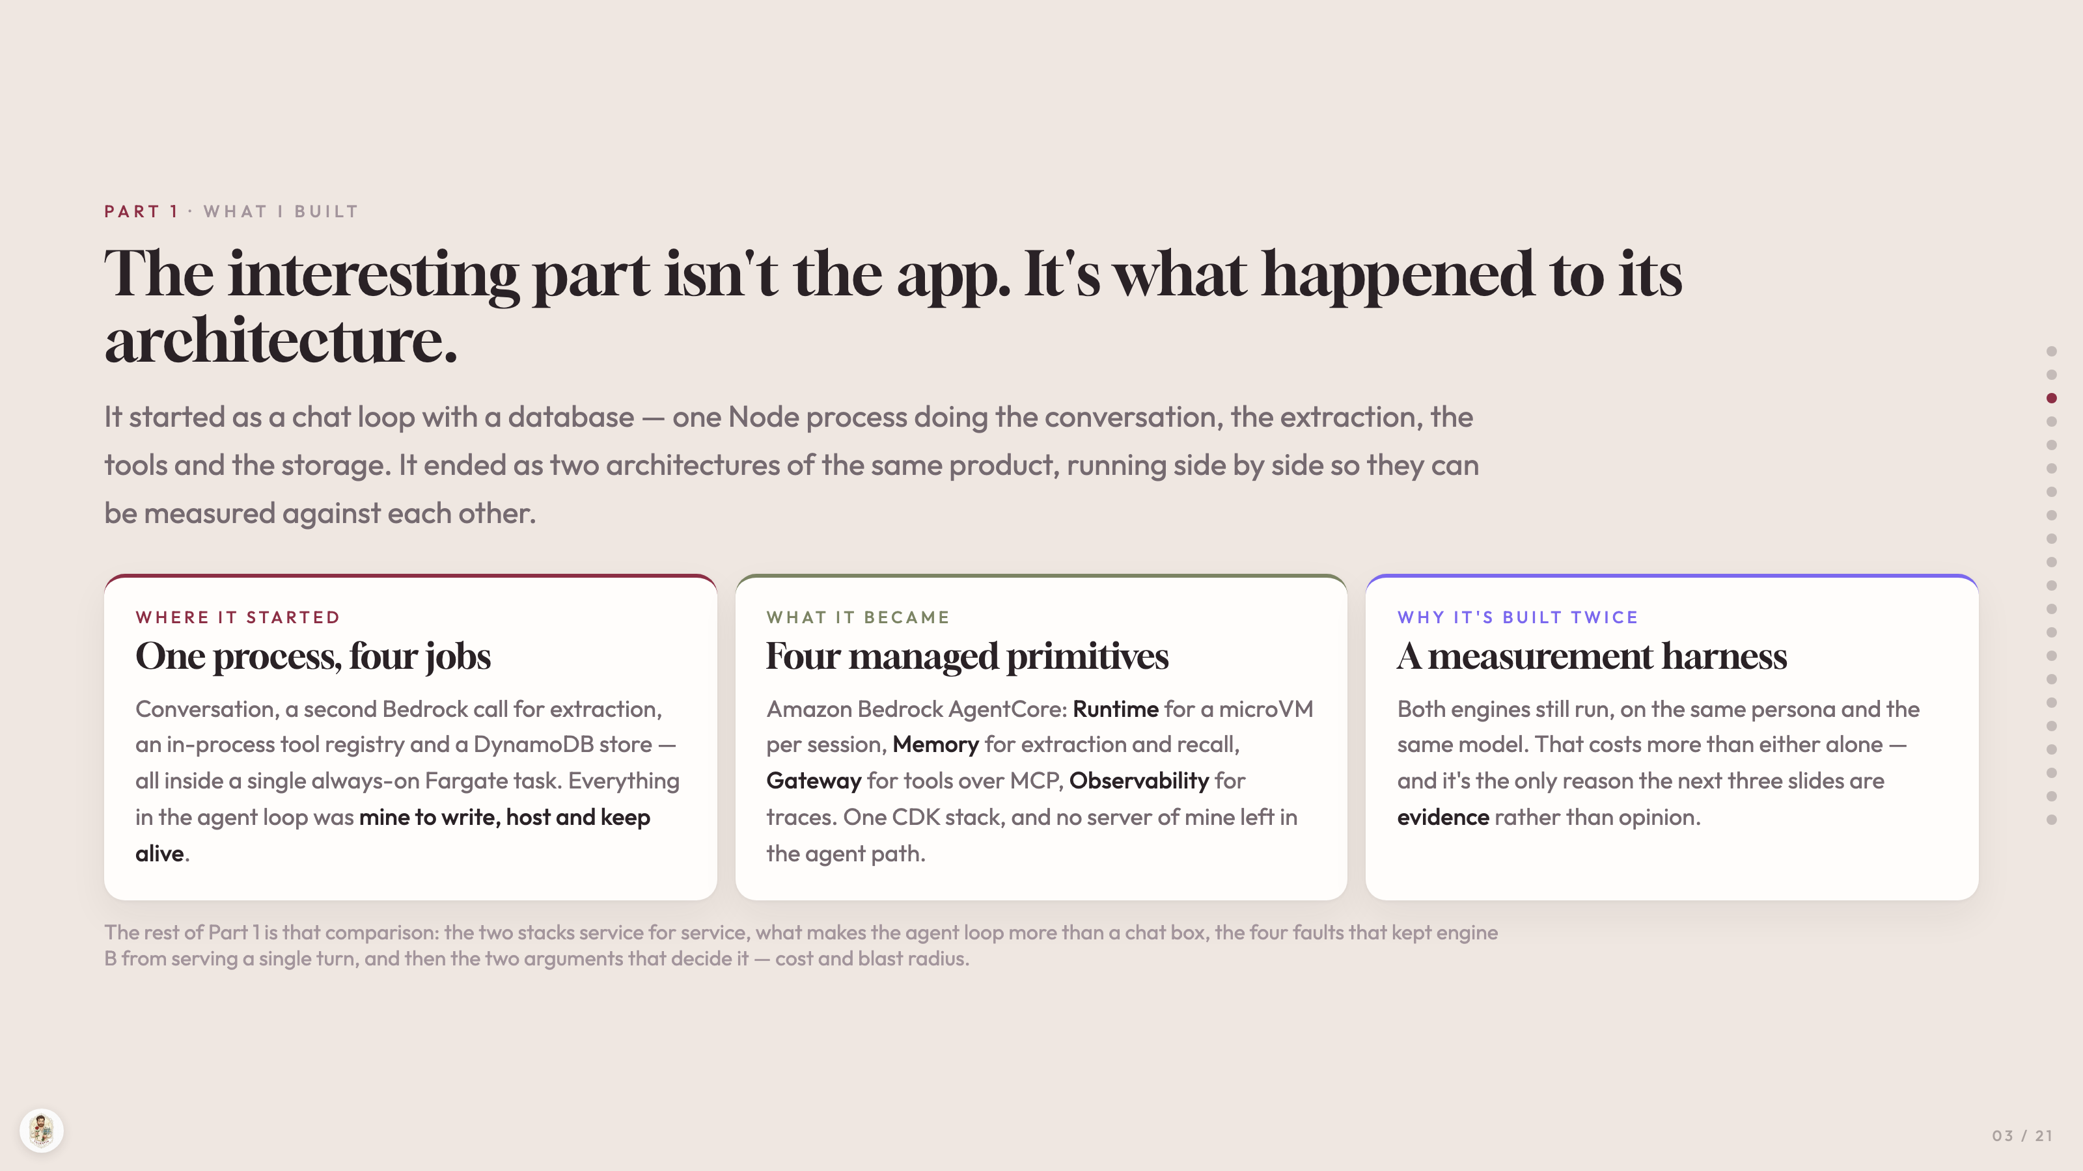
Notes:
PART 1 · WHAT I BUILT
The interesting part isn't the app. It's what happened to its architecture.
It started as a chat loop with a database — one Node process doing the conversation, the extraction, the tools and the storage. It ended as two architectures of the same product, running side by side so they can be measured against each other.
WHERE IT STARTED
One process, four jobs
Conversation, a second Bedrock call for extraction, an in-process tool registry and a DynamoDB store — all inside a single always-on Fargate task. Everything in the agent loop was mine to write, host and keep alive.
WHAT IT BECAME
Four managed primitives
Amazon Bedrock AgentCore: Runtime for a microVM per session, Memory for extraction and recall, Gateway for tools over MCP, Observability for traces. One CDK stack, and no server of mine left in the agent path.
WHY IT'S BUILT TWICE
A measurement harness
Both engines still run, on the same persona and the same model. That costs more than either alone — and it's the only reason the next three slides are evidence rather than opinion.
The rest of Part 1 is that comparison: the two stacks service for service, what makes the agent loop more than a chat box, the four faults that kept engine B from serving a single turn, and then the two arguments that decide it — cost and blast radius.

Slide 4
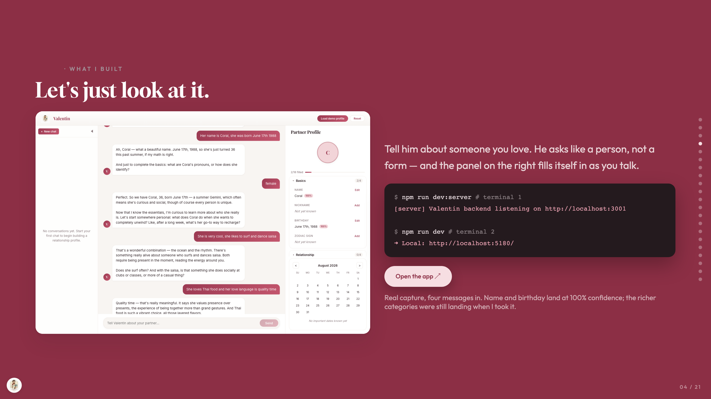
Notes:
PART 1 · WHAT I BUILT
Let's just look at it.
Tell him about someone you love. He asks like a person, not a form — and the panel on the right fills itself in as you talk.
$ npm run dev:server # terminal 1
[server] Valentin backend listening on http://localhost:3001
$ npm run dev # terminal 2
➜ Local: http://localhost:5180/
Open the app ↗
Real capture, four messages in. Name and birthday land at 100% confidence; the richer categories were still landing when I took it.

Slide 5
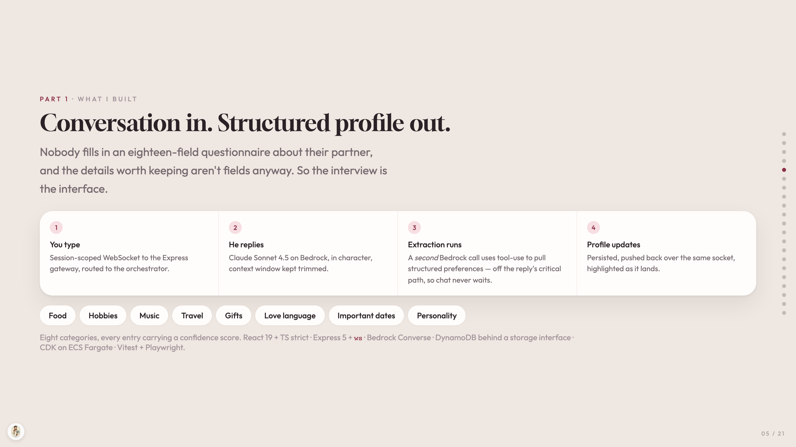
Notes:
PART 1 · WHAT I BUILT
Conversation in. Structured profile out.
Nobody fills in an eighteen-field questionnaire about their partner, and the details worth keeping aren't fields anyway. So the interview is the interface.
1
You type
Session-scoped WebSocket to the Express gateway, routed to the orchestrator.
2
He replies
Claude Sonnet 4.5 on Bedrock, in character, context window kept trimmed.
3
Extraction runs
A second Bedrock call uses tool-use to pull structured preferences — off the reply's critical path, so chat never waits.
4
Profile updates
Persisted, pushed back over the same socket, highlighted as it lands.
Food
Hobbies
Music
Travel
Gifts
Love language
Important dates
Personality
Eight categories, every entry carrying a confidence score. React 19 + TS strict · Express 5 + ws · Bedrock Converse · DynamoDB behind a storage interface · CDK on ECS Fargate · Vitest + Playwright.

Slide 6
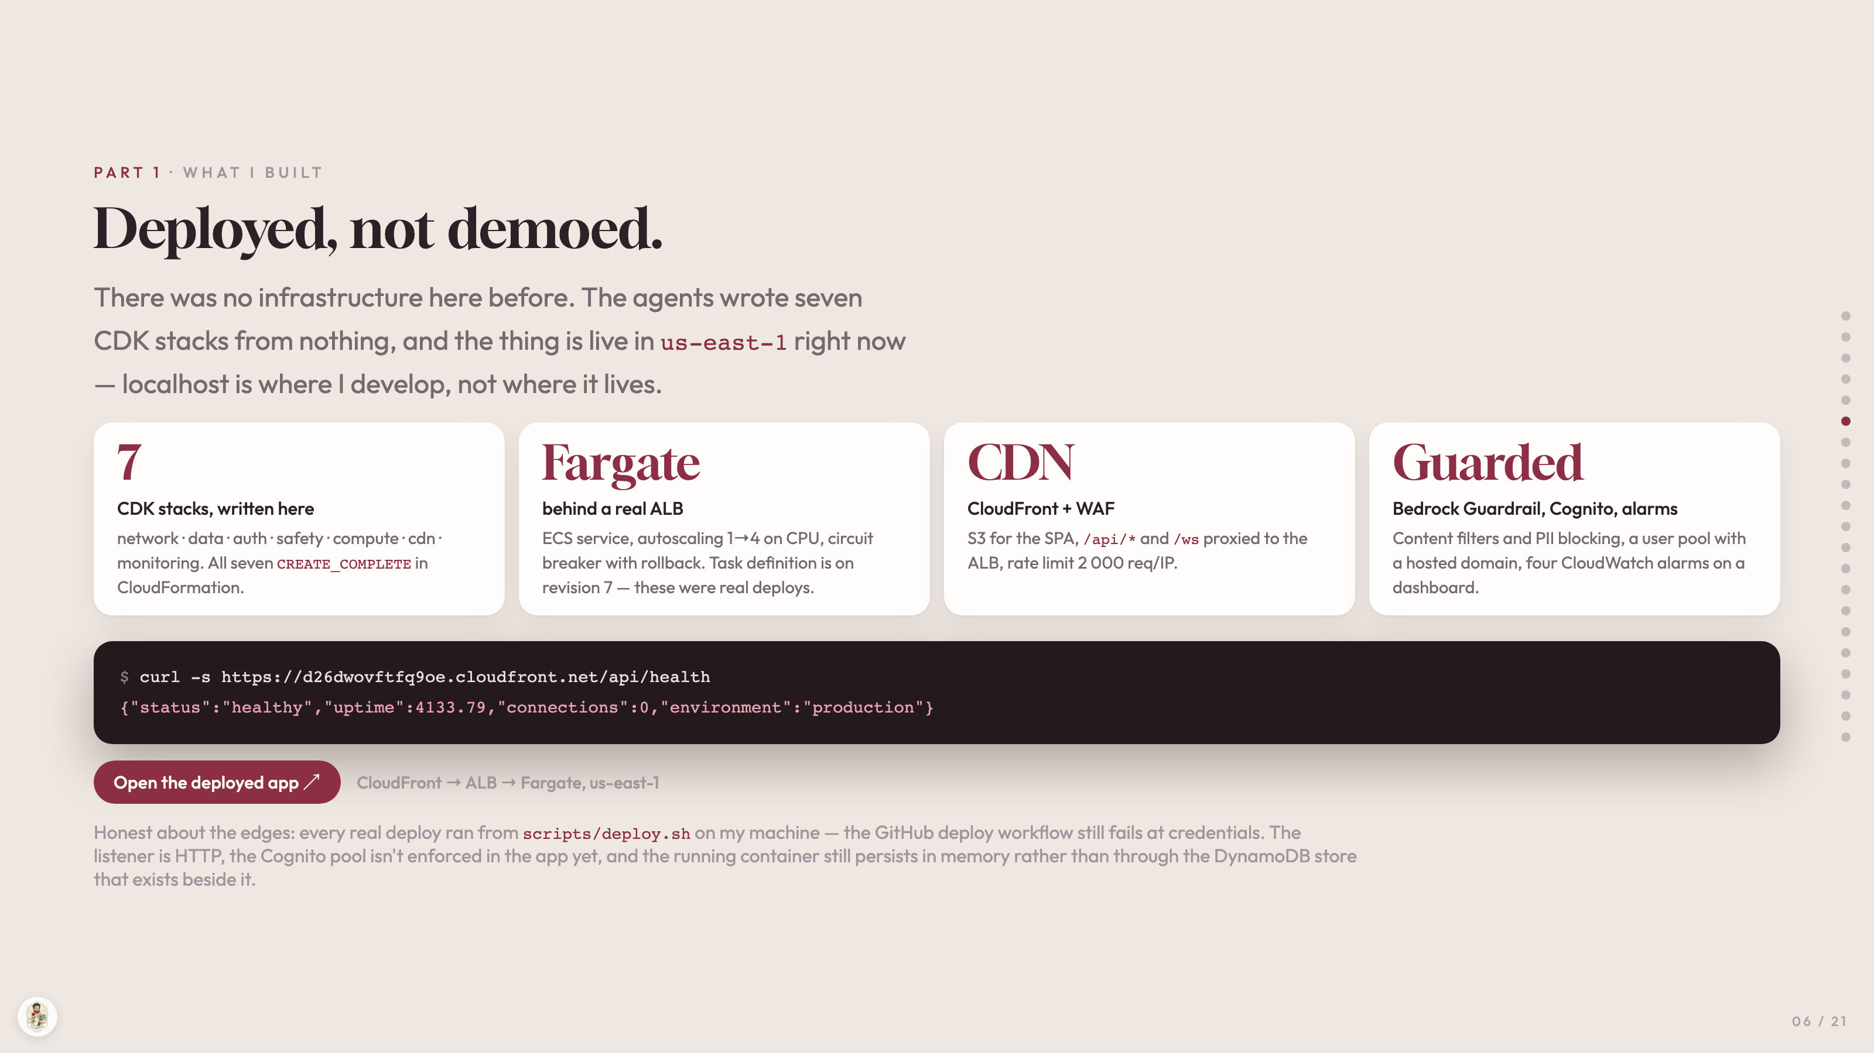
Notes:
PART 1 · WHAT I BUILT
Deployed, not demoed.
There was no infrastructure here before. The agents wrote seven CDK stacks from nothing, and the thing is live in us-east-1 right now — localhost is where I develop, not where it lives.
7
CDK stacks, written here
network · data · auth · safety · compute · cdn · monitoring. All seven CREATE_COMPLETE in CloudFormation.
Fargate
behind a real ALB
ECS service, autoscaling 1→4 on CPU, circuit breaker with rollback. Task definition is on revision 7 — these were real deploys.
CDN
CloudFront + WAF
S3 for the SPA, /api/* and /ws proxied to the ALB, rate limit 2 000 req/IP.
Guarded
Bedrock Guardrail, Cognito, alarms
Content filters and PII blocking, a user pool with a hosted domain, four CloudWatch alarms on a dashboard.
$ curl -s https://d26dwovftfq9oe.cloudfront.net/api/health
{"status":"healthy","uptime":4133.79,"connections":0,"environment":"production"}
Open the deployed app ↗
CloudFront → ALB → Fargate, us-east-1
Honest about the edges: every real deploy ran from scripts/deploy.sh on my machine — the GitHub deploy workflow still fails at credentials. The listener is HTTP, the Cognito pool isn't enforced in the app yet, and the running container still persists in memory rather than through the DynamoDB store that exists beside it.

Slide 7
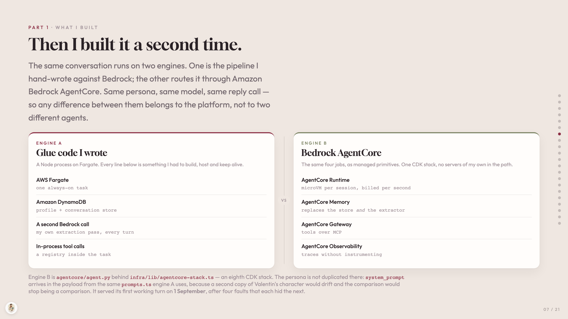
Notes:
PART 1 · WHAT I BUILT
Then I built it a second time.
The same conversation runs on two engines. One is the pipeline I hand-wrote against Bedrock; the other routes it through Amazon Bedrock AgentCore. Same persona, same model, same reply call — so any difference between them belongs to the platform, not to two different agents.
ENGINE A
Glue code I wrote
A Node process on Fargate. Every line below is something I had to build, host and keep alive.
AWS Fargate
one always-on task
Amazon DynamoDB
profile + conversation store
A second Bedrock call
my own extraction pass, every turn
In-process tool calls
a registry inside the task
VS
ENGINE B
Bedrock AgentCore
The same four jobs, as managed primitives. One CDK stack, no servers of my own in the path.
AgentCore Runtime
microVM per session, billed per second
AgentCore Memory
replaces the store and the extractor
AgentCore Gateway
tools over MCP
AgentCore Observability
traces without instrumenting
Engine B is agentcore/agent.py behind infra/lib/agentcore-stack.ts — an eighth CDK stack. The persona is not duplicated there: system_prompt arrives in the payload from the same prompts.ts engine A uses, because a second copy of Valentin's character would drift and the comparison would stop being a comparison. It served its first working turn on 1 September, after four faults that each hid the next.

Slide 8
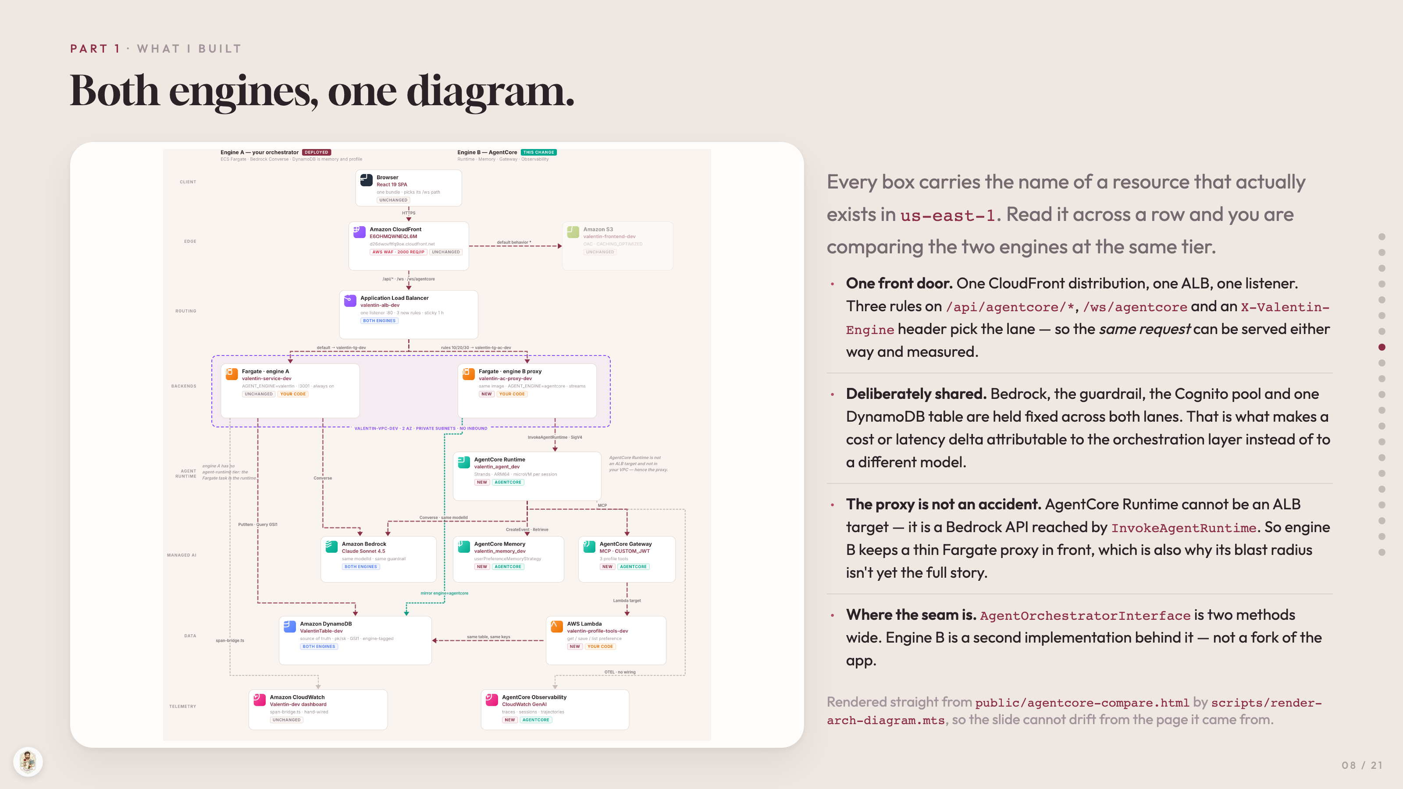
Notes:
PART 1 · WHAT I BUILT
Both engines, one diagram.
Every box carries the name of a resource that actually exists in us-east-1. Read it across a row and you are comparing the two engines at the same tier.
One front door. One CloudFront distribution, one ALB, one listener. Three rules on /api/agentcore/*, /ws/agentcore and an X-Valentin-Engine header pick the lane — so the same request can be served either way and measured.
Deliberately shared. Bedrock, the guardrail, the Cognito pool and one DynamoDB table are held fixed across both lanes. That is what makes a cost or latency delta attributable to the orchestration layer instead of to a different model.
The proxy is not an accident. AgentCore Runtime cannot be an ALB target — it is a Bedrock API reached by InvokeAgentRuntime. So engine B keeps a thin Fargate proxy in front, which is also why its blast radius isn't yet the full story.
Where the seam is. AgentOrchestratorInterface is two methods wide. Engine B is a second implementation behind it — not a fork of the app.
Rendered straight from public/agentcore-compare.html by scripts/render-arch-diagram.mts, so the slide cannot drift from the page it came from.

Slide 9
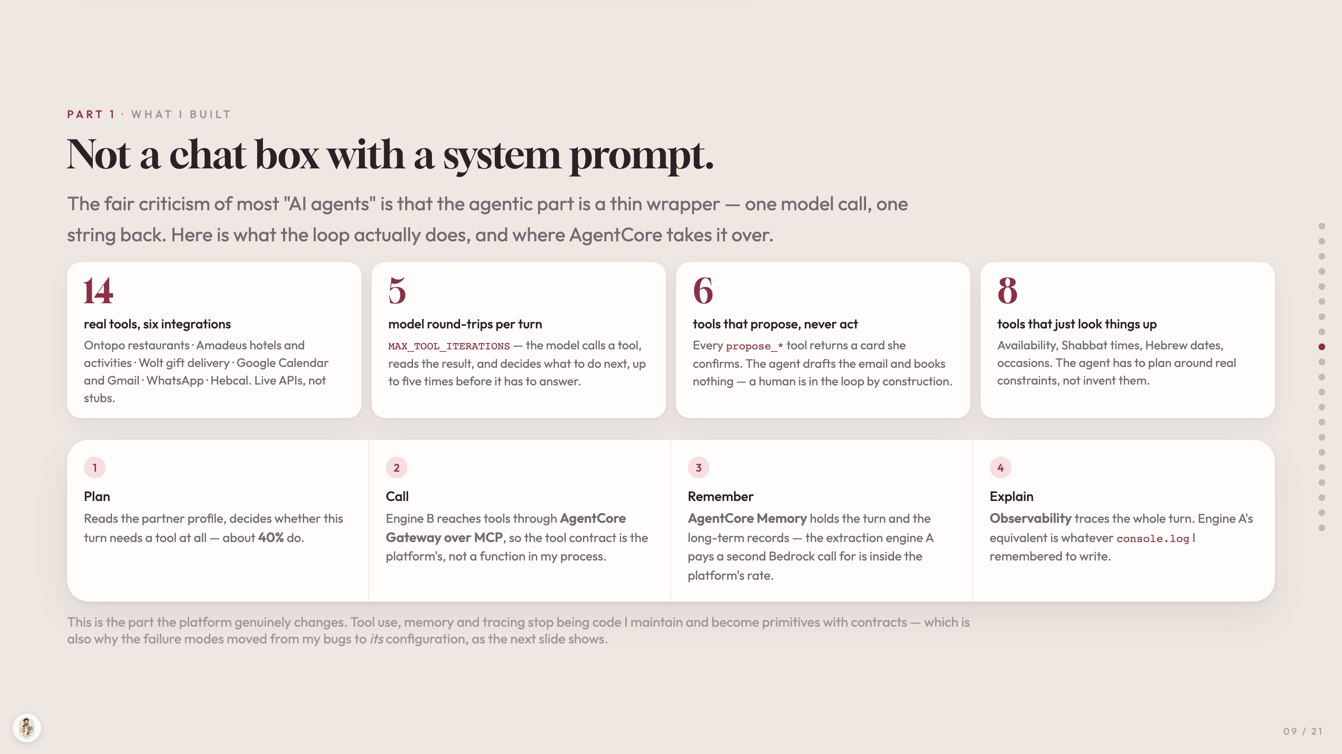
Notes:
PART 1 · WHAT I BUILT
Not a chat box with a system prompt.
The fair criticism of most "AI agents" is that the agentic part is a thin wrapper — one model call, one string back. Here is what the loop actually does, and where AgentCore takes it over.
14
real tools, six integrations
Ontopo restaurants · Amadeus hotels and activities · Wolt gift delivery · Google Calendar and Gmail · WhatsApp · Hebcal. Live APIs, not stubs.
5
model round-trips per turn
MAX_TOOL_ITERATIONS — the model calls a tool, reads the result, and decides what to do next, up to five times before it has to answer.
6
tools that propose, never act
Every propose_* tool returns a card she confirms. The agent drafts the email and books nothing — a human is in the loop by construction.
8
tools that just look things up
Availability, Shabbat times, Hebrew dates, occasions. The agent has to plan around real constraints, not invent them.
1
Plan
Reads the partner profile, decides whether this turn needs a tool at all — about 40% do.
2
Call
Engine B reaches tools through AgentCore Gateway over MCP, so the tool contract is the platform's, not a function in my process.
3
Remember
AgentCore Memory holds the turn and the long-term records — the extraction engine A pays a second Bedrock call for is inside the platform's rate.
4
Explain
Observability traces the whole turn. Engine A's equivalent is whatever console.log I remembered to write.
This is the part the platform genuinely changes. Tool use, memory and tracing stop being code I maintain and become primitives with contracts — which is also why the failure modes moved from my bugs to its configuration, as the next slide shows.

Slide 10
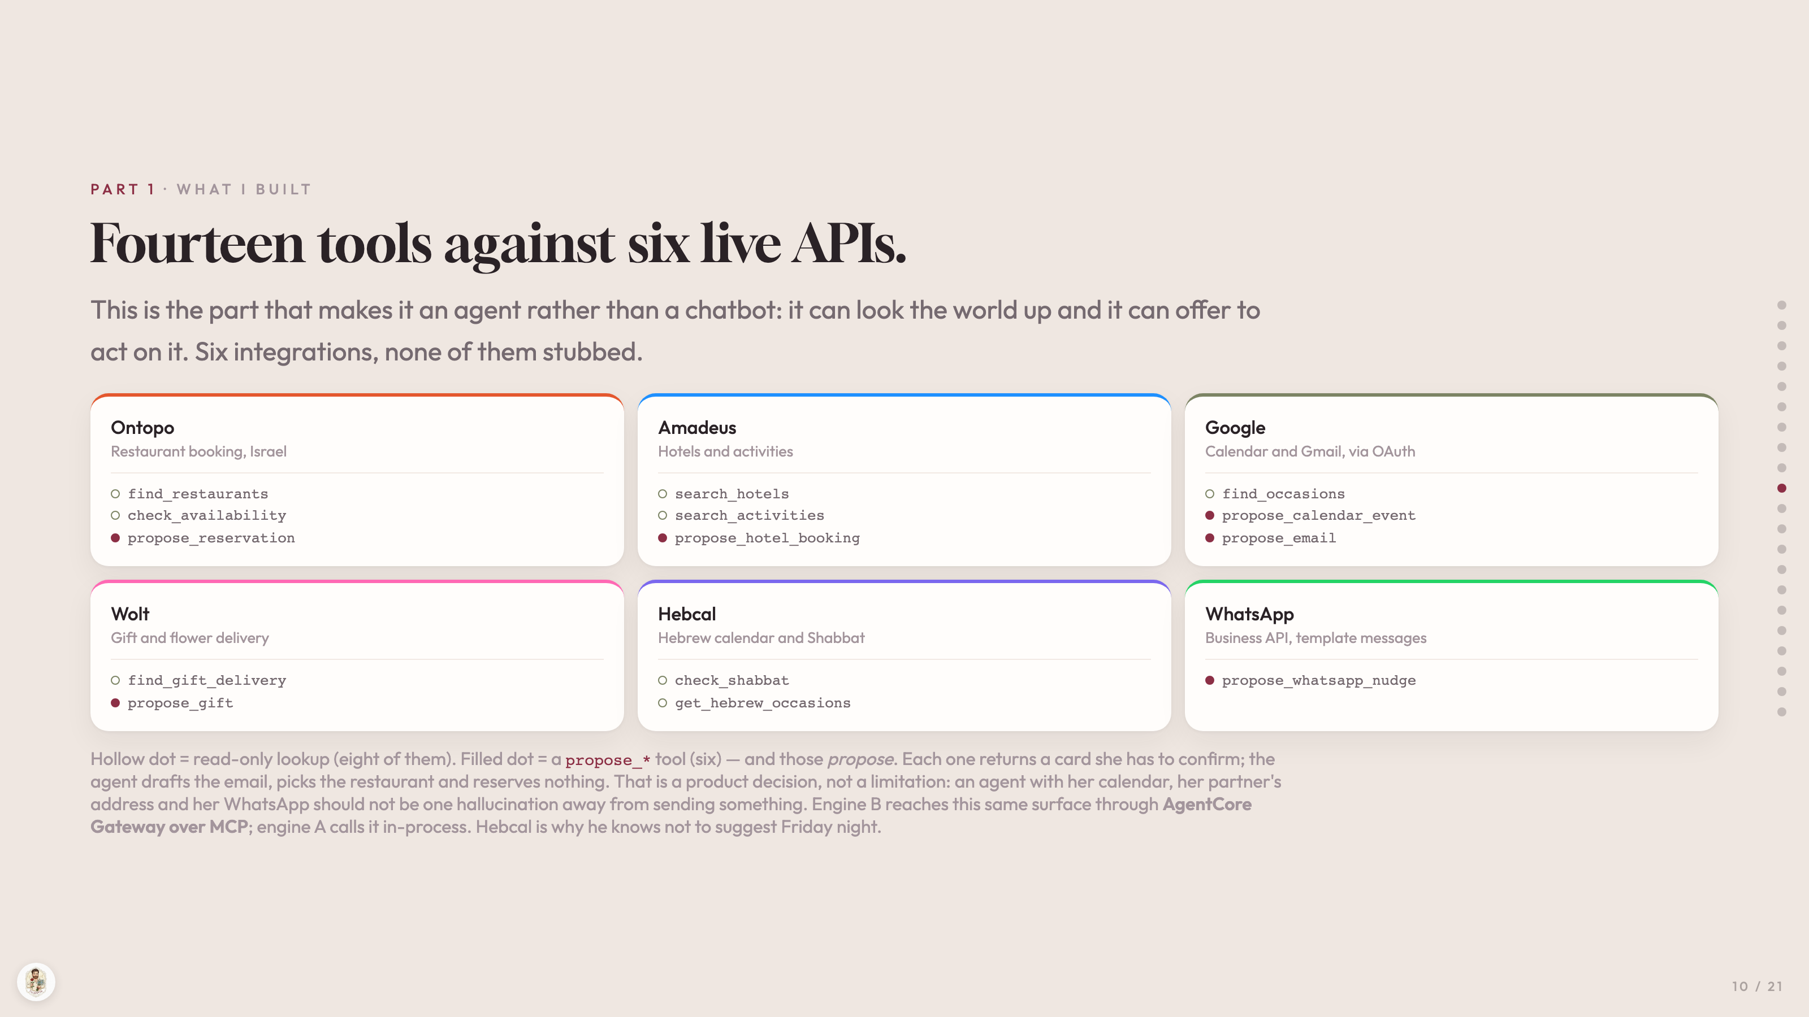
Notes:
PART 1 · WHAT I BUILT
Fourteen tools against six live APIs.
This is the part that makes it an agent rather than a chatbot: it can look the world up and it can offer to act on it. Six integrations, none of them stubbed.
Ontopo
Restaurant booking, Israel
find_restaurants
check_availability
propose_reservation
Amadeus
Hotels and activities
search_hotels
search_activities
propose_hotel_booking
Google
Calendar and Gmail, via OAuth
find_occasions
propose_calendar_event
propose_email
Wolt
Gift and flower delivery
find_gift_delivery
propose_gift
Hebcal
Hebrew calendar and Shabbat
check_shabbat
get_hebrew_occasions
WhatsApp
Business API, template messages
propose_whatsapp_nudge
Hollow dot = read-only lookup (eight of them). Filled dot = a propose_* tool (six) — and those propose. Each one returns a card she has to confirm; the agent drafts the email, picks the restaurant and reserves nothing. That is a product decision, not a limitation: an agent with her calendar, her partner's address and her WhatsApp should not be one hallucination away from sending something. Engine B reaches this same surface through AgentCore Gateway over MCP; engine A calls it in-process. Hebcal is why he knows not to suggest Friday night.

Slide 11
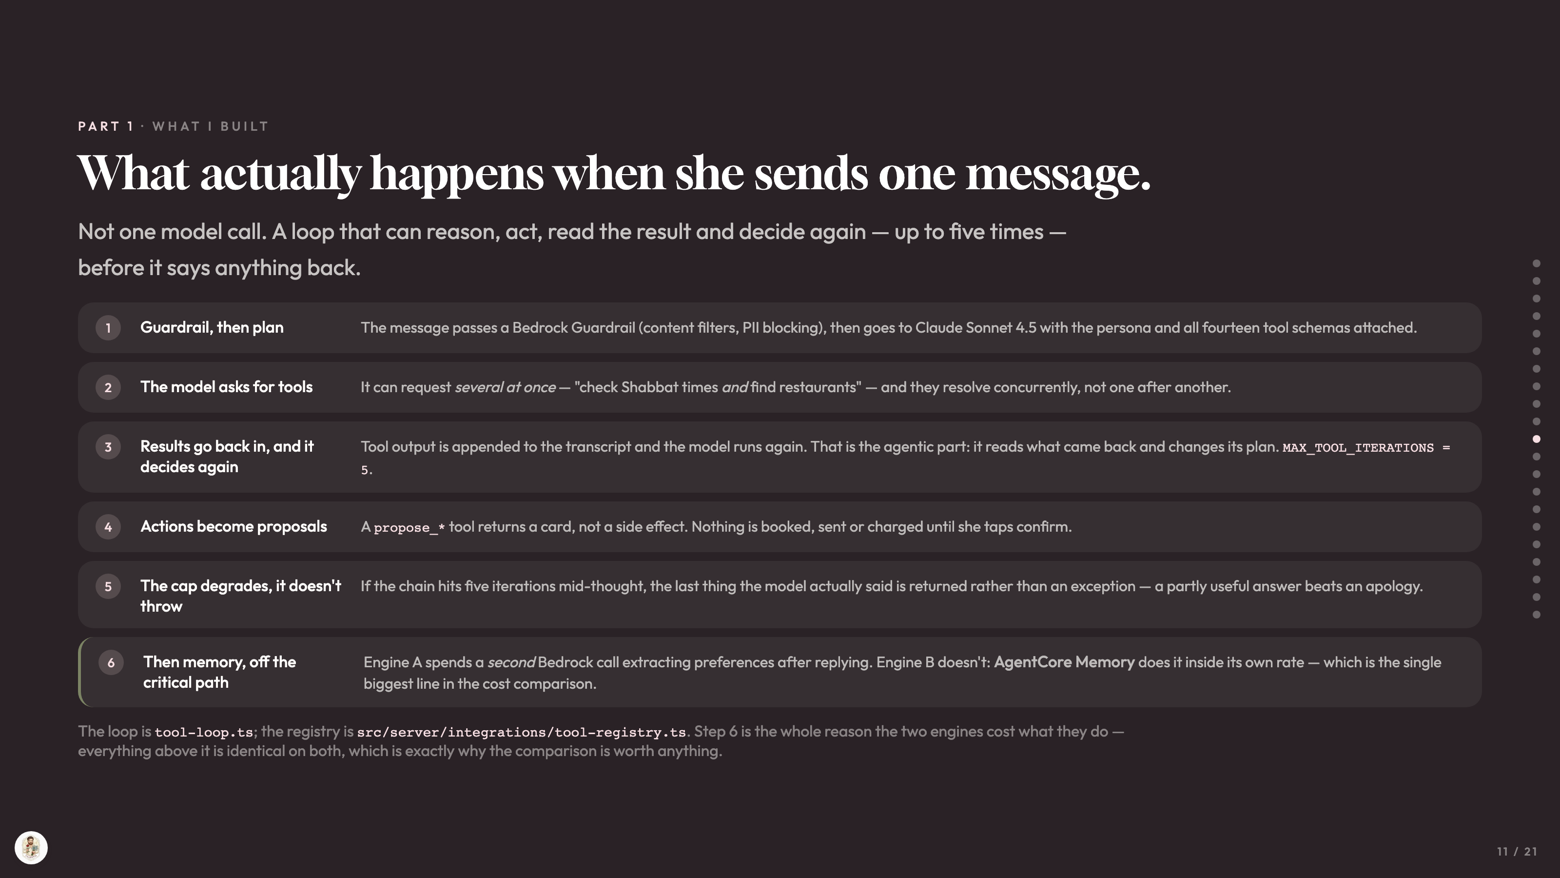
Notes:
PART 1 · WHAT I BUILT
What actually happens when she sends one message.
Not one model call. A loop that can reason, act, read the result and decide again — up to five times — before it says anything back.
1
Guardrail, then plan
The message passes a Bedrock Guardrail (content filters, PII blocking), then goes to Claude Sonnet 4.5 with the persona and all fourteen tool schemas attached.
2
The model asks for tools
It can request several at once — "check Shabbat times and find restaurants" — and they resolve concurrently, not one after another.
3
Results go back in, and it decides again
Tool output is appended to the transcript and the model runs again. That is the agentic part: it reads what came back and changes its plan. MAX_TOOL_ITERATIONS = 5.
4
Actions become proposals
A propose_* tool returns a card, not a side effect. Nothing is booked, sent or charged until she taps confirm.
5
The cap degrades, it doesn't throw
If the chain hits five iterations mid-thought, the last thing the model actually said is returned rather than an exception — a partly useful answer beats an apology.
6
Then memory, off the critical path
Engine A spends a second Bedrock call extracting preferences after replying. Engine B doesn't: AgentCore Memory does it inside its own rate — which is the single biggest line in the cost comparison.
The loop is tool-loop.ts; the registry is src/server/integrations/tool-registry.ts. Step 6 is the whole reason the two engines cost what they do — everything above it is identical on both, which is exactly why the comparison is worth anything.

Slide 12
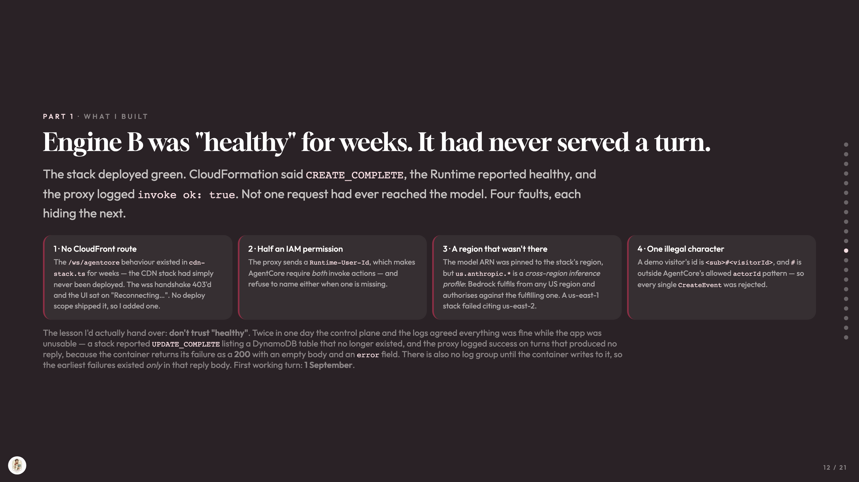
Notes:
PART 1 · WHAT I BUILT
Engine B was "healthy" for weeks. It had never served a turn.
The stack deployed green. CloudFormation said CREATE_COMPLETE, the Runtime reported healthy, and the proxy logged invoke ok: true. Not one request had ever reached the model. Four faults, each hiding the next.
1 · No CloudFront route
The /ws/agentcore behaviour existed in cdn-stack.ts for weeks — the CDN stack had simply never been deployed. The wss handshake 403'd and the UI sat on "Reconnecting…". No deploy scope shipped it, so I added one.
2 · Half an IAM permission
The proxy sends a Runtime-User-Id, which makes AgentCore require both invoke actions — and refuse to name either when one is missing.
3 · A region that wasn't there
The model ARN was pinned to the stack's region, but us.anthropic.* is a cross-region inference profile: Bedrock fulfils from any US region and authorises against the fulfilling one. A us-east-1 stack failed citing us-east-2.
4 · One illegal character
A demo visitor's id is <sub>#<visitorId>, and # is outside AgentCore's allowed actorId pattern — so every single CreateEvent was rejected.
The lesson I'd actually hand over: don't trust "healthy". Twice in one day the control plane and the logs agreed everything was fine while the app was unusable — a stack reported UPDATE_COMPLETE listing a DynamoDB table that no longer existed, and the proxy logged success on turns that produced no reply, because the container returns its failure as a 200 with an empty body and an error field. There is also no log group until the container writes to it, so the earliest failures existed only in that reply body. First working turn: 1 September.

Slide 13
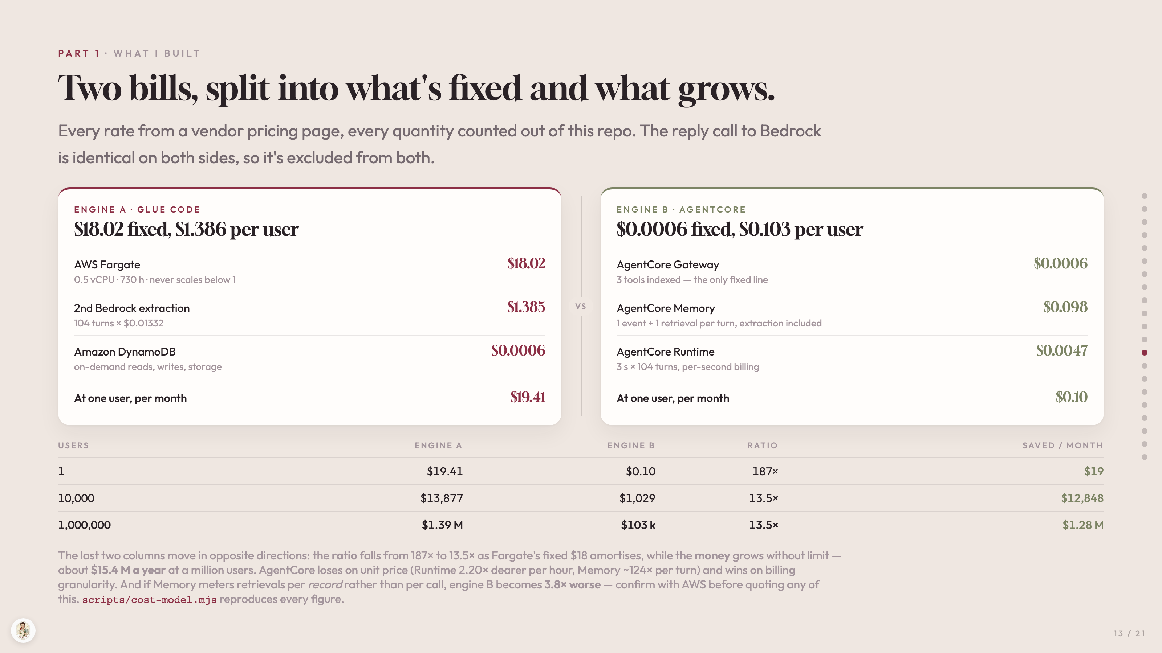
Notes:
PART 1 · WHAT I BUILT
Two bills, split into what's fixed and what grows.
Every rate from a vendor pricing page, every quantity counted out of this repo. The reply call to Bedrock is identical on both sides, so it's excluded from both.
ENGINE A · GLUE CODE
$18.02 fixed, $1.386 per user
AWS Fargate
0.5 vCPU · 730 h · never scales below 1
$18.02
2nd Bedrock extraction
104 turns × $0.01332
$1.385
Amazon DynamoDB
on-demand reads, writes, storage
$0.0006
At one user, per month
$19.41
VS
ENGINE B · AGENTCORE
$0.0006 fixed, $0.103 per user
AgentCore Gateway
3 tools indexed — the only fixed line
$0.0006
AgentCore Memory
1 event + 1 retrieval per turn, extraction included
$0.098
AgentCore Runtime
3 s × 104 turns, per-second billing
$0.0047
At one user, per month
$0.10
USERS ENGINE A ENGINE B RATIO SAVED / MONTH
1 $19.41 $0.10 187× $19
10,000 $13,877 $1,029 13.5× $12,848
1,000,000 $1.39 M $103 k 13.5× $1.28 M
The last two columns move in opposite directions: the ratio falls from 187× to 13.5× as Fargate's fixed $18 amortises, while the money grows without limit — about $15.4 M a year at a million users. AgentCore loses on unit price (Runtime 2.20× dearer per hour, Memory ~124× per turn) and wins on billing granularity. And if Memory meters retrievals per record rather than per call, engine B becomes 3.8× worse — confirm with AWS before quoting any of this. scripts/cost-model.mjs reproduces every figure.

Slide 14
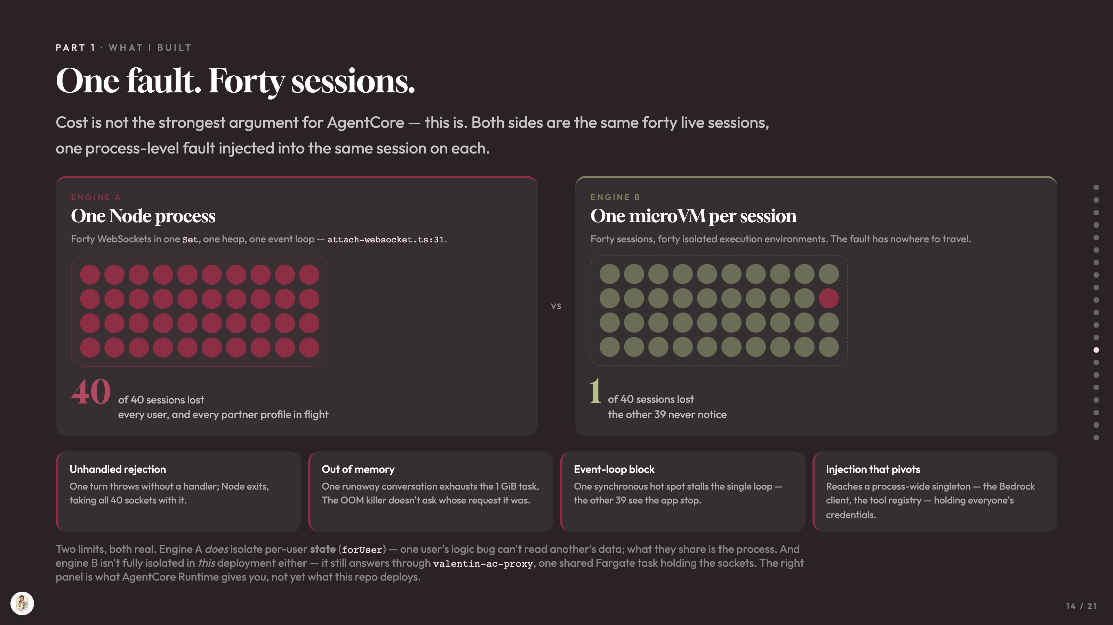
Notes:
PART 1 · WHAT I BUILT
One fault. Forty sessions.
Cost is not the strongest argument for AgentCore — this is. Both sides are the same forty live sessions, one process-level fault injected into the same session on each.
ENGINE A
One Node process
Forty WebSockets in one Set, one heap, one event loop — attach-websocket.ts:31.
40
of 40 sessions lost
every user, and every partner profile in flight
VS
ENGINE B
One microVM per session
Forty sessions, forty isolated execution environments. The fault has nowhere to travel.
1
of 40 sessions lost
the other 39 never notice
Unhandled rejection
One turn throws without a handler; Node exits, taking all 40 sockets with it.
Out of memory
One runaway conversation exhausts the 1 GiB task. The OOM killer doesn't ask whose request it was.
Event-loop block
One synchronous hot spot stalls the single loop — the other 39 see the app stop.
Injection that pivots
Reaches a process-wide singleton — the Bedrock client, the tool registry — holding everyone's credentials.
Two limits, both real. Engine A does isolate per-user state (forUser) — one user's logic bug can't read another's data; what they share is the process. And engine B isn't fully isolated in this deployment either — it still answers through valentin-ac-proxy, one shared Fargate task holding the sockets. The right panel is what AgentCore Runtime gives you, not yet what this repo deploys.

Slide 15
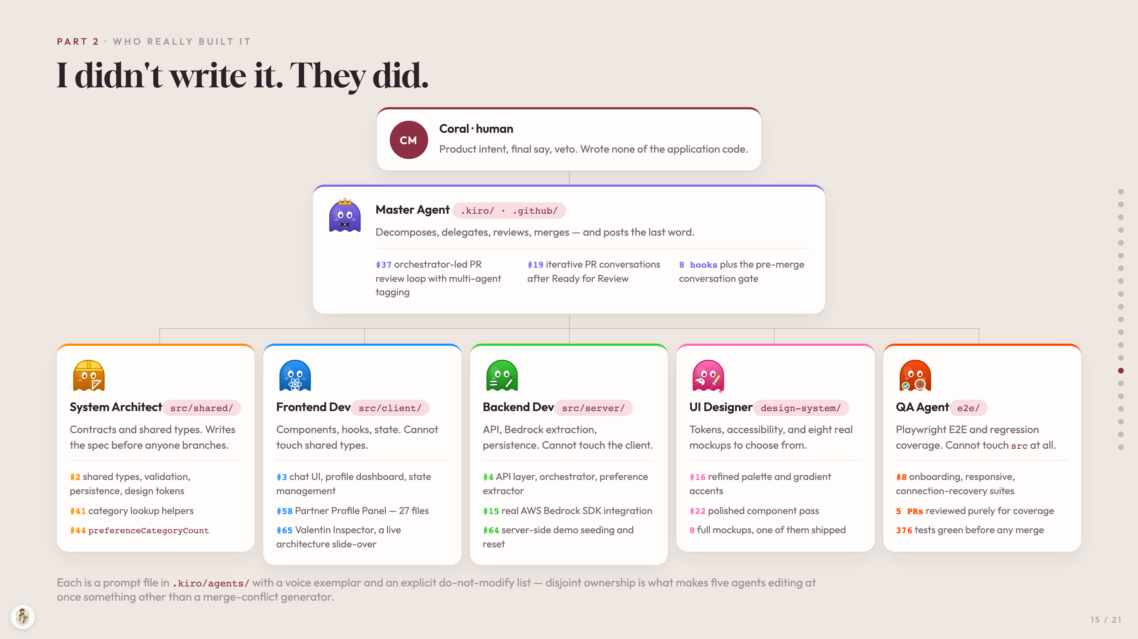
Notes:
PART 2 · WHO REALLY BUILT IT
I didn't write it. They did.
CM
Coral · human
Product intent, final say, veto. Wrote none of the application code.
Master Agent .kiro/ · .github/
Decomposes, delegates, reviews, merges — and posts the last word.
#37 orchestrator-led PR review loop with multi-agent tagging
#19 iterative PR conversations after Ready for Review
8 hooks plus the pre-merge conversation gate
System Architectsrc/shared/
Contracts and shared types. Writes the spec before anyone branches.
#2 shared types, validation, persistence, design tokens
#41 category lookup helpers
#44 preferenceCategoryCount
Frontend Devsrc/client/
Components, hooks, state. Cannot touch shared types.
#3 chat UI, profile dashboard, state management
#58 Partner Profile Panel — 27 files
#65 Valentin Inspector, a live architecture slide-over
Backend Devsrc/server/
API, Bedrock extraction, persistence. Cannot touch the client.
#4 API layer, orchestrator, preference extractor
#15 real AWS Bedrock SDK integration
#64 server-side demo seeding and reset
UI Designerdesign-system/
Tokens, accessibility, and eight real mockups to choose from.
#16 refined palette and gradient accents
#22 polished component pass
8 full mockups, one of them shipped
QA Agente2e/
Playwright E2E and regression coverage. Cannot touch src at all.
#8 onboarding, responsive, connection-recovery suites
5 PRs reviewed purely for coverage
376 tests green before any merge
Each is a prompt file in .kiro/agents/ with a voice exemplar and an explicit do-not-modify list — disjoint ownership is what makes five agents editing at once something other than a merge-conflict generator.

Slide 16
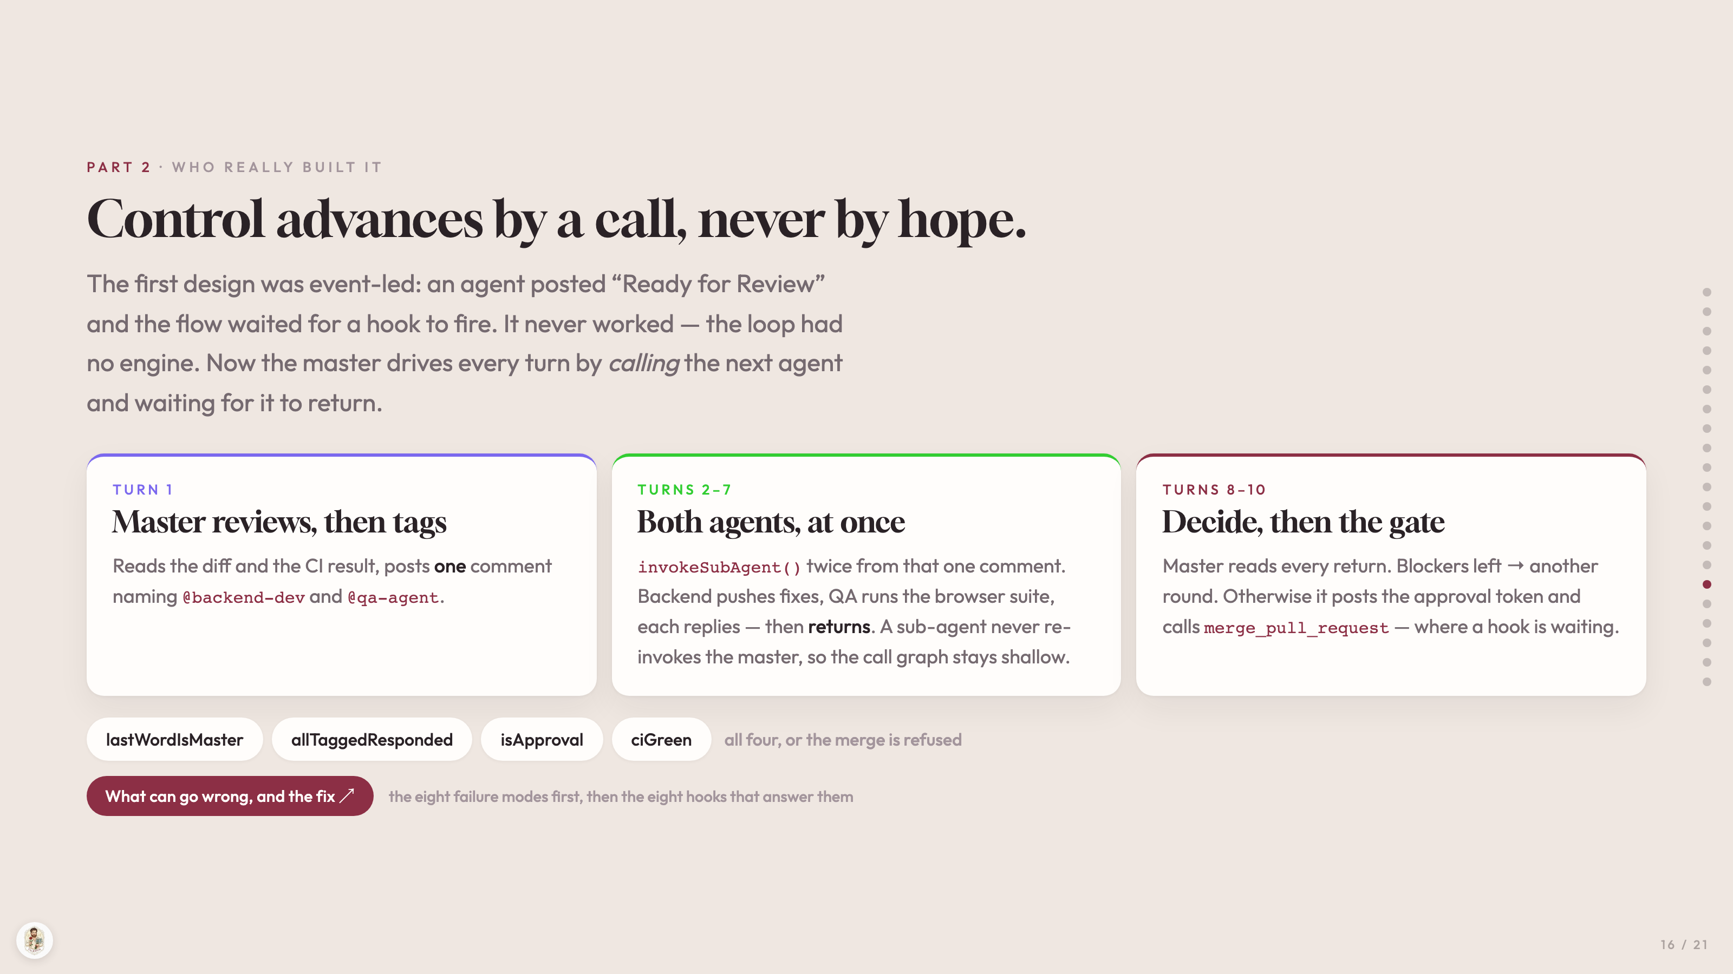
Notes:
PART 2 · WHO REALLY BUILT IT
Control advances by a call, never by hope.
The first design was event-led: an agent posted “Ready for Review” and the flow waited for a hook to fire. It never worked — the loop had no engine. Now the master drives every turn by calling the next agent and waiting for it to return.
TURN 1
Master reviews, then tags
Reads the diff and the CI result, posts one comment naming @backend-dev and @qa-agent.
TURNS 2–7
Both agents, at once
invokeSubAgent() twice from that one comment. Backend pushes fixes, QA runs the browser suite, each replies — then returns. A sub-agent never re-invokes the master, so the call graph stays shallow.
TURNS 8–10
Decide, then the gate
Master reads every return. Blockers left → another round. Otherwise it posts the approval token and calls merge_pull_request — where a hook is waiting.
lastWordIsMaster
allTaggedResponded
isApproval
ciGreen
all four, or the merge is refused
What can go wrong, and the fix ↗
the eight failure modes first, then the eight hooks that answer them

Slide 17
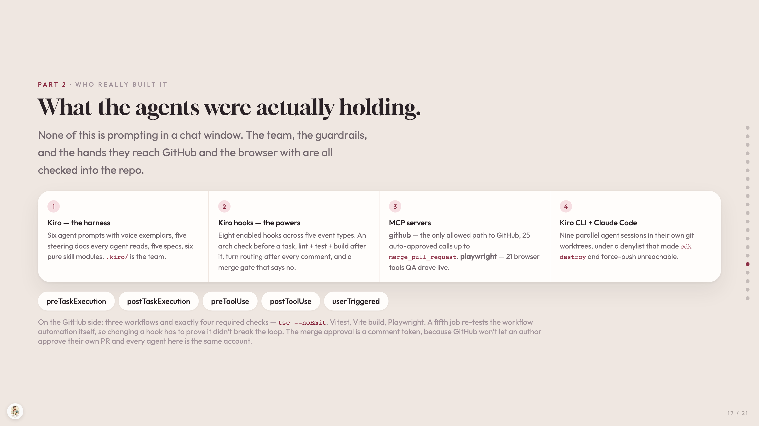
Notes:
PART 2 · WHO REALLY BUILT IT
What the agents were actually holding.
None of this is prompting in a chat window. The team, the guardrails, and the hands they reach GitHub and the browser with are all checked into the repo.
1
Kiro — the harness
Six agent prompts with voice exemplars, five steering docs every agent reads, five specs, six pure skill modules. .kiro/ is the team.
2
Kiro hooks — the powers
Eight enabled hooks across five event types. An arch check before a task, lint + test + build after it, turn routing after every comment, and a merge gate that says no.
3
MCP servers
github — the only allowed path to GitHub, 25 auto-approved calls up to merge_pull_request. playwright — 21 browser tools QA drove live.
4
Kiro CLI + Claude Code
Nine parallel agent sessions in their own git worktrees, under a denylist that made cdk destroy and force-push unreachable.
preTaskExecution
postTaskExecution
preToolUse
postToolUse
userTriggered
On the GitHub side: three workflows and exactly four required checks — tsc --noEmit, Vitest, Vite build, Playwright. A fifth job re-tests the workflow automation itself, so changing a hook has to prove it didn't break the loop. The merge approval is a comment token, because GitHub won't let an author approve their own PR and every agent here is the same account.

Slide 18
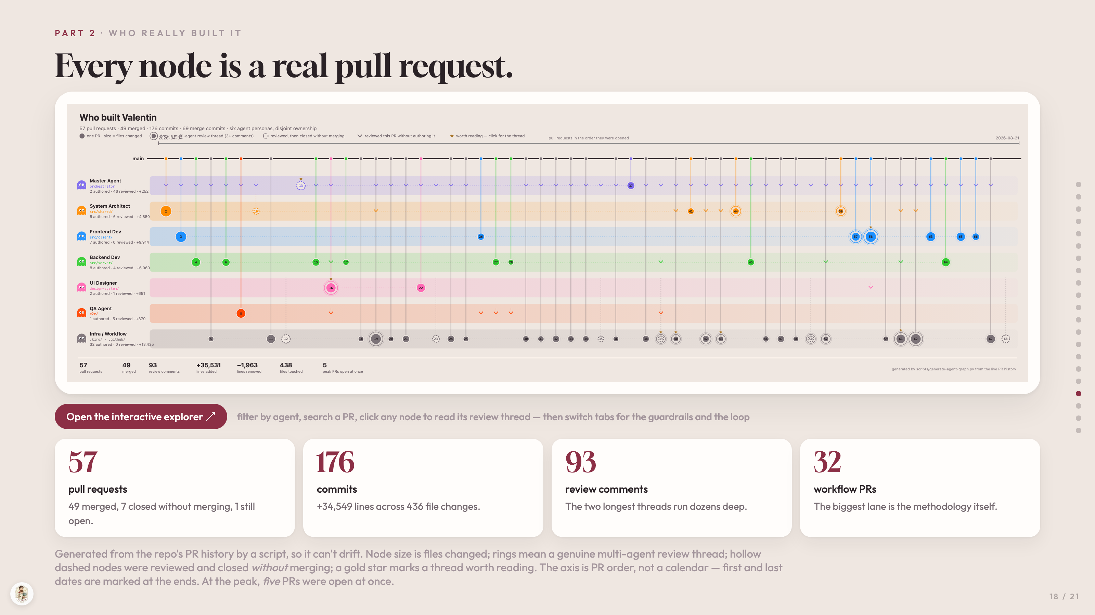
Notes:
PART 2 · WHO REALLY BUILT IT
Every node is a real pull request.
Open the interactive explorer ↗
filter by agent, search a PR, click any node to read its review thread — then switch tabs for the guardrails and the loop
57
pull requests
49 merged, 7 closed without merging, 1 still open.
176
commits
+34,549 lines across 436 file changes.
93
review comments
The two longest threads run dozens deep.
32
workflow PRs
The biggest lane is the methodology itself.
Generated from the repo's PR history by a script, so it can't drift. Node size is files changed; rings mean a genuine multi-agent review thread; hollow dashed nodes were reviewed and closed without merging; a gold star marks a thread worth reading. The axis is PR order, not a calendar — first and last dates are marked at the ends. At the peak, five PRs were open at once.

Slide 19
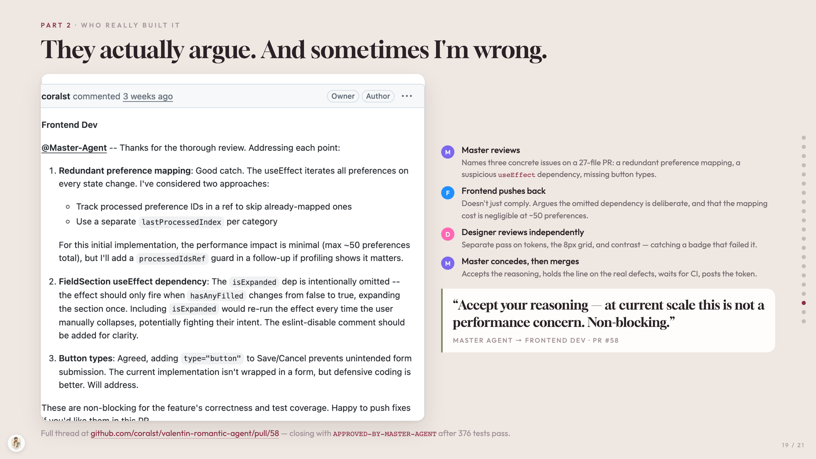
Notes:
PART 2 · WHO REALLY BUILT IT
They actually argue. And sometimes I'm wrong.
M
Master reviews
Names three concrete issues on a 27-file PR: a redundant preference mapping, a suspicious useEffect dependency, missing button types.
F
Frontend pushes back
Doesn't just comply. Argues the omitted dependency is deliberate, and that the mapping cost is negligible at ~50 preferences.
D
Designer reviews independently
Separate pass on tokens, the 8px grid, and contrast — catching a badge that failed it.
M
Master concedes, then merges
Accepts the reasoning, holds the line on the real defects, waits for CI, posts the token.
“Accept your reasoning — at current scale this is not a performance concern. Non-blocking.”
MASTER AGENT → FRONTEND DEV · PR #58
Full thread at github.com/coralst/valentin-romantic-agent/pull/58 — closing with APPROVED-BY-MASTER-AGENT after 376 tests pass.

Slide 20
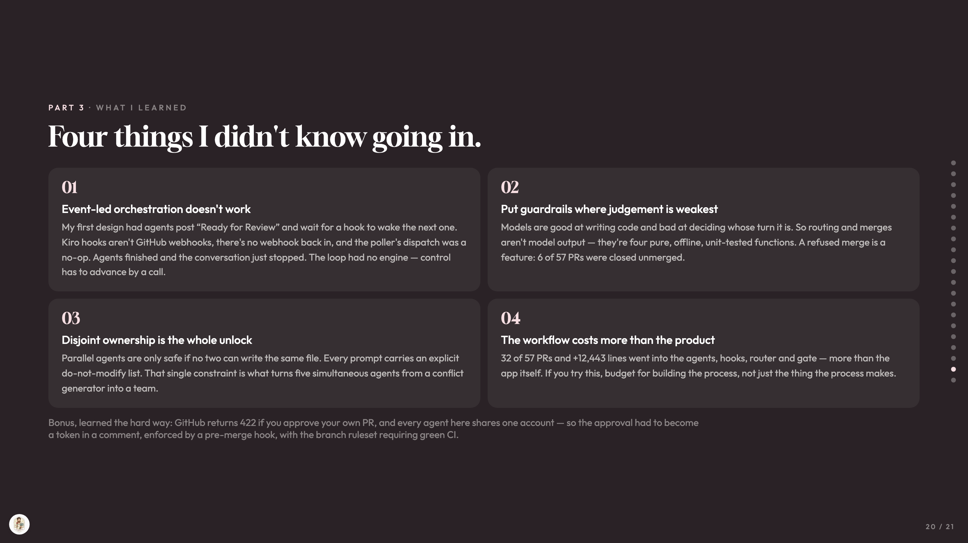
Notes:
PART 3 · WHAT I LEARNED
Four things I didn't know going in.
01
Event-led orchestration doesn't work
My first design had agents post “Ready for Review” and wait for a hook to wake the next one. Kiro hooks aren't GitHub webhooks, there's no webhook back in, and the poller's dispatch was a no-op. Agents finished and the conversation just stopped. The loop had no engine — control has to advance by a call.
02
Put guardrails where judgement is weakest
Models are good at writing code and bad at deciding whose turn it is. So routing and merges aren't model output — they're four pure, offline, unit-tested functions. A refused merge is a feature: 6 of 57 PRs were closed unmerged.
03
Disjoint ownership is the whole unlock
Parallel agents are only safe if no two can write the same file. Every prompt carries an explicit do-not-modify list. That single constraint is what turns five simultaneous agents from a conflict generator into a team.
04
The workflow costs more than the product
32 of 57 PRs and +12,443 lines went into the agents, hooks, router and gate — more than the app itself. If you try this, budget for building the process, not just the thing the process makes.
Bonus, learned the hard way: GitHub returns 422 if you approve your own PR, and every agent here shares one account — so the approval had to become a token in a comment, enforced by a pre-merge hook, with the branch ruleset requiring green CI.

Slide 21
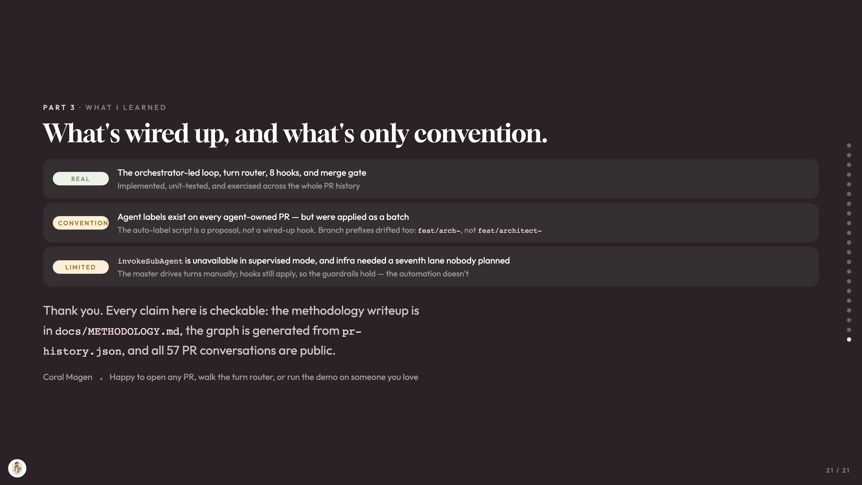
Notes:
PART 3 · WHAT I LEARNED
What's wired up, and what's only convention.
REAL
The orchestrator-led loop, turn router, 8 hooks, and merge gate
Implemented, unit-tested, and exercised across the whole PR history
CONVENTION
Agent labels exist on every agent-owned PR — but were applied as a batch
The auto-label script is a proposal, not a wired-up hook. Branch prefixes drifted too: feat/arch-, not feat/architect-
LIMITED
invokeSubAgent is unavailable in supervised mode, and infra needed a seventh lane nobody planned
The master drives turns manually; hooks still apply, so the guardrails hold — the automation doesn't
Thank you. Every claim here is checkable: the methodology writeup is in docs/METHODOLOGY.md, the graph is generated from pr-history.json, and all 57 PR conversations are public.
Coral Magen
Happy to open any PR, walk the turn router, or run the demo on someone you love

