Slide 1

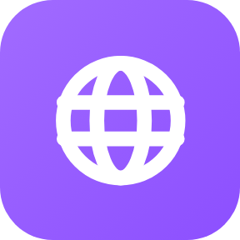



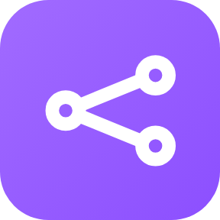
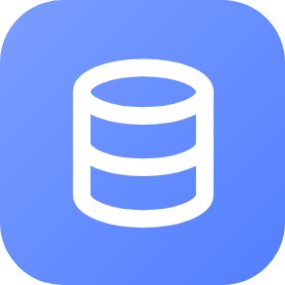
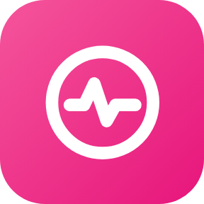
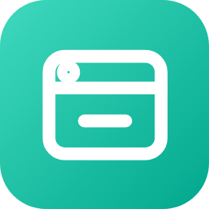
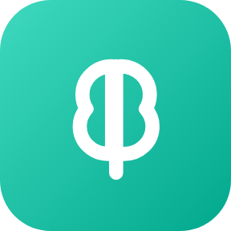
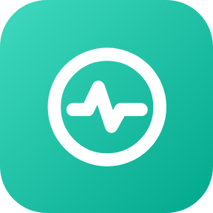
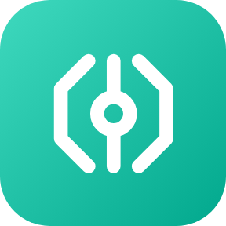
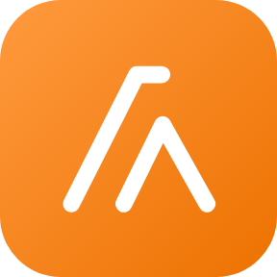
Architecture — one product, two engines
SHARED FRONT DOOR
ENGINE A · GLUE CODE
SHARED BY BOTH ENGINES
Browser
CloudFront
Fargate
Bedrock
the chat UI
one origin
valentin-service-dev
Claude Sonnet 4.5
S3
ALB
DynamoDB
CloudWatch
static assets
/api/* · /ws
ValentinTable-dev
one dashboard, both engines
ENGINE B · AGENTCORE
Fargate
Runtime
Memory
valentin-ac-proxy-dev
valentin_agent_dev
valentin_memory_dev
Observability
Gateway
Lambda
session traces
MCP · CUSTOM_JWT
valentin-profile-tools-dev
the request path
engine A · my code
engine B · AgentCore
shared · both engines
VALENTIN · GenAI TFC Capstone Deep-Dive
Notes:
[1:00 · Architecture] One product, two engines. Everything on the left is held fixed: the browser talks to CloudFront, which serves the React app out of S3 and sends /api/* and /ws to the ALB. The ALB is the fork.
Up and to the right is engine A — the glue code I wrote. One Fargate service, valentin-service-dev, calls Bedrock directly and keeps preferences in DynamoDB.
Down and to the right is engine B — the same product on Amazon Bedrock AgentCore. A thin Fargate proxy, valentin-ac-proxy-dev, hands the turn to the AgentCore Runtime valentin_agent_dev, which uses AgentCore Memory for preferences, Gateway to reach the profile-tools Lambda over MCP with CUSTOM_JWT, and Observability for session traces.
Both engines call the same model, Claude Sonnet 4.5, and both report into one CloudWatch dashboard. Only the two dashed regions differ — and the four decisions inside them are the next four slides.

