Slide 1

Notes:
GENAI TFC PROJECT
Valentin
Romantic Agent
Built twice — once by hand, once on Bedrock AgentCore.
Coral Magen
Technical Account Manager, AWS
SCROLL

Slide 2
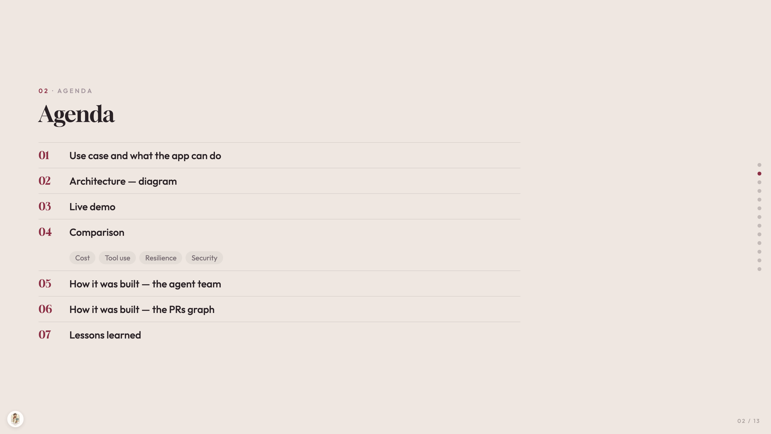
Notes:
02 · AGENDA
Agenda
01
Use case and what the app can do
02
Architecture — diagram
03
Live demo
04
Comparison
Cost
Tool use
Resilience
Security
05
How it was built — the agent team
06
How it was built — the PRs graph
07
Lessons learned

Slide 3
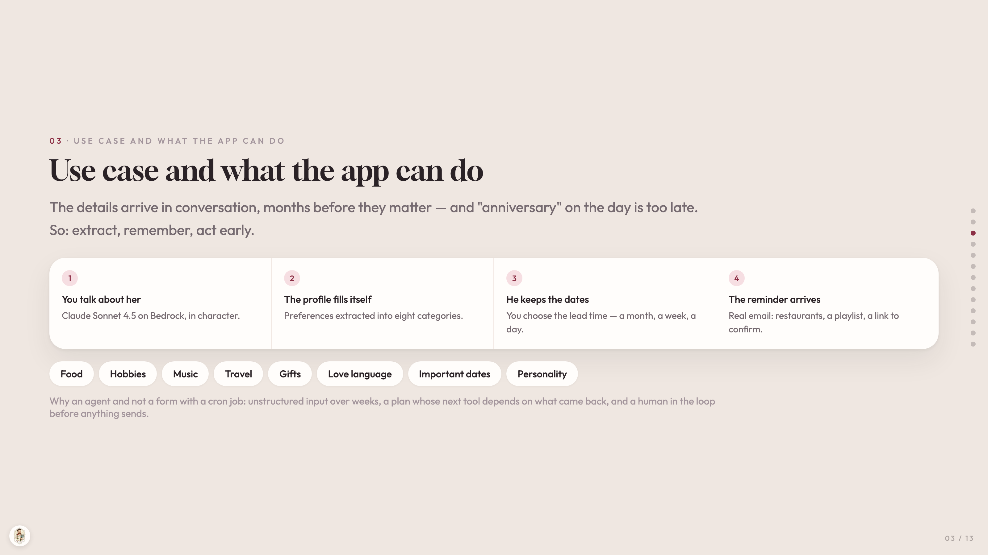
Notes:
03 · USE CASE AND WHAT THE APP CAN DO
Use case and what the app can do
The details arrive in conversation, months before they matter — and "anniversary" on the day is too late. So: extract, remember, act early.
1
You talk about her
Claude Sonnet 4.5 on Bedrock, in character.
2
The profile fills itself
Preferences extracted into eight categories.
3
He keeps the dates
You choose the lead time — a month, a week, a day.
4
The reminder arrives
Real email: restaurants, a playlist, a link to confirm.
Food
Hobbies
Music
Travel
Gifts
Love language
Important dates
Personality
Why an agent and not a form with a cron job: unstructured input over weeks, a plan whose next tool depends on what came back, and a human in the loop before anything sends.

Slide 4
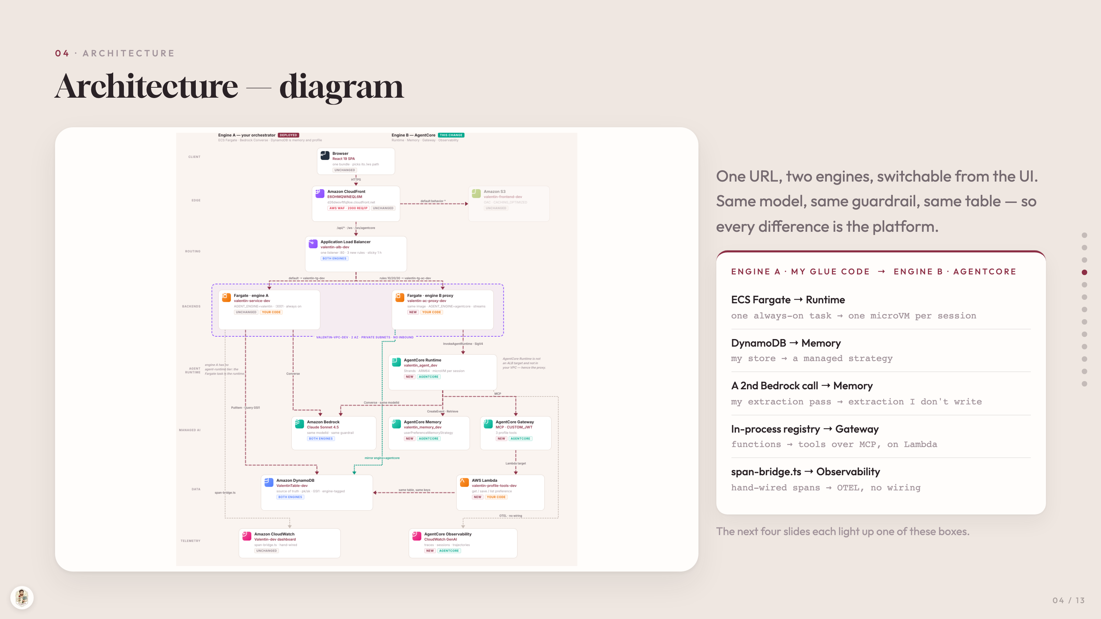
Notes:
04 · ARCHITECTURE
Architecture — diagram
One URL, two engines, switchable from the UI. Same model, same guardrail, same table — so every difference is the platform.
ENGINE A · MY GLUE CODE → ENGINE B · AGENTCORE
ECS Fargate → Runtime
one always-on task → one microVM per session
DynamoDB → Memory
my store → a managed strategy
A 2nd Bedrock call → Memory
my extraction pass → extraction I don't write
In-process registry → Gateway
functions → tools over MCP, on Lambda
span-bridge.ts → Observability
hand-wired spans → OTEL, no wiring
The next four slides each light up one of these boxes.

Slide 5
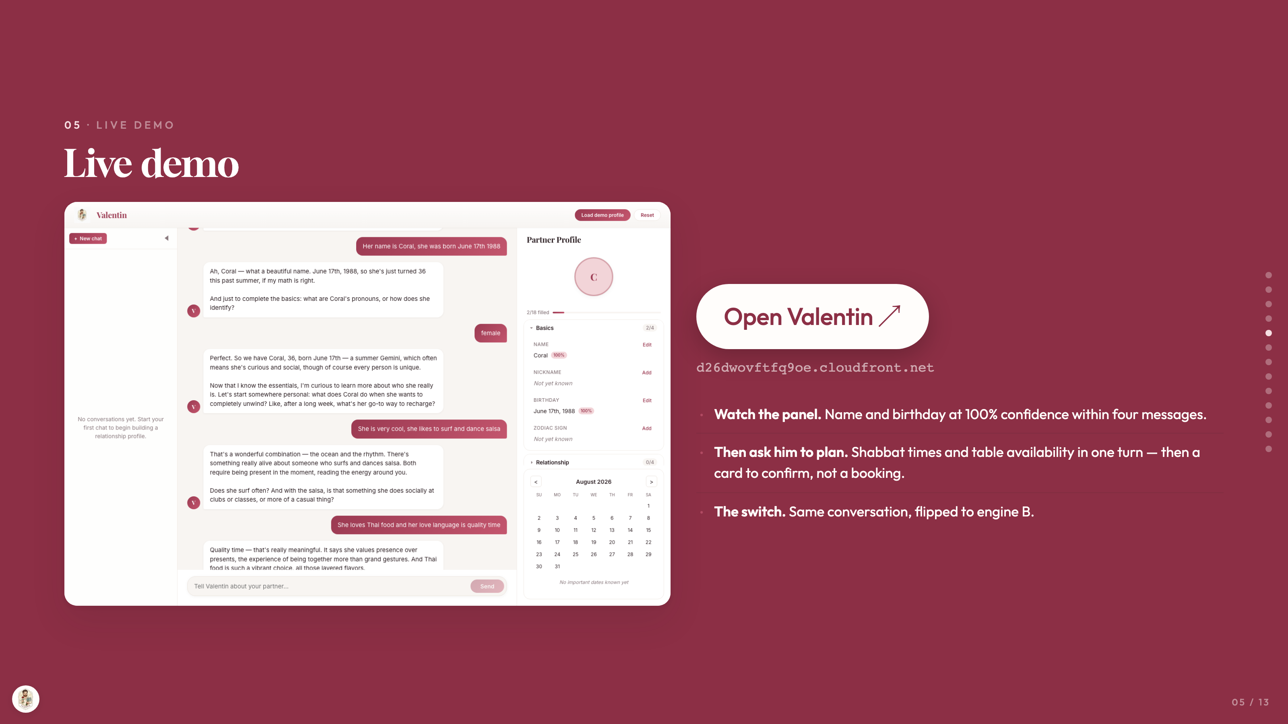
Notes:
05 · LIVE DEMO
Live demo
Open Valentin ↗
d26dwovftfq9oe.cloudfront.net
Watch the panel. Name and birthday at 100% confidence within four messages.
Then ask him to plan. Shabbat times and table availability in one turn — then a card to confirm, not a booking.
The switch. Same conversation, flipped to engine B.

Slide 6
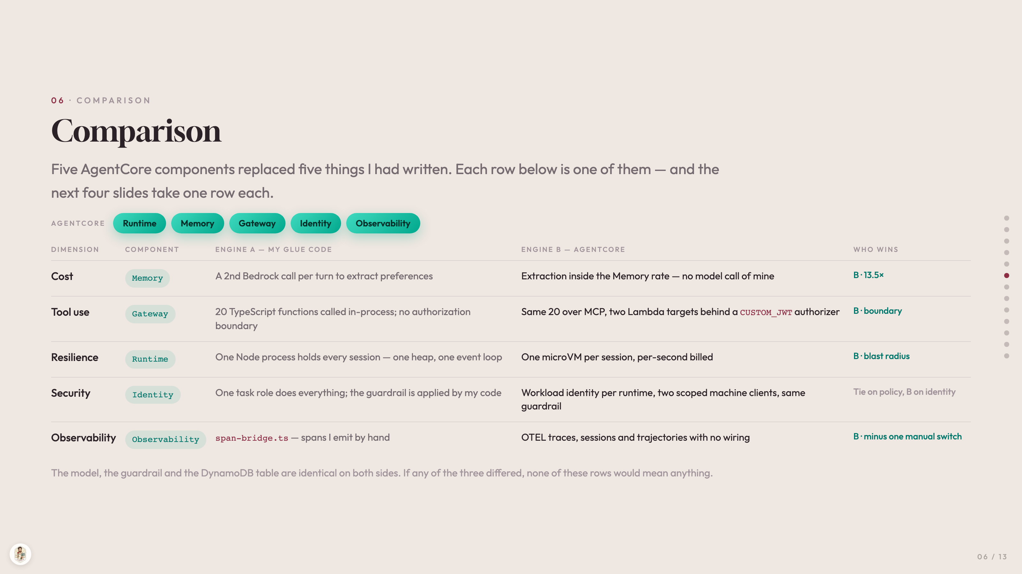
Notes:
06 · COMPARISON
Comparison
Five AgentCore components replaced five things I had written. Each row below is one of them — and the next four slides take one row each.
AGENTCORE
Runtime
Memory
Gateway
Identity
Observability
DIMENSION COMPONENT ENGINE A — MY GLUE CODE ENGINE B — AGENTCORE WHO WINS
Cost Memory A 2nd Bedrock call per turn to extract preferences Extraction inside the Memory rate — no model call of mine B · 13.5×
Tool use Gateway 20 TypeScript functions called in-process; no authorization boundary Same 20 over MCP, two Lambda targets behind a CUSTOM_JWT authorizer B · boundary
Resilience Runtime One Node process holds every session — one heap, one event loop One microVM per session, per-second billed B · blast radius
Security Identity One task role does everything; the guardrail is applied by my code Workload identity per runtime, two scoped machine clients, same guardrail Tie on policy, B on identity
Observability Observability span-bridge.ts — spans I emit by hand OTEL traces, sessions and trajectories with no wiring B · minus one manual switch
The model, the guardrail and the DynamoDB table are identical on both sides. If any of the three differed, none of these rows would mean anything.

Slide 7
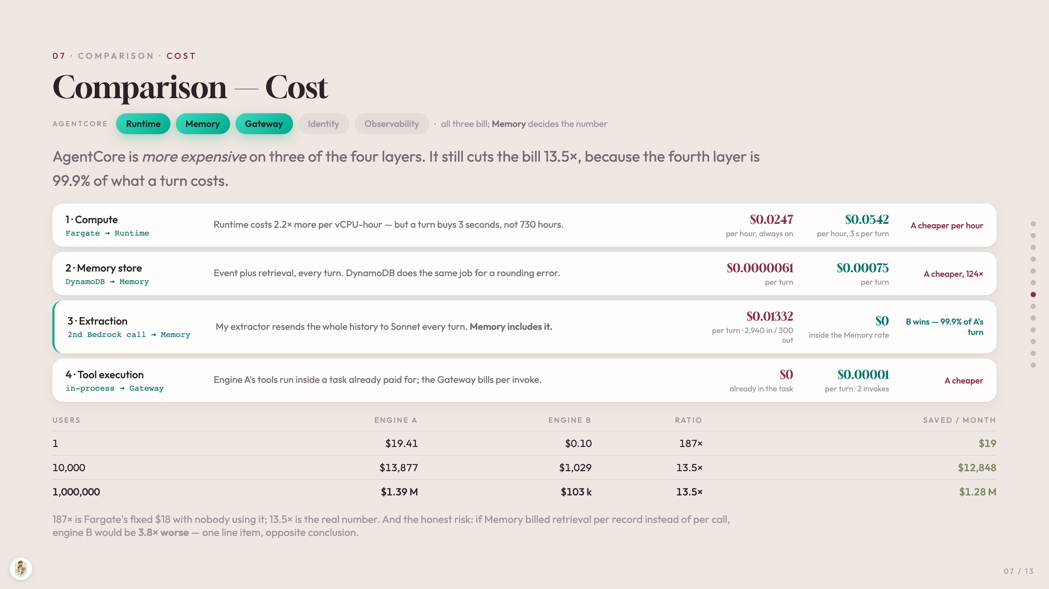
Notes:
07 · COMPARISON · COST
Comparison — Cost
AGENTCORE
Runtime
Memory
Gateway
Identity
Observability
·
all three bill; Memory decides the number
AgentCore is more expensive on three of the four layers. It still cuts the bill 13.5×, because the fourth layer is 99.9% of what a turn costs.
1 · Compute
Fargate → Runtime
Runtime costs 2.2× more per vCPU-hour — but a turn buys 3 seconds, not 730 hours.
$0.0247
per hour, always on
$0.0542
per hour, 3 s per turn
A cheaper per hour
2 · Memory store
DynamoDB → Memory
Event plus retrieval, every turn. DynamoDB does the same job for a rounding error.
$0.0000061
per turn
$0.00075
per turn
A cheaper, 124×
3 · Extraction
2nd Bedrock call → Memory
My extractor resends the whole history to Sonnet every turn. Memory includes it.
$0.01332
per turn · 2,940 in / 300 out
$0
inside the Memory rate
B wins — 99.9% of A's turn
4 · Tool execution
in-process → Gateway
Engine A's tools run inside a task already paid for; the Gateway bills per invoke.
$0
already in the task
$0.00001
per turn · 2 invokes
A cheaper
USERS ENGINE A ENGINE B RATIO SAVED / MONTH
1 $19.41 $0.10 187× $19
10,000 $13,877 $1,029 13.5× $12,848
1,000,000 $1.39 M $103 k 13.5× $1.28 M
187× is Fargate's fixed $18 with nobody using it; 13.5× is the real number. And the honest risk: if Memory billed retrieval per record instead of per call, engine B would be 3.8× worse — one line item, opposite conclusion.

Slide 8
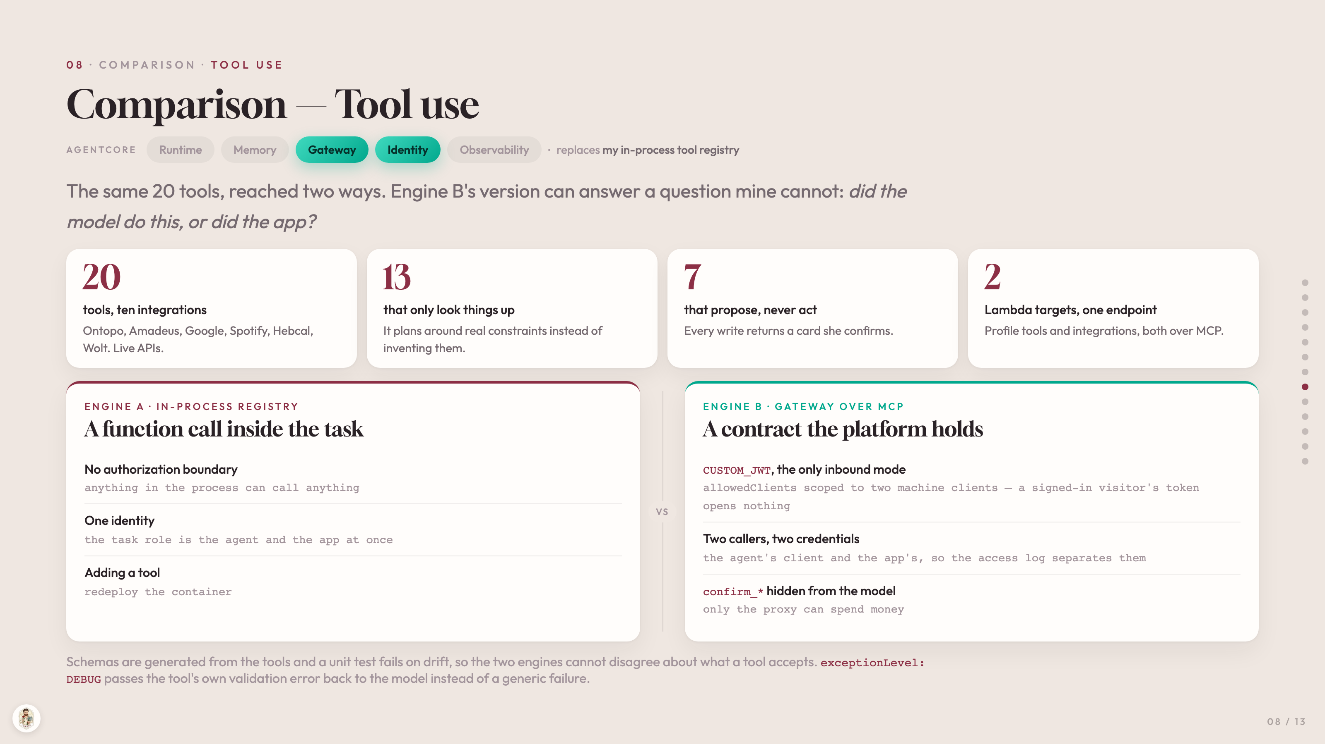
Notes:
08 · COMPARISON · TOOL USE
Comparison — Tool use
AGENTCORE
Runtime
Memory
Gateway
Identity
Observability
·
replaces my in-process tool registry
The same 20 tools, reached two ways. Engine B's version can answer a question mine cannot: did the model do this, or did the app?
20
tools, ten integrations
Ontopo, Amadeus, Google, Spotify, Hebcal, Wolt. Live APIs.
13
that only look things up
It plans around real constraints instead of inventing them.
7
that propose, never act
Every write returns a card she confirms.
2
Lambda targets, one endpoint
Profile tools and integrations, both over MCP.
ENGINE A · IN-PROCESS REGISTRY
A function call inside the task
No authorization boundary
anything in the process can call anything
One identity
the task role is the agent and the app at once
Adding a tool
redeploy the container
VS
ENGINE B · GATEWAY OVER MCP
A contract the platform holds
CUSTOM_JWT, the only inbound mode
allowedClients scoped to two machine clients — a signed-in visitor's token opens nothing
Two callers, two credentials
the agent's client and the app's, so the access log separates them
confirm_* hidden from the model
only the proxy can spend money
Schemas are generated from the tools and a unit test fails on drift, so the two engines cannot disagree about what a tool accepts. exceptionLevel: DEBUG passes the tool's own validation error back to the model instead of a generic failure.

Slide 9
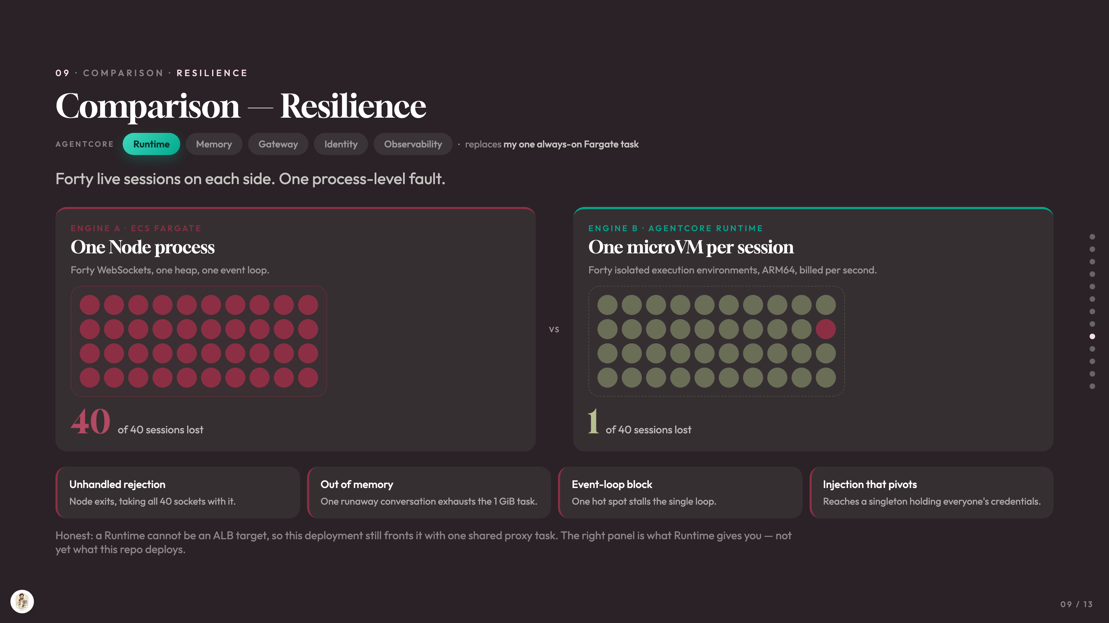
Notes:
09 · COMPARISON · RESILIENCE
Comparison — Resilience
AGENTCORE
Runtime
Memory
Gateway
Identity
Observability
·
replaces my one always-on Fargate task
Forty live sessions on each side. One process-level fault.
ENGINE A · ECS FARGATE
One Node process
Forty WebSockets, one heap, one event loop.
40
of 40 sessions lost
VS
ENGINE B · AGENTCORE RUNTIME
One microVM per session
Forty isolated execution environments, ARM64, billed per second.
1
of 40 sessions lost
Unhandled rejection
Node exits, taking all 40 sockets with it.
Out of memory
One runaway conversation exhausts the 1 GiB task.
Event-loop block
One hot spot stalls the single loop.
Injection that pivots
Reaches a singleton holding everyone's credentials.
Honest: a Runtime cannot be an ALB target, so this deployment still fronts it with one shared proxy task. The right panel is what Runtime gives you — not yet what this repo deploys.

Slide 10
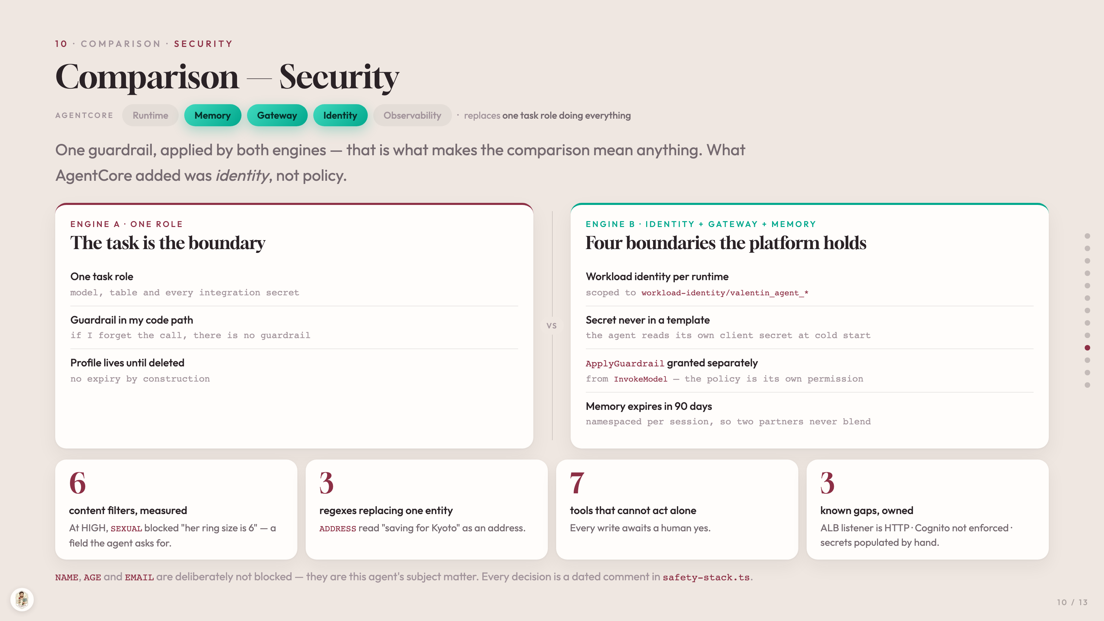
Notes:
10 · COMPARISON · SECURITY
Comparison — Security
AGENTCORE
Runtime
Memory
Gateway
Identity
Observability
·
replaces one task role doing everything
One guardrail, applied by both engines — that is what makes the comparison mean anything. What AgentCore added was identity, not policy.
ENGINE A · ONE ROLE
The task is the boundary
One task role
model, table and every integration secret
Guardrail in my code path
if I forget the call, there is no guardrail
Profile lives until deleted
no expiry by construction
VS
ENGINE B · IDENTITY + GATEWAY + MEMORY
Four boundaries the platform holds
Workload identity per runtime
scoped to workload-identity/valentin_agent_*
Secret never in a template
the agent reads its own client secret at cold start
ApplyGuardrail granted separately
from InvokeModel — the policy is its own permission
Memory expires in 90 days
namespaced per session, so two partners never blend
6
content filters, measured
At HIGH, SEXUAL blocked "her ring size is 6" — a field the agent asks for.
3
regexes replacing one entity
ADDRESS read "saving for Kyoto" as an address.
7
tools that cannot act alone
Every write awaits a human yes.
3
known gaps, owned
ALB listener is HTTP · Cognito not enforced · secrets populated by hand.
NAME, AGE and EMAIL are deliberately not blocked — they are this agent's subject matter. Every decision is a dated comment in safety-stack.ts.

Slide 11
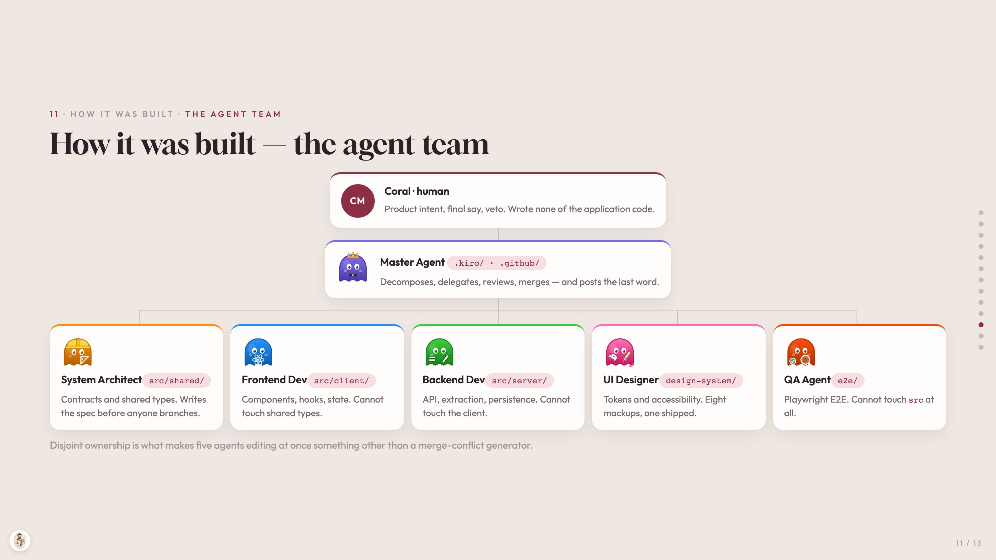
Notes:
11 · HOW IT WAS BUILT · THE AGENT TEAM
How it was built — the agent team
CM
Coral · human
Product intent, final say, veto. Wrote none of the application code.
Master Agent .kiro/ · .github/
Decomposes, delegates, reviews, merges — and posts the last word.
System Architectsrc/shared/
Contracts and shared types. Writes the spec before anyone branches.
Frontend Devsrc/client/
Components, hooks, state. Cannot touch shared types.
Backend Devsrc/server/
API, extraction, persistence. Cannot touch the client.
UI Designerdesign-system/
Tokens and accessibility. Eight mockups, one shipped.
QA Agente2e/
Playwright E2E. Cannot touch src at all.
Disjoint ownership is what makes five agents editing at once something other than a merge-conflict generator.

Slide 12
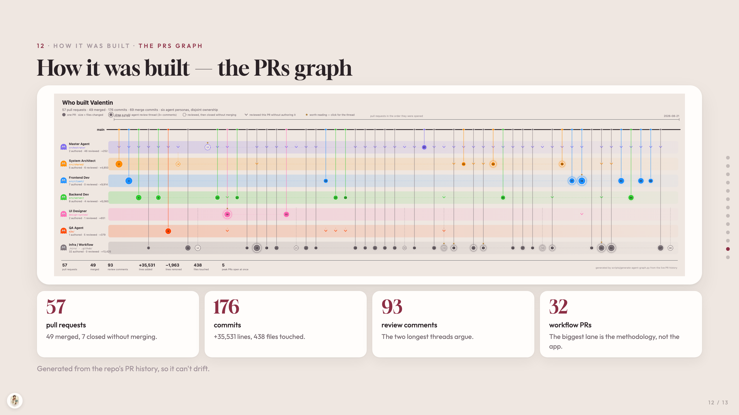
Notes:
12 · HOW IT WAS BUILT · THE PRS GRAPH
How it was built — the PRs graph
57
pull requests
49 merged, 7 closed without merging.
176
commits
+35,531 lines, 438 files touched.
93
review comments
The two longest threads argue.
32
workflow PRs
The biggest lane is the methodology, not the app.
Generated from the repo's PR history, so it can't drift.

Slide 13
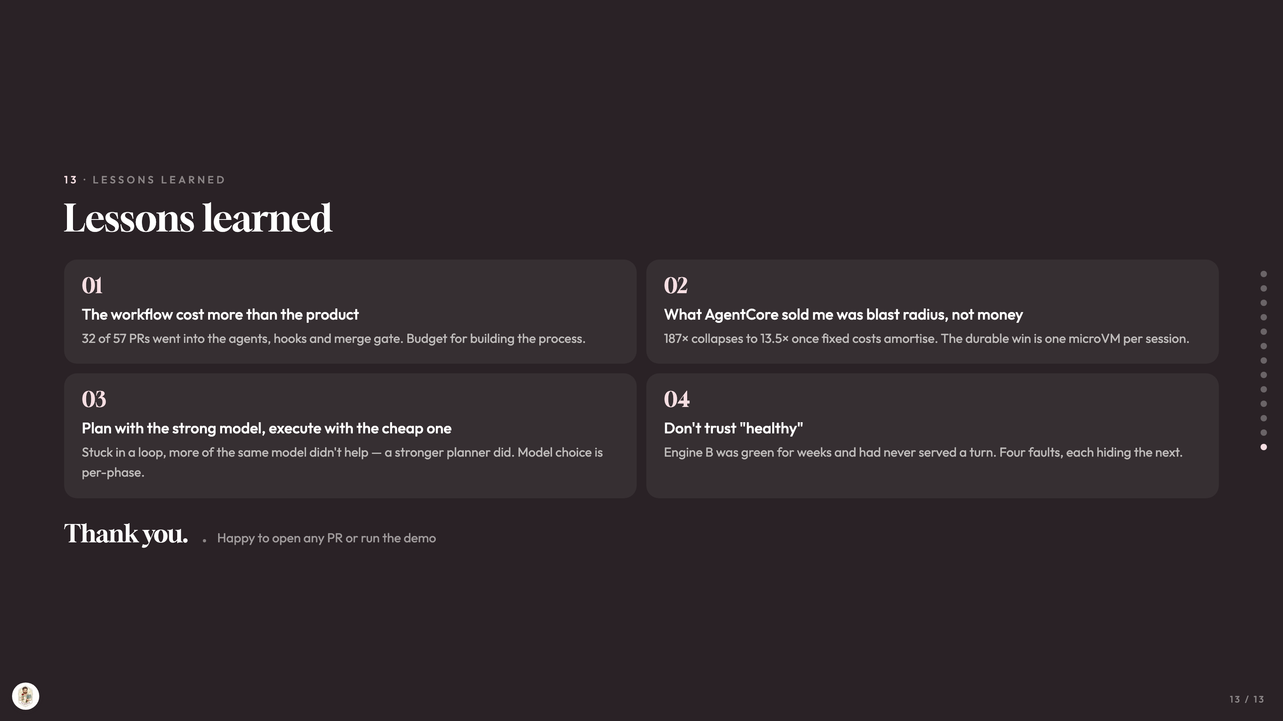
Notes:
13 · LESSONS LEARNED
Lessons learned
01
The workflow cost more than the product
32 of 57 PRs went into the agents, hooks and merge gate. Budget for building the process.
02
What AgentCore sold me was blast radius, not money
187× collapses to 13.5× once fixed costs amortise. The durable win is one microVM per session.
03
Plan with the strong model, execute with the cheap one
Stuck in a loop, more of the same model didn't help — a stronger planner did. Model choice is per-phase.
04
Don't trust "healthy"
Engine B was green for weeks and had never served a turn. Four faults, each hiding the next.
Thank you.
Happy to open any PR or run the demo

