Slide 1
Valentin
Built by a team of six AI agents. The product is the artifact — the workflow is the point.
Coral Steinberg
Notes:
Valentin is a working AI romantic concierge. But that's not why we're here. Every line of it was specced, built, reviewed, and merged by six specialised AI agents operating a real GitHub workflow, behind deterministic hooks and a merge gate. I'll show you the product at the end — the first two thirds is about how it got built, because that's the part I think is actually interesting.

Slide 2
Agenda
The experiment, and the team
The engine — and the failure behind it
Guardrails where judgement fails
The evidence, and the honest scope
The product, and a live demo
Notes:
Five movements. What the experiment is and who the six agents are. The engine that drives the loop, which came out of a design that didn't work. The determinism layer — where I deliberately took decisions away from the model. Then the evidence: the full PR history, plus a frank list of what's real versus what's convention. And finally the product itself, with a demo.

Slide 3
An experiment in agentic development
Six agents, one real GitHub workflow, a human with veto
Every PR opened, reviewed, and merged by agents
Ownership is enforced by prompt, not suggested
Routing and merges are deterministic code
A human sets intent and holds final say
The methodology was built, not declared
Notes:
The premise: give six agents distinct personas, distinct file ownership, and a real GitHub workflow — issues, branches, draft PRs, review threads, CI, merge — and see whether the thing that comes out is coherent. The human role is narrow on purpose: product intent, final say, veto. I don't write the code and I don't drive the review loop. The last point matters most: thirty-two of the fifty-seven PRs went into building the workflow itself. It was iterated and debugged like any other system.

Slide 4

Six agents, disjoint ownership
Master — orchestrates, reviews, merges; posts the last word
Architect — contracts and shared types; owns src/shared/
Frontend — components and hooks; owns src/client/
Backend — API, extraction, persistence; owns src/server/
Designer owns design-system/ · QA owns e2e/
Notes:
Six personas, each a real prompt file in .kiro/agents/, each with a written voice exemplar that sets the bar for how it writes on a PR — naming actual files and trade-offs, and pushing back when it disagrees with a review. The critical design point is the second half of every line: ownership. Each prompt carries an explicit do-not-modify list. Frontend cannot touch shared types. Backend cannot touch the client. QA cannot touch src at all. Disjoint ownership is what makes parallel agent work safe — without it, five agents editing at once is just a merge conflict generator.

Slide 5
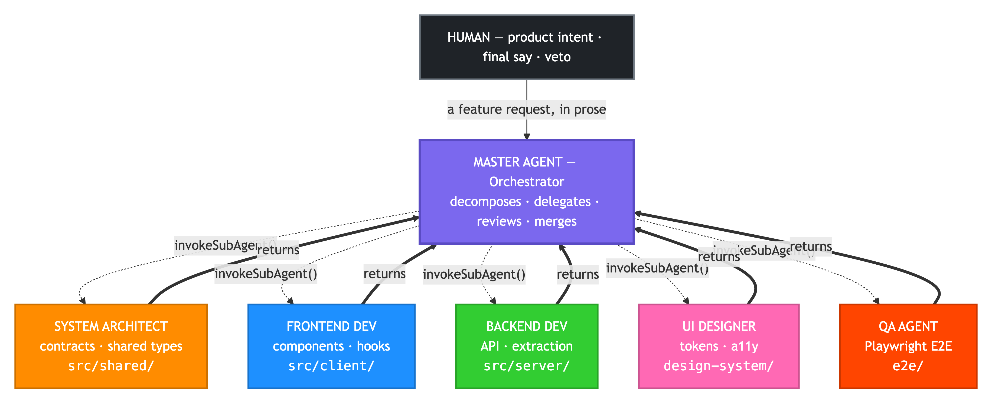
Hub and spoke, not a recursive tangle
Notes:
This is the call graph. The human hands a feature request in prose to the master. The master calls each sub-agent with invokeSubAgent — a function call, not a webhook and not a poller. The dashed arrows down are those calls; the bold arrows up are plain returns. The key property: a sub-agent returns to the master rather than re-invoking it. The return is the hand-back. That's what keeps this a shallow hub-and-spoke instead of a recursive tangle where agents call each other and nobody knows who's waiting on whom.

Slide 6
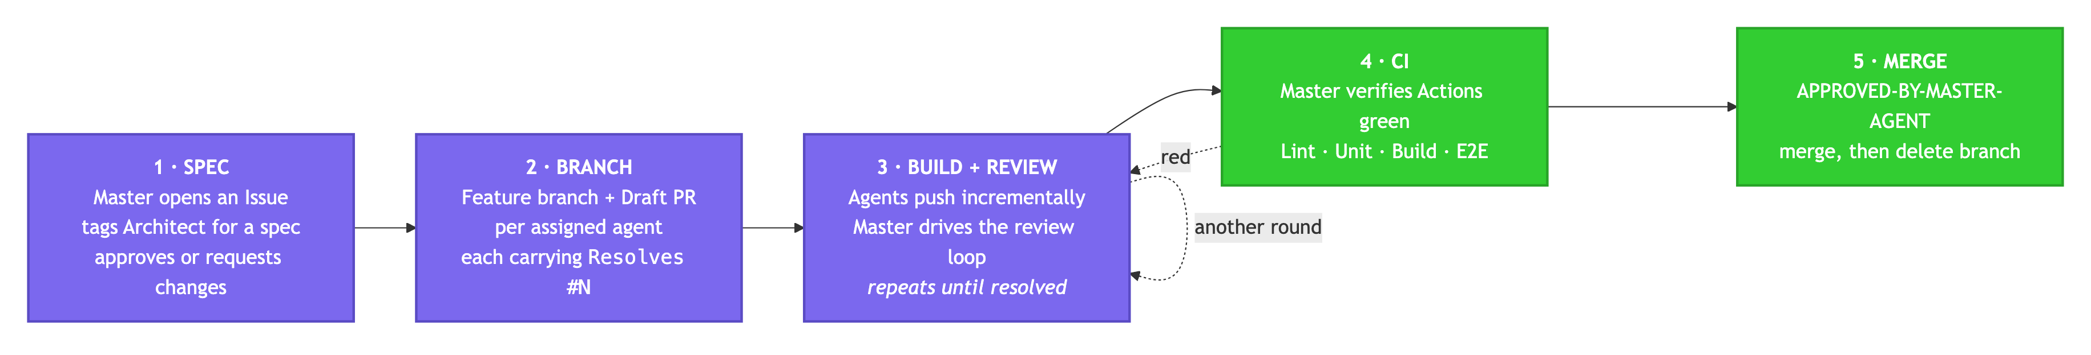
Five phases, spec before build
Notes:
Work moves through five phases, defined in a steering file every agent reads. Spec first: the master opens an issue and tags the architect for a spec, then approves it or sends it back. Only then does anyone branch. Build and review loops — that dotted self-arrow is another round, and it fires often. CI has to be green. Then merge with the approval token. Note the dotted line from CI back to build: red CI doesn't fail the PR, it reopens the review loop. Agents also push incrementally rather than in one dump, so the commit history reads as a narrative.

Slide 7
The first design didn't work
Event-led: agents waited for a trigger that never fired
Sub-agent posted "Ready for Review", then stopped
Kiro hooks are not GitHub webhooks
There is no webhook back into Kiro
The poller's dispatch was a no-op
The loop had no engine
Notes:
I want to show the failure, because the fix only makes sense against it. The original design was event-led. A sub-agent finishes, posts "Ready for Review", and the flow depends on a hook or poller firing to wake the next agent. It never worked. Kiro hooks are not GitHub webhooks, there's no webhook back into Kiro, and the poller's dispatch was effectively a no-op. So agents would finish their turn and the conversation just stopped, waiting on a trigger that was never going to arrive. The loop had no engine. The post-mortem is in the repo under .kiro/analysis/.

Slide 8
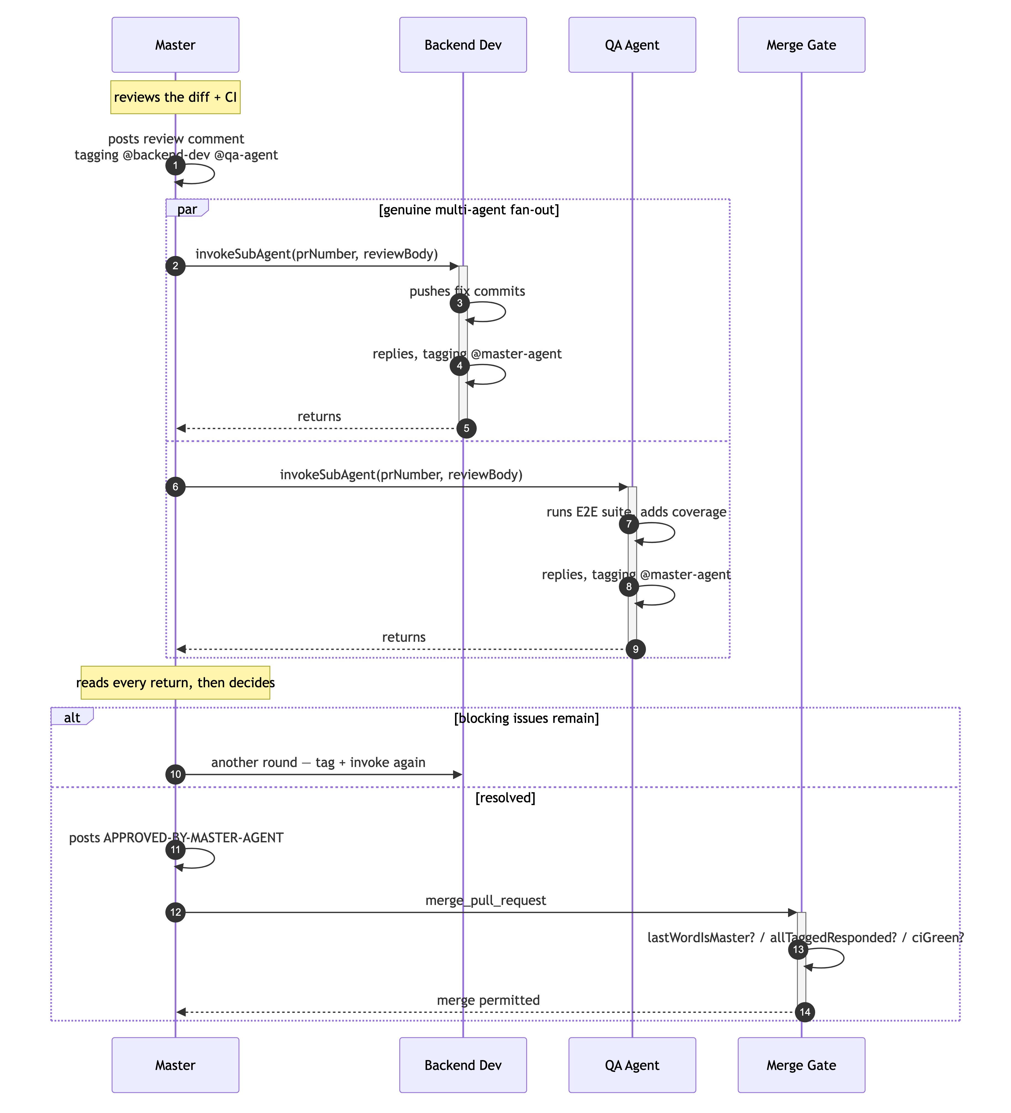
Orchestrator-led: control advances by a call
Notes:
The replacement. The master drives every turn by calling the next actor and waiting. Control advances by a function call, never by hoping a trigger fires. Look at the par block in the middle — that's genuine fan-out. The master tags two agents in one comment, invokes both, and collects both replies before deciding. Backend pushes fix commits while QA runs the E2E suite. Then the master reads every return and either runs another round or posts the approval token and calls the merge gate, which checks three conditions before permitting it. The at-mentions are still there, but now they're a human-readable transcript and a machine-parseable routing signal — not the trigger.

Slide 9
Guardrails where judgement is weakest
Routing and merge decisions are code, not model output
parseTurn — who spoke, who's tagged, is it terminal
lastWordIsMaster — master must close the thread
allTaggedResponded — nobody left hanging
evaluateConversationGate — the merge backstop
Pure, offline, unit-tested JavaScript
Notes:
Two layers, deliberately separated. Control is invokeSubAgent — the engine. Determinism is hooks plus the turn router, guarding the two fragile boundaries: each hand-off, and the merge. The principle is that guardrails matter precisely where model judgement is least trustworthy, so routing and merge decisions are not left to the model. These four functions are pure, offline, and fully unit-tested. Worth noting parseTurn returns nextActors as a list — that's what makes fan-out expressible rather than round-robin — and it flags a stall when a non-terminal comment tags nobody. And a refused merge is expected behaviour, not a bug: the gate blocks unless the master holds the last word with a valid token, no tagged agent was left hanging, and CI is green.

Slide 10
A real-world wrinkle
Every agent acts under the same GitHub account
GitHub blocks approving your own pull request
APPROVE returns 422, so the merge stalls forever
Fix: gate on an APPROVED-BY-MASTER-AGENT comment
Branch ruleset enforces quality via required CI
The hook makes the token trustworthy, not decorative
Notes:
A wrinkle worth telling because it's the kind of thing you only hit in practice. Every agent here, master included, acts under the same GitHub account. GitHub won't let a PR author formally approve their own PR — you get a 422, "can not approve your own pull request." So attempting a formal approval stalls the merge forever, waiting on something that can never happen. The workaround is explicit in the master's prompt: gate the merge on an approval comment containing an exact token, and let the branch ruleset enforce quality by requiring passing CI rather than a formal review state. The token in the comment is the approval — and the pre-merge hook is what makes that trustworthy rather than decorative.

Slide 11
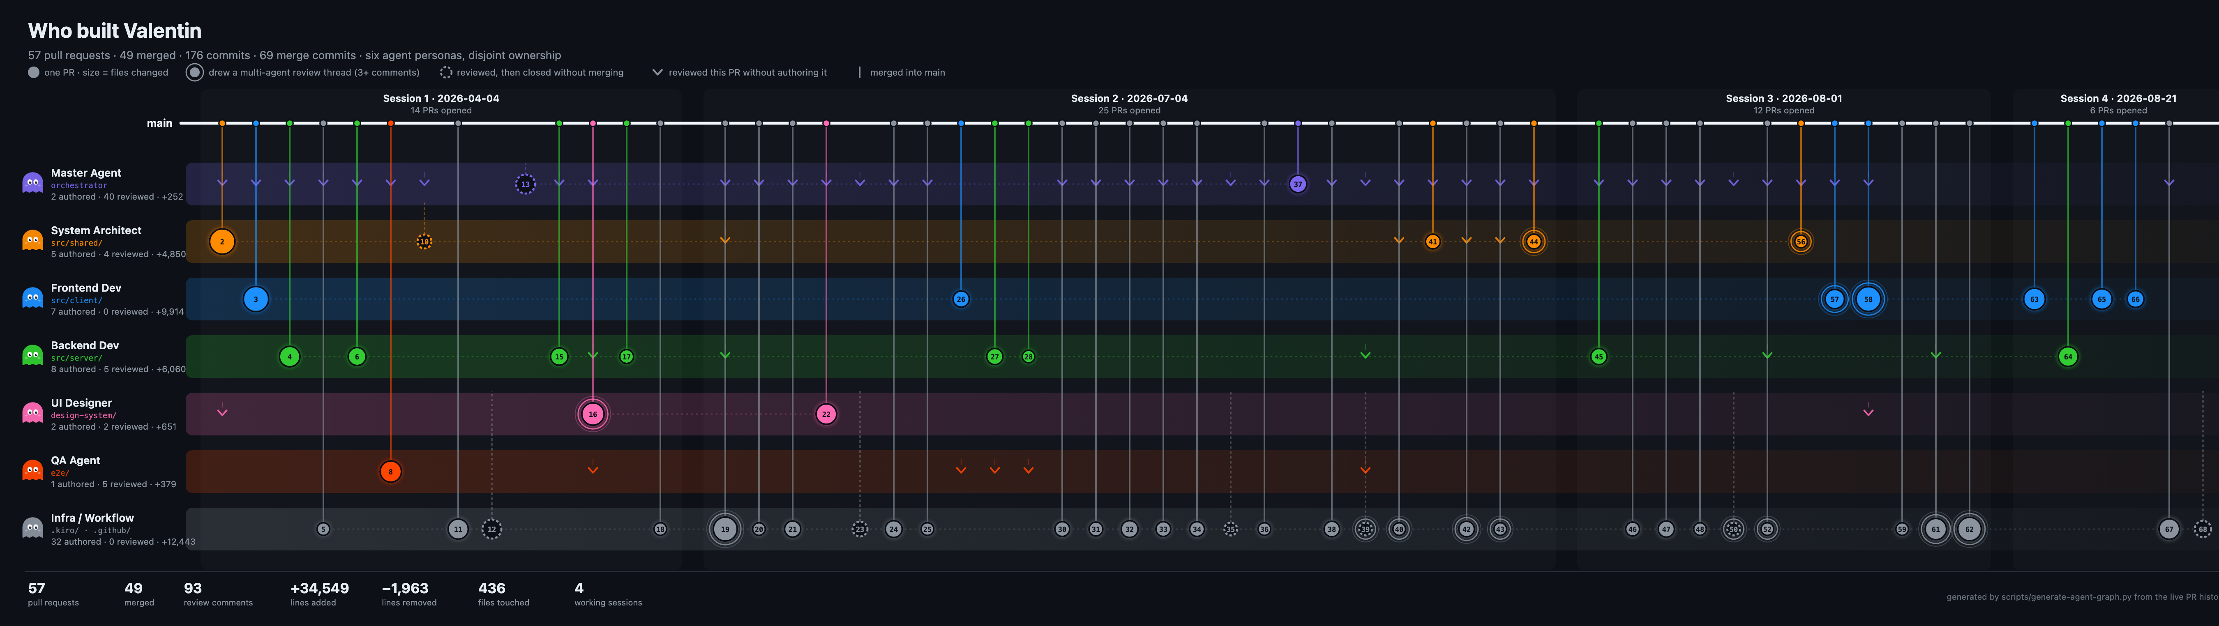
The work, as a graph — every node is a real PR
Notes:
Nothing here is illustrative. This is generated straight from the repository's PR history by a script, so it cannot drift from the truth. One node per pull request, sized by files changed, sitting in its owning agent's lane, with a line rising to the point on main where it merged. Concentric rings are PRs that drew a genuine multi-agent review thread. Hollow dashed nodes were reviewed and closed without merging — a workflow where nothing ever gets turned down isn't a review process. Three things to notice: the fan-out is real, with five lanes open at once inside a single session. The biggest lane is the workflow itself. And the x-axis is PR sequence grouped by session, not wall-clock time — all 57 PRs landed across four sessions, so a linear time axis collapses into four vertical stacks, which is exactly why GitHub's own network graph reads as empty here.

Slide 12
By the numbers
57 pull requests
176 commits
93 review comments
32 workflow PRs
49 merged, 6 closed without merging, across four working sessions and seven lanes.
69 of them merge commits. +34,549 lines added across 436 file changes.
Real multi-persona dialogue, not rubber-stamping — the two longest threads run dozens deep.
The largest lane is the methodology itself: +12,443 lines into .kiro/ and .github/.
Notes:
The headline numbers, all generated from the live PR history rather than typed by hand. Fifty-seven PRs, forty-nine merged, six closed unmerged. A hundred and seventy-six commits. Ninety-three review comments — that's the number I'd point at if someone asks whether the review loop is real or decorative. And the fourth column is the honest one: the single largest lane isn't the product, it's the workflow. Thirty-two PRs and over twelve thousand lines went into the agents, hooks, turn router, and merge gate. Supporting cast: six personas, eight hooks, six skill modules, five steering documents, five specs, forty-two test files.

Slide 13
Honest scope
What's wired up, and what's only convention
Real: the loop, turn router, hooks, and merge gate
Convention: agent labels, applied in batch not at creation
Branch prefixes drifted — feat/arch-, not feat/architect-
Infra work needed a seventh lane nobody planned
invokeSubAgent is unavailable in supervised mode
Notes:
I'd rather state this plainly, because a methodology writeup that overclaims is worth less than one that doesn't. The orchestrator-led loop, the turn router, the hooks, and the merge gate are real — implemented, unit-tested, and exercised across the whole PR history. The label conventions are conventions: the seven agent labels exist and are applied across every agent-owned PR, but that labelling was done as a batch, not by an agent at creation time. The auto-label script is a proposal, not a wired-up hook. Branch prefixes drifted from the documented scheme. Platform work landed under a feat/infra prefix the original six-agent design never anticipated, which is why there's a seventh lane on that graph. And in supervised mode invokeSubAgent isn't available — the master drives turns manually and the hooks still apply, so the guardrails hold, but the automation doesn't.

Slide 14
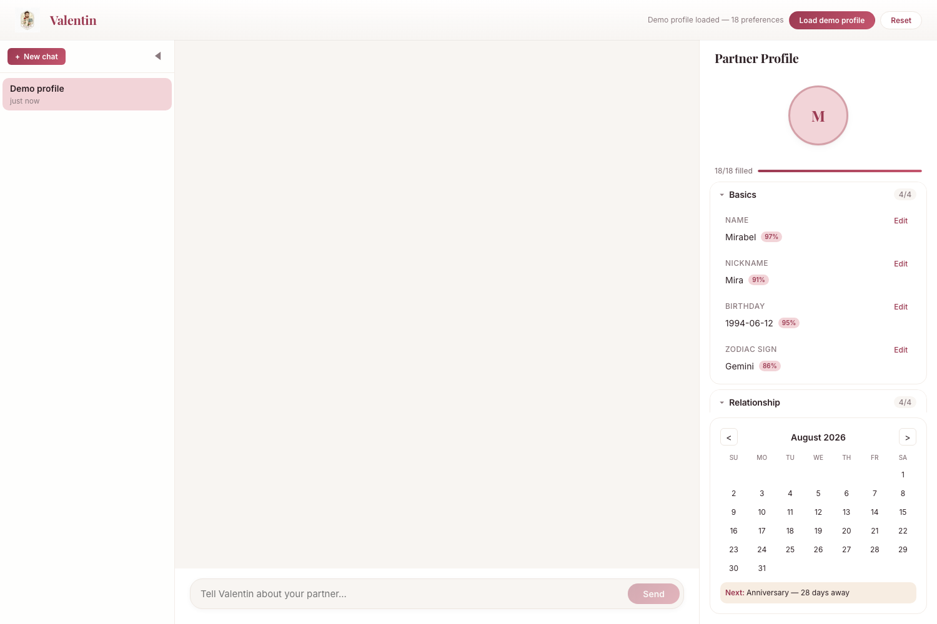
So what did they build?
A romantic concierge — conversation in, profile out
Nobody fills in 18 fields about their partner
Eight categories, from food to love language
Every entry carries a confidence score
The profile fills in live as you talk
Notes:
Now the product. You know her birthday; you half-remember the restaurant she liked; you forget the offhand comment about the trip she's always wanted — and then you're buying a candle again. Forms don't fix that, because nobody fills in an eighteen-field questionnaire about their partner and the interesting details aren't fields anyway. So Valentin runs a warm, unhurried interview instead. Every message is analysed in the background and anything he learns lands in the profile immediately, tagged by category and by confidence. This screenshot is the seeded demo profile — all eighteen fields filled, each with a confidence percentage, grouped into Basics and Relationship, with a calendar surfacing the next important date.

Slide 15
One message, four moves
1. You type
2. Valentin replies
3. Extraction runs
4. Profile updates
Message travels over a session-scoped WebSocket to the Express gateway, which routes it to the orchestrator.
Bedrock's Converse API returns a reply in character, with the context window kept trimmed and coherent.
A second Bedrock call uses tool-use to pull structured preferences from the same message, in parallel.
Preferences are persisted, pushed back over the same socket, and highlighted as they land.
Notes:
The important decision is step three. Extraction is a separate Bedrock call using tool-use, and it runs off the reply's critical path — the chat never waits on it. So the conversation stays as fast as a normal chat while the profile fills in behind it, and if extraction is slow or fails you still get your reply. Everything flows over one WebSocket, so the client gets the message and the profile delta on the same connection. The stack underneath: React 19 and TypeScript strict on Vite, Express 5 with a ws gateway, Claude Sonnet 4.5 on Bedrock, DynamoDB behind a storage interface, CDK for infrastructure — ECS Fargate, CloudFront, Cognito — and Vitest plus Playwright for tests.

Slide 16
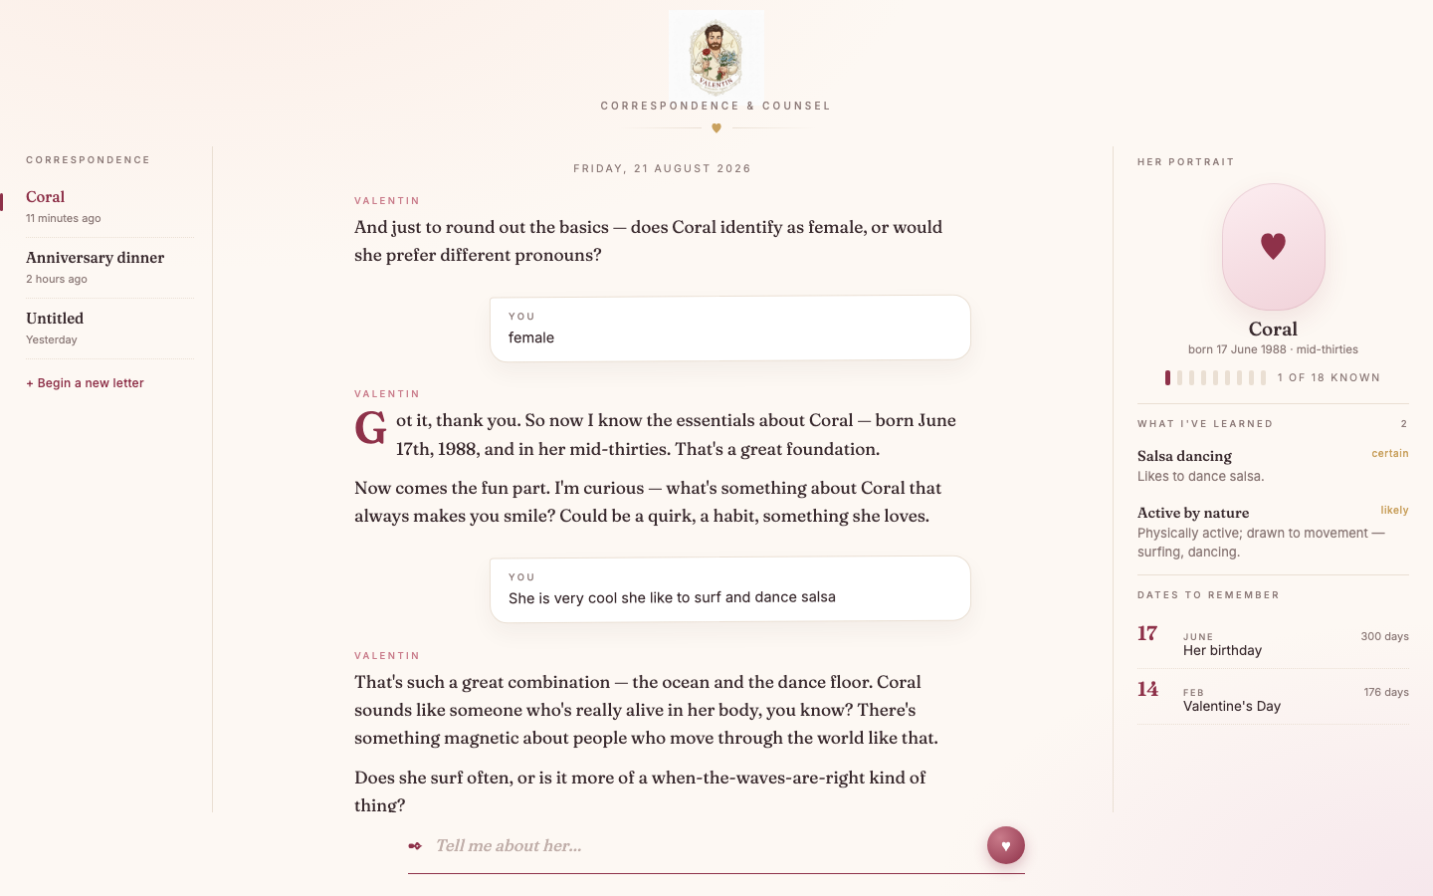
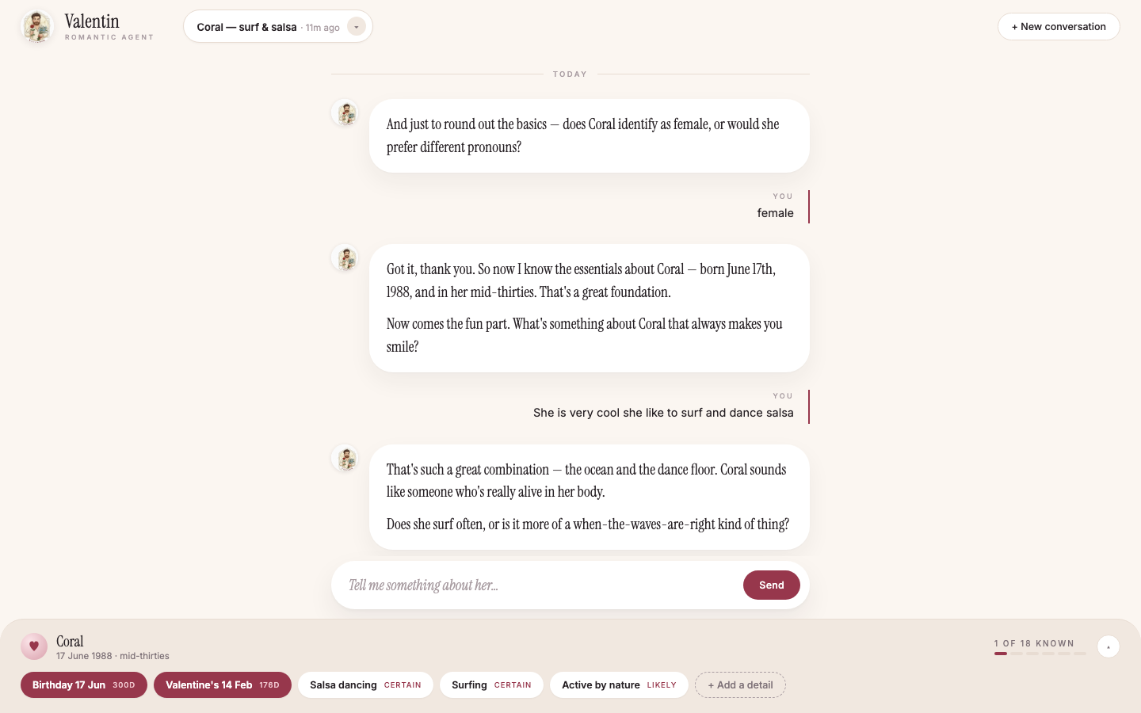
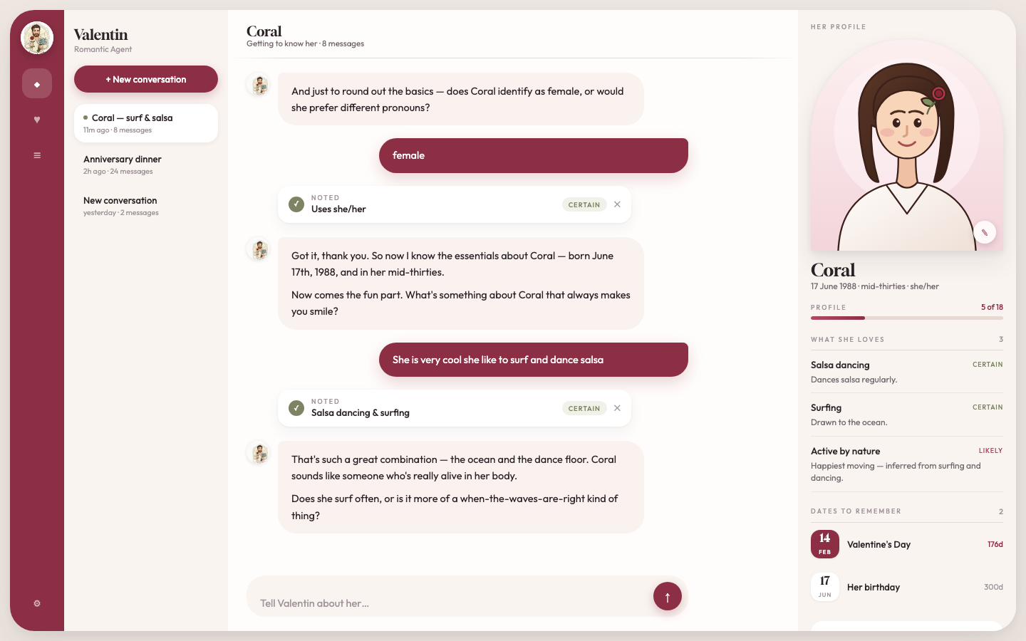
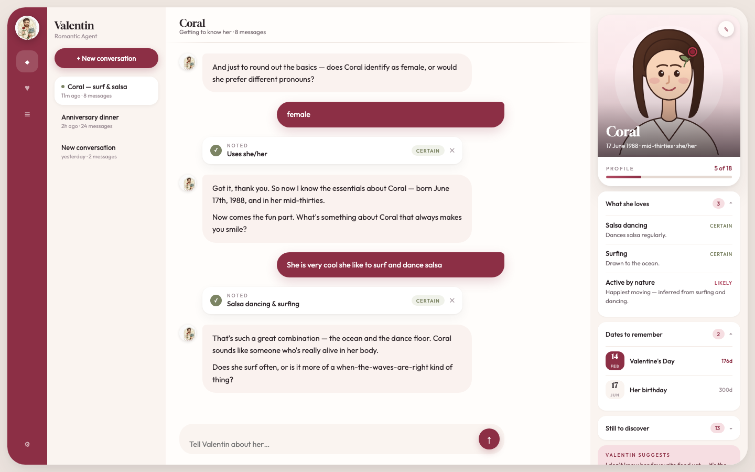
The designer agent explored eight directions
Love letter
Atelier
Dossier
Her card — chosen
Warm and editorial
Restrained, tool-like
Dense, information-first
Portrait-led, least chrome
Notes:
The product is emotional, so the interface had to be. Each candidate was built as a real working HTML mockup rather than a static comp — eight in total, four shown here. Love letter was too precious, atelier too cold, and dossier felt like surveillance, which is exactly the wrong feeling for a product about someone you love. Her card won: a portrait leads, the profile reads as something you'd keep rather than a database record, and it carries the least chrome of the finalists. All eight are still in the repo under public/mockups if anyone wants to argue for a different one.

Slide 17
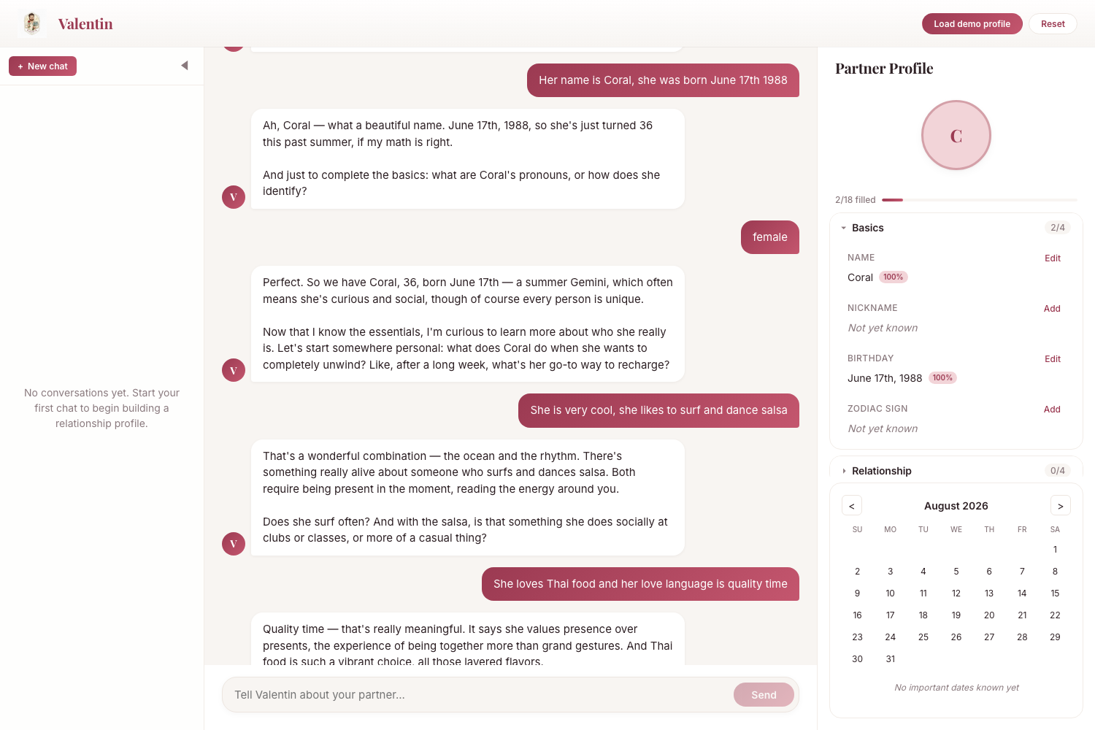
Live demo
Two terminals: backend, then frontend
Backend needs Bedrock access in the region
Four messages in, name and birthday at 100%
Richer categories were still landing
That gap is top of the next list
Notes:
This is a real capture, four messages into an actual conversation — not a mockup. He picks up the name and birthday at full confidence and reflects them straight into the panel. Being honest about what you're seeing: the Basics fields populate reliably, but the richer preference categories — surfing, salsa, Thai food, love language — were extracted and still landing when I took this, so the profile reads two of eighteen. That's the main thing I'd fix next, and it's on the next slide rather than hidden. One aside from capturing this: I hit a crash where Vite had two copies of the session context loaded, so provider and consumer disagreed. Clean restart fixed it — HMR only, not a production bug — but worth knowing before demoing off a long-running dev server.

Slide 18
Built, and what's next
Shipped
Next
The agent workflow: loop, router, 8 hooks, gate
Full-stack app on Bedrock with retry logic
Async extraction via tool-use
DynamoDB behind a storage interface
CDK stacks deployed; CI runs four gates
Tighten preference-category extraction
Auto-label PRs by agent at creation time
Real AgentCore SDK, replacing the stub
Session persistence across reloads
Export or share the partner profile
Notes:
On the left, what works today — and note the first line is the workflow, because that's the real deliverable: the orchestrator-led loop, turn router, eight hooks, merge gate, and a regression suite that tests the workflow itself. Then the product: Bedrock with retries, async extraction, DynamoDB behind the storage interface, CDK deployed, CI running lint, unit, build, and E2E. On the right, next. Top is tightening extraction for the richer categories, since that's the gap you just saw. Second is closing the honest-scope gap — making labelling an actual hook at PR creation instead of a batch job. Then the product roadmap.

Slide 19
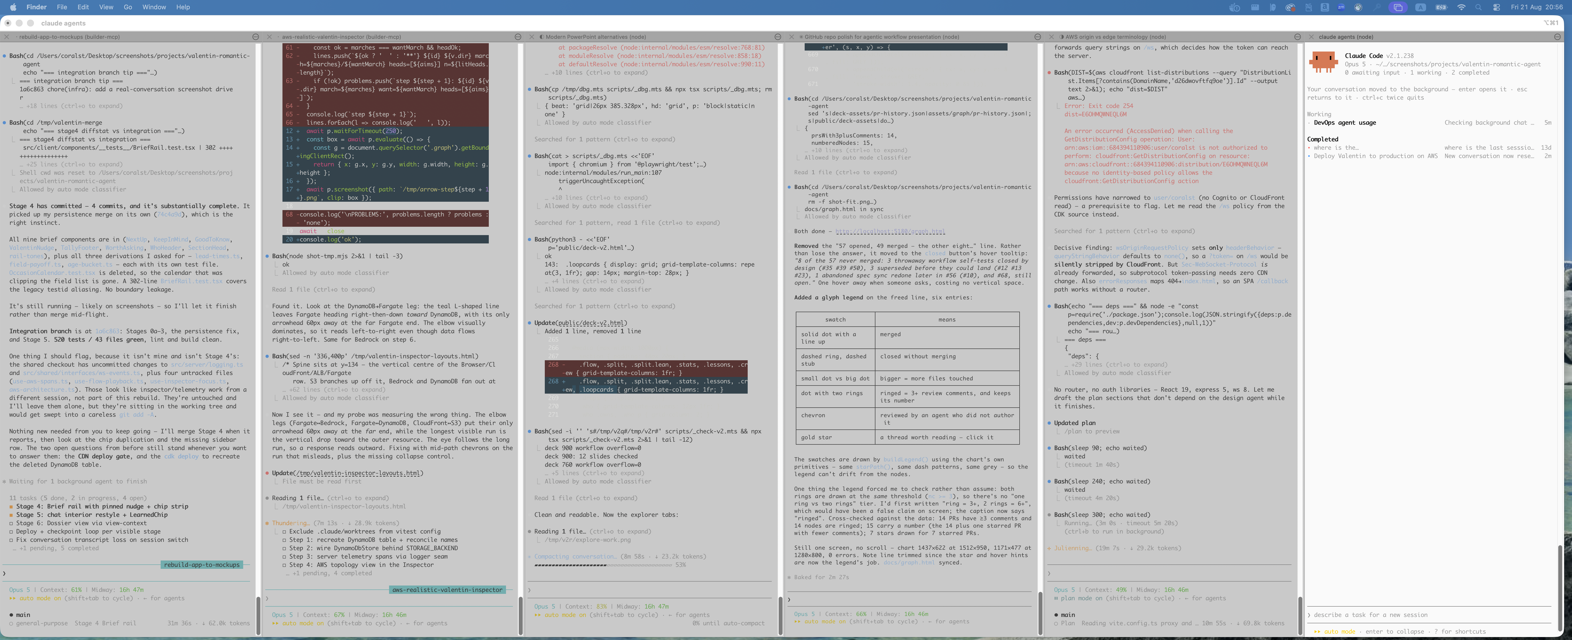

Slide 20
Thank you
Read the methodology · open any PR · questions welcome
Coral Steinberg
Notes:
Thank you. If you want to verify any of this, the methodology writeup is in docs/METHODOLOGY.md, and every PR conversation is readable on GitHub — I'd start with PR 40 or 58, the two longest review threads. Happy to take questions, dig into the turn router, or run the demo again with someone here describing their own partner.

