Slide 1
Valentin
A romantic concierge, powered by Bedrock
Coral Steinberg
Notes:
Valentin is an AI romantic concierge. You talk to him about the person you love, and he quietly builds a structured profile of them — the kind of notes nobody thinks to write down. Built as a full-stack app on AWS Bedrock. I'll show it running at the end.

Slide 2
Agenda
The problem
What Valentin does
How it works
Design and stack
Demo, and what's next
Notes:
Quick roadmap: why this problem is worth solving, what the product does, the architecture, how I arrived at the interface, the stack, a live demo, and where it goes next. About ten minutes, then questions.

Slide 3
Nobody keeps notes on people they love
The details that matter never get written down
Forms don't work — nobody fills in 18 fields
The best details are offhand, not fields
Memory needs somewhere to live
So you buy the same candle again
Notes:
You know her birthday. You half-remember the restaurant she liked. You forget the offhand comment about the trip she's always wanted — and then you're buying a candle again. Questionnaires fail because they feel clinical and the interesting details aren't fields. "She's very cool, she likes to surf and dance salsa" carries more signal than any dropdown — but only if something is listening and giving it structure.

Slide 4
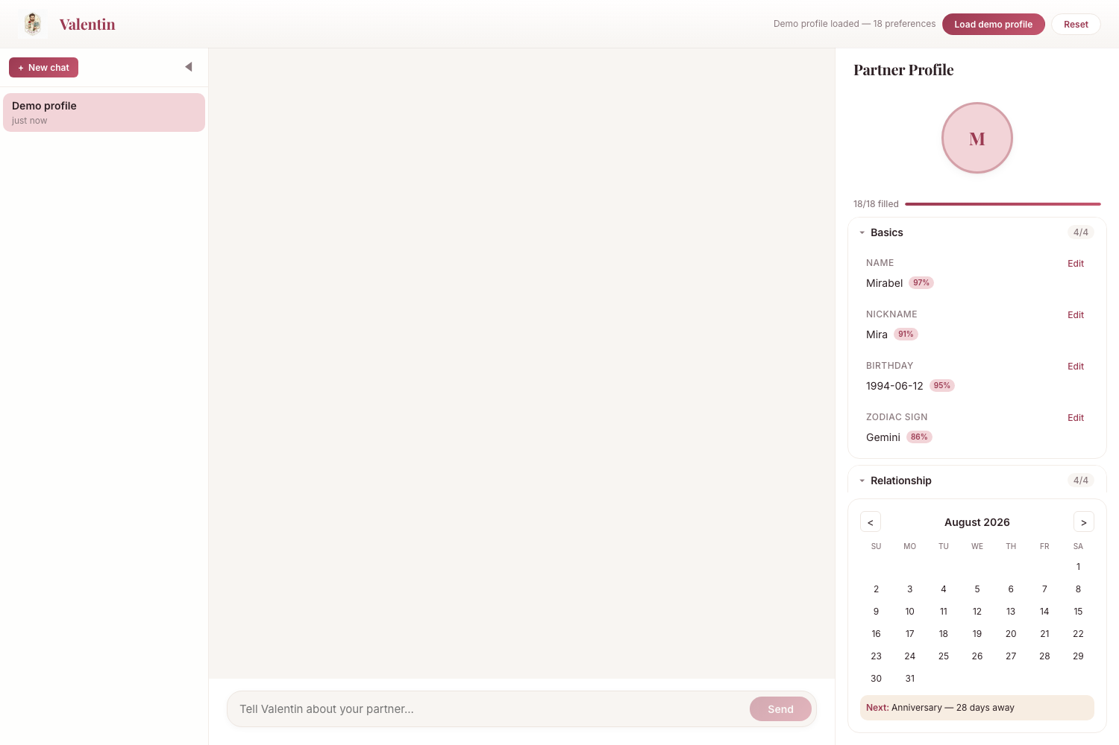
Conversation in, profile out
Warm, unhurried interview — not a form
Eight categories: food, hobbies, music, travel
Plus gifts, love language, dates, personality
Every entry carries a confidence score
Profile fills in live as you talk
Notes:
Valentin runs a warm interview. Every message is analysed in the background, and anything he learns lands in her profile immediately — tagged by category and by confidence. Certain when you said it outright, likely when he inferred it. The screenshot shows a fully populated profile: eighteen fields, each with a confidence percentage, grouped into Basics, Relationship, and preference categories, with a calendar surfacing the next important date.

Slide 5
One message, four moves
1. You type
2. Valentin replies
3. Extraction runs
4. Profile updates
Message travels over a session-scoped WebSocket to the Express gateway, which routes it to the orchestrator.
Bedrock's Converse API returns a reply in character, with the context window kept trimmed and coherent.
A second Bedrock call uses tool-use to pull structured preferences from the same message, in parallel.
Preferences are persisted, pushed back over the same socket, and highlighted as they land.
Notes:
The important design decision is step three. Extraction is a separate Bedrock call using tool-use, and it runs off the reply's critical path. The chat never waits on it. That means the conversation stays as fast as a normal chat while the profile fills in behind it — if extraction is slow or fails, you still get your reply. Everything flows over one WebSocket, so the client gets both the message and the profile delta on the same connection.

Slide 6
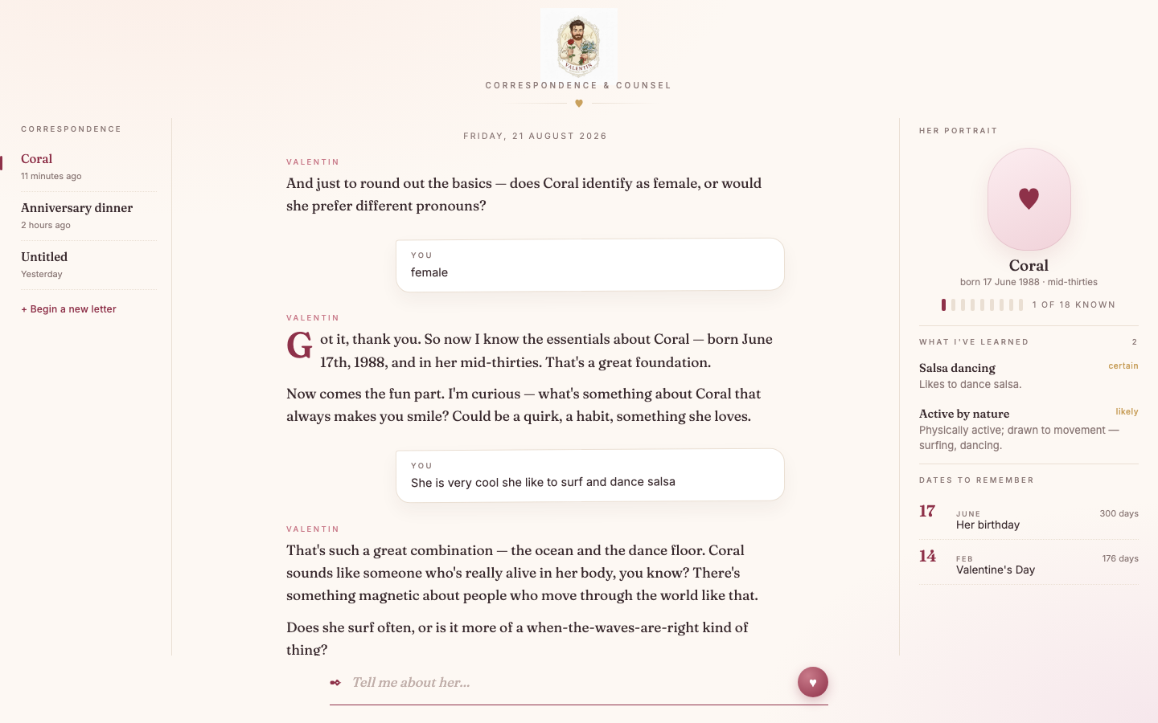
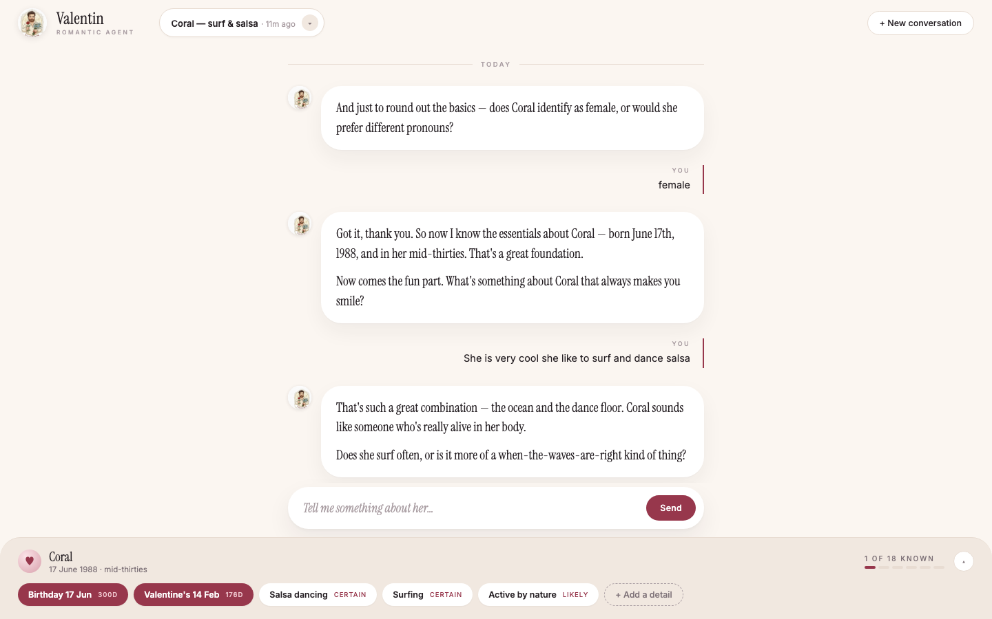
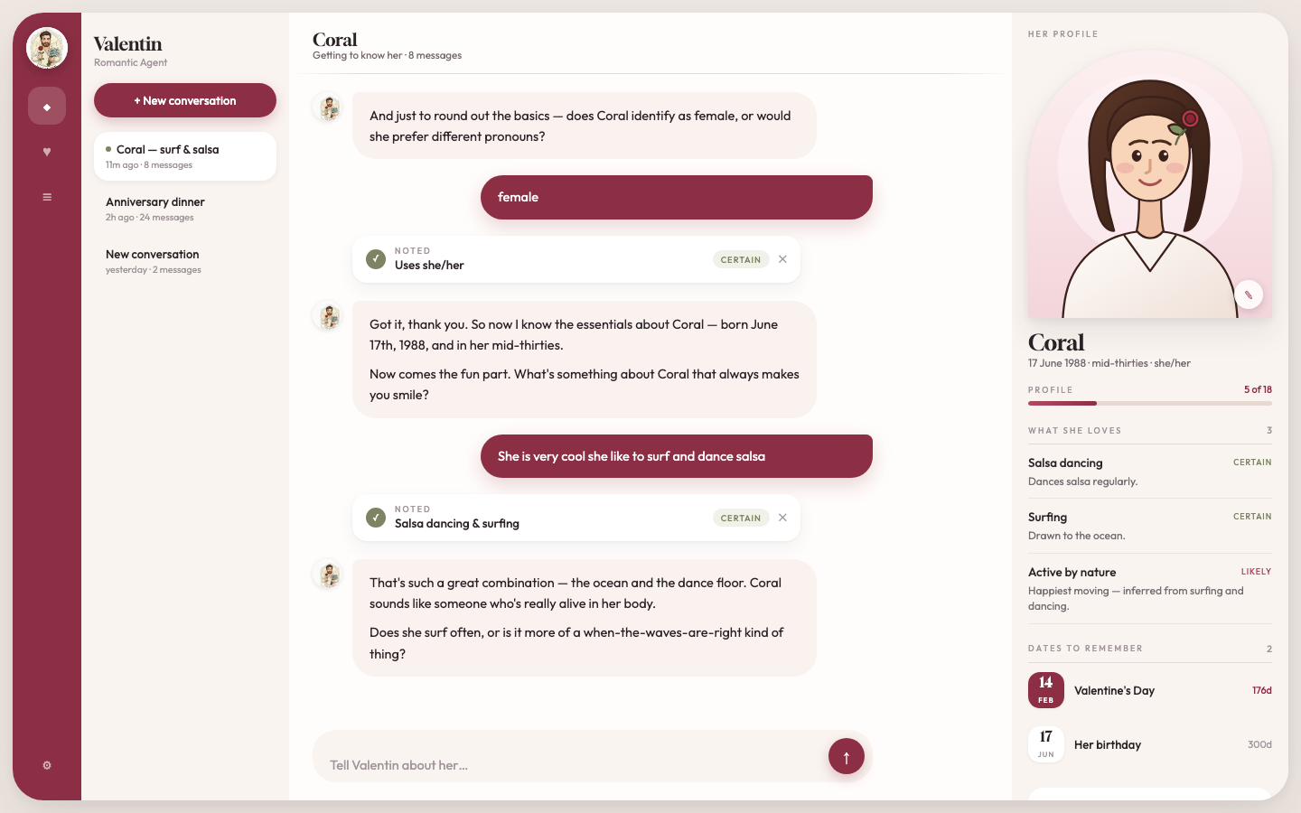
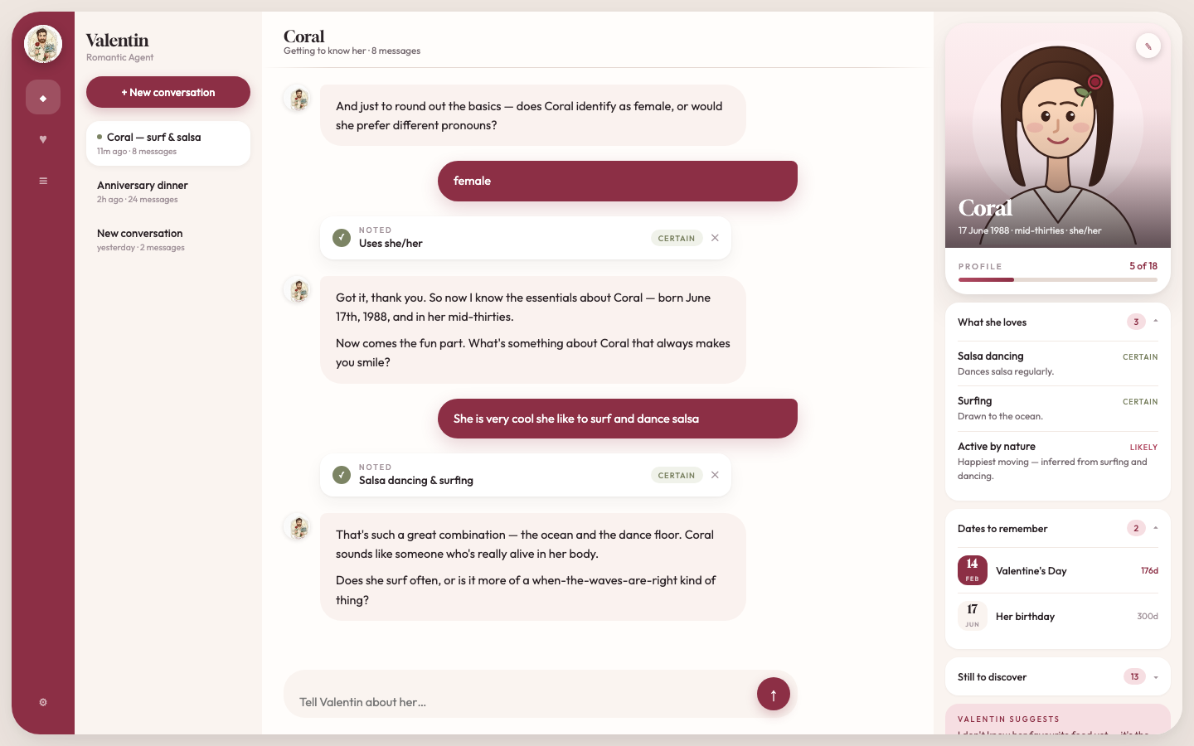
Eight directions, one chosen
Love letter
Atelier
Dossier
Her card — chosen
Warm and editorial
Restrained, tool-like
Dense, information-first
Portrait-led, least chrome
Notes:
The product is emotional, so the interface had to be. I built each candidate as a real working HTML mockup rather than a static comp — eight in total, four shown here. Love letter was too precious, atelier too cold, dossier felt like surveillance, which is exactly the wrong feeling for this product. Her card won: a portrait leads, the profile reads as something you'd keep rather than a database record, and it has the least chrome of the three finalists.

Slide 7
Under the hood
React 19 + TypeScript on Vite, strict mode
Express 5 with a ws WebSocket gateway
Claude Sonnet 4.5 on Bedrock, Converse API
DynamoDB behind a storage interface
CDK stacks; Vitest and Playwright tests
Notes:
Deliberately boring choices. The one piece of design I'd call out is the storage interface: swapping the in-memory store for DynamoDB touched a single file, and the test suite never knew, because tests run against the in-memory implementation. Extraction maps into eight preference categories via Bedrock tool-use. Tests are Vitest and React Testing Library for units, Playwright across Chromium, Firefox and WebKit for the critical flows. Infrastructure is CDK, deployed to dev and prod.

Slide 8
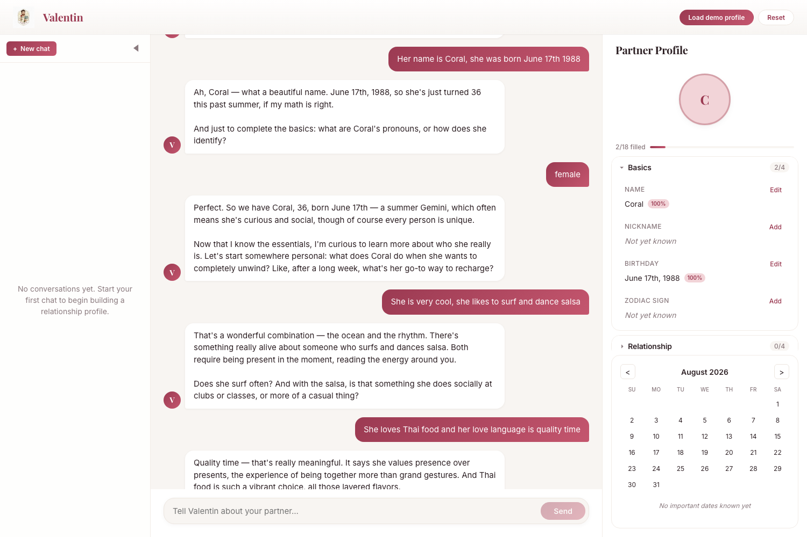
Live demo
Two commands: backend, then frontend
Backend needs Bedrock access in the region
Four messages in, name and birthday extracted
Each entry shows its confidence
Profile updates without a page refresh
Notes:
This is a real capture, not a mockup — four messages into an actual conversation. He picks up the name and birthday at full confidence and reflects them straight into the panel on the right. Worth being honest about what you're seeing: the Basics fields populate reliably, while the richer preference categories — surfing, salsa, Thai food, love language — are extracted but were still landing when I took this. That's the main thing I'm tightening next. If I'm demoing live, this is the moment to run it and ask the audience for someone to describe.

Slide 9
Built, and what's next
Shipped
Next
Full-stack app: React client, Express + ws
Bedrock Converse with retry logic
Async extraction via tool-use
Multi-session sidebar with rehydration
DynamoDB persistence; CDK deployed
Tighten preference-category extraction
Export or share the partner profile
Preference history — timeline per entry
Proactive nudges before key dates
Photo upload for the portrait card
Notes:
On the left, what's working today: the full stack, Bedrock integration with retries, async extraction, a multi-session sidebar that rehydrates both chat and profile when you switch, DynamoDB persistence, CDK stacks deployed and passing health checks, and unit plus end-to-end suites. On the right, what's next. Top of that list is tightening extraction for the richer categories, since that's the gap you saw in the demo. After that the interesting work is proactive: Valentin noticing an anniversary is three weeks out and suggesting something based on what he already knows.

Slide 10
Thank you
Questions welcome
Coral Steinberg
Notes:
Thank you — happy to take questions, dig into the architecture, or run the demo again with someone from the room describing their own partner.

