Slide 1
Course 2 Module 5 Programming Assignment Assignment is to ETL MIMIC data into the OMOP CONDITION_OCCURRENCE table

Slide 2
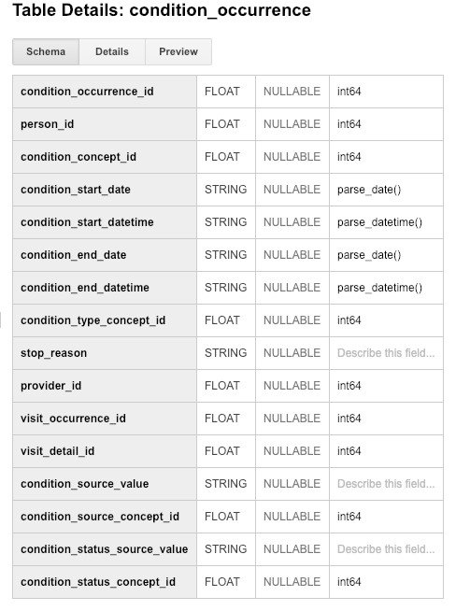
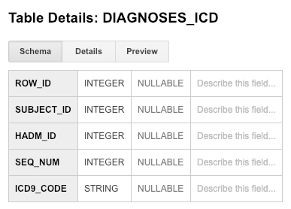
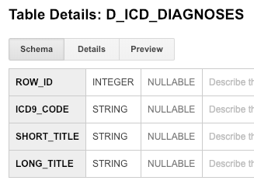
Step 1: Understand source/target data models
Person ID refers to subject ID – Identifying the patient/subject
HADM_ID – Is the admission detail with which we will use to identify the Visit when the condition was diagnosed
ICD9_CODE – Is the unique code refering to the condition as per the source data. Below is an additional table to identify the longer versions of the diagnosis codes.
Notes:
Paste into one or more slides, the key table or tables from MIMIC that hold data that can be used to fill in the OMOP CONDITION_OCCURRENCE table.
Choose the MIMIC table screenshots from this slide to indicate which MIMIC table or tables would be used in the ETL process. Delete the MIMIC tables that you will not use.

