Slide 1
STAT 645 - Time Series Forecasting
Forecasting Median Listing Price
in Rhode Island
FRED series MEDLISPRIRI - monthly, Jul 2016 to Mar 2026
Group X
Drexel University - Final Project

Slide 2
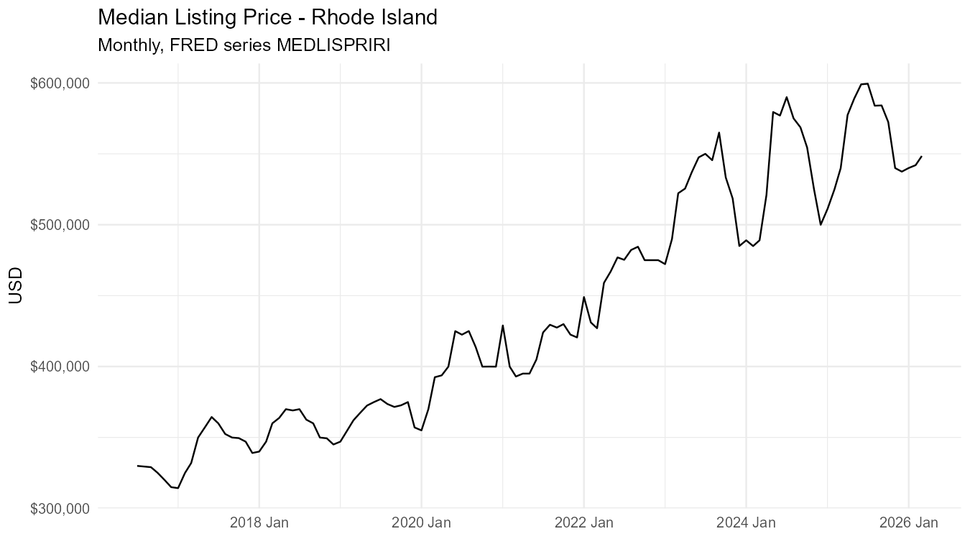
The data
FRED MEDLISPRIRI - monthly median listing price, Rhode Island
• Source: Zillow, distributed by St. Louis Fed (FRED)
• Frequency: monthly
• Window: Jul 2016 - Mar 2026 (n = 117)
• Range: $314k - $599k - ~90 percent expansion
• Captures 2020 - 2024 boom and 2025 - 2026 softening
• No missing observations, no gaps
Strong trend + 2020 acceleration + 2025 reversal.

Slide 3
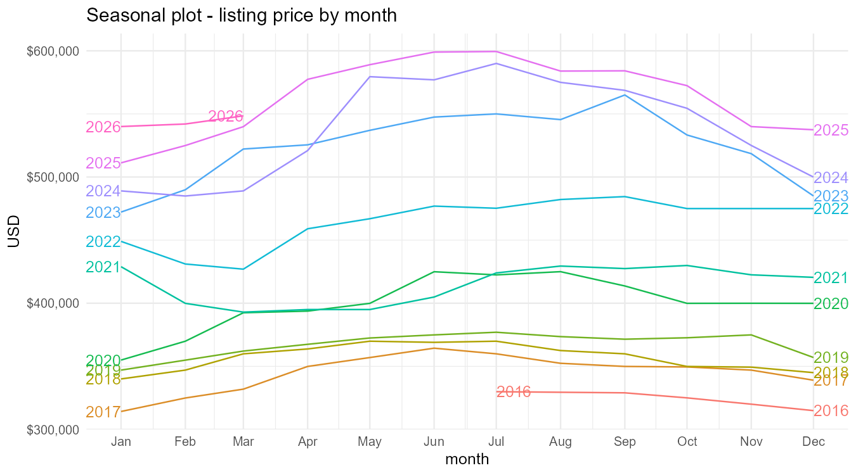
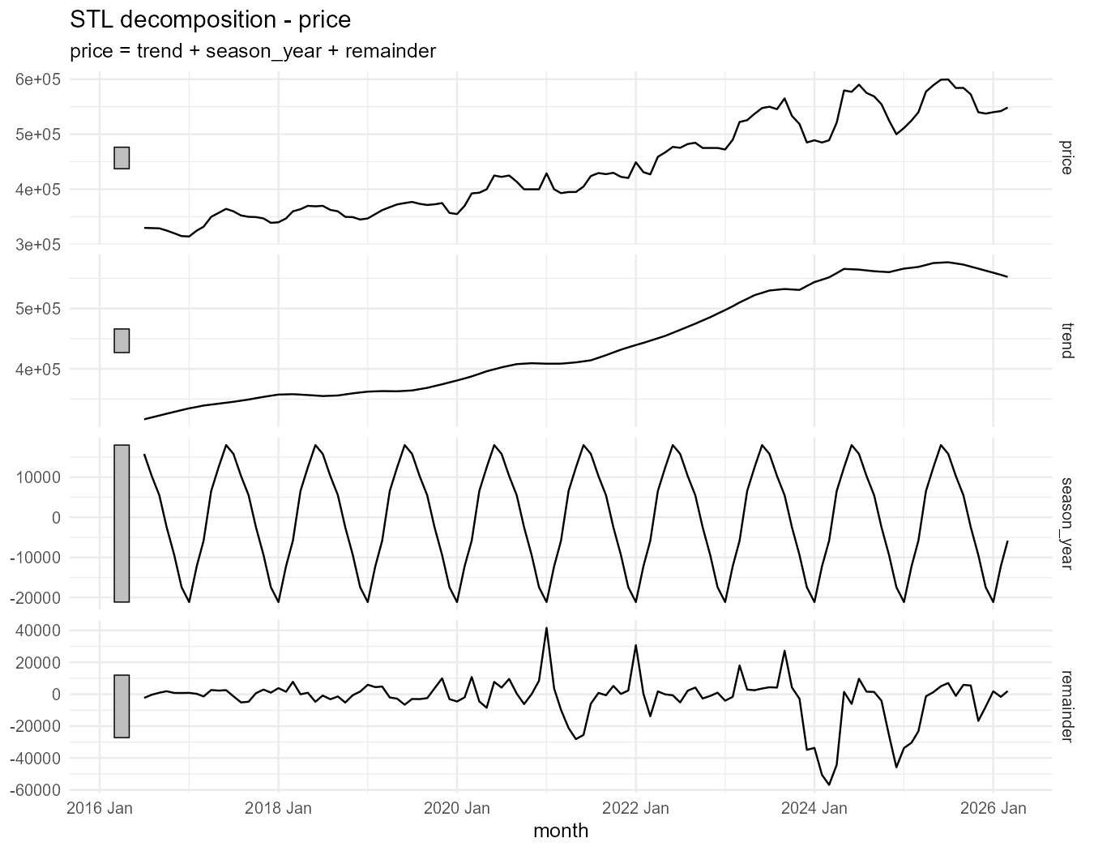
Trend and seasonality
STL decomposition isolates trend, yearly season, and remainder
Mild but consistent annual pattern - prices firm into summer.

Slide 4
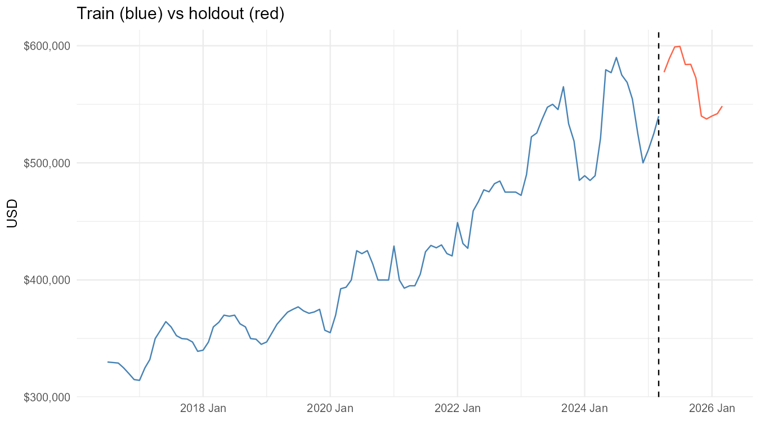
Approach
Hold out the last 12 months (~10 percent), fit every model family from class
Candidate models
Toolbox baselines
Mean, Naive, SNaive, Drift
TSLM regression
trend + season, trend + Fourier(K=2)
ETS family
M-A-M, damped A-Ad-A, log-ETS
ARIMA family
Holdout: last 12 months ; metrics: RMSE, MAE, MAPE, MASE.
auto, seasonal (1,1,1)(0,1,1)
STL + ETS
decomposition with ETS on adjusted series

Slide 5
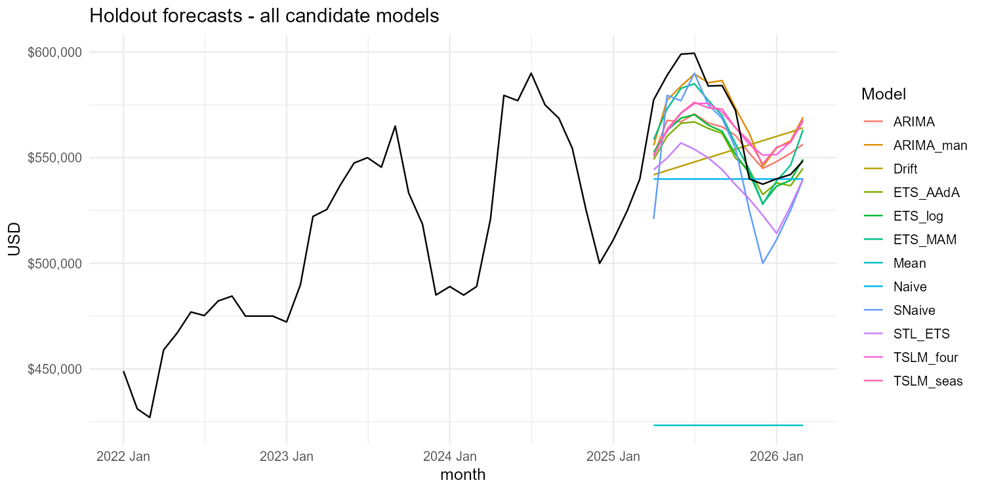
Holdout forecasts - all candidates
Visual check before scoring with accuracy metrics

Slide 6
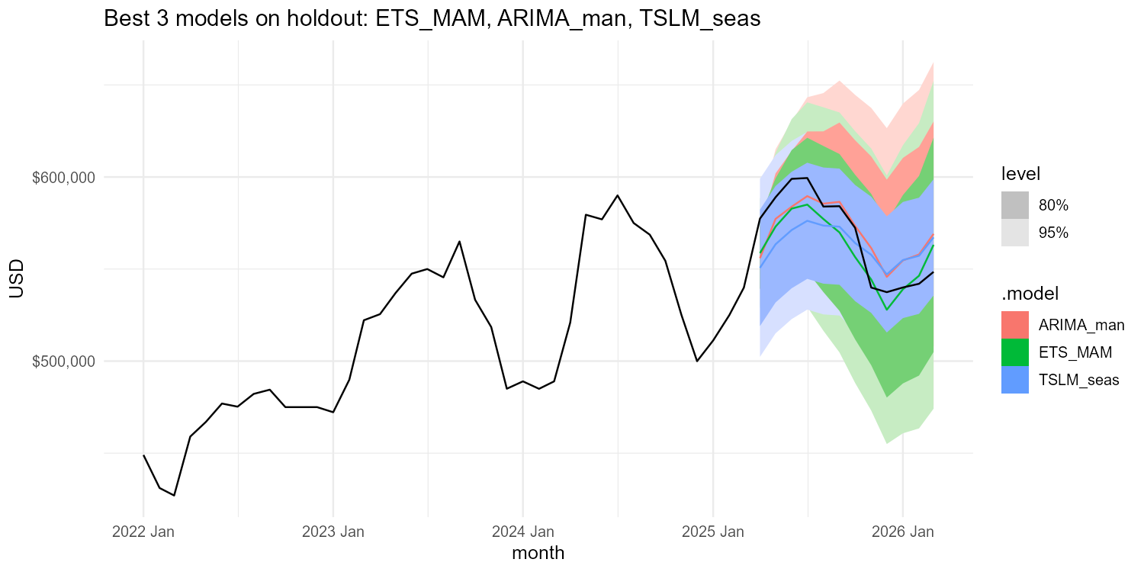
Best three models on the holdout
Zoomed view of the leading candidates

Slide 7
Forecast accuracy on the 12-month holdout
Sorted by RMSE - smaller is better
Model | RMSE | MAE | MAPE | MASE | RMSSE
ETS_MAM | 12,658 | 11,346 | 1.97 | 0.39 | 0.34
ARIMA_man | 14,021 | 12,014 | 2.14 | 0.41 | 0.38
TSLM_seas | 18,694 | 17,446 | 3.06 | 0.60 | 0.51
TSLM_four | 18,768 | 17,484 | 3.06 | 0.60 | 0.51
ARIMA | 18,859 | 16,934 | 2.93 | 0.58 | 0.51
ETS_log | 19,175 | 15,817 | 2.72 | 0.54 | 0.52
ETS_AAdA | 20,952 | 17,292 | 2.97 | 0.59 | 0.57
SNaive | 24,688 | 20,552 | 3.65 | 0.70 | 0.67
STL_ETS | 31,253 | 28,547 | 4.95 | 0.98 | 0.85
Drift | 32,930 | 30,174 | 5.24 | 1.03 | 0.89
Naive | 36,394 | 28,276 | 4.82 | 0.97 | 0.99
Mean | 146,366 | 144,483 | 25.32 | 4.96 | 3.97

Slide 8
Judgment calls
Decisions that shaped the final pick
Holdout length
12 months satisfies the >=10 percent rubric and exposes one full season.
ARIMA family included
Chapter 9 added - auto plus a seasonal (1,1,1)(0,1,1); the closest challenger, which confirms the ETS choice rather than overturning it.
Transformation
Guerrero lambda approximately -0.9 is numerically unstable here, so the transformed ETS uses a log scale instead of a raw Box-Cox.
Damped vs. undamped trend
2025 reversal makes undamped trend dangerous over a 12-month horizon - we include A-Ad-A and let accuracy decide.
TSLM Fourier order K=2
Captures the dominant annual cycle with fewer coefficients than 11 monthly dummies.

Slide 9
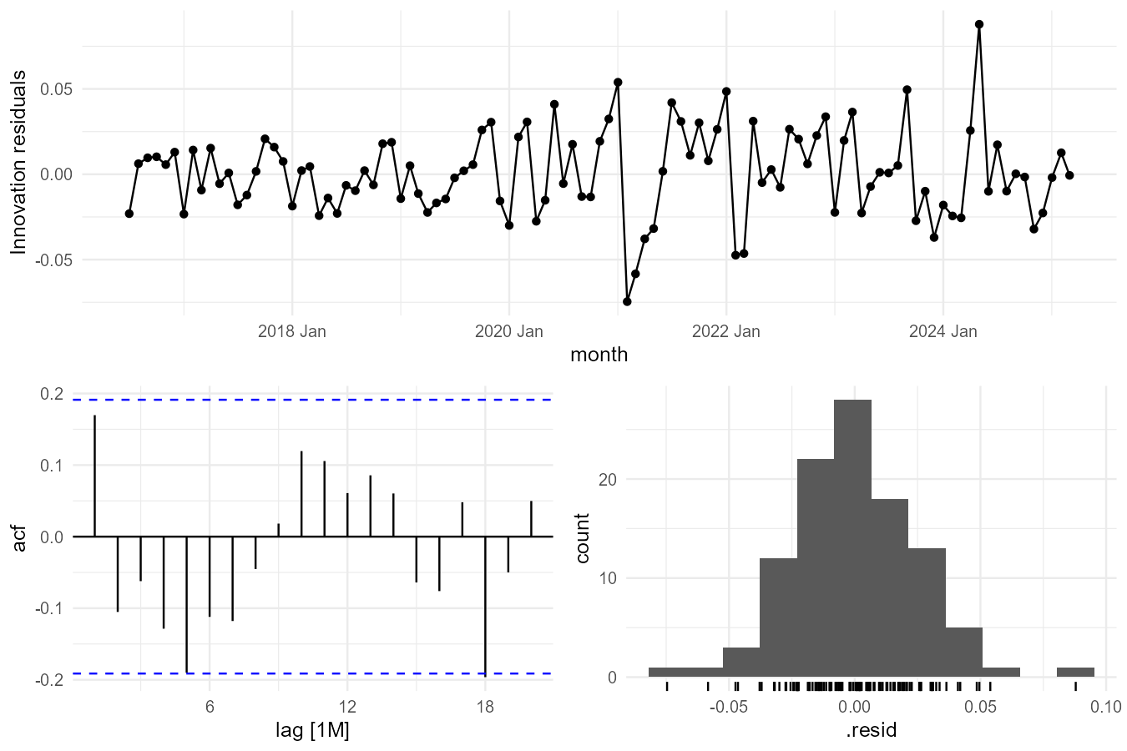
Chosen model: ETS_MAM - residual diagnostics
Innovation residuals, ACF, and distribution
Reading the diagnostics
• ACF: most lags fall within the significance bounds
• Residuals roughly symmetric and centred on zero
• Large residuals cluster in 2020-2022 (COVID market shock)
• Ljung-Box (lag 24, dof 17): chi-sq 29.3, p = 0.0001
• p < 0.05: some residual structure remains, traced to the 2020-22 shock
• Selection rests on holdout accuracy; intervals carry the residual risk

Slide 10
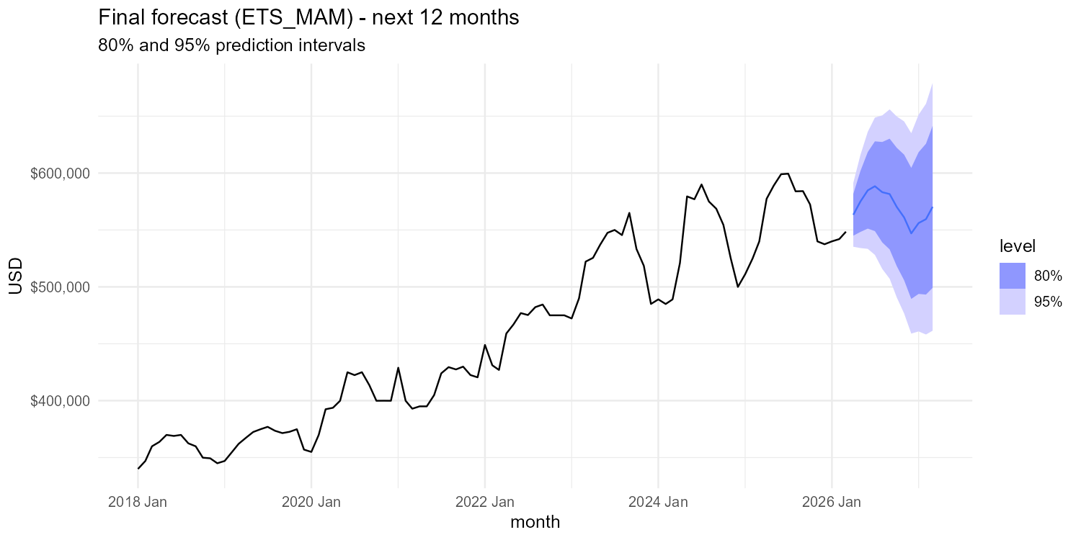
12-month forecast
Refit on the full series ; 80 percent and 95 percent prediction intervals - ETS_MAM

Slide 11
Conclusions and assumptions
What we found, what we are watching
Findings
Assumptions and caveats
• Chosen model: ETS_MAM
• Beats every baseline and the seasonal ARIMA on RMSE / MAPE
• Residual ACF mostly clean; Ljung-Box flags 2020-22 shock structure
• 12-month forecast widens reasonably given the recent regime change
• Only ~10 years of history; one full housing cycle
• 2020 - 2022 shock is a large share of the sample
• Forecast assumes no structural break (rates, policy)
• Refit monthly; watch standardised residuals for drift > 2 sigma
Group X - STAT 645 Final Project - Drexel University

