Slide 1
Parallel Homomorphic Encryption on a Distributed Image
MATH 424 Final Project
Presenter Corbin Graham

Slide 2
Parallel Homomorphic Encryption on a Distributed Image?
Parallelized algorithm for uploading an encrypted image to a distributed server network
Supports image modification without decryption
Can be run in parallel in the case of HPC or uniformly

Slide 3
About: Context / Implementations
Secure Image Storage
Secure Image Transmission
Homomorphic Encryption
Encrypts data asymmetrically (pub/priv keys)
Allows computation without decryption
Prevents Man-in-the-Middle Attacks
Recently, Google for ML
Medical Data
Secure Government Data
Data sharing with third parties

Slide 4
About: Proposed System Design
Encrypted
Encrypt
Client
HPC Parallel Encryption Layer
Distributed Cloud Server
Decrypt
Modification (while encrypted)
Notes:
Can be stored in a distributed state for greater security

Slide 5








About: Encryption Design
LAN
Server
HPC
Chunking
Crypto
Image
Row 1
Encrypt
Modify
Transmit
Row N
Key Pair
Notes:
Can be stored in a distributed state for greater security

Slide 6
About: Definitions
Partial Homomorphic Encryption (PHE)
Homomorphism
f: A->B is homomorphic if f(x*y) = f(x) * f(y) for all x,y in A, and should be inversible s.t. f: B->A exists
Any change made to the modified data will exist on the original data
PHE – Implementation
Singular time operator arithmetic on M,N Image
FHE
Infinite operator arithmetic on M,N Image
Asymmetric Encryption
Public Key, Private Key generated; data encrypted with public key and decrypted with private key
This allows for the key holder to invite new encryptions without providing decryption

Slide 7
About: Algorithm Design
Image Chunking:
Split an image into equal parts based on number of processors and threads
One process can handle multiple threads – for any function, and dist. storage
Each encoding happens on one thread in O(n)
Image Encryption
Using asymmetric pub/priv keypair, encode image homomorphically
Image Modification
Partial PHE – Only addition works, but different algorithms allow for FHE
Image Decryption
Return image to original state

Slide 8
Methods: Tools & Languages
Python
Numpy, Matplotlib, SKImage
Image import
Image translation
Graphing and modeling
C
OpenMPI, Math
Chunking / Parallelization
Encryption
Decryption
Keypair generation

Slide 9
Methods: Algorithm
Paillier Cryptosystem Variation
Key Generation
n = p*q s.t. p and q are primes in bit range (16 here)
Used 149, 197 hard coded for consistency. Dangerously low primes.
λ = lcm((p-1), (q-1))
g = 56602 (random 16-bit number hardset pub param)
L(u) = (u-1) / n (Adjusting the cypher for HE)
u = L(g^{λ} mod n²)⁻¹ mod n

Slide 10
Methods: Algorithm Ctd
Encryption E (I -> C) (pub: n,g)
1 < r < n where r is a random number
C = ((g^{m} mod n²) * (r^{n} mod n²) mod n²)
Addition A (C(m) -> C_{m}) (pub: n,g)
C_{m} = C * E(m) mod n²
Decryption D -> (C -> I) (priv: λ,u)
I = (((c^{λ} mod n²) - 1) / n) * u) % n)

Slide 11
Methods: Homomorphic Encryption Function
Let E be our homomorphic encryption function
Assume from our image 1 < k < L and all k in {0,1,...(p-1)}
Assume y is the sum of k’s pixels y=Sum^k(i=1) y_i
Let E->Z_p : E(y_1 + y_2 ... + y_k) = E(y_1) * E(y_2) * ... E(y_k)
Let C be our cryptographic function: C = [Sum^k(i=1) C_i [Sum^k(j=1) E(y_j) mod p]
Key generation:
Sum^k(i=1) q_i = \E(y_i)/p\ (\\ is floor)

Slide 12
Methods: Algorithm Ctd
Proving Homomorphism D[E(y)] = y
(((((g^{m} mod n²) * (r^{n} mod n²) mod n²) – 1) / n) * u) % n)
(((g^{mλ} mod n^{2 *} r^{nλ} mod n²) mod n² - 1) / n * u) % n)
(g^{m} mod n^{2 *} r^{n} mod n² ) mod n²
(E(y) * u-u) mod n
D[E(y)] = E(y) mod n
Encryption E (I -> C)
C = ((g^{m} mod n²) * (r^{n} mod n²) mod n²)
Decryption D -> (C -> I)
I = (((C^{λ} mod n²) - 1) / n) * u) % n)

Slide 13
Methods: MPI Implementation
Chunking
P is number of processors
T is number of threads
M is length of image
N is width of image
Chunk(M,N,P) -> M // P, T = N/T_{c}
During encryption, decryption, and modification
Run all operations in parallel
Apply each operation to a row
Implication: O(n^2) -> O(n) with maximum parallelization

Slide 14
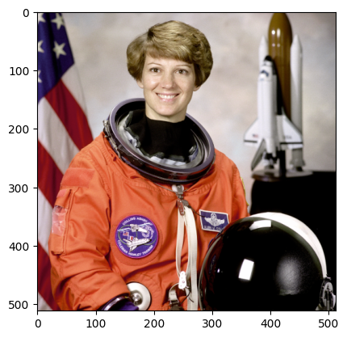
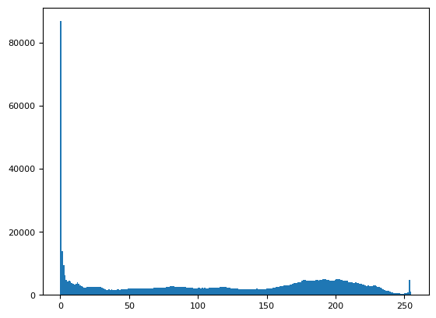
Results: Original Image - Histogram
Original Image
Image Histogram

Slide 15
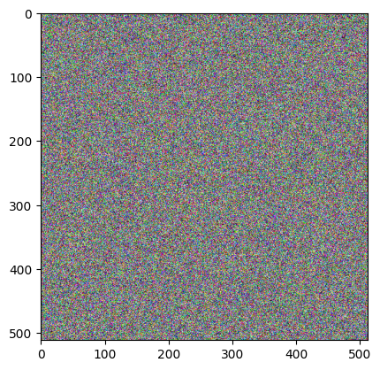
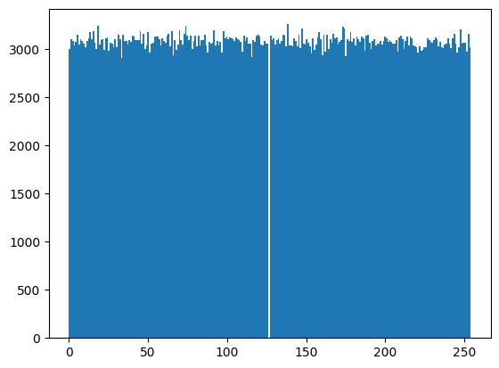
Results: Cryptographic Image
Cryptographic Image
Image Histogram

Slide 16
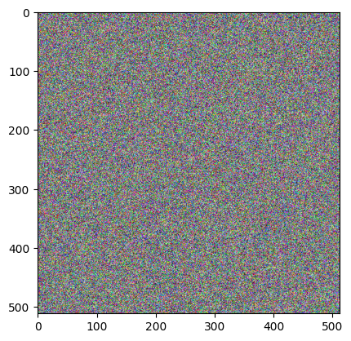
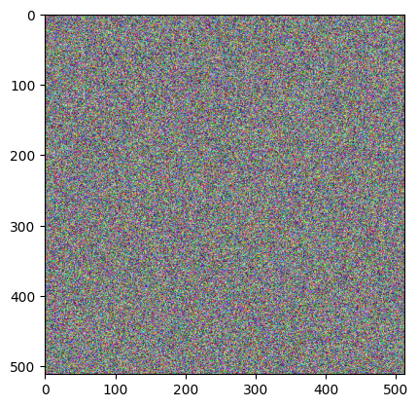
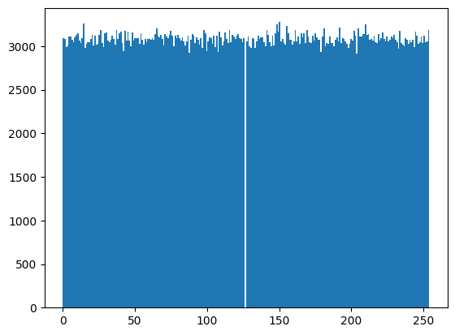
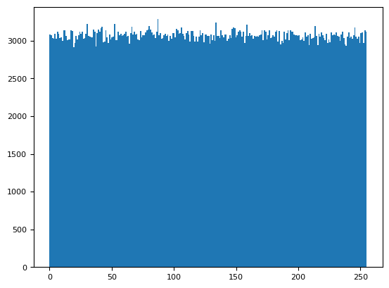
Results: Modified Cryptographic Image
4% Brighter Cryptographic Image
Image Histogram

Slide 17
Results: Cryptographic Image Difference
Difference
Diff Histogram

Slide 18
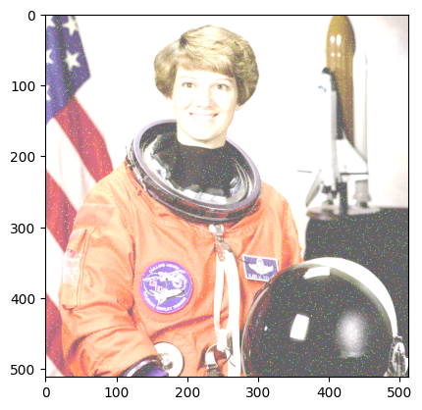
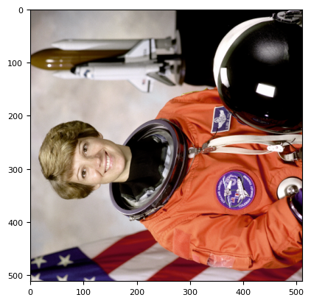
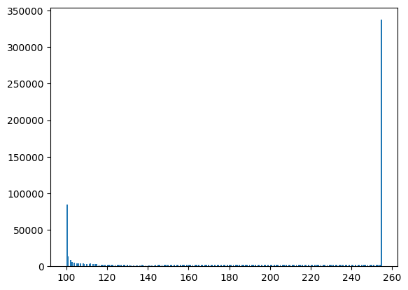
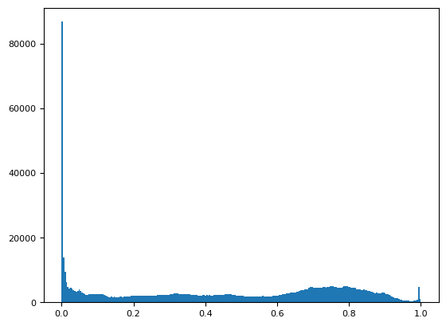
Results: Modified Decrypted Image
(Modified) Decrypted Image
Image Histogram

Slide 19
Results: Histogram Comparison
Original Image Histogram
Nonmodified D-Image Histogram

Slide 20
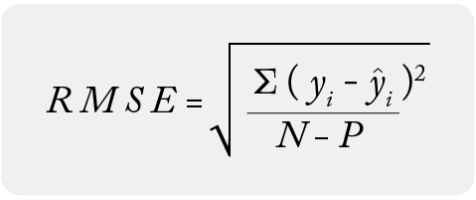

Results: Accuracy Measurement – PSNR
RMSE (Root MSE)
PSNR (Peak Signal-to-Noise Ration)
Ideal: 30-50 dB
Result: -125.80123893438882 – Way too much noise from low bit range

Slide 21
Results: Parallel Acceleration
OpenMPI – Not Fully Implemented
Processes | Threads | Time | Result
1 | 1 | 3.9100000000000e-04 | +0.0000000000000e-0
 | 2 | 3.9100000000000e-04 | +0.0000000000000e-0
2 | 1 | 2.8476000000000e-02 | +1.0624000000000e-0
 | 2 | 2.0000000000000e-02 | +0.8476000000000e-0
4 | 1 | 2.0000000000000e-02 | +0.0000000000000e-0
 | 2 | 2.0000000000000e-02 | +0.0000000000000e-0
8 | 1 | 2.0000000000000e-02 | +0.0000000000000e-0
 | 2 | 2.0000000000000e-02 | +0.0000000000000e-0
16 | 1 | 2.0000000000000e-02 | +0.0000000000000e-0
 | 2 | 2.0000000000000e-02 | +0.0000000000000e-0

Slide 22
Results: Discussion
Accuracy Measurements
Accurate Prime Number Generation (higher bit count)
Pixel Compression (currently exponential)
Vulnerabilities: Deterministic

Slide 23
Conclusion
Can be parallelized, efficiently before transmission
Allows for optimal distributed storage
Proven and deployed
Allows for third party cloud storage
Prevents many known attacks – if implemented properly
Issues: Security, speed, efficiency
Ideas: CNN Inference for rescaling compressed images

Slide 24
References
Public-Key Cryptosystems Based on Composite Degree Residuosity Classes https://www.cs.tau.ac.il/~fiat/crypt07/papers/Pai99pai.pdf
Somewhat Practical Fully Homomorphic Encryption https://eprint.iacr.org/2012/144.pdf
Carmichael function https://en.wikipedia.org/wiki/Carmichael_function
Modular multiplicative inverse https://en.wikipedia.org/wiki/Modular_multiplicative_inverse
RSA (cryptosystem) https://en.wikipedia.org/wiki/RSA_(cryptosystem)
Homomorphic encryption https://en.wikipedia.org/wiki/Homomorphic_encryption
Paillier cryptosystem https://en.wikipedia.org/wiki/Paillier_cryptosystem
An Efficient Homomorphic Medical Image Encryption Algorithm For Cloud Storage Security https://www.sciencedirect.com/science/article/pii/S1877050917319798
Distributed Image Encryption Based On a Homomorphic Cryptographic Approach https://ieeexplore.ieee.org/stamp/stamp.jsp?tp=&arnumber=8993025
An Efficient Secret Key Homomorphic Encryption Used in Image Processing Service https://www.hindawi.com/journals/scn/2017/7695751/
Parallelizing fully homomorphic encryption for a cloud environment https://www.elsevier.es/en-revista-journal-applied-research-technology-jart-81-articulo-parallelizing-fully-homomorphic-encryption-for-S166564231500005X

