Slide 1
Climate Analysis of Milan, Italy
DS202 Final Project
Coleman Dimmer, Corbin Graham

Slide 2
Introduction
Is climate change occurring?
Why not look at data to get clues
Wanted to learn more about climate change
Why might it be happening?
Is it only in America, or is it a global threat?

Slide 3
About the Data: Background
Monthly Weather Data for Milan, Italy
National Centers for Environmental Information (NCEI)
Is for date range (Y/M/D) of 1763-01-01 to 2008-11-30

Slide 4
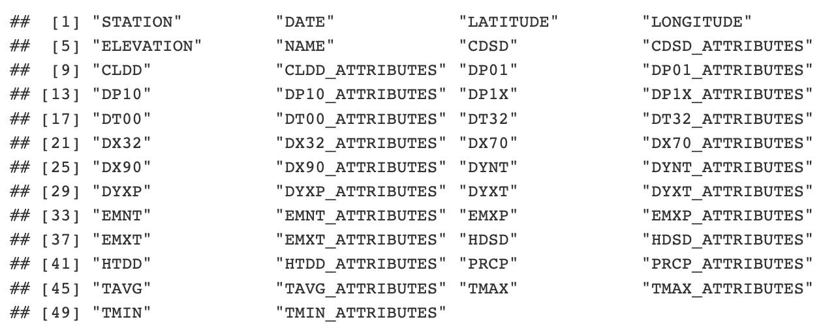
About the Data: Data Points

Slide 5
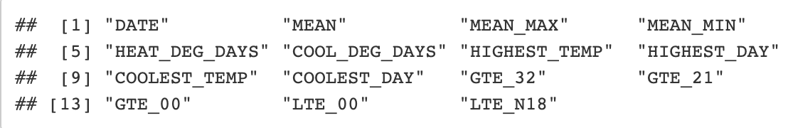
About the Data: Key Data Points
The points we drew were those most important to temperature data with negation to precipitation:
MEAN ← TAVG MEAN_MAX ← TMAX MEAN_MIN ← TMIN HIGHEST_DAY ← EMXT_ATTRIBUTES GTE_21 ← DX70 | HEAT_DEG_DAYS ← HTDD COOLEST_TEMP ← EMNT GTE_00 ← DX32 | COOL_DEG_DAYS ← CLDD COOLEST_DAY ← EMNT_ATTRIBUTES LTE_00 ← DT32 | HIGHEST_TEMP ← EMXT GTE_32 ← DX90 LTE_N18 ← DT00

Slide 6
About the Data: Important Data Highlights
All data points were recorded at the Milan Weather Station
First Recording Date: January 1767
Final Recording Date: November 2008
Lowest Recorded Temperature: January 1767, -4.75C (23.45F)
Highest Recorded Temperature: July 2006, 31.2C (88.16F)

Slide 7
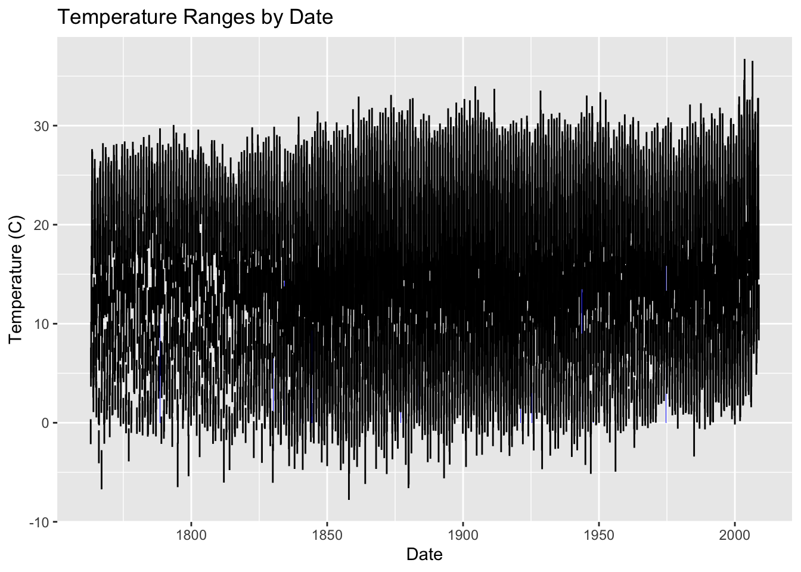
Analysis: Temperature Ranges (Monthly)
Clear Range Increases:
1860
2000

Slide 8
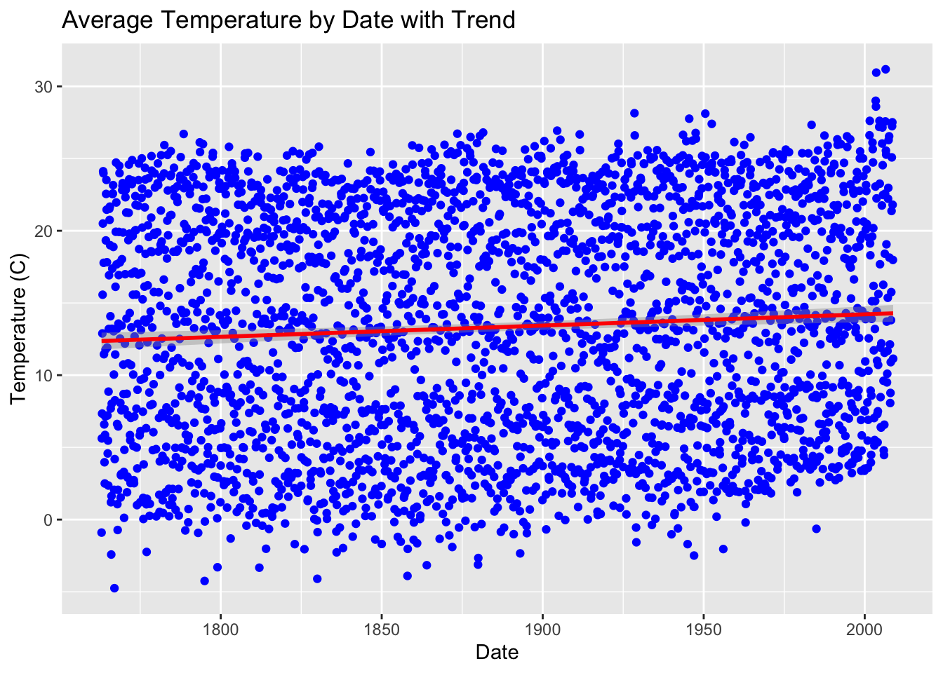
Analysis: Monthly Temperatures with Trend Line
Trend line shows clear increase

Slide 9
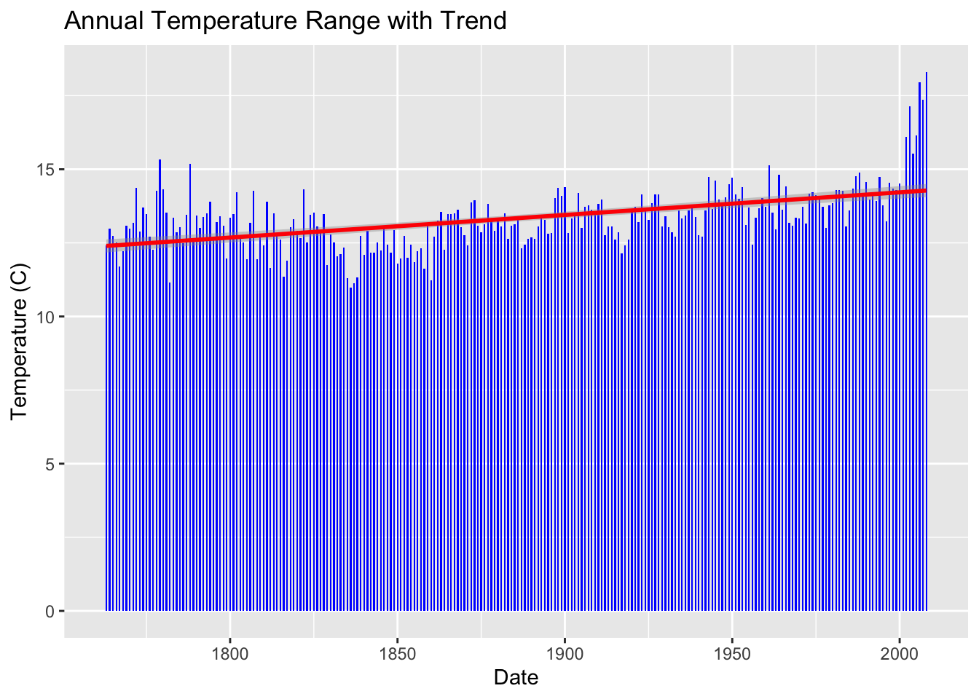
Analysis: Annual Temperatures with Trend Line
Annual temperatures clearly increase over time with massive leap in 2000

Slide 10
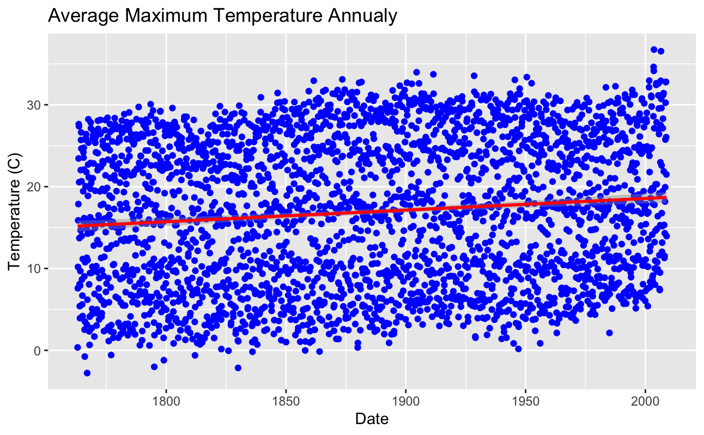
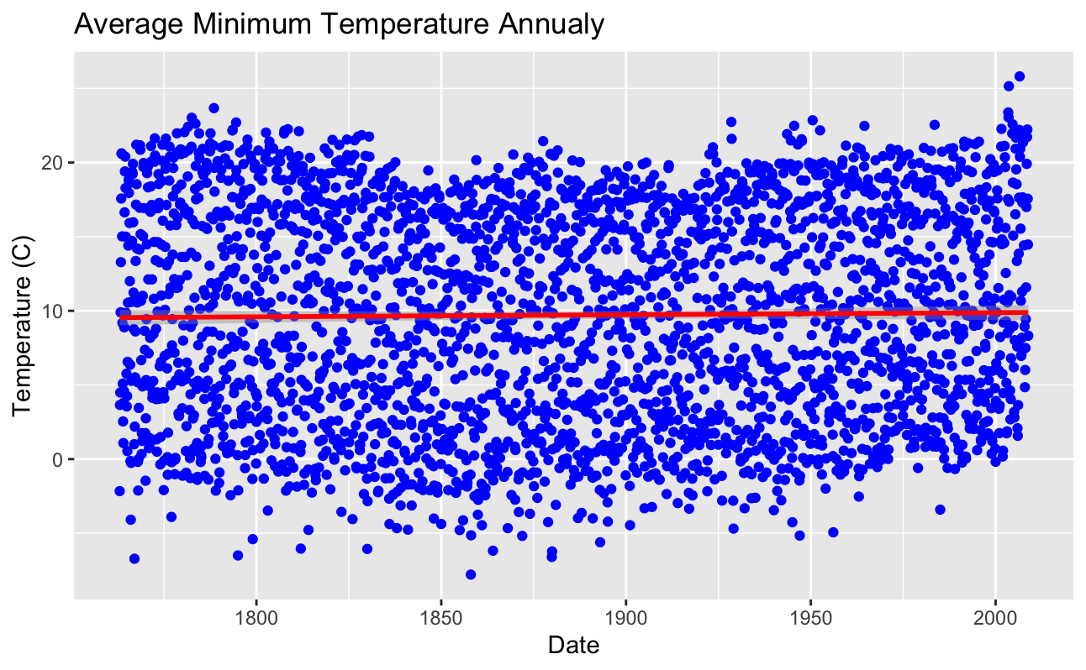
Analysis: Temperature Trends

Slide 11
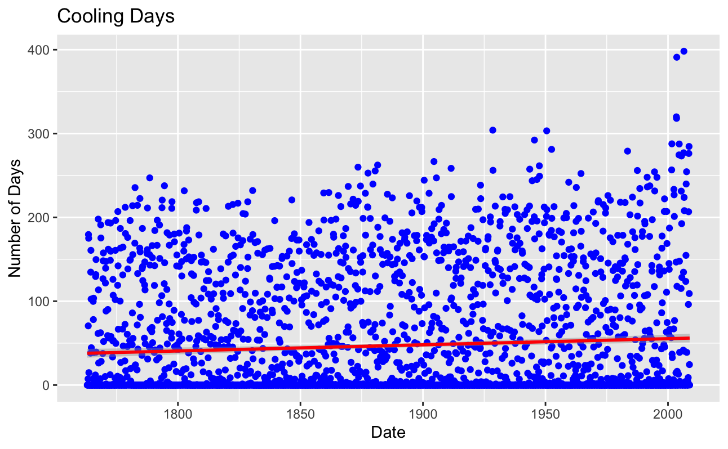
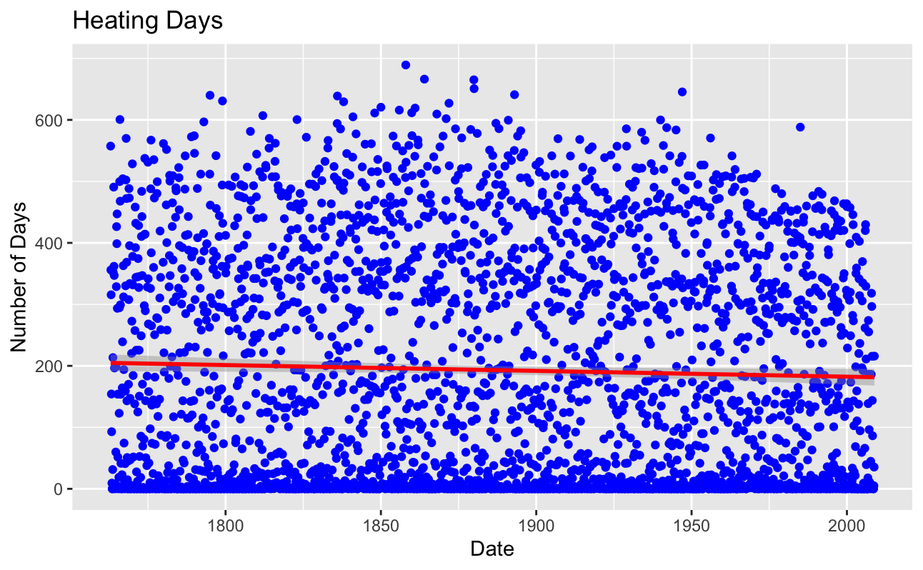
Analysis: Temperature Trends
Degree days are the difference between the daily temperature mean and monthly temperature mean
Cooling: More days below monthly average
Heating: More days above monthly average
https://www.weather.gov/key/climate_heat_cool

Slide 12
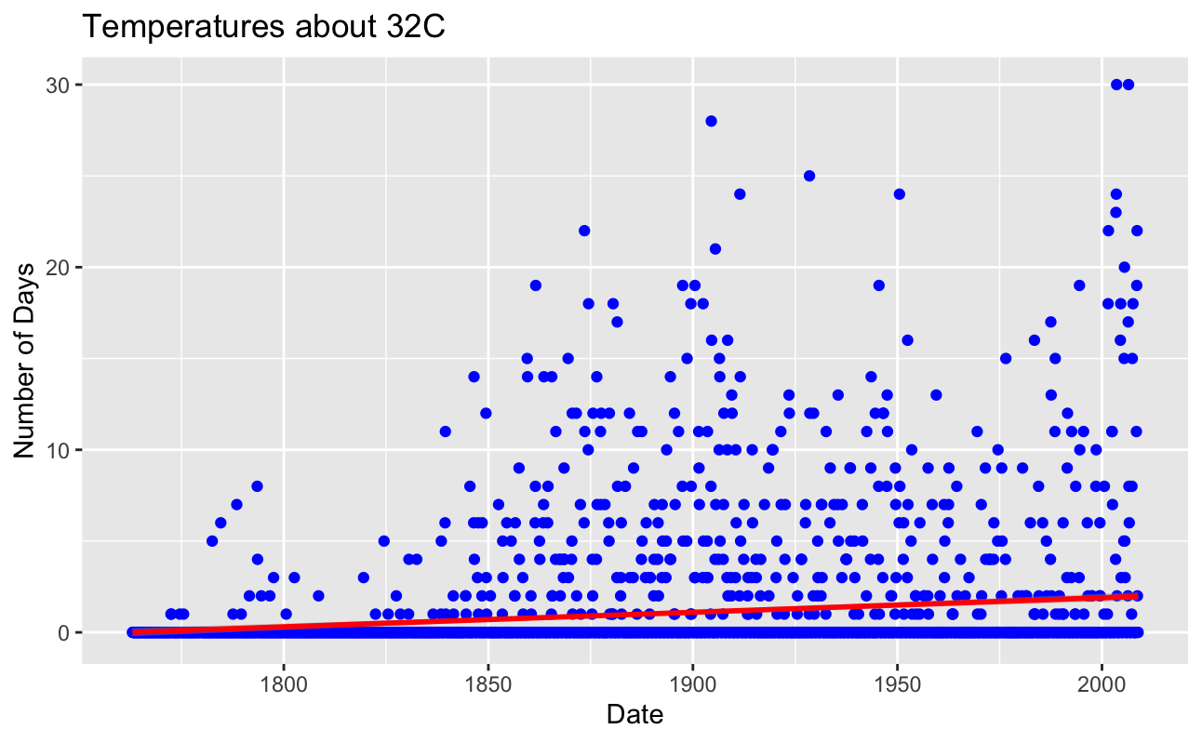
Analysis: Temperature Trends

Slide 13
Analysis: Explaining Temperature Trends
The Industrialization of Italy
First industrialization in Milan began in 1850 with cotton processing
Industrial revolution peeked in Milan in 1897-1913
https://www.erih.net/how-it-started/industrial-history-of-european-countries/italy#:~:text=The%20Industrial%20Revolution%20swept%20the,plant%20near%20Naples%20in%201908.
Economic Success:
After WWII in the 1950s to 1970s
“In the years from 1950 to 1973, per capita GDP rose by an average of 5.06% per annum, reaching a peak of 7.72% in 1961.”
https://ideas.repec.org/p/pra/mprapa/12817.html

Slide 14
Conclusion
Clear indication of annual temperature increase annually
Explanations and defining events to correlate with data found

Slide 15
References
Monthly Weather Data, Milan, Italy, NCEI https://www.ncei.noaa.gov/access/search/data-search/global-summary-of-the-month?startDate=1800-01-03T00:00:00&endDate=1800-01-03T23:59:59
abc

