Slide 1
Climate Analysis of Milan, Italy
DS202 Final Project
Coleman Dimmer, Corbin Graham

Slide 2
Introduction
What is the longest-recorded weather data, globally?
How can older data tell us more about climate trends?
Using this data, can we detect any trends?
What sources affect the trends we see?
Do trends correlate to local or global events?

Slide 3
About the Data: Background
Monthly Weather Data for Milan, Italy
Sourced from National Centers for Environmental Information (NCEI)
Recorded by government of Italy
241 years of data (1767-2008)

Slide 4
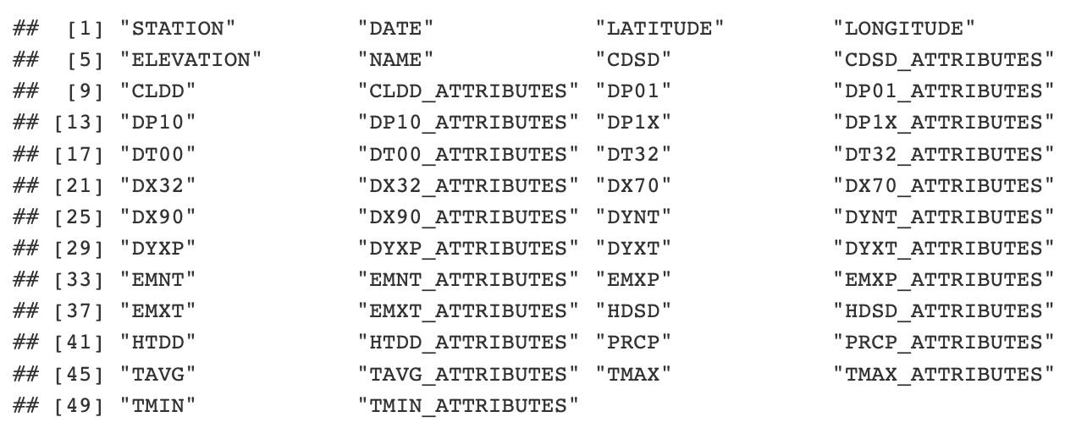
About the Data: Data Points

Slide 5
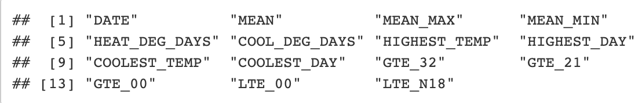
About the Data: Key Data Points
The points we drew were those most important to temperature data with negation to precipitation:
MEAN ← TAVG MEAN_MAX ← TMAX MEAN_MIN ← TMIN HIGHEST_DAY ← EMXT_ATTRIBUTES GTE_21 ← DX70 | HEAT_DEG_DAYS ← HTDD COOLEST_TEMP ← EMNT GTE_00 ← DX32 | COOL_DEG_DAYS ← CLDD COOLEST_DAY ← EMNT_ATTRIBUTES LTE_00 ← DT32 | HIGHEST_TEMP ← EMXT GTE_32 ← DX90 LTE_N18 ← DT00

Slide 6
About the Data: Important Data Highlights
All data points were recorded at the Milan Weather Station
First Recording Date: January 1767
Final Recording Date: November 2008
Lowest Recorded Temperature: January 1767, -4.75C (23.45F)
Highest Recorded Temperature: July 2006, 31.2C (88.16F)

Slide 7
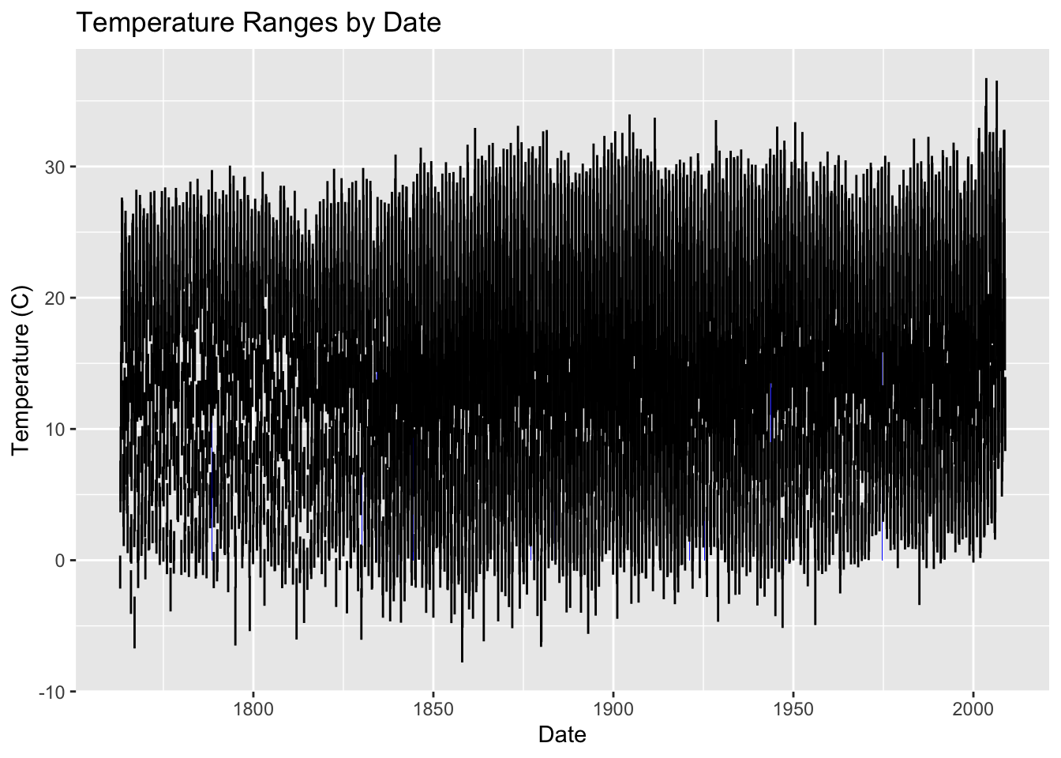
Analysis: Temperature Ranges (Monthly)
Clear Range Increases:
1860
2000

Slide 8
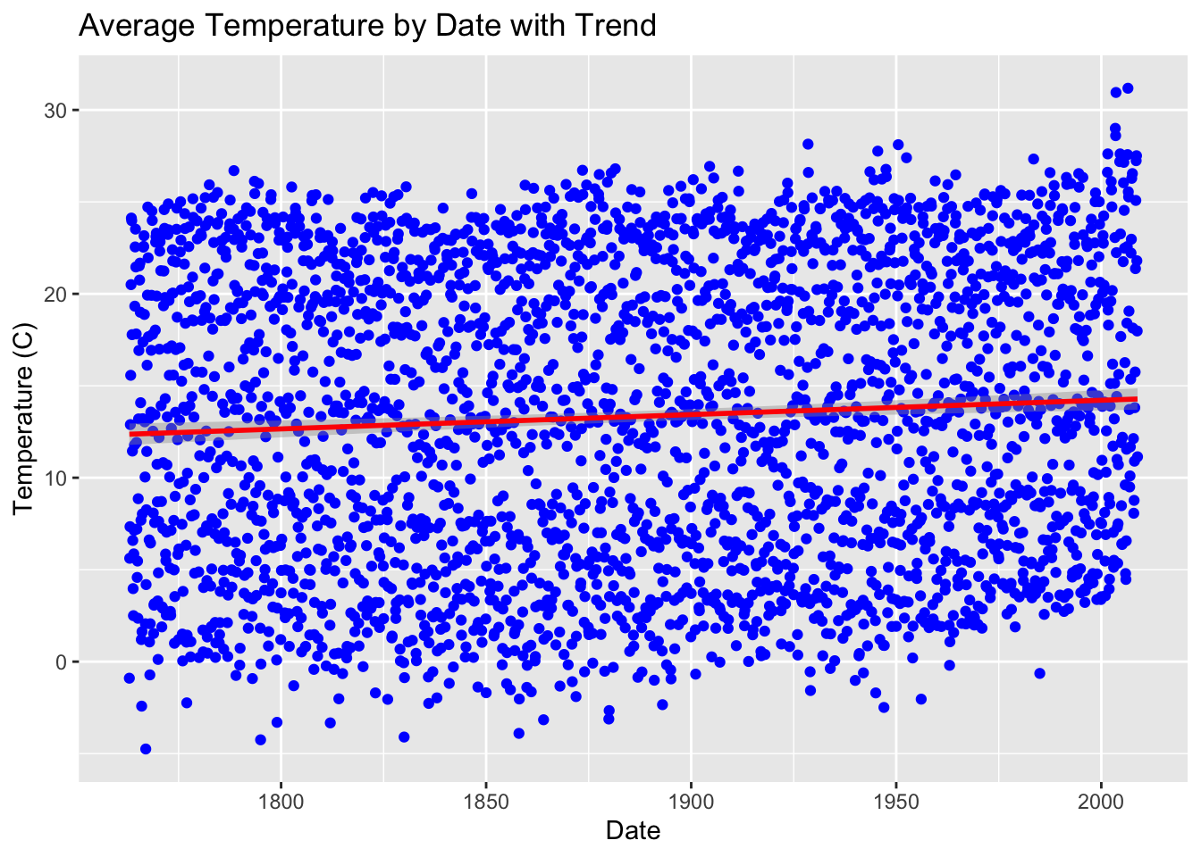
Analysis: Average Monthly Temperatures
Trend line shows clear increase

Slide 9
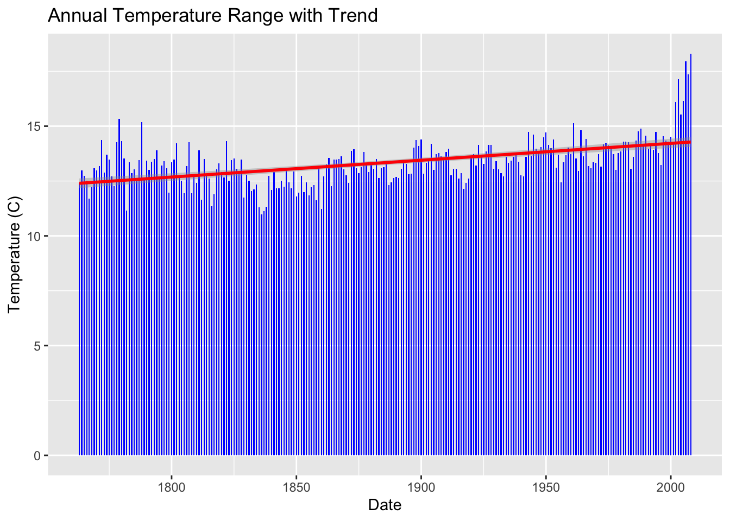
Analysis: Average Annual Temperatures
Annual temperatures clearly increase over time with massive leap in 2000

Slide 10
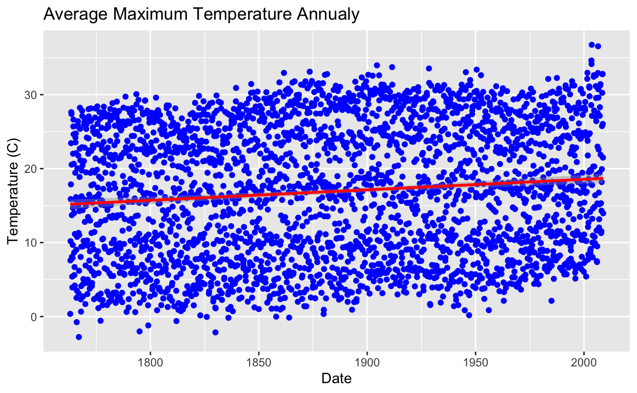
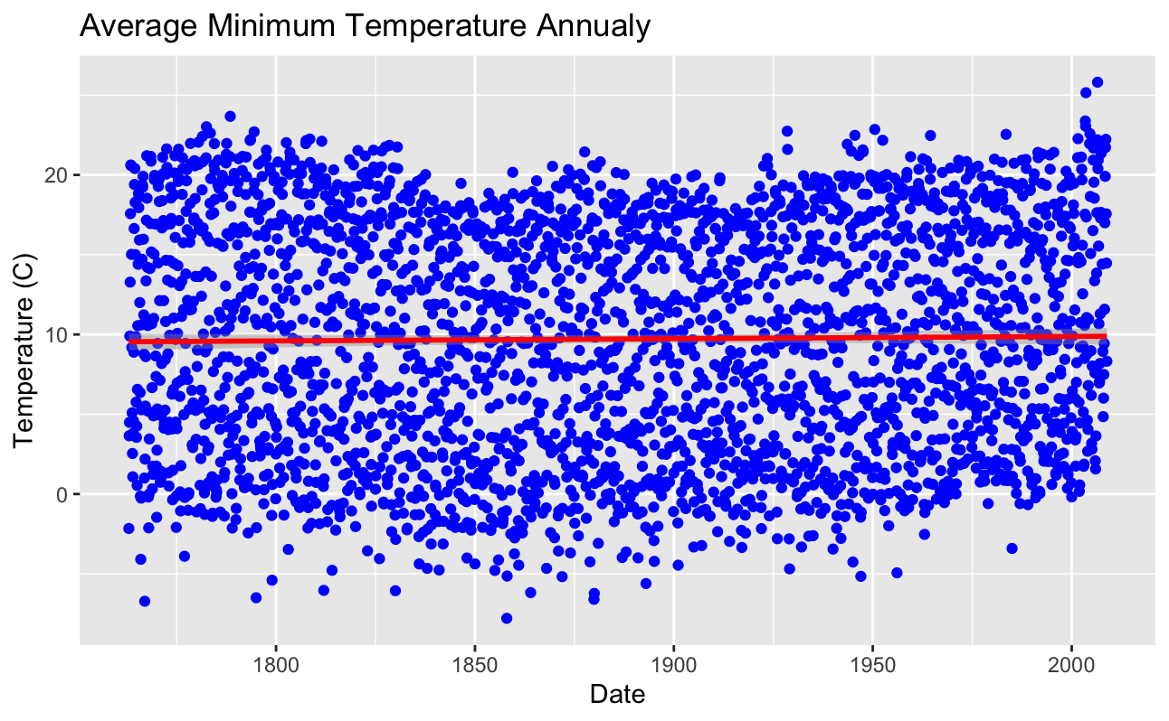
Analysis: Temperature Trends

Slide 11
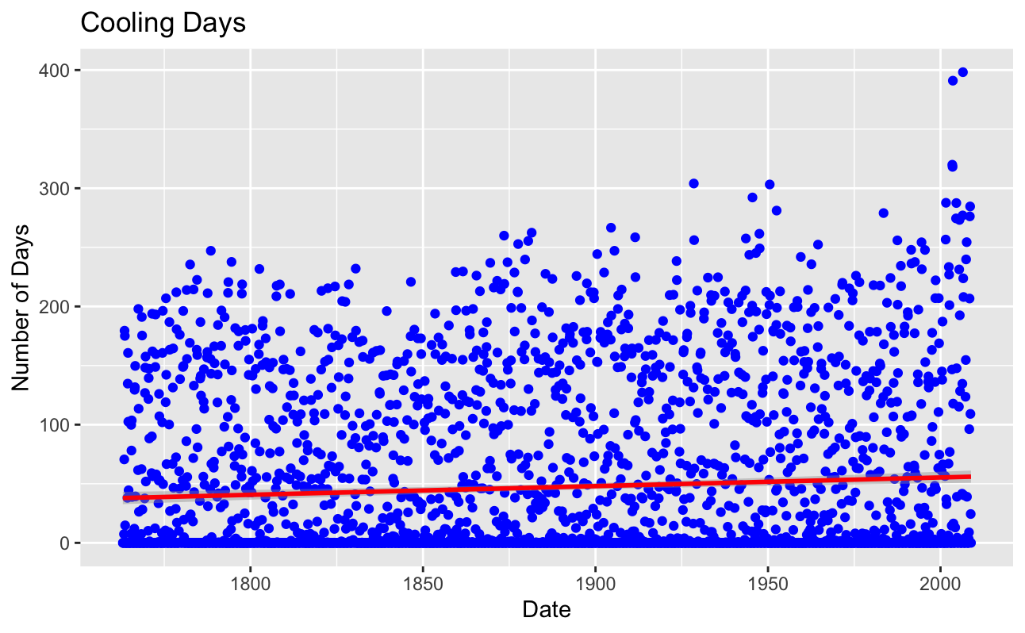
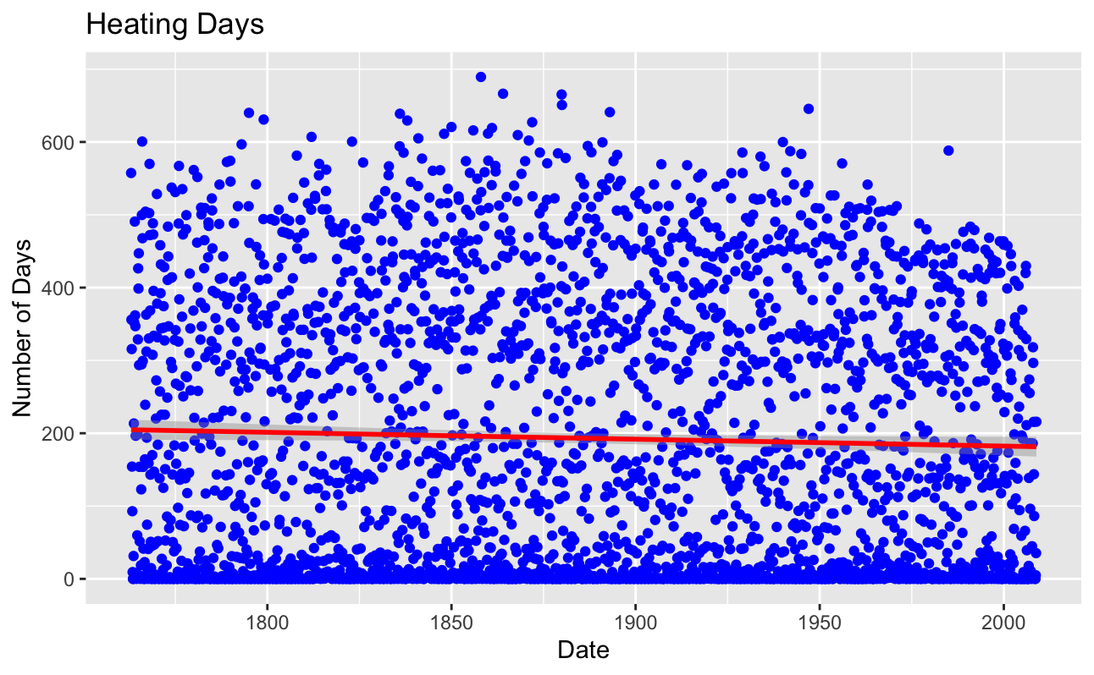
Analysis: Temperature Trends
Degree days are the difference between the daily temperature mean and monthly temperature mean
Cooling: More days below monthly average
Heating: More days above monthly average
https://www.weather.gov/key/climate_heat_cool

Slide 12
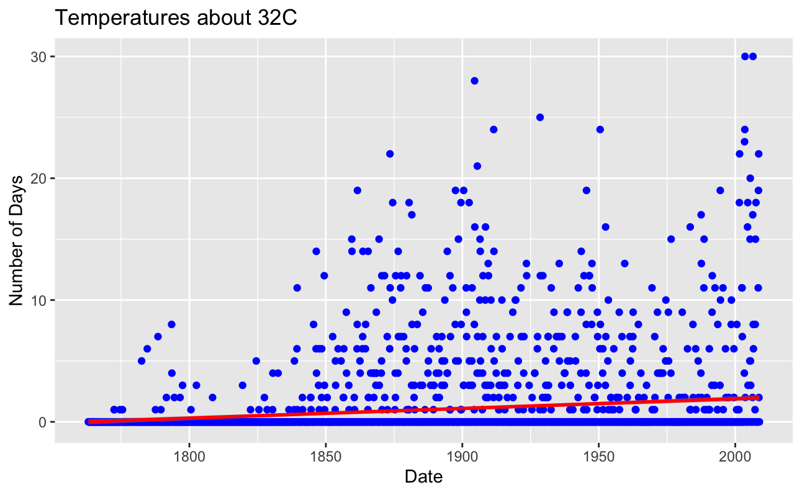
Analysis: Temperature Trends

Slide 13
Exploring Temperature Trends
The Industrialization of Italy
First industrialization in Milan began in 1850 with cotton processing
Industrial revolution peeked in Milan in 1897-1913
https://www.erih.net/how-it-started/industrial-history-of-european-countries/italy#:~:text=The%20Industrial%20Revolution%20swept%20the,plant%20near%20Naples%20in%201908.
Economic Success:
After WWII in the 1950s to 1970s
“In the years from 1950 to 1973, per capita GDP rose by an average of 5.06% per annum, reaching a peak of 7.72% in 1961.”
https://ideas.repec.org/p/pra/mprapa/12817.html

Slide 14
Conclusion
What is the longest-recorded weather data, globally?
Milan, Italy, 241 years (as of last official update)
Using this data, can we detect any trends?
Clear correlation between economic success and annual temperature increase
Global industrialization (and local) correlated to the first major increase in temperatures

Slide 15
References
Monthly Weather Data, Milan, Italy, NCEI https://www.ncei.noaa.gov/access/search/data-search/global-summary-of-the-month?startDate=1800-01-03T00:00:00&endDate=1800-01-03T23:59:59
Industrial Revolution of Milan, Italy https://www.erih.net/how-it-started/industrial-history-of-european-countries/italy#:~:text=The%20Industrial%20Revolution%20swept%20the,plant%20near%20Naples%20in%201908
Economic Growth of Italy https://ideas.repec.org/p/pra/mprapa/12817.html

