Slide 1
Climate Analysis of Milan, Italy
DS202 Final Project
Coleman Dimmer, Corbin Graham

Slide 2
Introduction

Slide 3
About the Data: Background
National Centers for Environmental Information (NCEI)
Monthly Weather Data for Milan, Italy

Slide 4
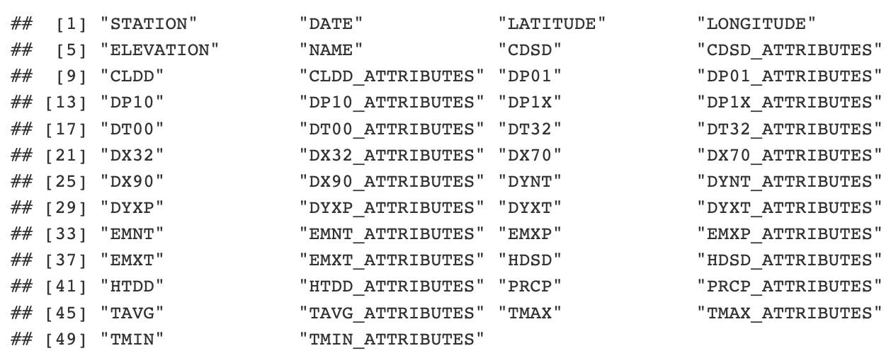
About the Data: Data Points

Slide 5
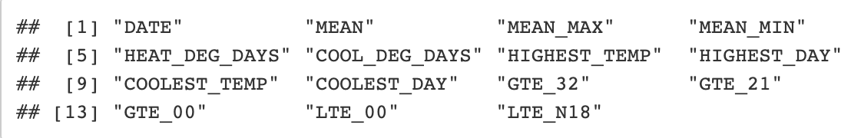
About the Data: Important Data Points
The points we drew were those most important to temperature data with negation to precipitation

Slide 6
About the Data: Important Data Highlights
All data points were recorded at the Milan Weather Station
First Recording Date: January 1767
Final Recording Date: November 2008
Lowest Recorded Temperature: January 1767, -4.75C (23.45F)
Highest Recorded Temperature: July 2006, 31.2C (88.16F)

Slide 7
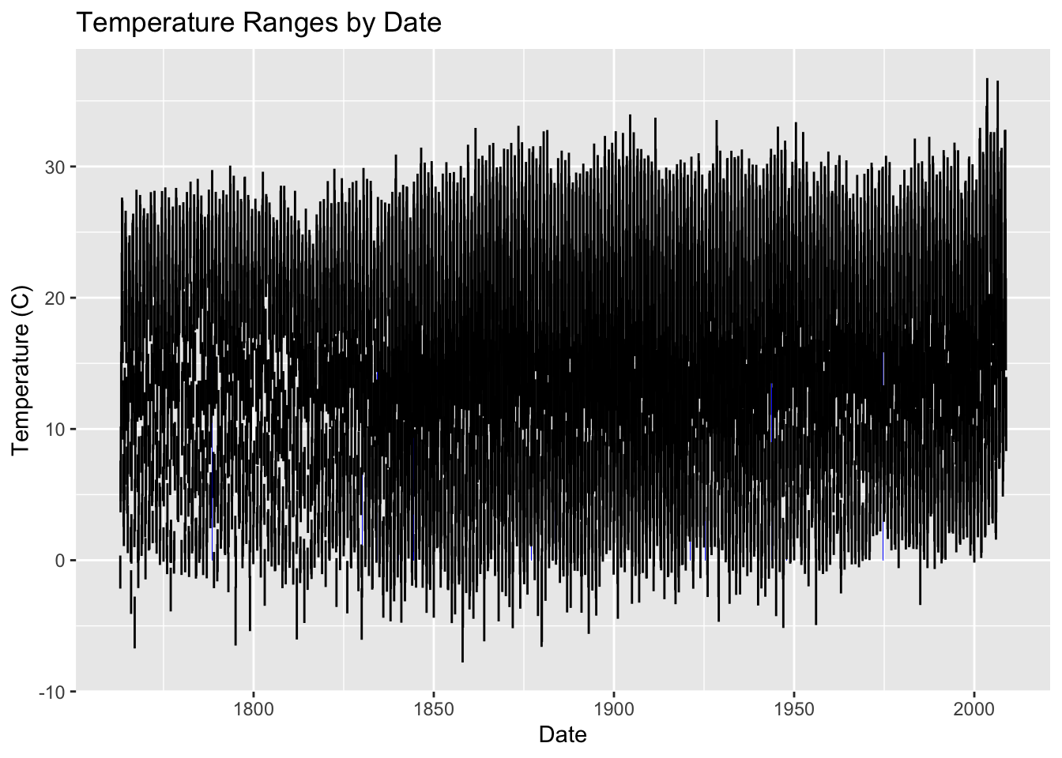
Analysis: Temperature Ranges (Monthly)
Clear Range Increases:
1860
2000

Slide 8
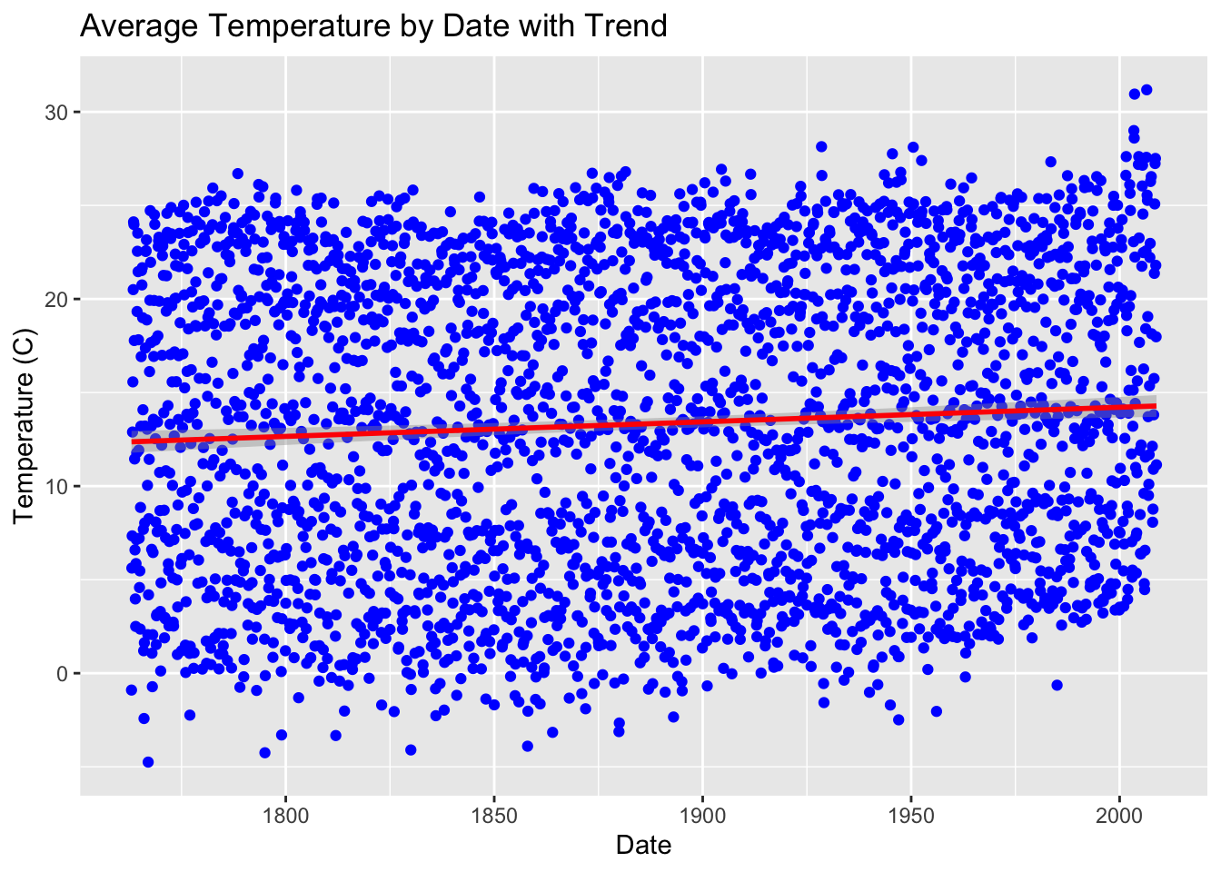
Analysis: Monthly Temperatures with Trend Line
Trend line shows clear increase

Slide 9
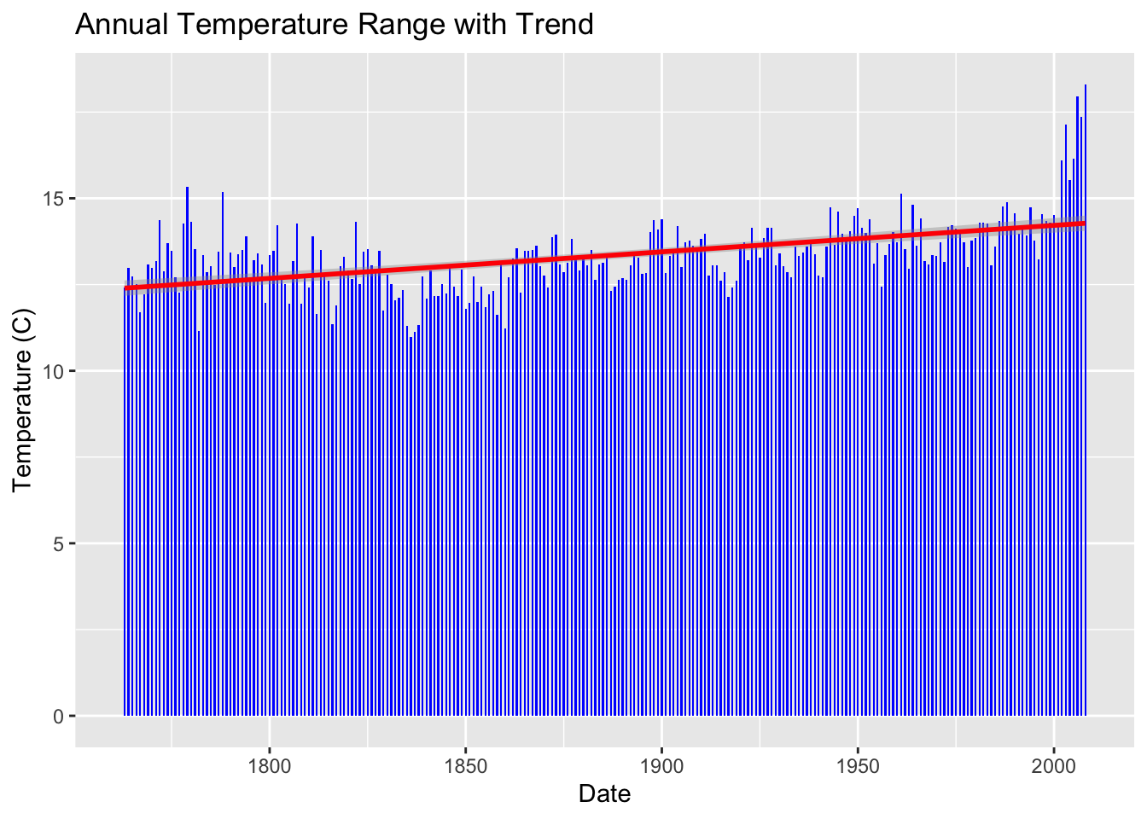
Analysis: Annual Temperatures with Trend Line
Annual temperatures clearly increase over time with massive leap in 2000

Slide 10
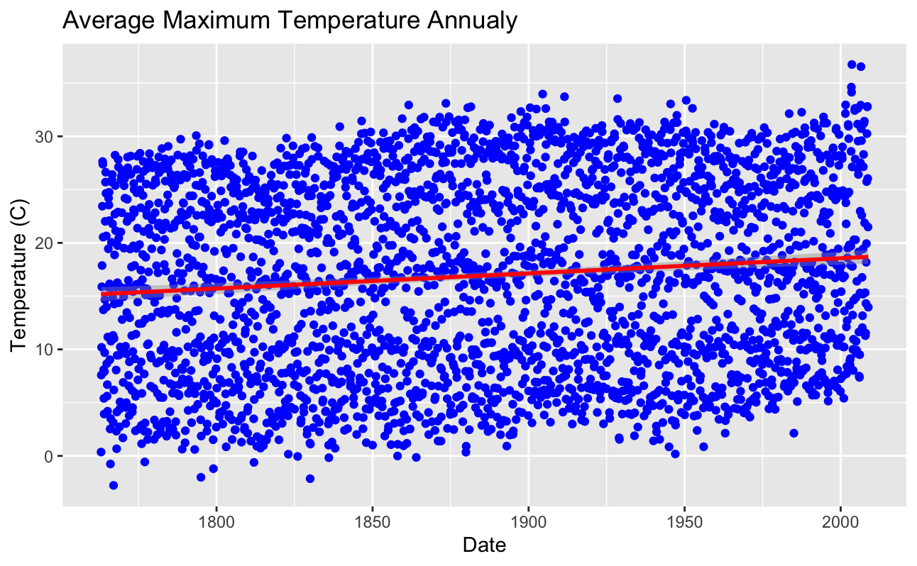
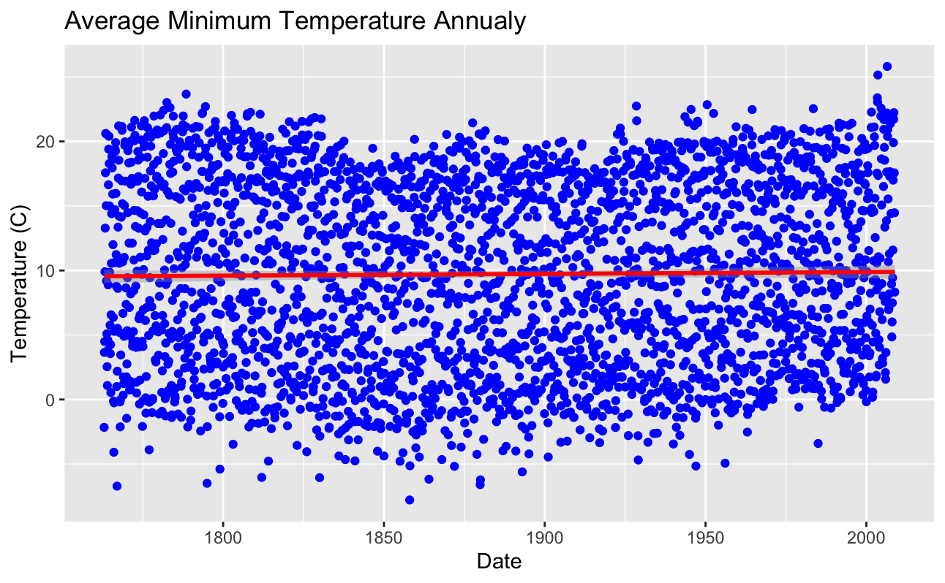
Analysis: Temperature Trends

Slide 11
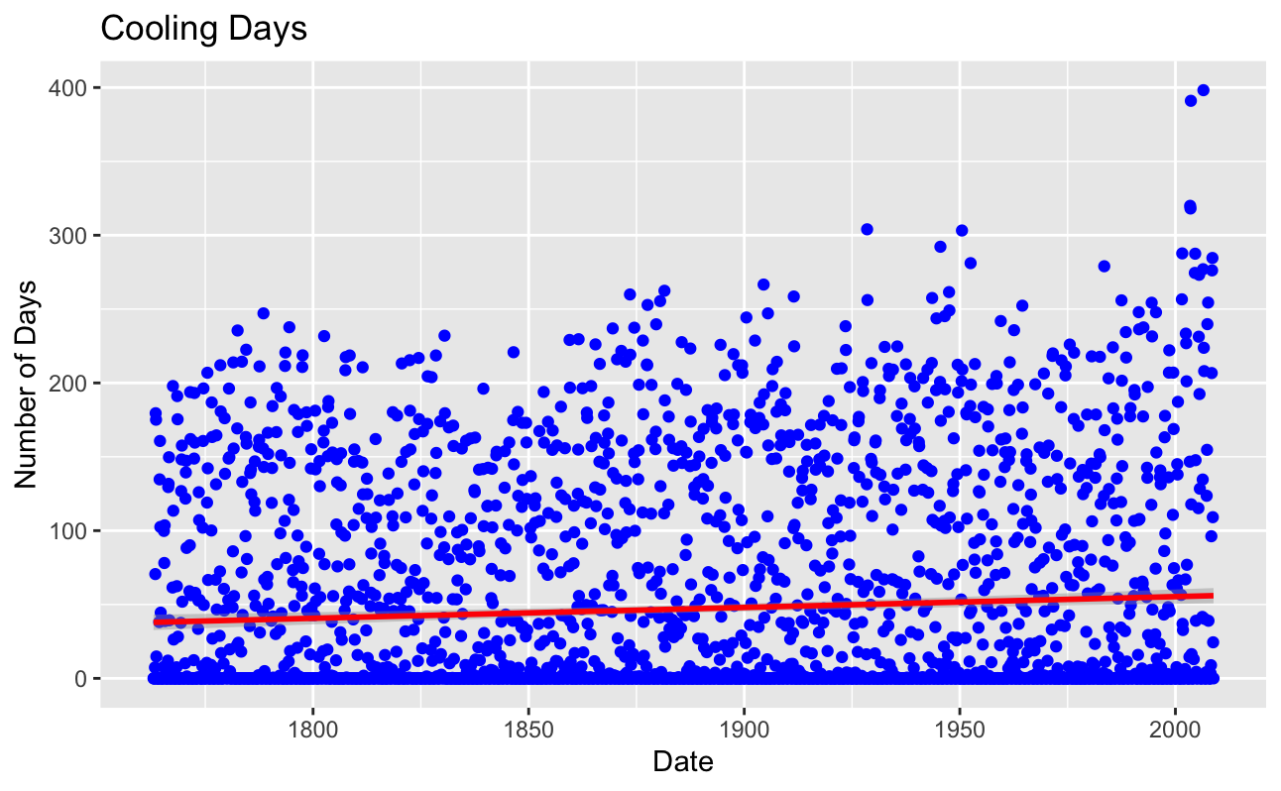
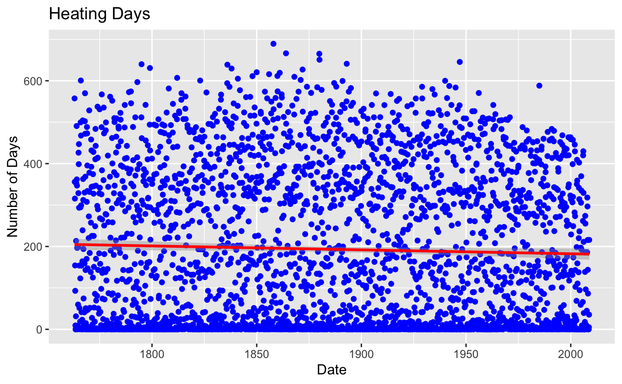
Analysis: Temperature Trends
Degree days are the difference between the daily temperature mean and monthly temperature mean
Cooling: More days below monthly average
Heating: More days above monthly average
https://www.weather.gov/key/climate_heat_cool

Slide 12
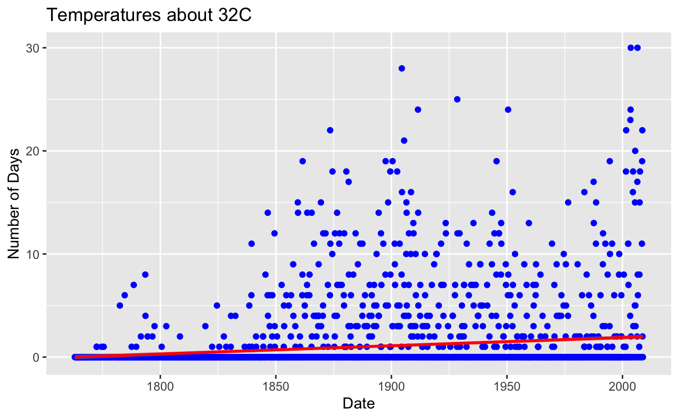
Analysis: Temperature Trends

Slide 13
Analysis: Explaining Temperature Trends
The Industrialization of Italy
First industrialization in Milan began in 1850 with cotton processing
Industrial revolution peeked in Milan in 1897-1913
https://www.erih.net/how-it-started/industrial-history-of-european-countries/italy#:~:text=The%20Industrial%20Revolution%20swept%20the,plant%20near%20Naples%20in%201908.

Slide 14
Conclusion
Clear indication of annual temperature increase annually

Slide 15
References
Monthly Weather Data, Milan, Italy, NCEI https://www.ncei.noaa.gov/access/search/data-search/global-summary-of-the-month?startDate=1800-01-03T00:00:00&endDate=1800-01-03T23:59:59
abc

