Slide 1

Curl –y //hackers
Project: Dungeons
TEAM: Corbin Graham & Vincent Zefran

Slide 2
DUNGEONS
WRITE IT AND PLAY IT.

Slide 3
DUNGEONS
MAKE YOUR IDEAS COME TO LIFE.

Slide 4
DUNGEONS
NEW GAMES WHEN YOU WANT.

Slide 5
DUNGEONS

Slide 6
DUNGEONS
ENEMIES
SESSION INFORMATION
Enemy Traits
. . .
MAPS
World 1
. . .

Slide 7
INTERACTIVE
MENU
ATTACK
INVENTORY
FLEE

Slide 8
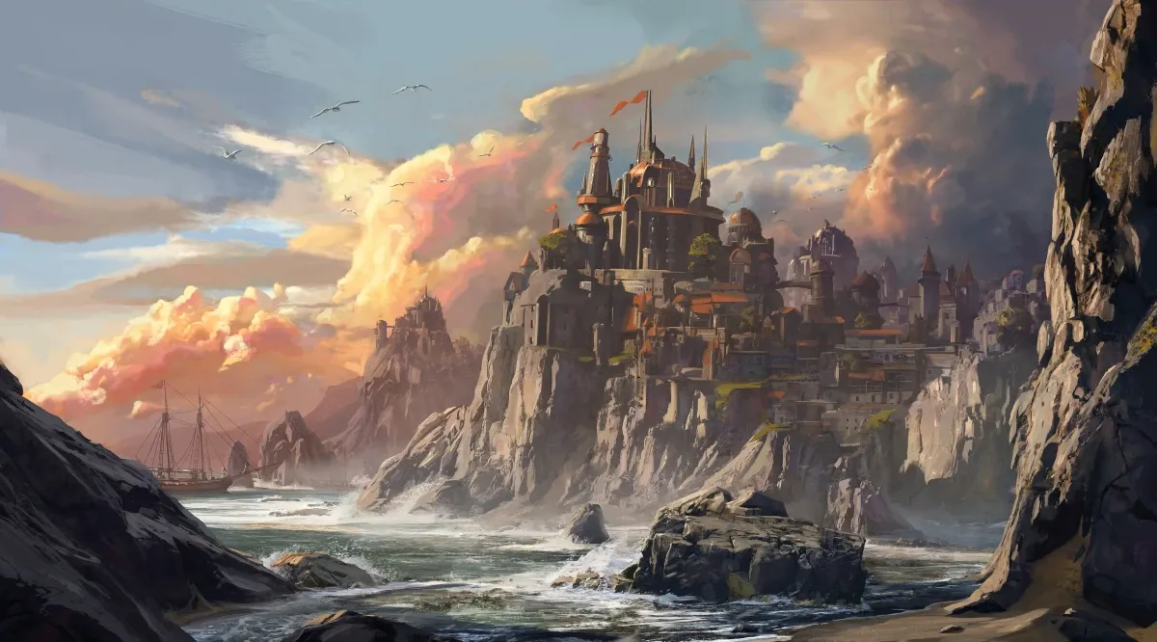

YOUR GAME. YOUR STORY.

Slide 9
5:46:12
but it didn’t work.

Slide 10
7:29:03
npm ERR! **Unexpected end of JSON input while parsing near '...nt-webpack-plugin":"0'**

Slide 11
8:45:00
NameError: name 'json' is not defined

Slide 12
9:02:33
and it just didn’t work.

Slide 13
9:14:56
all hope was lost.

Slide 14
10:48:32
we gave up.

Slide 15
10:56:59
build success.

Slide 16
after losing almost 4 hours, it worked.

Slide 17
here is what we made
in 14 hours.

Slide 18
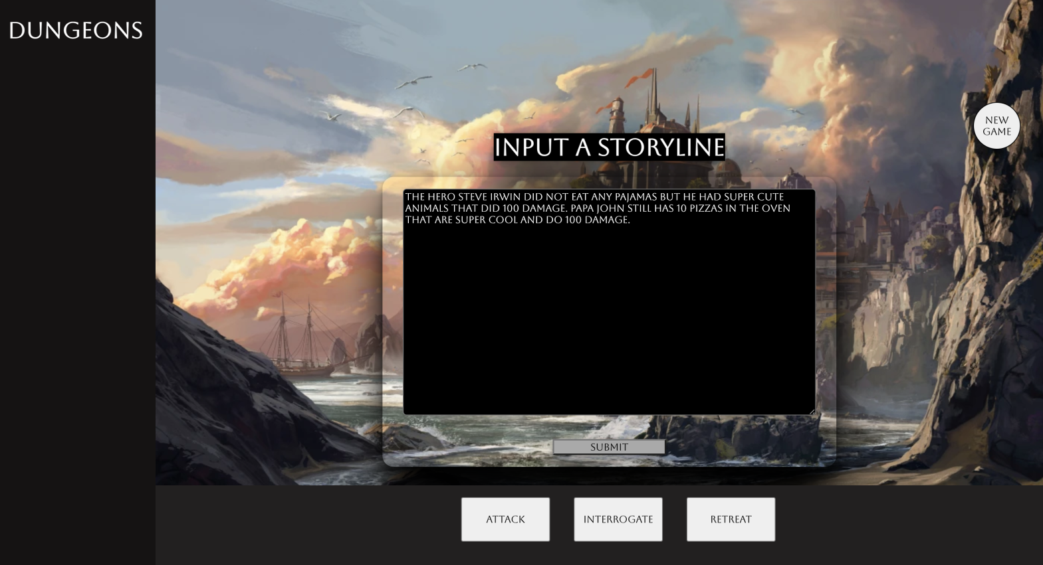
[demo]

Slide 19
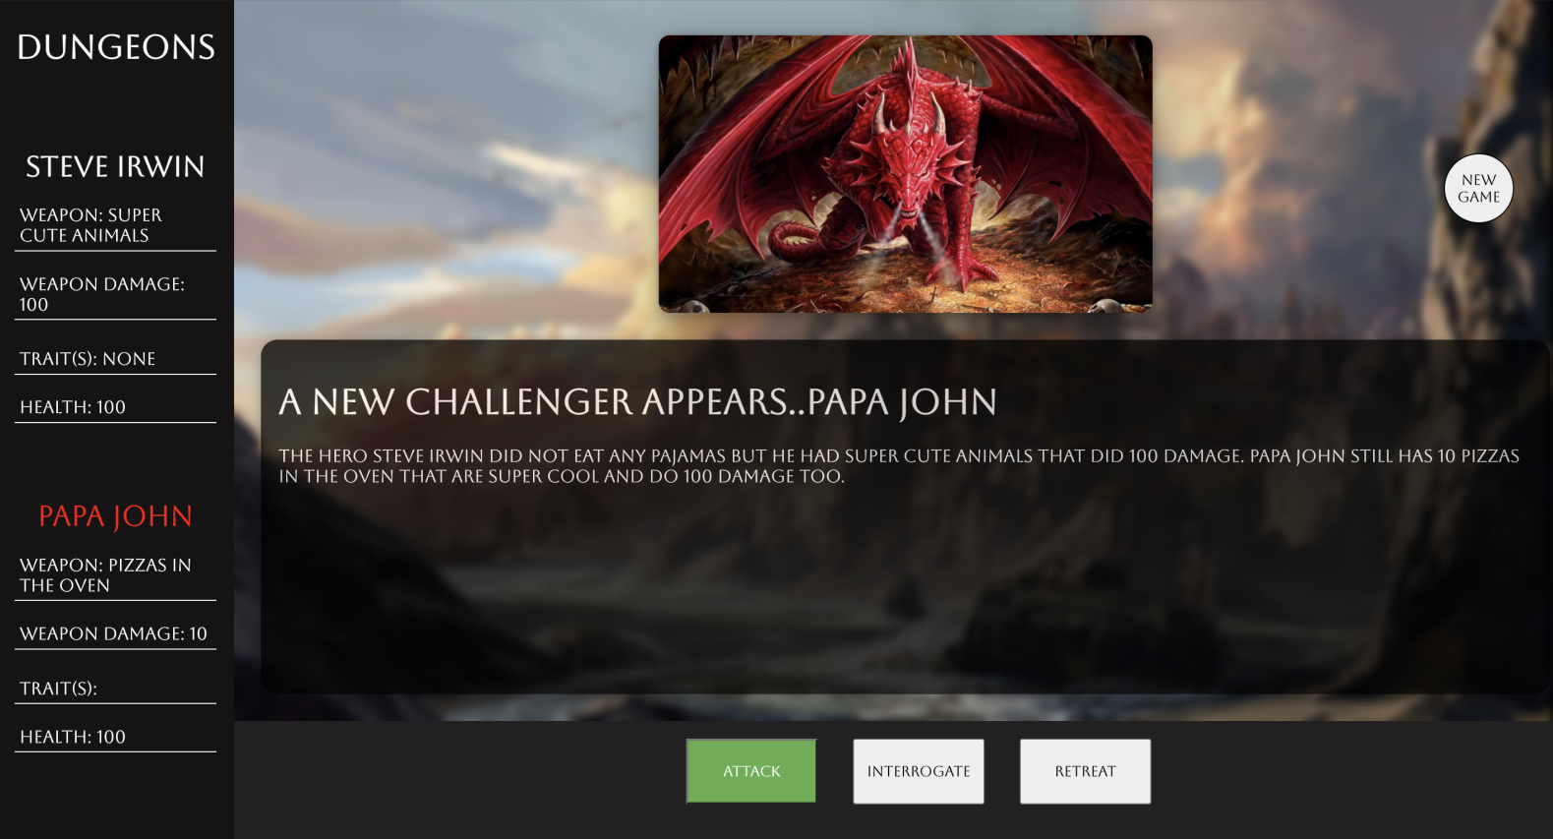
[demo]

Slide 20
now let’s see it in action.

Slide 21
Dungeons is a web-based application modeled off the popular board game “Dungeons & Dragons”.
The game prompts the user for an input of a story that the game will be based around moving forwards.
Your skills, health, and enemies are then generated within our application.
You are presented by enemy after enemy and are given the ability to either attack, negotiate, or retreat.

Slide 22
TECHNOLOGIES USED
JAVASCRIPT/HTML/CSS
REACT.JS
NODE.JS
NLP( Natural language Processing )
GIT/GITHUB( Project Orginization/ Collaboration)

Slide 23
ML & NLP
NATURAL.JS Natural Language Processor:
Classifying Words
Detecting ‘filler’ Words
DALLE-e MiNi
- Generate Images from the provided text to enhance gameplay

Slide 24
Game Engine
Dungeons converts raw text in ‘Natural’ formatting to a classified style using NLP (Natural).
The Engine converts and formats the classified data into modifiable objects that can be used and manipulated through gameplay.

Slide 25
Engine Structure
Game Engine
Interface
Interfacing Engine
Natural Language Processor
Data Management Engine
Image Generator

Slide 26
LESSONS LEARNED
Running into disabling problems very early on can be a big test on your mental strength as a developer.
Time management and prioritizing the right features is crucial when in a time crunch for a project.
Sleep deprivation is not a great experience, but sometimes useful.
Communication is key with your partner(s)!

