Slide 1
How casual rides and annual members use Cyclistic bike differently
File created: 09/03/2026 12:21:51

Slide 2
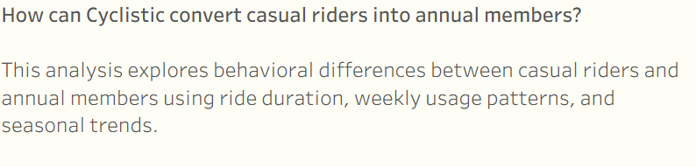
How casual rides and annual members use Cyclistic bike differently
Business question

Slide 3
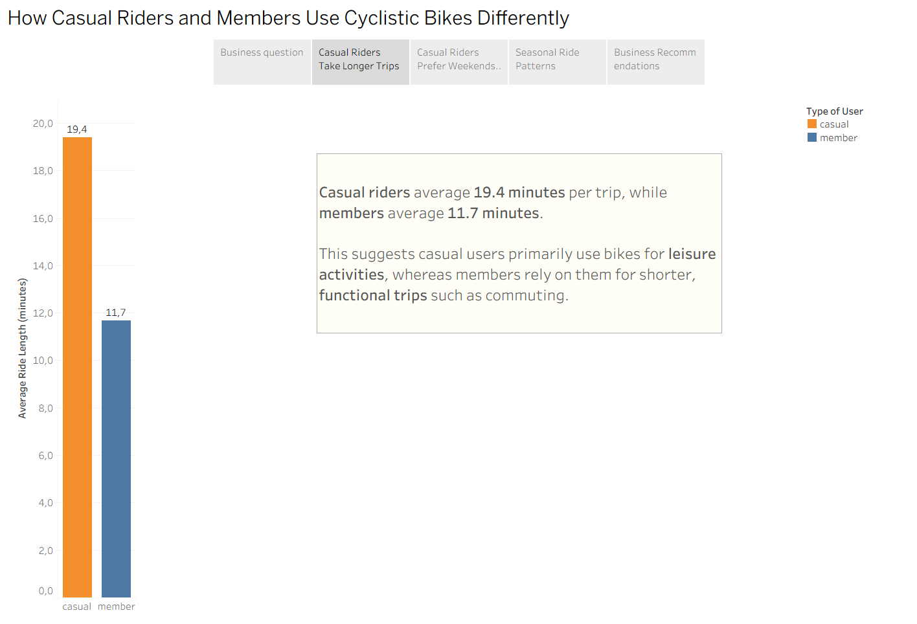
How casual rides and annual members use Cyclistic bike differently
Casual Riders take longer trips

Slide 4
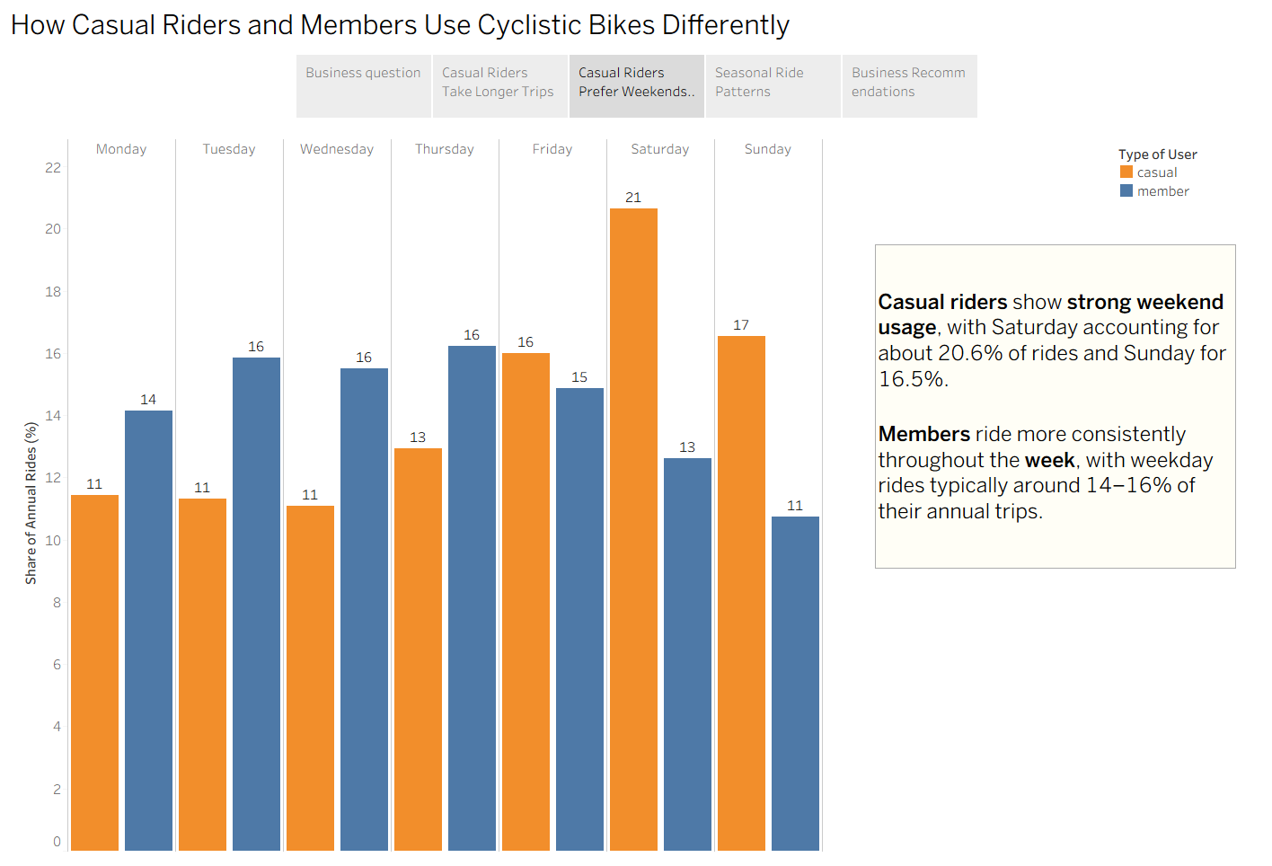
How casual rides and annual members use Cyclistic bike differently
Casual Riders prefer weekends

Slide 5
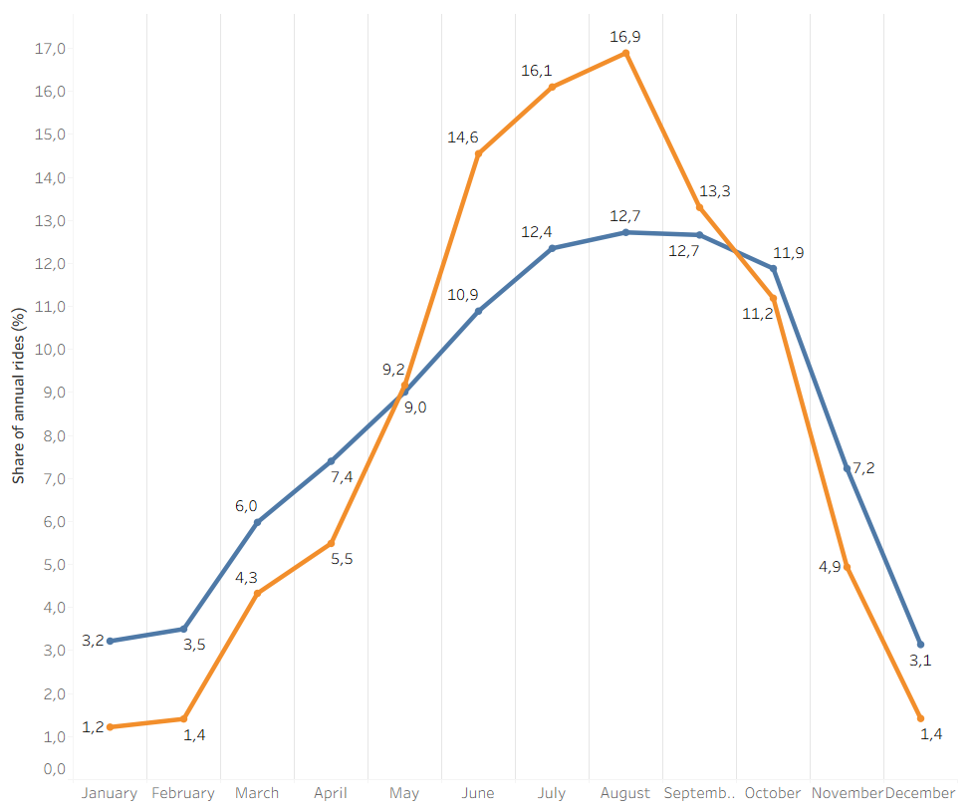
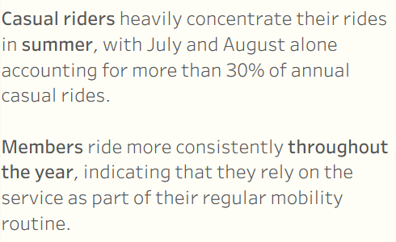
How casual rides and annual members use Cyclistic bike differently
Seasonal Ride Patterns

Slide 6
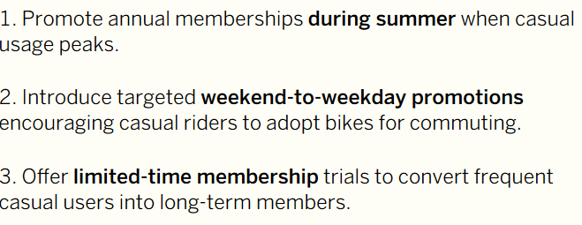
How casual rides and annual members use Cyclistic bike differently
Business Recommendations

