Slide 1
Stabilization of Inverted, Vibrating Pendulums
Big ol’ physics smile…
By Professor and
El Comandante
and Schmedrick

Slide 2
Equilibrium
Necessarily: the sums of forces and torques acting on an object in equilibrium are each zero^{[1]}
Stable Equilibrium—E is constant, and original U is minimum, small displacement results in return to original position ^{[5]}.
Neutral Equilibrium—U is constant at all times. Displacement causes system to remain in that state ^{[5]}.
Unstable Equilibrium—Original U is maximum, E technically has no upper bound ^{[5]}.
Static Equilibrium—the center of mass is at rest while in any kind of equilibrium^{[4]}.
Dynamic Equilibrium—(translational or rotational) the center of mass is moving at a constant velocity^{[4]}.
ω = constant

Slide 3
Simple Pendulum Review
Schmedrick says:
The restoring torque for a simple rigid pendulum displaced by a small angle is
MgrsinΘ ≈ mgrΘ and that τ = Ια…
MgrΘ = Ια → grΘ = r²Θ’’ → α = -gsinΘ⁄r
α ≈ g ⁄ r
Where g is the only force-provider
The pendulum is not in equilibrium until it is at rest in the vertical position: stable, static equilibrium.
Θ
r
m
mgcosΘ
mgsinΘ
mg

Slide 4
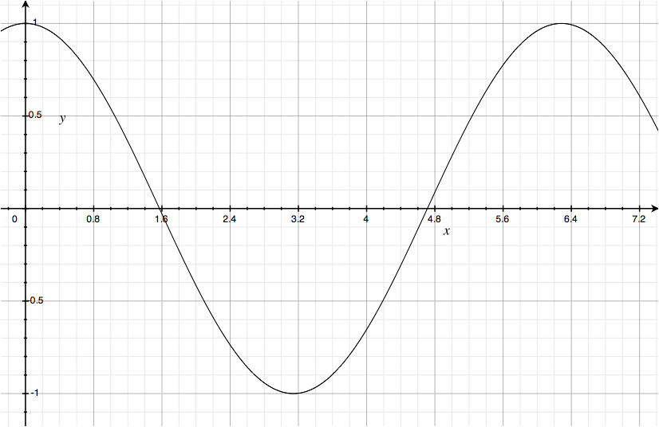
Mechanical Design
Rigid pendulum
Pivot height as a function of time
Oscillations exert external force:
  Downward force when pivot experiences h’’(t) < 0 ; help gravity.
  Upward when h’’(t) > 0 ; opposes gravity.
  Zero force only when h’’(t) = 0 (momentarily, g is only force-provider)
1
h(t) = Acos(ωt)
pivot
2
ω
shaft
Differentiating:
h’(t) = -Aωsin(ωt)
h’’(t) = -Aω²cos(ωt) = translational acceleration due to motor
A
pivot
Disk load
Motor face
Notes:
The pendulum itself is limited to only vertical motion, which is caused by the rotational motion of the motor. This design is similar to a crankshaft in a car engine, which pushes and pulls a piston linearly in and out of a shaft.

Slide 5

Analysis of Motion
m
h’’(t) is sinusoidal and >> g, so F_{net} ≈ 0 over long times^{[3]}
Torque due to gravity tends to flip the pendulum down, however, lim_{t} → ∞ (τ_{net}) ≠ 0 ^{[3]}, we will see why…
Also, initial angle of deflection given; friction in joints and air resistance are present. Imperfections in ω of motor.
mgsinΘ
mgcosΘ
mg
Θ
r
g
h’’(t) = -Aω²cos(ωt)

Slide 6
Torque Due to Vibration: 1 Full Period
Note: + angular accelerations are toward vertical, + translational accelerations are up
Θ₃
Θ₁
#1
1
Pivot accelerates down towards midpoint, force applied over r*sinΘ₁; result: Θ ⬇
1
h’’(t) > 0
Not very large increase in Θ b/ small torque, stabilized
h’’(t)
Large Torque (about
mass at end of pendulum arm)
#3
1
On the way from 2 to 1, the angle opens, but there is less α to open it, so by the time the pivot is at 1, Θ₃ < Θ₁
Therefore, with each period, the angle at 1 decreases, causing stabilization.
2
#2
2
Same |h’’(t)|, however, a smaller τ is applied b/c Θ₂ < Θ₁. Therefore, the pendulum experiences less α away from the vertical than it did toward the vertical in case #1
Θ₂
h’’(t)
2
Small Torque
Notes:
Note that from case #1 to case #2 the pendulum actually overshoots the vertical, so just take the image of case #2 and flip it horizontally. I just wanted to make diagram as simple as possible. This means that #3 should also be flipped horizontally as well.

Slide 7
Explanation of Stability
Gravity can be ignored when ω_{motor} is great enough to cause large vertical accelerations
Downward linear accelerations matter more because they operate on larger moment arms (in general)
…causing the average τ of “angle-closing” inertial forces to overcome “angle-opening” inertial forces (and g) over the long run.
Conclusion: “with gravity, the inverted pendulum is stable wrt small deviations from vertical…”^{[3]}.

Slide 8

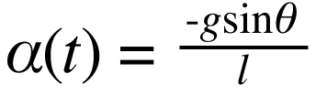
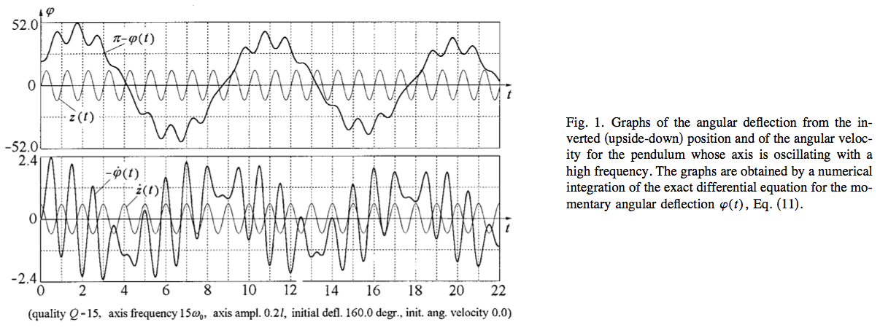
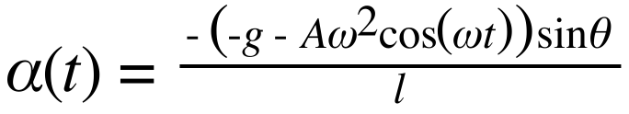
Mathieu’s Equation: α(t)
α due to gravity is in competition with oscillatory accelerations due to the pivot and motor.
g is always present, but with the motor:
Differentiating:
h(t) = Acos(ωt)
h’(t) = -Aωsin(ωt)
h’’(t) = -Aω²cos(ωt) = translational acceleration due to motor
1) Linear acceleration at any time:
2) Substitute a(t) into the “usual” angular acceleration eqn: . But assuming that “g” is a(t) from (1) since “gravity” has become more complicated due to artificial gravity of the motor…
[3]

Slide 9
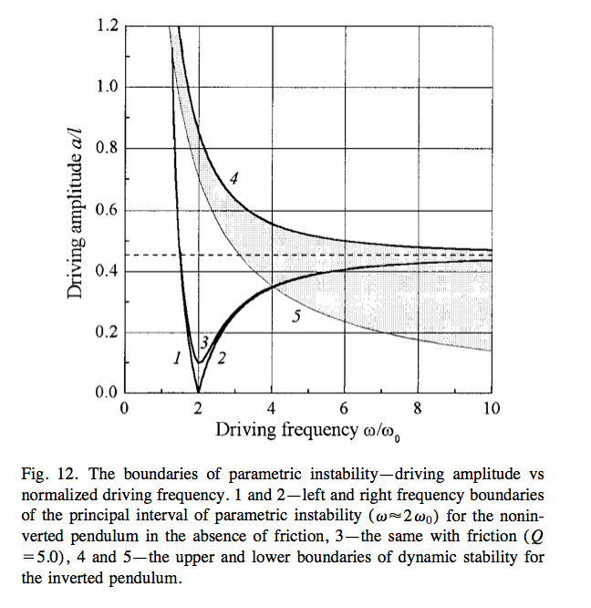
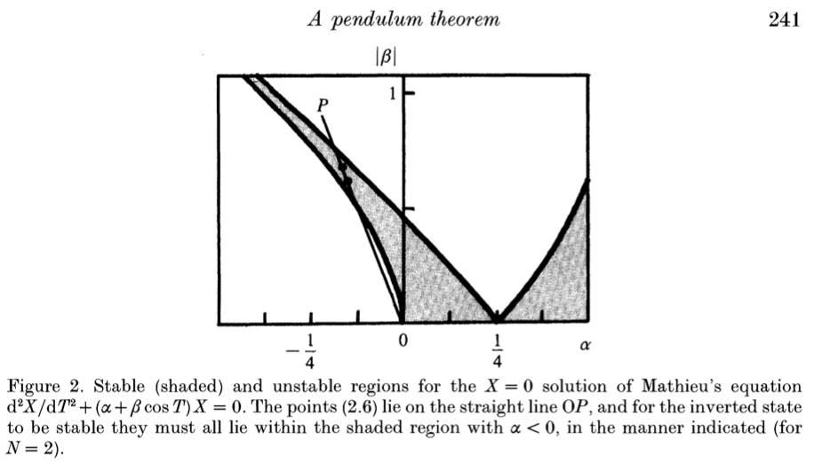
Conditions for Stability
From [3]; (ω₀)² = g/r
Mathieu’s equation yields stable values for:
  α < 0 when |β| = .450 (where β =√2α ^{[4]}
[2]

Slide 10
Works Cited
Acheson, D. J. From Calculus to Chaos: An Introduction to Dynamics. Oxford: Oxford UP, 1997. Print. Acheson, D. J.
"A Pendulum Theorem." The British Royal Society (1993): 239-45. Print. Butikov, Eugene I.
"On the Dynamic Stabilization of an Inverted Pendulum." American Journal of Physics 69.7 (2001): 755-68. Print. French, A. P.
Newtonian Mechanics. New York: W. W. Norton & Co, 1965. Print. The MIT Introductory Physics Ser. Hibbeler, R. C.
Engineering Mechanics. New York: Macmillan, 1986. Print.

