Slide 1
Outgoing P2P
SOCKS Proxy
Bridge
Inbound P2P
Float
Shared Artemis Broker
DMZ
RPC Client
Corda Node EntityA
Corda Node EntityB
RPC Client
EntityA vault
EntityB vault
JDBC
External P2P communication
RPC connection
Notes:
Single Bridge/Float phase
Single set of Bridge/Float servicing multiple nodes.
This will be Corda Enterprise 4.0 deliverable.
As for inbound P2P connection there will be a single network endpoint which using Service Name Indication (SNI) extension to TLS allows talking to different legal identities.

Slide 2
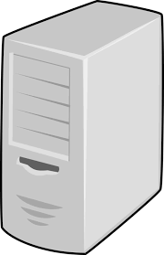
Physical deployment
Outbound HTTP Get/Post
Outbound CRL Fetch
Inbound P2P
DataCentre1
vmNodesPrimary
vmInfra1
vmFloat1
Outbound P2P
vmZkWitness
Outbound HTTP Get/Post
vmSocks
Inbound P2P
DataCentre2
Firewall (outgoing only)
vmNodesSecondary
vmInfra2
vmFloat2
Outbound CRL Fetch
Firewall
Green Zone
Outbound HTTP Get/Post
DMZ

Slide 3
Inside Infras
Infra 1
Infra 2
Bridge
(follower)
Bridge
(leader)
Outgoing to Proxy
Nodes Comm.
Artemis Master
ZK Cluster
Nodes Comm.
Artemis Slave
ZK Cluster
zkWitness
ZK Cluster

Slide 4
vmInfra
Bridge
Artemis Cluster
ZK Cluster

