Slide 1
GetFit Workout Tracker

Slide 2
Major Components
HOME
Ability to make workout plan
Ability to go through programmed workout
Workout Figure that shows hit muscles
List of old workouts
Total Tracker of # of pounds lifted
Progress graphs of exercises
Ability to add exercises
OPTIONS
PROGRESS
START WORKOUT
MAKE WORKOUT
WORKOUT FIGURE
DURING WORKOUT
ADD NEW EXERCISE

Slide 3
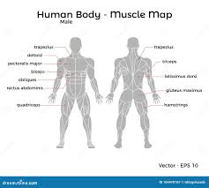

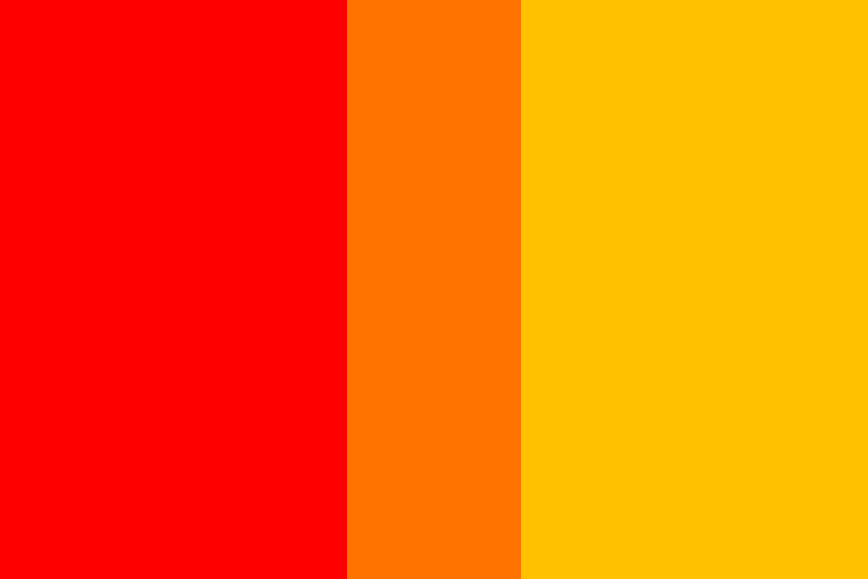

COLOR SCHEMES
Workout Figure
Main UI
RED, ORANGE, YELLOW
COBBER COLORS

Slide 4
Main Screen Mockup
GetFit
1
2
3
4
5
6
7
8

Slide 5
1. Main Figure
GetFit
Contains a Diagram of the Human Body Highlighting Major Muscle Groups Like:
Chest
Back
Biceps
Triceps
Trapezius
Glutes
Hamstrings
Quadriceps
Abs
Calves
1
2
3
4
5
6
7
8

Slide 6
2. Program Name
GetFit
Highlights the name of our program: “GetFit Workout Tracker”
1
2
3
4
5
6
7
8

Slide 7
3. Start Workout
GetFit
Opens an interface that allows you to input exercises done through your workout
Each exercise let you know what muscles are being worked
At the end of the workout it will tell you what muscles were worked, and how much you lifted
1
2
3
4
5
6
7
8

Slide 8
Start Workout Screen
GetFit
Id + Component | Description
1. Back Button | Returns to home screen
2. Start Button | Starts currently selected workout and moves to during workout screen
3.Workout Selection | Lists workouts and allows user to select one
4. Workout Info | Gives info about the selected workout
1
2
3
4

Slide 9
During Workout Screen
GetFit
Id + Component | Description
1. Back Button | Returns to home screen
2. Complete Workout | Ends workout and records stats
3. Workout Figure | Shows muscles worked in current workout
4. Exercise List | Lists exercises in workout and allows user to input sets + reps
5. Workout Info | Lists stats like time + total weight lifted
1
2
3
4
5

Slide 10
4. Make Workout
GetFit
Allows you to name your workout
Stores the exercises input for easy
1
2
3
4
5
6
7
8

Slide 11
Make Workout Screen
GetFit
Id + Component | Description
1. Back Button | Returns to home screen
2. Add Workout | Adds workout to workout database
3. Workout Figure | Shows muscles hit in workout
4. Workout Display | Shows current exercises + allows for removing
5. Exercise Selector | Allows user to select and add exercise/sets/reps to workout
1
2
3
4
5

Slide 12
5. Add Exercise
GetFit
Make your own exercise
Personalized name
Add which muscles it works
Able to add to your workout plans
1
2
3
4
5
6
7
8

Slide 13
Add Exercise Screen
GetFit
Id + Component | Description
1. Back Button | Returns to home screen
2. Add Exercise | Adds exercise to exercise database
3. Workout Figure | Allows user to select what muscles the exercise will hit
4. Exercise Input | Allows user to input an exercise with statistics from before using app
1
2
3
4

Slide 14
6. Progress
GetFit
Total tracker of pounds lifted (fun competition)
Diagrams and color codes the body with varying colors based on how much they’ve been worked
Yellow - Worked lightly
Orange - Worked Moderately
Red - Worked Hard
1
2
3
4
5
6
7
8

Slide 15
Progress Screen
GetFit
Id + Component | Description
1. Back Button | Returns to home screen
2. Mode Selector | Allows user to choose between individual workouts, exercises, and time periods
3. Workout Figure/Progress Chart | Displays based on users options
4. Exercise/Workout Selector | Allows user to choose which workout/exercises stats are displayed
5. Other Stats | Shows total times a workout or exercise has been done, total weight moved etc.
1
2
3
4
5

Slide 16
7. Program Description
GetFit
Brief description of what our program does and is intended for
1
2
3
4
5
6
7
8

Slide 17
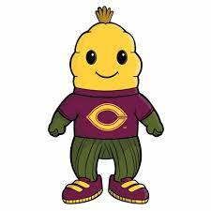
8. Cobber Logo
GetFit
Roll Cobbs
1
2
3
4
5
6
7
8

Slide 18
Component Descriptions
ID | Name | Description
1. | Main Figure | Displays Workout Figure
2. | Program Name | Displays Program Name
3. | Start Workout | Allows user to plug in their exercises
4. | Make Workout | Allows making of personal workout
5. | Add Exercise | Allows personal addition of exercises
6. | Progress | Shows progress made
7. | Program Description | Brief description of the program
8. | Cobber Logo | Roll Cobbs

