Slide 1
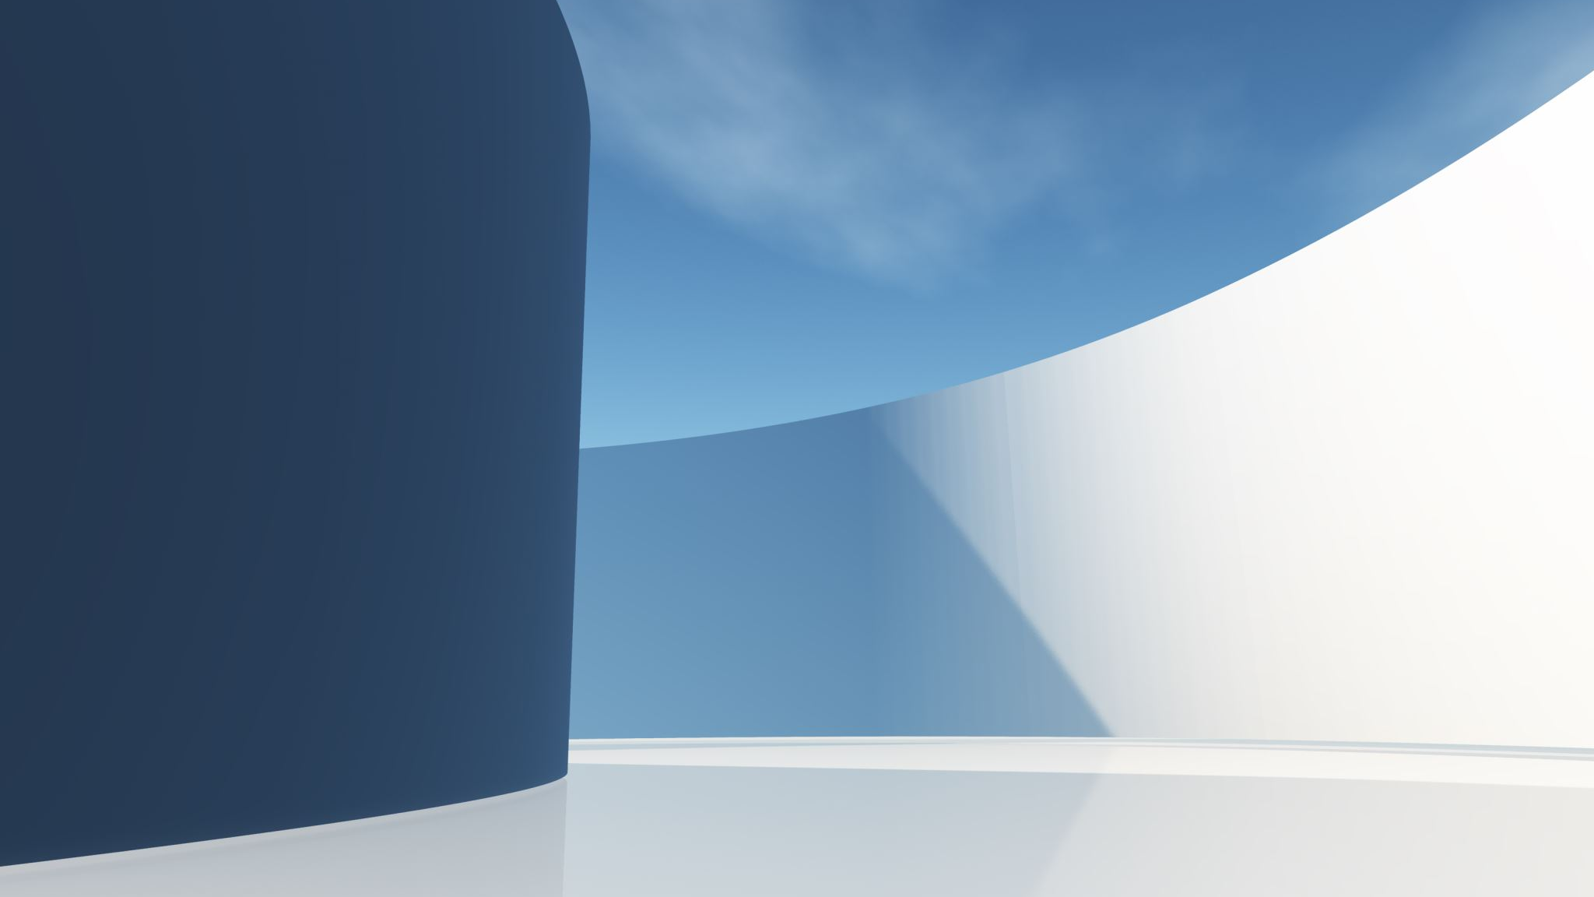
Developing an E-commerce website on Selling Cars
Aftab Uddin
Project Overview
Designed and developed a full-stack car dealership website using PHP, MySQL, HTML, CSS, and JavaScript
Built a dynamic platform for browsing cars, managing carts, and completing purchases
Focused on usability, responsiveness, and real-world e-commerce functionality.’
Frontend Development
Implemented modern UI using HTML5, CSS3 Applied premium design principles (clean layouts, spacing, typography)
Added interactive elements using JavaScript:
  Live search
  Filtering by price
  Dynamic buttons and UI feedback
Focused on user experience and professional dealership aesthetics

Slide 2
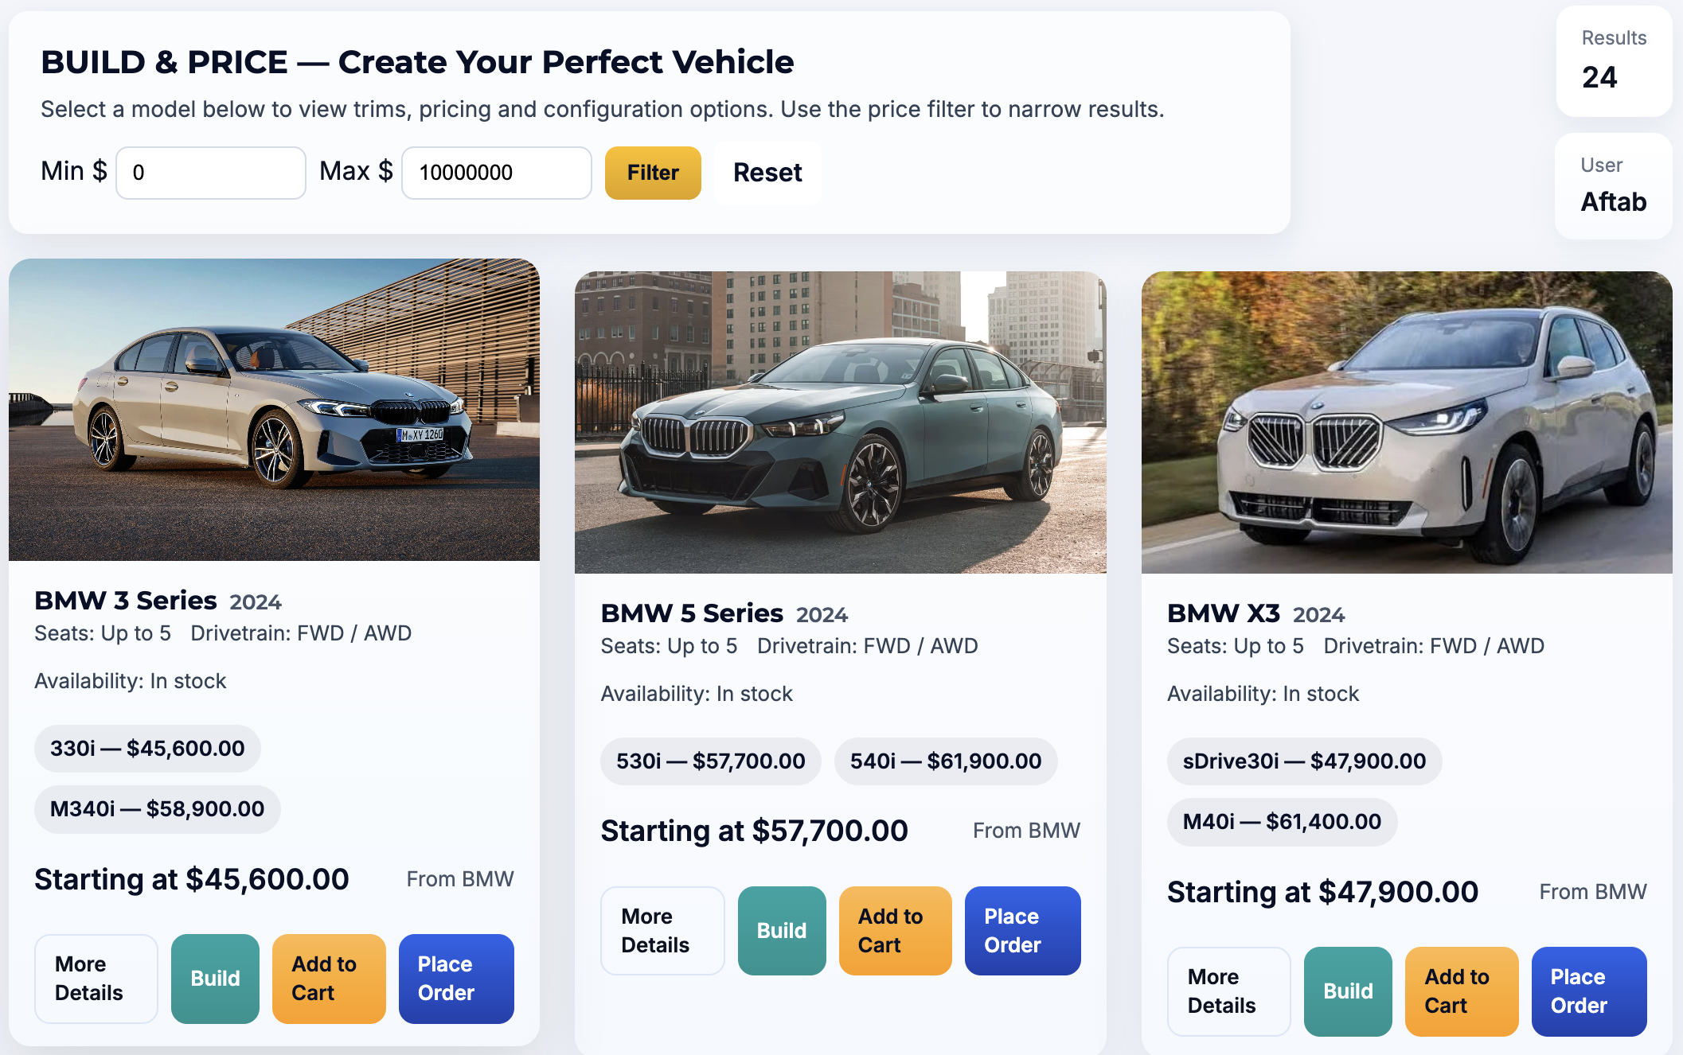
Some Backend development
Backend Development
Developed server-side logic using PHP
Implemented user authentication with sessions
Built dynamic pages that fetch car data directly from the database
Used prepared statements to ensure secure database queries

Slide 3
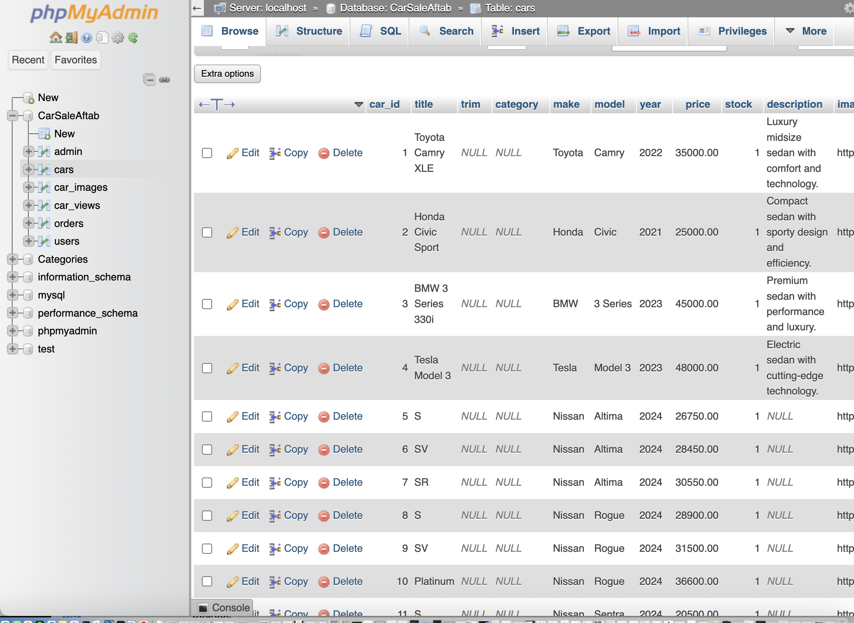
Database Design
Database Design & Integration
Designed a relational MySQL database schema:
  Users
  Cars
  Categories
  Cart
  Orders
Connected frontend components to real database data
Enabled CRUD operations (Create, Read, Update, Delete)

Slide 4
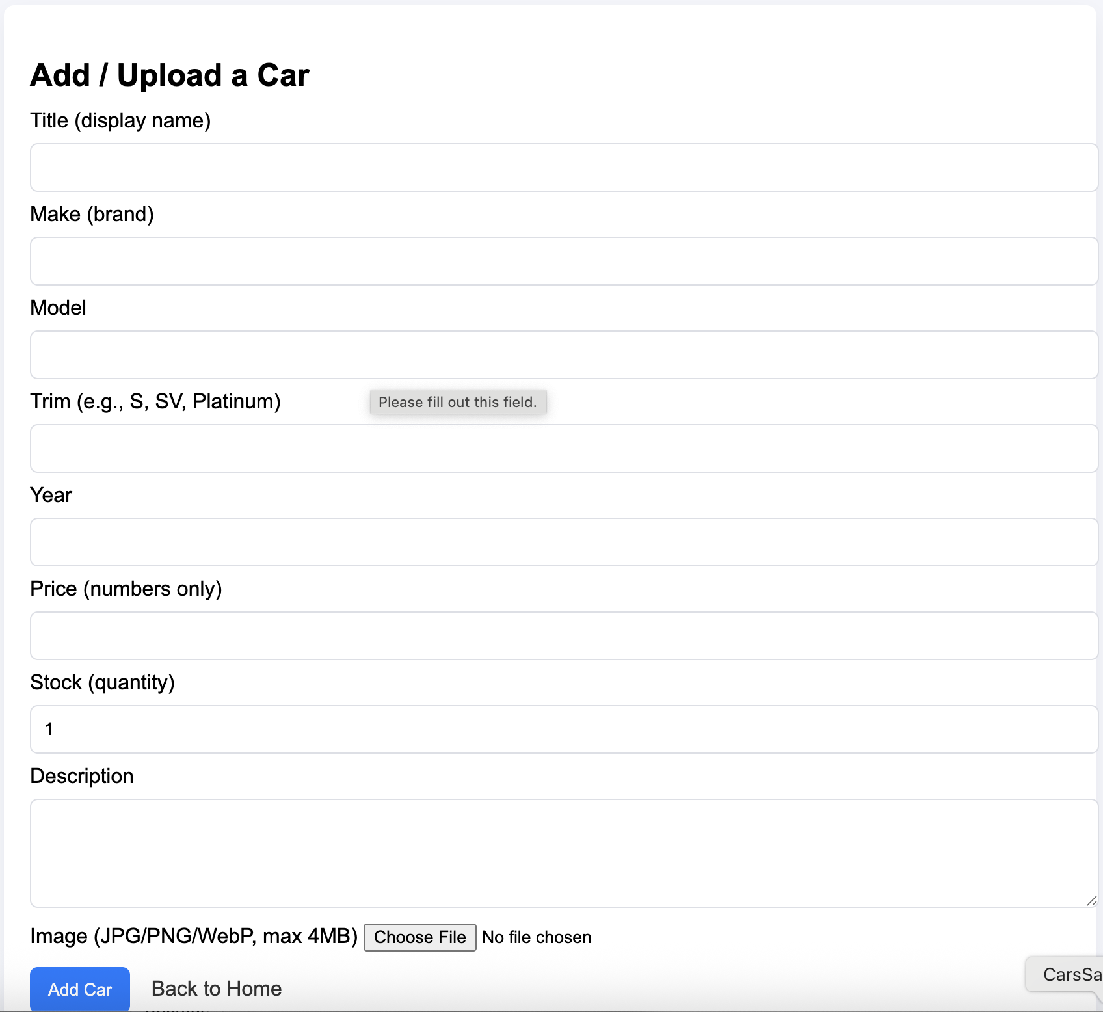
Shopping Cart + Order + Add Upload Car
Shopping Cart & Order System
Built a complete add-to-cart system
Allowed users to:
  Select a car
  Choose quantity
  Review cart contents
Implemented checkout functionality
Generated a purchase receipt displaying:
  Car details
  Price
  Quantity
  Total cost

Slide 5
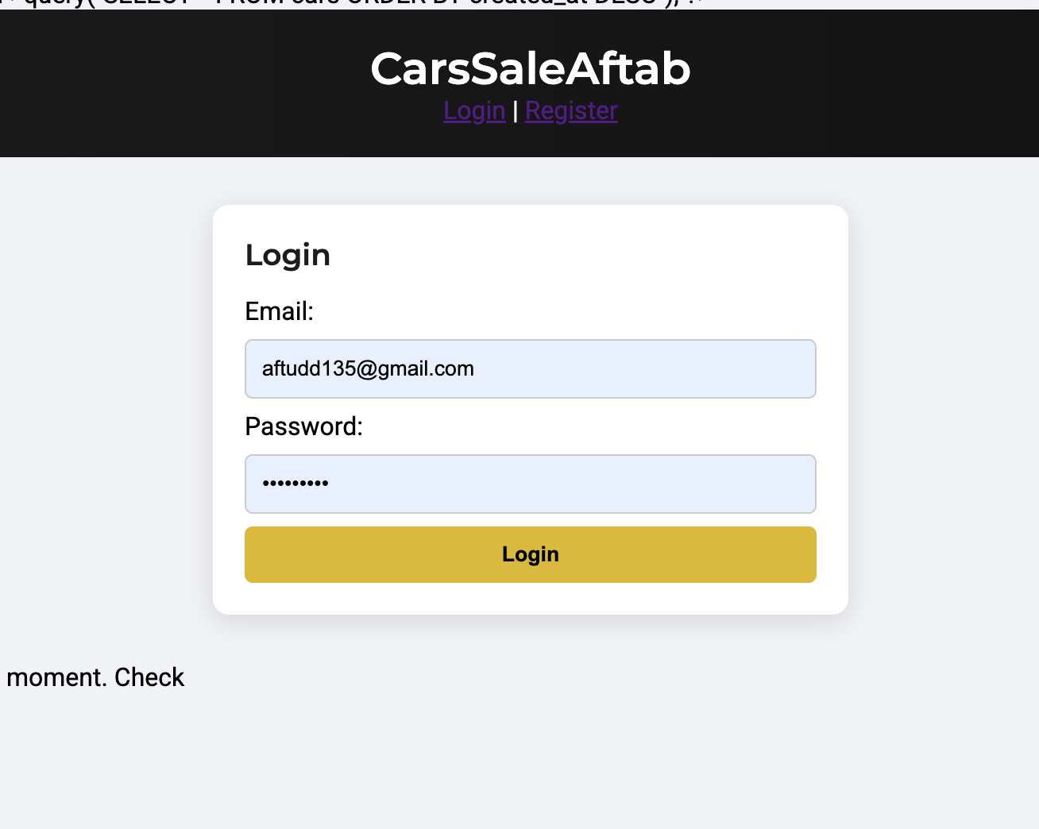
ADMIN PANEL + MANAGEMENT
Admin Panel & Management
Developed an admin system for:
  Adding new cars
  Editing existing listings
  Managing inventory
Implemented role-based access (admin vs user)
Created structured file organization for maintainability
Debugging & Problem Solving
Resolved server-side errors (404, connection issues)
Debugged PHP session and routing problems
Fixed cart and order logic bugs
Improved error handling and system stability

