Slide 1
Habitica Redux
The Three Engiteers: John, Sam, Olly

Slide 2
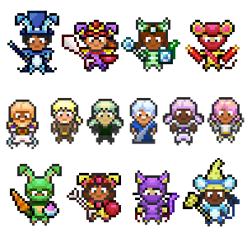
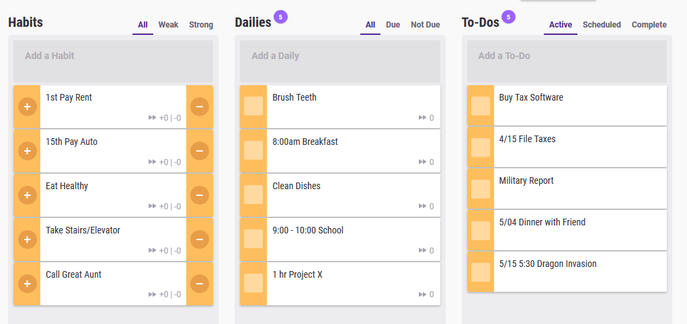
Introduction
Habitica is a task and habit planning RPG
Habits, to-dos, dailies
Rewards (Gold)
Equipment
Class
Quest
Notes:
Sam

Slide 3
Work So Far
Decided on open source software project
Planning document
New features
Project proposal preparation
Notes:
Sam

Slide 4
Successes
Meetings
Planning
Communication

Slide 5
Challenges
Meeting in person
Dealings with schedule
Sometimes ways to communicate online

Slide 6
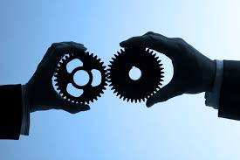
Plans for the Future
Create user stories
Formalized functional and nonfunctional requirements
Create use case scenarios and diagrams
Give final presentation to “investors”
Notes:
One of the major assets of the Engiteer team is our rigorous approach to requirements engineering. We follow agile best practices to break the elephant into bite sized chunks and run it to ground. By breaking down requirements into user stories, we set the the foundation for formalizing both functional requirements that our users need as well as non functional constraints on our systems. This sort of best-in-class 360 degree thinking will let us create detailed use case scenarios and diagrams before surfacing this information to key stakeholders in our final semester briefing.

Slide 7
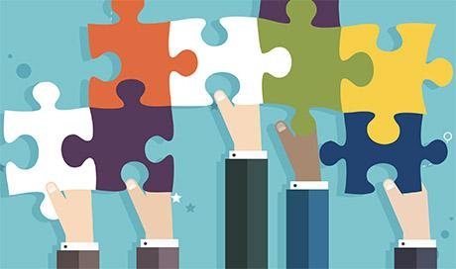
Conclusion
Full steam ahead
Teamwork makes the dream work
Challenges: overcome

Slide 8
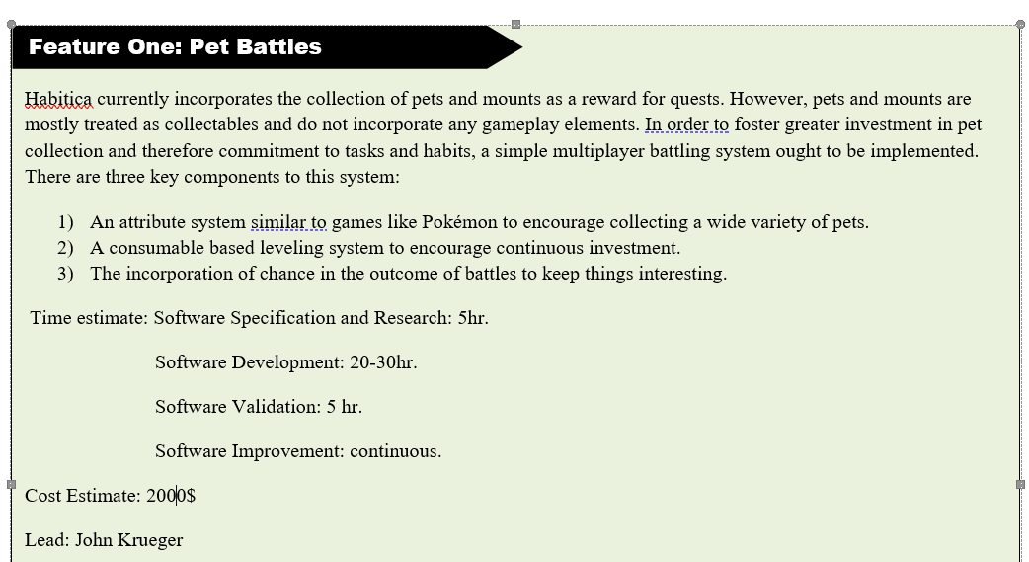
Pet Battles
Notes:
Currently we have a high level plan and proposal document. You can basically understand our group as bidding for a contract to develop these three features.

Slide 9
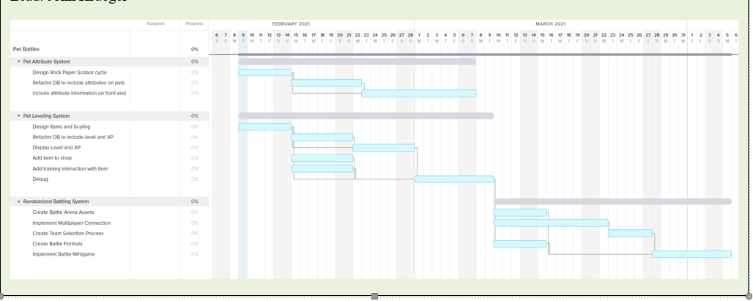
Pet Battles
Notes:
We’re charted out rough estimates for the pet battling feature including extensive critical path analysis.

Slide 10
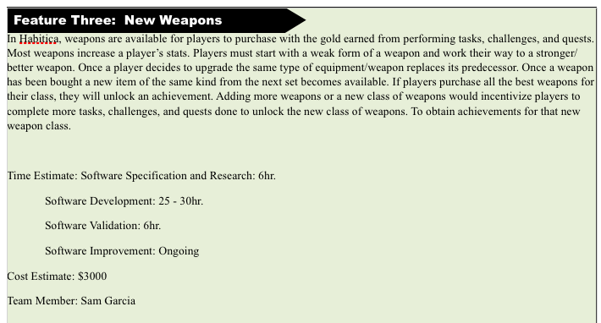
New Weapons

Slide 11
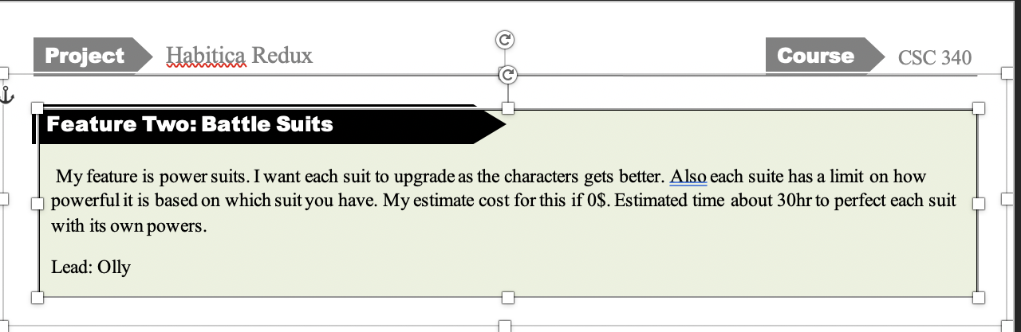
Battle suits

