Slide 1
Habitica Redux
The Three Engiteers: John, Sam, Olly

Slide 2
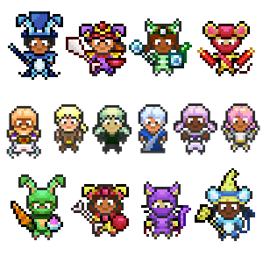
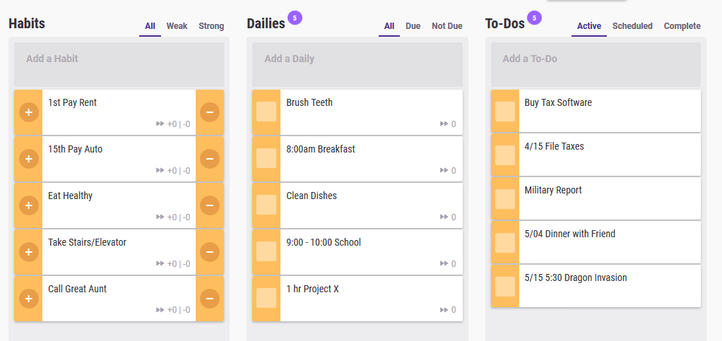
Introduction
Habitica is a task and habit planning RPG
Habits, to-dos, dailies
Rewards (Gold)
Equipment
Class
Quest
Notes:
Sam

Slide 3
Work So Far
Decided on open source software project
Planning document
Project proposal preparation
Identify Stakeholders, User stories and scenarios
Functional & Non Functional requirements
Notes:
Sam

Slide 4
Successes
Meetings
Planning
Communication
Completed milestones on time
Helped members

Slide 5
Challenges
Meeting in person
Dealings with schedule
Sometimes ways to communicate online
Working on milestones together

Slide 6

Plans for the Future
Specialize features
Formalized functional and nonfunctional requirements
Moving it more into support phase
scale up the project by investing
Notes:
One of the major assets of the Engiteer team is our rigorous approach to requirements engineering. We follow agile best practices to break the elephant into bite sized chunks and run it to ground. By breaking down requirements into user stories, we set the the foundation for formalizing both functional requirements that our users need as well as non functional constraints on our systems. This sort of best-in-class 360 degree thinking will let us create detailed use case scenarios and diagrams before surfacing this information to key stakeholders in our final semester briefing.

Slide 7

Conclusion
Developed members features
Teamwork makes the dream work
Challenges: overcome
Enjoyed developing this project

Slide 8
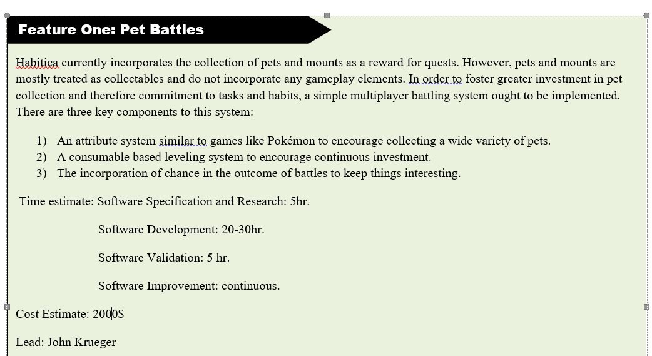
Pet Battles
Notes:
Currently we have a high level plan and proposal document. You can basically understand our group as bidding for a contract to develop these three features.

Slide 9
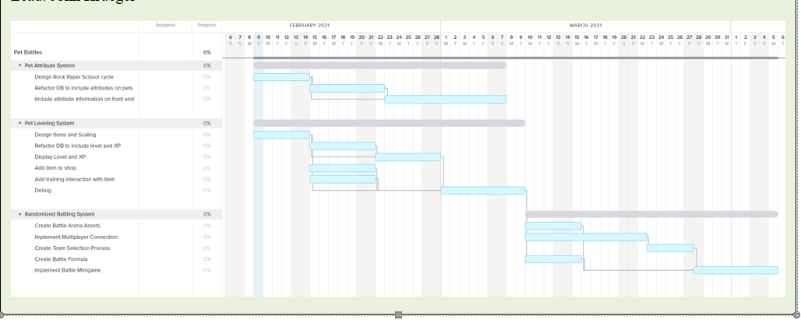
Pet Battles
Notes:
We’re charted out rough estimates for the pet battling feature including extensive critical path analysis.

Slide 10
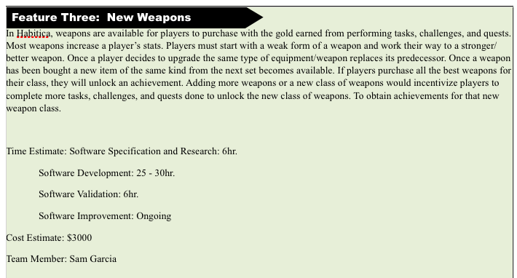
Weapons

Slide 11
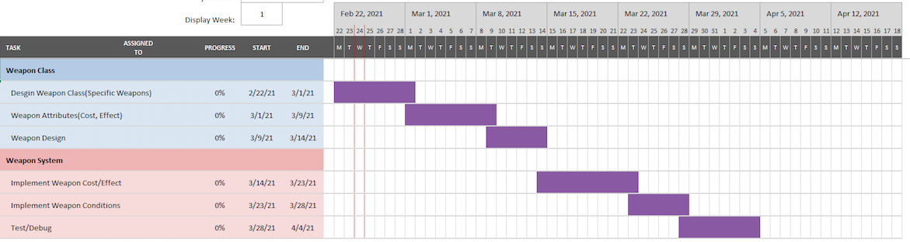
Weapons

Slide 12
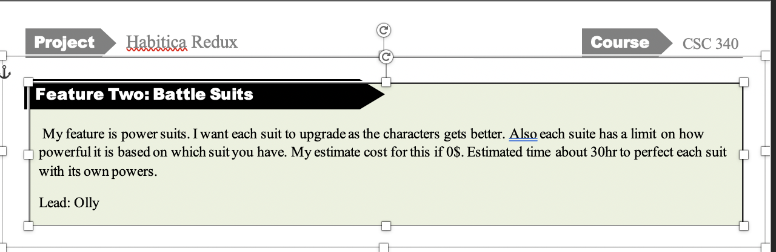
Battle suits

Slide 13
Functional and non Functional
Pet Battles:
Functional:
A user shall be able to buy consumable items at the store for gold.
A user shall be able to battle another user in the coliseum.
A user shall be able to acquire multiple pets.
Non-Functional
Users shall keep a consistent inventory of items
Users shall keep a consistent stable of pets
The system should be easy to use even by end users with relatively low familiarity with the system.
Battle Suits:
Functional:
User can unlock suits at each high level
User can trade battle suits with other users
User is allowed to unlock as many suits as possible
Non- Functional
Users will keep all suits in their inventory
Users will keep consistent stable of suits
Users should be able to access the system easily

Slide 14
User Stories
Pet Battles:
Carl is a college student using Habitica to manage homework and daily chores. In order to stay invested in using the application, he needs deeper gamification to provide gratification. While Carl enjoys collecting pets, leveling and training pets provides a long term reward, especially since he’s already achieved a full collection. Finally, buying consumables for his pets helps him stay motivated to complete tasks and habits.
Jenny is a hard core gamer using Habitica to get their life back on track. After playing pokemon for many years, they gravitate towards the core gameplay loop of collecting pets then using them to battle. Jenny is especially interested in the social aspect of pet battling. By fighting in the coliseum, Jenny has an engaging way to stay connected with guild members and friends. This element of friendly competition keeps Jenny engaged with their dailies, habits, and quests.
Johnson is using habitica to manage his daily work. After a while he manages to get into pets to help him manage his comfort life. Johnson then began playing Pokémon which helped him stay in better form fit his comfort life
Weapons:
Andy is a college student that uses Habitica to improve or get rid of not so healthy habits. Andy likes doing challenges and quests. He is invested in earning all the weapons
Jay is a busy professional who needs a fun and light hearted way to stay on top of things. Jay enjoyed playing rpgs growing up, and they are particularly invested in using expanded weapons to customize their character. Jay does not focus on the utilitarian aspects of the weapons, they aren't particularly involved in questing or guilds, but they do value them for how they look.
Olivier is a student at Concordia and uses habitica to his competitiveness. He then challenges himself on call of duty to earn all the heavy weapons. This then helps him build his competitive side.

Slide 15
User Stories
Battle Suits:
Dylan is a lifestyle enthusiast who uses Habitica to manage his self improvement goals. After watching the Iron Man movies he has become enamored with the concept of sophisticated battle suits and science fiction. While most of Habitica is fantasy themed, using his battle suit and upgrading it for quests and adventures lets him feel like a real life self improvement Tony Stark.
Nate has always been a fashion person. He managed to bring that into habitica. He uses it to create different types of suits with different powers to fulfill his fashion desires.
Tony watches the avengers and has always wanted to be a superhero. To bring his dream to reality, he uses habitica to create different superpowers through suits. Makes him feel like his dreams are accomplished.

Slide 16
Scenarios:
Pet Battles:
Battling at the Coliseum
Initial Assumption: Two users have at least one pet that is able to battle. Both users have internet access and are logged in to their accounts.
Normal: Players can send each other battle requests by navigating to the player’s profile and clicking the request battle icon. This will then send a link via private message that can be used to access the coliseum by both players for that particular battle. Otherwise, players can navigate to the coliseum from the stable by clicking on the coliseum icon, and then they can challenge any of the friends for guild members via a searchable list of opponents. Once both players have joined the battle lobby, they can both mark themselves as ready. Once the game starts, both players are prompted to choose a pet to battle with. Once both players have chosen, a battle occurs where pet level, element, and random chance are used to choose a victor. Both players can choose to battle again or exit the minigame.
What Can Go Wrong: One or more players can timeout during the pet selection process. If this happens, the game shows a timeout error to the user then returns them to the main coliseum page. Additionally, one or more players may lose connection mid battle. If this occurs, the game system awards the win to the remaining connected player, drops the game in the case of both, and the relevant results are recorded on the user’s profile and reflected in changed pet xp levels.
Other Activities: Players can chat while battling
System State of Completion: Pets are awarded XP, player statistics are updated to reflect new win loss.

