Slide 1
Scheduled Notifications Using Amazon CloudWatch Events, SNS, and Lambda
Nikki Yodo
May 14th, 2020

Slide 2
ABOUT
Nikki Yodo
Degree: Computer Science
Background: Web Application Developer
AWS Experience: 1+ years (Nov 2018)
LinkedIn: https://www.linkedin.com/in/nikkiyodo

Slide 3
REQUIREMENTS
Notifications for recurring events
Can be scheduled
Multiple messages, picked randomly
Subscribe/unsubscribe
Managed via mobile

Slide 4
DIAGRAM
Scheduler
Set date/time
Trigger
Manager
Processor
Pass message
Sender
Pick random message
Save messages
Storage

Slide 5

IMPLEMENTATION
Scheduler
CloudWatch Events
Set date/time
Trigger
Manager
Android
Processor
Lambda
Pass message
Sender
SNS
Pick random message
Save messages
Storage
DynamoDB

Slide 6

INTERACTIVE DEMO
Visit: https://bit.ly/testdonkey
Select topic(s) (multiple topics supported)
Enter your email and click subscribe
Confirm your email
Unsubscribe by clicking link in the email

Slide 7

AWS LAMBDA
“Run code without provisioning or managing servers”
Steps:
Create function
Attach execution role
Set CloudWatch Events trigger permission
Notes:
AWS Toolkit for Visual Studio
Dynamic trigger and target
More Info:
https://docs.aws.amazon.com/lambda/latest/dg/welcome.html

Slide 8

AMAZON CLOUDWATCH EVENTS
“Schedule automated actions”
Steps:
Define schedule expression (cron)
Create rule
Set target (Lambda)
Notes:
Permission is set on target (Lambda)
Amazon EventBridge
More Info:
https://docs.aws.amazon.com/AmazonCloudWatch/latest/events/WhatIsCloudWatchEvents.html

Slide 9

Amazon Simple Notification Service (SNS)
“Coordinates and manages the delivery or sending of messages”
Steps:
Create a topic
Add subscription and set protocol (SMS, email, etc)
Publish message (send)
Notes:
SMS defaults to USD 1.00 per month limit (soft limit)
Email is unformatted (no HTML)
Can’t delete pending subscription (expire in 3 days)
More Info:
https://docs.aws.amazon.com/sns/latest/dg/welcome.html

Slide 10
Q&A
Did you NOTICE the aws services used are all serverless?

Slide 11
THANK YOU!

Slide 12
ADDITIONAL SLIDES

Slide 13
REALITY
AuthN
Auth0
Validate token
AuthZ
STS
Scheduler
CloudWatch Events
Pass token
Set date/time
Trigger
Get token
Manager
Android
RESTful
Endpoint
API Gateway
Pass request
Picker
Lambda
Pass message
Sender
SNS
Get Topics
Save messages
Subscribe
Pick random message
Subscriber
Browser
Web page
Web Host
S3 + CloudFront
Storage
DynamoDB

Slide 14
CRON
cron(minutes hours day-of-month month day-of-week year)
Examples:
More Info:
https://docs.aws.amazon.com/AmazonCloudWatch/latest/events/ScheduledEvents.html
Every 15 minutes | cron(0/15 * * * ? *)
Daily (at midnight) | cron(0 0 * * * ? *)
Weekly (at 8 AM on Monday) | cron(0 8 ? * * MON *)
Monthly (at 9:11 AM every 1st) | cron(11 9 1 * ? *)
Every 5 minutes Monday – Friday between 8 AM – 5:55 PM | cron(0/5 8-17 ? * MON-FRI *)

Slide 15

AUTH0
“Rapidly integrate authentication and authorization”
Steps:
Create application
Add user
Implement QuickStart
Notes:
Supports OAuth 2.0 and OpenID
Free tier available
More Info:
https://auth0.com/

Slide 16

AWS Mobile SDK for Android
“Build connected mobile applications using AWS”
Steps:
Add dependency per service
Request temporary credentials via WebIdentityFederationSessionCredentialsProvider
Use AWS API
Notes:
Not all AWS services supported (CloudWatch Events not supported)
Production ready
More Info:
https://github.com/aws-amplify/aws-sdk-android

Slide 17

AWS Security Token Service (STS)
“Request temporary, limited-privilege credentials”
Steps:
Create an Identity Provider in IAM (Auth0)
Create role
Provide role ARN to WebIdentityFederationSessionCredentialsProvider
Notes:
No Access Key ID and Secret Access Key on device
Temporary credentials (default to 1 hour)
More Info:
https://docs.aws.amazon.com/STS/latest/APIReference/Welcome.html

Slide 18

AMAZON DYNAMO DB
“Fully managed NoSQL database service”
Steps:
Create table
Set primary key
CRUD operations on item
Notes:
Auto Scaling (RCU and WCU)
DAX and Global Tables
More Info:
https://docs.aws.amazon.com/amazondynamodb/latest/developerguide/Introduction.html

Slide 19

AMAZON API GATEWAY
“Create, publish, maintain, monitor, and secure REST, HTTP, and WebSocket APIs”
Steps:
Create API, resource, methods
Choose integration point (Lambda)
Deploy API
Notes:
CORS
API Key
More Info:
https://docs.aws.amazon.com/apigateway/latest/developerguide/welcome.html

Slide 20

AMAZON SIMPLE STORAGE SERVICE (S3)
“Host a static website”
Steps:
Create bucket
Set to host static website (optional)
Upload code
Notes:
Separate website endpoint
API calls
More Info:
https://docs.aws.amazon.com/AmazonS3/latest/dev/Welcome.html

Slide 21

Amazon CloudFront
“Fast content delivery network (CDN) service”
Steps:
Create web distribution
Configure OAI (Origin Access Identity)
Specify a Default Root Object
Notes:
TTL (Time To Live), extra charge if manually invalidate cache
Default Root Object
More Info:
https://docs.aws.amazon.com/AmazonCloudFront/latest/DeveloperGuide/Introduction.html

Slide 22
BEYOND THE SEA
Other technology:
Android Studio
AWS Architecture Icons
AWS IAM Identity Providers
AWS Toolkit for Visual Studio
Bootstrap
Bundler
C#
Emmet
Go
Gradle
Gson
Java
jQuery
JSON
Kotlin
Kotlin Coroutine
Krita
Logitech Capture
Maven
Netbeans
NodeJS
OAuth 2.0
OpenID
Python
REST
Retrofit
Ruby
ZoomIt (part of Sysinternals Suite)
VS Code
VS Community

Slide 23
Just for Fun
The Interactive Demo backend is built using 5 different programming languages:
Refresh Topics -> API Gateway -> Lambda in NodeJS
Subscribe -> API Gateway -> Lambda in Go
Check Subscriptions -> API Gateway -> Lambda in Ruby
Refresh Topic Metrics -> API Gateway -> Lambda in Java
Refresh Messages List -> API Gateway -> Lambda in Python

Slide 24

DESIGN
One schedule per event
Schedule for Event 1
Event 1
Schedule for Event N
Event N

Slide 25
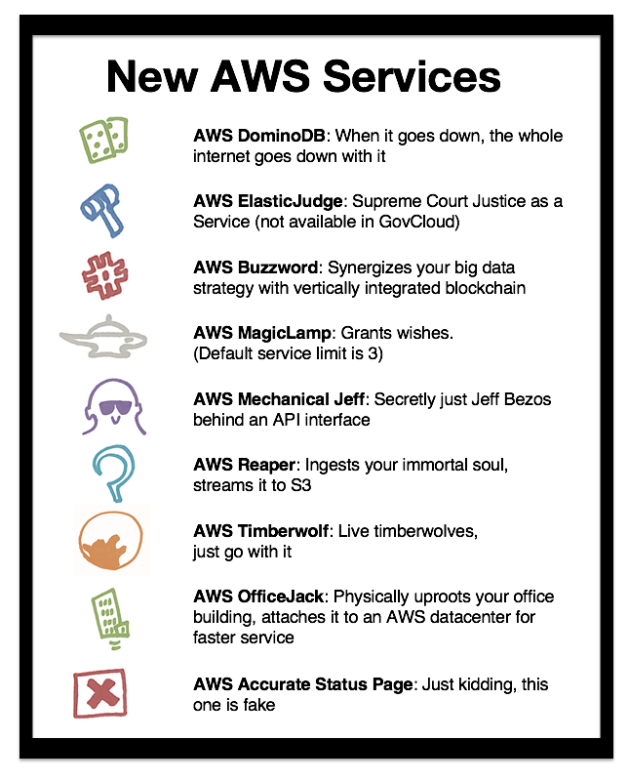
Funny as a Service (FaaS) and Furious
©2020 Forrest Brazeal

