Slide 1
DEMO – Auto Scaling
Muhammad Cordiaz

Slide 2
Using Auto Scaling to Provide Elasticity
A highly available and elasticity application is the one that is continuously operational for a long period of time to serve hundred of thousand of visitors and has minimum downtime.
Examples of such applications can be Google, Facebook, Twitter and Amazon and your blog.. ☺

Slide 3
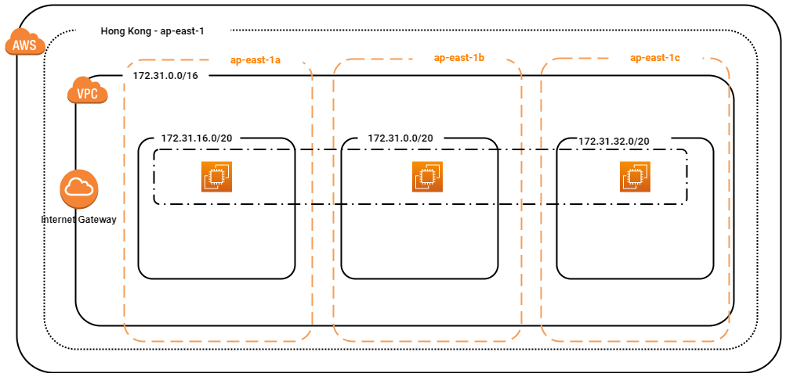
Demo - Diagram

Slide 4
The Technology
Launch Configuration
Auto Scaling Group
Security Group
Amazon SNS
Amazon VPC
Amazon EC2

Slide 5
Step by Step
Create Launch Configuration
Create Auto Scaling Group
Terminate instance - demo

Slide 6
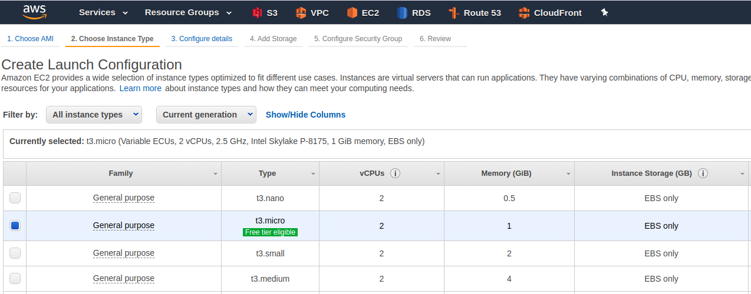
Amazon EC2 – Choose Instance Type

Slide 7
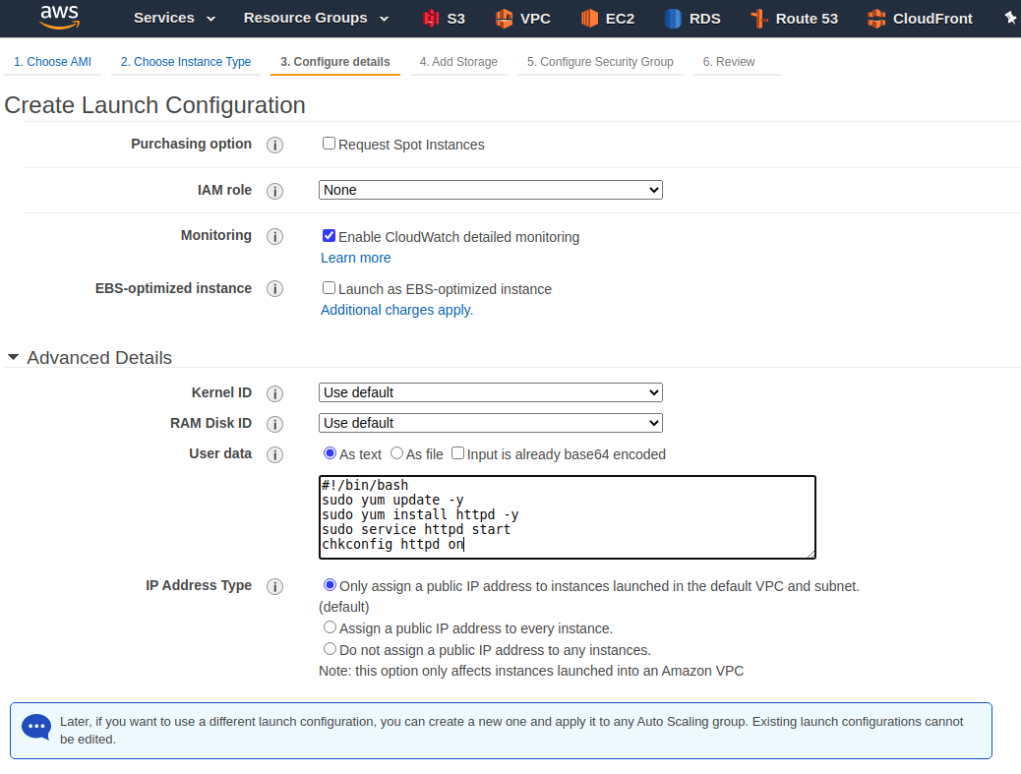
Configuration details – User data

Slide 8
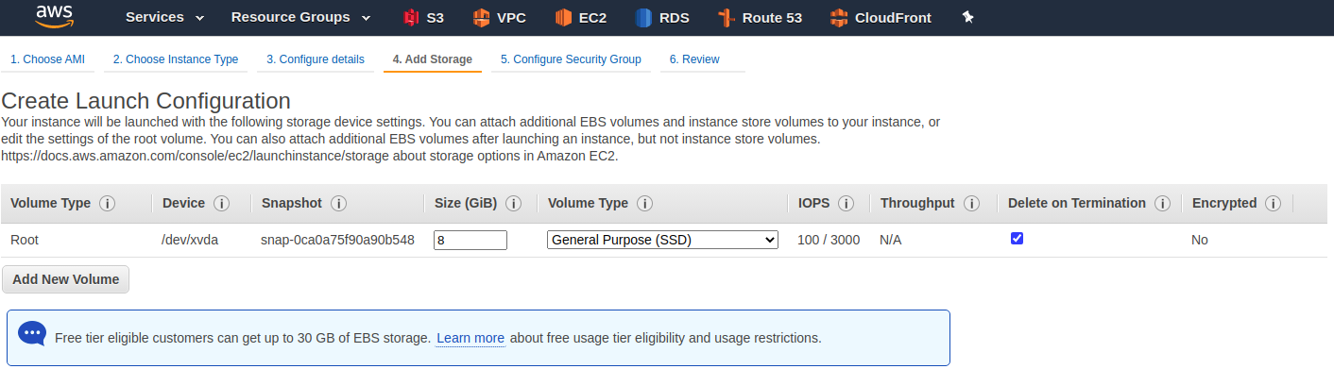
Add Storage

Slide 9
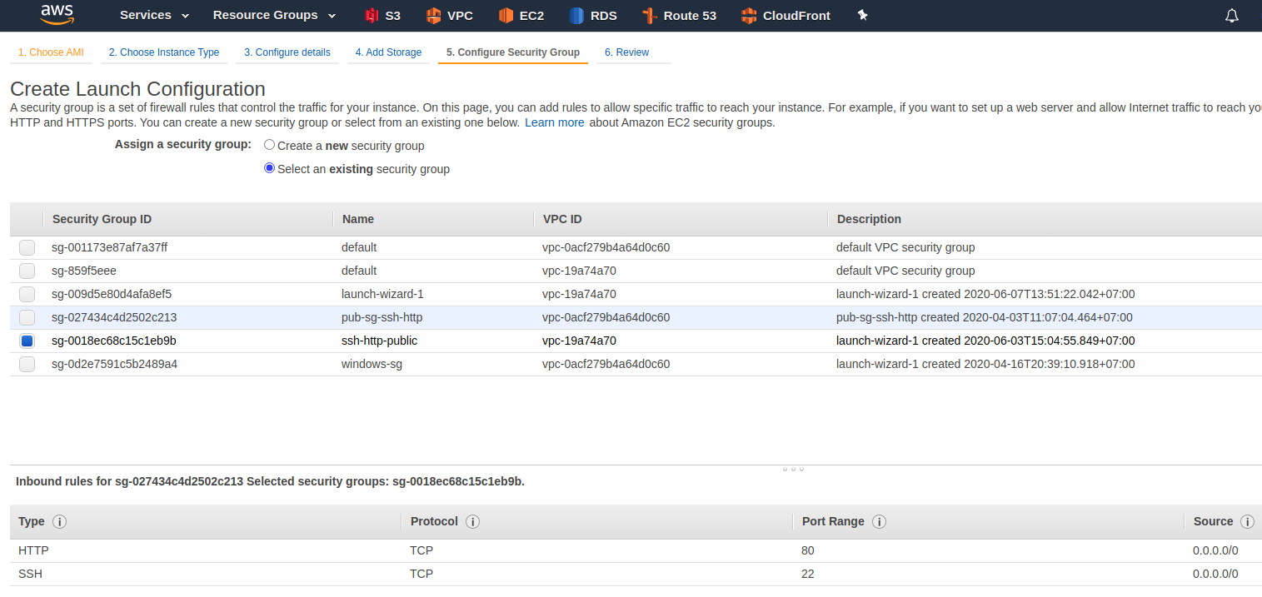
Security Group

Slide 10
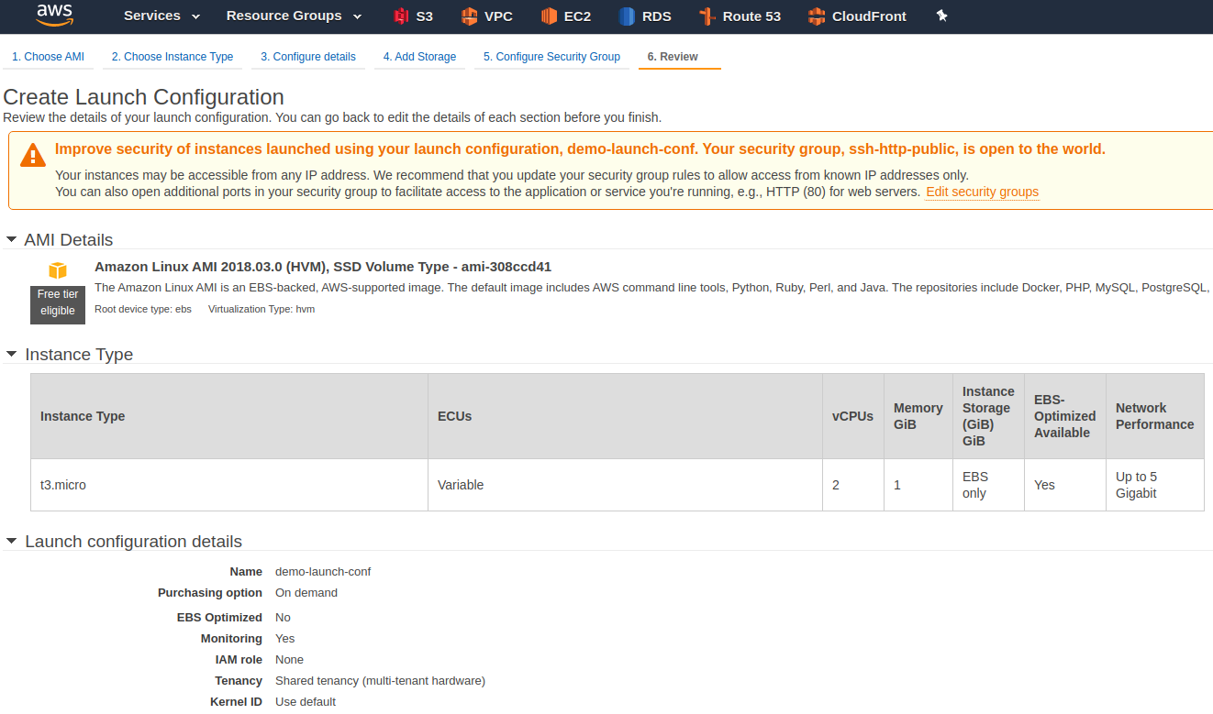
Launch Configuration - Review

Slide 11
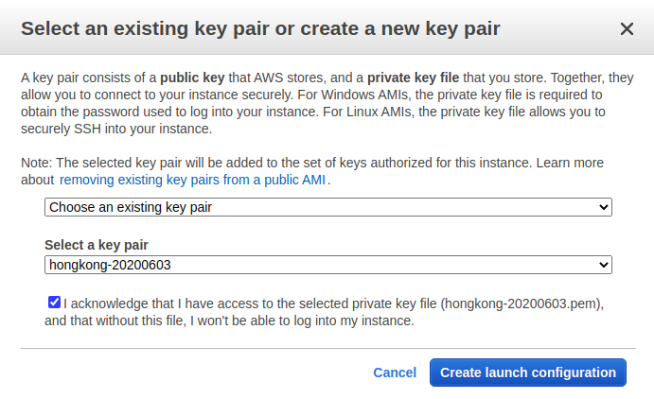
Key pair

Slide 12
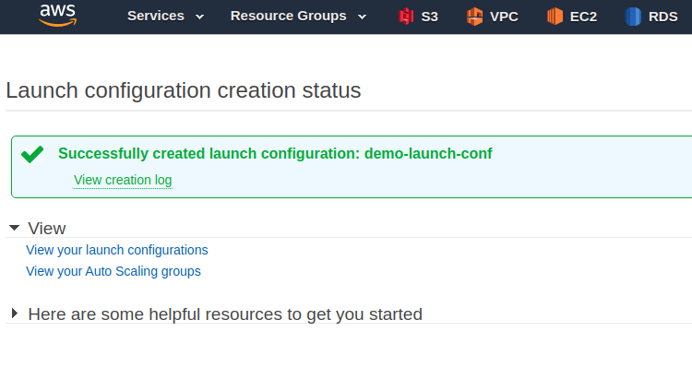
Successfully Launch Configuration

Slide 13
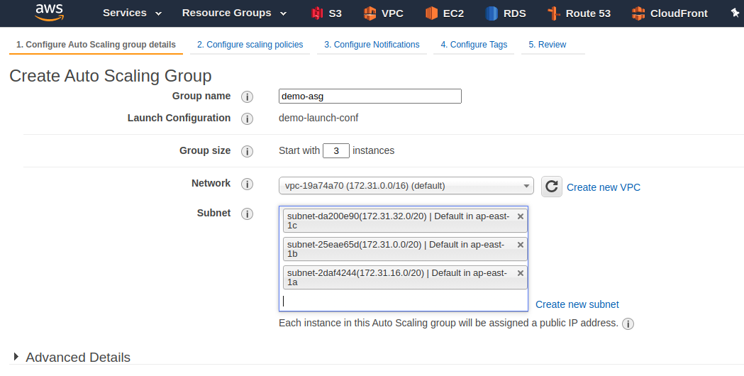
Create Auto Scaling Group

Slide 14
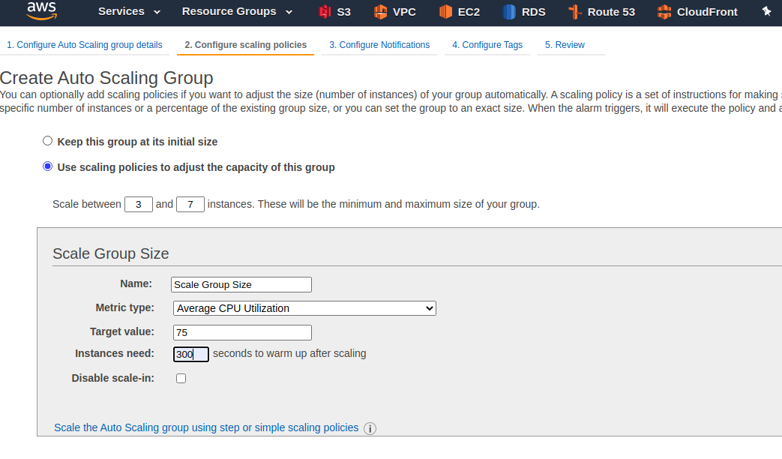
Scaling Policies

Slide 15
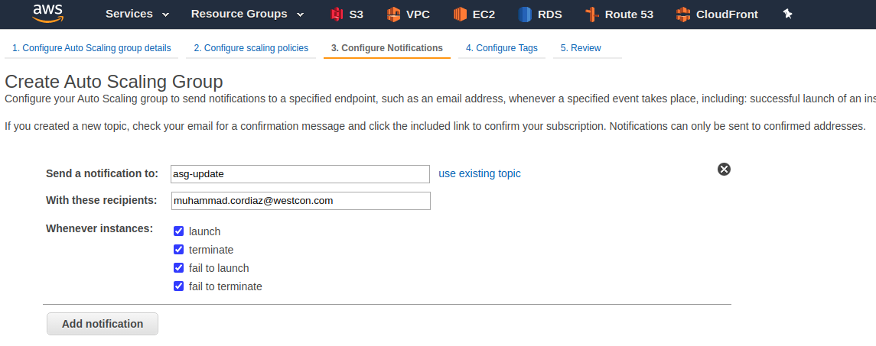
Configuration Notification

Slide 16
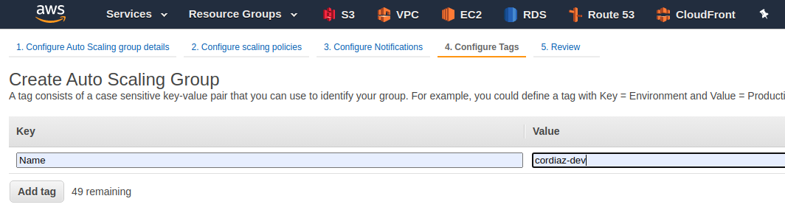
Configuration Tags

Slide 17
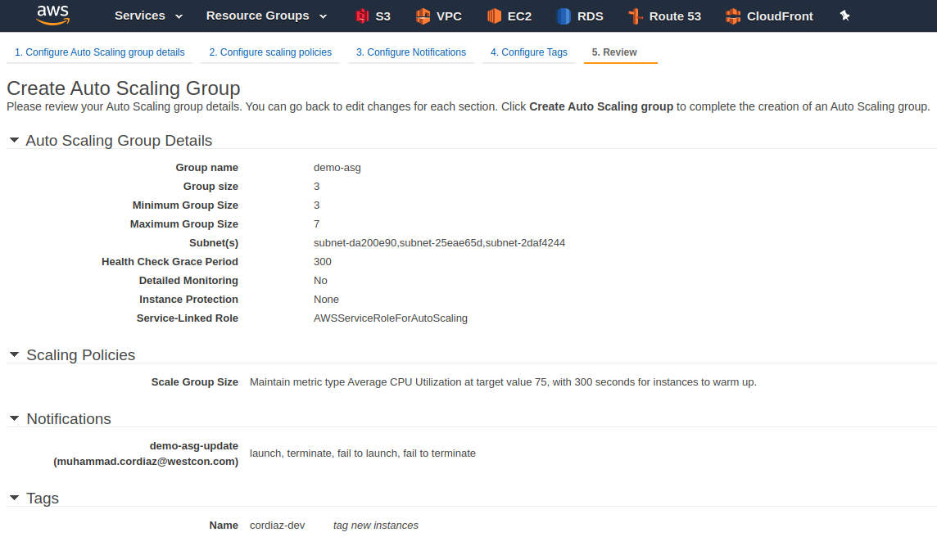
Auto Scaling Group - Review

Slide 18
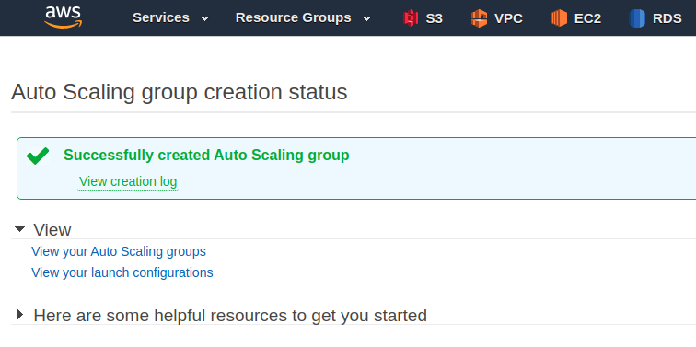
Successfully Auto Scaling Group

Slide 19
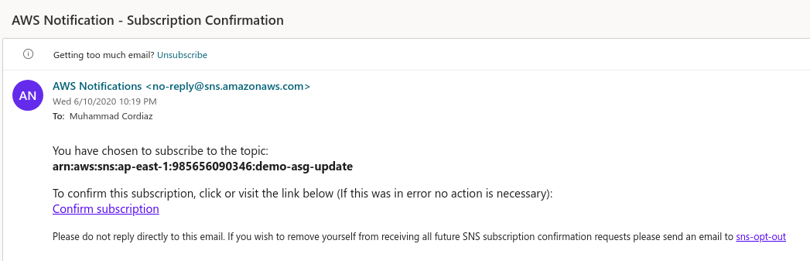
Amazon SNS – Email Notification

Slide 20
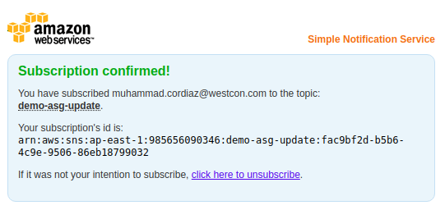
Subscribe Amazon SNS Notification

Slide 21
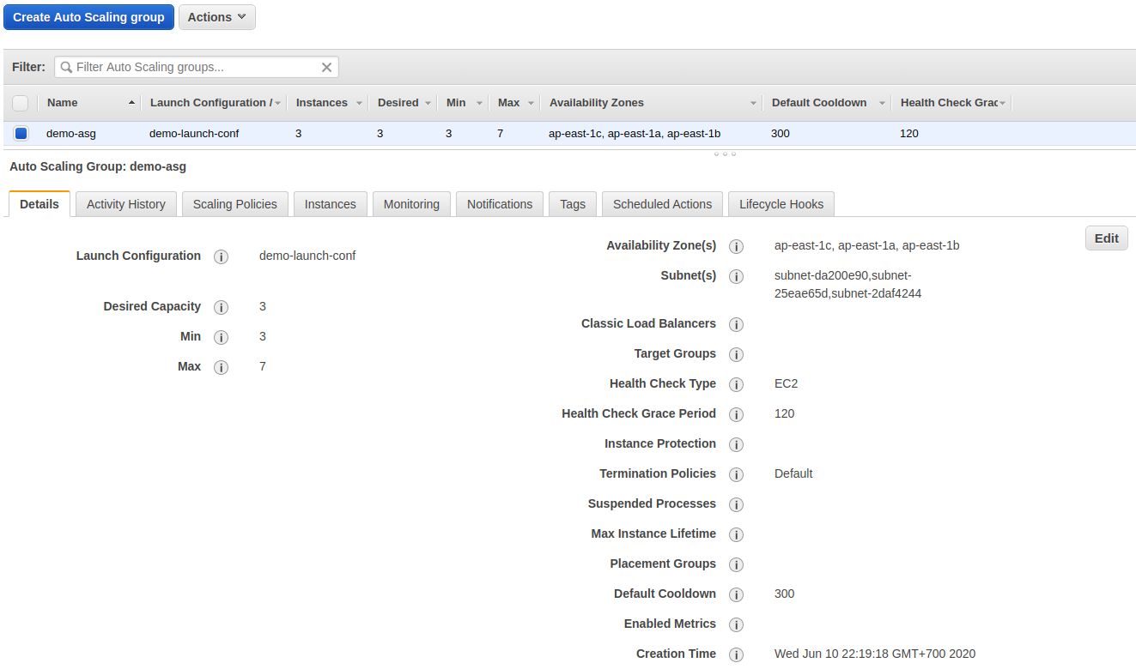
Auto Scaling Group – Detail demo-asg

Slide 22
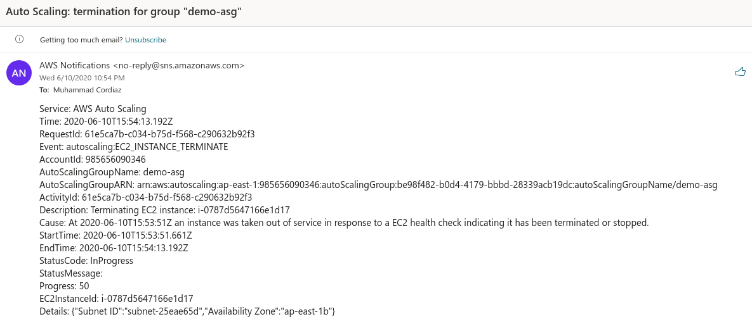
ASG Notification – termination instance

Slide 23
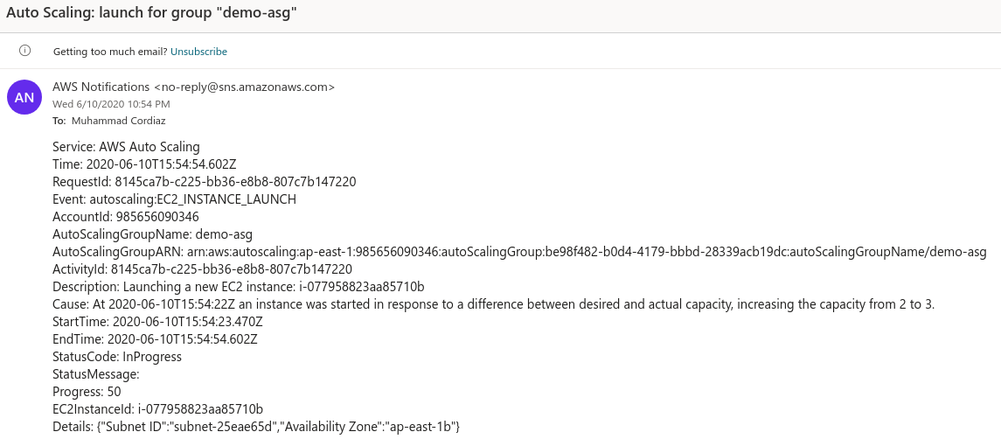
ASG Notification – launch instance

Slide 24
Thank You

