Slide 1
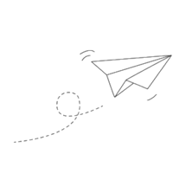
How to Throw a Paper-Plane
Team Popeyes
Notes:
Hello, guys. We are popeyes team. Today we gonna present our final project:paper-plane.

Slide 2

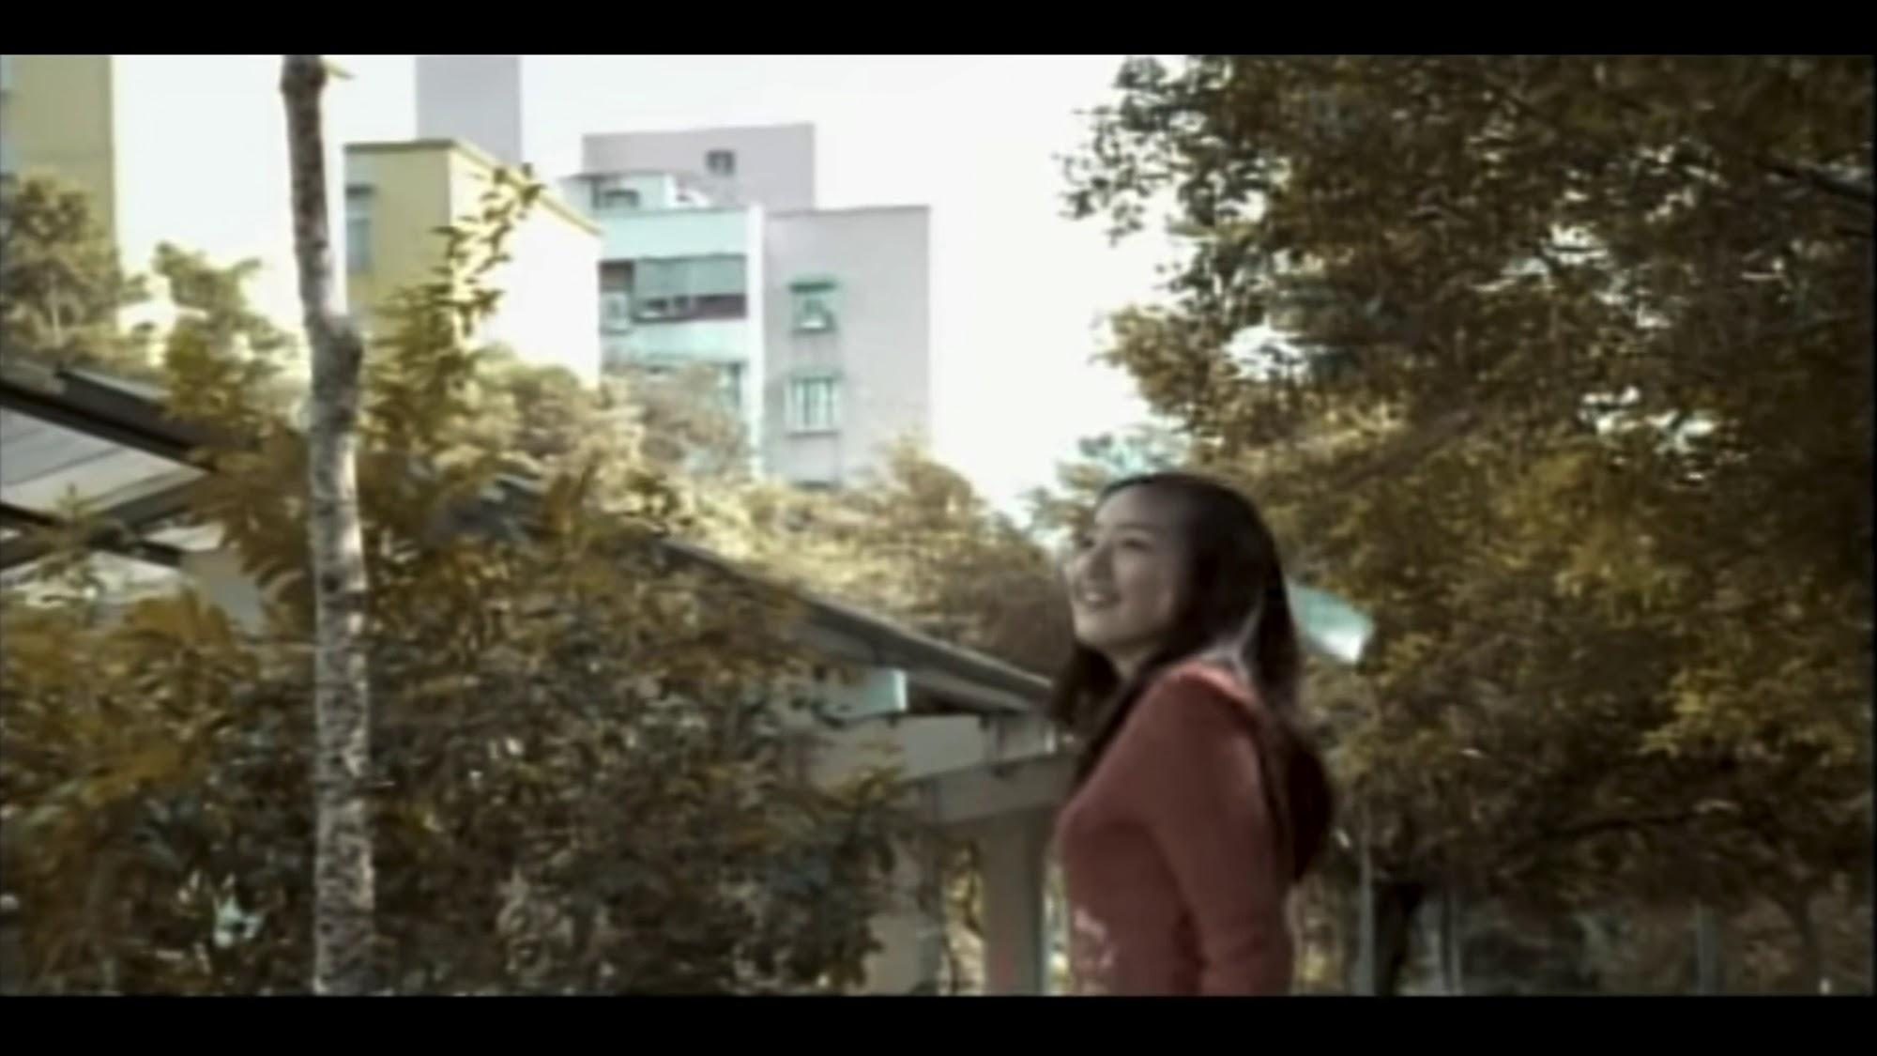
Introduction
Notes:
The paper-plane was originated in China 2000 years ago. It has been one of the most popular toys, but only a few people are experts.

Slide 3
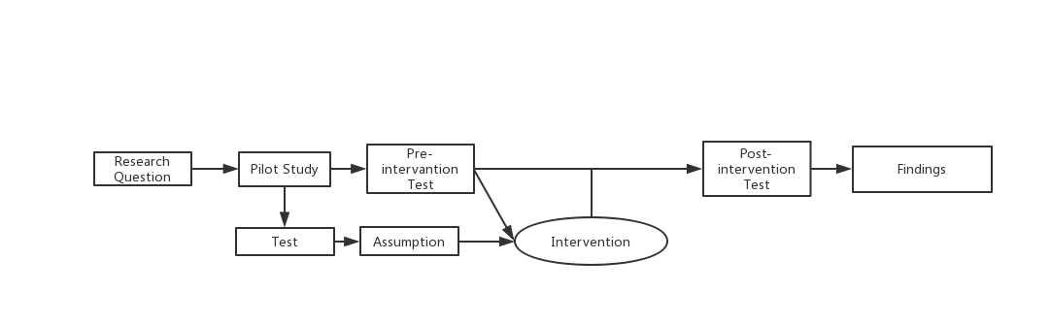
Procedure

Slide 4
Research Question
Are there differences in the throwing motion between experts and novices?
How can we capture these differences?
What do these differences look like?
What do the differences mean in the game?
Can participants improve by intervention?

Slide 5
Pilot Study

Slide 6
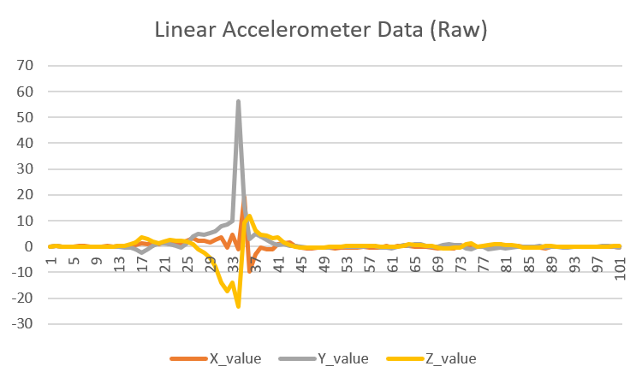
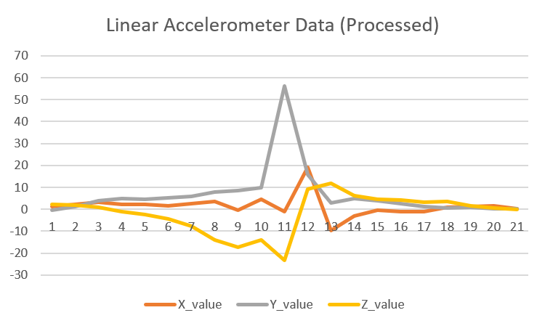
Pilot Test
We collect 20 data to do data pre-processing
Find maximum arousal number
Takeaway findings: Maximum values are always on Y-value.
Select ten point-in-time before max arousal number and ten time points after max arousal number
Reset time - reset the first time points as 0

Slide 7
Why we need pilot study
Help us to better identify the correlation between the distance of the paper-plane flight and the instantaneous data when throwing the paper-plane, minimizing the influences of other actions on the data analysis
Standardize starting point of time: 0.00
Standardize number of time points: 21 time points
Standardize timing of the peak: set the 11st time points as the peak

Slide 8
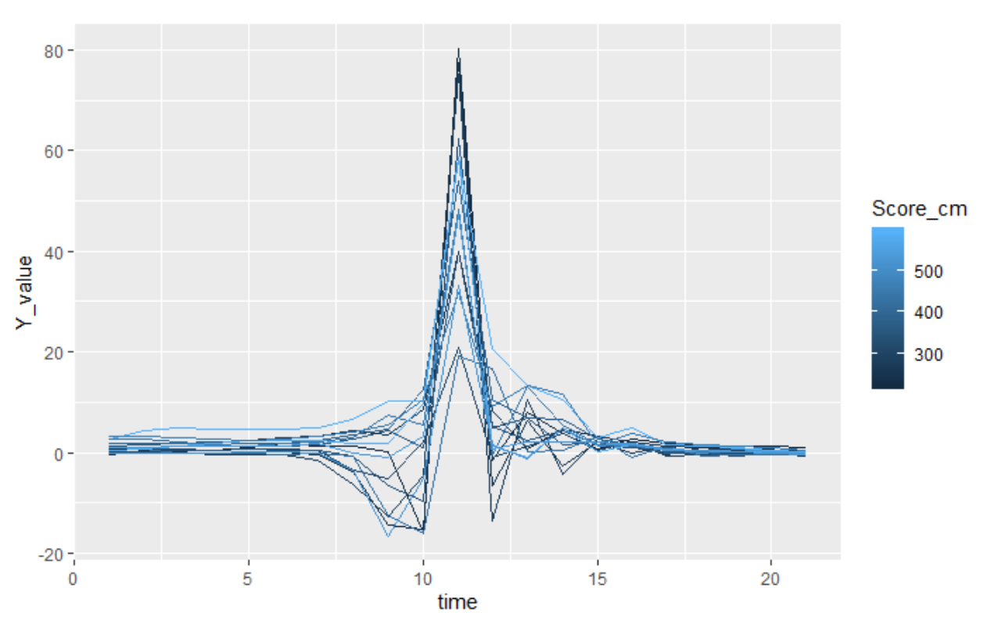
Assumption
The person accelerates at the beginning can throw paper-plane further in distance.
The paper-plane with the fastest acceleration peak actually fly shorter in distance.
When Y-value ranges from 40 to 60, the paper-plane flight distance is longer.
Notes:
The lighter the blue, the shorter the paper-plane flight distance.
The graph shows the relationship between paper-plane flight distance and y-value acceleration.

Slide 9
Experiment Designing

Slide 10
Experiment Designing - Definition
Strike: Scores 480 cm
Non-strike: Score 480 cm
Expert: the average of the five round >= 450 cm
Novice: the average of the five round < 450 cm

Slide 11
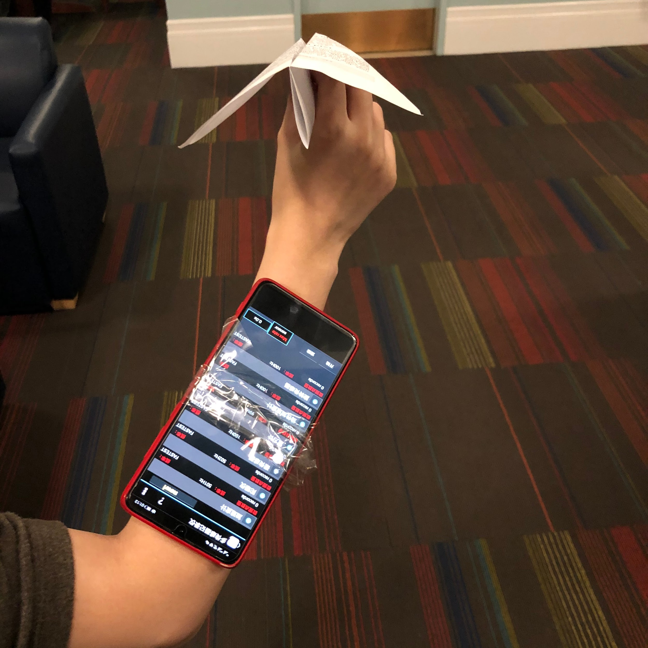
Measurement
Materials:
Sheets of Paper
Iphone: Sensor Kinetics Pro App
Ruler: Measure distance
Free indoor space
Participants:
Expert: A, B
Novice: C, D, E, F

Slide 12
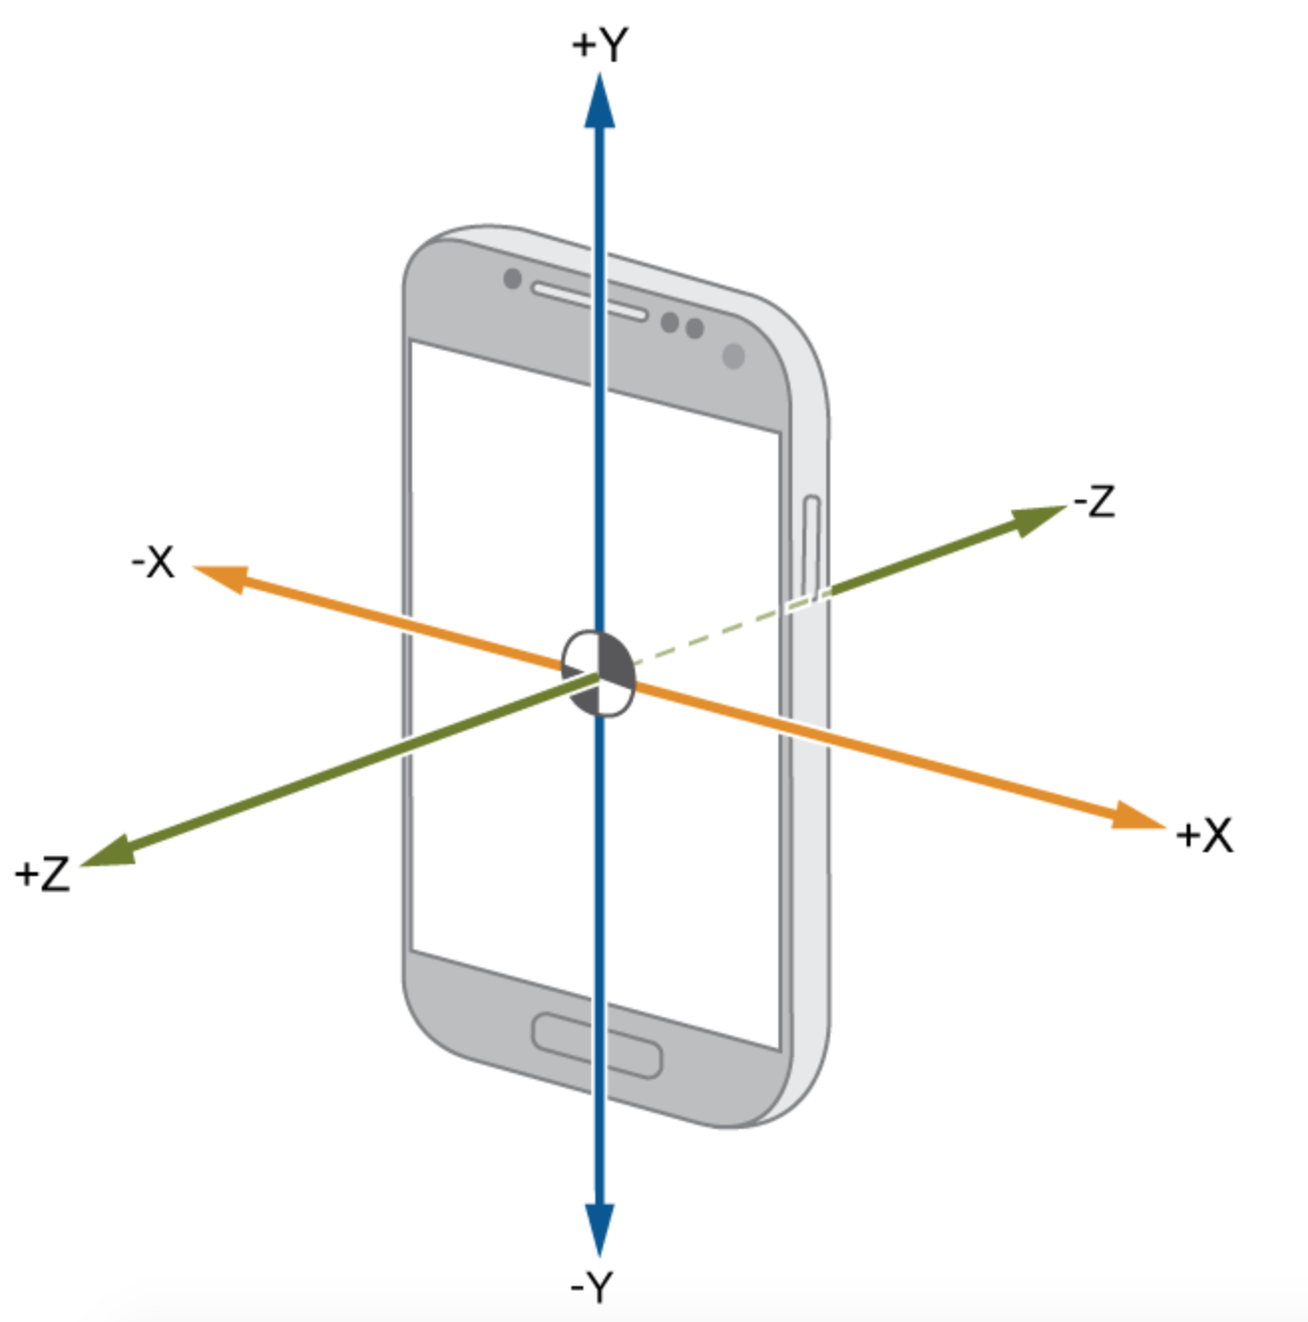
Measurement - Kinetic Sensor
Linear Acceleration Sensor (LAC):
Measure linear acceleration along X, Y, and Z axes.
X: Left/Right movement
Y: Up/Down movement
Z: Forward/Back movement
Notes:
The movement of throwing the paper plane is a sudden movement, recognizable by a sudden spike in the sensor data
Linear Acceleration sensor composed of three axes based on phone orientation.

Slide 13
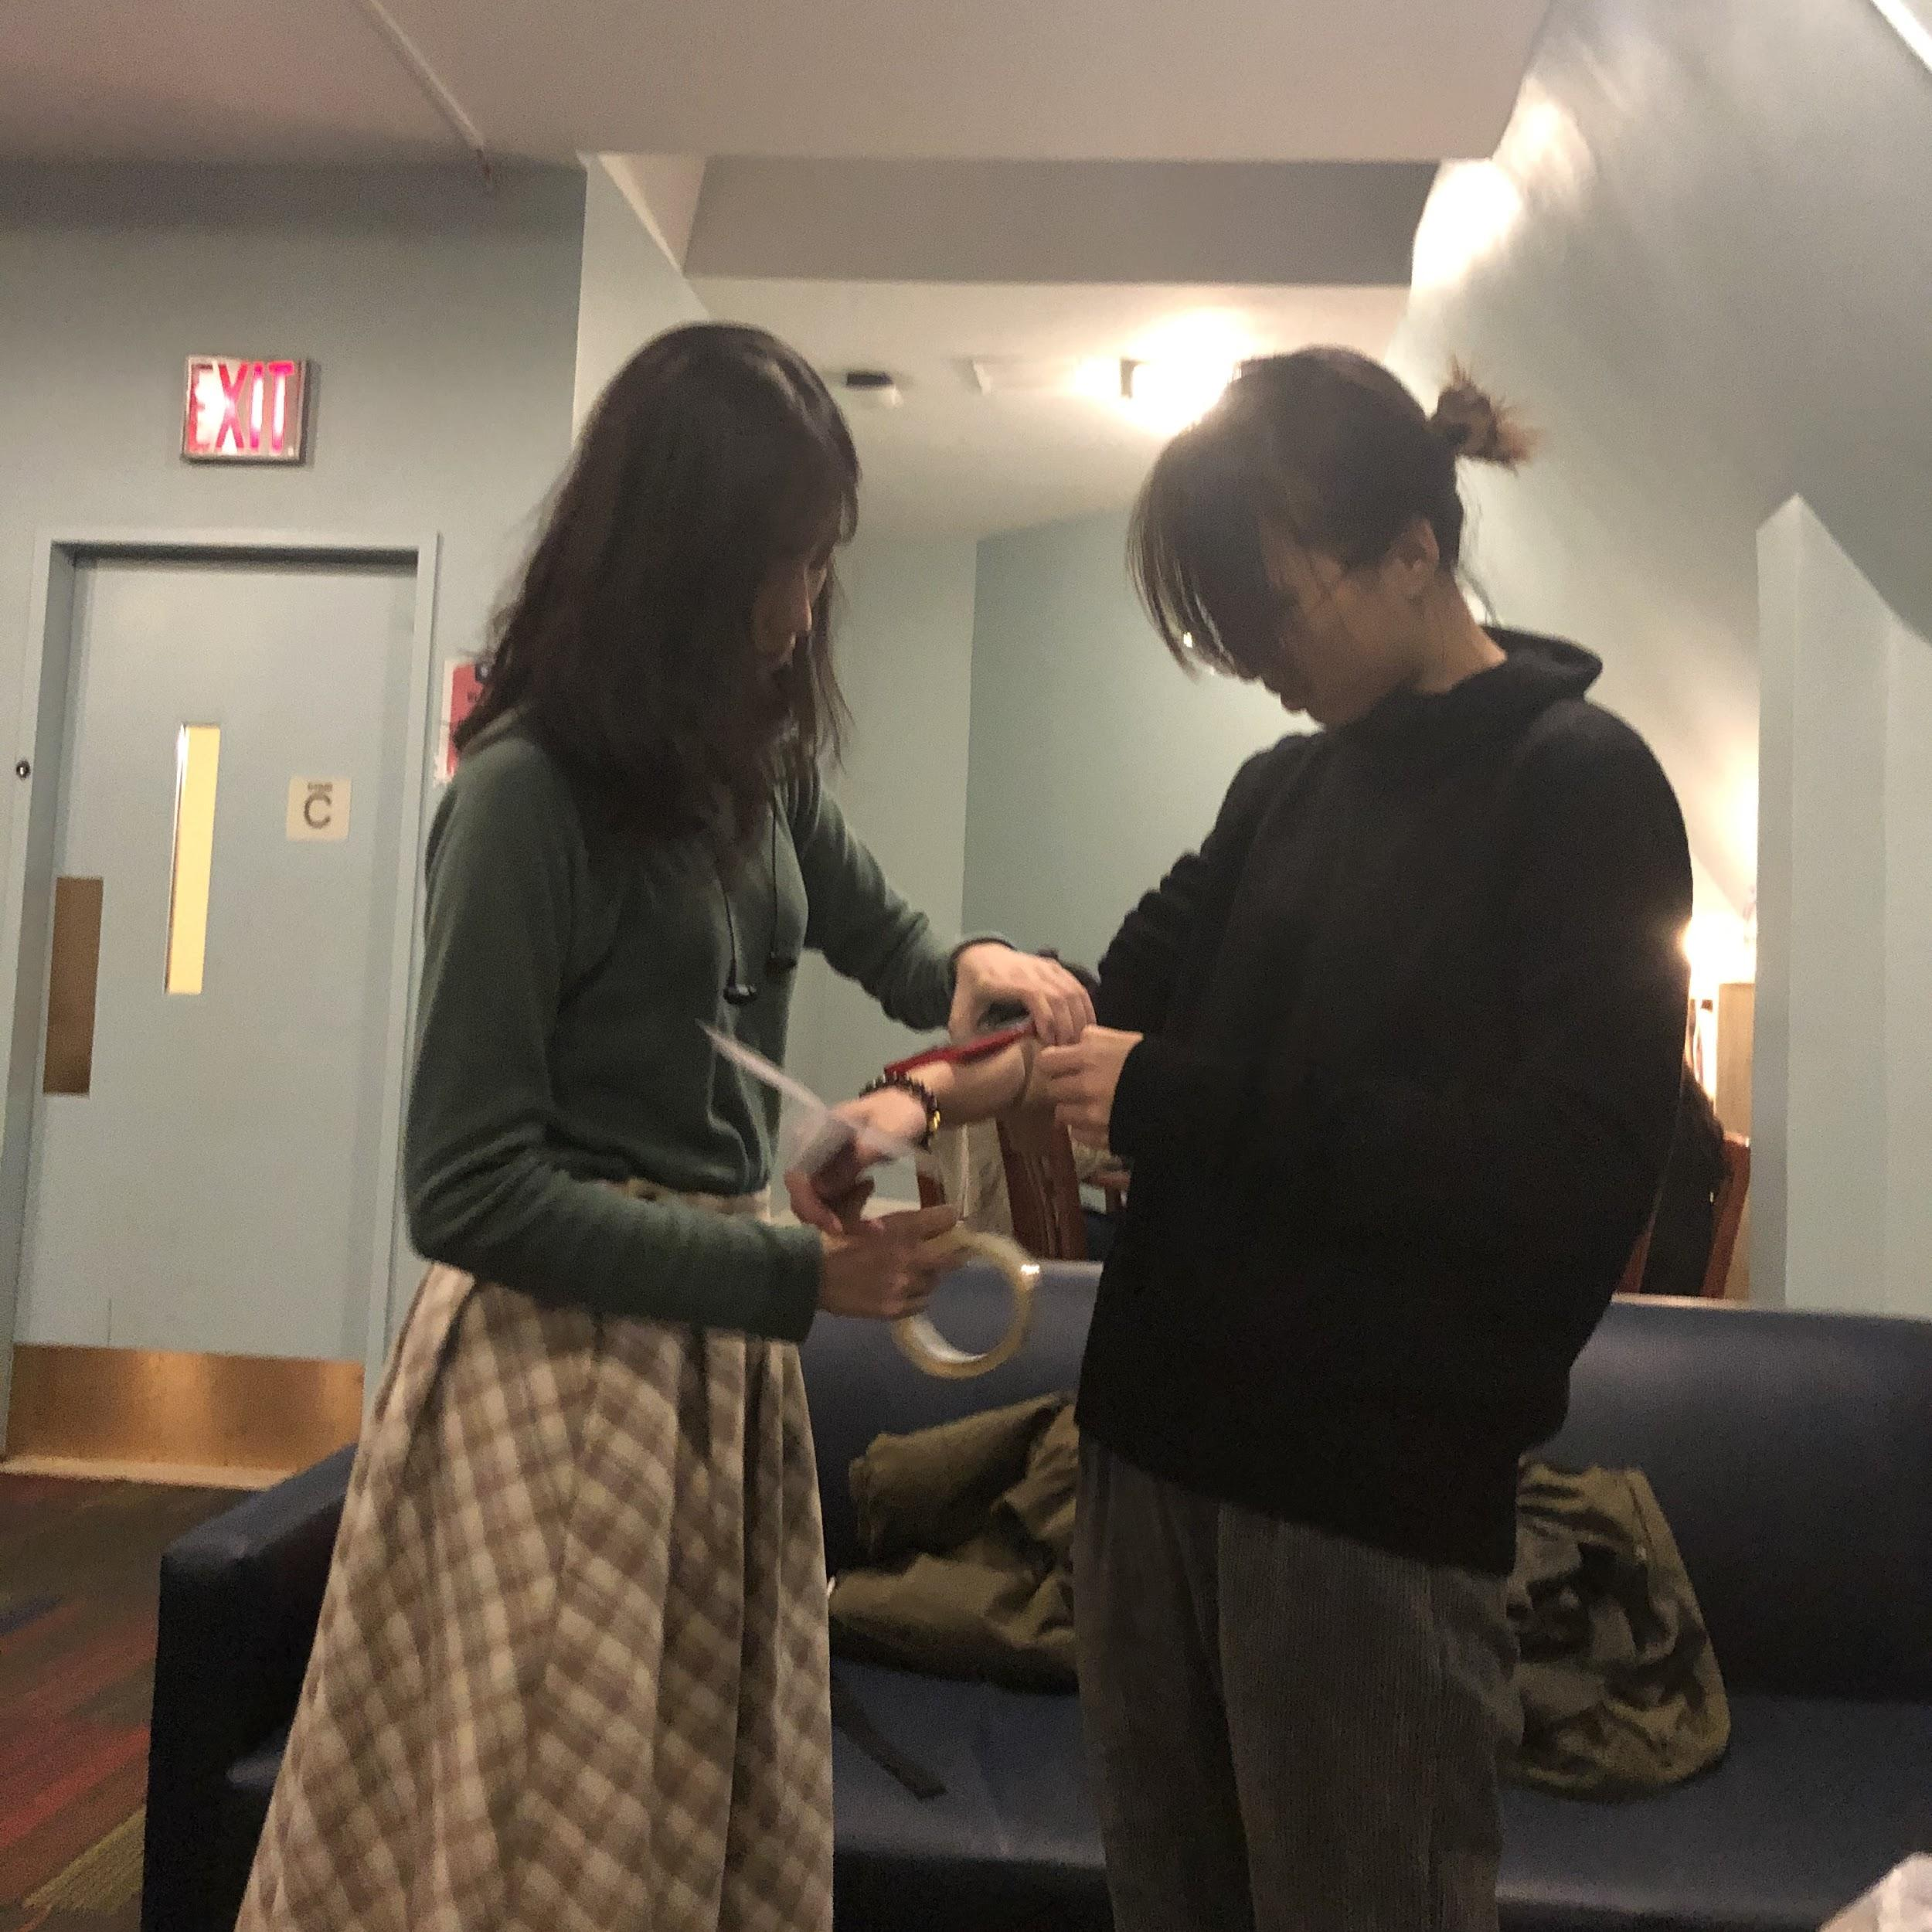
Measurement
Control Variables:
Same paper-plane
Same starting point
Same sensor position at forearm
Same measuring point (the head of the plane)

Slide 14
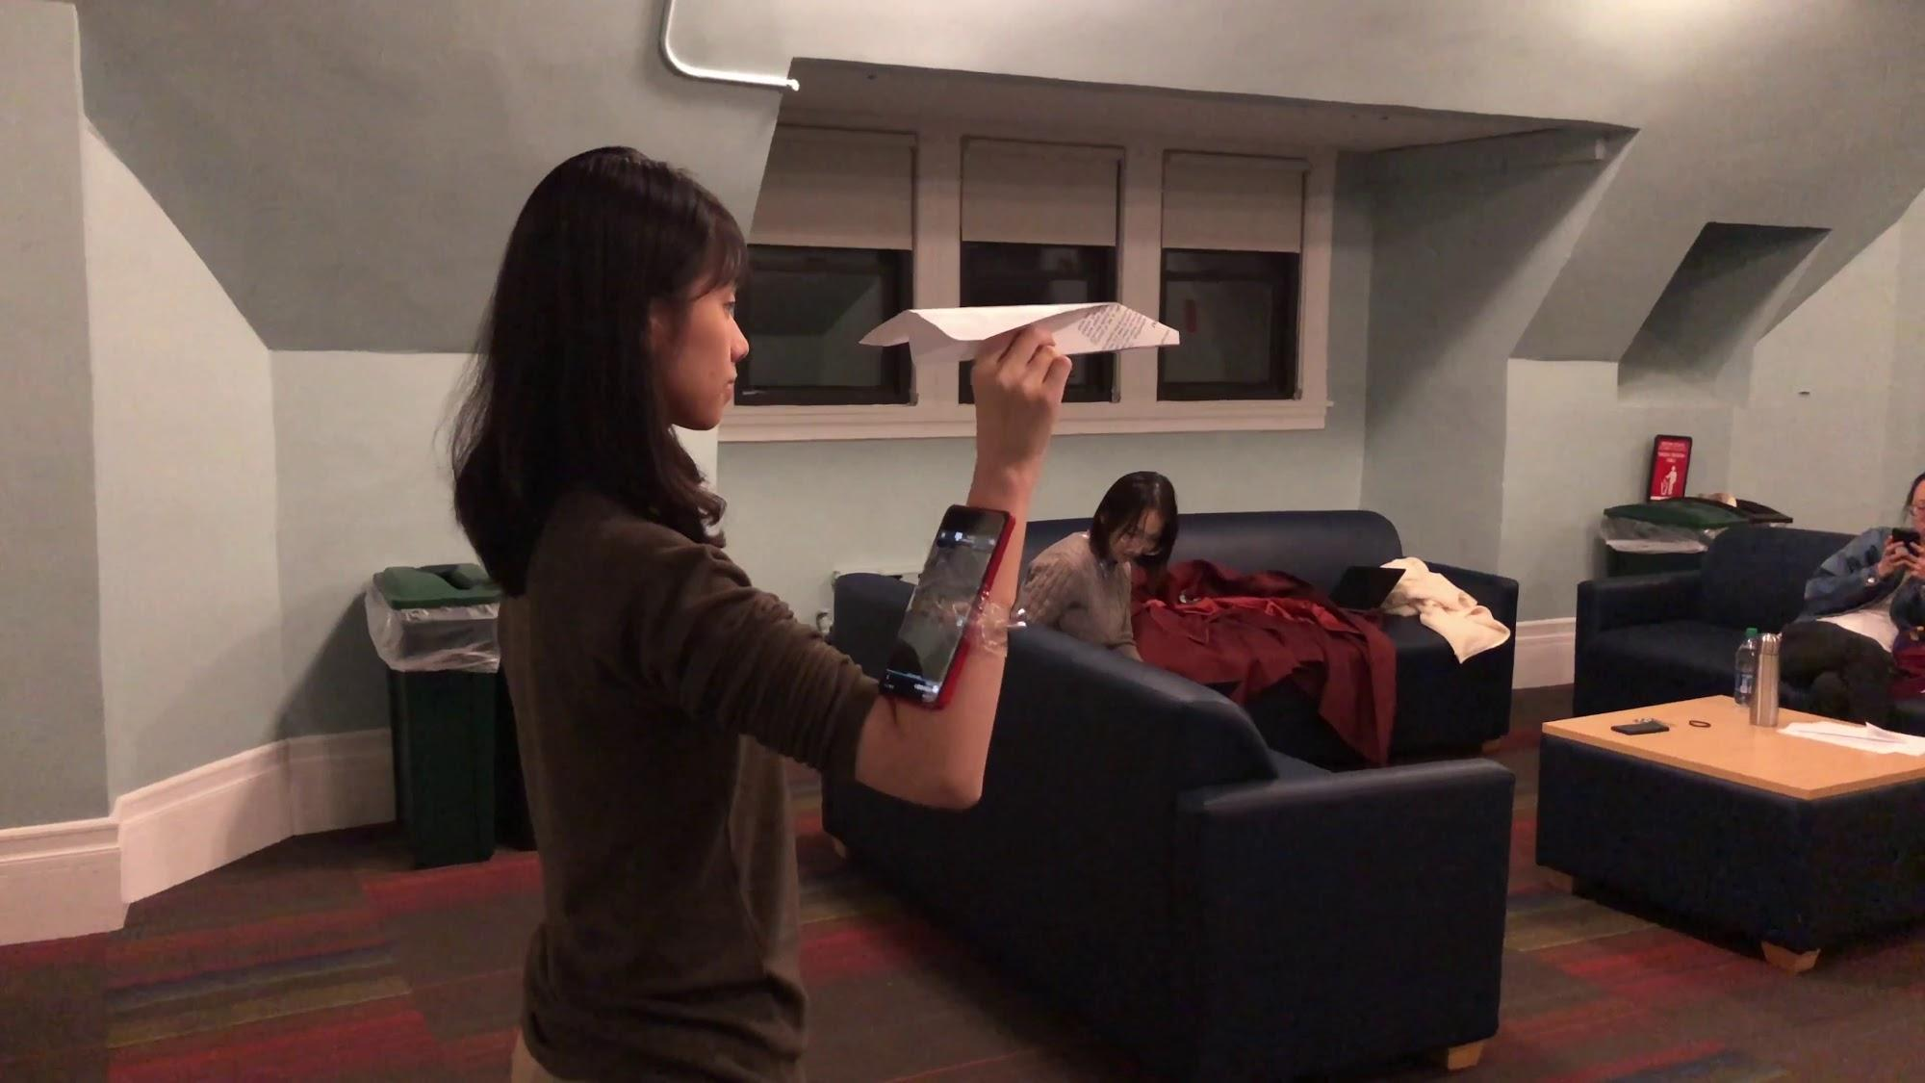
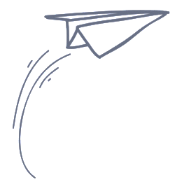
Video

Slide 15
Pre-intervention Test
Notes:
Pre-intervention test

Slide 16
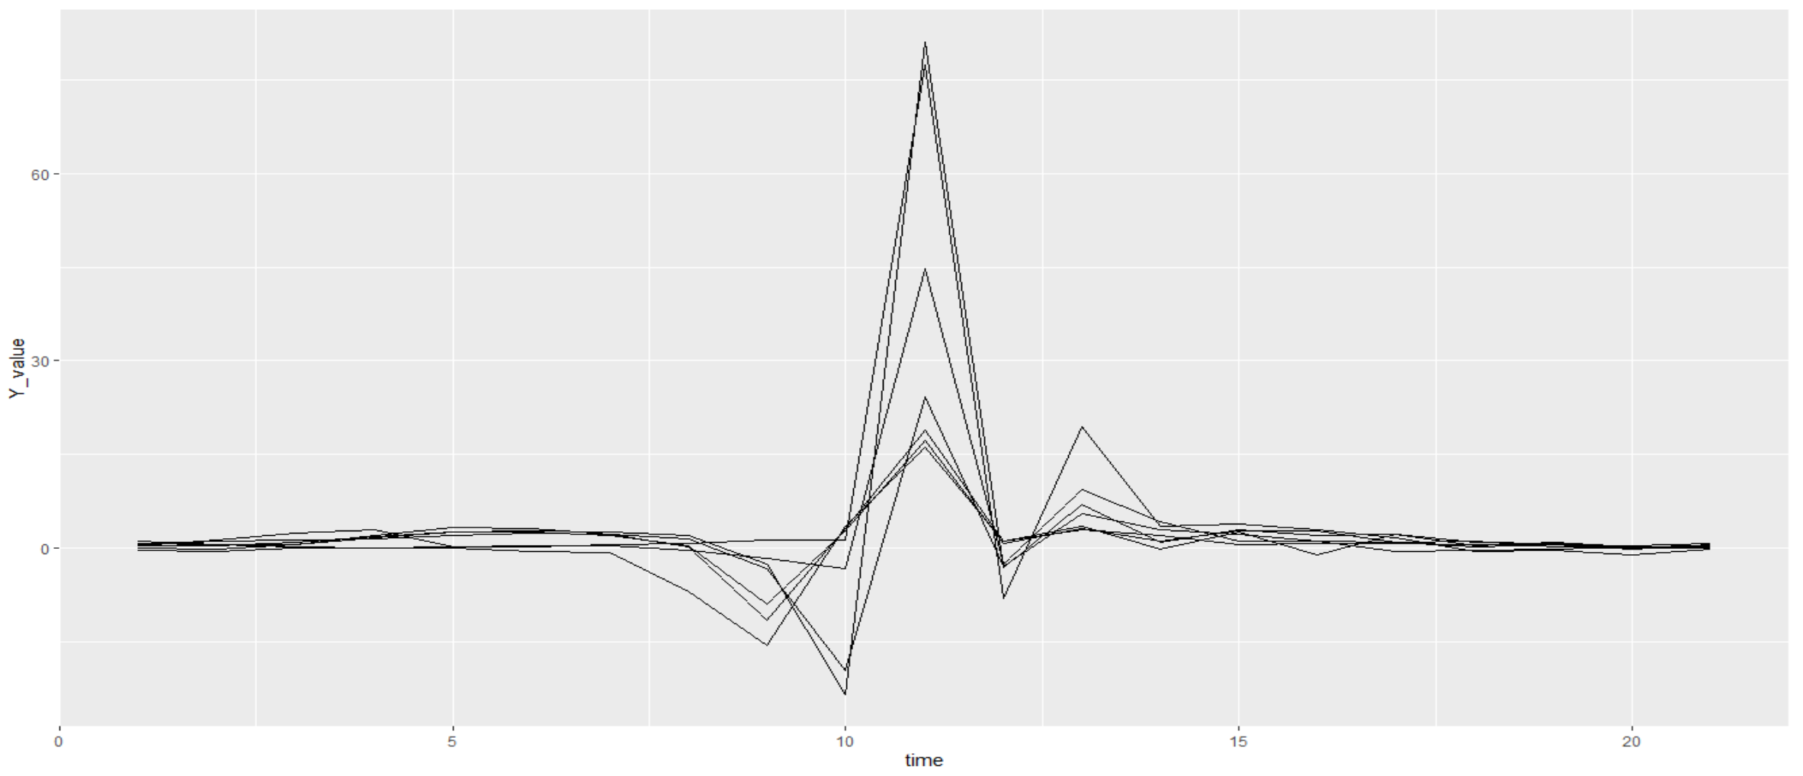
Pre-intervention Strike (>=480cm) Y-value

Slide 17
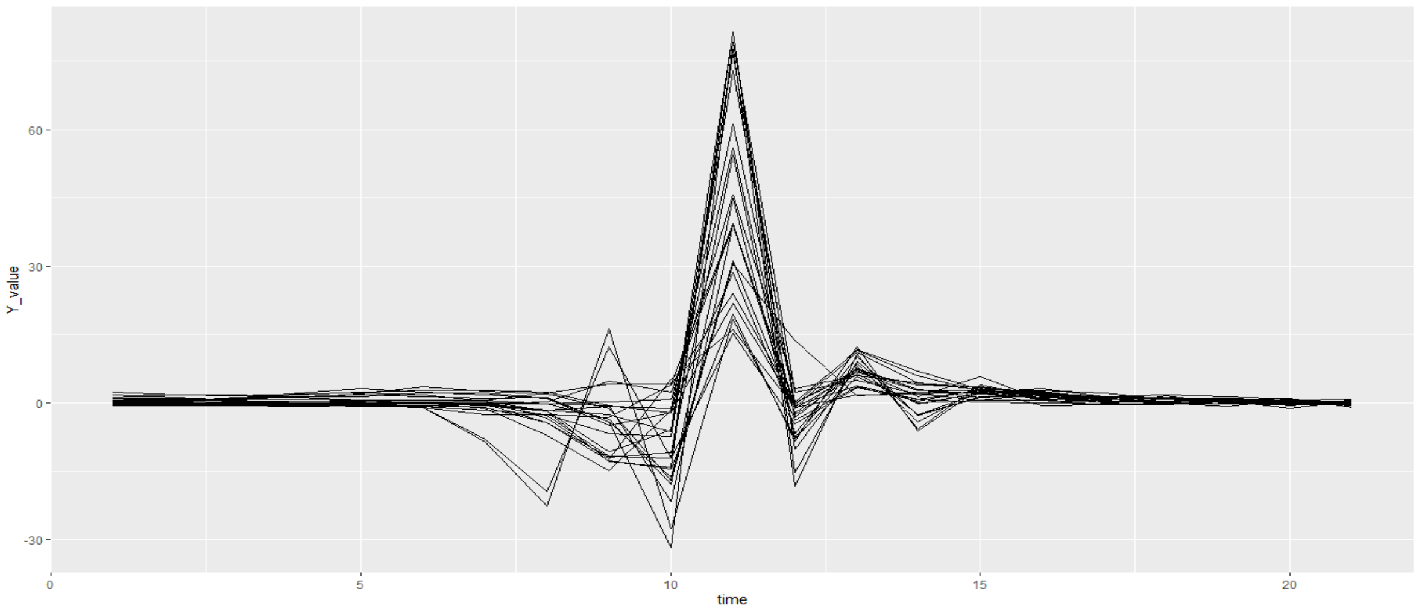
Pre-intervention Non-Strike (<480cm) Y-value

Slide 18
Intervention
Notes:
Pre-intervention test

Slide 19
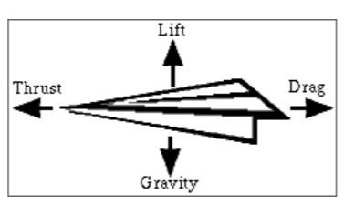
Training
According to the patterns in the pilot study part and the pre-intervention test part, we make some suggestions to the participants:
Throw the paper-plane gently and slowly
Drag as little as possible
The test results are showing in the next slide.

Slide 20
Post-intervention Test
Notes:
Pre-intervention test

Slide 21
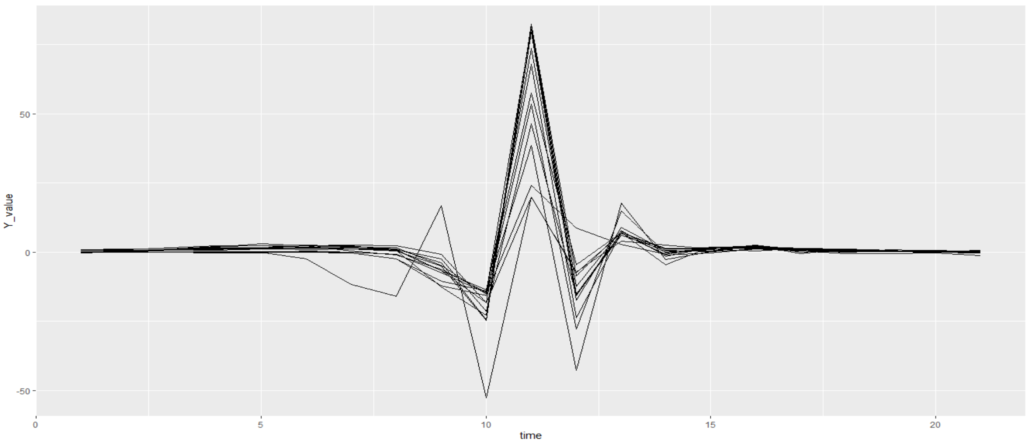
Post-intervention Strike (>=480cm) Y-value

Slide 22
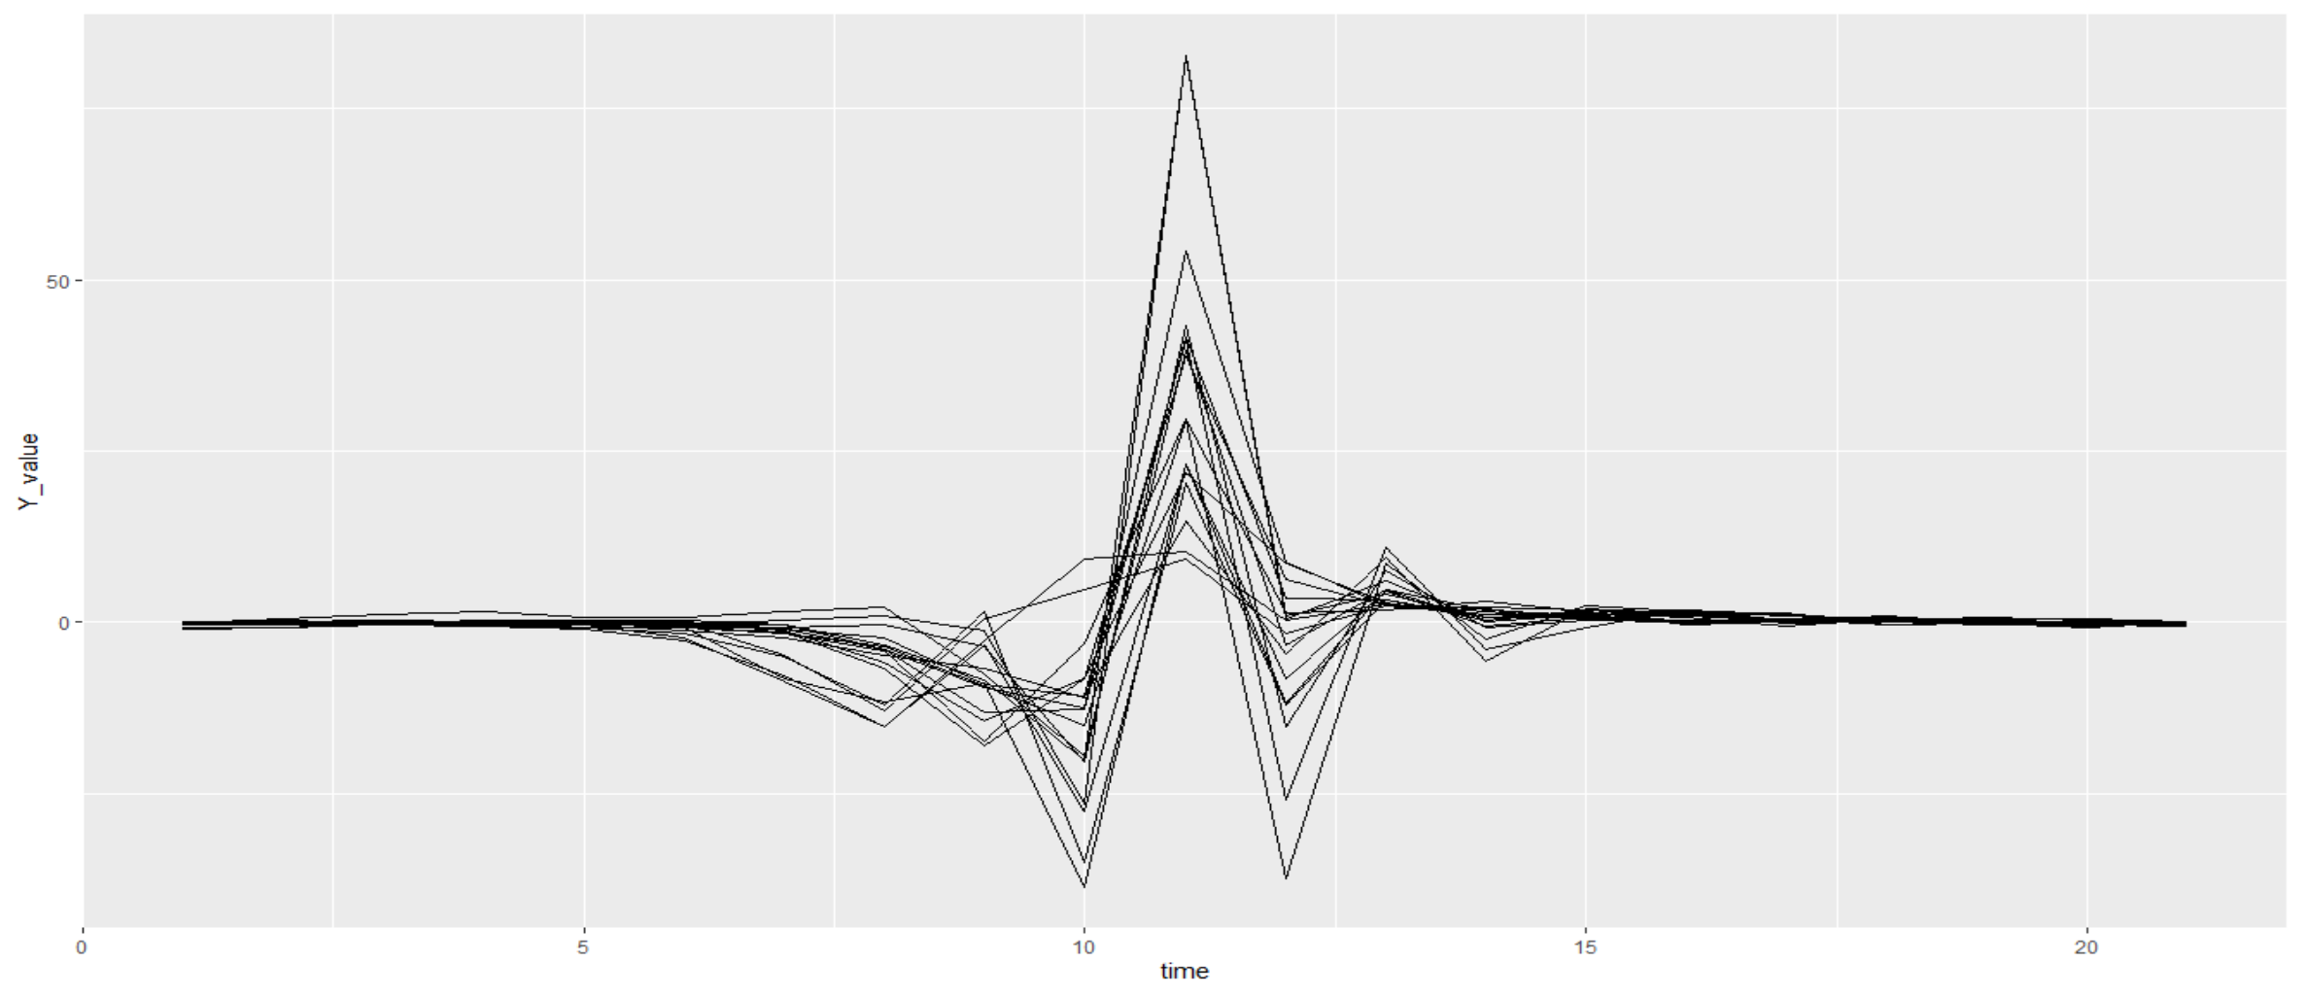
Post-intervention Non-Strike (<480cm) Y-value

Slide 23
Findings
Notes:
Pre-intervention test

Slide 24
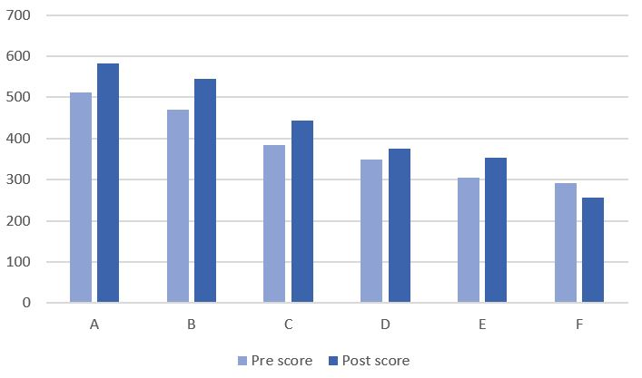
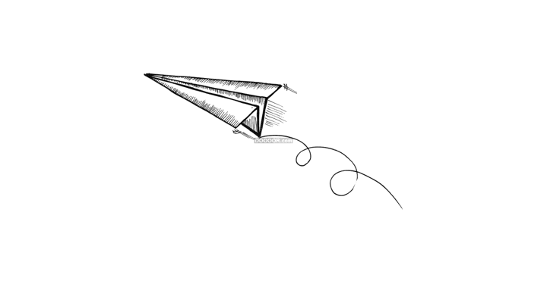
Intervention Result
Both experts and novices make progress after training, except group member F.
Improvement: 14% ~ 16%
Notes:
Even though experts are still in expert levels and novices are still in novice levels,

Slide 25
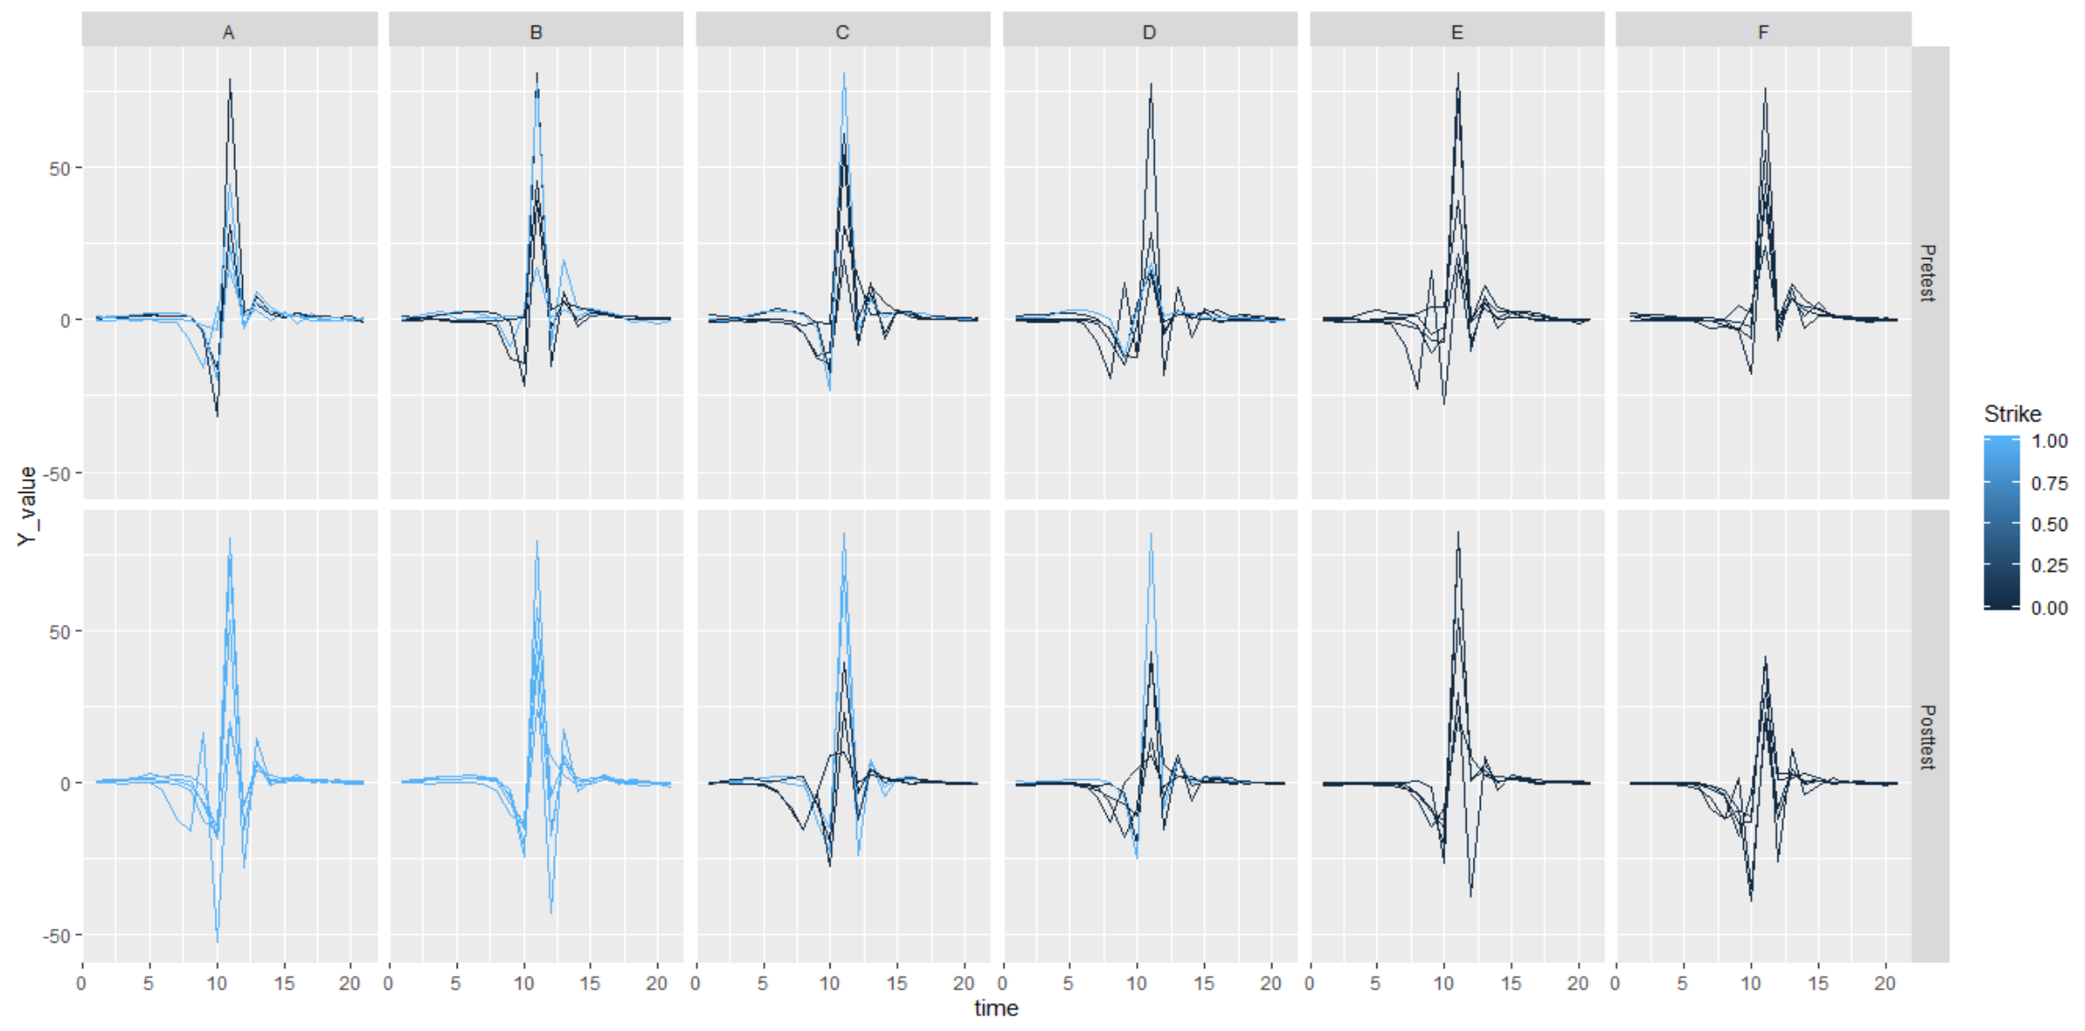
Comparison between pre & post intervention

Slide 26
Post-intervention findings
Training works: the total number strikes increased
If we have a new session of training...
Recommendation for novices: throw the paper-plane gently and slowly
Recommendation for experts (who have already formed their own pattern): keep own pattern and throw fast

Slide 27
Retrospective
Good:
Pilot study: data pre-processing (20 data) to support the proper design of the experiment
Removed data when the paper-plane hits obstacles during test
Jie Chen designed a python program for pre-possessing which largely improved our efficiency
Bad:
Only analyzed the Y-value
Only measure data of forearm
Factors such as height, angle and aerodynamic were not taken into account

Slide 28
Appendix
Notes:
Pre-intervention test

Slide 29
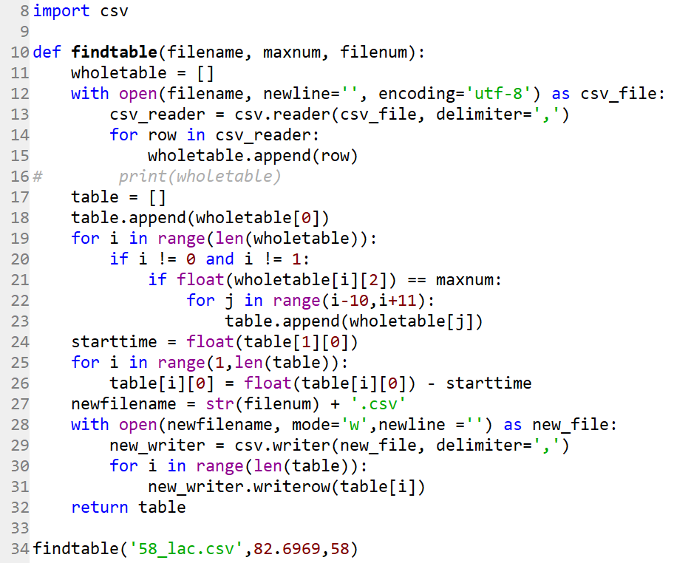
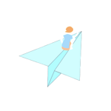
Python code for pre-processing data

Slide 30
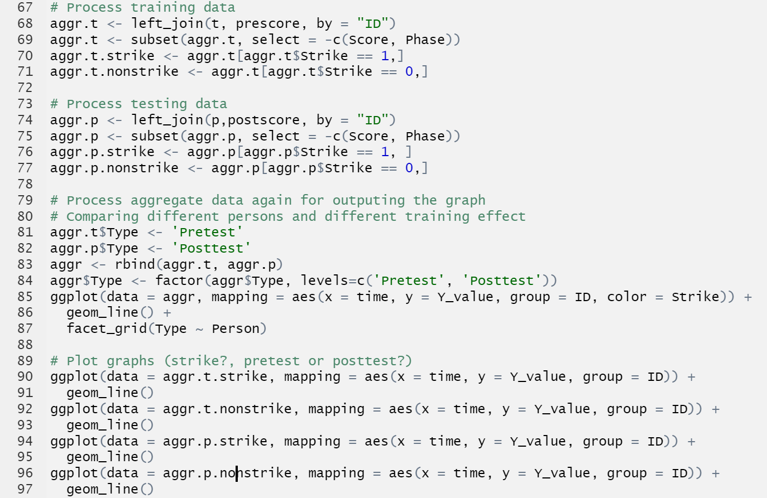
R code for plotting data

Slide 31

Thank you!

