Slide 1

AcadAI
AI-Powered Student Performance Insights
Transforming education through intelligent prediction and data-driven intervention
Designed by – Surya Pratap Chaudhary , Shivansh Singh, Varun Kashyap

Slide 2




The Education Challenge Today
No Real-Time Visibility
No Early Warning System
Teachers lack tools to track student performance effectively across multiple assessments and learning activities
Struggling students often go undetected until it's too late to intervene successfully
Data Silos Persist
Schools collect vast amounts of data, but it remains unused or underutilized without intelligent analysis

Slide 3

Our Solution: AI-Driven Intelligence
https://acad-ai-azure.vercel.app/login
AcadAI leverages machine learning to predict student performance, classify risk levels, and deliver actionable insights that empower educators to intervene early.
What Makes Us Different
Real-time predictive analytics powered by proven ML algorithms
Automated risk classification with clear priority levels
Data-driven recommendations tailored to each student
Intuitive dashboard that transforms complex data into clear visuals

Slide 4




Why This Matters Now
Early Intervention
Identify at-risk students weeks before traditional methods would flag them
Better Outcomes
Proactive support leads to improved grades, retention, and graduation rates
Data-Driven Decisions
Move beyond intuition with evidence-based insights that guide teaching strategies

Slide 5






Core Features That Drive Results
Student Data Management
AI Prediction Engine
Centralized platform for grades, attendance, assignments, and behavioral data across all courses and terms
Machine learning models analyze patterns to forecast performance with proven accuracy
Risk Classification
Insights & Recommendations
Automatic categorization into Low/Medium/High risk tiers with color-coded priority levels
Specific, actionable interventions tailored to each student's learning patterns and gaps
Dashboard Analytics
Automated Reports
Real-time visualizations showing trends, correlations, and progress across entire classrooms or individual students
Generate detailed performance reports for parents, administrators, and counseling sessions

Slide 6
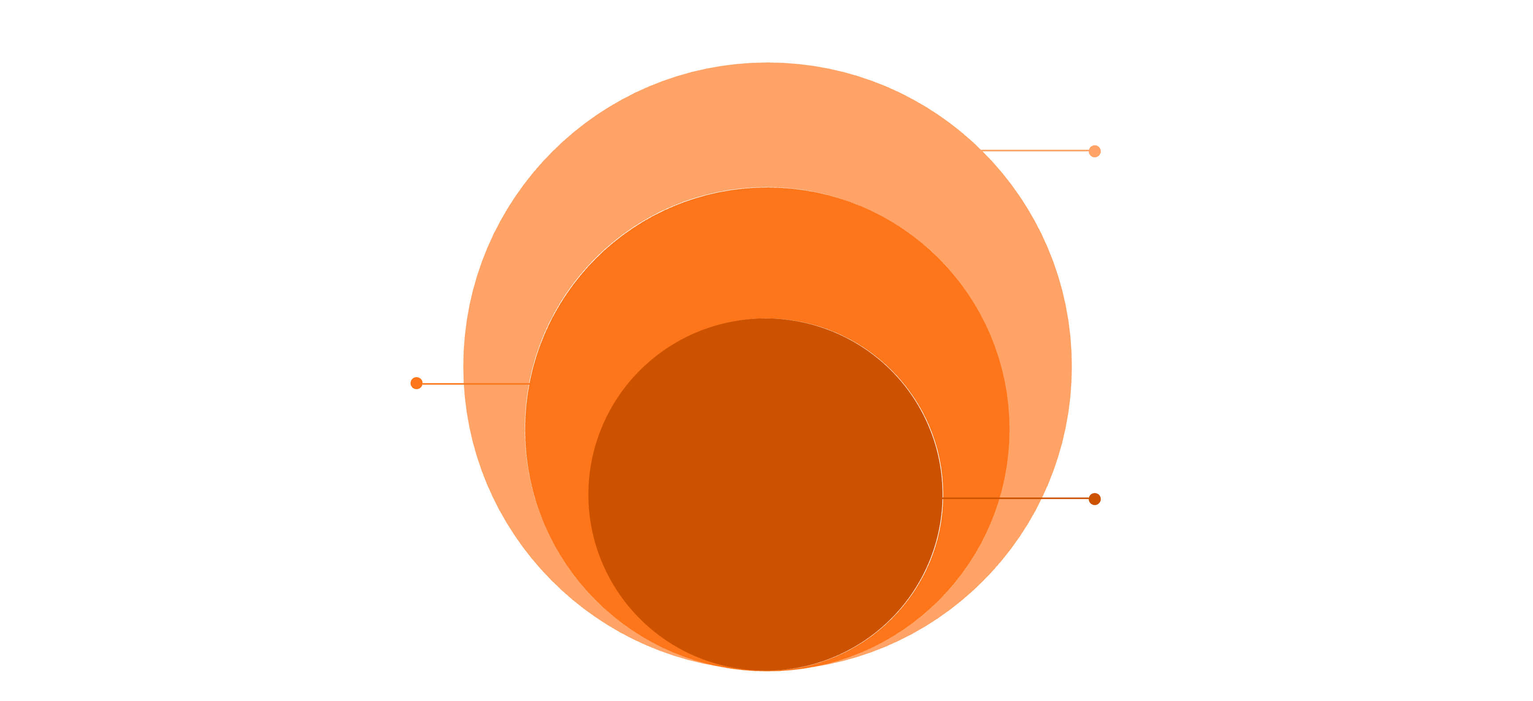
System Architecture
Backend & Frontend
Node.js APIs with React/Next.js UI
AI Services
Python ML models and prediction engine
Core Data
PostgreSQL for reliable storage

Slide 7





How It Works: The Workflow
Data Input
Teachers and systems upload grades, attendance, assignments, and behavioral data through simple interfaces or automated integrations
Processing
Data is cleaned, normalized, and transformed into features that machine learning models can analyze effectively
Prediction Generation
Trained AI models process the data to predict future performance and classify risk levels with confidence scores
Insights Creation
System generates specific recommendations and identifies patterns that teachers can act upon immediately
Dashboard Display
Real-time visualizations and alerts appear on teacher dashboards, mobile apps, and administrative reports

Slide 8
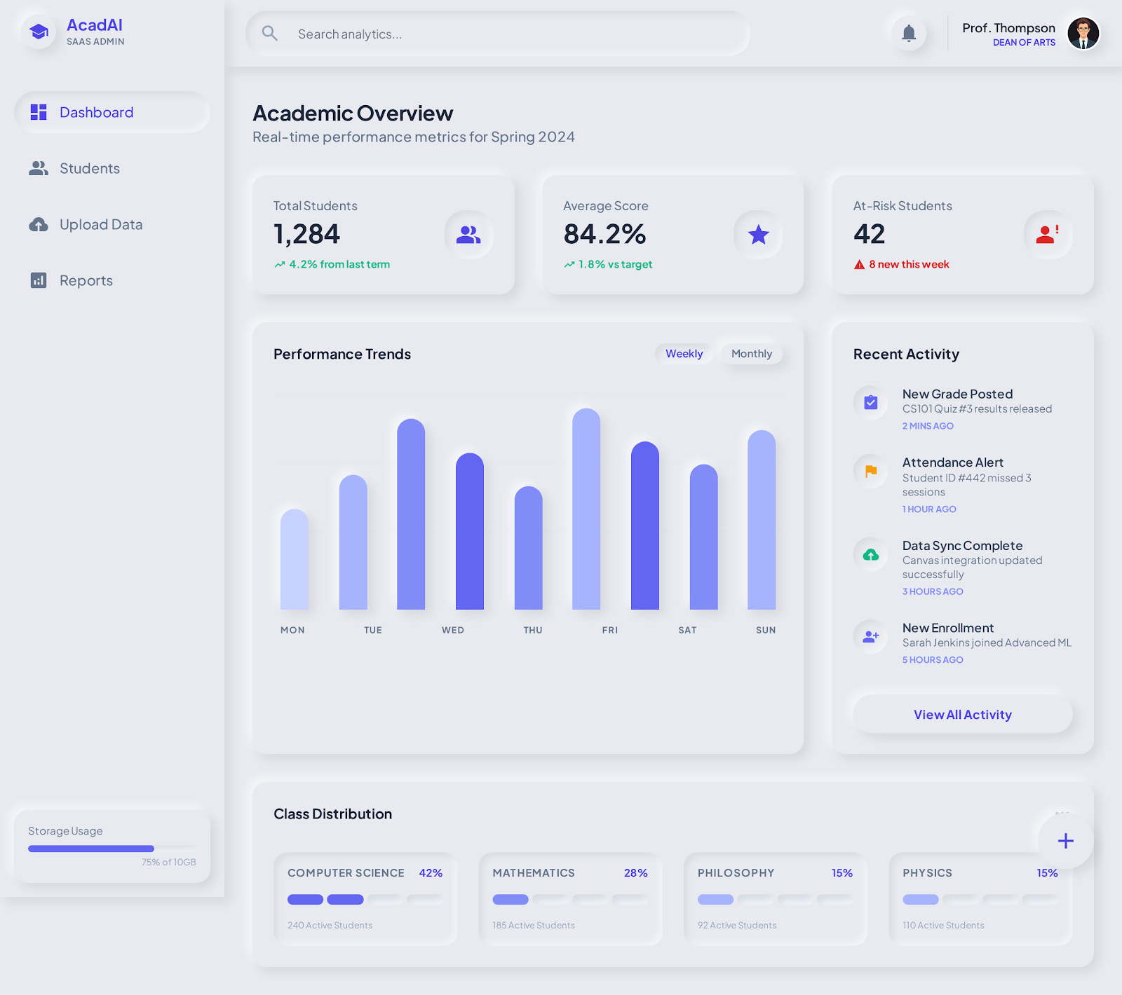
Live Dashboard Preview
At a Glance
Key Metrics
Class overview with risk distribution
Individual student profiles
Progress trend analysis
Prediction accuracy rates
Intervention effectiveness
Grade improvement tracking

Slide 9




Technology Stack
Frontend
Backend
React.js with Next.js framework
Node.js runtime environment
Tailwind CSS for modern styling
Express.js web framework
Responsive design for all devices
RESTful API architecture
AI Engine
Data Layer
Python programming language
PostgreSQL relational database
scikit-learn for ML models
Secure data storage and retrieval
Pandas for data manipulation
Scalable infrastructure

Slide 10

The Future of Education is Here
Immediate Benefits
Future Roadmap
Higher student success rates through early intervention
Reduced teacher workload with automated insights
Data-driven decision making for administrators
Mobile app for real-time notifications
Integration with LMS platforms
Advanced NLP for essay analysis
"AcadAI transforms raw data into actionable intelligence, empowering educators to help every student succeed."

