Slide 1

Creating a Dream
CANDY

Slide 2

Creating a Dream
CANDY

Slide 3

Creating a Dream
CANDY

Slide 4

Creating a Dream
CANDY
No, they aren’t

Slide 5


Creating a Dream
CANDY

Slide 6


Creating a Dream
CANDY

Slide 7
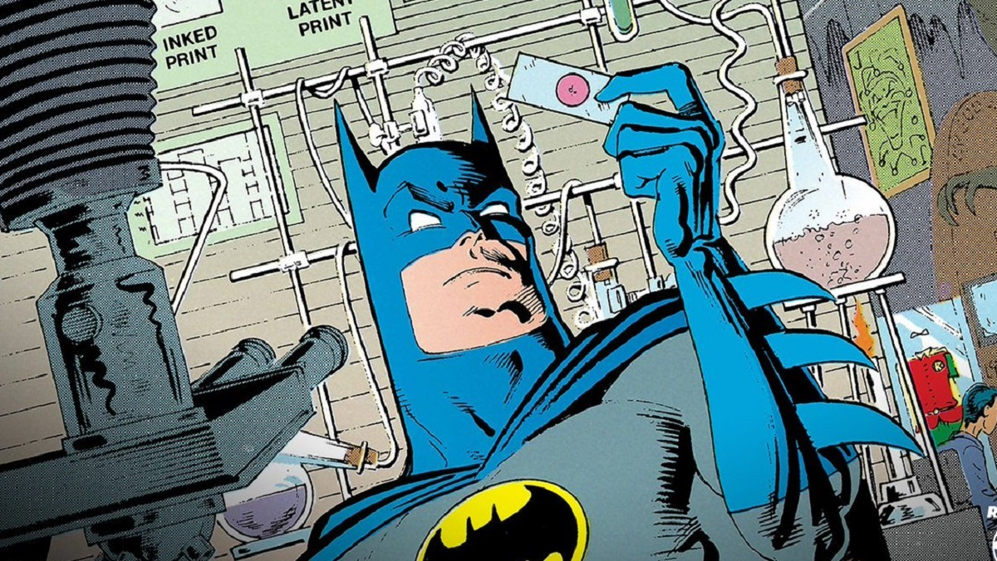
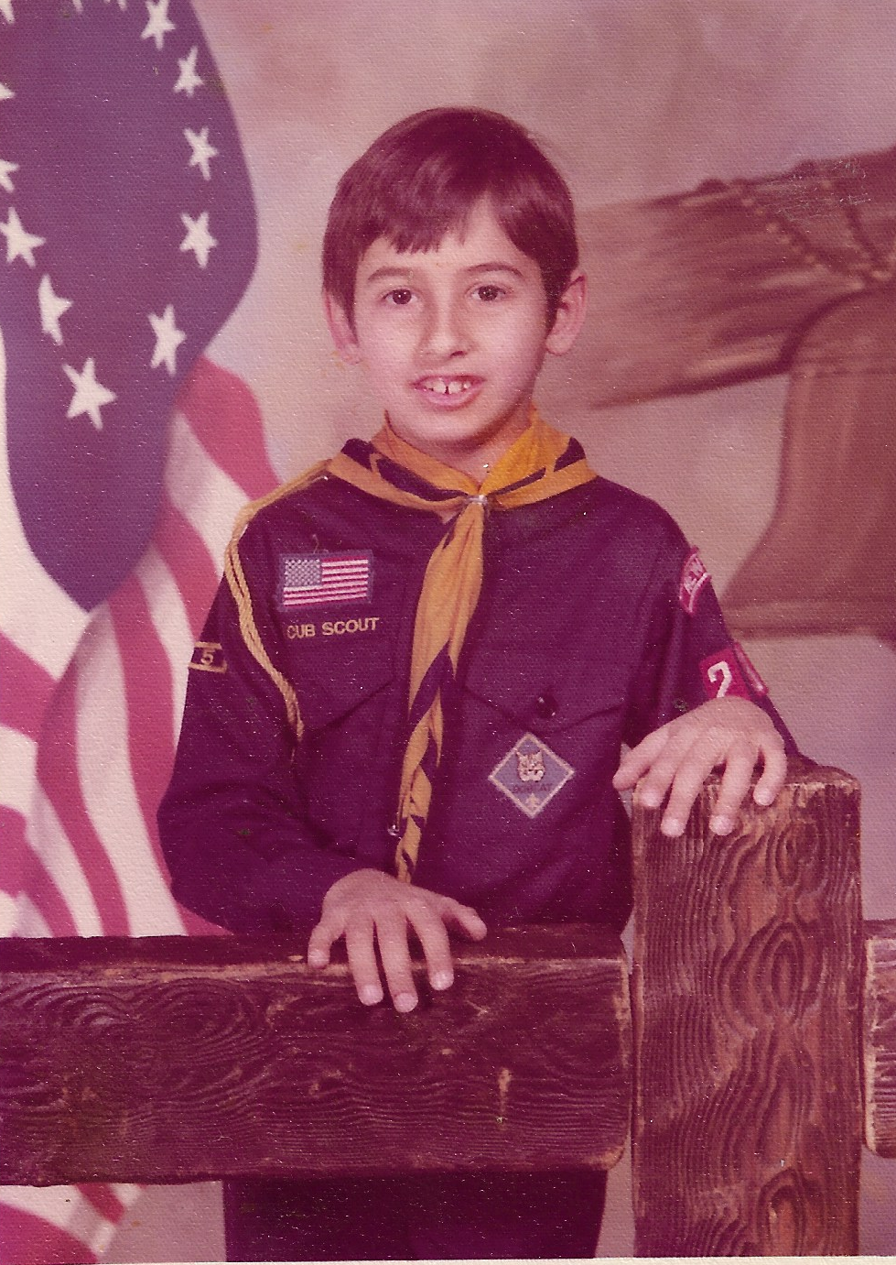


Creating a Dream
CANDY
1976

Slide 8

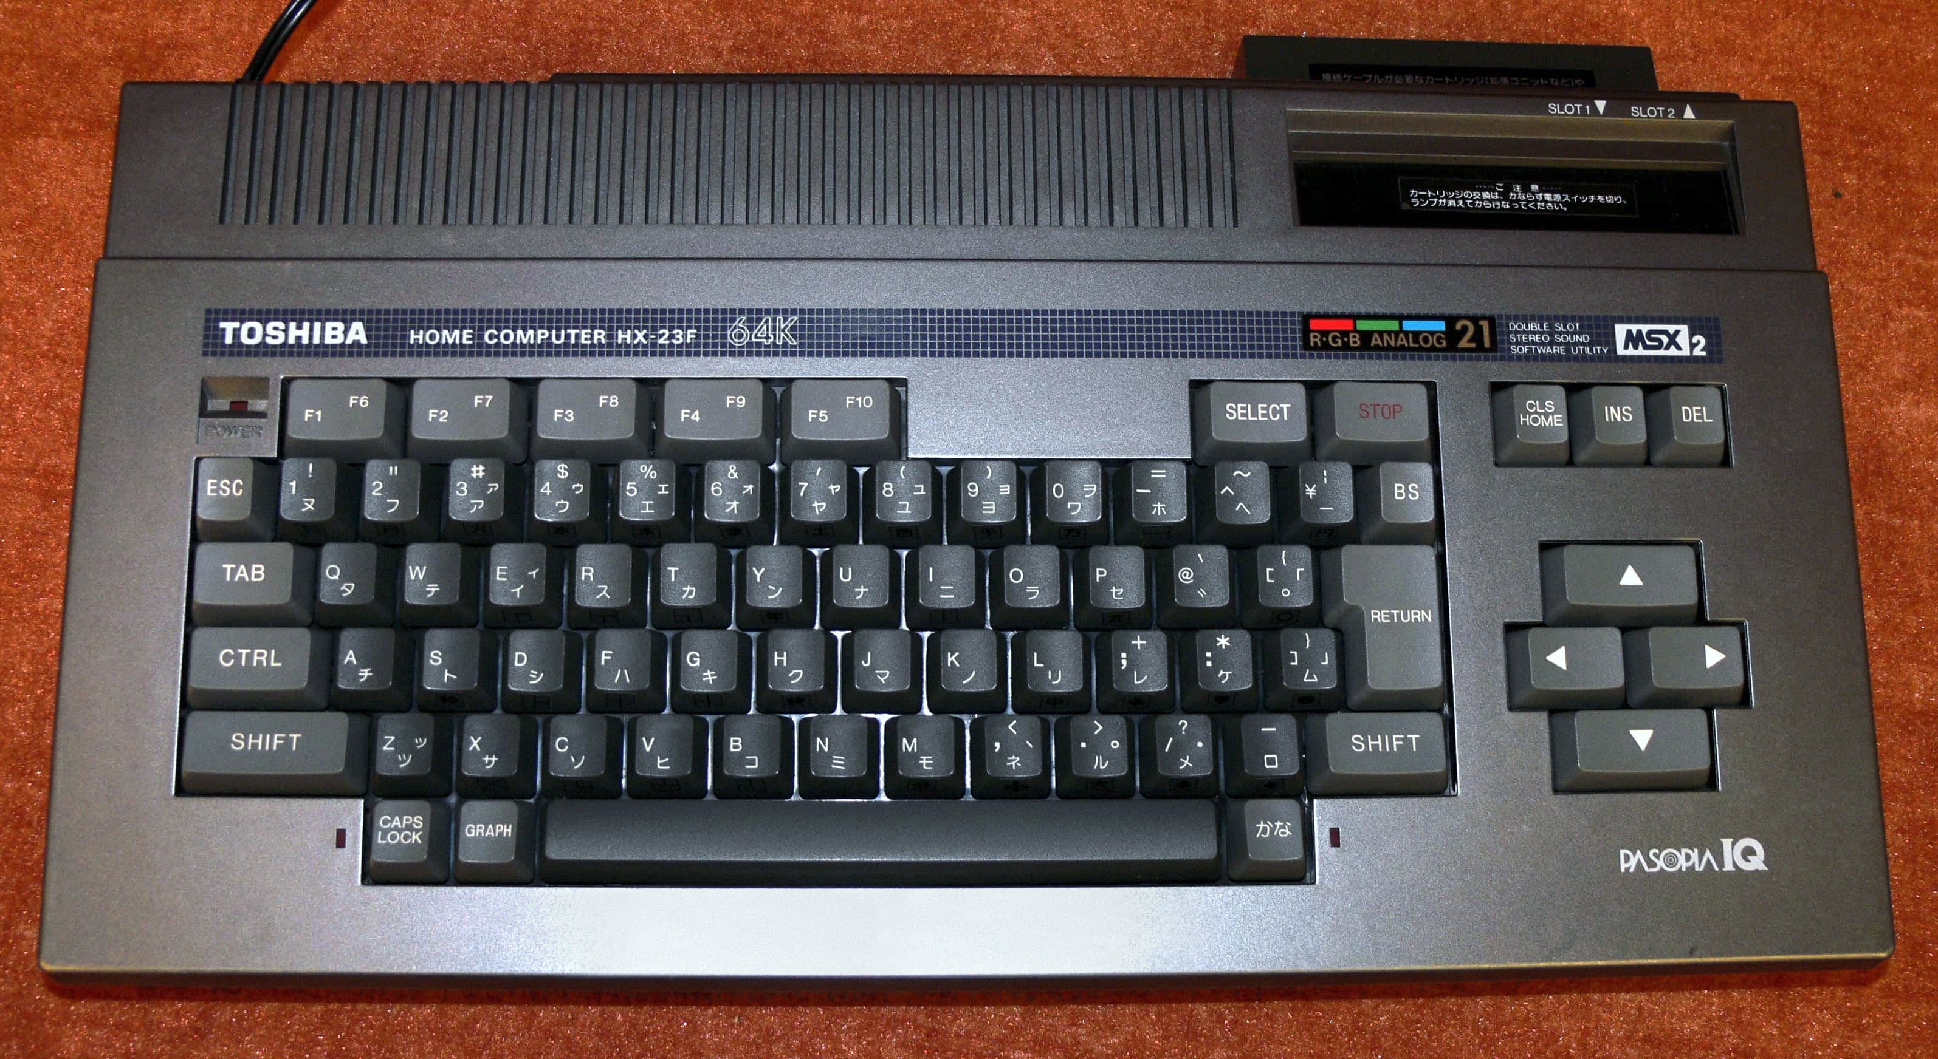
Creating a Dream
1986

Slide 9

Creating a Dream
CANDY

Slide 10

Creating a Dream
CANDY

Slide 11
Found my Dream
Creating a Dream
1986
1997

Slide 12
Found my Dream
Creating a Dream
Helping People Through Technology
1986
1997

Slide 13

Creating a Dream
CANDY
1997

Slide 14

Creating a Dream
CANDY
2004

Slide 15

Creating a Dream
CANDY
29 May 2011

Slide 16

Creating a Dream
2014

Slide 17


Creating a Dream
CANDY
2023

