Slide 1
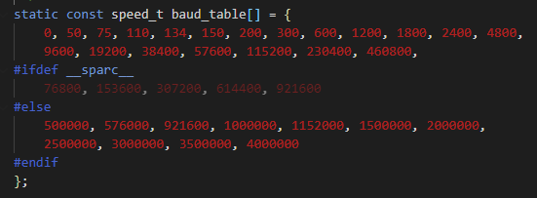
uart_register_driver()
Register a uart driver, and then in turn register as tty driver with the tty layer.
uart_add_one_port()
This allows the UART driver to register its own uart_port structure.
uart_unregister_driver()
uart_remove_one_port()
uart_get_baud_rate()
Return baud rate by decoding the termios structure.
The buad rates are recorded in an array - buad_table

Slide 2
uart_get_divisor()
Calculate the uart clock divisor for the port by the given buad rate.
* Buad rate is not a concept of hardware, so it needs to convert the buad rate to the frequency of the internal clock.
uart_update_timeout()
Set the port FIFO timeout value.
* before the port closing, wait for some time, so the data in FIFO can transmit successfully.
uart_insert_char()
push a char to the uart layer.
uart_write_wakeup() - 检查有没有用这个函数
This routine is used by the interrupt handler to schedule processing in the software interrupt portion of the driver.
唤醒使用这个串口的程序，可以发送数据到循环缓冲区
uart_suspend_port()/uart_resume_port()
Supend/Resume the UART port. --- 用于电源管理？
uart_handle_cts_change()
uart_handle_dcd_change()

