Slide 1
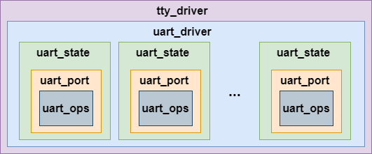
The serial-core layer registers a tty driver, creates tty device nodes in devfs, creates several files in sysfs, and provide the APIs and several structures for serial-driver layer to register a low level driver.
The relationships between these structures are as bellow:
The struct uart_driver

Slide 2
/proc/tty/driver

Slide 3
The serial-driver layer needs to register a UART driver (it is called low level driver in TTY layer) , adds UART ports, implements the UART operation and requests an interrupt.
A UART driver describes bellow information
the driver name
the uart devices name and number of the devices
which tty driver it is belongs to
the uart_state
A UART port
A UART operation
The interrupt is registered when the port is opened and unregistered when the port is closed.

