Slide 1
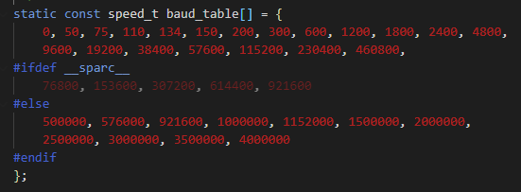
uart_register_driver()
Register a uart driver, and then in turn register as tty driver with the tty layer.
uart_add_one_port()
This allows the UART driver to register its own uart_port structure.
uart_unregister_driver()
uart_remove_one_port()
uart_get_baud_rate()
Return baud rate by decoding the termios structure. The buad rates are recorded in an array - buad_table

Slide 2
uart_get_divisor()
Calculate the uart clock divisor for the port by the given buad rate.
* Buad rate is not a concept of hardware, so it needs to convert the buad rate to the frequency of the internal clock.
uart_update_timeout()
Set the port FIFO timeout value.
* before the port closing, wait for some time, so the data in FIFO can transmit successfully.
uart_insert_char()
push a char to the uart layer.
uart_write_wakeup() - 检查有没有用这个函数
This routine is used by the interrupt handler to schedule processing in the software interrupt portion of the driver.
唤醒使用这个串口的程序，可以发送数据到循环缓冲区
uart_suspend_port()/uart_resume_port()
Supend/Resume the UART port. --- 用于电源管理？
uart_handle_cts_change()
uart_handle_dcd_change()

Slide 3
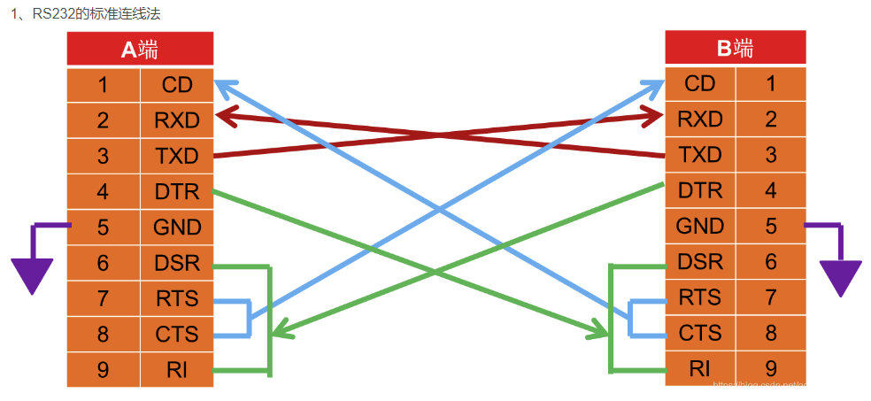
https://blog.csdn.net/qq_42992084/article/details/104761474

Slide 4
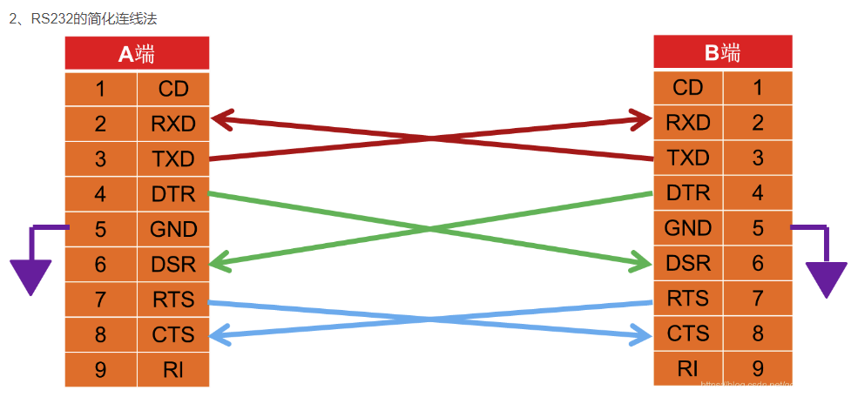
https://blog.csdn.net/qq_42992084/article/details/104761474

Slide 5
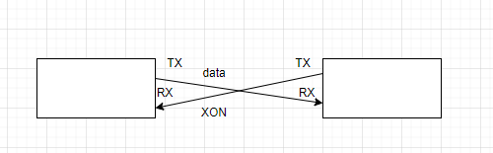
SW flow control
The flow control can also be controlled by software throught sending two ASCII characters.
Character | Description | ASCII Hex
XOFF | Suspend transmitting, sending by slave | 0x16
XON | Resume transmitting, sending by slave | 0x11
In this case, the software of both master and slave devices should support this control situation, and only RX and TX pins are needed in the communication.
The limitation of SW flow control
The ASCII 0x16 and 0x11 should not send in a normal transmission.
Before the master deal with XOFF/XON, the character should wait in line until the previous characters are all read by software, ....

Slide 6
Diffrences between HW and SW flow control
Flow control type | Need RTS/CTS | Speed
HW | YES | fast
SW | NO | slow

