Slide 1
GCAM Assignment #3
ITM 20235575 안지석

Slide 2
Intro
I ran two different scenarios(Reference, Decarbonization) using the given material for GCAM assignment 3.
To plot the results, used R library called gcamextractor.
After data is imported to R with gcamextractor, wrote a function to plot results for different parameters.
Tried to plot the results as clearly as possible to recognize, so stylistically beautiful plots(than before) are included.

Slide 3
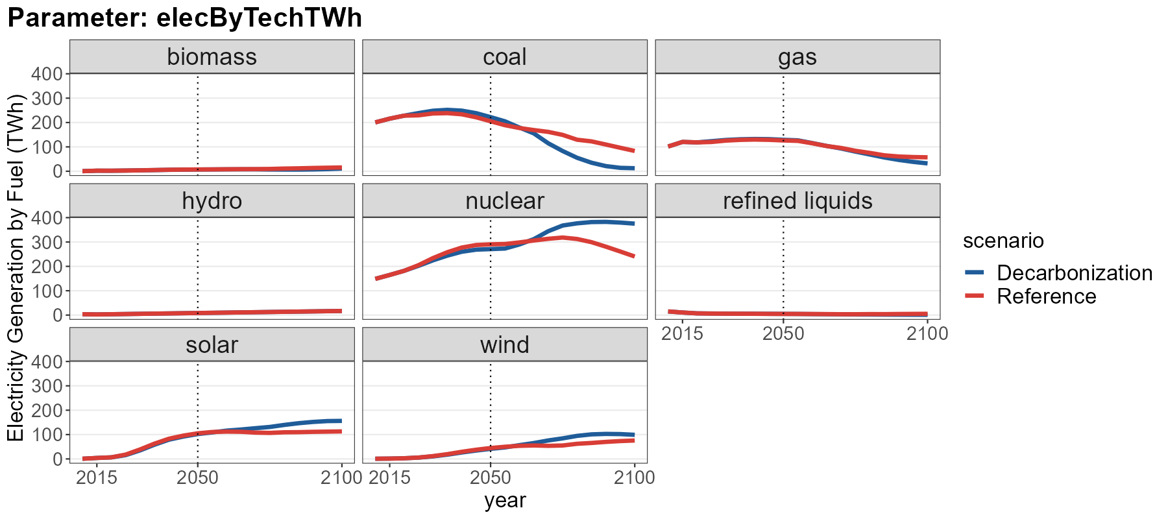
What fuel decreases and what fuel increases?
- Concerning electricity generation in Decarbonization scenario, coal decreases but nuclear, solar, wind increase

Slide 4
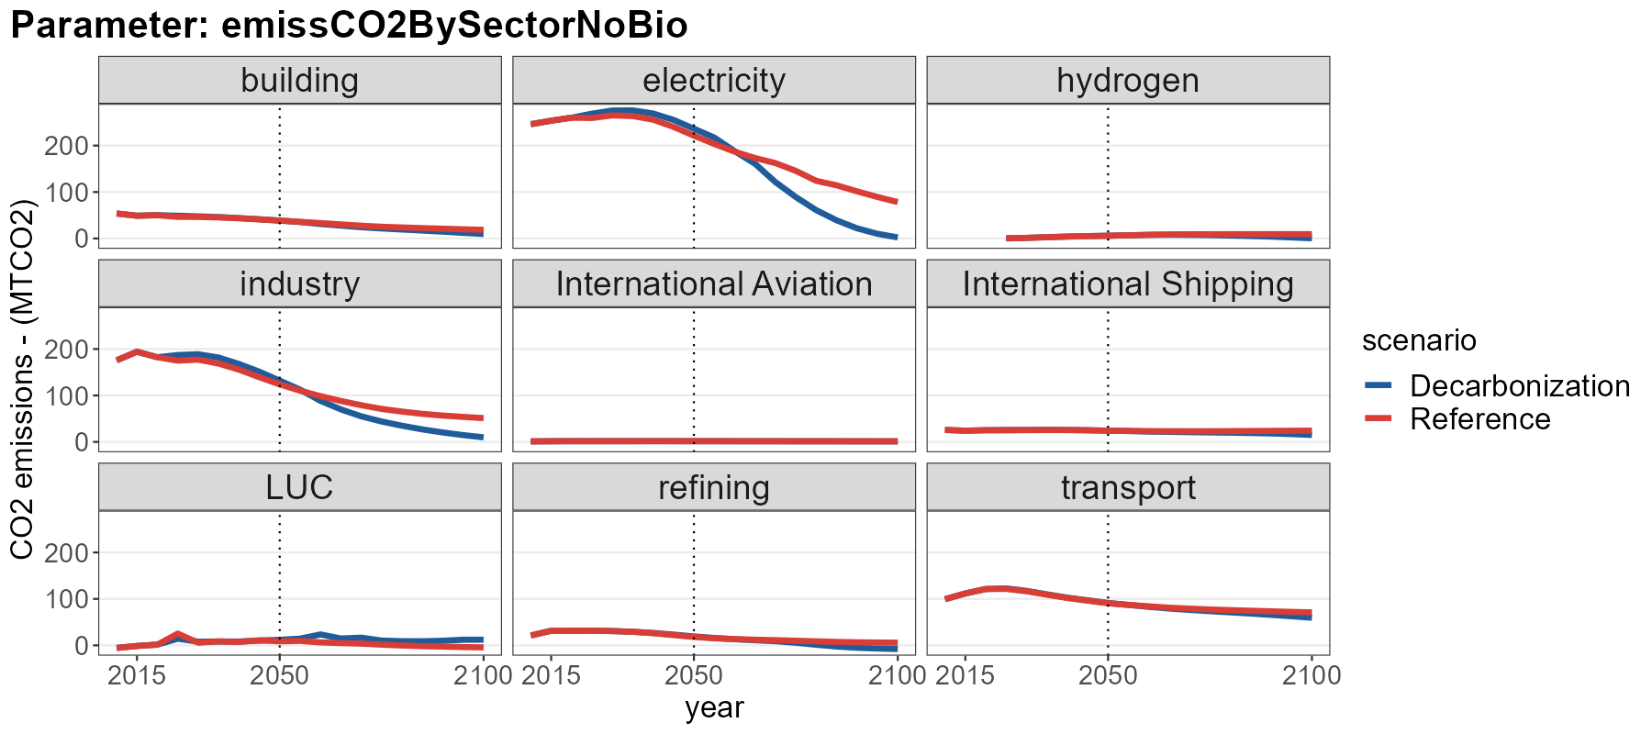
What sector does most of the emission reductions?
- CO2 emissions from the electricity sector show the biggest reductions.

Slide 5
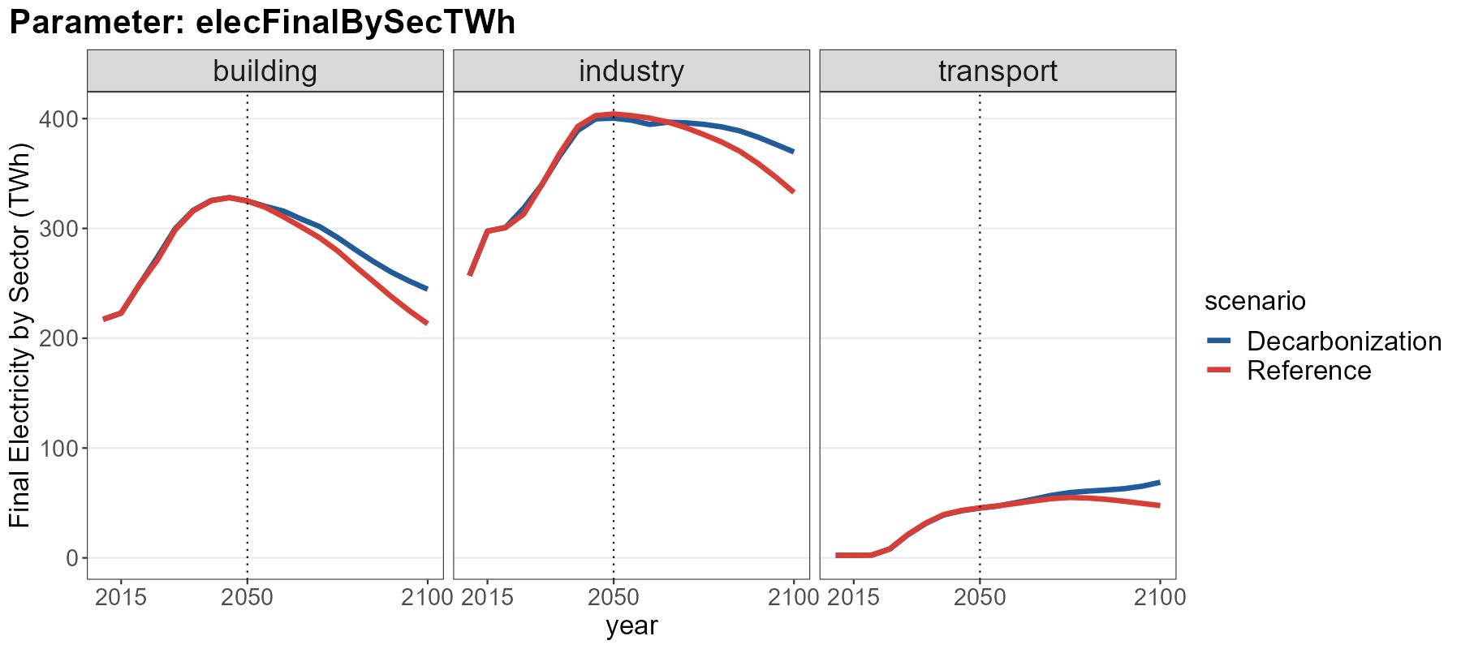
How much is demand reduction vs. fuel switching?
- Concerning sectoral electricity demand, all sectors show increase in electricity final consumption. It means that electrification is necessary in Decarbonization scenario

Slide 6
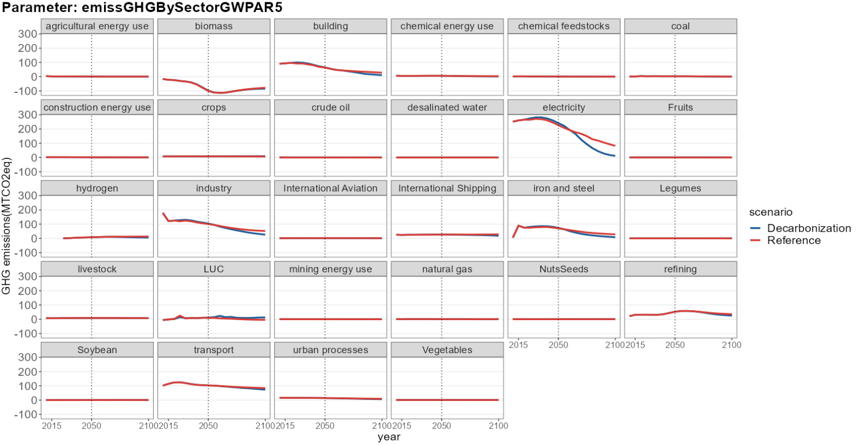
What fuel decreases and what fuel increases?
- We can see from GHG emissions from different sectors that electricity sector shows the biggest GHG reduction, and it is due to decrease in coal and increase in nuclear(showed in slide 3)

Slide 7
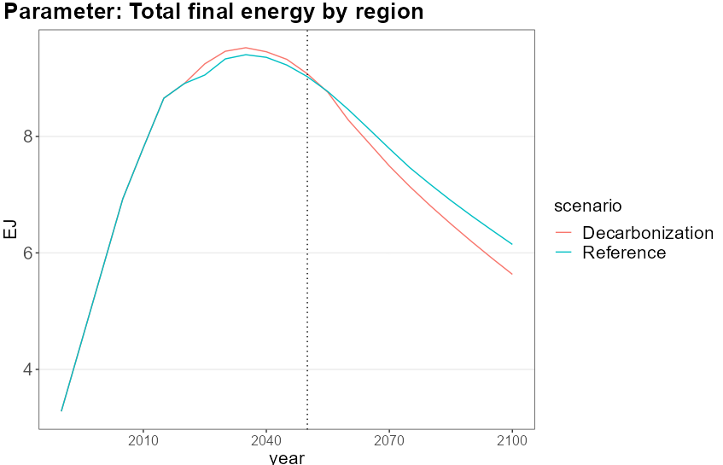
How much reduction happens in supply side vs. demand side?
In demand side, we can look at the final energy consumption. And in the Decarbonization scenario, final energy consumption decreases compared to the Reference.

