Slide 1
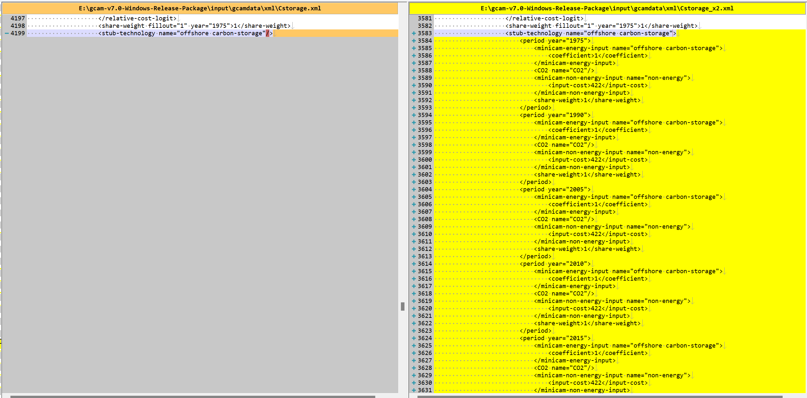
Success story
What’s the difference between Cstorage.xml and Cstorage_X2.xml
Cstorage_X2.xml ->target country : South Korea, target tech : offshore carbon-storage

Slide 2
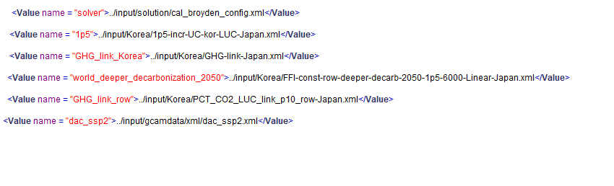
+
Cstorage.xml or Cstorage_x2.xml
(dac scenario) (dac+cstorage scenario)

Slide 3
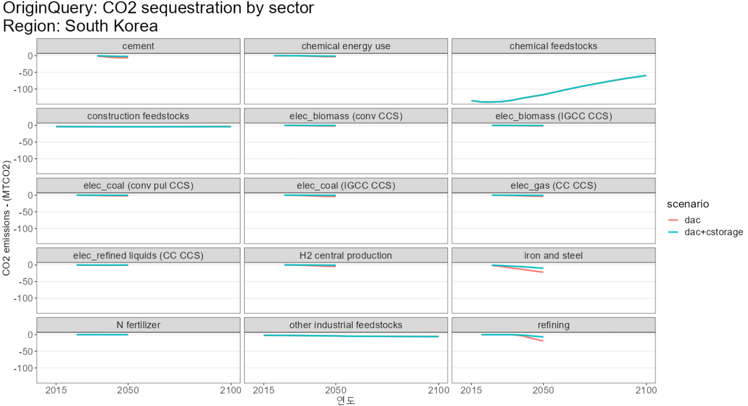
Success story
Carbon storage is about negative emission technology.
In dac+cstorage scenario, negative emission in iron and steel & refining sector decreases due to increased cost

