Slide 1
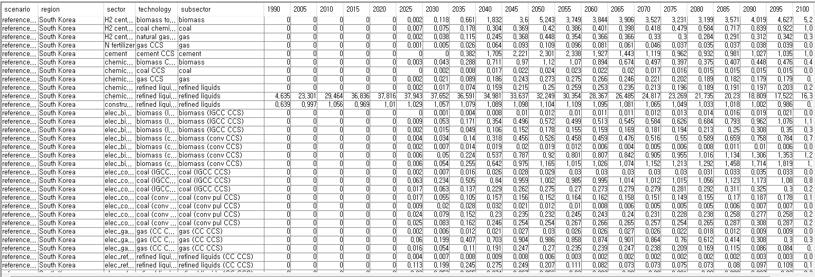
Reference_with_dac_ssp_2 scenario & South Korea
CO2 sequestration by tech
There is no dac technology

Slide 2
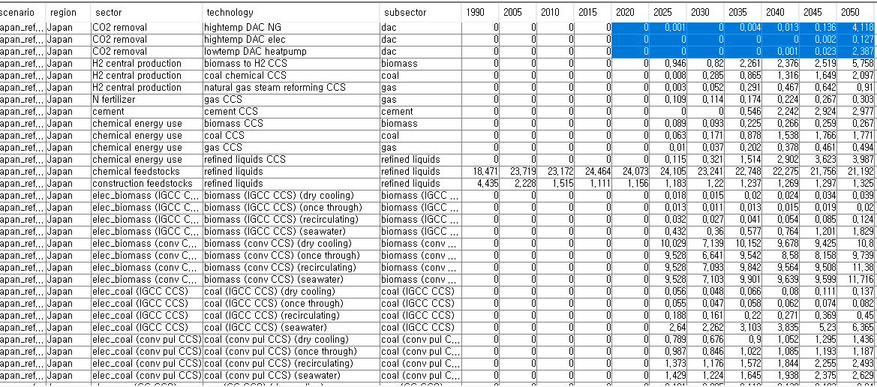
Reference_with_dac_ssp_2 scenario & Japan
CO2 sequestration by tech
There are dac technologies

Slide 3
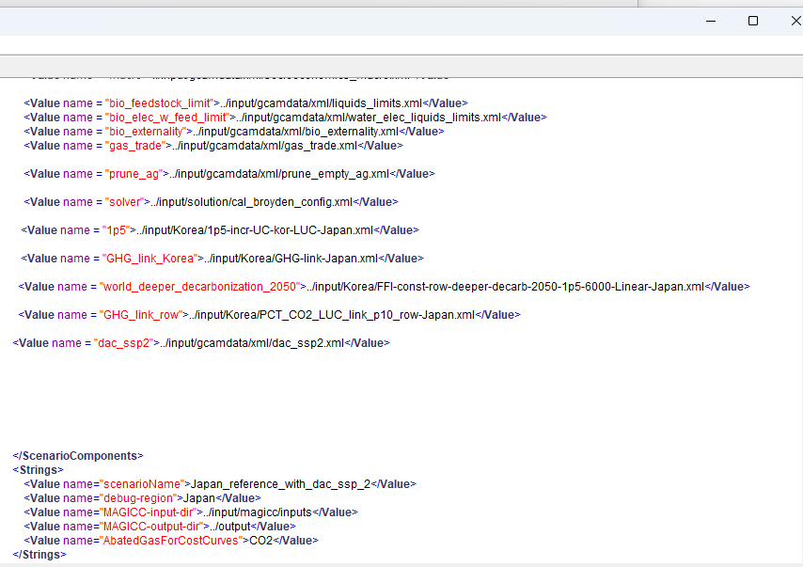
DAC technologies doesn’t show up only in South Korea. That’s because of wrong scenario setting for South Korea? To verify, Changed scenario target country from South Korea to Japan

Slide 4
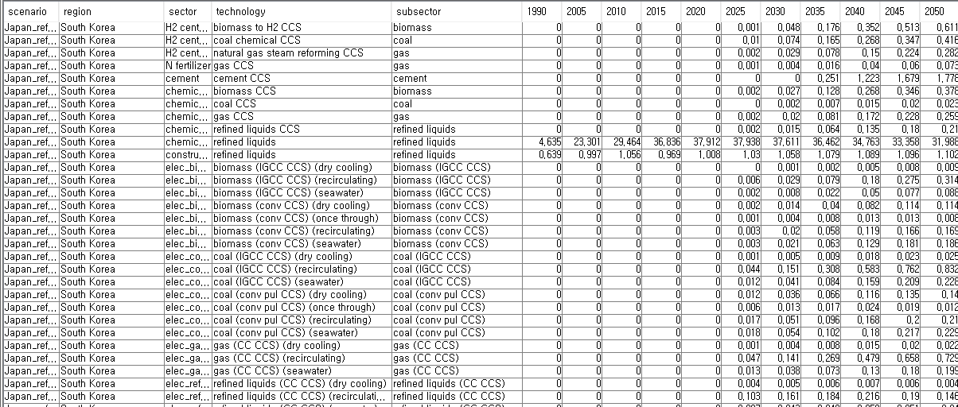
New scenario :: South Korea
CO2 sequestration by tech
There is no dac technology

Slide 5
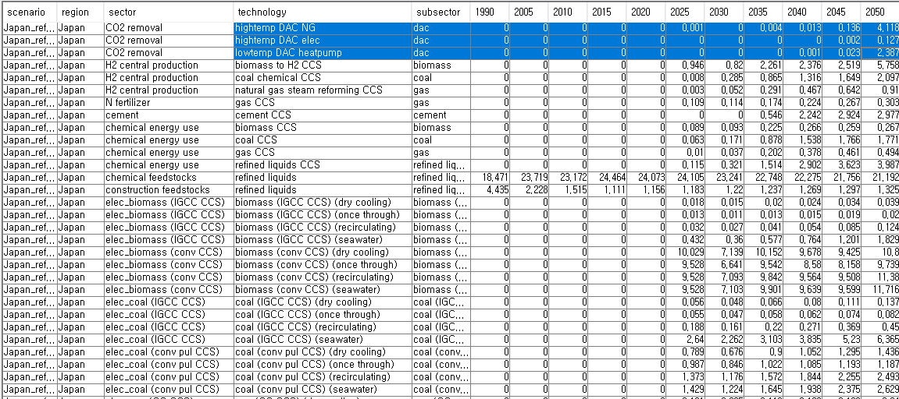
New scenario :: Japan
CO2 sequestration by tech
There is no dac technology
- No DAC tech in South Korea doesn’t originate from scenario settings…

