Slide 1
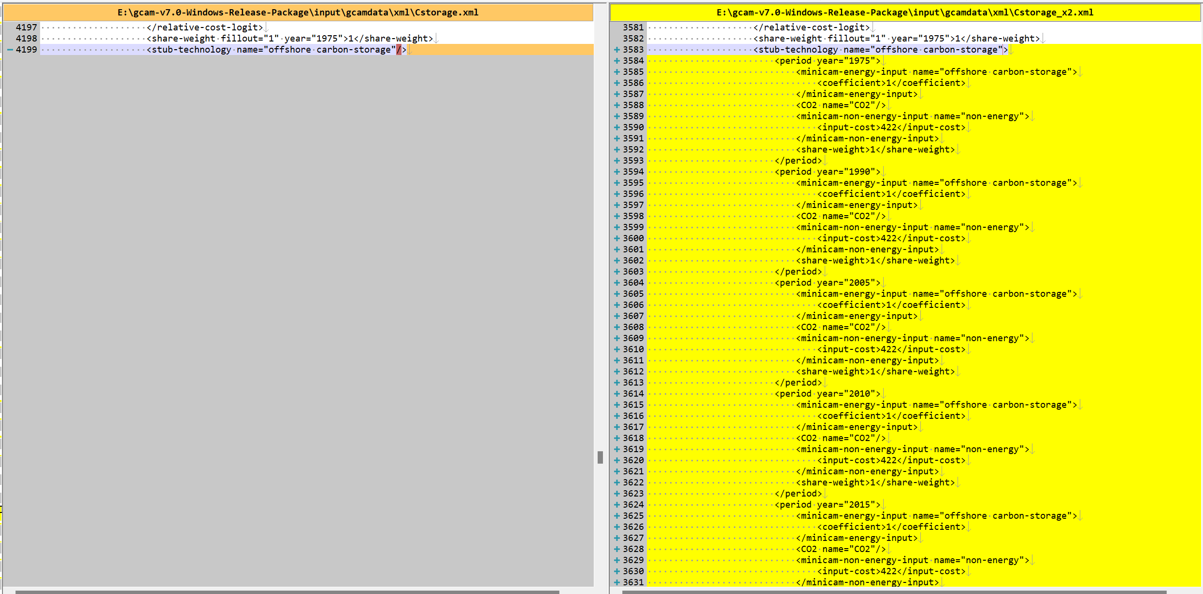
Success story
Tried to find out the the difference between Cstorage.xml and Cstorage_X2.xml
Some modifications are found in Cstorage_X2.xml file. target country : South Korea, target tech : offshore carbon-storage
Input cost for South Korea’s offshore carbon storage is set to 423 by 2050. Where does that number come from??

Slide 2
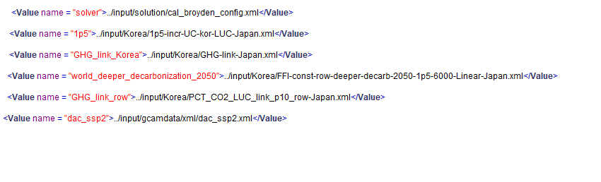
Success story
- Scenario setting is as follows.
These are scenarios for Japan
+
Cstorage.xml or Cstorage_x2.xml
=> dac scenario => dac+cstorage scenario

Slide 3
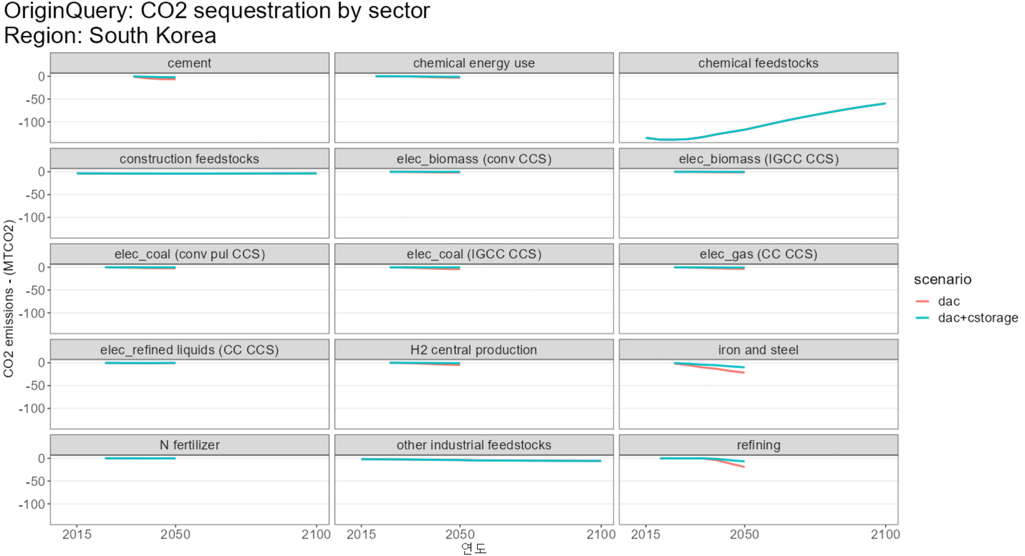
Success story
Carbon storage is about negative emission technology.
In dac+cstorage scenario, negative emission in iron and steel & refining sector decreases due to increased cost.

Slide 4
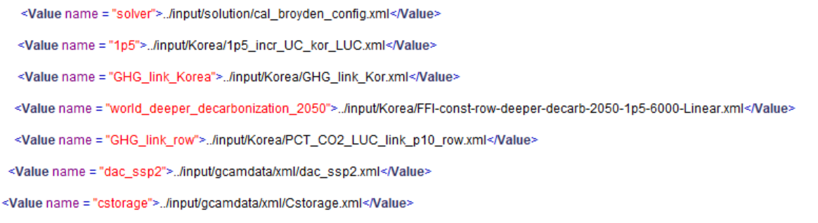
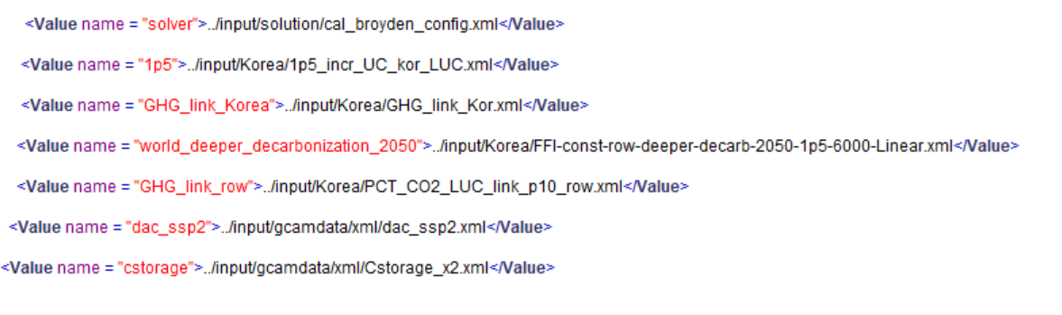
Fail story
With original scenario for South Korea(blue ones), applied two different cstorage scenarios.
dac_ssp2_cstorage scenario
dac_ssp2_cstorage_x2 scenario

Slide 5
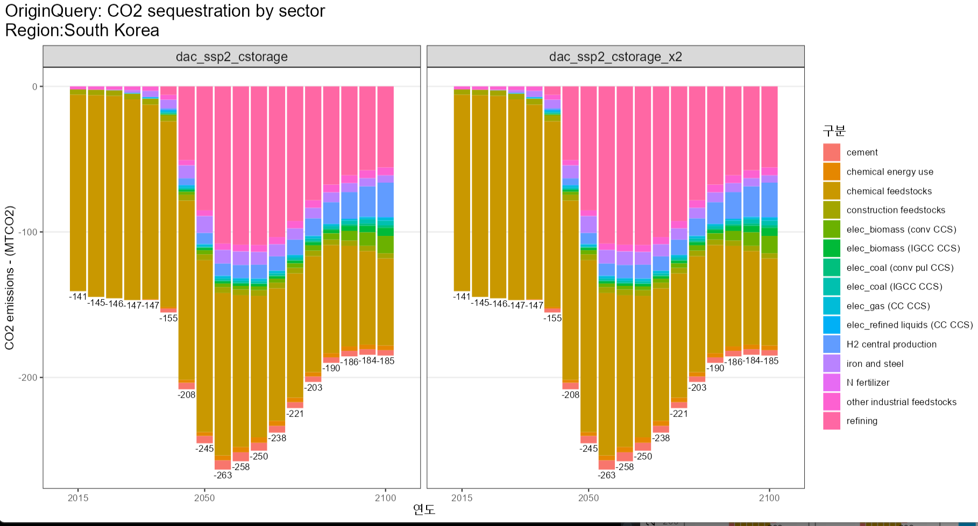
Fail story
South Korea’s CO2 sequestration from two scenarios are the same -> seems that cstorage_x2 doesn’t work. Or neither cstorge or cstorage_x2 doesn’t work?

Slide 6
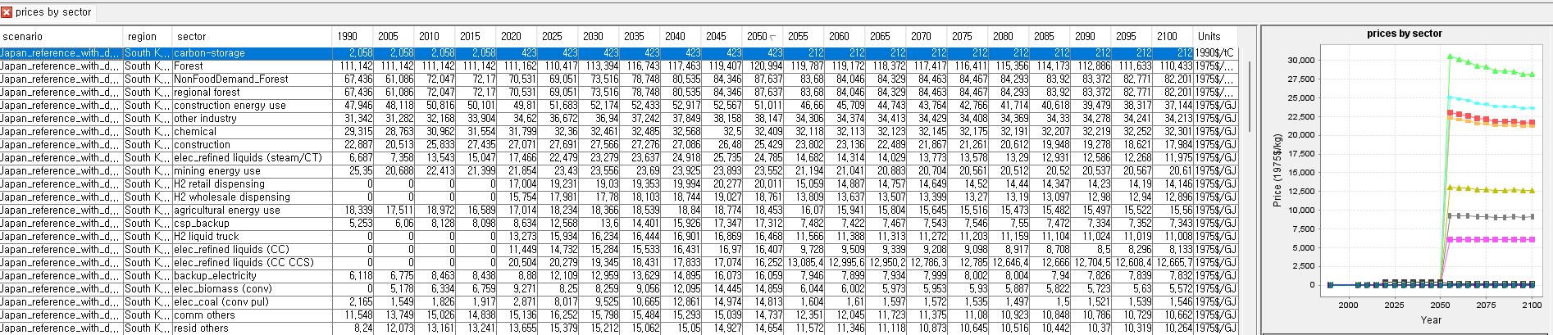
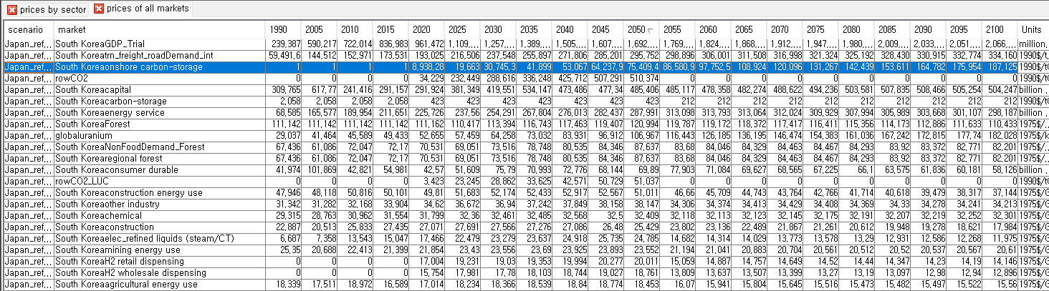
Issues
From the last meeting, we found that carbon-storage price for South Korea is set to be extremely high. That is the reason why cstorage file doesn’t work in the result. -> What to do with this extreme cost setting? Should we need to modify the cost?

Slide 7
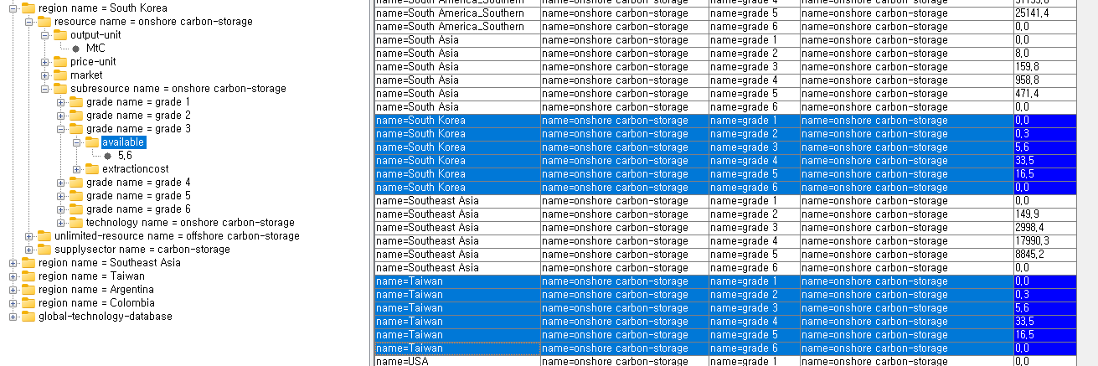
231004 Success
Cstorage 파일에서 South Korea의 onshore availiable이 0으로 되어있어서 Taiwan 과 같은 값으로 수정!!

Slide 8
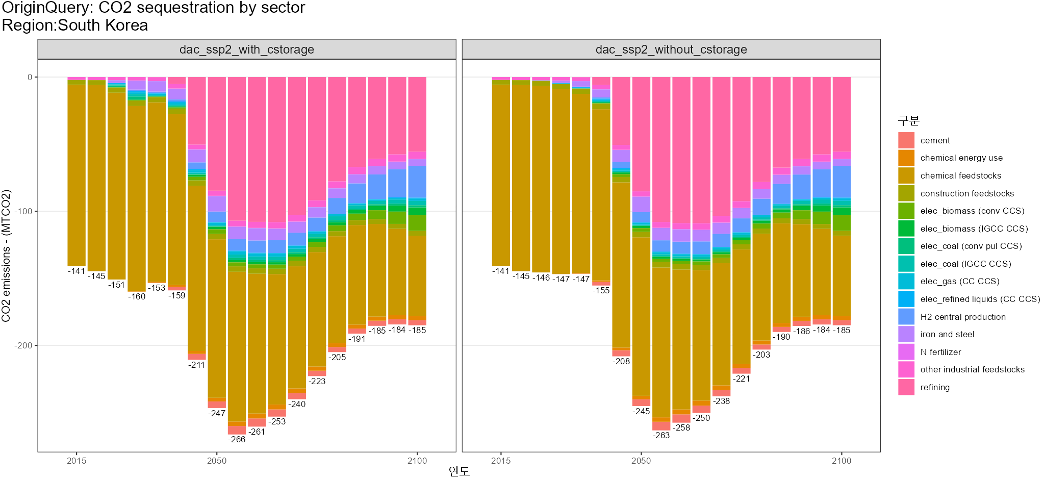
231004 Success
- No differences are observable from the figure below-> need to plot differently!

Slide 9
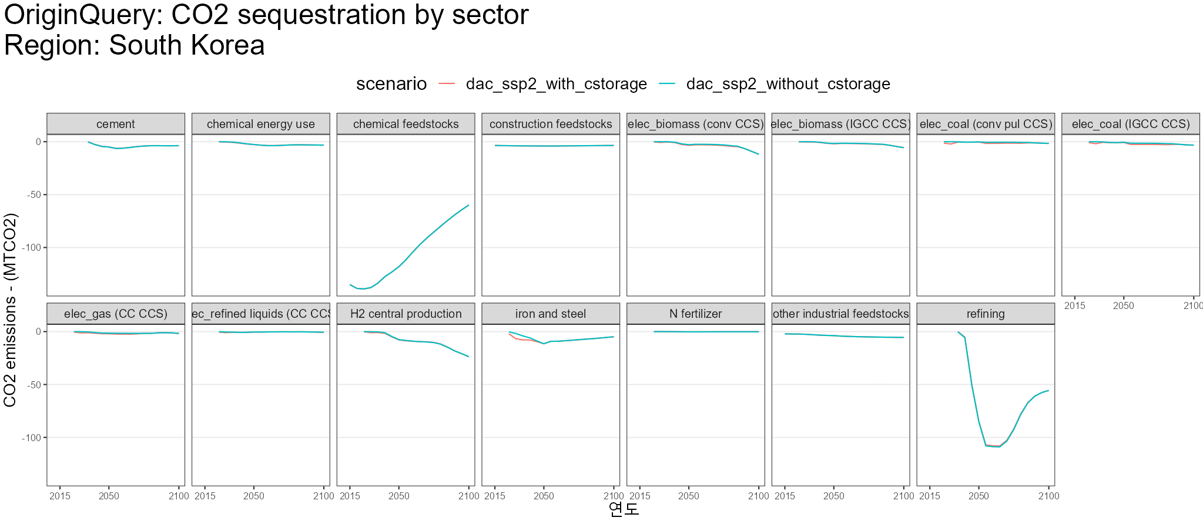
231004 Success
We rarely see any huge differences between the scenarios

Slide 10
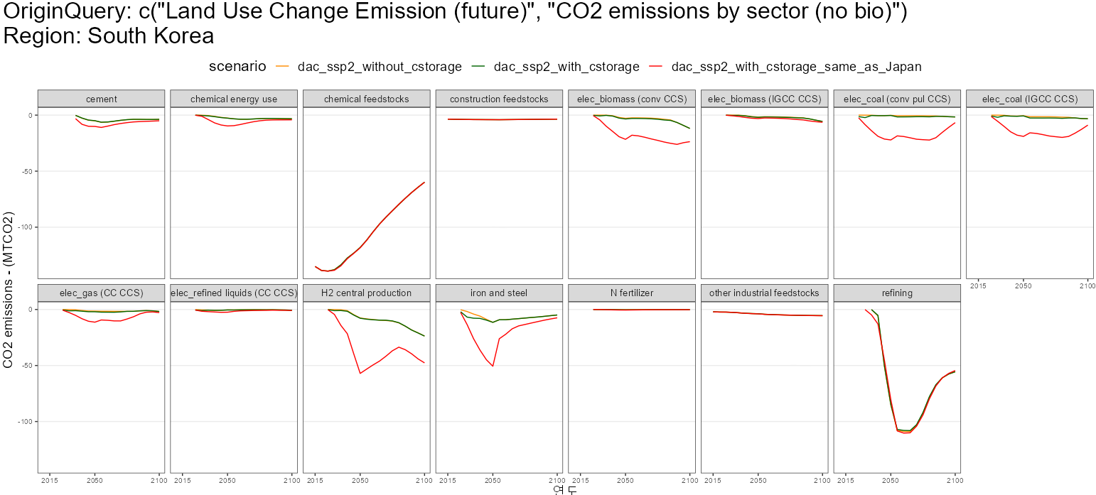
231010 Success -> 일본 값으로 변경
Onshore 값 일본과 동일하게 변경 후 파악
No dac technologies introduced

Slide 11
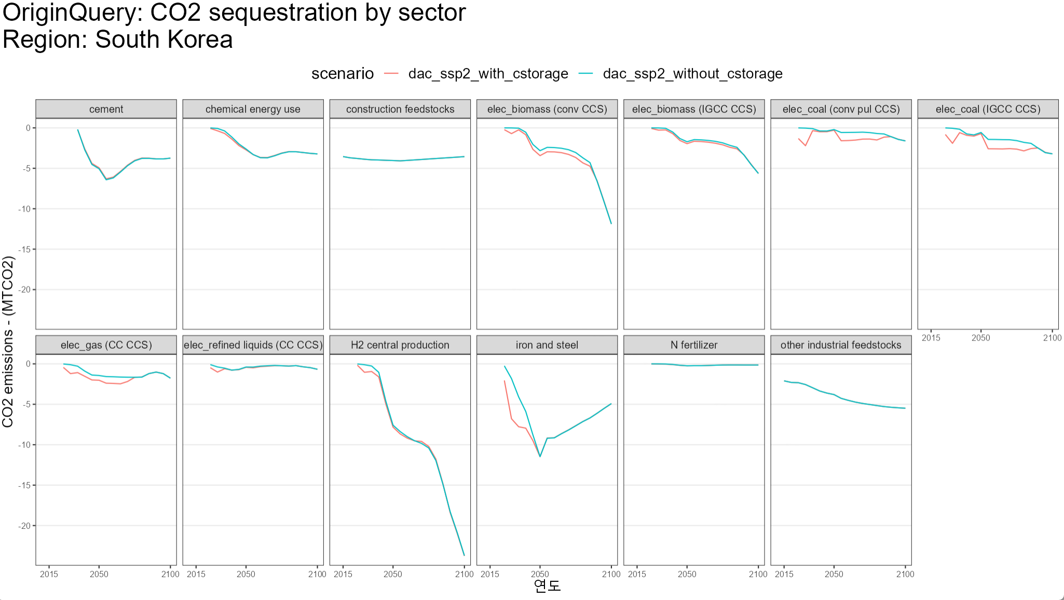
231004 Success
I deliberately filtered out huge negative emission sectors like chemical feed stocks and refining to clearly see the differences between the scenarios.

Slide 12
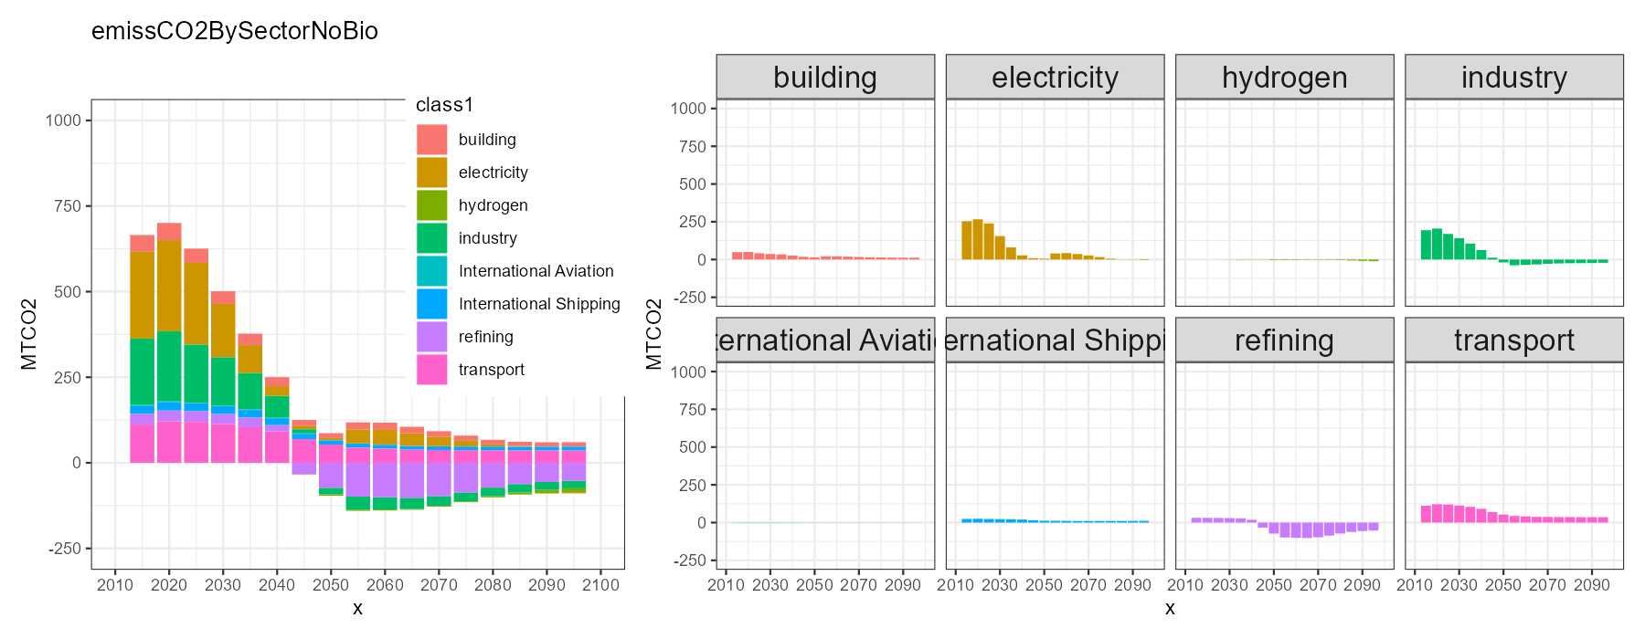
231004 Success
- CO2 emission by sector no bio for South Korea

Slide 13

231010 Success -> 일본 값으로 변경
- CO2 emission by sector no bio for South Korea

Slide 14
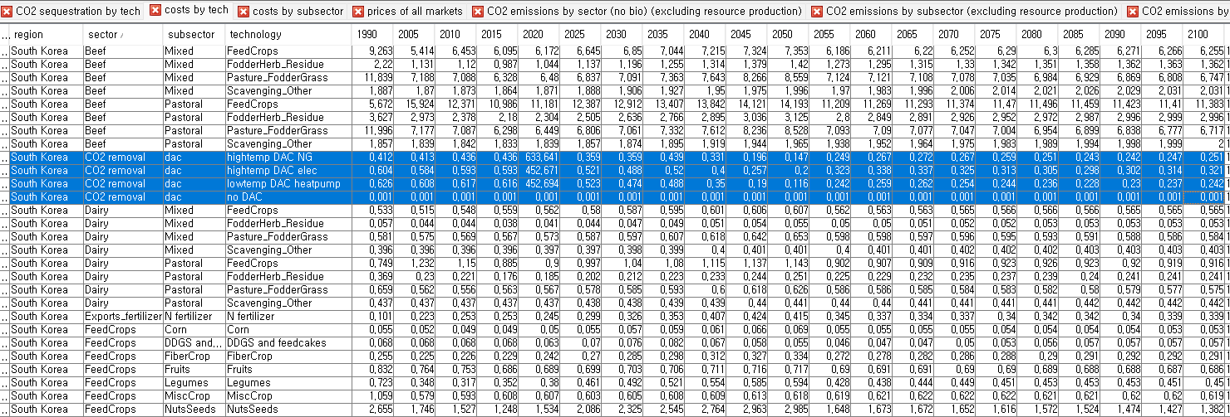
231004 Questions
- Cost by tech, CO2 removal dac technologies costs are extremely high only in year 2020. why??

Slide 15
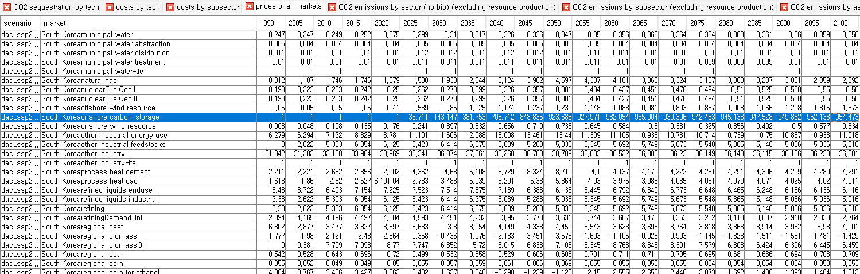
231004 Questions
In prices of all markets, South Korea’s onshore carbon-storage market prices are high from 2025 to 2100.
What’s the implications of these high prices?

Slide 16
Research questions
My research questions are regarding negative emission technologies generally, their treatment by IAMs, and the potential role and adverse effects of implementing large-scale NETs, particularly on a country-scale(South Korea) energy system.
1. What are the consequences of the current treatment of negative emissions technologies by IAMs for South Korea’s net zero in 2050?
2. How can the availability of CCUS contribute to country-scale decarbonization efforts?

Slide 17
Research questions
a research question or two that is "specific" enough to be a unique and tangible topic to work with, "relevant" to stakeholders (policymakers, analysts, or business managers), and "novel" enough to fill the gap in the literature.
References for research question
[1] J. Fuhrman, “Integrated Assessment Modeling of Direct Air Capture for Negative CO₂ Emissions,” University of Virginia, 2021. doi: 10.18130/QGGA-G857.
[2] 관계부처 합동, “탄소중립 녹색성장 국가전략 및 제1차 국가 기본계획”, 2023.4.

Slide 18
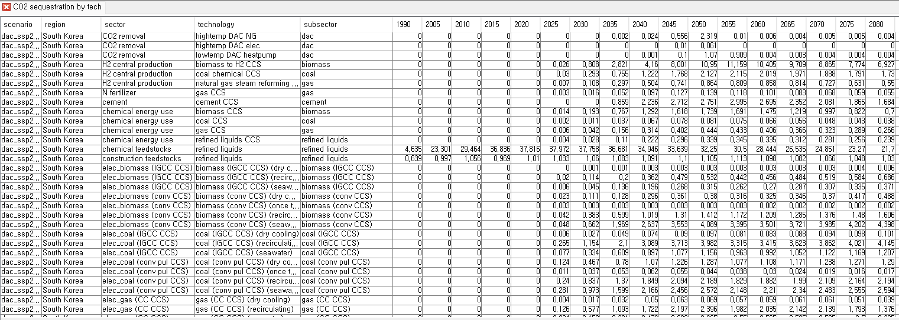
231011
Dac 에서 2015년 base service = 10, no dac = 10으로 설정
아래와 같이 dac 기술 들어오는거 확인(South Korea)

Slide 19
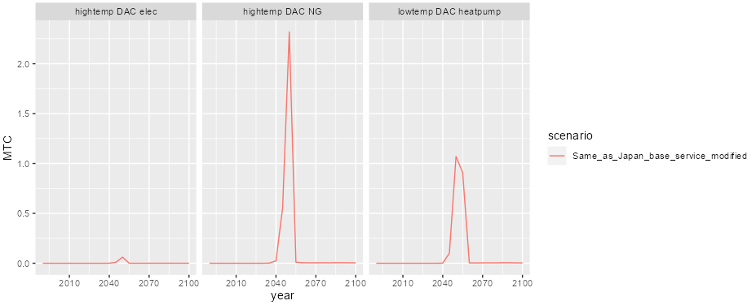
231011
Dac 에서 2015년 base service = 10, no dac = 10으로 설정
아래와 같이 dac 기술 들어오는거 확인(South Korea)

Slide 20
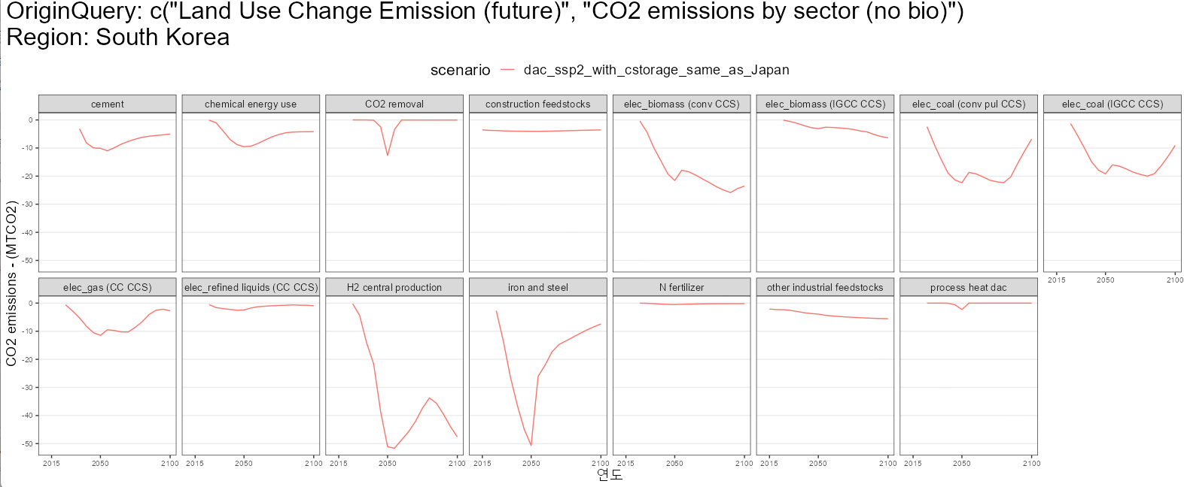
231011
Dac 에서 2015년 base service = 10, no dac = 10으로 설정
아래 CO2 removal과 같이 dac 기술 들어오는거 확인(South Korea) -

Slide 21
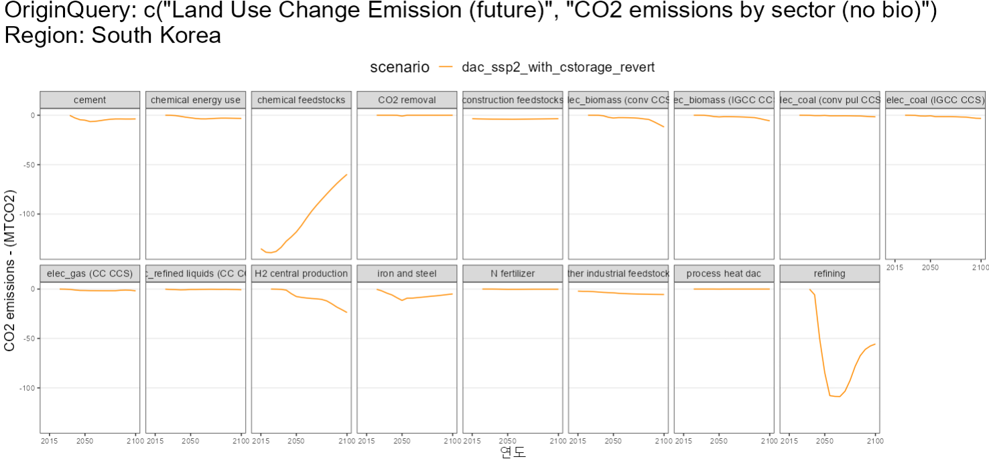
231018
Dac 에서 2015년 base service = 10, no dac = 10으로 설정
-> revert to South Korea ->ahuge amount of CO2 sequestration in chemical feedstocks appears. Why?

Slide 22
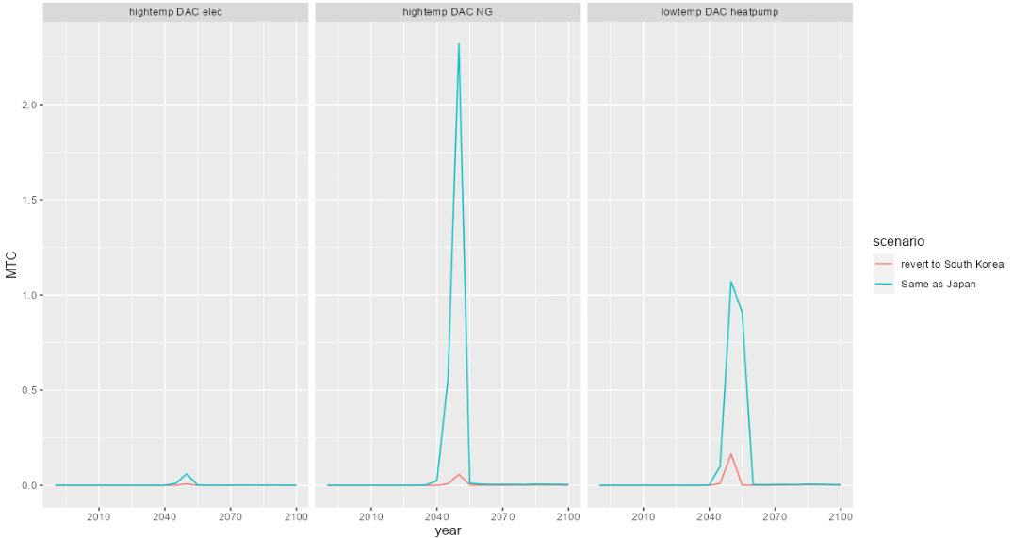
231018
Dac 에서 2015년 base service = 10, no dac = 10으로 설정
-> when we revert to South Korea’s original value from Japan’s value, CO2 removal(MTC) has been decreased. ANYWAYS WE CAN SEE THAT DACs ARE COMING IN FOR SOUTH KOREA ☺

Slide 23
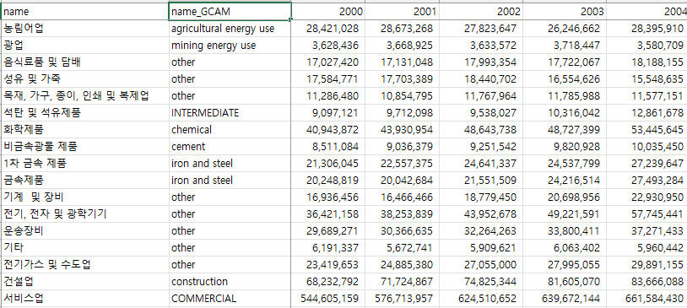
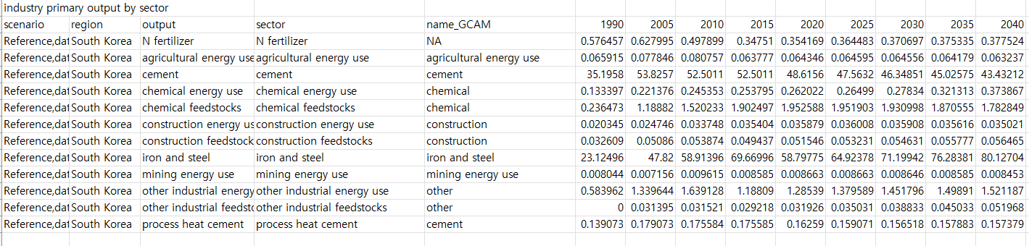
231103
KPX 데이터는 한국의 산업분류별 2040년까지 전망
GCAM7 reference 시나리오에서 industry primary output by sector
한국의 산업분류를 GCAM7 sector에 할당

Slide 24
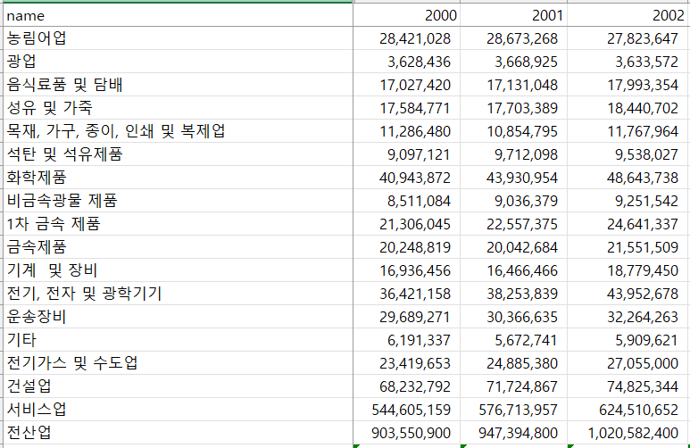
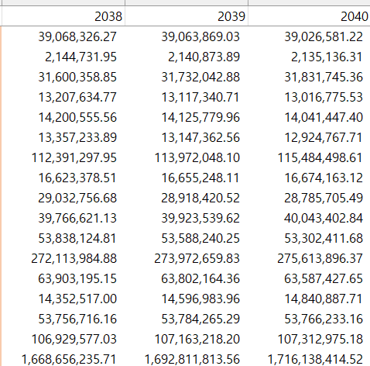
231103
We have data given by KPX(2023), containing 17 different industry outputs from 2000 to 2040. Measured by Million \
=>I wanted to figure out where this classification came from.
~

Slide 25
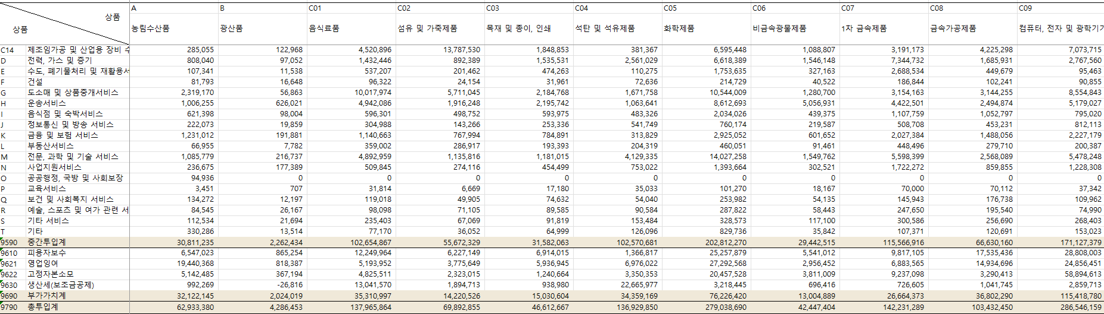
231103
The structure of the data mostly follow the Input-Output Tables by Korea Bank(산업연관표_통합대분류 -> 투입산출표(생산자가격).
Value added for producer’s prices
How close are these values? For KPX and Korea Bank?

Slide 26
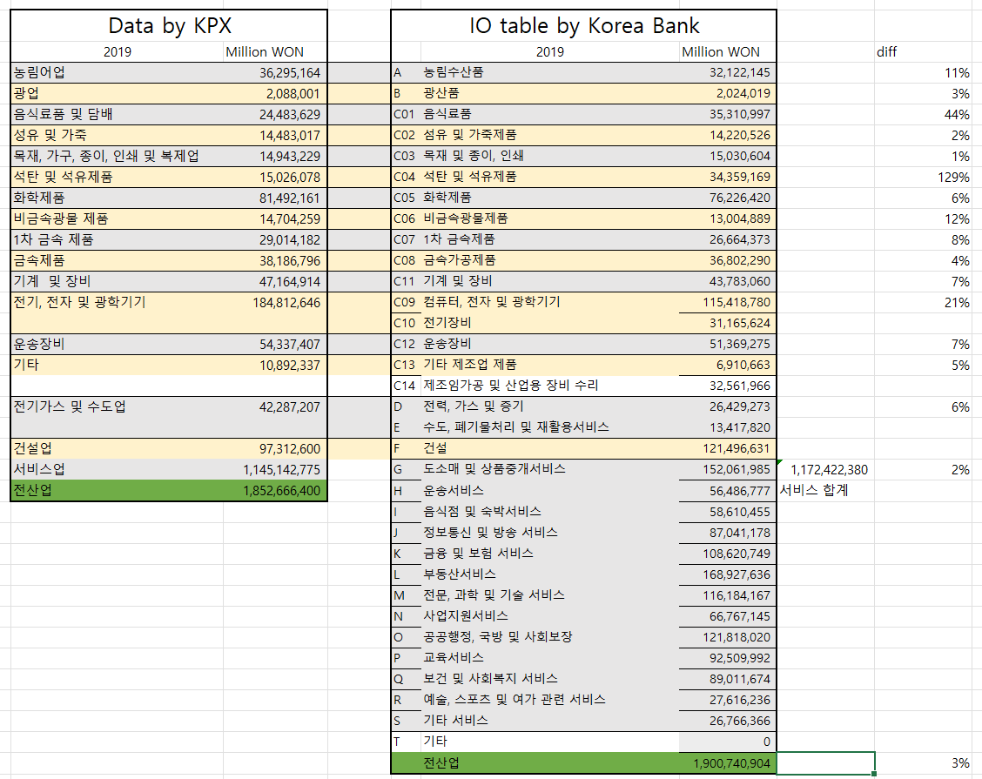
231103
Data by KPX and Korea Bank IO tables are quite close(except for few sectors).
In total, they showed only 3% of difference.
Conclustion : Data by KPX has a comparably high(?) constistency with the IO table by Korea Bank.

Slide 27
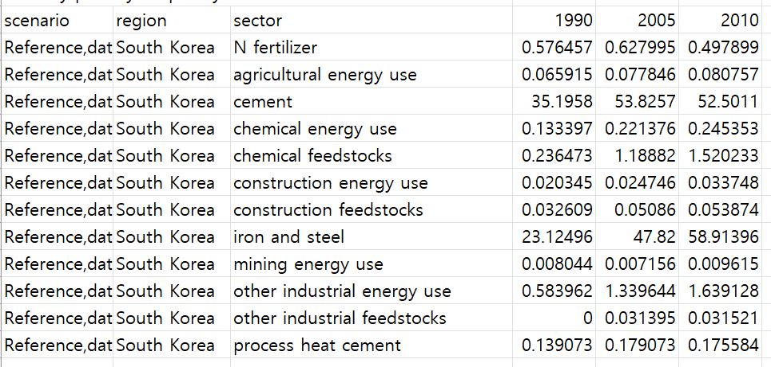
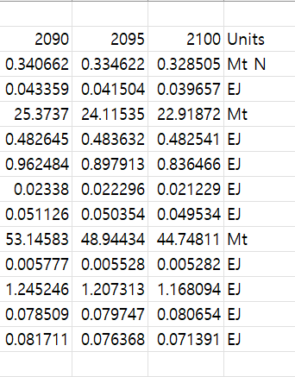
231103
We also have GCAM 7 reference scenario output for 12 different sectors. Query: industry primary output by sector.
~

Slide 28
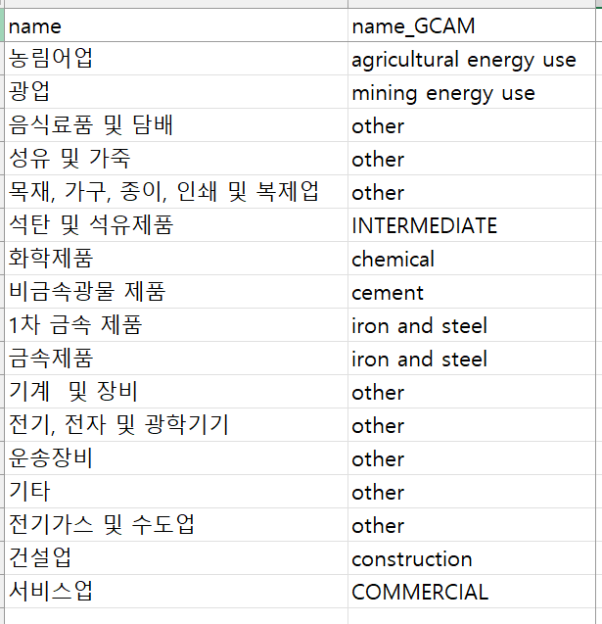
231103
Assigned GCAM sector name to industry classified by KPX.

Slide 29
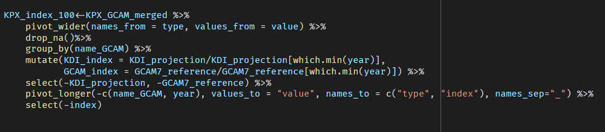
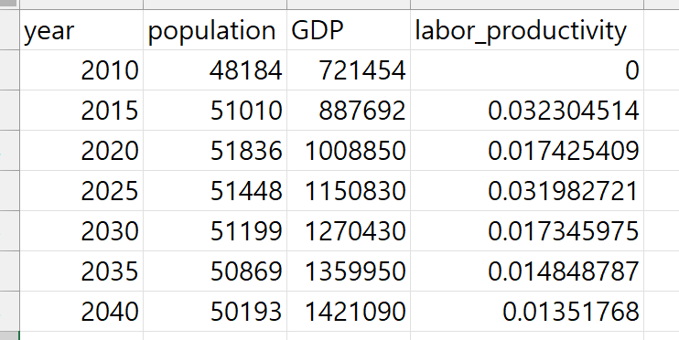
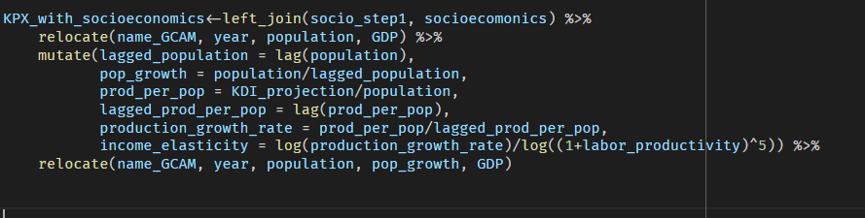
231103
Using R, calculated index value, income elasticity for each industry
Assumed the population and GDP from the values from 광남’s work
Data taken from 광남’s file for KPX 10th work

Slide 30
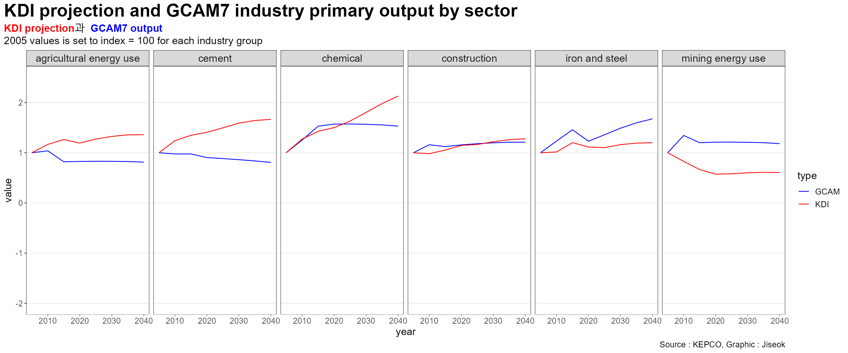
231103
Indexing to show trends in data measured in different units(in this case, KDI projection in won, GCAM output in EJ, MT)
Set 2005 value in each industry to 1, and scaled all other values based on their ratio to the 2005 value

Slide 31
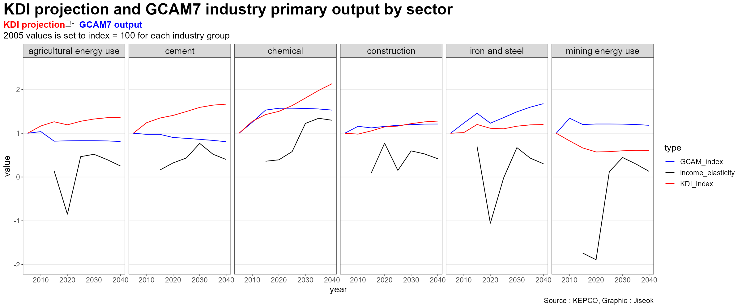
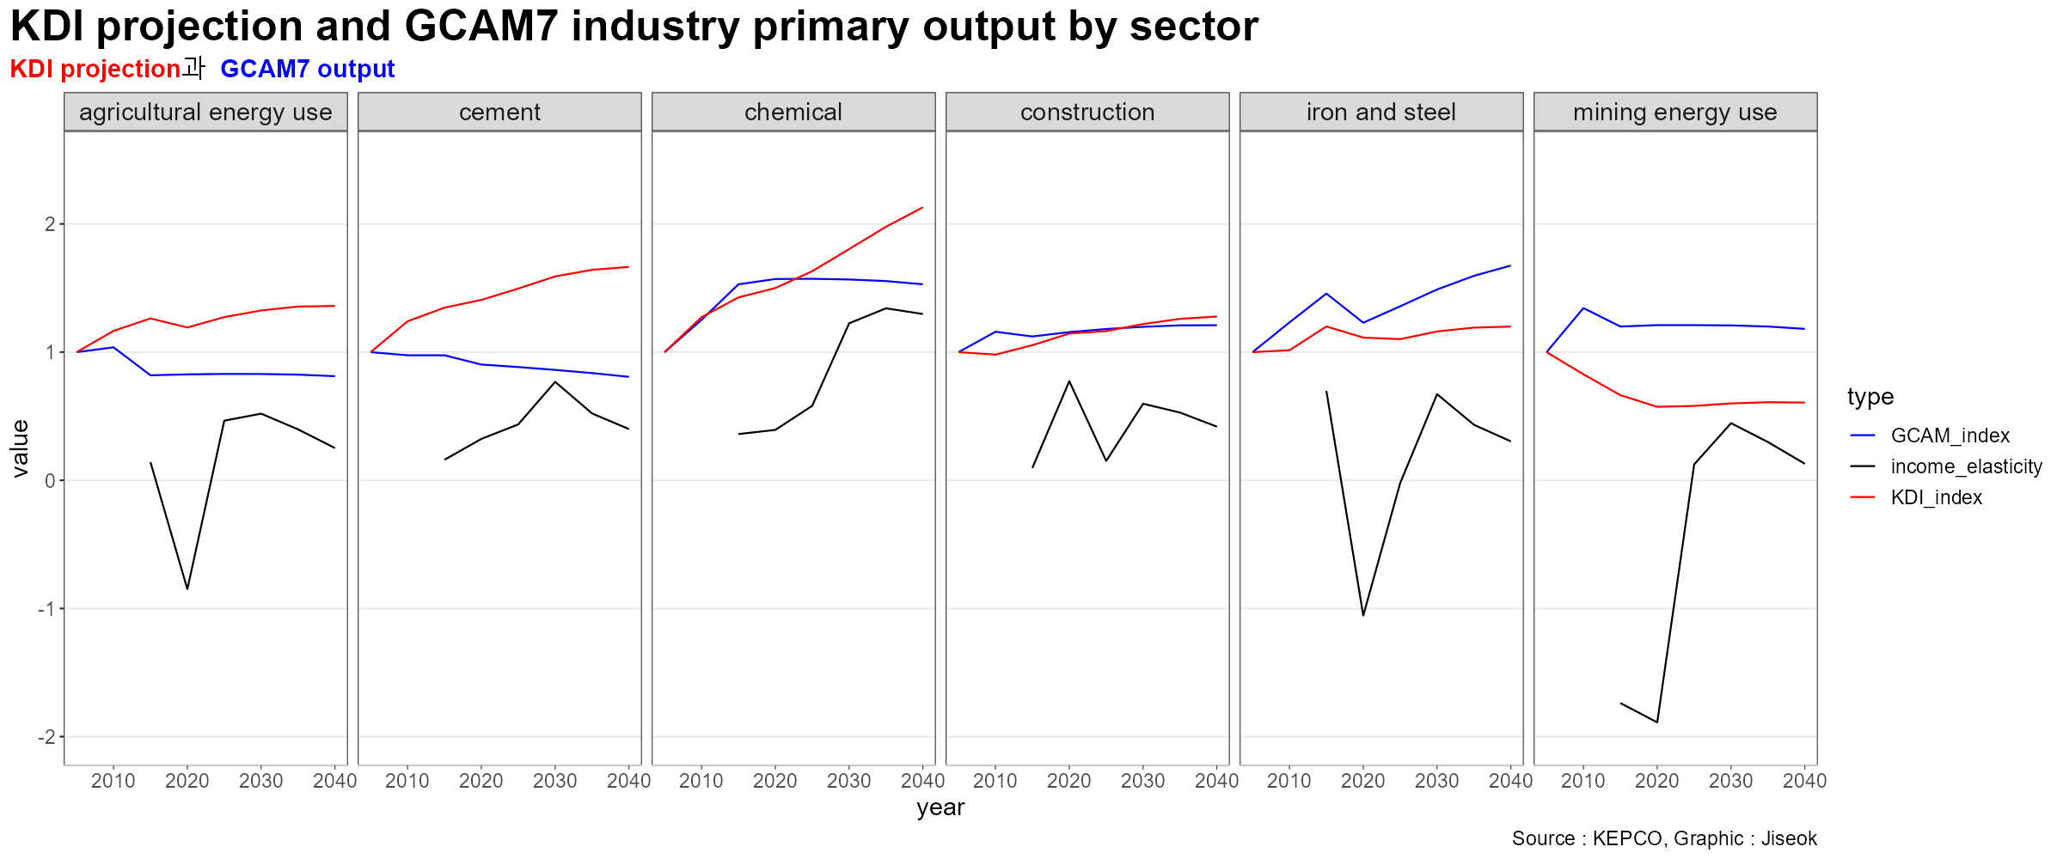
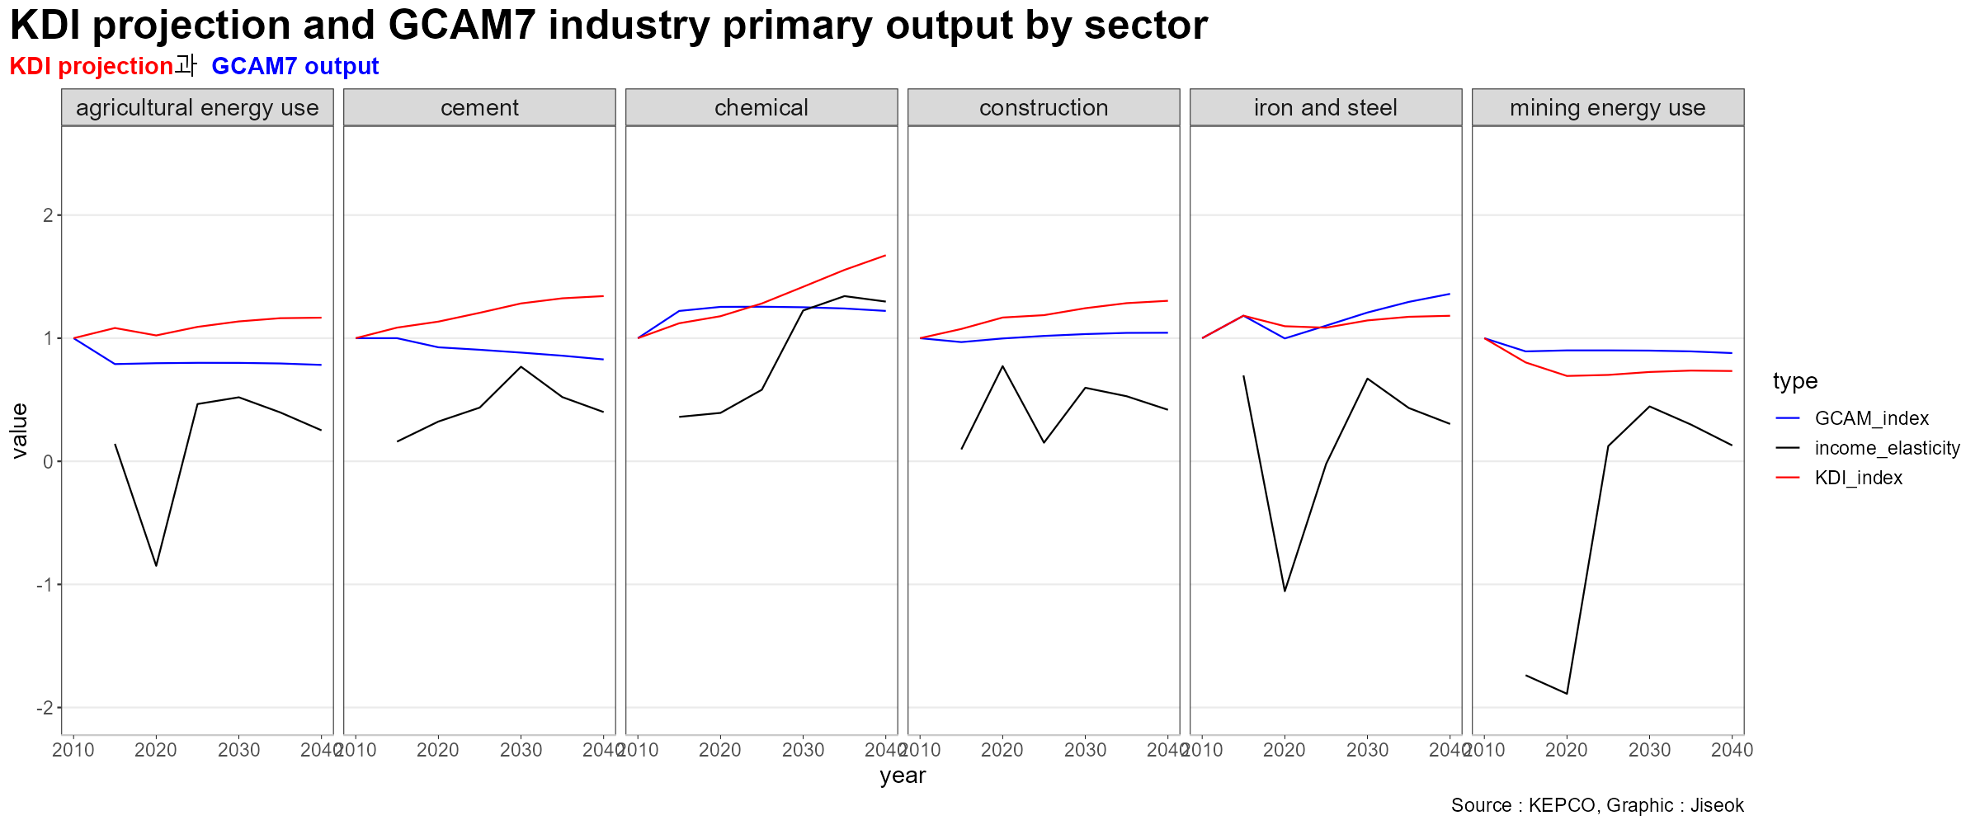
231103
Income elasticity for each industry is also shown in the figure.

Slide 32
231103
In conclusion,
Tried to keep the consistency of KPX data with IO tables by Korea bank.
By using index value, it is possible to see data trends measured in different units(KPX vs GCAM)
Calculated the income elasticity of each industry and compared them with index value.

